Slide 1
  Ultra-high dose rate (UHDR): ≥40 Gy/sec vs CONVentional rates of a few Gy/min
Enhanced clonogenic cell survival (1960s)
Hypothesis: molecular O2 depleted by O2•-generation <10⁻¹²s confers hypoxic protection
≈3x dose needed at <1% O2 as under ‘normoxia’ (4 - 21% O2) for same chemical or biological effect

Slide 2
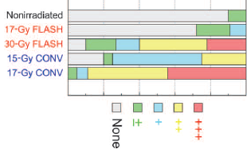
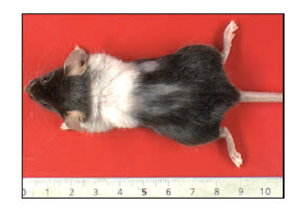
  Irradiation of rat lung; coloured bars indicate different levels of damage incl. fibrosis
36 weeks post-RT
60 Gy/sec
2 Gy/min
Favaudon, Sci Trans Med, 2014, 6; 1-10
Notes:
30Gy FLASH causes less lung fibrosis than 17Gy conventional dose rate
Mouse is fine after FLASH, except exposed thorax fur turns white

Slide 3
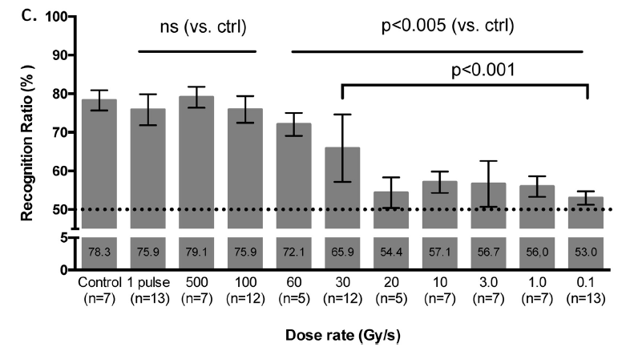
  Sparing of memory by 10 Gy UHDR to whole mouse brain
⬆
1.8μsec
Montey-Gruel, Radioth Onc, 2017, 124; 365-69
Notes:
Recognition ratio (RR, %) is a measure of spatial memory 2 months after RT compared to pre-RT (100%)
Column 1: Control (no RT) has a mean RR of 78.3% (7 animals)
Column 2: single dose of 10Gy delivered in 1.8usec
Columns 3-5: single dose 10Gy delivered at 500, 100 & 60 Gy/sec
Columns 6-11; single dose delivered at 30, 20, 10 etc Gy/sec
Mice represented in Columns 1-5 have same protection of memory as No RT group
Columns 6-11: complete loss of memory (same level of RR as mice who never participated in any memory-testing expt)
Acharya 2011:
Groups of animals were tested on a novel place recognition (NPR) task at 1 or 4 months post engraftment. The NPR task uses spontaneous exploration as a means of assessing spatial recognition memory, which has been shown previously to rely on intact hippocampal function (26, 27). A standard protocol for automated tracking and exploration detection, with exploration defined as the animal's head being directed toward and located within a 2-cm radius of the stimulus.

Slide 4
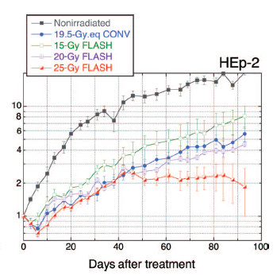
  No impact on growth delay of
  a human tumour xenograft
Tumour
volume
Favaudon, Sci Trans Med, 2014, 6; 1-10

Slide 5
  In vivo evidence consistent with an O2 consumption model
Mice irradiated after 25 sec breathing 100% N2 prior to rescue with 100% O2
Abdomen irradiated to 10 Gy x 1 total dose at conventional & ultra-high dose rates
Both groups protected from GI syndrome to same degree
Loo, Stanford, 2018 unpublished

Slide 6
  In vivo evidence inconsistent with an O2 consumption model
Mice breathing 21% O2 exposed to UHDR 4 Gy x 1 to thorax
Less lung epithelial cell death compared to 4 Gy x 1 at CONV dose rate 1 month post-RT
Unlikely to be explained by O2 depletion, so chemistry (<10⁻¹¹ sec) not the whole story?
Fouillade, Paris, unpublished 2018

Slide 7
  Questions that might be asked in humans (former RT patients) after UHDR?
Are early skin responses milder?
Can milder responses be quantified in terms of dose given at CONV dose rate?
Can temporary radiobiological skin hypoxia be induced to test if this abolishes a sparing effect?

Slide 8
  What is the enhancement ratio for an early ‘sunburn-like’ skin responses?
Endpoints:
      Skin redness by reflectance spectrophotometry
      Induced DNA damage in 4 mm skin biopsies

Slide 9
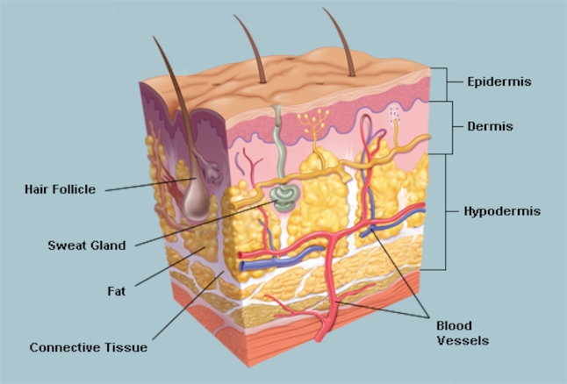
  Human skin overlying subcutaneous fat
≈5 mm

Slide 10
  Human skin overlying subcutaneous fat
≈ 6 mm

Slide 11
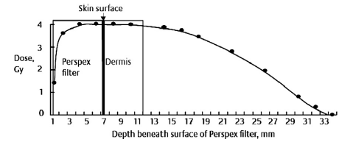
  Human skin as an experimental model
Single dose 4 Gy
5 mm below skin surface
6 MeV electrons
➔
➔
➔
Chua, Radioth Onc 2011, 99; 225-30

Slide 12
  ‘Postage stamp’ areas of skin over the upper buttock
CONV
UHDR
8Gy
8Gy
4Gy
0Gy

Slide 13
  What is the enhancement ratio for an early skin ‘sunburn-type’ reaction?
CONV
UHDR
8Gy
8Gy
4Gy
0Gy

Slide 14
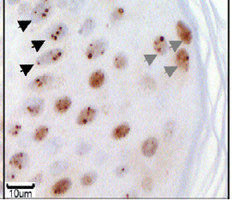
  Are there differences in DNA double strand break (DSB) induction & repair?
Epidermal cell nuclei stained
for DSB 24hr after 4 Gy
4 mm diameter
core biopsies
epidermis &
dermis
CONV
○○○ O O
O O
8Gy
4Gy
Chua, Radioth Onc 2011, 99; 225-30

Slide 15
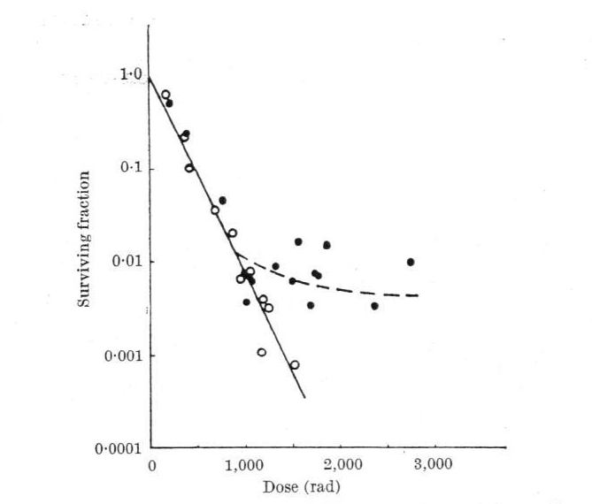
  HeLa cells given 14 MeV e⁻ in single 1.3 usec pulse or two pulses separated by 2.5 msec
Cells irradiated in equilibrium with 21% O2
Total dose as single pulse
Total dose as 2 fractional pulses
10 20 30 Gy
Town, Nature, 1967, 215; 847-848
Notes:
Open symbols; 2.5msec between pulses prevents resistance at single doses >10Gy.
Proposed explanation is that 2.5msec is long enough to allow O2 to diffuse back (exposure under conditions of 100% N2 consistent with this)

Slide 16
  UHDR Workshop at Lausanne, Sept 2018
Mouse ovarian cancer model with multiple metastases in abdomen
All safely cured after UHDR 12 Gy x 1
12 Gy x 1 at conventional dose rate causes 100% gastro-intestinal mortality (diarrhoea etc)
No difference in tumour control dose
Loo, Stanford, unpublished 2018
Notes:
Confirmation of earlier xenograft data from Lausanne (Favaudon 2014 above)

Slide 17
  In vitro evidence inconsistent with an O2 consumption model
IMR90 human foetal lung cells given 4, 10 & 20 Gy at standard dose rate vs UHDR
No UHDR effect on clonogenic survival or H2AX fluorescence
‘Strong’ UHDR reduction in TGFβ & NFκ2 (fibrogenic signalling) & β-galactosidase expression ⬇ after UHDR at 1 month
Grilj, Colombia, unpublished 2018

Slide 18
  “Nothing special about UHDR chemistry (<10⁻¹¹s), but the biology is different”
100 Gy/sec generate 200,000X more ionisations per unit time than 1 Gy/min: O2 ➔ O2•⁻
Superoxide dismutase (biology) catalyses conversion O2•⁻ ➔ H202
Labile Fe⁺⁺ + H2O2 ➔ Fe⁺⁺⁺+ OH• represent a major threat to cells, especially cancers (classic Fenton reaction)
Limoli, Iowa, discussion 2018
Notes:
Limoli model: UHDR generates enormous amounts of H2O2 reaction product of SOD catalysis of superoxide radical. Normal cells very efficient at managing oxidative stress.
Tumours have ‘much higher’ labile Fe++, a potent source of OH• radicals (Fenton) that permeabilise lysosomal & mitochondrial membranes.

Slide 19
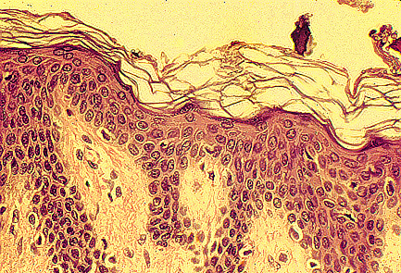
  Human skin
Keratin (dead cells)
≈5 mm
Epidermis
Dermis

Slide 20
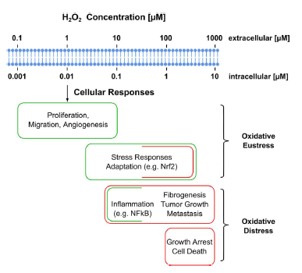
  Hydrogen peroxide & oxidative stress

Slide 21
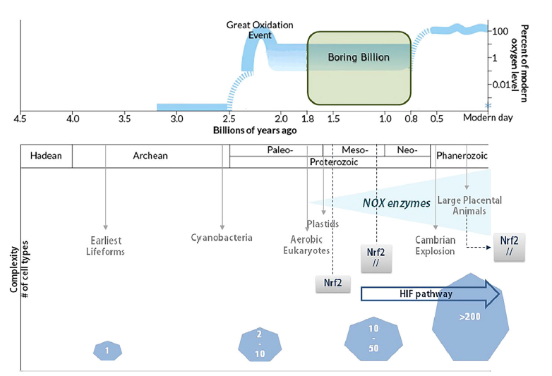
  Enzymatic reduction of reactive oxygen species is ancient

