Slide 1
LhARA Endstation Discussions - Summary
22nd September 2020
Tony Price, Ruth McLauchlan, Laura Holland, and Ken Long

Slide 2
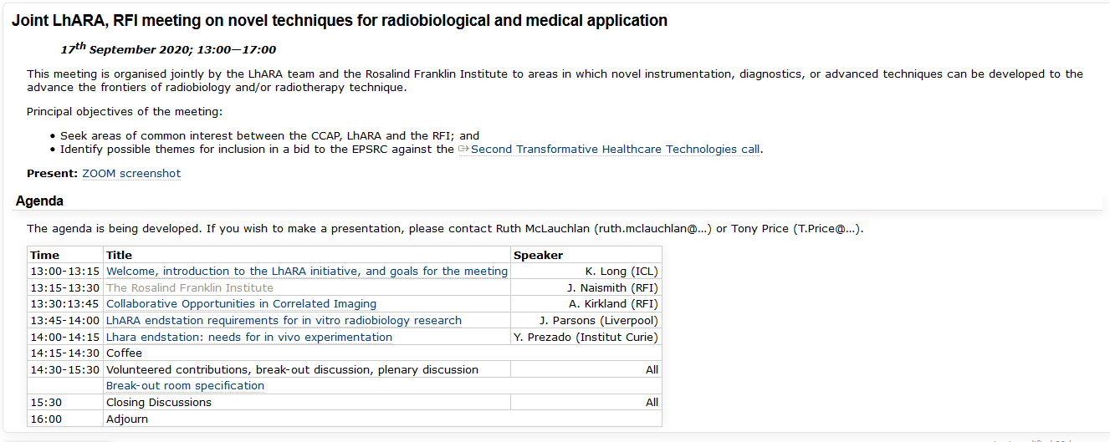

https://ccap.hep.ph.ic.ac.uk/trac/wiki/Research/DesignStudy/PreCDR/Meetings/2020/2020-09-17-THT-EndStn

Slide 3
Key Themes
Dosimetry of intense beam
  Photo acoustic Imaging
  Require microsecond bunches. CERN/CCC/UoB accelerator developments?
  Dose rate dependancies from other groups
Irradiations and Positioning
  RFI cell imaging capabilities. We provide samples irradiated in novel ways and RFI image
  3D automated robotics and samples (Christie like)
QA and Beam Monitoring
  Incremental detector developments, BPMs, SciFibres, silicon
  Key development Photoacoustic imaging electronics to compliment beam developments

Slide 4
Key Deliverables
Quantify benefits from LhARA and specify final end-stations parameters.
Develop/Research accelerator facility for deliver required pulses for photoacoustic imaging
Electronics development for photoacoustic imaging
Perform relevant incremental R&D
Write Pre-CDR on End-station requirements

Slide 5
Notes from Prelim talks and initial thoughts
Dose calibration of intense beams
  Micro beams
  FLASH currents
  Require a modality that will not be affected by dose rates
  Ionisation chambers can suffer from ion recombination and space charge effects at high currents
    Ongoing studies – e.g. EMPIR network
  Graphite calorimetry is dose rate independent (NPL)
  Alanine – dose rate and energy independent (NPL service)
Patient positioning
  CBCT
  x-rays
  other?
  Proton radiography?
Cell irradiations
  Cell positioning systems
    2D stages
    Robotic arms such as at Christie
  Beam QA and range modifications
  Simulations of setups
  Hypoxia cabinets for FLASH studies
  Analysis facilities close by
Cell imaging
  Molecular imaging
  Cell level chemistry
  activation
  Mass spec
  Chemical changes inside cell during treatment
QA Services
  Depth dose curve measurments
  Beam uniformity
  Beam Current
  Beam position
  Treatment Planning System checks
Online Dose monitors
  Ionisation chambers
  Scintillators (SciWire etc.)
  CMOS detectors
  Low material budgets to maintain low energy beam
  Photoacoustics
  Prompt Gamma
  PET
  Bioluminescence
Beam Diagnostics
  BPMs
  Intensity Monitors
  Non invasive in beam line
  Energy Measurements
    ToF (LGADs) https://physicsworld.com/a/ultrafast-detectors-line-up-for-proton-beam-energy-measurements/
    MLFC
Feedback systems
  LhARA beam structure requires fast feedback from all of the above to alter treatment / interrupt
  Triggered delivery
  Magnetic focusing
Speed!
  Short sharp pulses will require fast detectors, systems, analysis, feedback

