Slide 1
Milestones
Full mockup on level 5
Online training for LhARA & recap of items
In-person training (at own leisure, if possible, on level 5)
Full mockup
Trial day/run through/dress rehearsal

Slide 2
Suggested deadlines
Full mockup
In person training
- Move everything up from level 5
Learn how to use equipment
People can either come for level 5 or level 8 set up whenever they have the time
Before
mid June
End of May
Mid-late June
Before
mid June
Before
mid-late June
Level 5 mockup
Online training
Rehearsal
Procure all equipment
Decide on layout
Full mock-up ready
Find a time before the trial after we have al equipment
About LhARA
Overview of the exhibit
- Full rehearsal with Imperial physics academics to test us

Slide 3
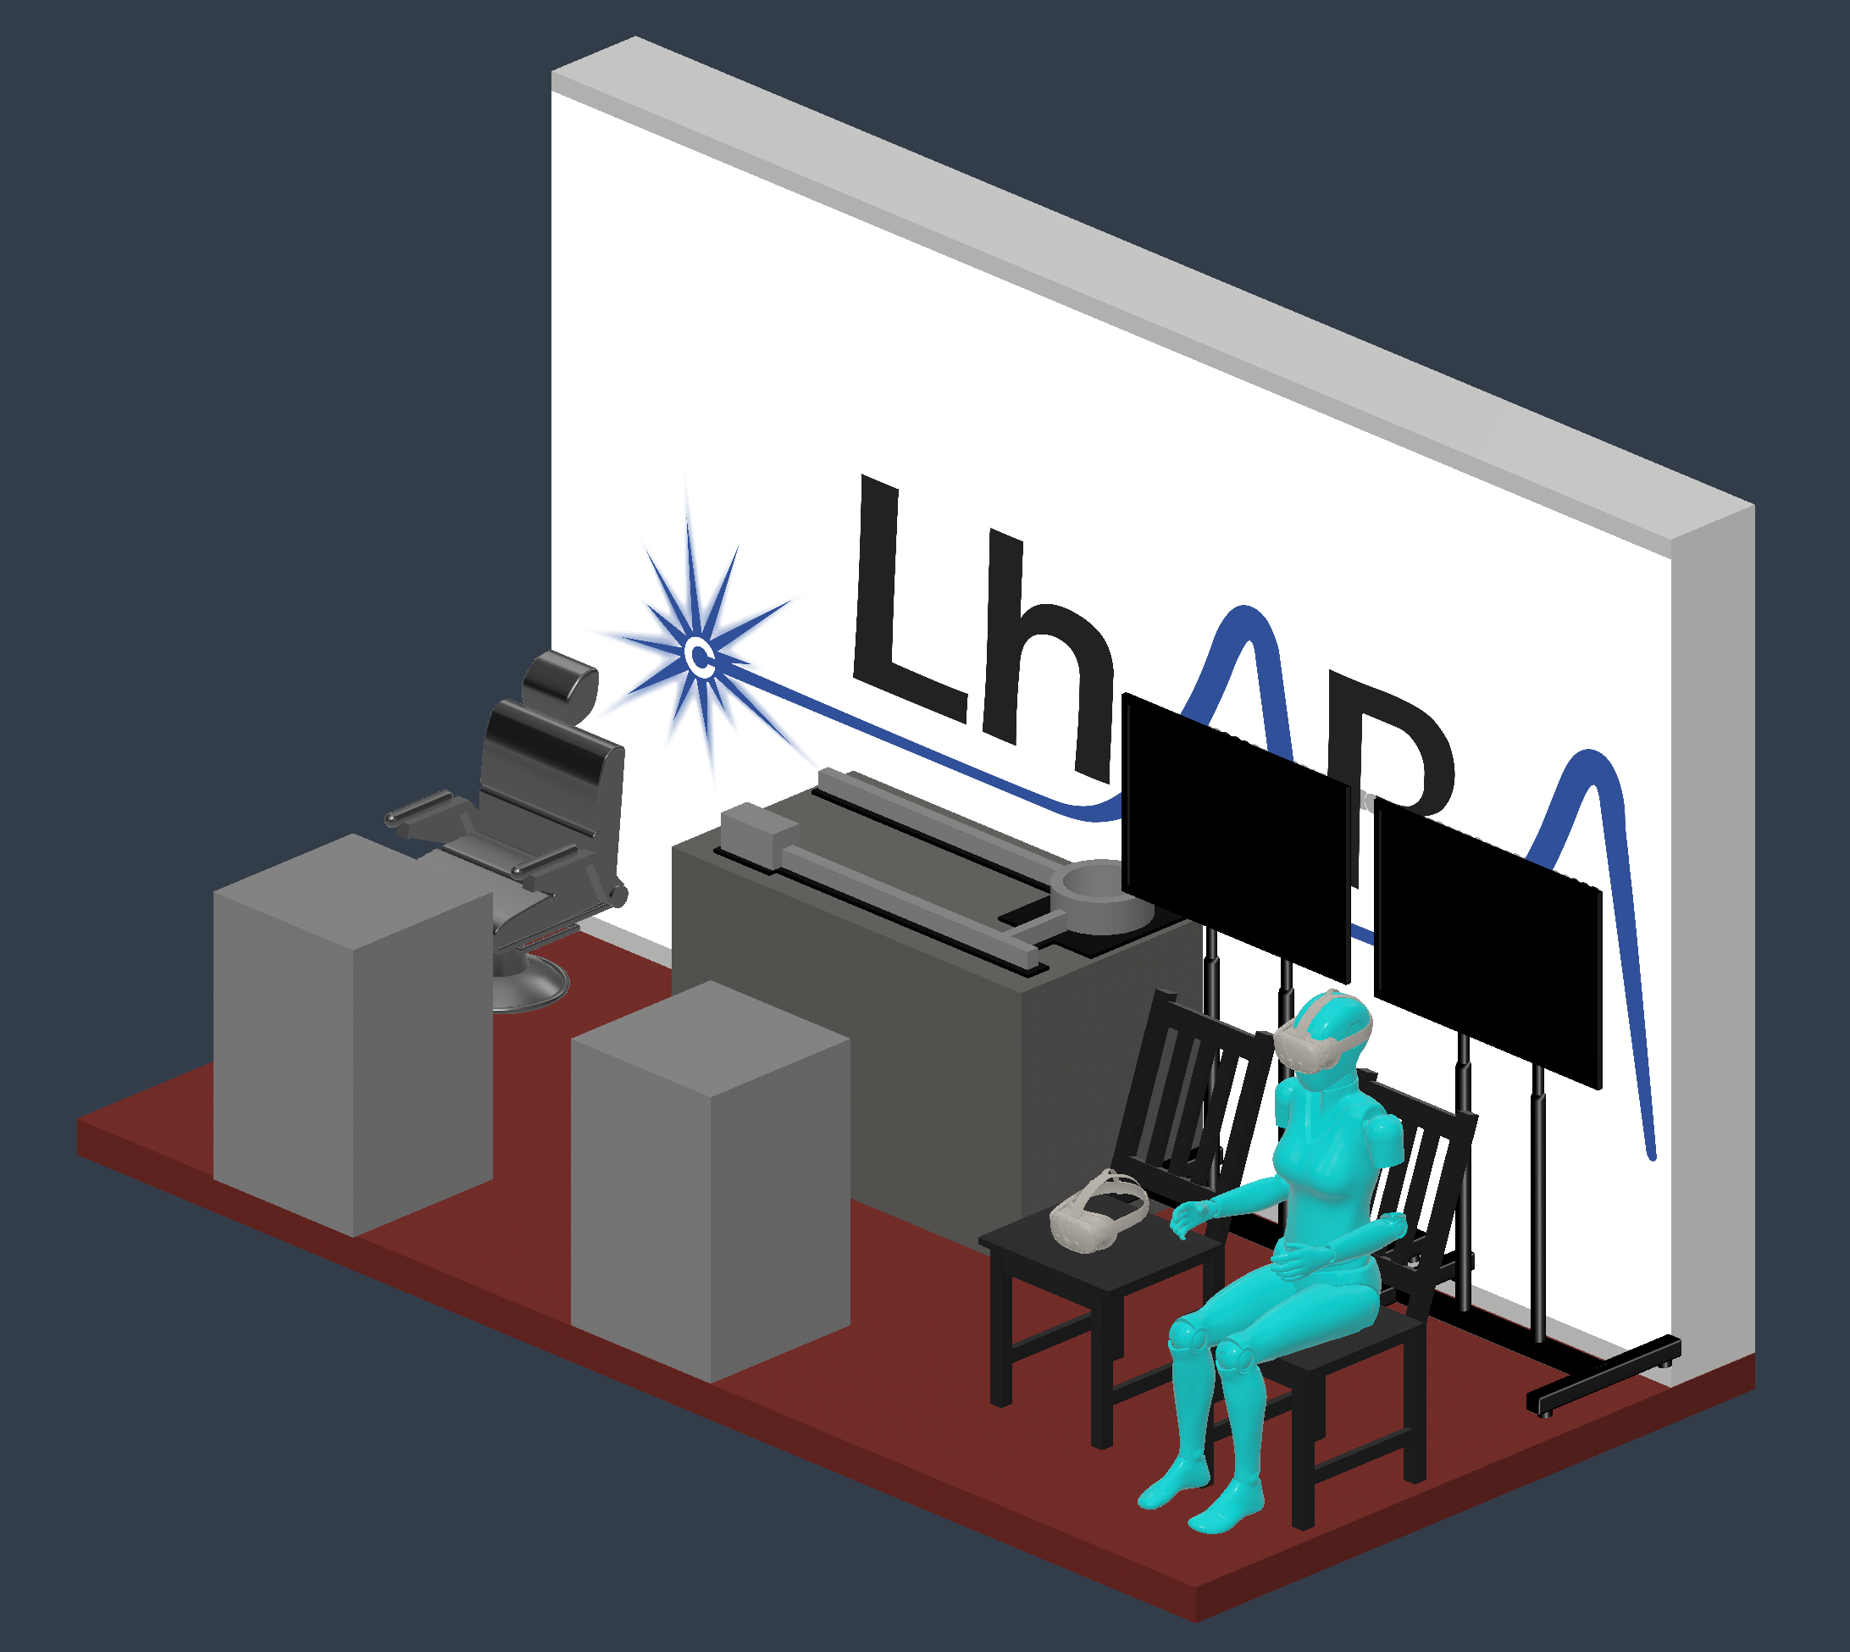
layout
Designed by Will Shields

Slide 4
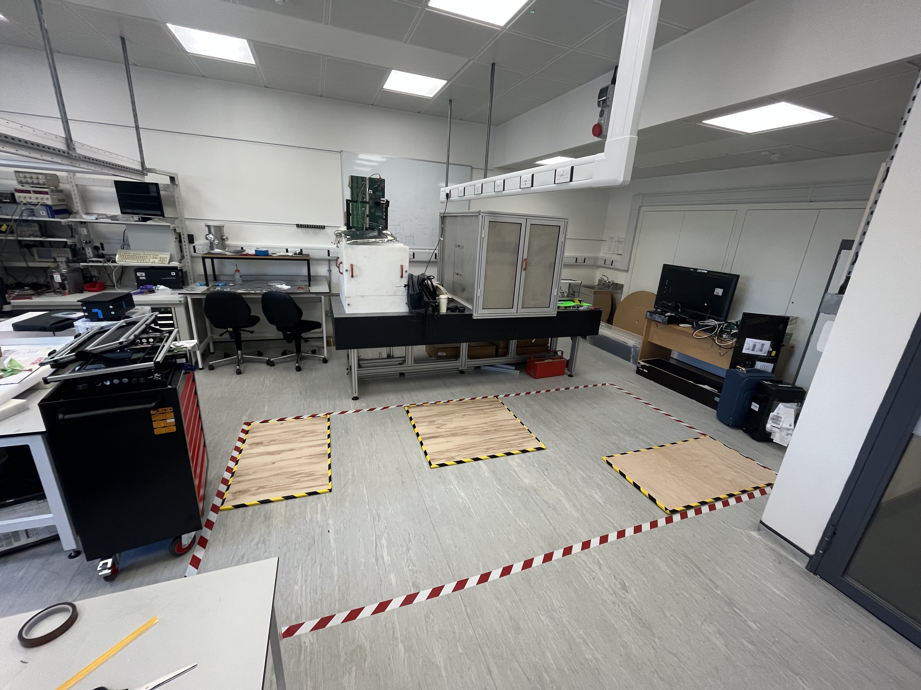
layout

Slide 5
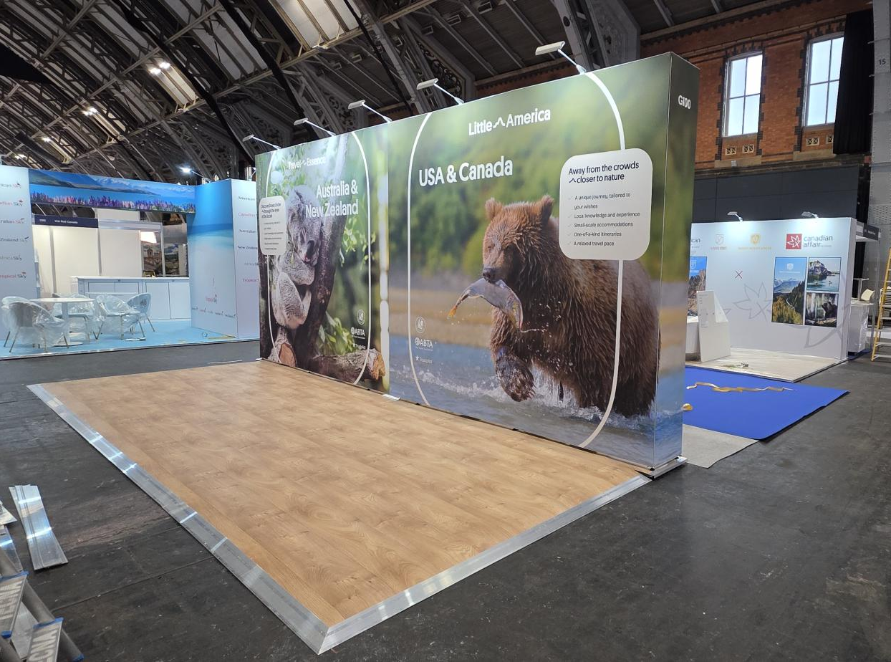
Backdrop
Designed by Darien Laird

Slide 6
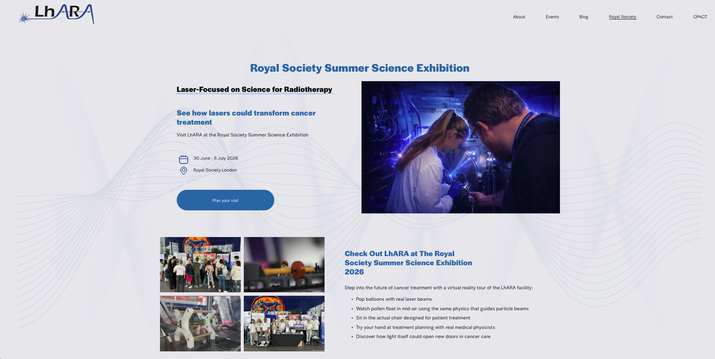
Landing page
Contact Darien with your role, name and headshot if you haven’t already!

Slide 7
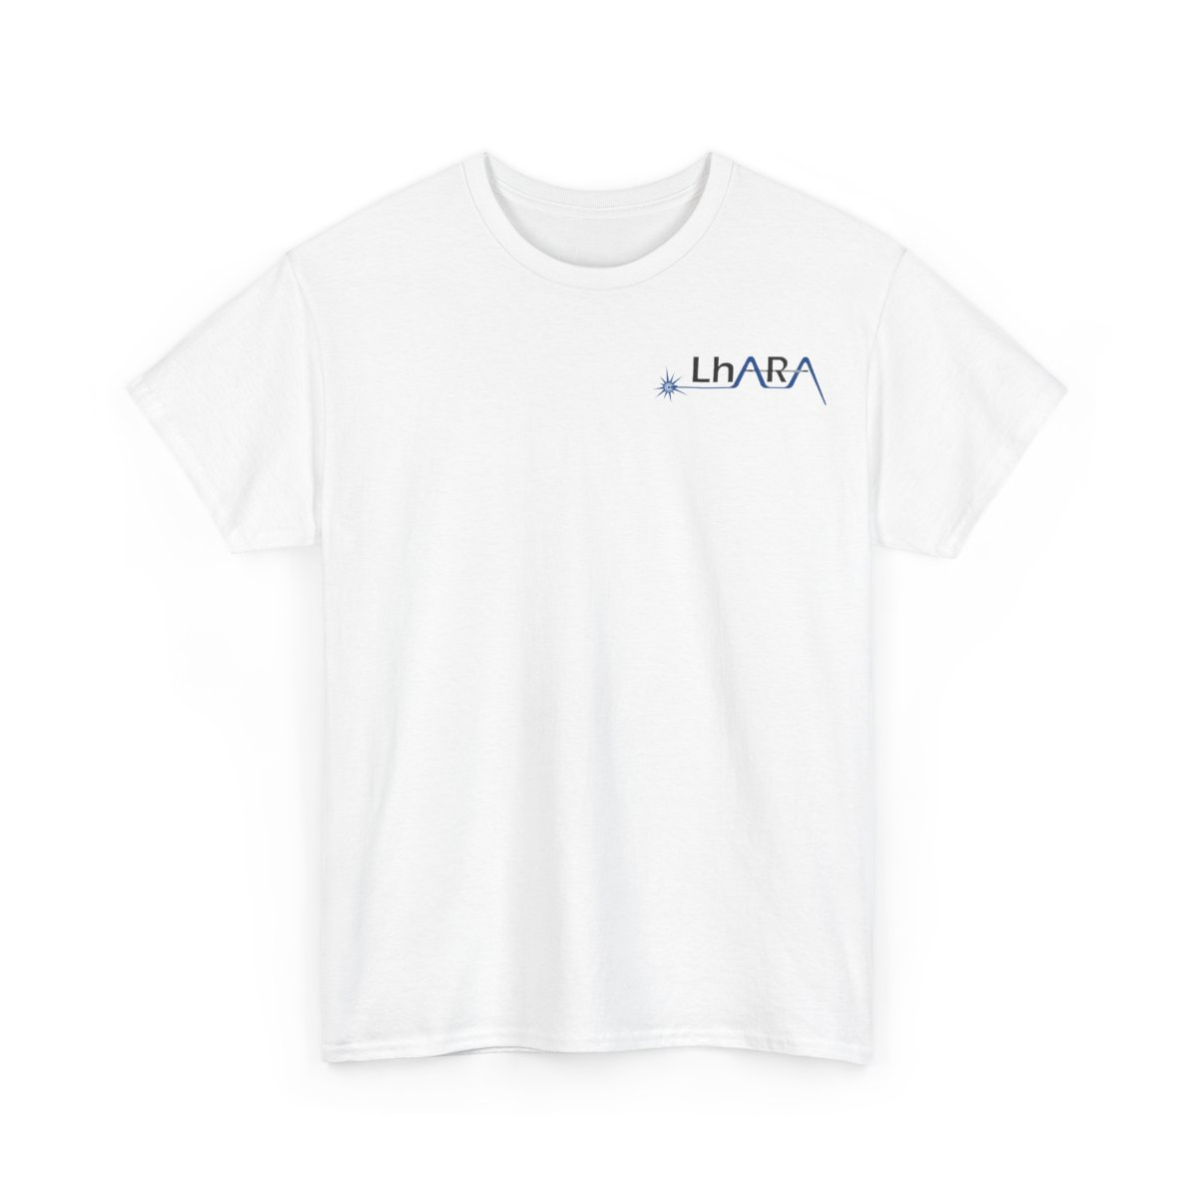

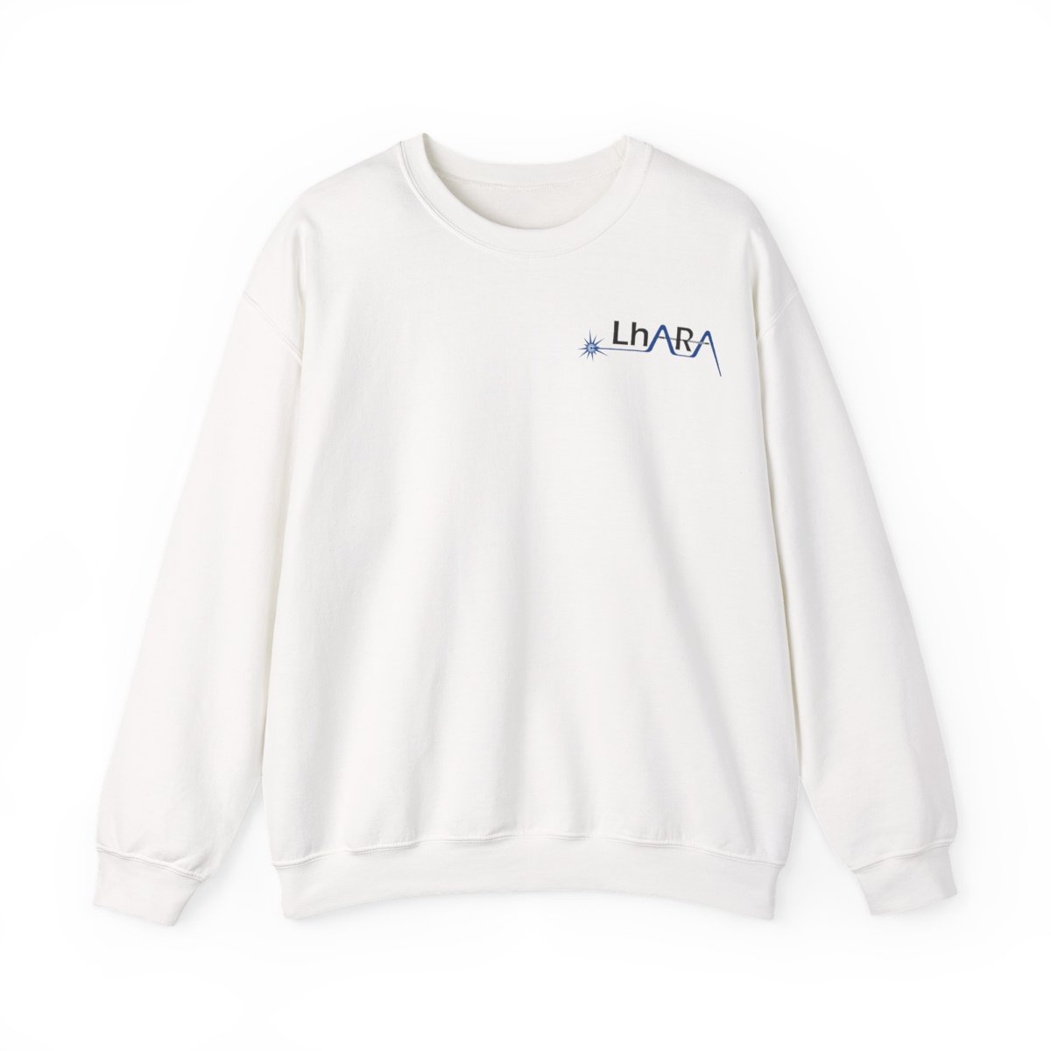
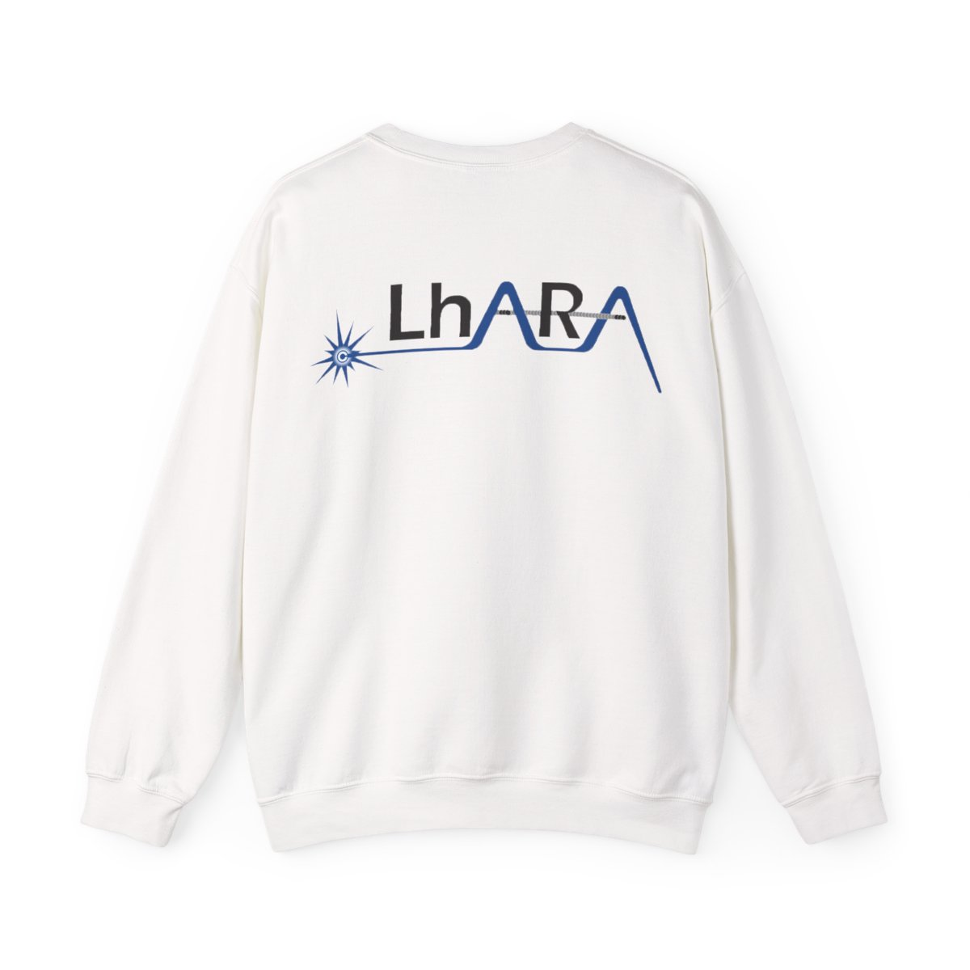
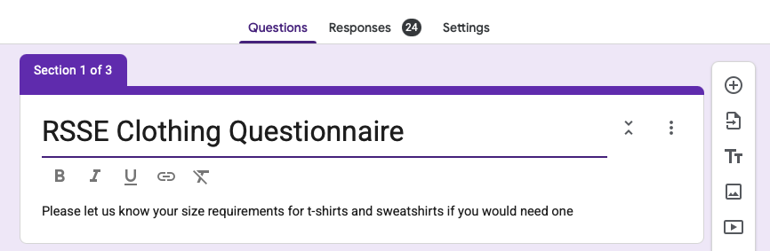
Clothing
Contact me if you have not received this survey or have issues with access

Slide 8
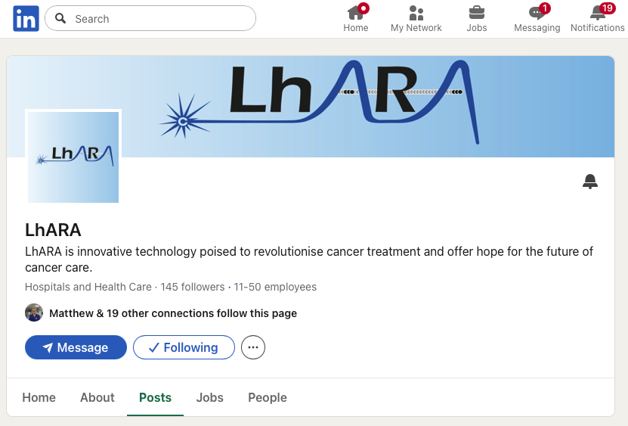
Social media
Contact Calvin with up to 3 sentences describing your role and experience at LhARA

