Slide 1

EPSRC Programme Grant introduction to discussion

Slide 2
EPSRC Programme Grants
Strategic, flexible investment in world-leading research teams
Not simply a large grant
A coherent, long-term programme tackling a major research challenge through a “best with best” team.
Up to 6 years • Strategic research theme • Critical mass investment
EPSRC Programme Grants | UKRI guidance, accessed 16 October 2026

Slide 3
Purpose and distinctive value
Why EPSRC uses the Programme Grant mechanism
Ambition
Critical mass
Long-term freedom
Address significant, open-ended research challenges requiring a coherent, holistic approach.
Concentrate internationally recognised expertise and complementary capabilities.
Provide stability for risk-taking, longer-range planning and emerging research opportunities.
EPSRC Programme Grants | UKRI guidance, accessed 16 October 2026

Slide 4
Six defining features
What the programme should demonstrate
Quality & ambition
Partnership
Creativity
Transformative challenge and compelling vision
Complementary, world-leading collaboration
New ideas, skills and research directions
Impact & advocacy
Career development
Flexibility
Influence, engagement and visibility
Leadership and independence for ECRs
Dynamic redeployment as priorities evolve
EPSRC Programme Grants | UKRI guidance, accessed 16 October 2026

Slide 5
Flexibility with accountability
A defining strength — but not an unallocated budget
Resources initially allocated
Resources can be redirected
All requested resources should be provisionally assigned to planned activities at the outset.
Adjust projects, recruitment and priorities; stop weaker strands and pursue promising opportunities.
A credible decision-making and risk-management framework is essential.
EPSRC Programme Grants | UKRI guidance, accessed 16 October 2026

Slide 6
Leadership, governance and people
EPSRC expectations for running the investment
Independent advice
Programme management
Research culture
Advisory board meets at least annually; independent chair; at least 50% independent membership.
Clear oversight, risk strategy and resource flexibility; EPSRC strongly encourages dedicated project-management support.
Embed equality, diversity and inclusion; responsible innovation; ECR mentoring, responsibility and progression.
EPSRC Programme Grants | UKRI guidance, accessed 16 October 2026

Slide 7
Application pathway
Current process supersedes older pre-outline guidance
1
2
3
Engage EPSRC
Outline
Invited full proposal
Contact the relevant theme lead to discuss strategic fit and conditions.
Combined outline process introduced October 2024; internal EPSRC panel with external observers.
Detailed proposal assessed under the current funding opportunity criteria.
Check the live UKRI funding opportunity for eligibility, assessment and submission details.
EPSRC Programme Grants | UKRI guidance, accessed 16 October 2026

Slide 8
What a strong proposal must establish
Questions to resolve before developing work packages
Scientific case
Integration
Team
What major challenge unites the programme?
Why is this more than a collection of projects?
Why is this the right “best with best” consortium?
Added value
Legacy
Why are long-term flexibility and scale essential?
How will capability, talent and impact persist?
EPSRC Programme Grants | UKRI guidance, accessed 16 October 2026

Slide 9
Sources and interpretation
Official EPSRC guidance
Programme grants — scope, features and expectations
https://www.ukri.org/councils/epsrc/guidance-for-applicants/types-of-funding-we-offer/programme-grants/
How to apply for programme grants
https://www.ukri.org/councils/epsrc/guidance-for-applicants/types-of-funding-we-offer/programme-grants/how-to-apply/
Note: the scheme overview still refers to the older pre-outline stage. The application guidance specifies the combined outline process from October 2024. Always confirm current opportunity-specific requirements.
EPSRC Programme Grants | UKRI guidance, accessed 16 October 2026

Slide 10
So, for us …

Slide 11

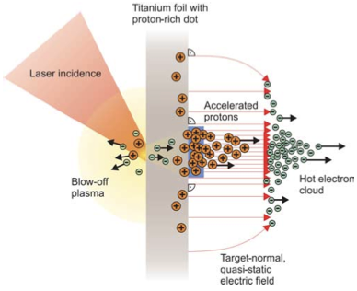
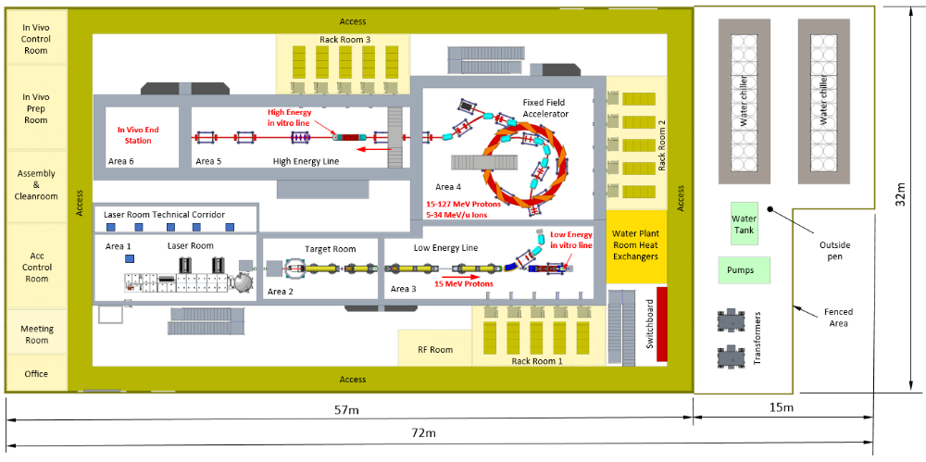
The LhARA initiative:
Deliver a systematic and definitive radiation biology programme
Prove the feasibility of laser-driven hybrid acceleration
  Spin into curiosity-driven science
Lay the foundations for the transformation of ion beam therapy
  automated, patient-specific proton and ion beam therapy

Slide 12
The LhARA initiative
Preparation
Proposals:
Establish R&D
R&D:
Stage 1
Project:
Stage 2
Project:
Stage 3
Ambition:
EU: MCSA
UKRI: TBD
IS-8+ Bucket 2
...
Business case
Radiobiology
Laser/accel.
Science,
Industrial
partnership
End station
Interpretation
Staged build & operation of laser-hybrid source serving low-energy in-vitro end station
Staged build & operation of boosted beam serving high-energy in-vitro and in-vivo end stations
LhARA facility: radiobiology
Co-creation of laser-hybrid system for the clinic
2026/27
2028 …
2030 …
2035 …
2040 ..

Slide 13
Initial programme grant …
Have discussed development in three pilars:
  Novel techniques for systematic radiobiology programme with ever-increasing sensitivity and precision:
    Requires beamline and end-station instrumentation
    Microscopy, including time resolved live-cell imaging
    Automation, fast feedback, control, data handling
    Advanced tools for interpretation and abstraction:
      Application of ML/AI tools, for example
  Plasma-lens, high acceptance, strong focusing, cylindrically symmetric
    Active and passive
    University of Oslo on board
  Co-creation of, e.g., automation and realtime dosimetry with Leo Cancer Care:
    Target developments which will enhance clinical impact of Leo chair which are required for the LhARA initiative, e.g.:
      Automation, dose-profile measurement in real time, feedback …

Slide 14
Steps agreed with Programme manager @ EPSRC
First, produce 2 pager:
  They will review and potentially share with other Research Councils
Second, outline application:
  Start when 2-pager done
  Can we make it by next gathering on 01Dec26?

Slide 15
UK–Norway collaboration: a special route
Money Follows Cooperation (MFC) agreement
Norwegian co-lead
Eligible Norway-based researchers may join a UK-led EPSRC bid as project co-lead (international).
One integrated application
The Norwegian work is included in the UK proposal; MFC is not a separate grant scheme.
Scientific partnership
Co-leads can contribute to research direction, intellectual leadership and programme delivery.
Application detail
Use the “UKRI-Norway” prefix in the application title; verify Programme Grant eligibility with EPSRC.
Sources: UKRI Norway collaboration; EPSRC eligibility (2026)

Slide 16
Additional resources for Norway
What may be requested within the grant
International contribution
Normally up to 30% of overall project cost (100% FEC basis), across international co-leads.
Research people
Eligible research associates, specialists, technicians and enabling staff at the Norwegian institution.
Direct research costs
Justified consumables, travel, subsistence and certain other directly incurred research costs.
Funding treatment
Eligible Norwegian direct costs at 100%; normally no overseas overheads or equipment items above £25,000.
Sources: UKRI project co-lead (international) policy, updated Jan 2026

Slide 17
Designing a UK–Norway Programme Grant
Translate funding flexibility into scientific advantage
Integrated work packages
Give Norwegian teams clear intellectual ownership of complementary scientific challenges.
Joint capability
Plan staff exchanges, shared methods, data, experiments and technical development.
Budget transparently
Identify Norwegian direct costs separately; justify why the collaboration is essential.
Confirm before submission
Discuss the international co-lead arrangement and cost eligibility with the relevant EPSRC theme.
Sources: EPSRC international collaboration guidance; UKRI–RCN MFC agreement

Slide 18
UKRI sources and next decisions
Guidance for the proposed Norway collaboration
MFC opportunity
https://www.ukri.org/opportunity/collaborate-with-researchers-in-norway/
International co-lead policy
https://www.ukri.org/publications/ukri-project-co-lead-international/ukri-project-co-lead-international-policy/
EPSRC eligibility
https://www.ukri.org/councils/epsrc/guidance-for-applicants/check-if-you-are-eligible-for-funding/
Next decision
Identify Norwegian co-leads, research contributions and a justified indicative resource envelope.
Sources: UKRI official guidance, accessed October 2026

Slide 19
University of Oslo:
Have discussed with:
  Erik Adli, Carl Lindstrøm, Kyrre Sjobaek
Interested to come on board:
  Expertise and interest in active plasma lens
  PhD students are employees in Norway, so ask for:
    1 FTE to be made up out of postdoc and student
Discuss!!

