Slide 1
BioPhysicsX
The future of convergent science

Slide 2
Why BioPhysicsX
To develop better clinical systems and improved treatment outcomes for patients
To understand how DNA in living cells reacts to different beams and cancer treatment regimes
To develop skills and expertise
To attract and retain world-class researchers
To work with industry and entrepreneurs

Slide 3
What is BioPhysicsX
A multidisciplinary institute – physics, radiobiology and clinical disciplines
Will be based at Imperial College’s White City campus
A partnership between Imperial College and Oxford University
A collaboration of national and international institutes, expertise and entrepreneurs

Slide 4
Who is BioPhysicsX
Trusted experts and leaders in each discipline – excellence everywhere
Co-located fostering a co-operative setting and removing silos
Coordinated approach and jointly developed science programme
Industry partners

Slide 5
How does BioPhysicsX work: its purpose and aims
Environment for ground-breaking research: physics, engineering, laser, biological clinical
Application driven – focused on delivering novel cancer care to transform clinical practice
Interdisciplinary research
Developing skills through training to create expert users who will work in the emerging field

Slide 6
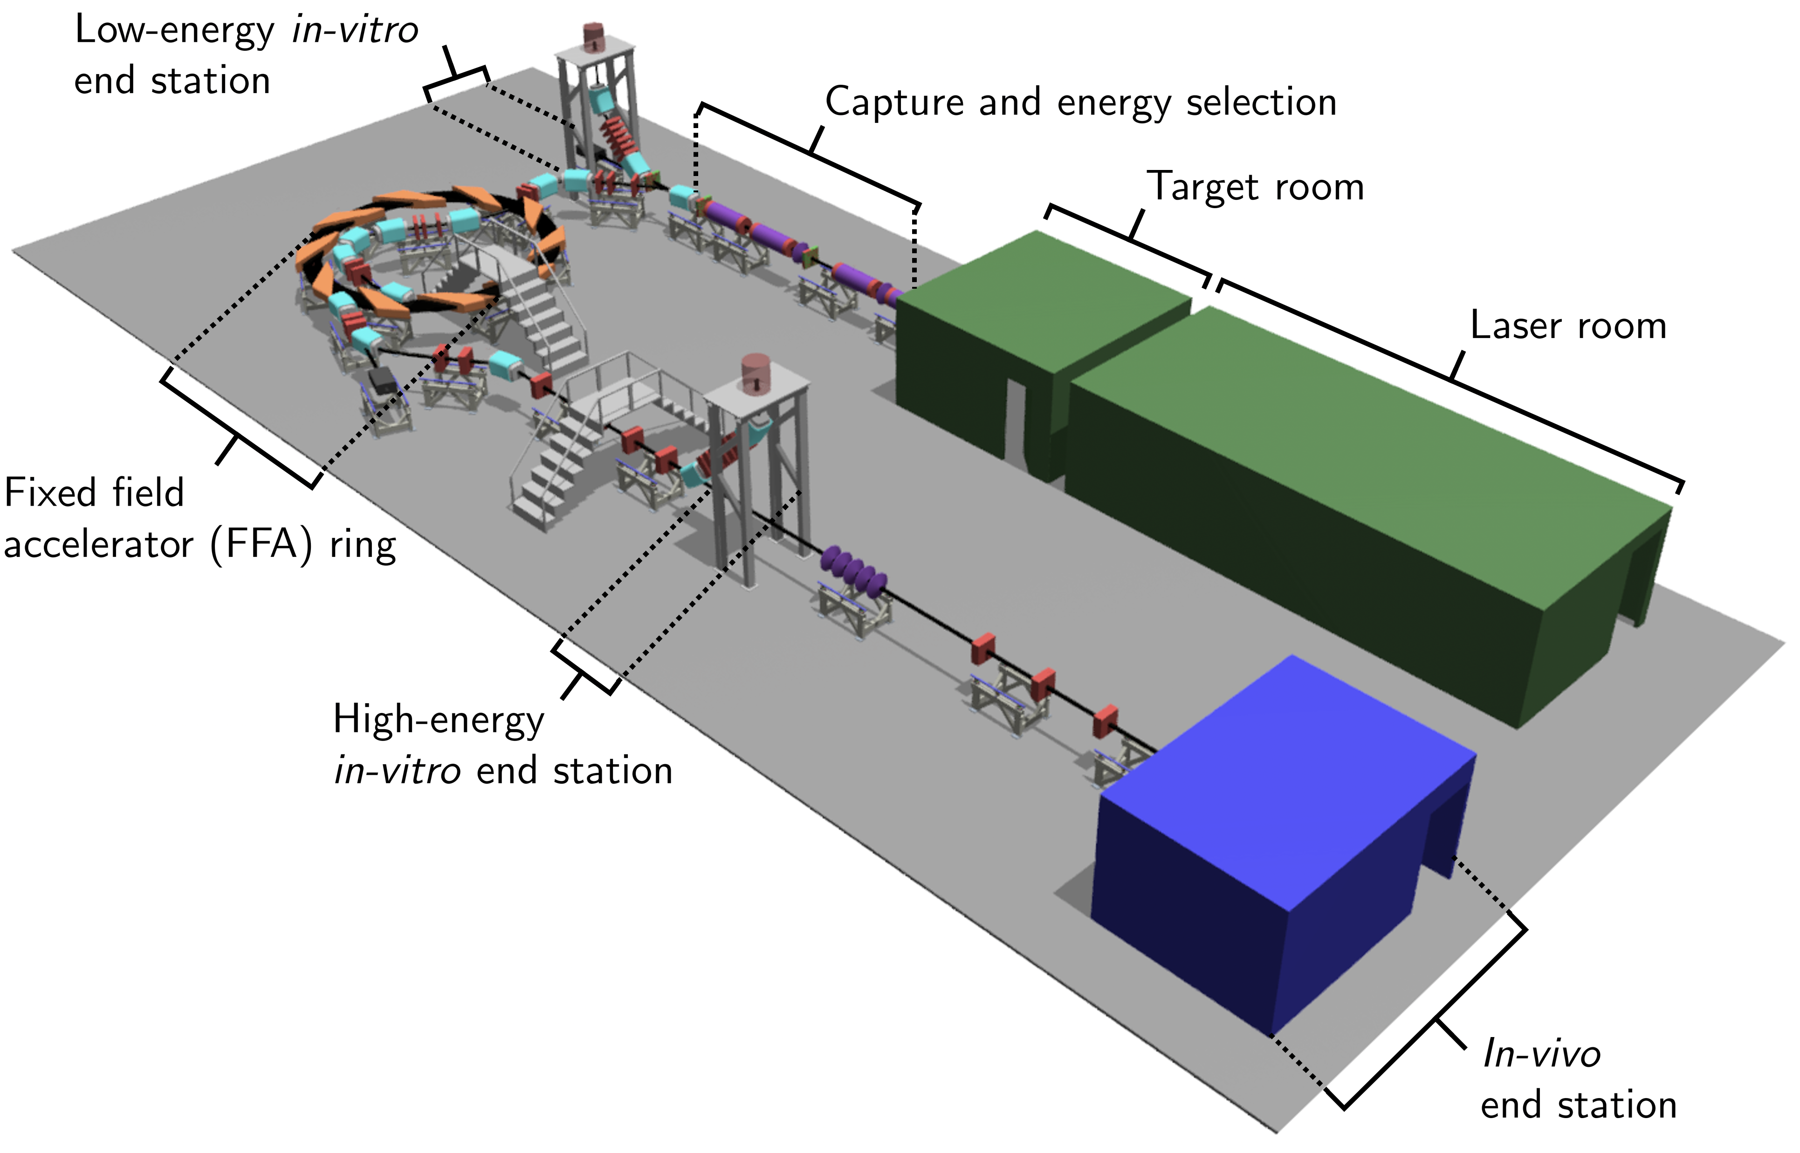
BioPhysicsX and LhARA
The Laser-hybrid Accelerator for Radiobiological Applications (LhARA) is at the heart of BioPhysicsX
The accelerator facility will deliver ion species at ultra-high dose rate in different spatial- temporal and spectral fractionation schemes
2-year funding for preliminary study is underway

Slide 7
BioPhysicsX: current research
Physics – energy efficient accelerator with fixed field alternating gradient
Laser – system large of flux in nano-second pulses with interactive feedback to reposition the beam
Physics (?) – Gabor lens a capture device that removes the limitations on the instantaneous dose rate
Clinical treatment (?) – ion acoustic dose profile measurement
Computing – simulation systems and techniques, machine learning
Radiobiology – study of relative biological effectiveness of different ions and effectiveness of different beam systems

