Slide 1
The Laser-hybrid Accelerator for Radiobiological Applications
LhARA

Slide 2
Plan
Challenges and opportunities
Radiobiology
LhARA
New techniques with wide application
Conclusions

Slide 3
Challenges and opportunities
The Laser-hybrid Accelerator for Radiobiological Applications (LhARA)

Slide 4
Radiotherapy; the challenge
Cancer: second most common cause of death globally
  Radiotherapy indicated in half of all cancer patients
Significant growth in global demand anticipated:
  14.1 million new cases in 2012 ⇢ 24.6 million by 2030
  8.2 million cancer deaths in 2012 ⇢ 13.0 million by 2030
Scale-up in provision essential:
  Projections above based on reported cases (i.e. high-income countries)
  Opportunity: save 26.9 million lives in low/middle income countries by 2035
Provision on this scale requires:
  Development of new and novel techniques … integrated in a
  Cost-effective system to allow a distributed network of RT facilities
Atun, Lancet Oncol. 2015 Sep;16(10):1153-86

Slide 5
The benefit of particles
Maximise therapeutic benefit by:
  Maximising damage to tumour
  Minimising damage to healthy tissue
X-ray therapy:
  Modality used in most radiotherapy
  Dose falls exponentially with depth
  Proximity of sensitive organs limits dose to tumour

Slide 6
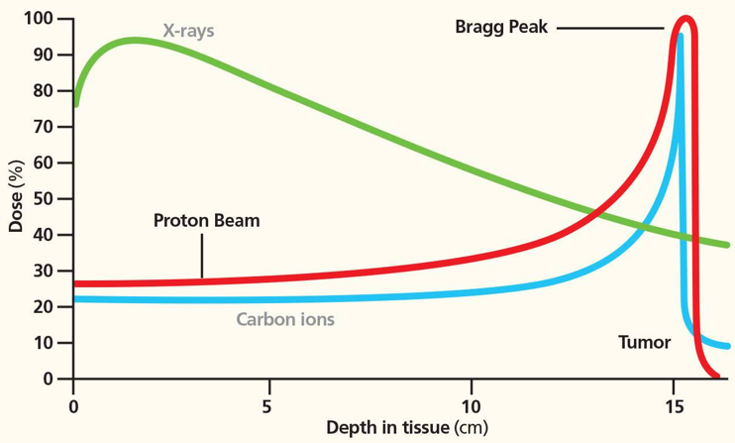
Particle-beam therapy
Proton and ion-beam therapy:
  Bulk of dose deposited in Bragg peak
  Significant normal-tissue sparing (entry)
  Almost no dose beyond the Bragg peak

Slide 7
The need for a step-change in capability
Growing recognition of benefits of PBT worldwide:
  70 PBT centres in operation;
  40 under construction
‘Incremental’ development
of technique
  Existing suppliers
  New initiatives
Exciting indications of benefits of novel beams …

Slide 8
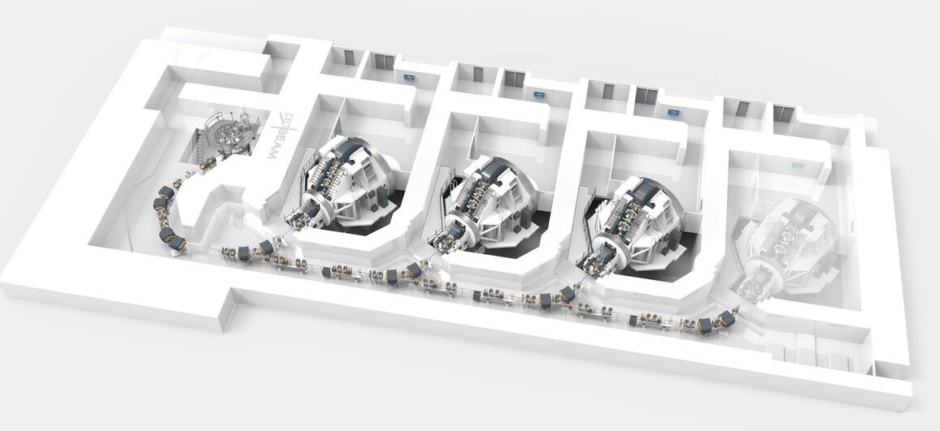
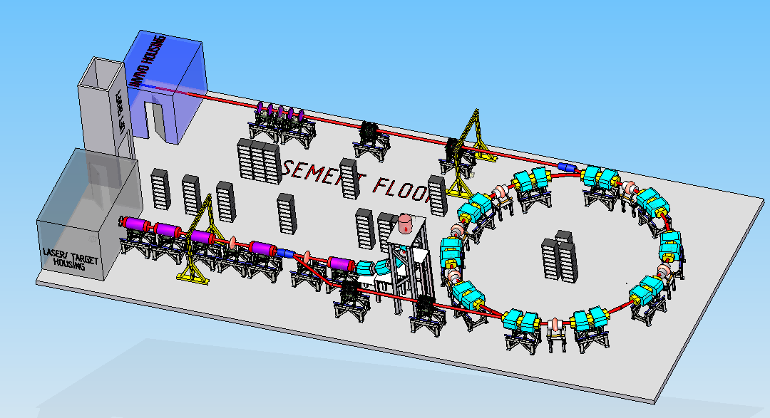
Particle beam therapy today
Cyclotron based:
  Limitations:
    Energy modulation
    Instantaneous dose rate
Synchrotron based:
  Limitiations:
    Complexity
    Instantaneous dose rate
⇒ reduce footprint,
cost and complexity
‘PBT for the many’!
Christie Hospital Manchester
⇒ increase flexibility
optimize treatments
MedAustron
Austria

Slide 9
Radiobiology
The Laser-hybrid Accelerator for Radiobiological Applications (LhARA)

Slide 11

The case for fundamental radiobiology
Relative biological effectiveness:
  Defined relative to reference X-ray beam
  Known to depend on:
    Energy, ion species
    Dose & dose rate
    Tissue type
    Biological endpoint
Yet:
  p-treatment planning uses 1.1
  Effective values are used for C⁶⁺
Maximise the efficacy of PBT now & in the future:
  Require systematic programme to develop
  full understanding of radiobiology
Paganetti,
van Luijk
(2013)
SemRadOncol

Slide 12
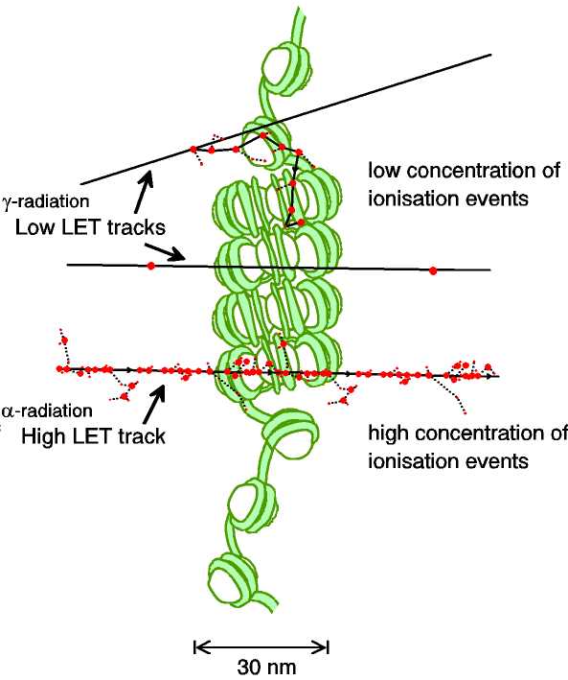
Biological impact ^{from the} physics of ionisation
Low-LET radiation:
  Repairable single/double
  strand breaks
High-LET radiation:
  Complex DNA lesions
    Multiple DNA pathways
    More difficult to repair
    Enhances cell death
Programmatic approach:
  Dynamic studies of impact of radiation
  Interpret with advanced computer models (e.g. G4DNA)

Slide 13
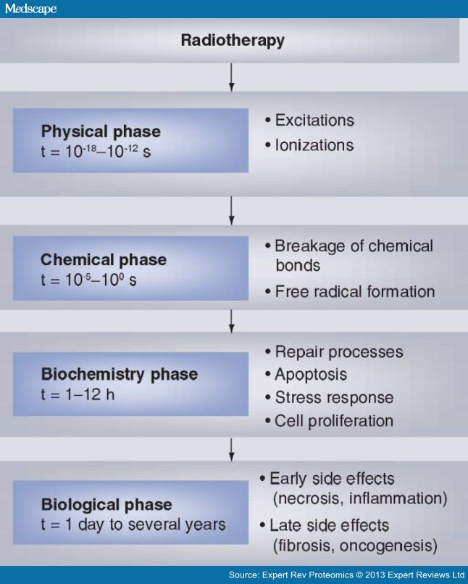
A complex, multi-facetted problem
Carter et al, and Parsons
(2018) IJROBP & (2019) IJROBP
Multidisciplinary approach essential
Time

Slide 14
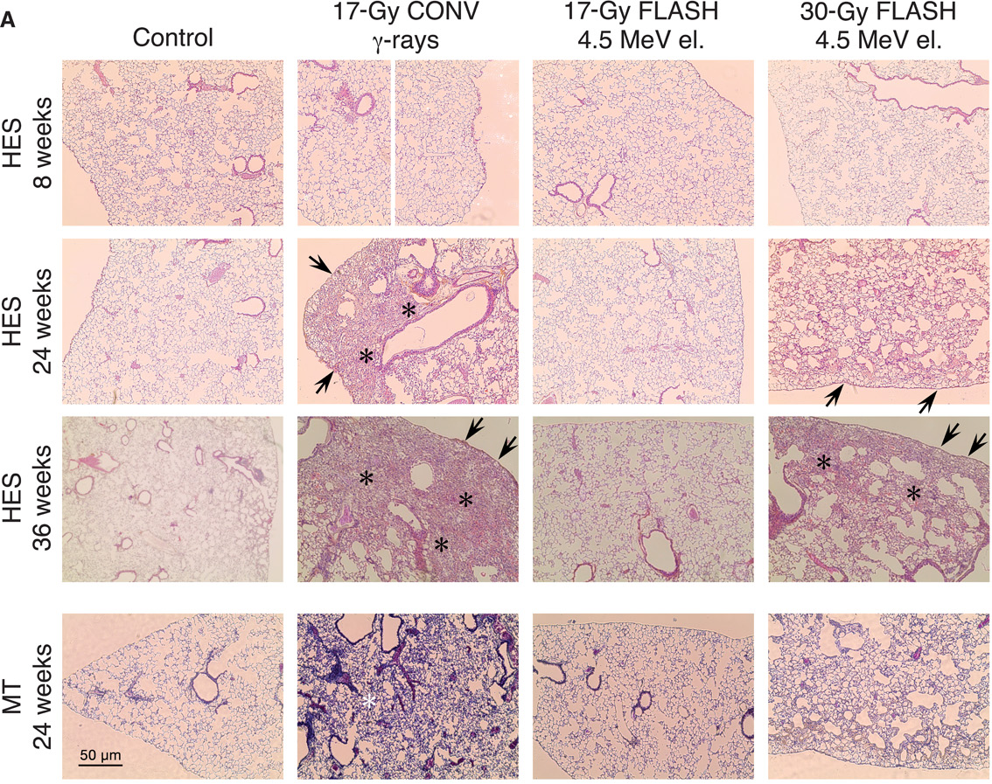
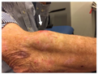
Radiobiology in new regimens
Worked example: FLASH
Conventional regime : ~2 Gy/min
FLASH regime : >40 Gy/s
Evidence of normal-tissue sparing while tumour-kill probability is maintained:
i.e. enhanced therapeutic window
Time line:
Initial reports: 2014 (e.g. Flauvadon et al, STM Jul 2014)
Confirmation in mini-pig & cat: 2018 (Clin. Cancer Research 2018)
First treatment 2019 (Bourhis et al, Rad.Onc. Oct 2019)

Slide 15
Radiobiology in new regimens
Prezado; 13Nov19
Worked example: micro beams
Conventional regime : > 1 cm diameter; homogeous
Microbeam regime : < 1 mm diameter; no dose between ‘doselets’
Remarkable increase of normal rat brain resistance.
[Dilmanian et al. 2006, Prezado et al., Rad. Research 2015]
Dose escalation in the tumour possible – larger tumor control prob.

Slide 16
Radiobiology in new regimens
Time
domain
Space
domain
The ideally
flexible beam facility
can deliver it all!
⇒ substantial
opportunity for a
step-change in
understanding!
Ion
species
Energy
In combination
and with chemo/immuno Therapies

Slide 17

Laser-hybrid Accelerator for Radiobiological Applications
LhARA; a novel, hybrid, approach:
  High-flux, laser-driven proton/ion source:
    Overcome instantaneous dose-rate limitation
    Delivers protons or ions in very short pulses:
      Pulse length 10 – 40 ns
    Can provide arbitrary pulse structure
  Novel plasma-lens capture & focusing
  Fast, fixed-field post acceleration
⇒ compact, uniquely flexible facility
LhARA consortium

Slide 18
Our vision and our ambition
LhARA will be a uniquely-flexible, novel system that will:
Deliver a systematic and definitive radiobiology programme
Prove the feasibility of the laser-driven hybrid-accelerator approach
Lay the technological foundations for the transformation of PBT
  automated, patient-specific: implies online imaging & fast feedback and control

Slide 19
LhARA
The Laser-hybrid Accelerator for Radiobiological Applications (LhARA)

Slide 20
LhARA

Slide 21
LhARA; overview
Laser-driven source:
  Enormous instantaneous dose
    Overcome space-charge limit of today’s ion sources
Proton/ion capture using plasma (Gabor) lens:
  Electrostatic focusing, short focal length:
Post-acceleration using fixed-field accelerator:
  Rapid, energy-efficient acceleration of protons or ions
    Protons up to 127 MeV p;
    Ions up to ~35 MeV/u
Staged implementation:
  Stage 1: In vitro studies with protons at energies up to 15 MeV
  Stage 2: In vivo & in vitro studies with protons up to 127 MeV and ions up to 35 MeV/u

Slide 22
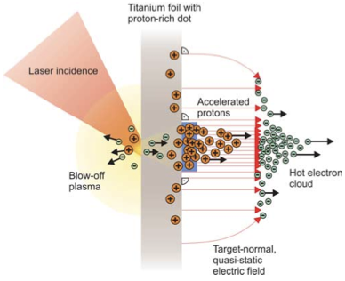
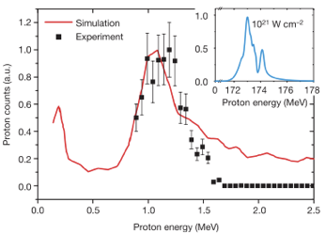
Sheath acceleration
Laser incident on foil target:
  Drives electrons from material
  Creates enormous electric field
Field accelerates protons/ions
  Dependent on nature of target
First observation ~2000
Active development:
  Laser: power and rep. rate
  Target material, transport
Schwoerer, H. et al., 2006; Nature, 439(7075).

Slide 23
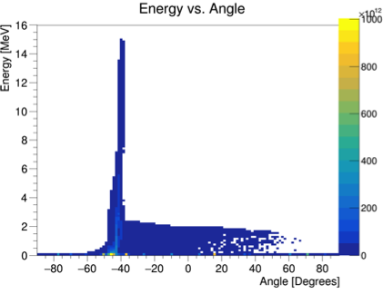
Laser-driven proton/ion source
Advantage:
  Enormous proton/ion flux at 10—15MeV in tiny (30 fs) pulse at 10 Hz
Ti:Sapphire commercial system >15TW
Pulse ~35fs at rep-rate of at least 10Hz
At least 500mJ laser energy - I_{L} ~ 1020 Wcm⁻²
Issue to be solved:
  Efficient capture, focusing, selectin and manipulation of divergent ion beam

Slide 24
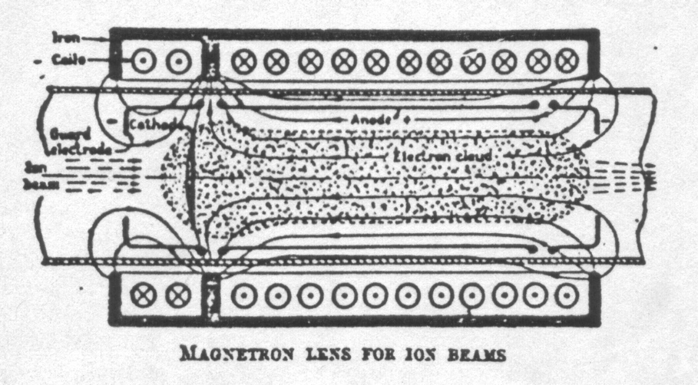
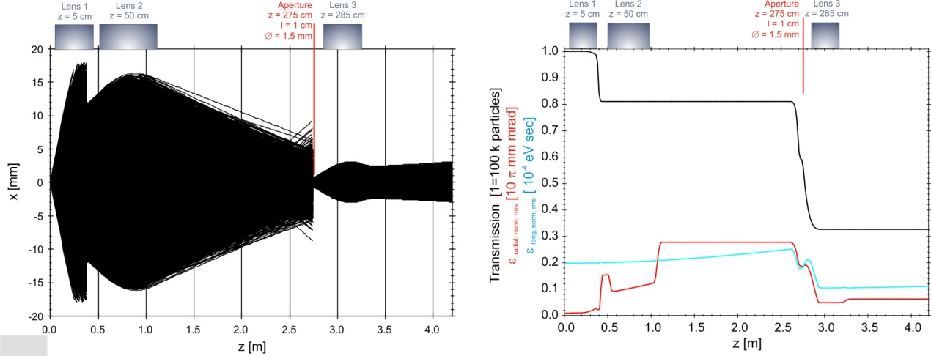
Beam capture/production principle
Posocco, Pozimski
Plasma (Gabor) lens:
  Strong focusing exploiting
  electron plasma in solenoid

Slide 25
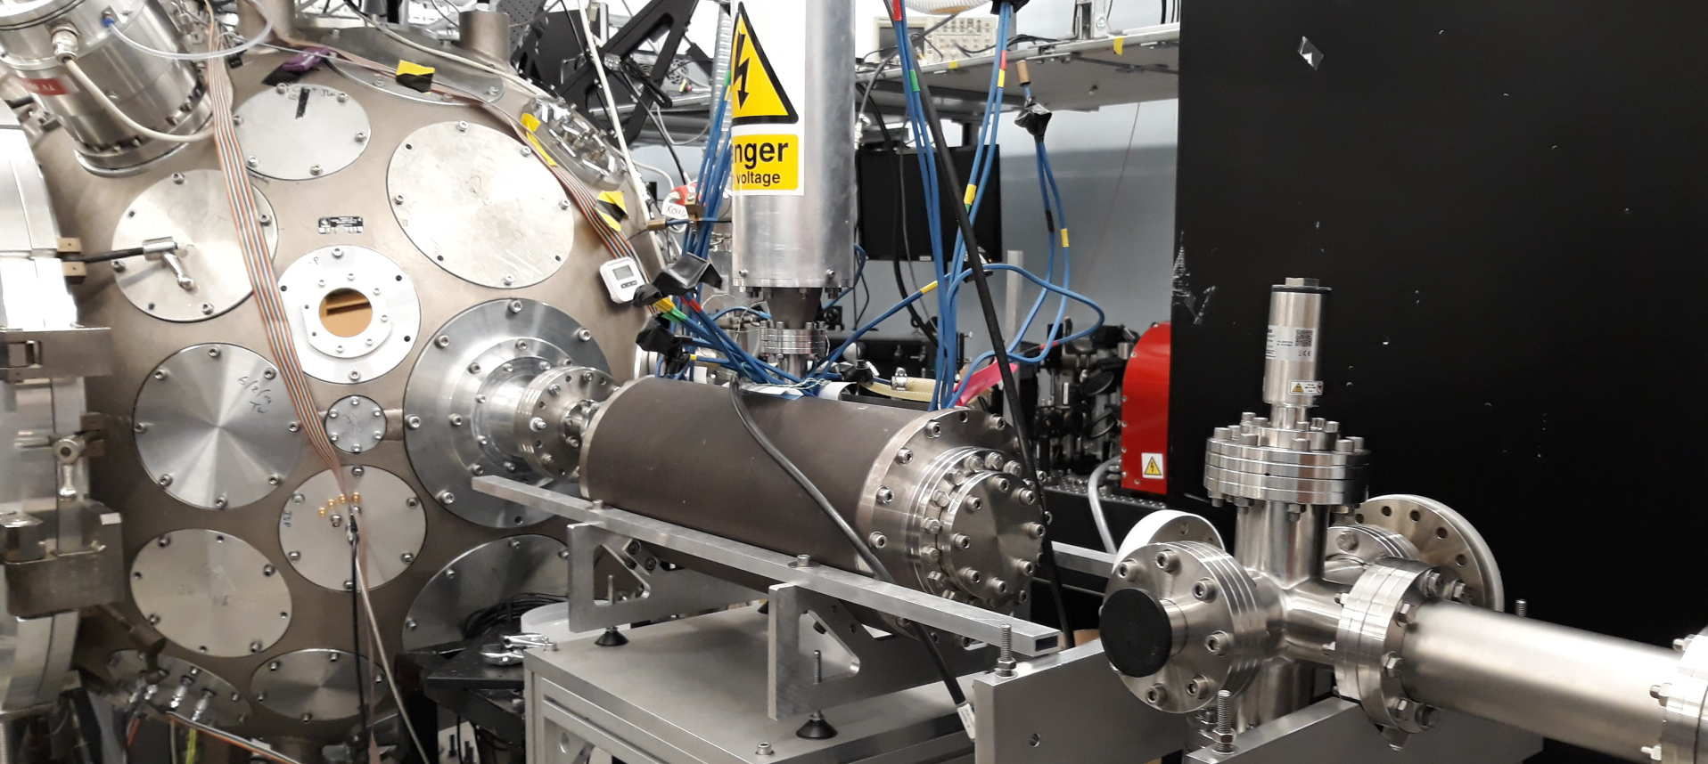
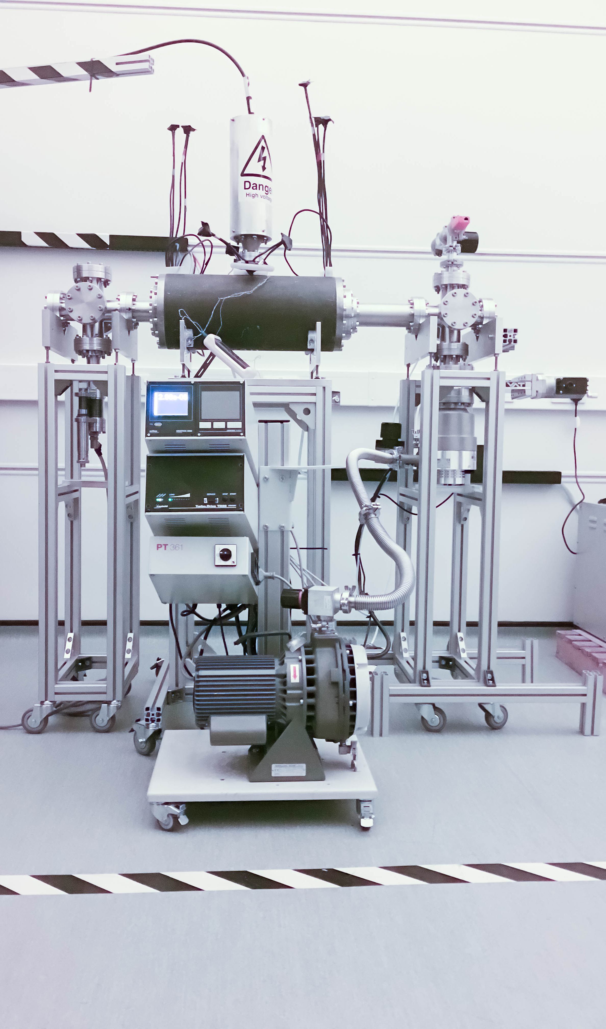
LhARA: ion-source development
Capture
Laser source/capture test
Electron plasma:
  Strong focusing
  of +ve ions
1st prototype:
  1 MeV protons
  Surrey Ion Beam
  Centre
  Aberrations
  observed
Upgraded
prototype:
  Under development
  Imperial
Integration test:
  Gabor lens on cerberus Laser at Imperial
Plan:
  “Now”: prepare to validate lens with α
  Next: test using laser-driven source

Slide 26
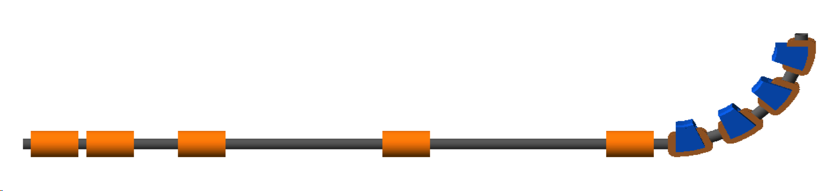
LhARA; stage 1
Pasternak
Vertical arc
Laser
Capture @ 10—15 MeV
Energy selection
Phase-space matching
11.6 m

Slide 27
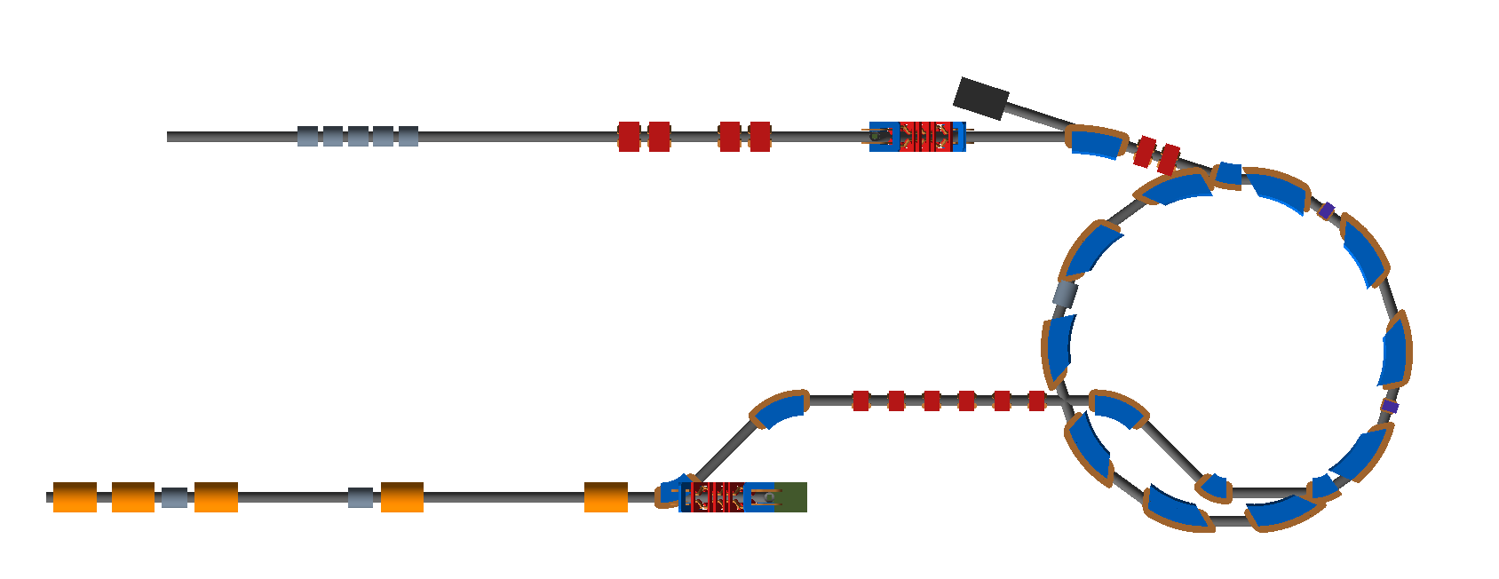
LhARA – Stage 2
In-vitro radiobiology using animal models:
  Post-acceleration required
Baseline:fixed field accelerator:
  x3 increase in momentum
    15 MeV protons accelerated to 127 MeV
    3.8 MeV/u carbon 6+ ions accelerated to 33 MeV/u

Slide 28
Fixed Field Accelerator
Bending magnetic fields do not vary in time.
  Rapid acceleration.
Alternating gradient gives strong focussing.
Very large acceptance.
  Useful, e.g. to accelerate muon beams.
Advantages over conventional medical cyclotron
  Variable energy operation without energy degraders
  Operation with different ions
  Multiple extraction ports

Slide 29
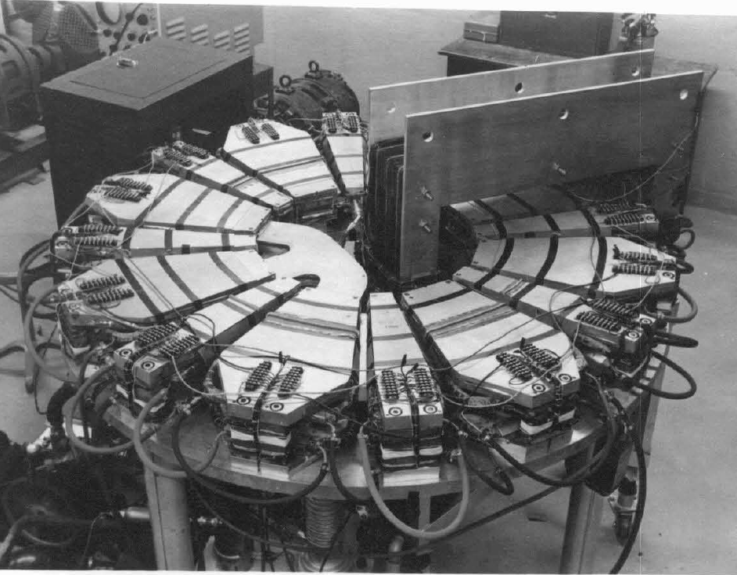
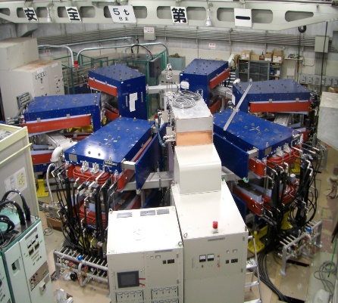
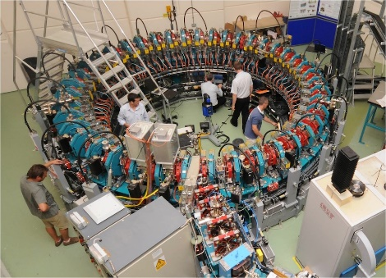
FFA potted history
Early 1950s, FFAG developed independently:
  Japan by Tihiro Ohkawa
  US by Keith Symon
  Russia by Andrei Kolomensky.
The first prototype was operated in 1956
  Jones, Terwilliger, Technical Report MURA-LWJ/KMT-5
  (MURA-104), April 3, 1956.
Not much activity until first proton accelerator in 2000
The Michigan Mark I FFA 400KeV electron accelerator was the first operational FFA.
500 keV Proton proof-of-principle FFA at KEK.
PRISM muon beam phase rotation demonstration ring at Osaka.
Kyoto University FFA for ADSR
EMMA at Daresbury

Slide 30
LhARA FFA
Parameters
Number of sectors 10
k 5.19
Spiral angle 47.64°
R_{max} 3.49 m
R_{min} 2.92 m
B_{max} 1.4 T
Max Proton injection energy 15 MeV
Max Proton extraction energy 127.4 MeV
h 1
RF frequency
for acceleration (15-127.4MeV) 2.89 – 6.48 MHz
Bunch intensity ~10⁸ protons
Pasternak

Slide 31
Present multidisciplinary collaboration
Further interest from:
Groups in the UK and overseas
The International Biophysics Collaboration [spokespeople: Patera, Prezado]

Slide 32
The next steps
Preparation of ‘pre-CDR’ for LhARA:
  Deliverable: pre-CDR for LhARA [milestone April 2020]
  Very modest resources
  Milestone set to allow next wave of bids
LhARA and radiobiology test facility:
  Deliverable: proton-FLASH dosimetry [milestone April 2020]
  Again, very modest resources
International Biophysics Collaboration (IBC):
  ‘Networking activity’ [milestone September 2021]

Slide 33
New techniques with wide application
The Laser-hybrid Accelerator for Radiobiological Applications (LhARA)

Slide 34


The Standard Model
u
c
t
g
up
charm
top
gluon
Quarks
s
γ
d
b
down
strange
bottom
Force Carriers
photon
ν_{e}
ν
ν
W
μ
τ
Leptons
e-neutrino
μ-neutrino
τ-neutrino
e
μ
τ
W boson
Z
electron
muon
tau
Z boson
Generations of matter
I
II
III
Higgs
Boson
Higgs
Boson

Slide 35
Energy frontier to illuminate limit of SM
Degrassi et al, 10.1007/JHEP08(2012)098
Hernandez, Granada, 2019
Measurement at highest possible energy
  Experimental motivation clear!
    Theorists motivated by ‘meta-stability’ of SM

Slide 37
Neutron scattering facilities in Europe;
Present status and future perspectives
ESFRI Physical Sciences and Engineering Strategy Working Group
Neutron Landscape Group
STFC, Neutron scattering Materials research for modern life

Slide 38
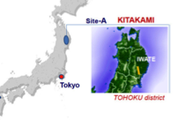
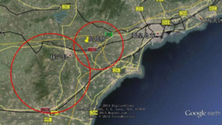
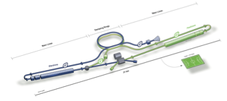
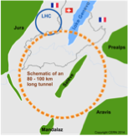
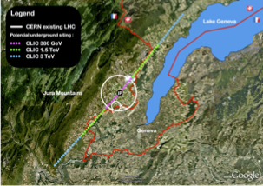

Options for ⎷s x 10
250—350 GeV
for Higgs & e/w
CepC, ILC &/or CLIC
pp @ 100 TeV
⎷s ⇢ 10 TeV
for exploration
FCC-hh

Slide 39
Laser-driven acceleration
Shrink footprint using ultra-high gradient acceleration:
  Exploit plasma waves
P. Ratoff, CI/Lancaster
/ particle
Excitation of plasma:
  Photon (laser)
  Particle beam:
    Electron or proton

Slide 40
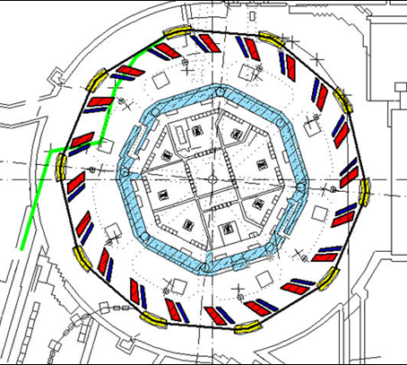
High-power driver for neutron production
High power:
  Required to serve many beamlines
    Maximise scientific return
Example:
  ISIS II:
    Consider Fixed-Field Accelerator (FFA):
    Reduced power consumption
J. Thomason, G. Aymar:
[ISIS II] PROJECT LIFECYCLE PLAN

Slide 41
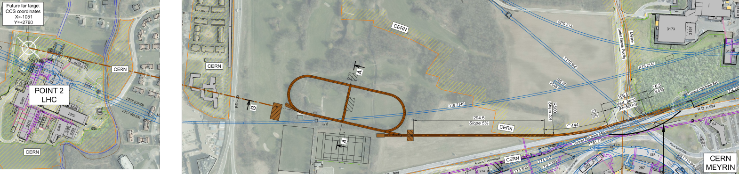
Neutrinos from stored muons
Scientific objectives:
  %-level (ν_{e}N) cross sections
    Double differential
  Sterile neutrino search
    Beyond Fermilab SBN
  Muon-accelerator R&D
    FFA optics; cooling …
Precise neutrino flux:
  Normalisation: < 1%
  Energy (and flavour) precise
π ⇢ μ injection pass:
  “Flash” of muon neutrinos

Slide 42
Conclusions
The Laser-hybrid Accelerator for Radiobiological Applications (LhARA)

Slide 43

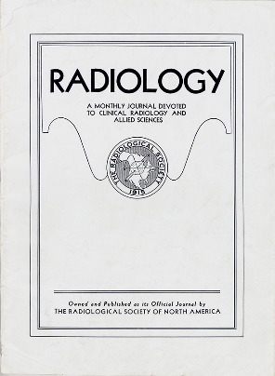
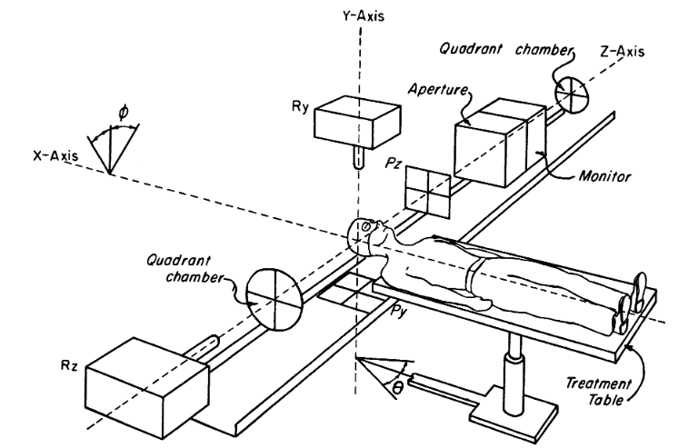
Novel accelerator techniques
System: image processing
fast feedback, control
1946
↓
1960
Fundamental
radiobiology
1970
1980
1990
2000
2010
2020
2030
2040
2050

Slide 44
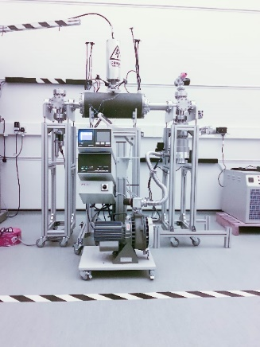
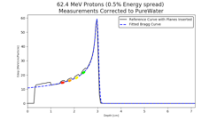
Novel accelerator techniques
System: image processing
fast feedback, control
Fundamental
radiobiology

Slide 45
Conclusions
Laser-hybrid approach has potential to:
  Overcome dose-rate limitations of present PBT sources;
  Deliver uniquely flexible facility:
    Range of ion species, energy, dose, dose-rate
  Disruptive/transformative approach ‘for 2050’ …
Opportunity:
  Develop and prove novel systems in production system;
  Deliver research facility dedicated to radiobiology;
  Contribute to study of biophysics of charged-particle beams
First and next steps:
  Initial concept developed and prototype evaluation underway
  Working towards ‘pre-CDR’ for LhARA
  Wonderful opportunity to build novel techniques to spin back in!

