Slide 1
nuSTORM Beamline Optics Results
Tiago Alves

Slide 2
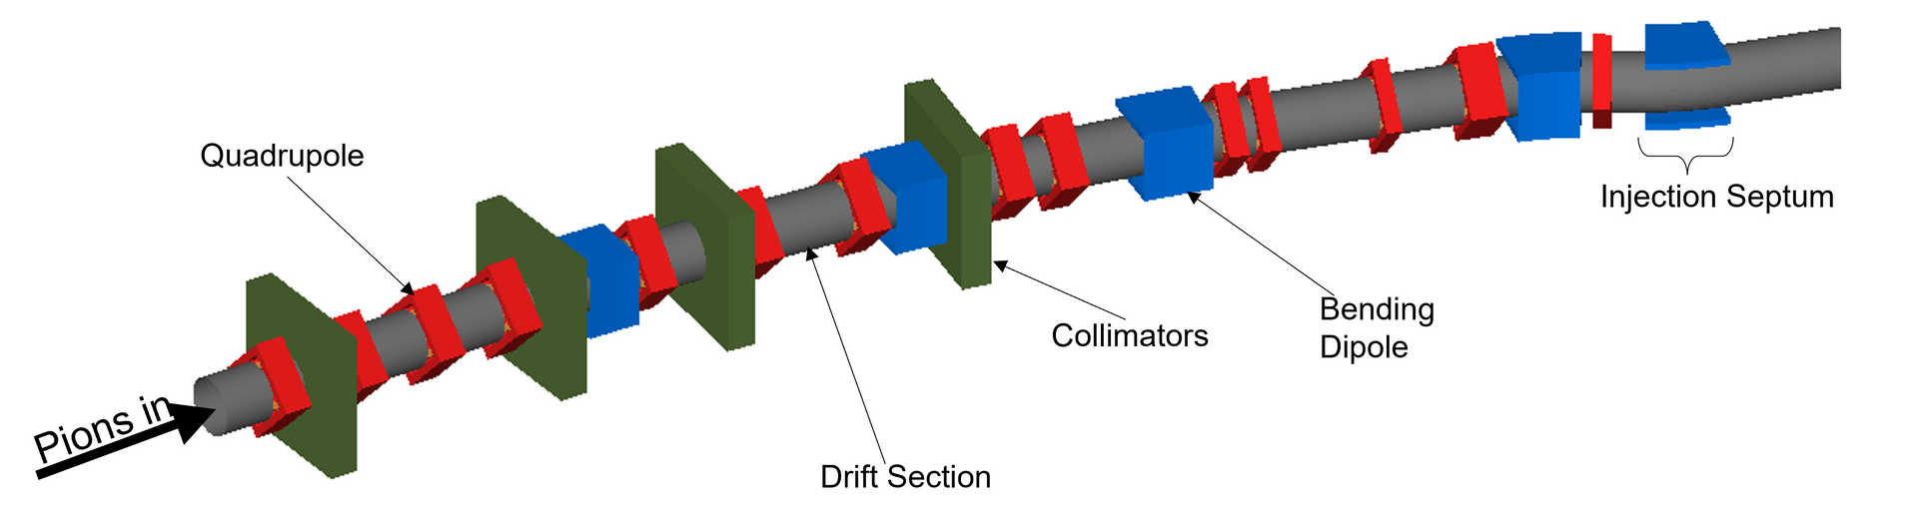
Motivations & Overview
nuSTORM will produce a beam of known flavour and energy
A 100 GeV proton beam hits a target producing particles of various energies
The pion transport line uses quadrupoles and dipoles to differentiate particles and their respective momenta
The pions pass through an OCS to combine with circulating muons in the storage ring
Pions decay in the production straight to produce muons and if their dynamical and physical acceptances are within the accepted range, they continue circulating
Fig 1 – A visualisation of the π transport line with labelled components

Slide 3
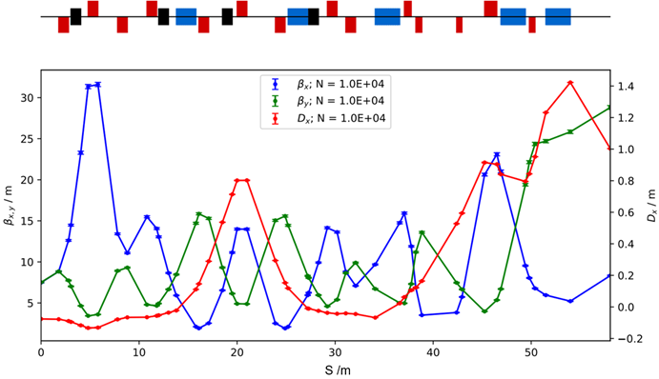
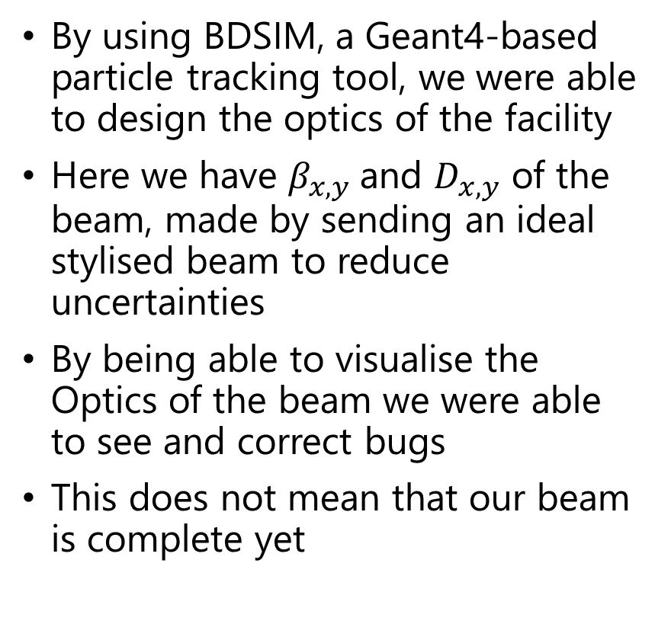
Beamline Optics and Simulations
By using BDSIM, a Geant4-based particle tracking tool, we were able to design the optics of the facility
Here we have $β_{x,y}$and $D_{x,y}$ of the beam, made by sending an ideal stylised beam to reduce uncertainties
By being able to visualise the Optics of the beam we were able to see and correct bugs
This does not mean that our beam is complete yet
Fig 2 – The β and Dispersion of the π transport line

Slide 4
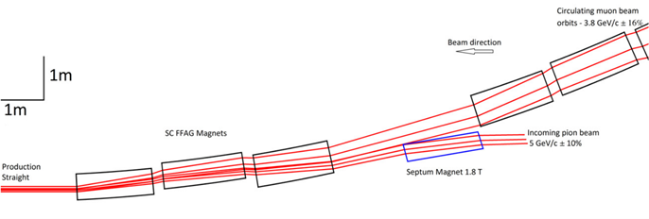
Orbital Combination System
nuSTORM is a hybrid facility, using FODO cells and Fixed Field Alternating gradient (FFA) magnets
The OCS is an FFA combined function magnet that combines pions and muons incoming from different positions and with different momenta
No Geant4 toolkit as of yet can accurately simulate the magnetic fields of an FFA combined function magnet
We’ve had to create our on field maps for the OCS FFA
Fig 3 – A diagram showing how the OCS Magnets work. Beams are going right to left

Slide 5
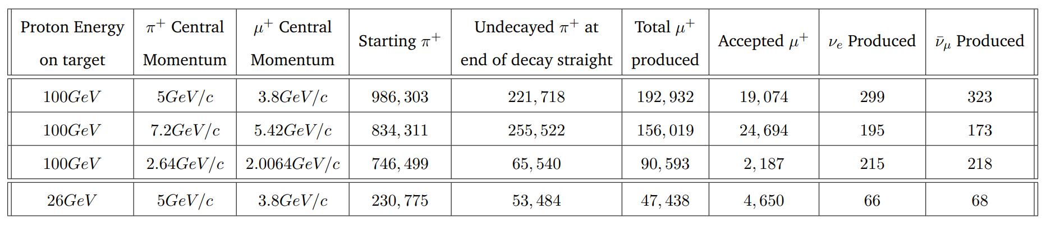
Final Test Runs

Slide 6
Thank You
Questions?

Slide 7
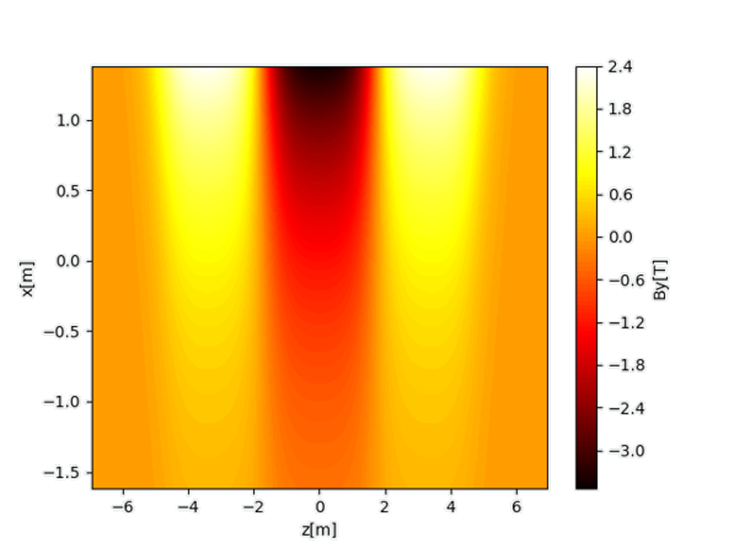
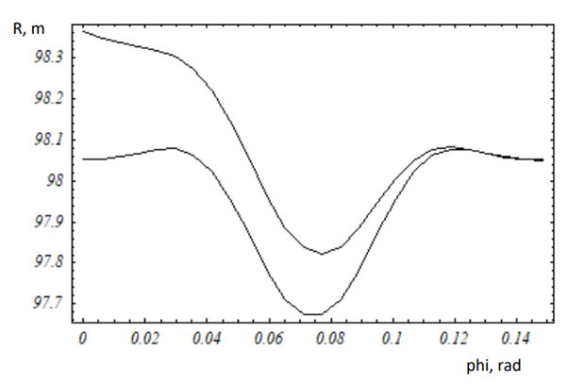
OCS Field Maps
Fig 4 – A diagram showing how the OCS Magnets work. Beams are going right to left
Fig 5 – A diagram showing how the OCS Magnets work. Beams are going right to left

Slide 8
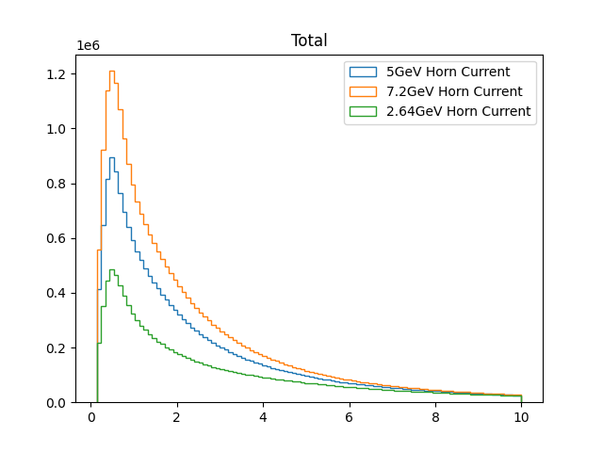
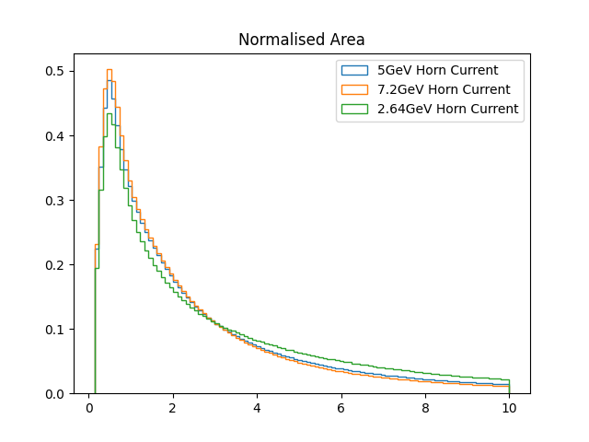
Pion Energy for different Horn Currents
E[GeV]
E[GeV]
Fig 6 – The Energy Spectrum for the Horn Currents tailored to the muons Momenta seen above
Fig 7 – The same Energy Spectrum but with normalised area to see the shape of graphs

Slide 9
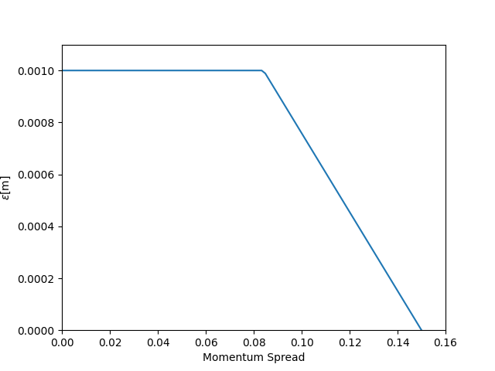
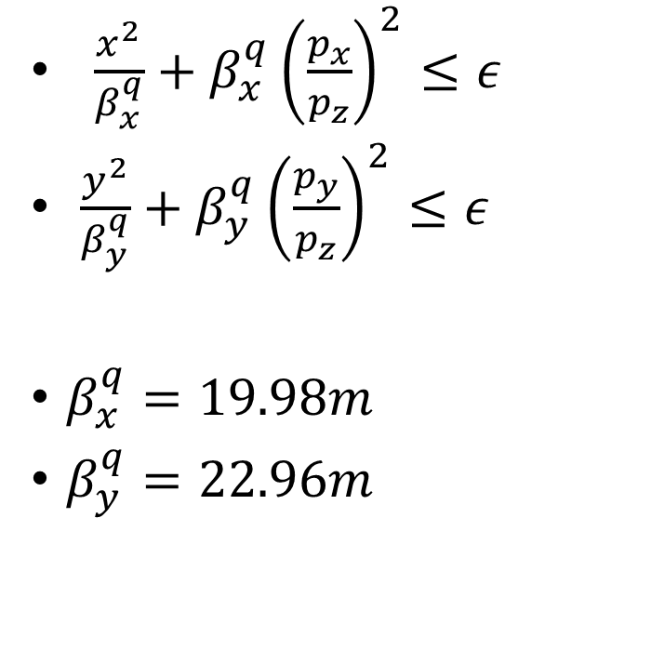
Muon Cuts
$\frac{x^{2}}{β_{x}^{q}}+β_{x}^{q}{\left(\frac{p_{x}}{p_{z}}\right)}^{2}≤ε$
$\frac{y^{2}}{β_{y}^{q}}+β_{y}^{q}{\left(\frac{p_{y}}{p_{z}}\right)}^{2}≤ε$
$β_{x}^{q}=19.98m$
$β_{y}^{q}=22.96m$
Fig 8 – The relationship between the Emittance and the Momentum Spread so we can make the muon cuts

Slide 10
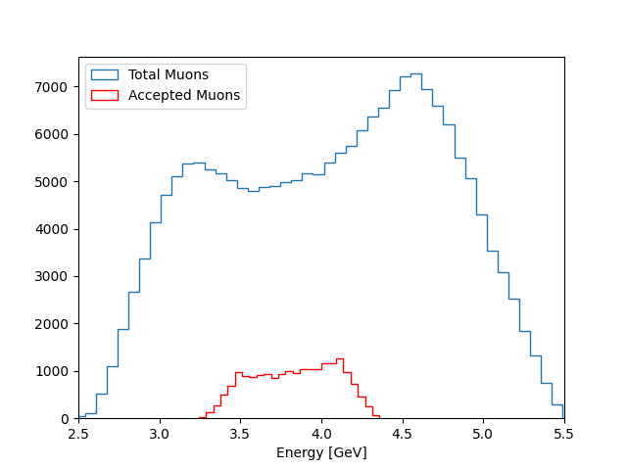
Mirror OCS Muon Energies
Because we still do not have a working 3-D OCS field map we have to make the muon cuts artificially
The muon energies for all muons measured at the end of the decay straight we then plotted in histograms
The two distinct peaks exist because of forward and backward decay
Fig 9 – The Energy Spectrum for the Total Muons and the Accepted Muons for a 5GeV/c Reference Pion Momenta

Slide 11
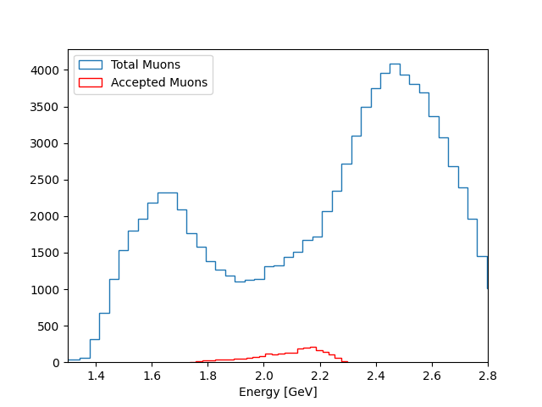
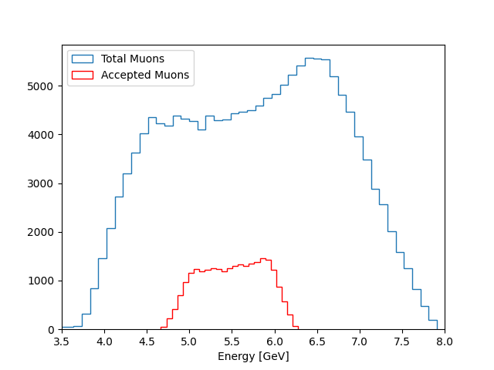
Muon Energies Cont.
Fig 10 – The Energy Histogram for the Total Muons and the Accepted Muons for a 2.64GeV/c Reference Pion Momenta
Fig 11 – The Energy Histogram for the Total Muons and the Accepted Muons for a 7.2GeV/c Reference Pion Momenta

Slide 12
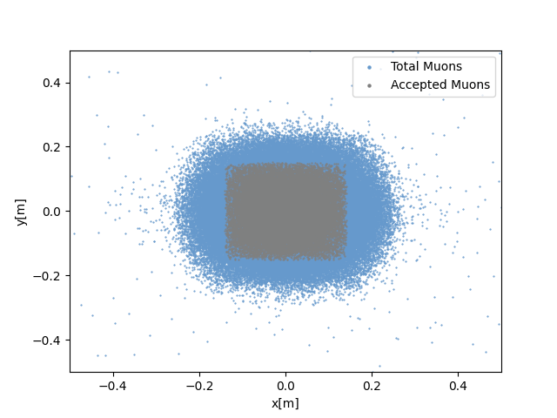
Mirror OCS Position of Muons
The position of the particle beam is then taken right at the end of the decay straight
The accepted muons form a square shape in the center due to the way we make cuts to the muons
Its important that we are making cuts before the muons pass through the OCS
Fig 12 – The Position of the muons and the accepted muons for a 5GeV/c Reference Pion Momenta

Slide 13
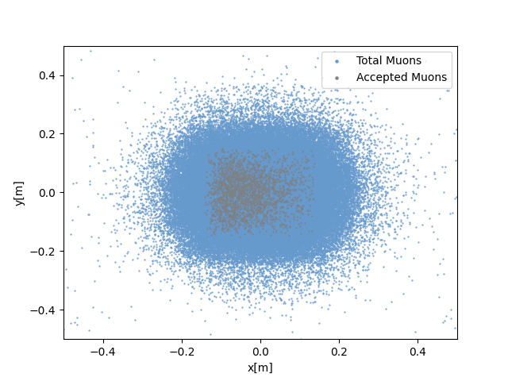
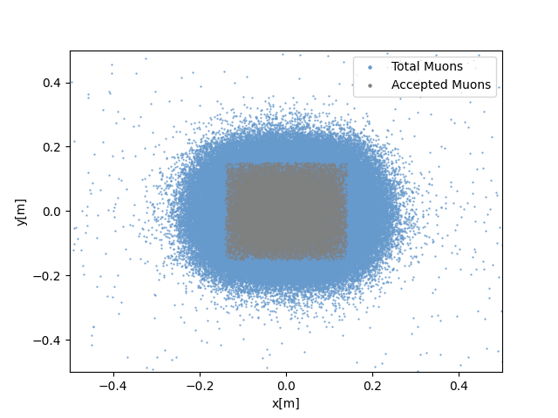
Muon Position cont.
Fig 13 – The Position of the muons and the accepted muons for a 2.64GeV/c Reference Pion Momenta
Fig 14 – The Position of the muons and the accepted muons for a 7.2GeV/c Reference Pion Momenta

Slide 14
SPS vs PS

Slide 15
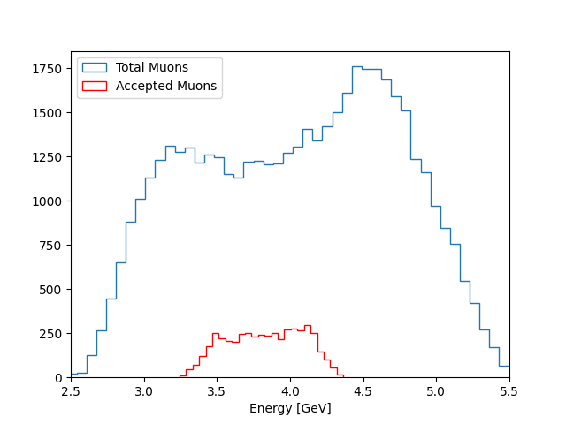
SPS vs PS Muon Energy Range

Slide 16
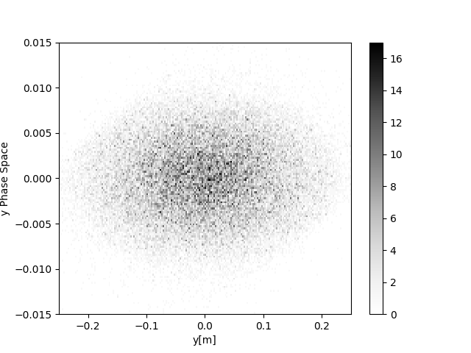
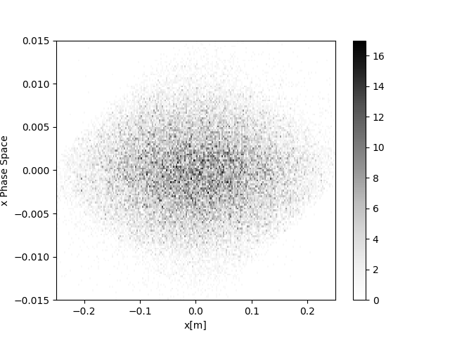
Total Muons PS Phase Space

Slide 17
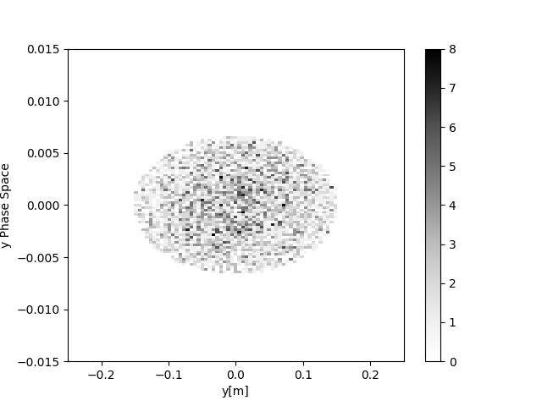
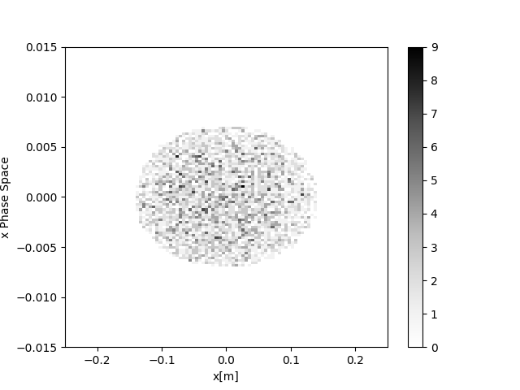
Accepted Muons PS Phase Space

Slide 18
More Results

Slide 19
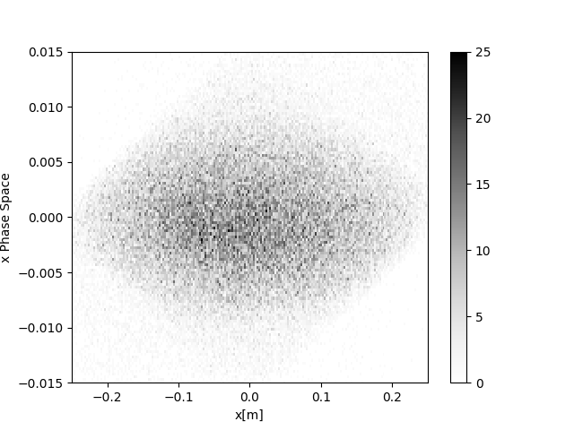
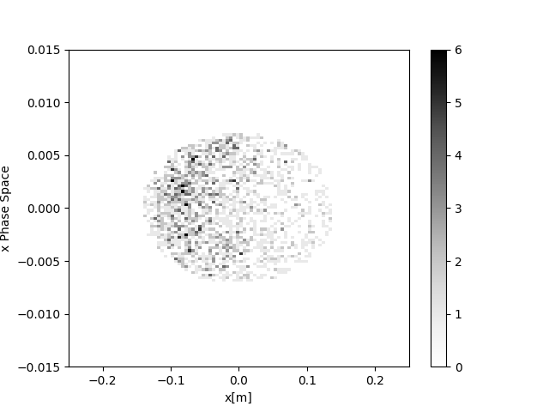
x-Phase Space 2.64GeV

Slide 20
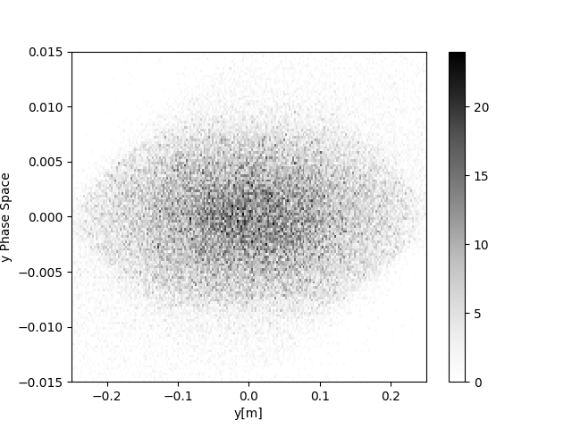
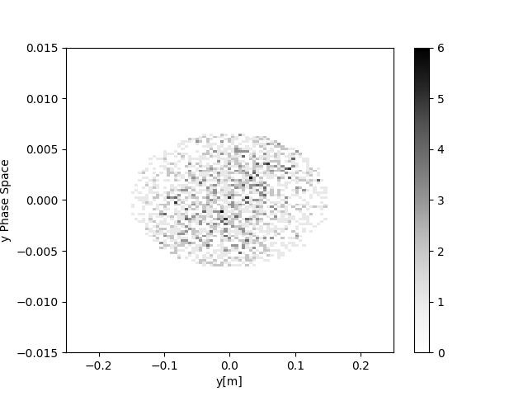
y-Phase Space 2.64GeV

Slide 21
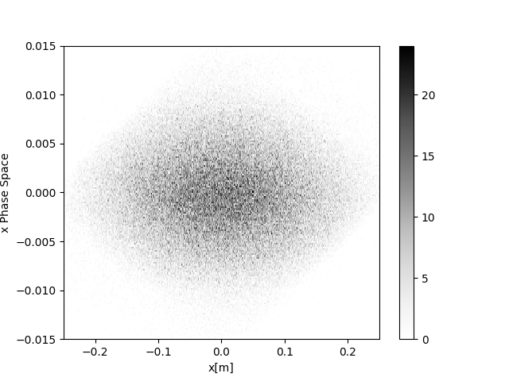
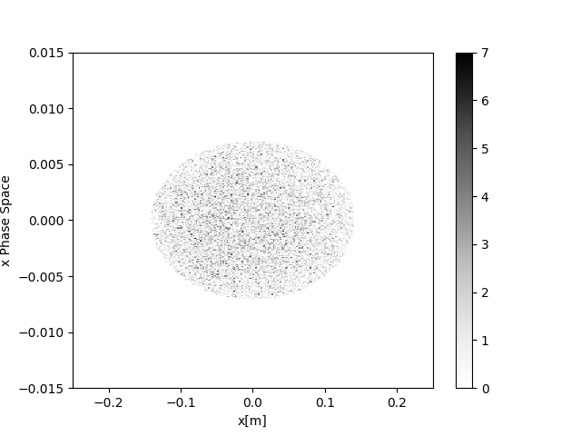
x-Phase Space 5GeV

Slide 22


y-Phase Space 5GeV

Slide 23
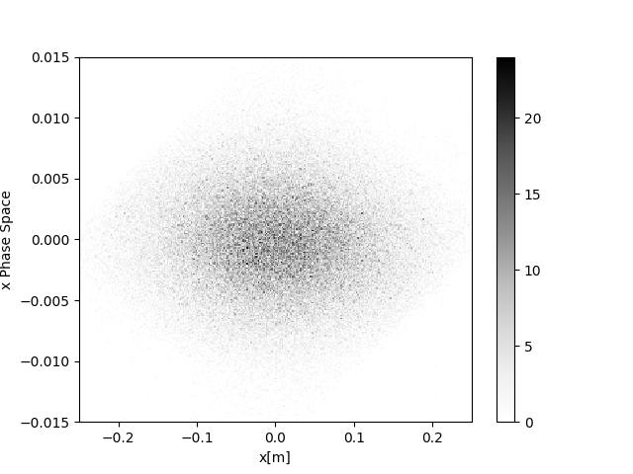
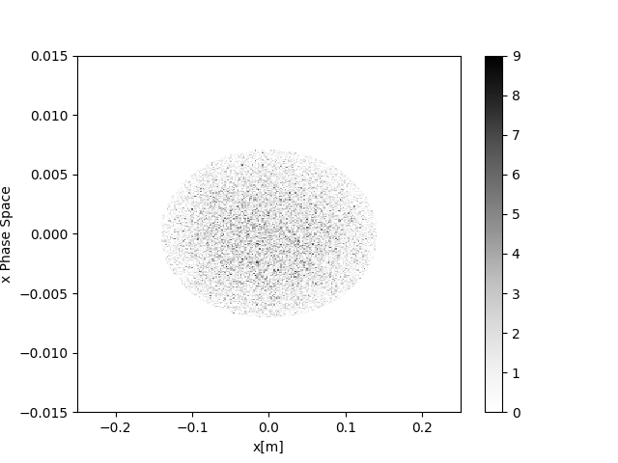
x-Phase Space 7.2GeV

Slide 24
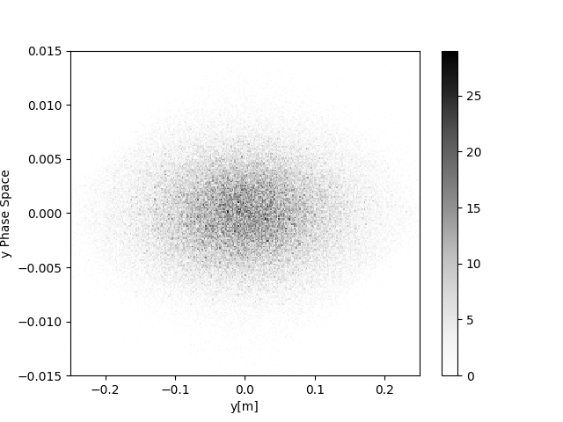
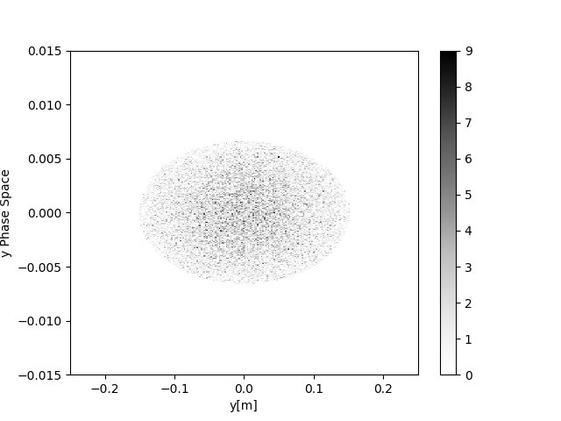
y-Phase Space 7.2GeV

Slide 25
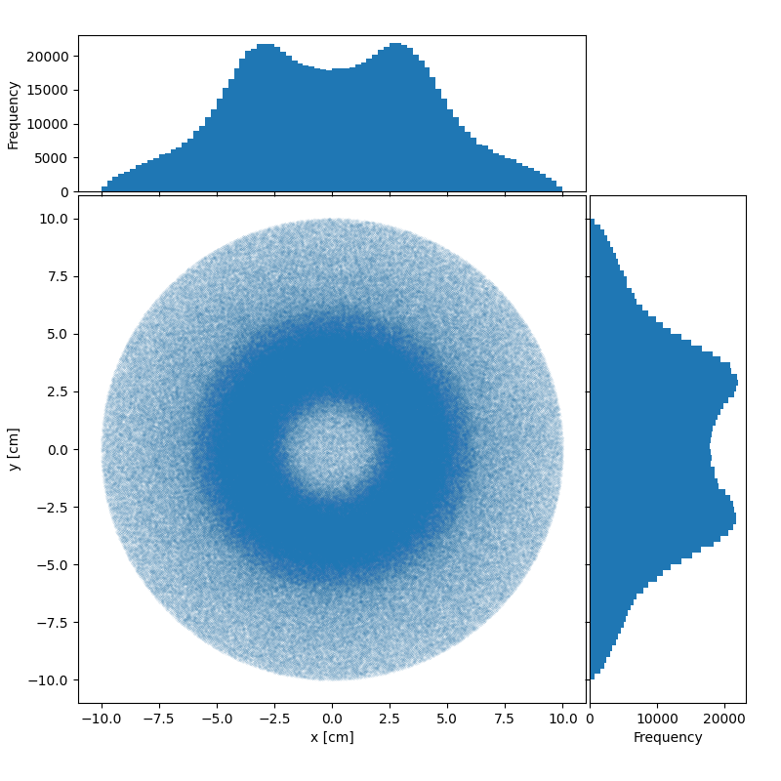
Pion Beam Position

Slide 26
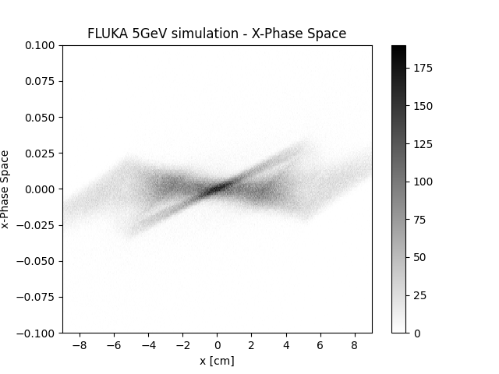
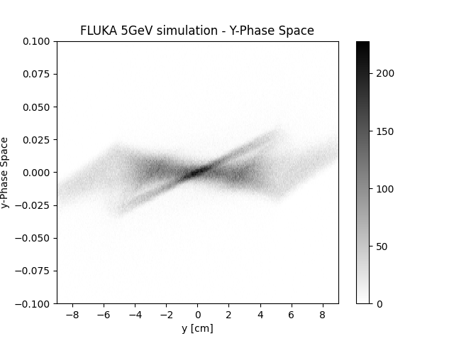
Pion Phase Spaces 5GeV

Slide 27
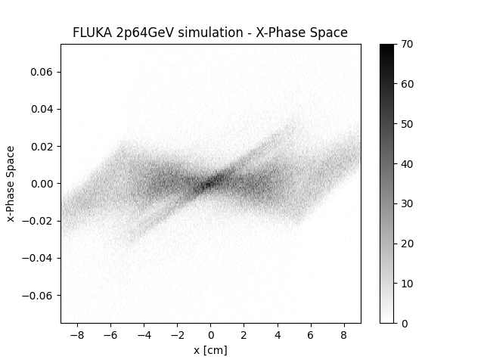

Pion Phase Space 2.64GeV

Slide 28
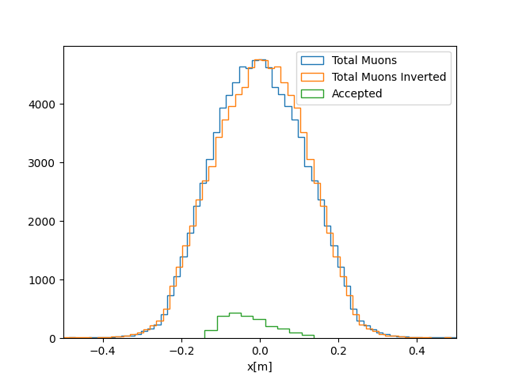
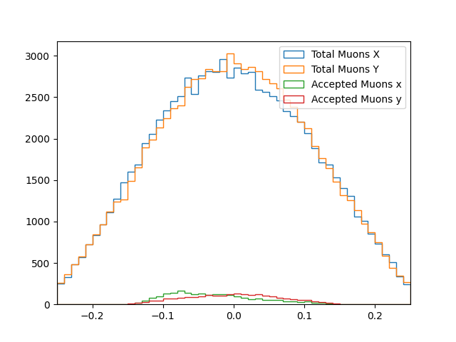
Left sided Conundrum
x[m]

Slide 29
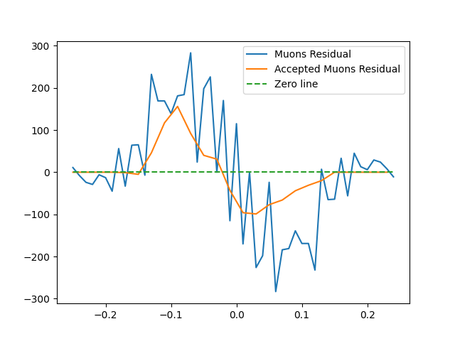
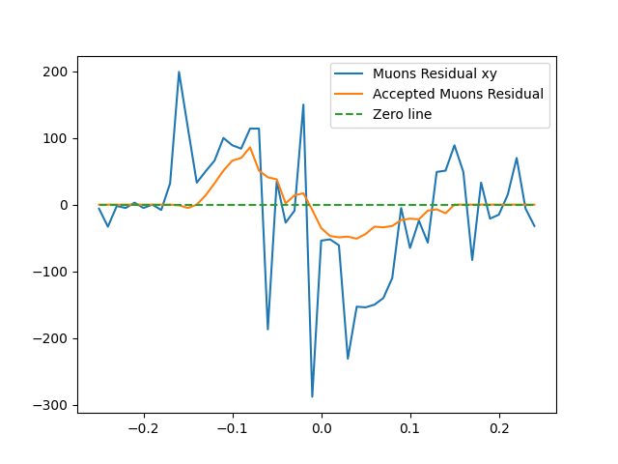
Residual
x[m]
x[m]

Slide 30
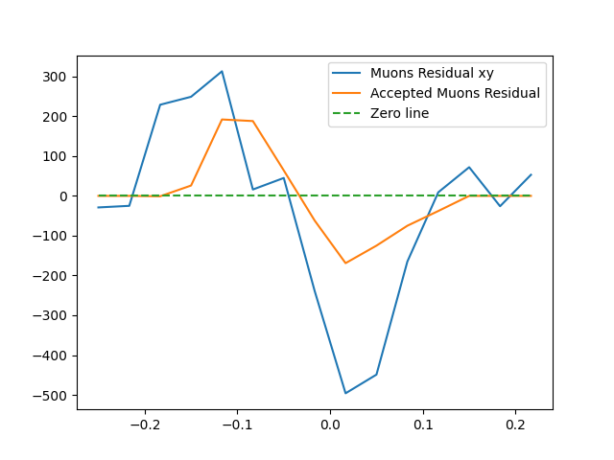
Larger Bin Size
x[m]

Slide 31
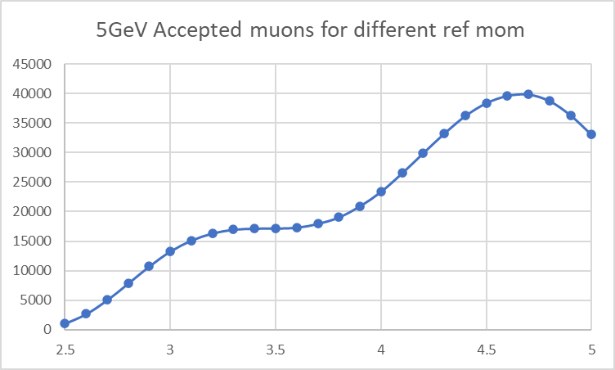
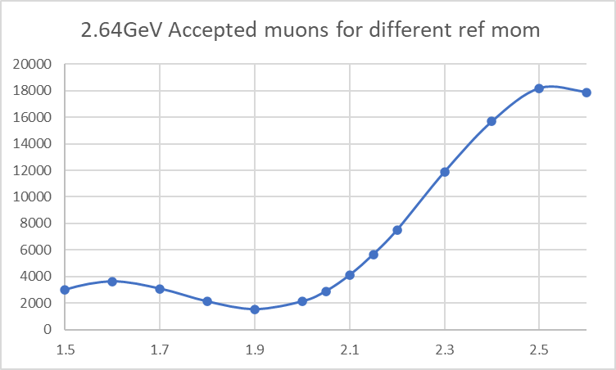
Different Mom Spread for 5 & 2.64GeV/c

