Slide 1

Welcome and introduction

Slide 2
Welcome!

Slide 3
A. Kurup
https://ccap.hep.ph.ic.ac.uk/trac/wiki/Communication/Logo

Slide 4
The emerging
CCAP programme
Welcome and introduction

Slide 5
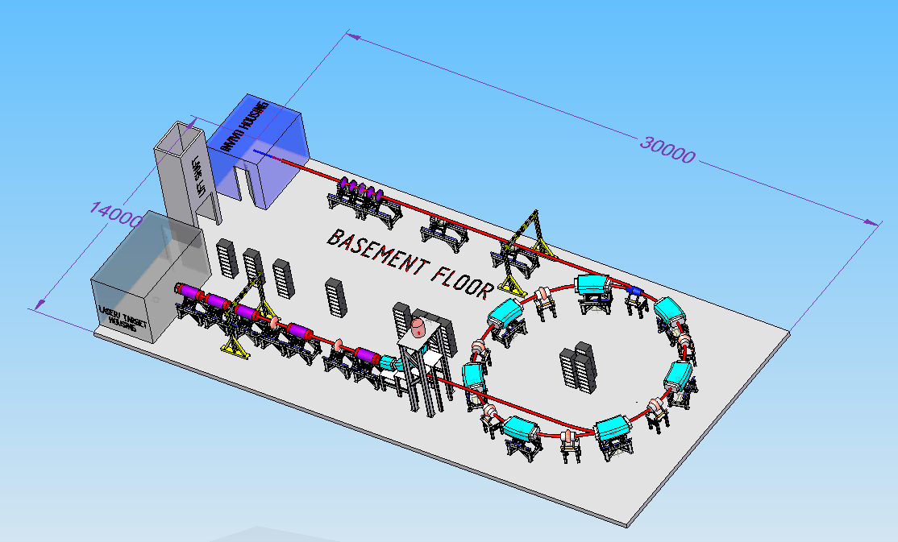
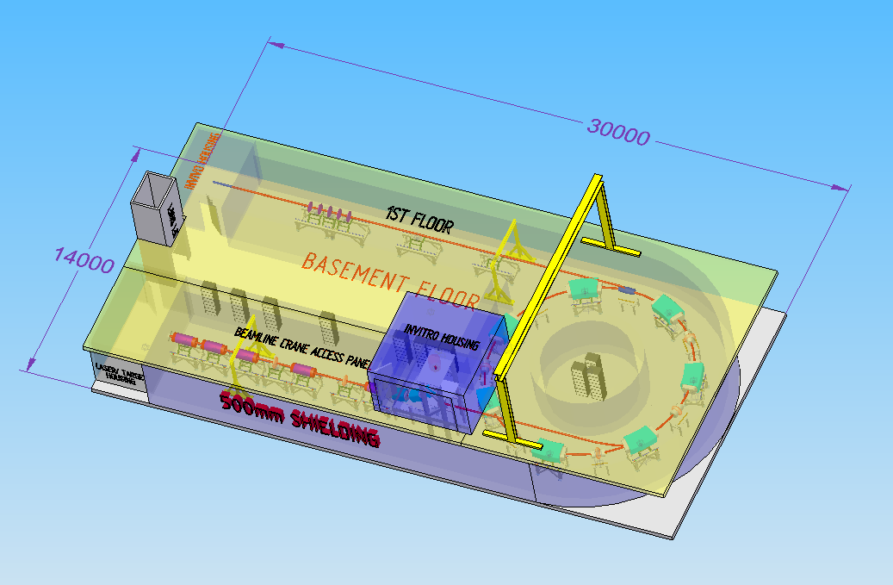
Laser-hybrid Accelerator for Radiobiological Applications (LhARA)
Progress:
  Design (JPa)
  Initial consideration of footprint/infrastructure:
    JPo with L/Clarke (TD/RAL); consultation with ISIS engineering

Slide 6
Project title: Advanced concepts and novel technologies for the study of the impact of
ionising radiation on tissue
Programme: Advanced technologies for radiobiology and clinical radiotherapy
Project team: Ab initio a multi-disciplinary collaboration:
Clinical oncology, biology/biophysics,
physics (laser, medical, accelerator, instrumentation),
computing, laboratory, industry
Aims and objectives:
Outline CDR for the Laser-hybrid Accelerator for Radiobiological Applications:
  Spring-board to bid successfully for significant resources to deliver the exciting programme.
Establish advanced-technology test-bed at the Clatterbridge Cancer Centre (CCC):
  Early access to FLASH capability and essential test bed for development of LhARA.
Position UK as a force within International Biophysics Collaboration (IBC)
  Optimise UK potential to contribute to – and to benefit from – the IBC.

Slide 7
Workpackages, deliverables, and cost
Preparation of initial CDR for LhARA:
  Deliverable: initial CDR for LhARA [milestone April 2020]
  Resources:
    Key enabling investment: 1.75 PDRAs for 6 months
      In place; can efficiently become core of effort to deliver initial CDR
    Leverage support from participating institutes and project partners
    Exploit strong synergy and close collaboration with ISIS Upgrade team
  Request:
    Staff: Imperial (Physics): £62.70k, Liverpool (Biology): £38.12k
LhARA and radiobiology test facility:
  Deliverable: proton-FLASH dosimetry [milestone April 2020]
  Resources:
    Key enabling investment: 0.25 PDRA for 6 months
      In place; existing collaboration with Clatterbridge Cancer Centre (CCC)
    Leverage support from CCC, participating institutes, and project partners
  Request:
    Staff: Liverpool (Biology): £17.24k
UK and the International Biophysics Collaboration (IBC):
  Deliverables: Forge UK identity and define UK role in IBC [milestone September 2021]
  Resources:
    Key enabling investment: UK and European travel for effective networking activity
  Request:
    Staff: Liverpool (Biology): £6.30k
    Travel: £15k
Total cost to STFC: £139.35k In-kind income from project partners: £170.00k

Slide 8
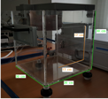
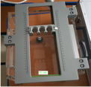
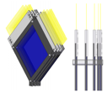
Scintillating-fibre instrumentation
SciWire (AK):
  Flux measurement for low-energy ion beams
SmartPhantom (HTL):
  Instrumentation for radiobiological studies
  Collaboration with MUW, TUW, MedAustron

Slide 9
Image processing and automation
No talk today, but:
Concept:
  Local processing of cone-beam CT to:
    Augment present ‘boney match’ with ‘soft-tissue match’
    Automatically relocate patient couch:
      This will need to be prediction of required movement in first instance
Genesis of idea/programme:
  Gujral/Williams and Mclauchlan – all of CXH
Working towards:
  STFC Case application
  EPSRC Healthcare Technologies application

Slide 10
Under discussion
Ultra-high dose rate (FLASH):
  Electron-beam studies (Yarnold, ICR)
Impact of high-energy electron irradiation:
  Idea James Pluckett (ICR); future unclear

Slide 11
Simulation and experiment
Informal discussion of common issues/studies
  Run monthly by AK

Slide 12
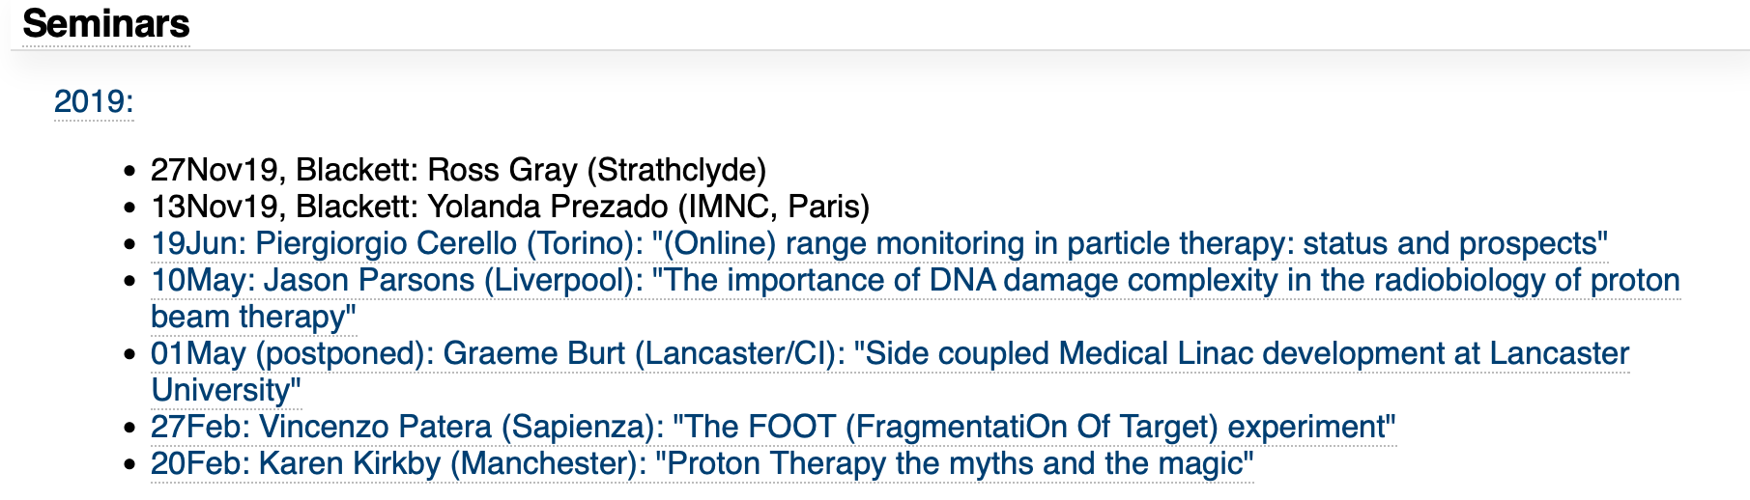
Seminars

Slide 13
Next meetings
11th December 2019
24th June 2020

Slide 14
This meeting
Welcome and introduction

Slide 15
