Slide 1





Proton radiobiology research at University of Liverpool/Clatterbridge Cancer Centre
Dr Jason Parsons
Senior Lecturer – University of Liverpool
Lead of Radiobiology Research – Clatterbridge Cancer Centre

Slide 2
Head and neck squamous cell carcinoma (HNSCC)
6th most common cancer worldwide.
Major contributory factors are smoking and drinking.
Rapid rise in incidence of human papilloma virus (HPV-16) associated cancers of the oropharynx (OPSCC).
HPV-positive tumours are more sensitive to radiotherapy and chemotherapy, thus improved prognosis, than HPV-negative tumours.
Underlying cellular mechanisms responsible for this effect are unclear.

Slide 3
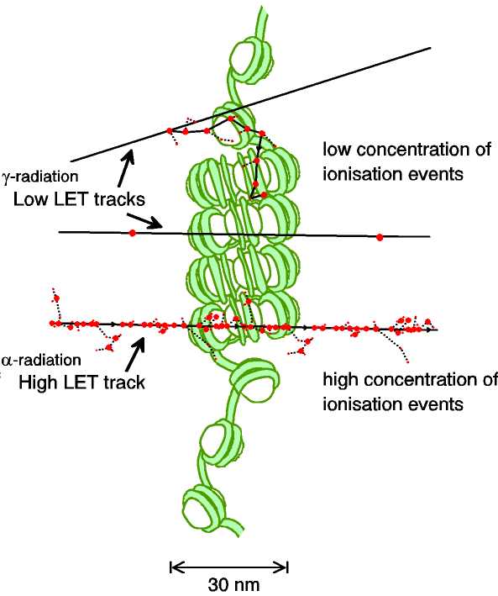
  The radiobiology of proton beam therapy
Tumour
Bragg peak
Distal fall-off
Relative dose
LET
Proton energy
Depth in tissue
  Surprisingly, the radiobiological effects of proton irradiation (in comparison to x-ray irradiation) remain poorly understood.

Slide 4
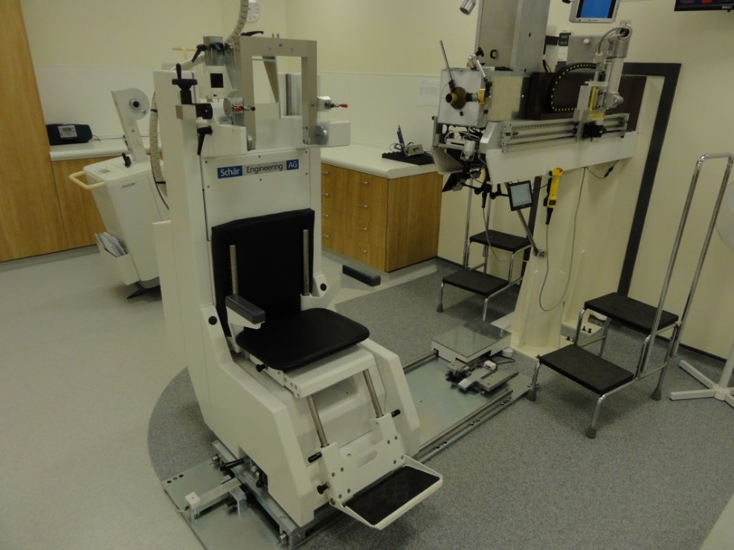
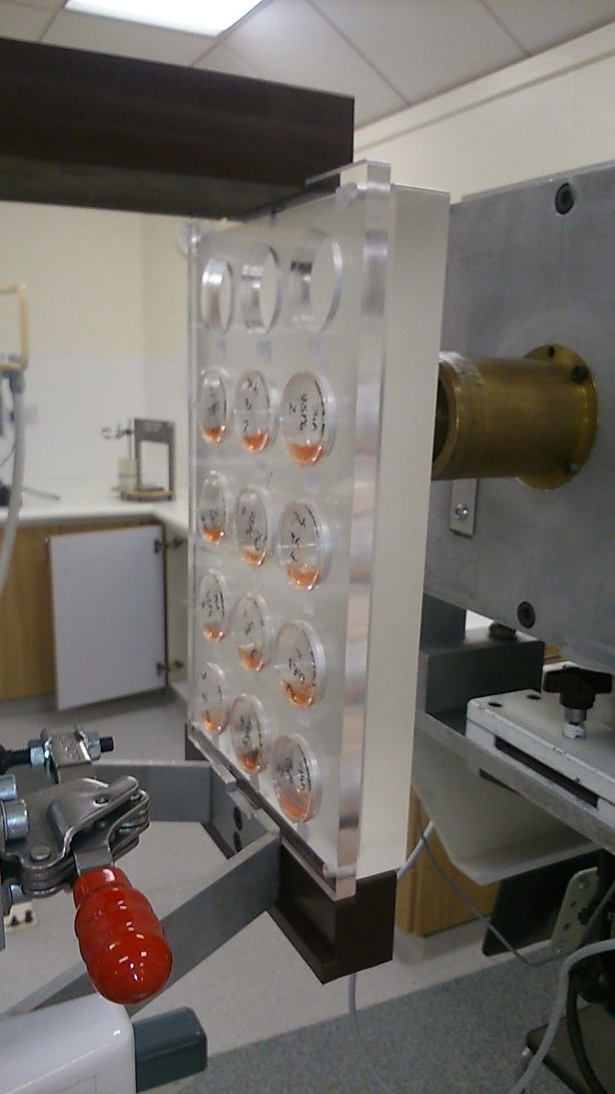
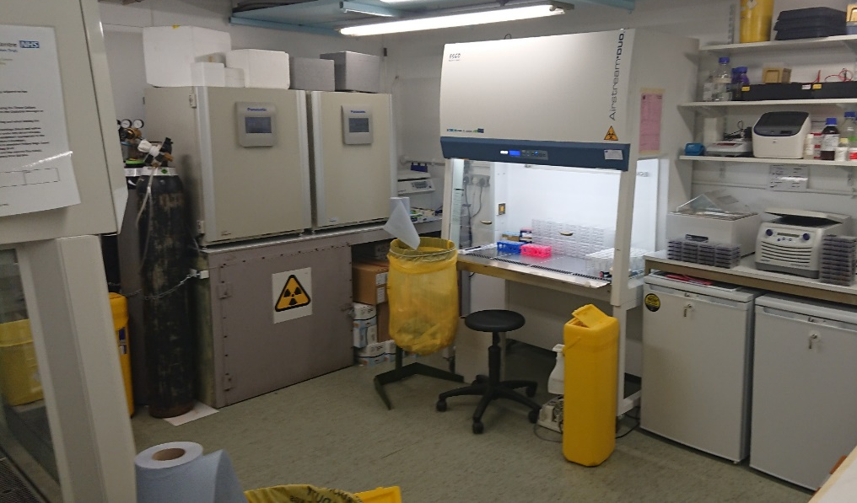
  Proton beam and radiobiology facilities at the Clatterbridge Cancer Centre (CCC)
  Collaboration with Andrzej Kacperek

Slide 5
  Low energy protons cause a decrease in cell survival compared to high energy protons
  HeLa
Tumour
  UMSCC6
Distal fall-off
Relative dose
LET
Proton energy
  SF2, p<0.02
Depth in tissue
  SF2, p<0.01
  58 MeV (1 keV/μm); 11 MeV (12 keV/μm)
  Carter et al., (2018) Int J Rad Oncol Biol Phys

Slide 6
  The repair of DNA single strand breaks/alkali labile sites is slower in cells following low energy protons
  HeLa
Alkaline (SSB)
Neutral (DSB)
***
*
**
  *p<0.005, **p<0.002, ***p<0.001
  Carter et al., (2018) Int J Rad Oncol Biol Phys

Slide 7
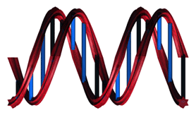
  Low energy protons induce the formation of CDD
Holt and Georgakilas, 2007
-Base damage/SSB/DSBs
****
*
Neutral (DSB)
Electrophoresis
***
**
Modified neutral (CDD+DSB)
DNA repair enzymes
  *p<0.02, **p<0.01, ***p<0.005, ****p<0.001
Electrophoresis
  Carter et al., (2018) Int J Rad Oncol Biol Phys

Slide 8
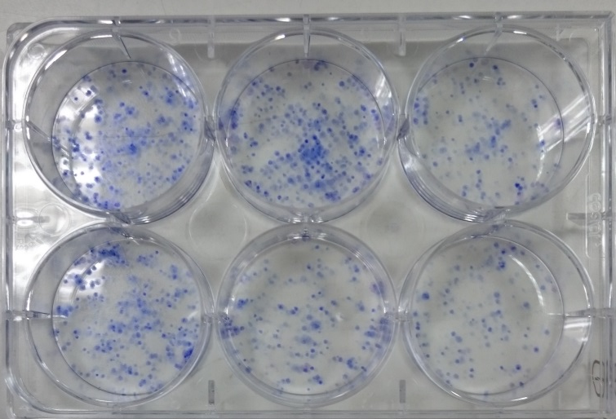
Identification of DUBs involved in the response to complex DNA damage induced by IR
HeLa cells as a monolayer
Transfect cells with DUB plasmids/siRNA
Irradiate (x-rays, α-particles or protons), trypsinise, count and seed into individual cells
Allow colonies to grow for ~7 days, fix, stain and count
  In collaboration with Mike Clague and Sylvie Urbe

Slide 9
Modulation of proton-induced cellular sensitivity following DUB siRNA knockdown
58 MeV protons
  HeLa
11 MeV protons
  Carter et al., (2019) Int J Rad Oncol Biol Phys

Slide 10
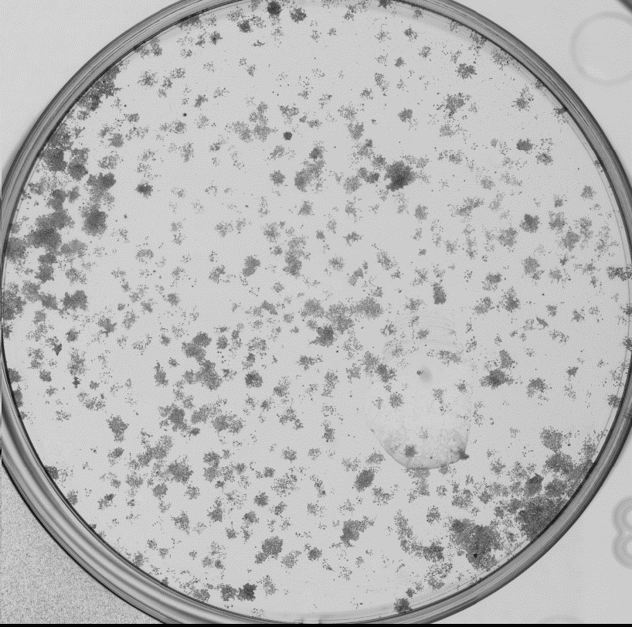
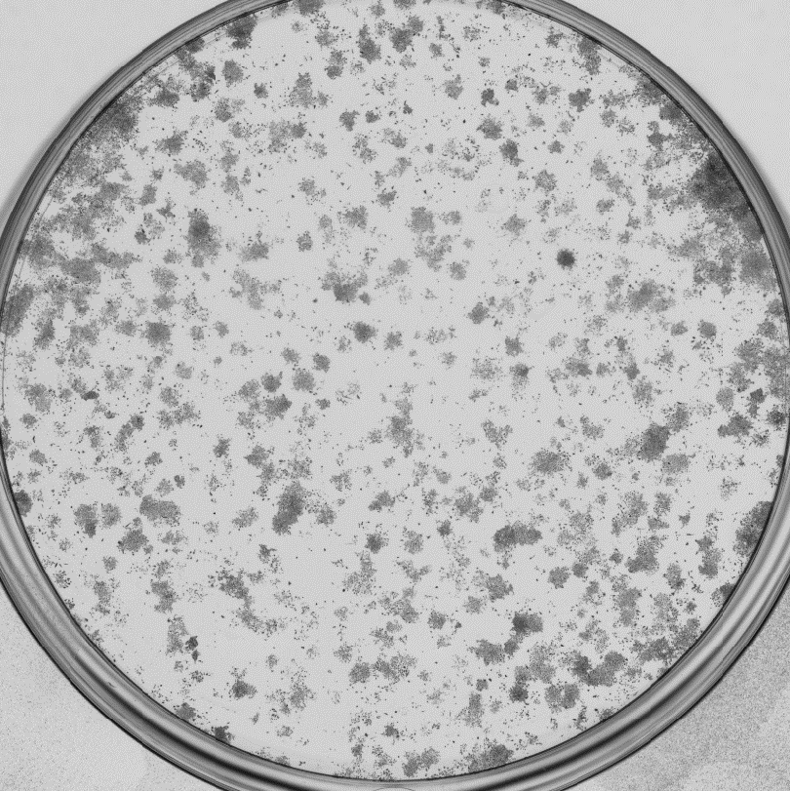
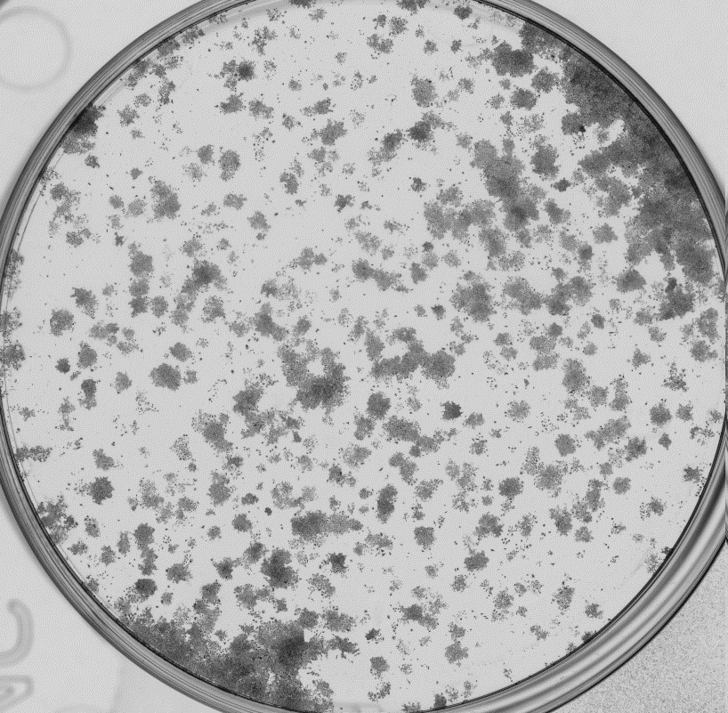
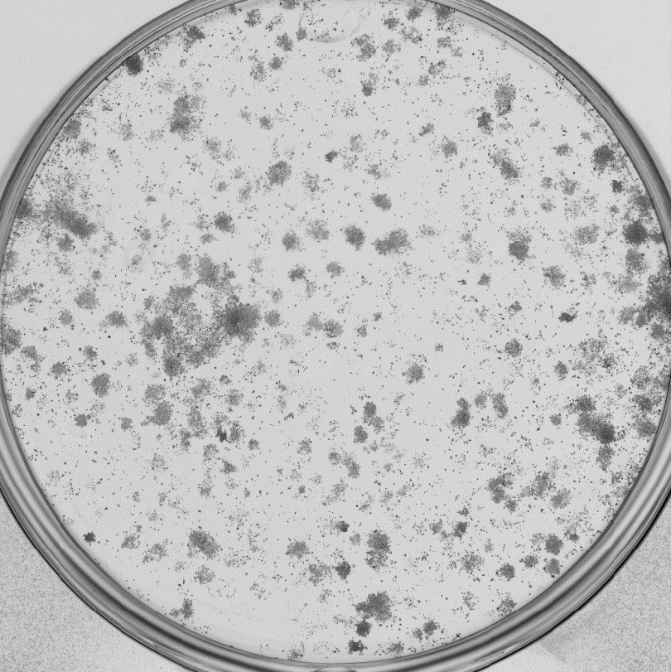
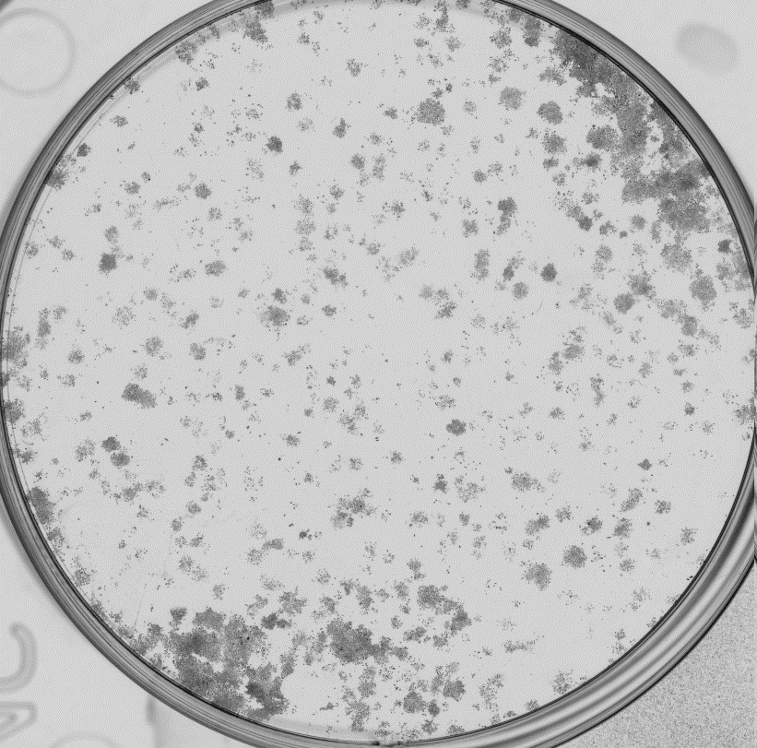
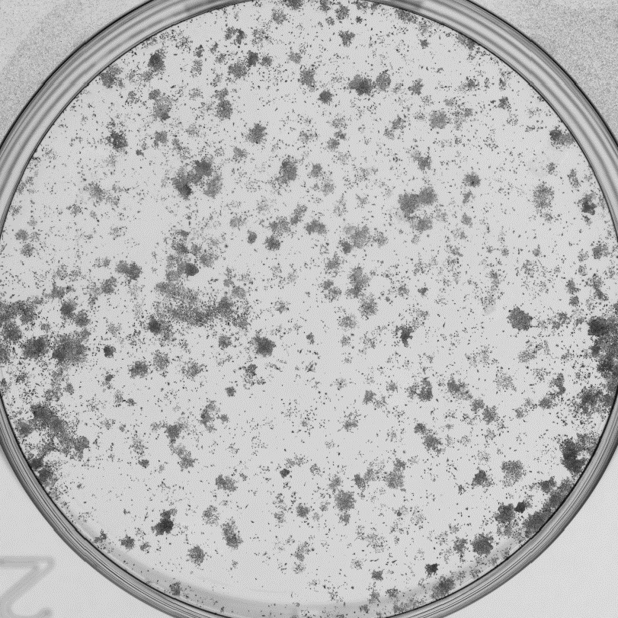
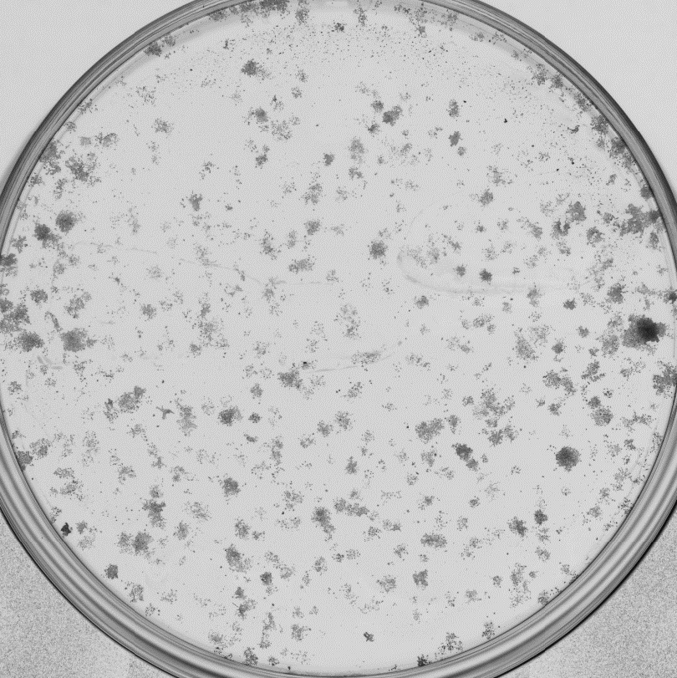
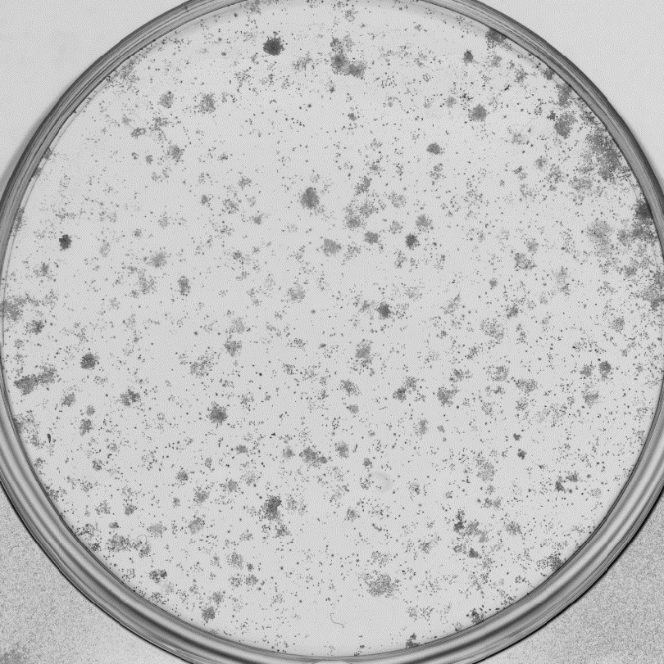
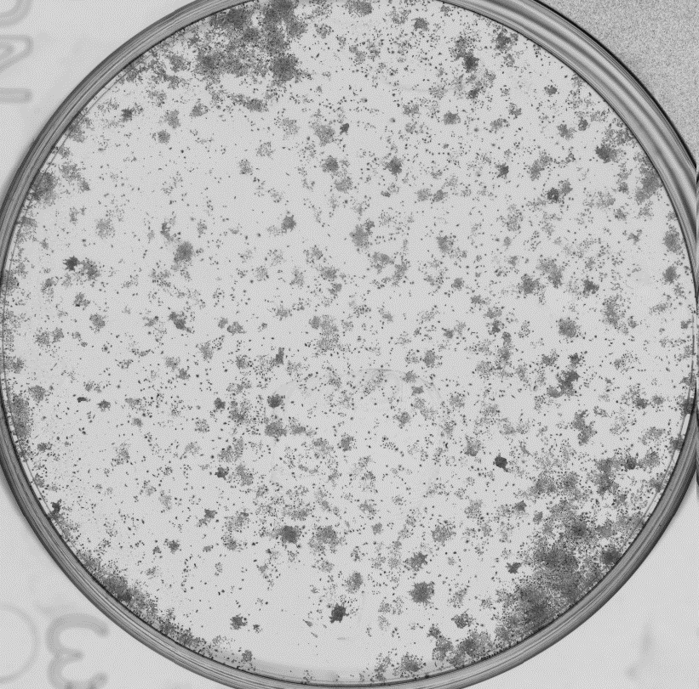
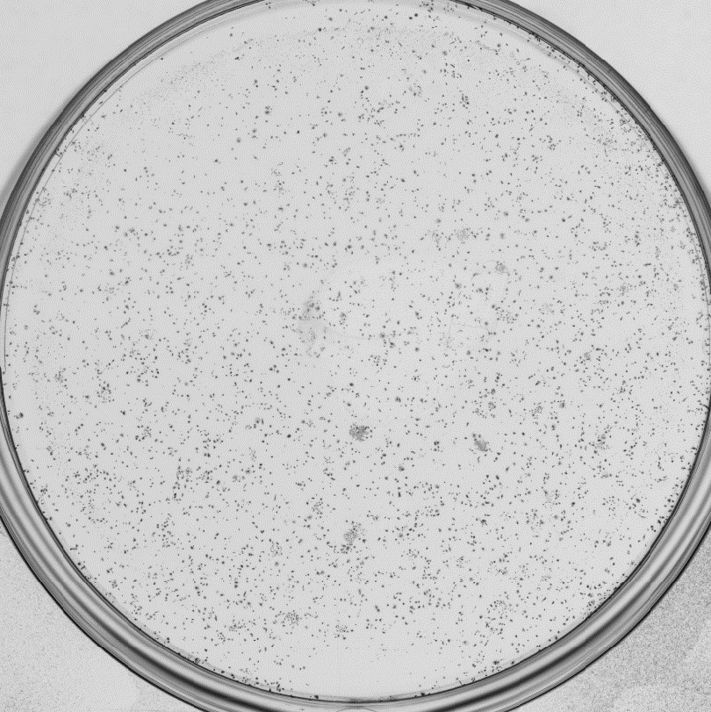
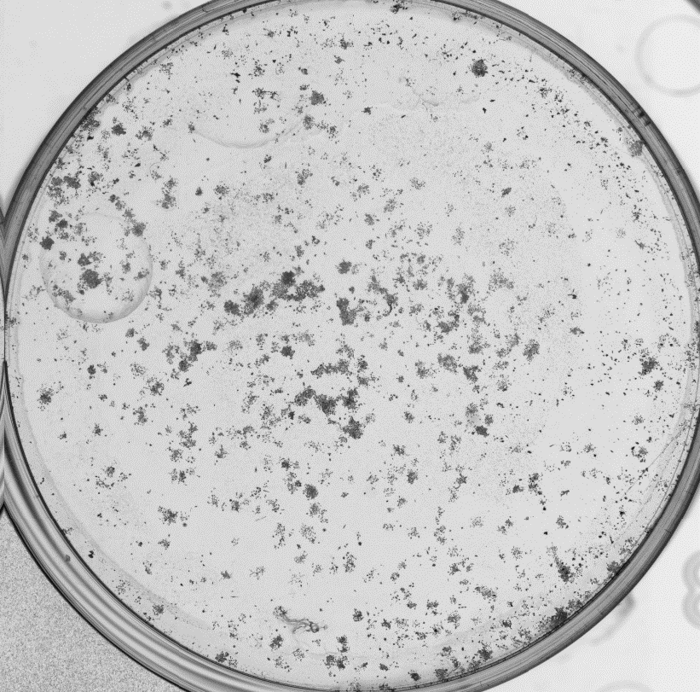
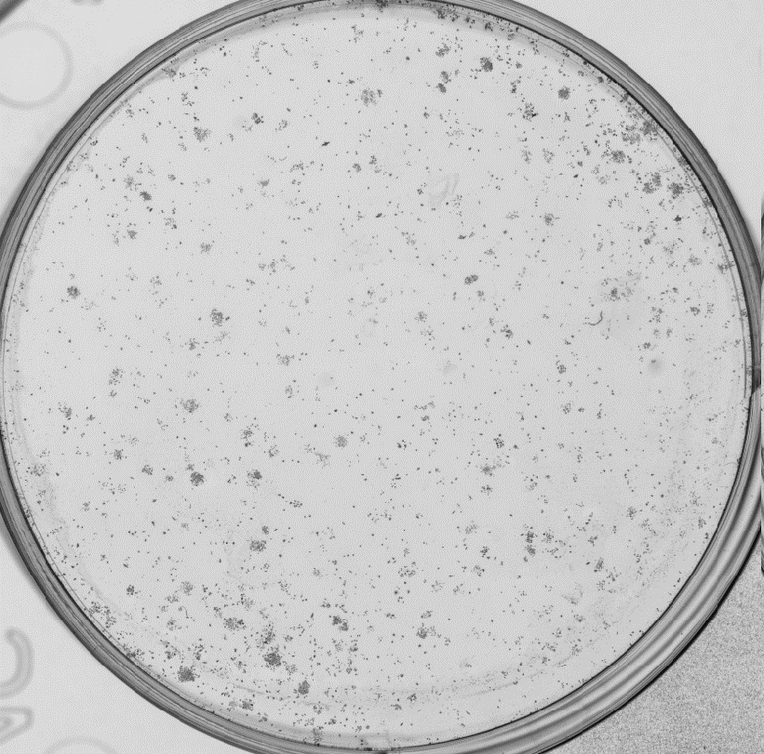
USP9X and USP6 control in the cellular response to low energy protons
Control
4 Gy
NT siRNA
  UMSCC74A
58 MeV
58 MeV
USP6 siRNA
USP9X siRNA
Control
4 Gy
11 MeV
11 MeV
NT siRNA
USP6 siRNA
USP9X siRNA
  Carter et al., (2019) Int J Rad Oncol Biol Phys

Slide 11
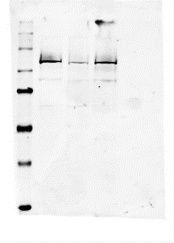
Knockdown of USP6 causes persistence of complex DNA damage and G2/M arrest in response to low energy protons
11 MeV
  *p<0.05 **p<0.01,
USP6 siRNA
NT siRNA
USP9X siRNA
USP9X
USP6
PARP-1
  *p<0.01, **p<0.005, ***p<0.002, ****p<0.001
XRCC1
APE1
Actin
1.0 0.3 1.1
PARP-1/actin ratio
  Carter et al., (2019) Int J Rad Oncol Biol Phys

Slide 12
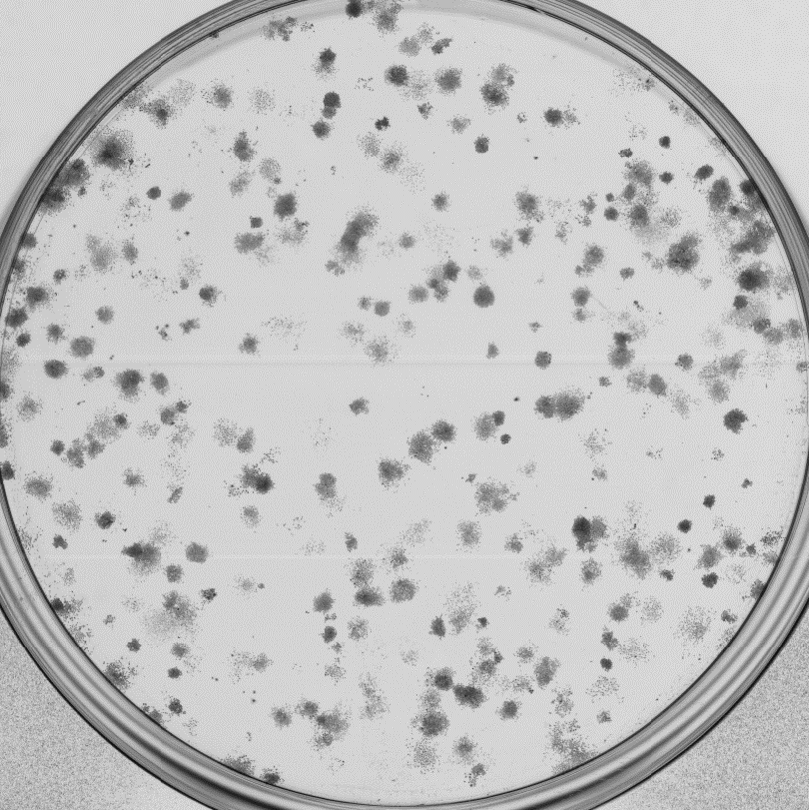
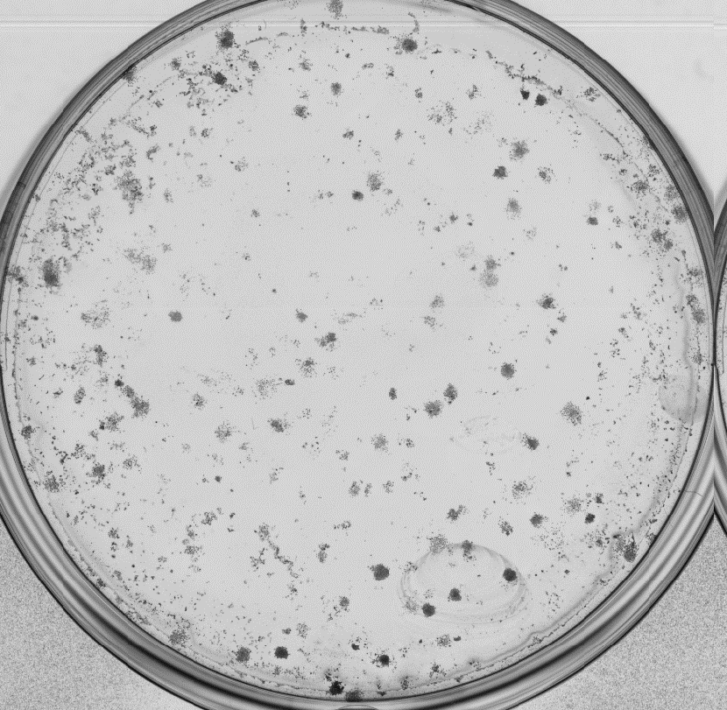
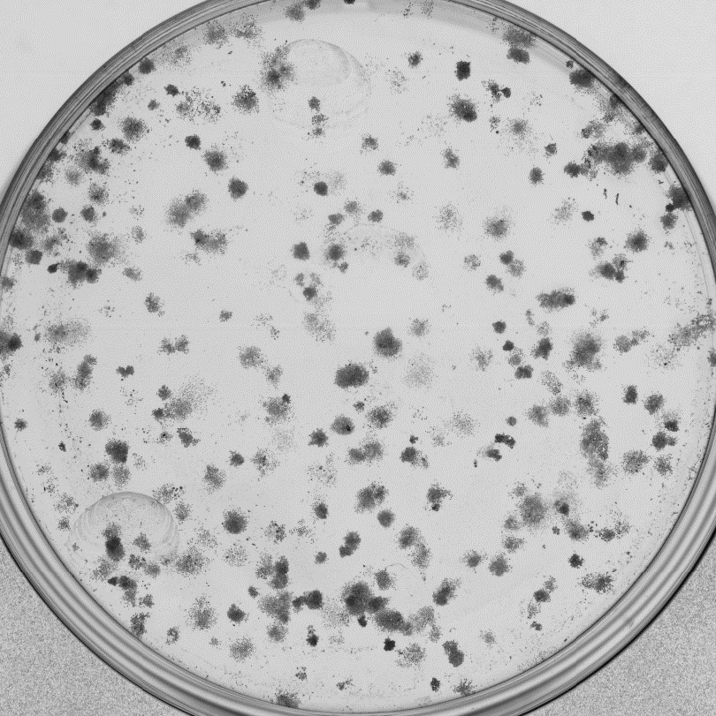
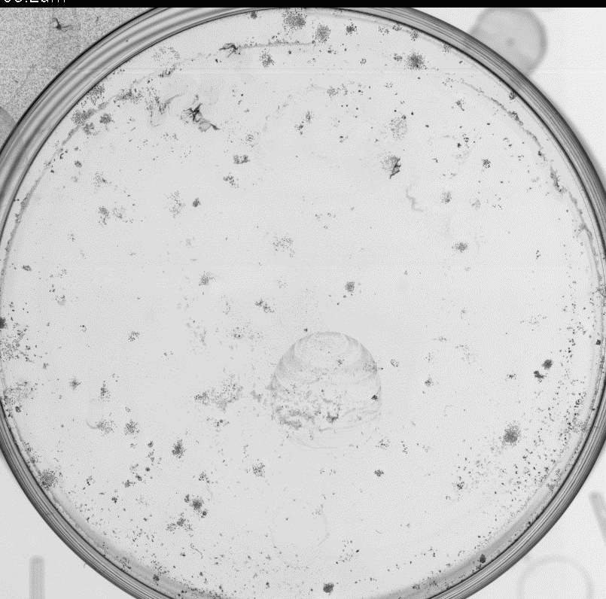
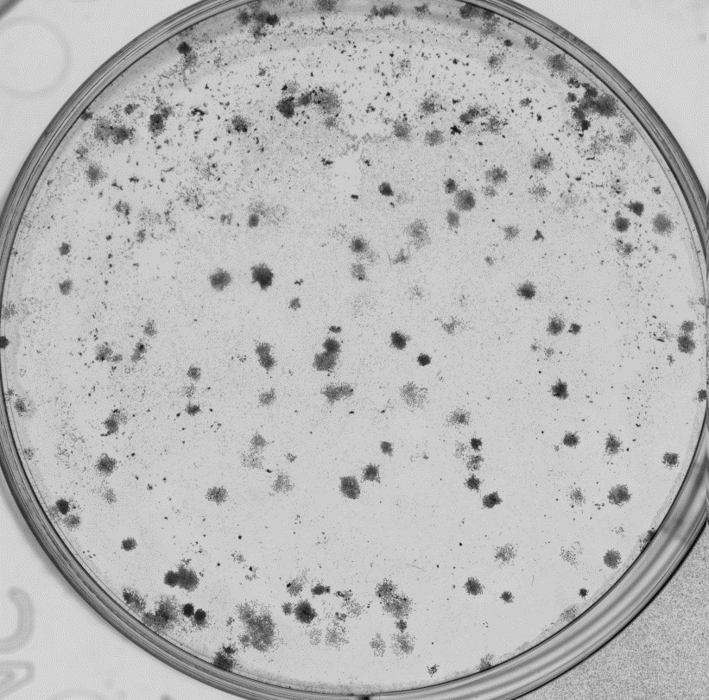
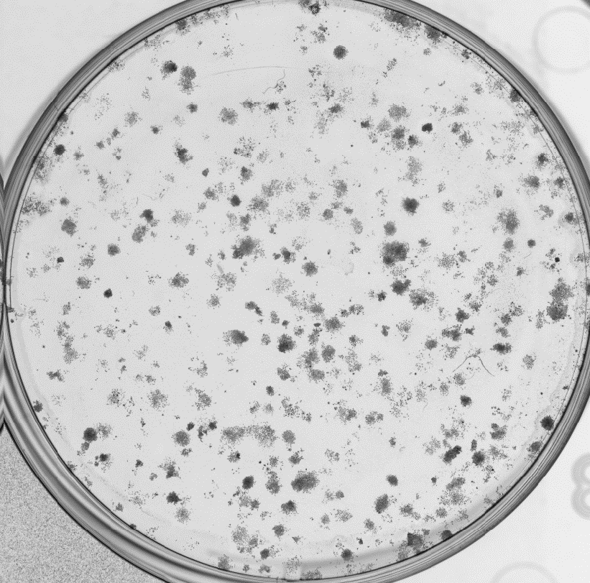
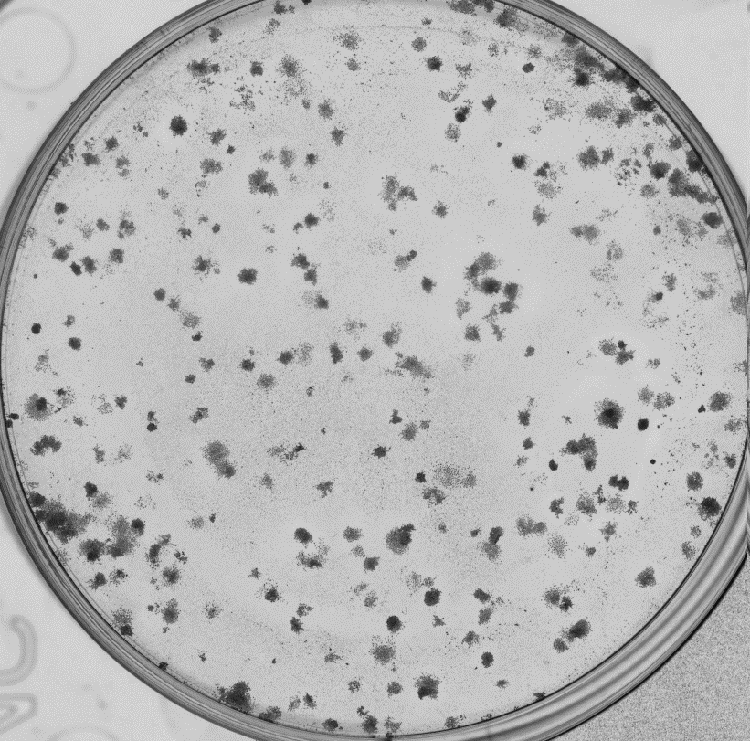
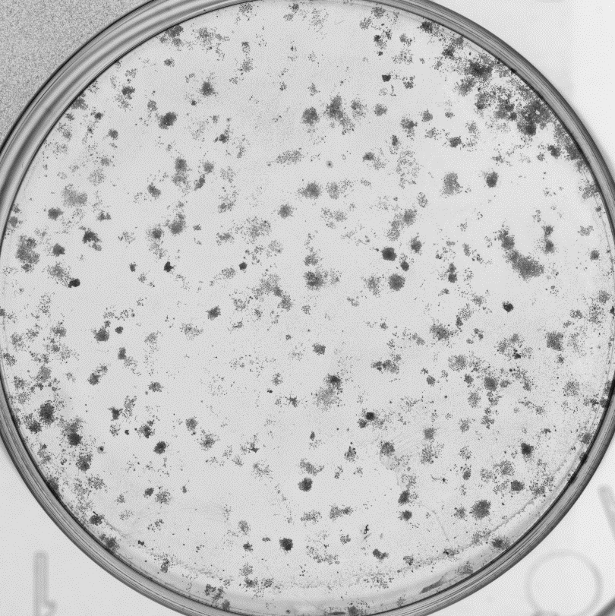
Olaparib synergies with low energy protons in promoting cancer cell killing
Control
4 Gy
11 MeV
DMSO
Olaparib
Control
4 Gy
DMSO
Olaparib
  Carter et al., (2019) Int J Rad Oncol Biol Phys

Slide 13
  Model for the recognition and repair of CDD in chromatin
DNA damage -
High-LET IR
H2B_{ub} induction
RNF20/40
MSL2
Me
Ub
DUB
Chromatin remodelling/DNA repair protein recruitment
PARP-1

Slide 14
Modulation of proton-induced cellular sensitivity following DNA damage protein siRNA knockdown
  HeLa
BER/SSB repair proteins

Slide 15
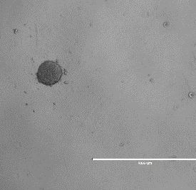
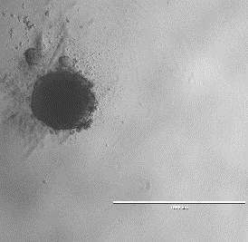
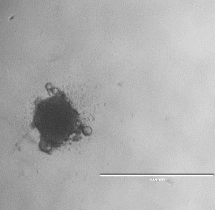
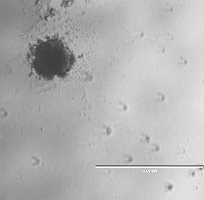
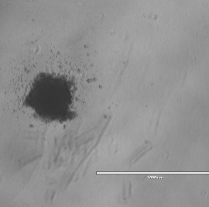
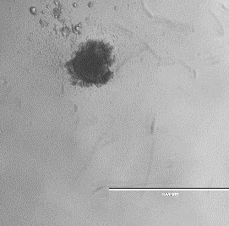
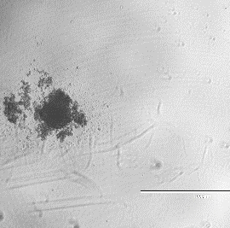
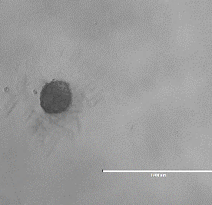
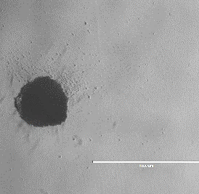
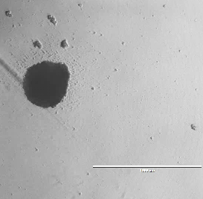
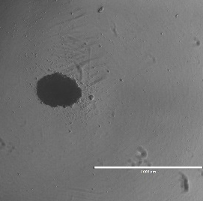
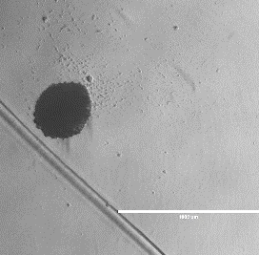
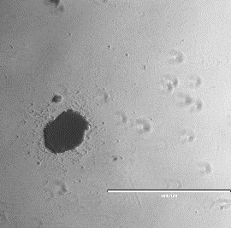
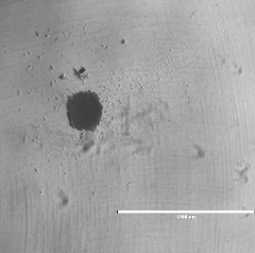
  Day 4
  Day 11
  Day 11
  DMSO
  DMSO
  DMSO+1 Gy
  DMSO+2 Gy
  Olaparib
  Olaparib +1 Gy
  Olaparib+2 Gy
  UMSCC6
1000 µm
1000 µm
1000 µm
1000 µm
1000 µm
1000 µm
1000 µm
  UMSCC74A
1000 µm
1000 µm
1000 µm
1000 µm
1000 µm
1000 µm
1000 µm
  UMSCC6 (x-rays)
  UMSCC74A (x-rays)
  UMSCC74A (protons)
  IR
  IR
  IR

Slide 16



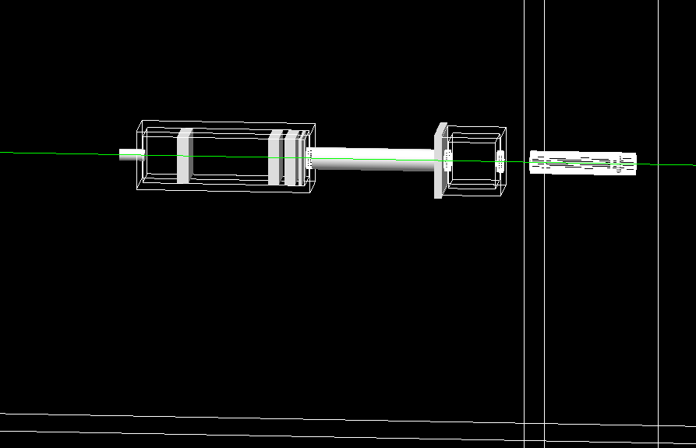
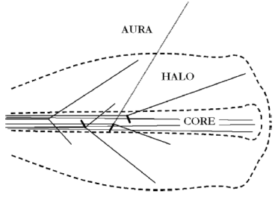
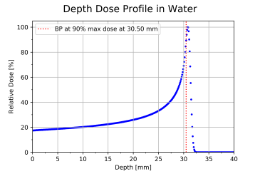
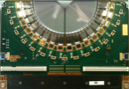

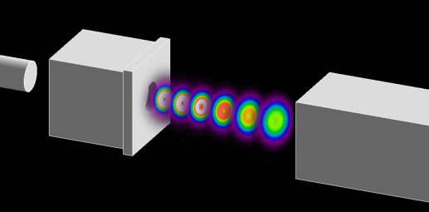
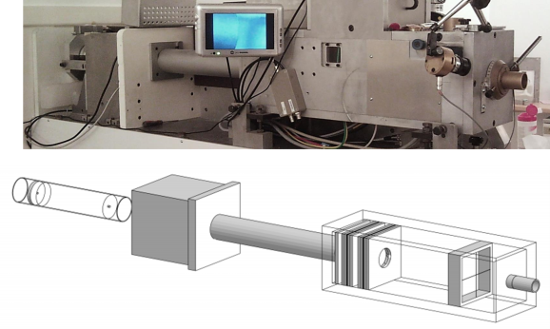
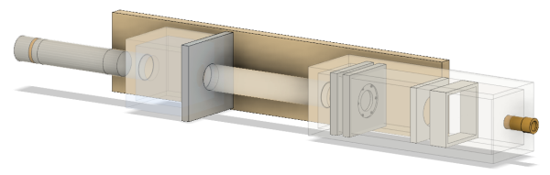
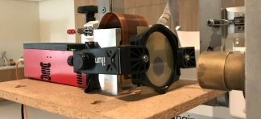



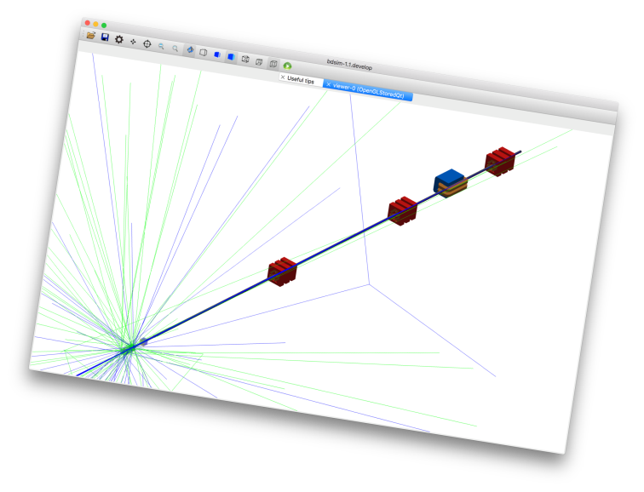


Jacinta Yap
‘Halo Dose Correlation in a Medical Accelerator’
  Correlation of beam halo to dose
  Stand alone, non-interceptive beam monitoring system based on LHCb VELO detector technology
  Implementation into the Clatterbridge Cancer Centre (CCC), UK 60 MeV clinical eye proton beamline
  Experimental & simulation work
    Beam current & profile measurements
    Characterisation of halo
    Correlate maps of halo with beam core
    Convert current & halo characteristic with total dose delivery
  Online database of reliable dose readings correlated to halo measurements
  CCC beam characterisation & BTL study
  Beam transport & optics
    MadX, BDSIM
  Particle tracking
    Monte Carlo simulations - Geant4, TOPAS
  Experimental
    Emittance measurements
    Profile measurements – Film, Medipix3
    Validation of simulation model
  Development of a complete end-to-end beamline simulation model
  Validated, standard model for public users of CCC beamline
    Macroscopic links to radiobiological cell studies
    Modelling of energy spectra across experimental parameters
    High LET vs low LET irradiation
  Link between physics & radiobiological damage

Slide 17



Acknowledgements
Parsons Group
Rachel Carter
Katie Nickson
Maria Fabbrizi
Terpsi Vitti
Eleanor Madders
Chumin Zhou
Jonathan Hughes
Sifaddin Konis
Rachael Clifford
Hayley Fowler
Rumana Hussain
Institute of Translational Medicine
Mike Clague, Sylvie Urbe
Clatterbridge Cancer Centre
Andrzej Kacperek
Oxford Institute for Radiation Oncology
Mark Hill, James Thompson
Peter O’Neill

