Slide 1

Welcome and introduction

Slide 2
Welcome!

Slide 3
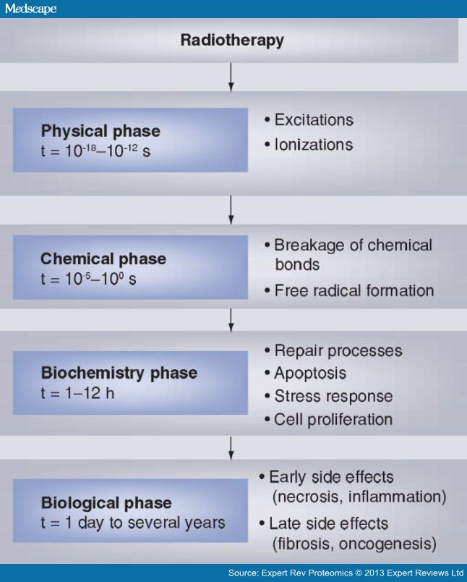
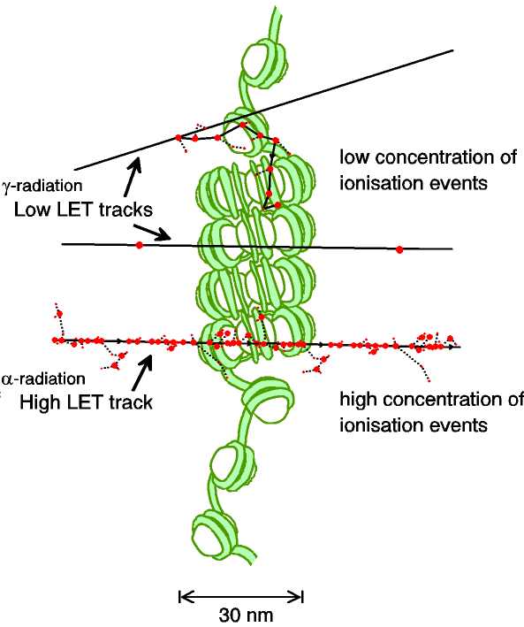
A complex, multi-facetted problem
Carter et al, and Parsons
(2018) IJROBP & (2019) IJROBP
Multidisciplinary approach essential
Time

Slide 4
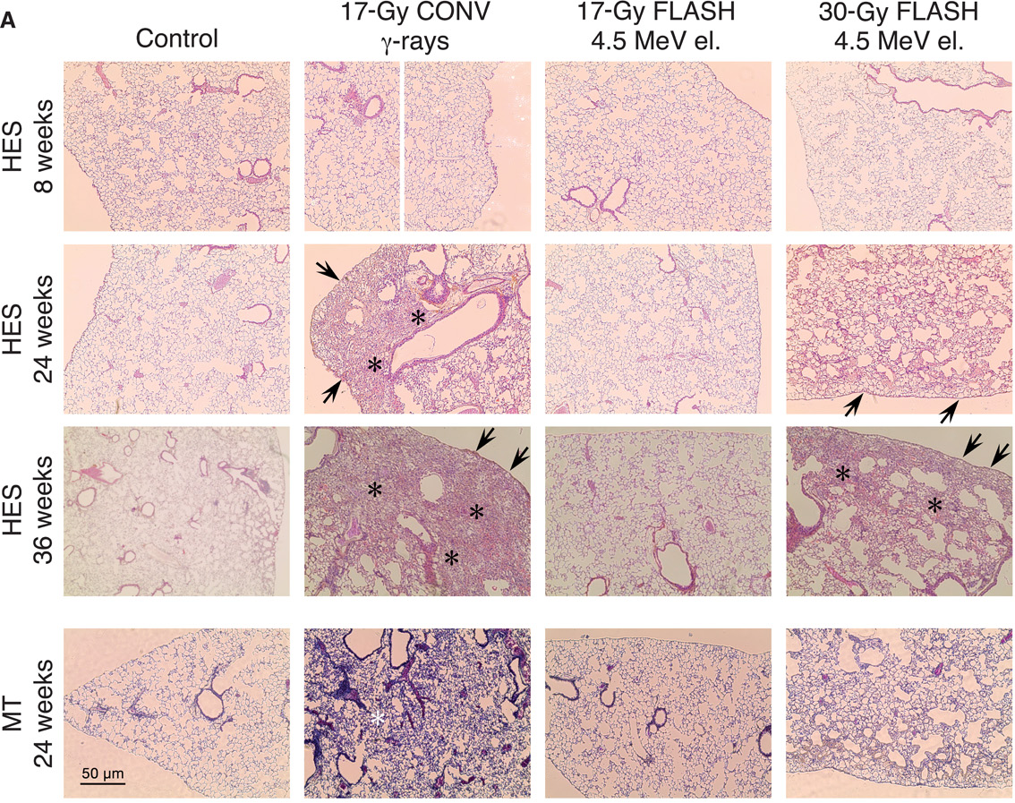
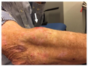
Radiobiology in new regimens
Worked example: FLASH
Conventional regime : ~2 Gy/min
FLASH regime : >40 Gy/s
Evidence of normal-tissue sparing while tumour-kill probability is maintained:
i.e. enhanced therapeutic window
Time line:
Initial reports: 2014 (e.g. Flauvadon et al, STM Jul 2014)
Confirmation in mini-pig & cat: 2018 (Clin. Cancer Research 2018)
First treatment 2019 (Bourhis et al, Rad.Onc. Oct 2019)

Slide 5
Radiobiology in new regimens
Time
domain
Space
domain
LhARA the ideally
flexible beam facility
that can deliver it all!
⇒ substantial
opportunity for a
step-change in
understanding!
Ion
species
Energy
In combination
and with chemo/immuno Therapies

Slide 6
Laser-hybrid Accelerator for Radiobiological Applications
LhARA; a novel, hybrid, approach:
  High-flux, laser-driven proton/ion source;
  Novel plasma (Gabor) lens capture & focusing
  Post-acceleration and phase rotation: FFA &/or SC RF
  Results in compact facility
Unique features:
  Very large flux of p or ions in very short pulses:
    Enormous instantaneous dose
  Inject at ~15 MeV into first accelerating structure
    Overcomes space-charge limit of today’s ion sources
  Staged implementation:
    In-vitro studies permitted at 15 MeV:
      Source, capture, transport
    In-vivo studies using post-accelerator (127 MeV p; ~35 MeV/u)
Uniquely flexible radiobiology facility:
  Many ions, proton to carbon, in single facility
  Wide range of energy and dose rate, allows UHDR/FLASH radiotherapy
Technologies can be developed to create uniquely flexible therapy facility

Slide 7
Present multidisciplinary collaboration
Further interest from:
Groups in the UK and overseas
The International Biophysics Collaboration [spokespeople: Patera, Prezado]

Slide 8
Workpackages, deliverables, and cost
Preparation of initial CDR for LhARA:
  Deliverable: initial CDR for LhARA [milestone April 2020]
  Resources:
    Key enabling investment: 1.75 PDRAs for 6 months
      In place; can efficiently become core of effort to deliver initial CDR
    Leverage support from participating institutes and project partners
    Exploit strong synergy and close collaboration with ISIS Upgrade team
  Request:
    Staff: Imperial (Physics): £62.70k, Liverpool (Biology): £38.12k
LhARA and radiobiology test facility:
  Deliverable: proton-FLASH dosimetry [milestone April 2020]
  Resources:
    Key enabling investment: 0.25 PDRA for 6 months
      In place; existing collaboration with Clatterbridge Cancer Centre (CCC)
    Leverage support from CCC, participating institutes, and project partners
  Request:
    Staff: Liverpool (Biology): £17.24k
UK and the International Biophysics Collaboration (IBC):
  Deliverables: Forge UK identity and define UK role in IBC [milestone September 2021]
  Resources:
    Key enabling investment: UK and European travel for effective networking activity
  Request:
    Staff: Liverpool (Biology): £6.30k
    Travel: £15k
Total cost to STFC: £139.35k In-kind income from project partners: £170.00k

Slide 9
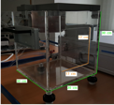
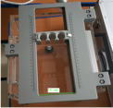
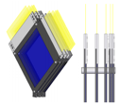
Scintillating-fibre instrumentation
SciWire (AK):
  Flux measurement for low-energy ion beams
SmartPhantom (HTL):
  Instrumentation for radiobiological studies
  Collaboration with MUW, TUW, MedAustron

Slide 10
Image processing and automation
No talk today, but:
Concept:
  Local processing of cone-beam CT to:
    Augment present ‘boney match’ with ‘soft-tissue match’
    Automatically relocate patient couch:
      This will need to be prediction of required movement in first instance
Genesis of idea/programme:
  Gujral/Williams and Mclauchlan – all of CXH
Working towards:
  EPSRC Healthcare Technologies application

Slide 11

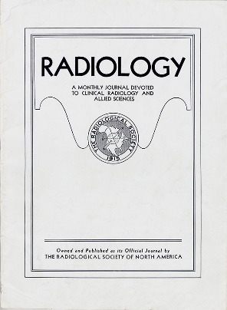
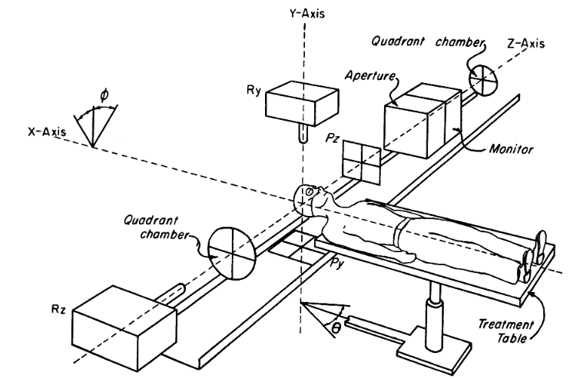
Novel accelerator techniques
System: image processing
fast feedback, control
1946
↓
1960
Fundamental
radiobiology
1970
1980
1990
2000
2010
2020
2030
2040
2050

Slide 12
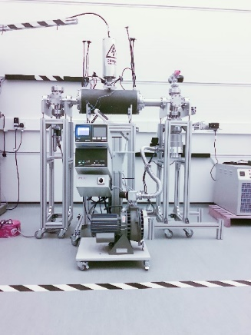
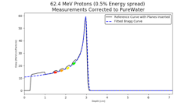
Novel accelerator techniques
System: image processing
fast feedback, control
Fundamental
radiobiology

Slide 13
Automated personalized,
adaptive, photon, electron,
proton, and ion-beam therapy
Image processing
Rapid acquisition of CT images
Dosimetry
Combined strategies for pre-therapy imaging/planning:
U/sound, PET, MRI, photo-acoustic, …
Generation of 3D information from 2D projections
Treatment planning
LhARA
Pre-CDR will determine timescales and R&D plan
Radiobiology and modelling (photon, electron, proton, ion)
Study as function of time & space structure, ion species, energy …
Imperial strengths:
DESI, Raman spectroscopy
Exploit to study toxicity, difference FLASH/routine
Important to generate discussion leading to strategy
Elucidation of mechanisms
that determine the impact of
ion particle beams
on tissue
2020
2025
2030
2040

Slide 14
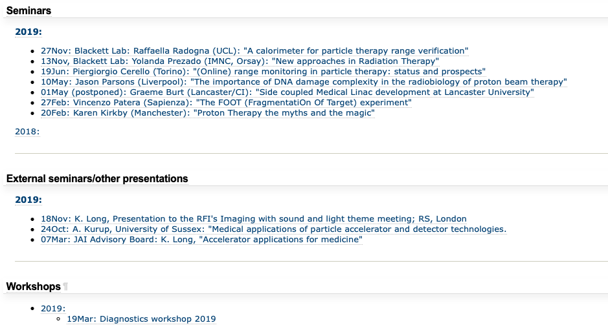
Seminars

Slide 15
Next meetings
11th December 2019
24th June 2020
9th December 2020

Slide 16
This meeting
Welcome and introduction

Slide 17
