Slide 1


End-to-end Simulation WP report
5th Plenary Meeting of the CCAP
Ajit Kurup
11th December 2019

Slide 2
Introduction
End-to-end simulation.
  What is meant by end-to-end and the various simulation stages.
Current status.
  CCAP-v4.0
Schedule.

Slide 3
End-to-end simulation
The particle tracking simulation of the LhARA facility will be broken down into different parts:
  Definition of the input beam generated by the laser target interaction.
    With the option to collimate part of this beam due to the differential pumping plate.
  Stage 1 tracking using GPT: from the target for a drift of 5cm without space charge and then with space charge through to just before the vacuum window.
  Stage 1 tracking using BDSIM: 5cm from the target through the end station.
  Stage 2 tracking using BDSIM: from the end of the last Gabor lens through a switching dipole that bends the beam away from the 90 deg vertical bend and into the injection transfer line of the FFA up to just before the septum.
  Stage 2 tracking using Zygoubi: tracking from the beginning of the injection septum and through the FFA.
    Beam parameters will be extracted after the extraction septum.
  Stage 2 tracking using BDSIM: tracking from after the extraction septum, through the extraction line and switching magnet to the vertical bend and through the in vitro end station.
  Stage 2 tracking using BDSIM: tracking from after the extraction septum, through the extraction line and switching magnet to the transfer line for the in vivo end station (including the option for sweeper magnets for spot scanning) and through the in vivo end station.

Slide 4
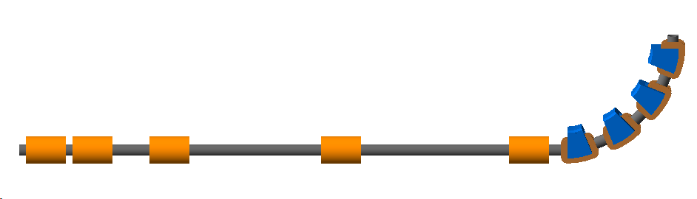
Current status
Repository for the code https://ccap.hep.ph.ic.ac.uk/trac/browser/ccap-sim
CCAP-v4.0
CCAP-v4.1
  Alternative vertical bend using dipoles and quadrupoles design by summer student Theo Keseman.

Slide 5
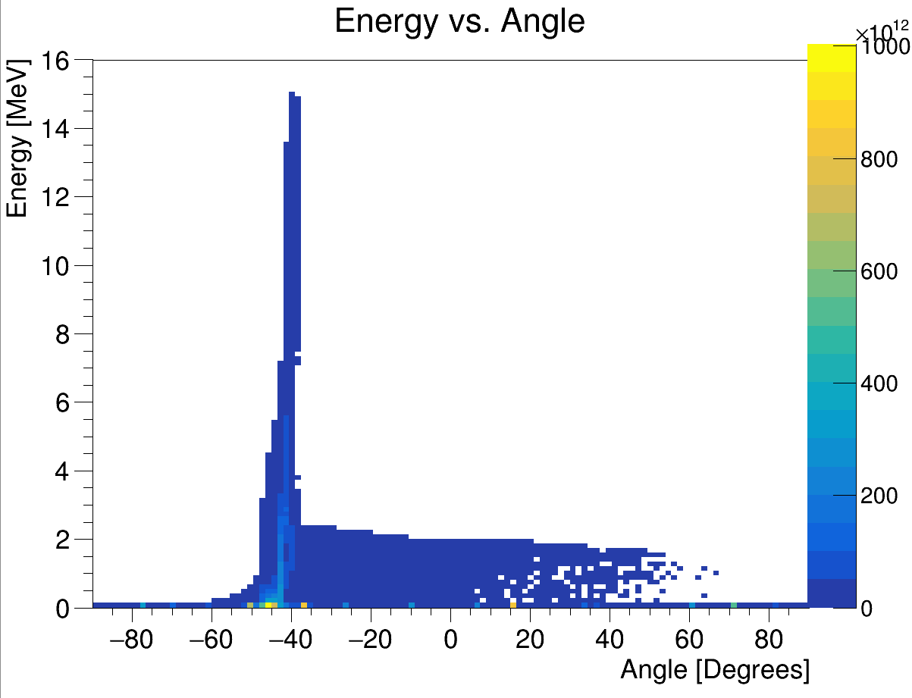
Current status
Input beam
  2D data from Ollie.
  HT Lau looking at transforming this into a 3D distribution.
  Ideally would like to use 3D particle coordinates from Smilei.
    Being worked on by Oliver Ettlinger and George Hicks.
Energy vs angle with respect to laser beam direction
Laser driven ion beam simulation using EPOCH.

Slide 6
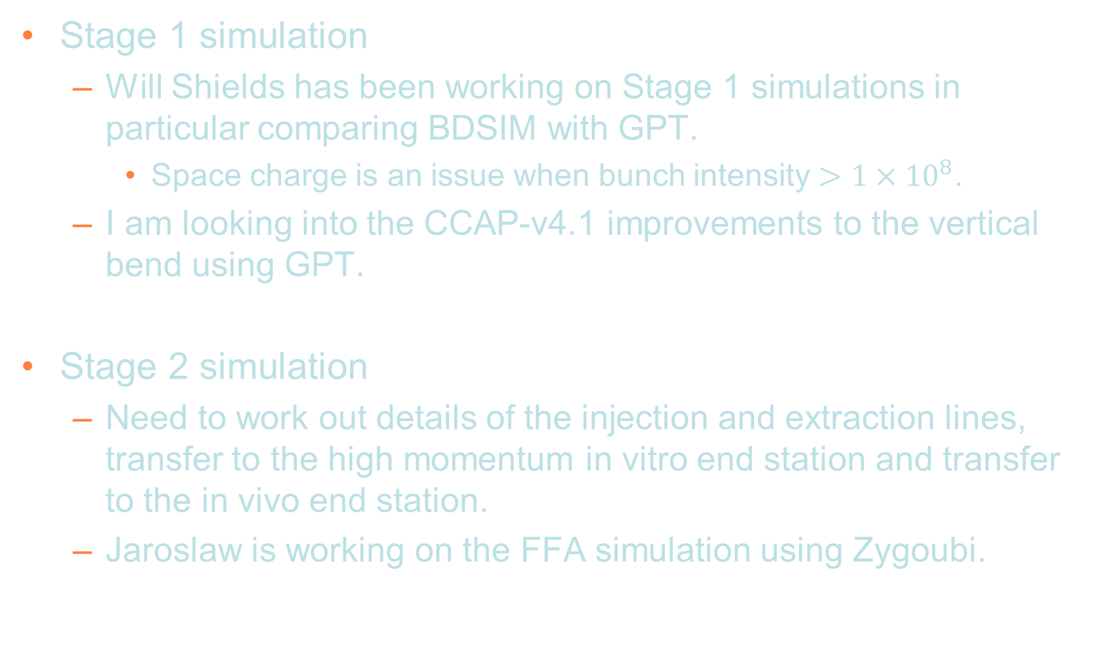
Current status
Stage 1 simulation
  Will Shields has been working on Stage 1 simulations in particular comparing BDSIM with GPT.
    Space charge is an issue when bunch intensity $>1×{10}^{8}$.
  I am looking into the CCAP-v4.1 improvements to the vertical bend using GPT.
Stage 2 simulation
  Need to work out details of the injection and extraction lines, transfer to the high momentum in vitro end station and transfer to the in vivo end station.
  Jaroslaw is working on the FFA simulation using Zygoubi.

Slide 7
Schedule and plans
31 Dec 2019: First end-to-end simulation!
31 Jan 2020: Design of the facility will be frozen.
Other details to be discussed.
  Abort lines.
  Rebunching after the FFA.
  Sweeper magnets for spot-scanning.

