Slide 1


Preparations for the LhARA pre-CDR
5th Plenary Meeting of the CCAP
Ajit Kurup
11th December 2019

Slide 2
Introduction
Overview of the preparations for the LhARA pre-CDR.
  https://ccap.hep.ph.ic.ac.uk/trac/wiki/Research/DesignStudy/PreCDR
Organisation, WBS and schedule.
Current status.
  Overview.
  More details from work package managers.
Upcoming deadlines.

Slide 3
What will go in the pre-CDR
Description of the proposed facility including
  Details of the staged approach for in vitro and in vivo experiments.
  Alternative technology options.
  R&D plan and costing.
Major sections include:
  Laser driven proton and ion source.
  Proton and ion capture.
  Stage 1 beam transport: Beam transport and delivery to the in vitro end station.
  Stage 2 beam transport: Post-acceleration and beam delivery to the in vivo end station.
  Biological end stations.
  Infrastructure and Integration.
  Project plan for the delivery of LhARA.
  Safety.
  End-to-end simulation.
  Instrumentation.

Slide 4
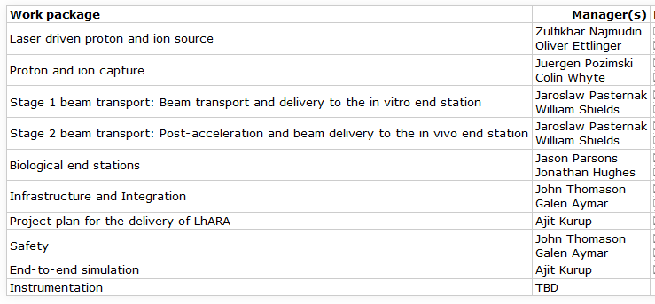
Organisation and the WBS
Work breakdown structure follows the sections of the pre-CDR. https://ccap.hep.ph.ic.ac.uk/trac/raw-attachment/wiki/Research/DesignStudy/PreCDR/2019-11-05-WBS.pdf
Work package managers https://ccap.hep.ph.ic.ac.uk/trac/wiki/Research/DesignStudy/PreCDR#Workpackagemanagers

Slide 5
LhARA Steering Group
Consists of members of the LhARA consortium.
Meeting dates:
  28 Nov 2019
  17 Dec 2019
  31 Jan 2020
  28 Feb 2020

Slide 6
Schedule and deadlines
https://ccap.hep.ph.ic.ac.uk/trac/wiki/Research/DesignStudy/PreCDR#Keydates
29 Nov 2019: First issue of the baseline. This will include lists from the various systems of what needs to be updated on the existing floor layout, WBS, interfaces document and the parameter table.
31 Dec 2019: First end-to-end simulation.
31 Jan 2020:
  Design of the facility will be frozen.
  First view of the costs.
  R&D programme needed to take the programme forward will be defined.
28 Feb 2020: Complete the write-up of the pre-CDR.
Mar 2020: External review of pre-CDR in advance of publication.

Slide 7
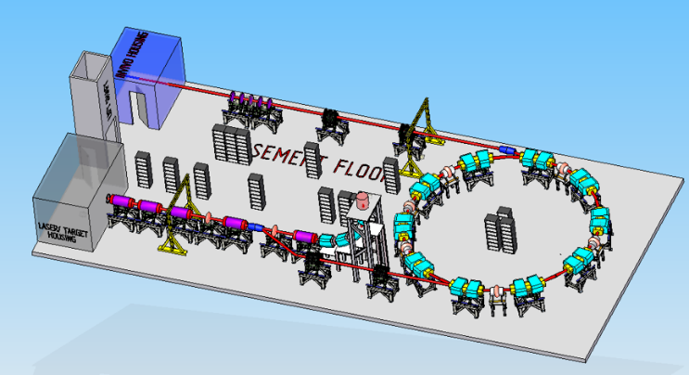
Floor plan
Version 0 of the floor plan.
  https://ccap.hep.ph.ic.ac.uk/trac/attachment/wiki/Research/DesignStudy/PreCDR/FloorPlan-v0.png
  Details of updates:
    https://ccap.hep.ph.ic.ac.uk/trac/wiki/Research/DesignStudy/PreCDR#Floorplan
RAL will provide an engineer to draw the floor plan of the final version of the LhARA facility to go in the pre-CDR.
  Due in February.
Design will be frozen by the end of January.

Slide 8
System interfaces
https://ccap.hep.ph.ic.ac.uk/trac/raw-attachment/wiki/Research/DesignStudy/PreCDR/2019-11-15-Interfaces.pdf
Mostly straight-forward.
Detail at the laser-capture interface being discussed to work out some of the space needed for monitoring the laser and differential pumping whilst ensuring we capture as much of the beam produced by the laser.

Slide 9
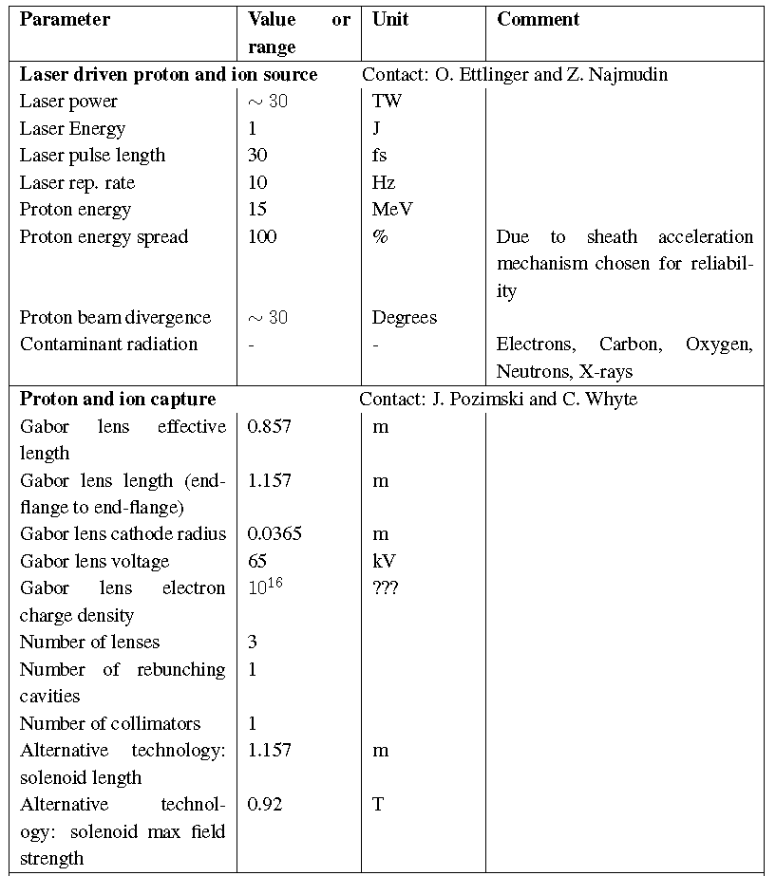
Parameter table
https://ccap.hep.ph.ic.ac.uk/trac/raw-attachment/wiki/Research/DesignStudy/PreCDR/LhARA_parameter_list-v2.pdf

Slide 10
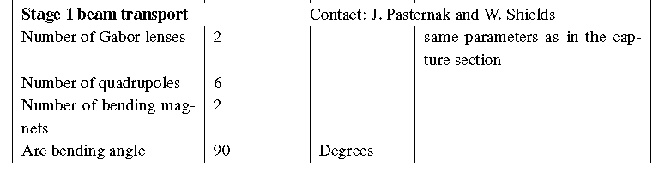
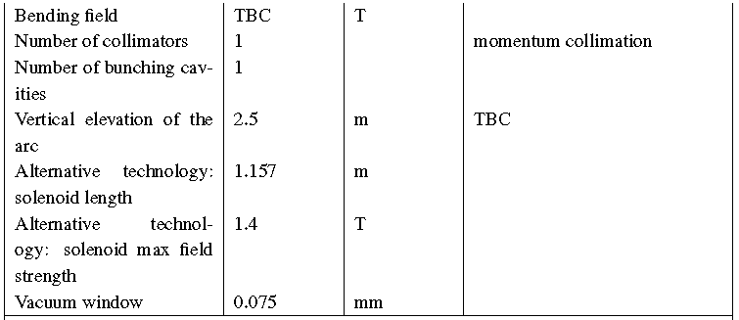
Parameter table

Slide 11
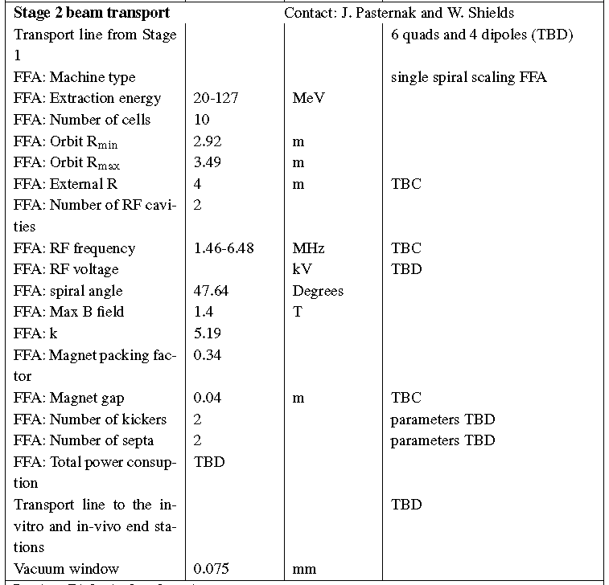
Parameter table

Slide 12
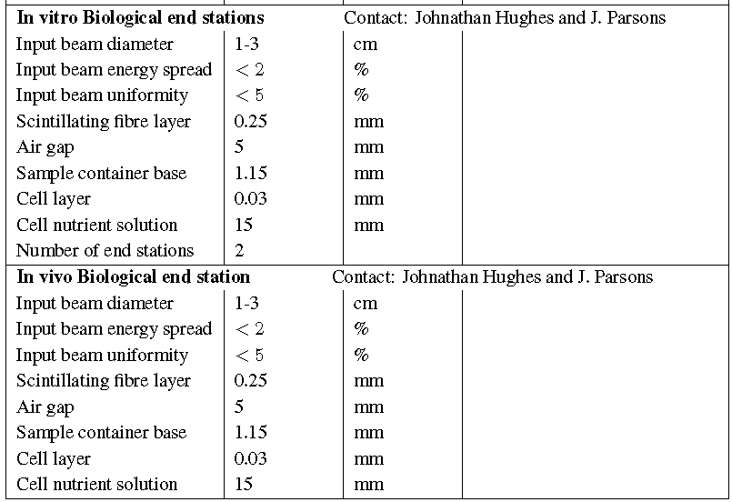
Parameter table

Slide 13
R&D plan
https://ccap.hep.ph.ic.ac.uk/trac/wiki/Research/DesignStudy/PreCDR#RDPlan
Laser
  No major R&D needed for the laser since it will be a commercial system.
  Target particle production.
Proton and ion capture.
  Gabor lens prototype development and performance verification.
Stage 1 beam transport.
  No major R&D needed.
Stage 2 beam transport.
  FFA: Magnet design and prototyping.
  FFA: RF cavity performance verification.
End station
  Automation.
Instrumentation.
  Dose calibration for high-intensity beams.
  Online dose monitor.
  Online beam monitor for low energy beam.

Slide 14
Upcoming deadlines
31 Dec 2019: First end-to-end simulation.
  More details in the talk later.
31 Jan 2020:
  Design of the facility will be frozen.
  First view of the costs.
  R&D programme needed to take the programme forward will be defined.
28 Feb 2020: Complete the write-up of the pre-CDR.

Slide 15
Summary
Very good progress.
  Defined the first version of the base line design: updates to the floor plan, parameter table.
Work in progress
  Interface between laser target vessel and the first Gabor lens.
  Simulations.
Next focus will be on the R&D plan and costing.

