Slide 1
The Christie Proton Research Beamline and Radiobiology Endstation
Mike Merchant
20’ talk 24/06/20
CCAP LhARA Plenary meeting

Slide 2
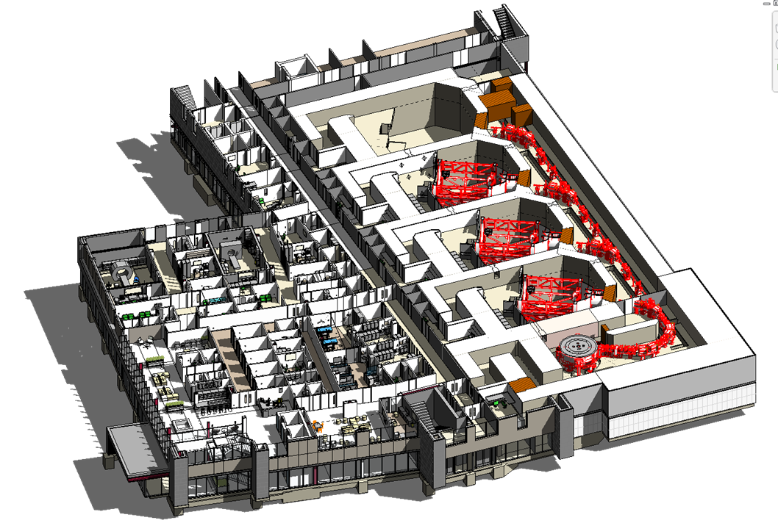
The Research Room
The Research Room!
Gantry ‘pit’
Radiobiology prep room
Varian ProBeam cyclotron
4th room and research beamline funded by Christie Charity
Gantry clinical treatment rooms 1-3
Notes:
The “research room“ – sounds like a trendy bar?

Slide 3
Beamline A: Built and commissioned. Final infrastructure works before ready for radiobiology. 20/6/20
Lab access restricted due to COVID-19
Water tank interlock
Configurable research space
Beamline B:
Pre-clinical beamline – in design & evaluation phase
Design aims:
1 mm σ spot
5 cm x 5 cm scanning area
Imaging capability – Xstrahl SAARP
Lots of options - drawing may change!
70 – 245 MeV
6 mm σ spot
30 x 40 cm scan area
BPM
Quadrupole triplet
SAARP

Slide 4
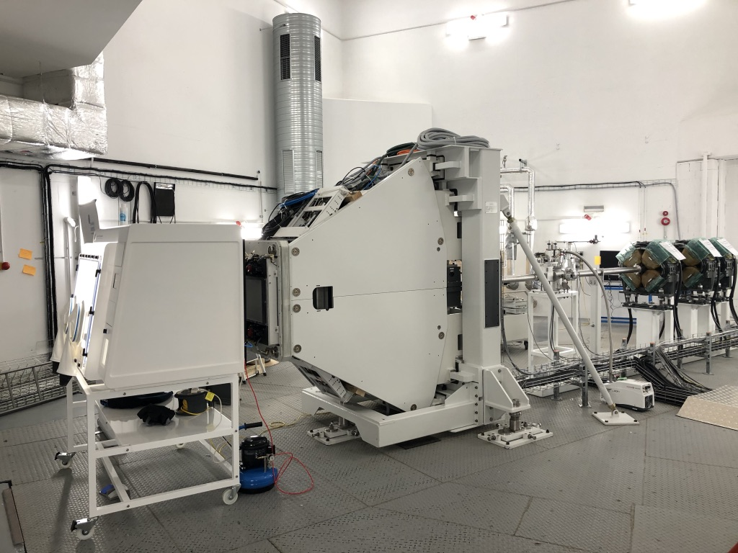
The Christie Research Beamline
Commissioning tests

Slide 5
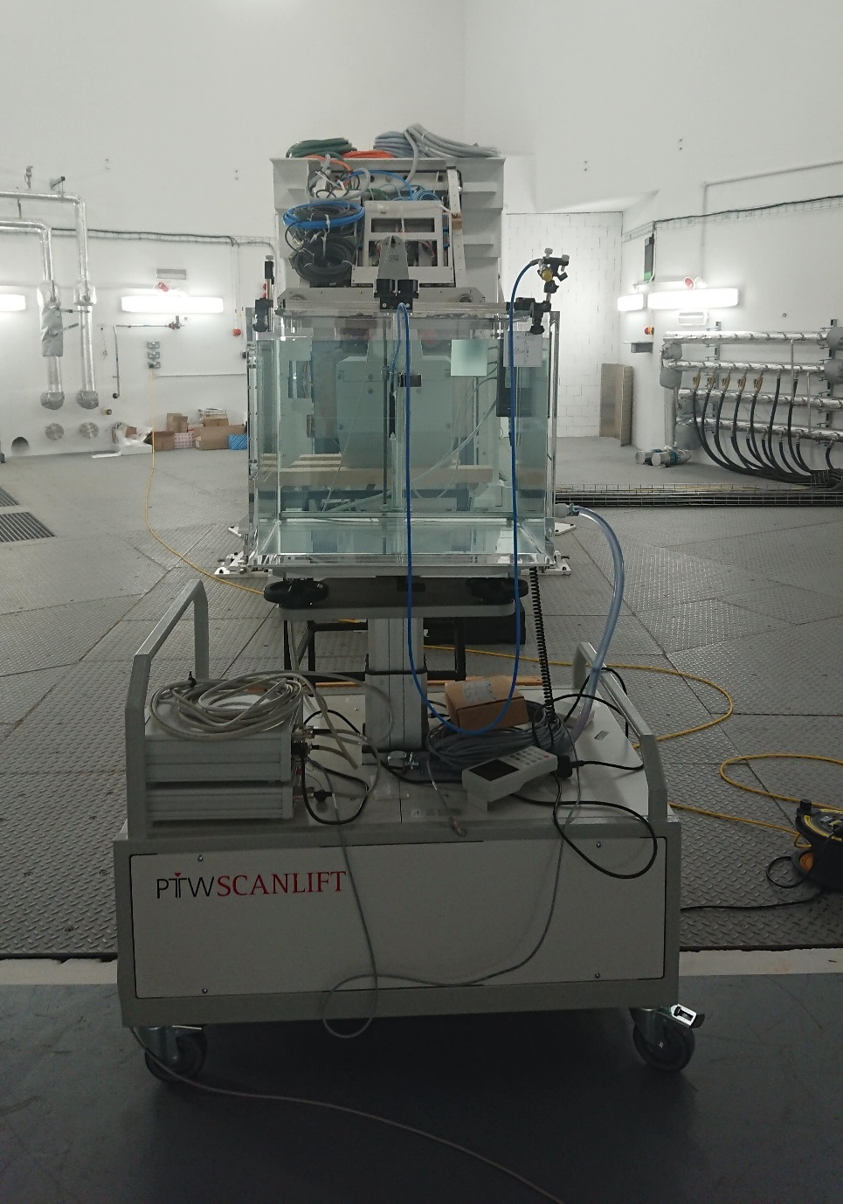
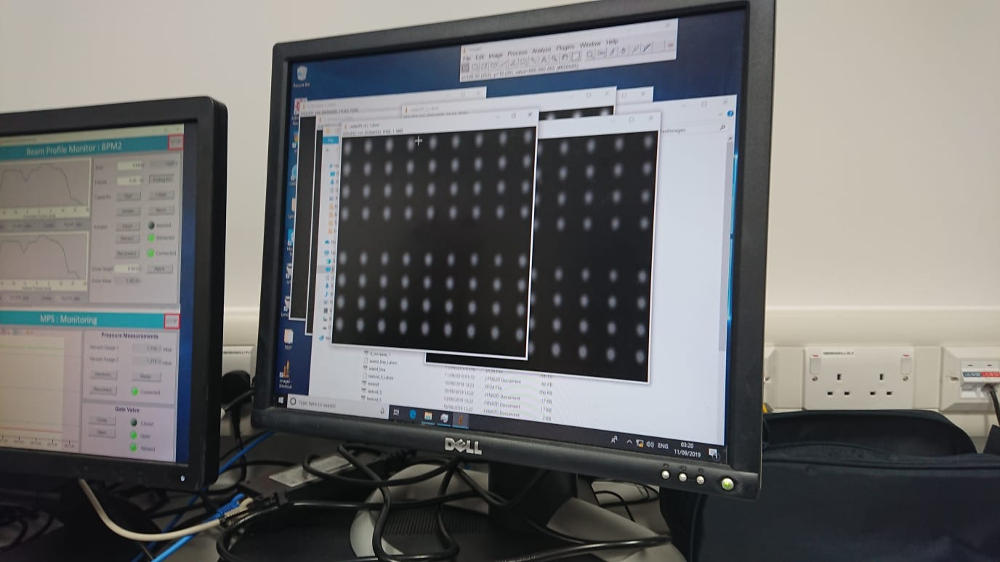
PBT room commissioning
Beam line with IBA Lynx to measure beam spots and water phantom to measure Bragg peak (when Lynx removed)
Spot scanning at different energies using Lynx, measuring spot size and scanning speed

Slide 6
End-station Requirements
At least 4 separate radiobiology experimental scenarios identified:
Radiobiology
High through-put cell irradiator
  Environmental control (Temperature, CO₂, Hypoxia)
  Range of sample types
  Spheroids, Organoids
Single ion tracking cell irradiator (FNTDs, CR-39)
  Low throughput
Bragg peak depth simulator (water tank) – irradiate cells in many different energy layers, energy spectra.
Online microscopy end-station – short term and long term timelapse, observe repair protein kinetics, cell cycle arrest etc.
  Low throughput

Slide 7
Christie Proton Research Beamline Radiobiology End-station
Beam entry window (kapton)
6 axis robot (Thermo Scientific)
Hypoxia workstation (Don Whitley Scientific)
Cell dish stack (out of beam)
Beam exit window + lead glass
245 MeV protons
Water tank + Bragg peak detector
Varian Engineering Scanning Nozzle
Experimental Trolley
PTW water phantom
Funding for radiobiology end-station from CRUK

Slide 8
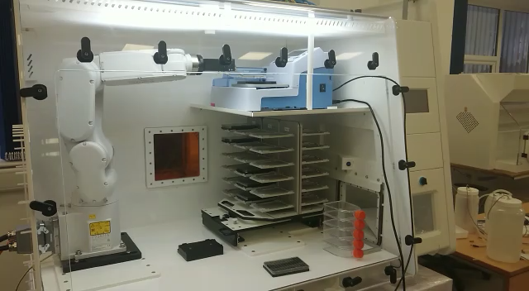

Robotic Automated Hypoxia End-station
Automation for liquid handling: Cell fixing.
FANUC 6-axis robot arm
‘Hotel’ for 36 flasks or well plates
Proton beam entry window
Funding for radiobiology end-station from CRUK

Slide 9
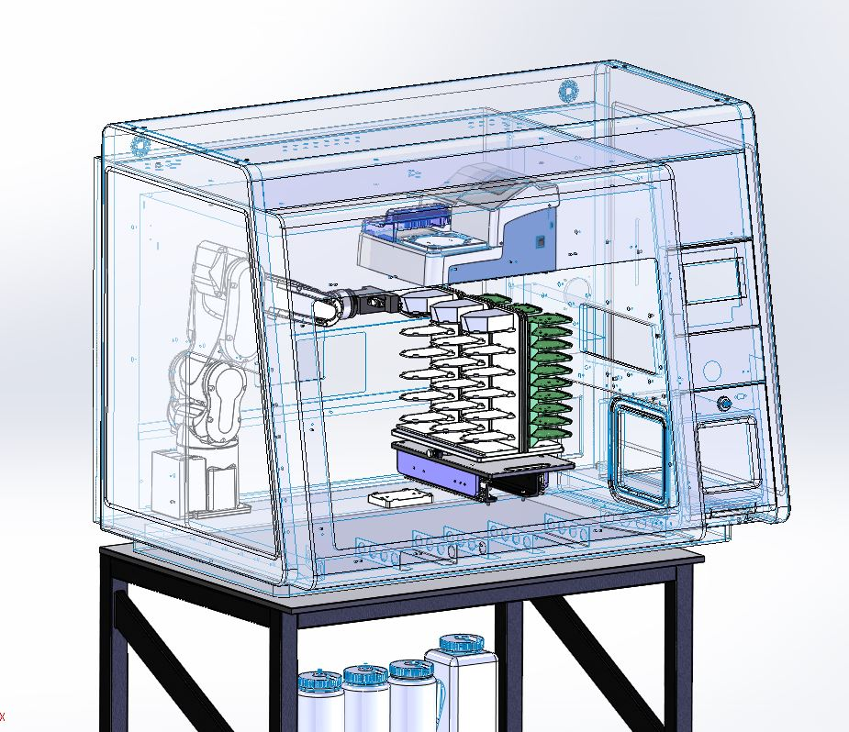
Proton Hypoxia Radiobiology End-station
Recognised a need to preform high through-put repeatable experiments to reduce experimental error in proton radiobiology.
Wellwash Versa liquid handling station allows us to make best use of imaging facilities in the Manchester Cancer Research Centre.
Version 2: Investigating options for live imaging –
e.g. DNA repair protein kinetics
Funding for radiobiology end-station from CRUK

Slide 10
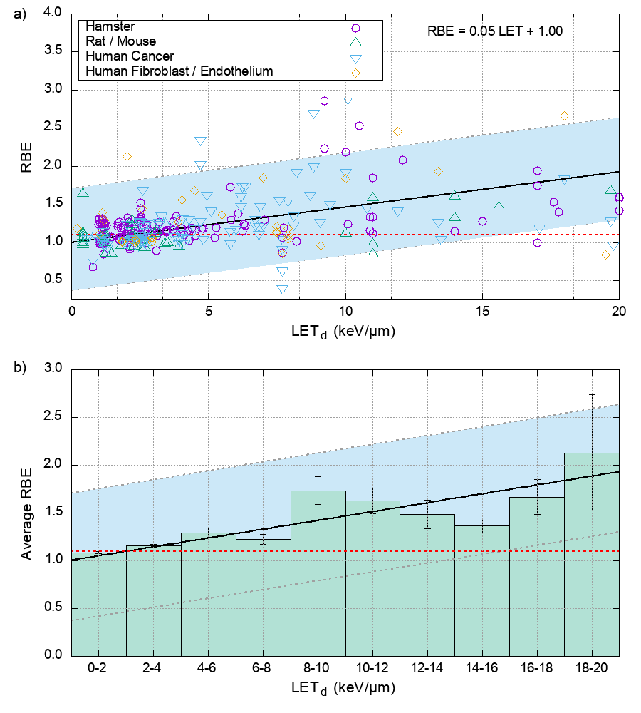
Proton Relative Biological Effectiveness
Is there a link between LET and RBE?
Experimental data collated by Paganetti (2014)
Data reproduced from Paganetti, Phys. Med. Biol., 2014
Notes:
Equation

Slide 11
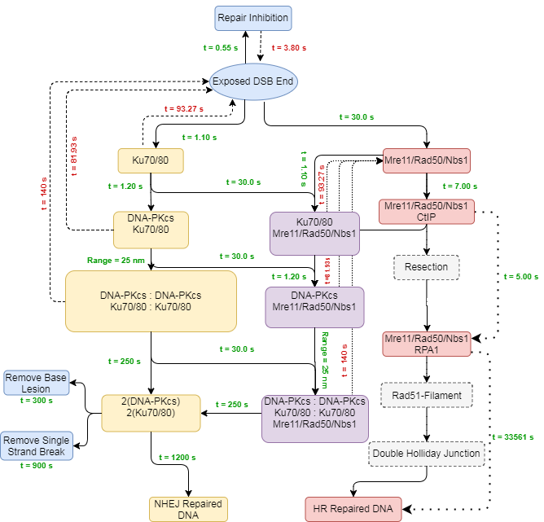
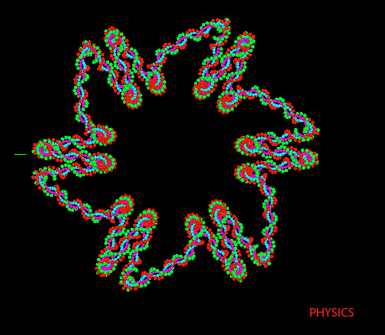
Protons: Mechanistic Modelling of DNA Damage & Repair
Nanodosimetric modelling of DNA damage complexity
Mechanistic modelling of DNA repair
Henthorn et al. Rad. Res. 2017
Henthorn et al. RSC advances 2019
Warmenhoven & Henthorn et al. Nature Scientific Reports 2017
Ingram et al. Nature Scientific Reports 2019
Warmenhoven et al. DNA Repair 2020

Slide 12
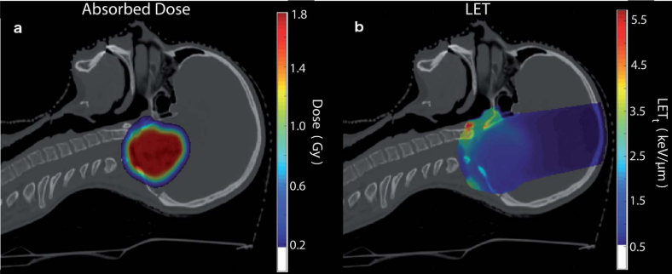
Protons: Biologically Augmented Treatment Planning
Physical Dose
Linear Energy Transfer

Slide 13
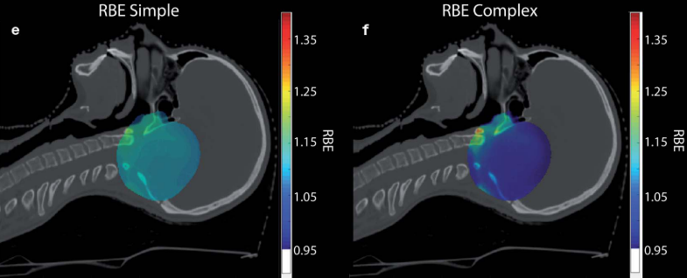
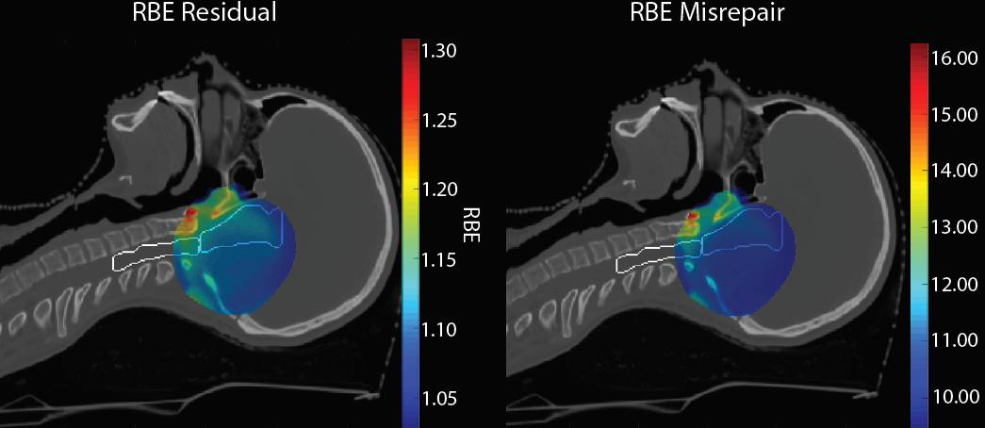
Protons: Biologically Augmented Treatment Planning
DNA Damage model
DNA Repair model
N. Henthorn et al., RSC Advances, 2019
E. Smith et al., Nat. Sci. Rep 2019

Slide 14


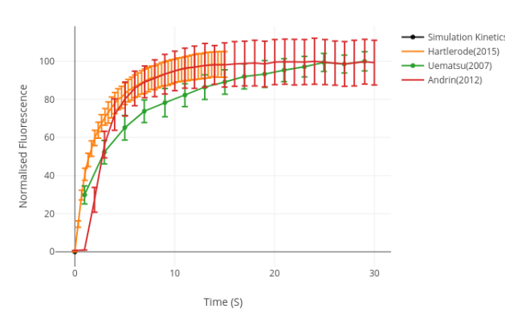
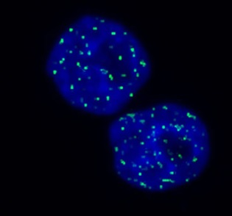

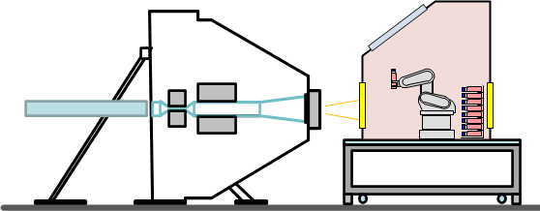
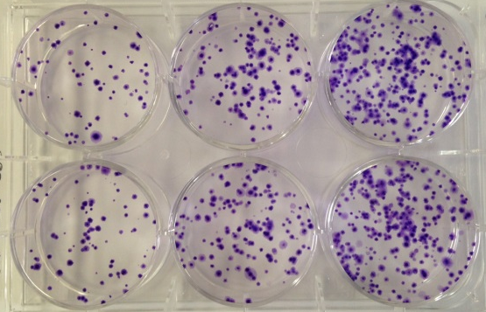
Mechanistic Modelling and Validation of Biological Effect
Model Qualification
Multi-assay validation
Measurement
Analysis
Conceptual Model
Model Validation
Simulation
Iteration
Clinical Translation
Equipment designed for experimental need
Computerised Model
Development
Model Verification
Modelling determines experiments

Slide 15
Beamline A: Built and commissioned. Final infrastructure works before ready for radiobiology. 20/6/20
Lab access restricted due to COVID-19
Water tank interlock
Configurable research space
Beamline B:
Pre-clinical beamline – in design & evaluation phase
Design aims:
1 mm σ spot
5 cm x 5 cm scanning area
Imaging capability – Xstrahl SAARP
Lots of options - drawing may change!
70 – 245 MeV
6 mm σ spot
30 x 40 cm scan area
BPM
Quadrupole triplet
SAARP

Slide 16
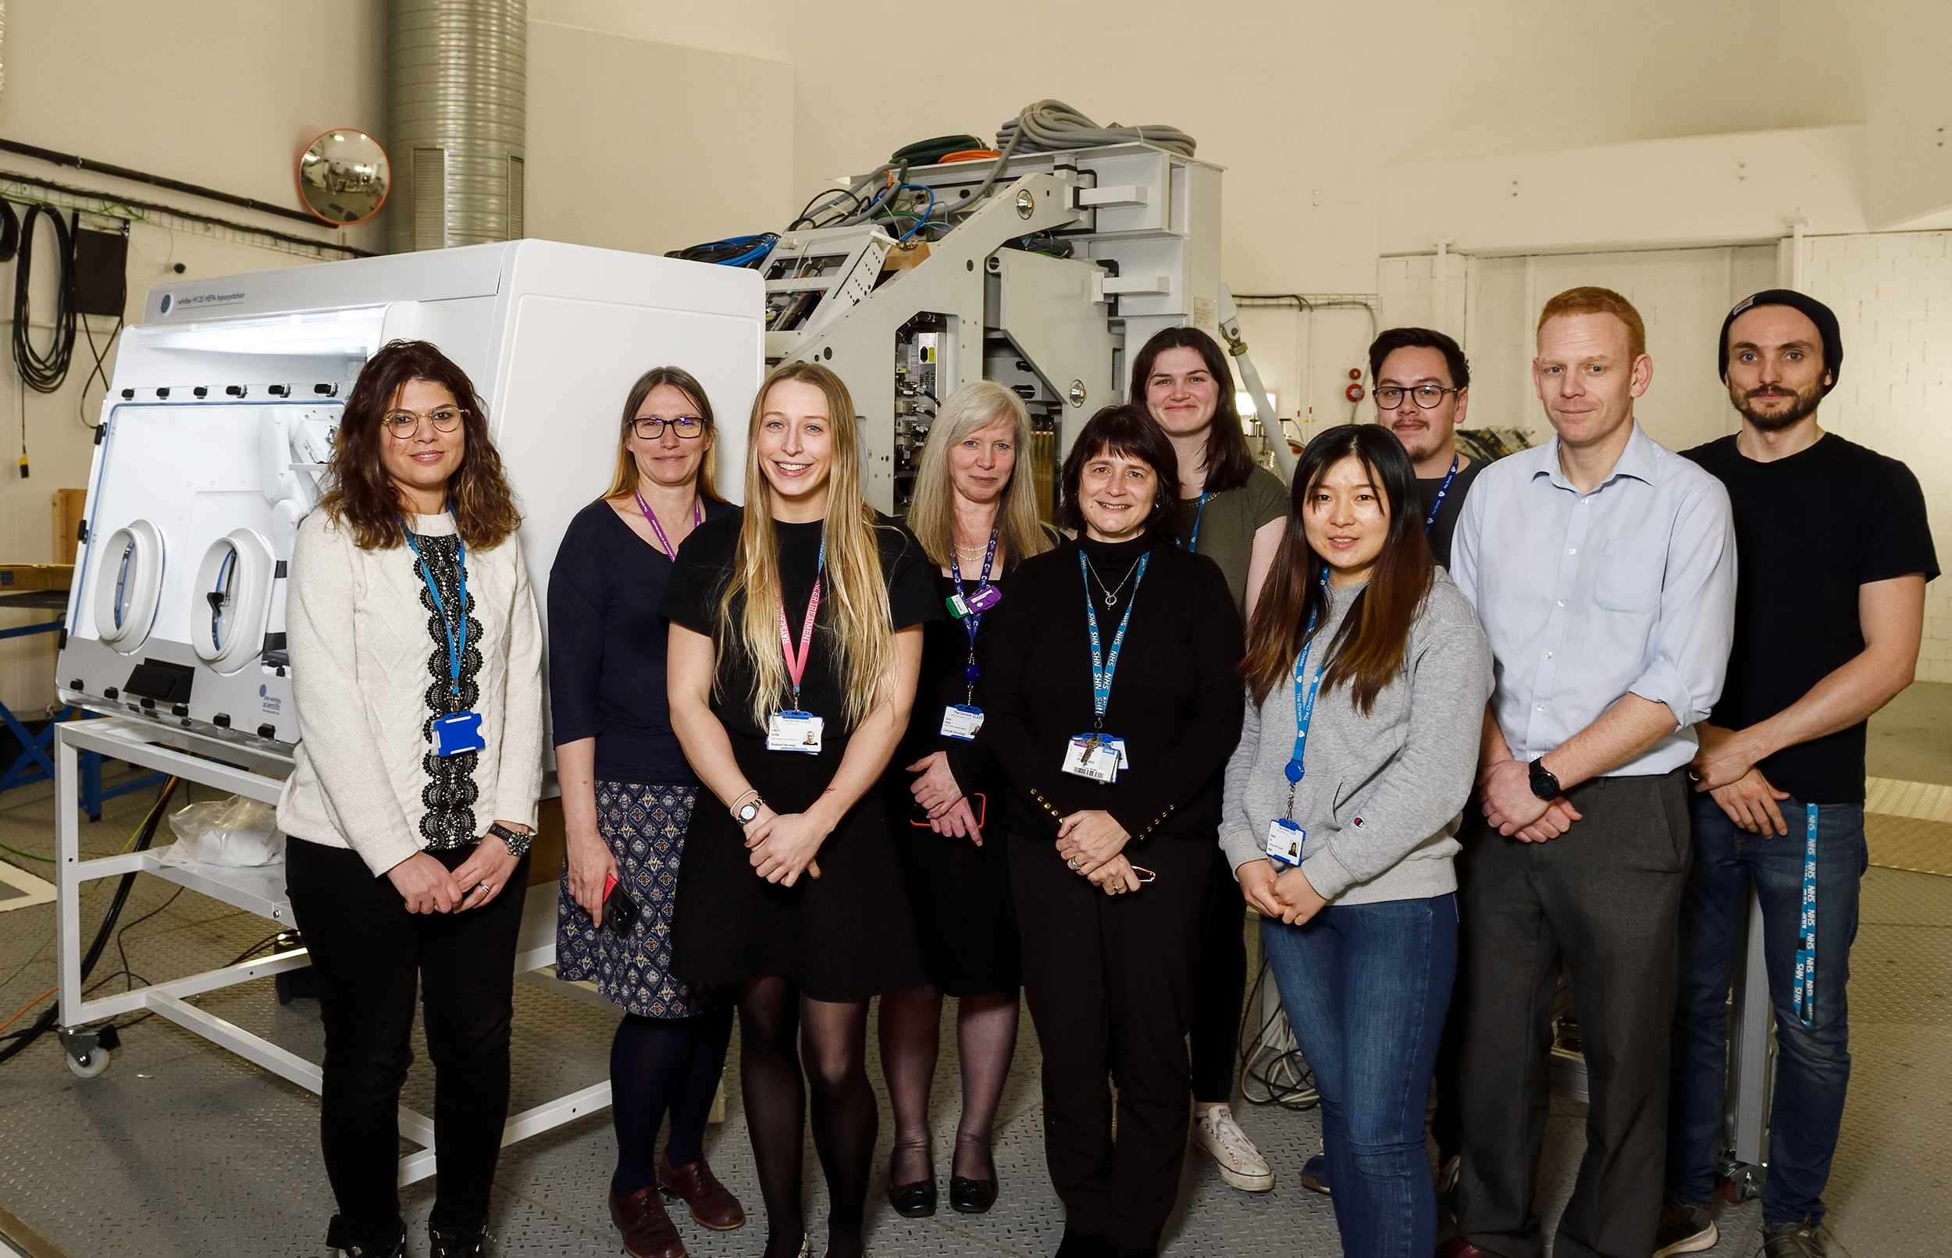
(Some of) Manchester Research Group in Research Room

