Slide 1





The need for radiobiology research
Dr Jason Parsons
Cancer Research Centre
Department of Molecular and Clinical Cancer Medicine

Slide 2

The radiobiology of protons
Tumour
Bragg peak
Distal fall-off
Relative dose
LET
Proton energy
Depth in tissue
Vitti and Parsons (2019) Cancers
Taken from Paganetti and van Luijk (2013) Sem Rad Oncol
  A constant relative biological effectiveness (RBE) value of 1.1 is used in clinical practice. However, there is a large uncertainty with using this approach as RBE is variable and dependent on many factors, including:-
  Proton energy (therefore linear energy transfer, LET) and dose.
  Radiosensitivity/radiobiology of the tissue.
  Biological end-point examined (e.g. clonogenic survival, tumour growth delay).
  Therefore, further research exploiting the biological impact of protons is vital for investigating RBE, and thus improving clinical use of proton beam therapy.

Slide 3
  Low energy protons cause a decrease in cell survival through delayed SSB repair
  HeLa
  UMSCC6
  SF2, p<0.02
  (RBE=1.67)
  SF2, p<0.01
  (RBE=1.68)
Alkaline (SSB)
Modified-Neutral (CDD)
****
  *p<0.02, **p<0.01, ***p<0.005, ****p<0.001
*
*
  *p<0.001
*
*
*
***
**
  Carter et al., (2018) Int J Rad Oncol Biol Phys
  58 MeV (1 keV/μm); 11 MeV (12 keV/μm)

Slide 4
siRNA screening to identify novel modulators of cell survival in response to proton irradiation
11 MeV
11 MeV
USP9X
USP6
DNA damage -
High-LET IR
11 MeV
Site-specific histone modifications
RNF20/40
MSL2
Ub
DUB
  *p<0.01
  **p<0.005
  ***p<0.001
Chromatin remodelling/DNA repair protein recruitment
PARP-1
Restoration of DNA integrity
  Carter et al., (2019) Int J Rad Oncol Biol Phys

Slide 5
Targeting DNA double strand break repair in head and neck cancer cells with photons and protons
X-rays
UMSCC6
UMSCC74A
Dose enhancement ratios (DER)
Inhibitor | 6 | 74A | 47 | 090
ATM | 2.06 | 1.91 | 1.38 | 1.15
ATR | 1.91 | 2.01 | 1.36 | 1.02
DNA-Pkcs | 1.93 | 2.39 | 1.69 | 1.36
Protons
UMSCC6
UMSCC74A
Dose enhancement ratios (DER)
Inhibitor | 6 | 74A | 47 | 090
ATM | 1.62 | 1.52 | 1.49 | 1.24
ATR | 1.25 | 1.42 | 1.28 | 1.30
DNA-Pkcs | 2.01 | 1.64 | 1.38 | 1.32
  Vitti and Parsons (2020) Cancers
KU-55933 (ATM); VE-821 (ATR); KU-57788 (DNA-Pk)

Slide 6
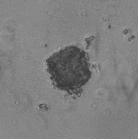
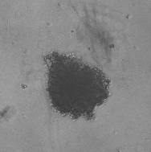
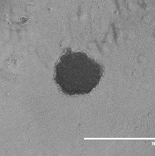
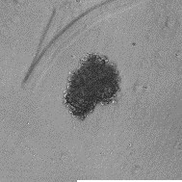
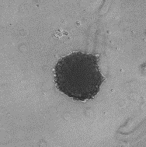
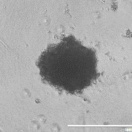
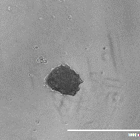
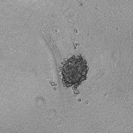
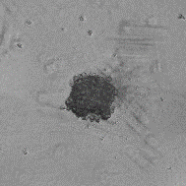
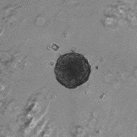
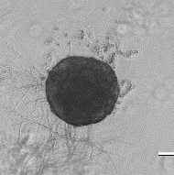
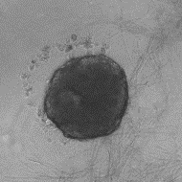
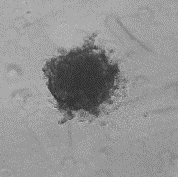
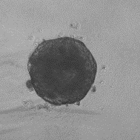
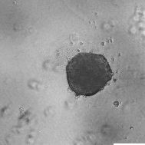
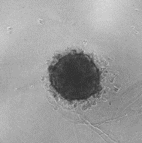
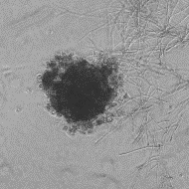
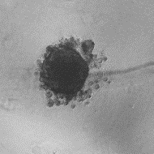
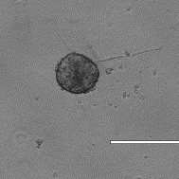
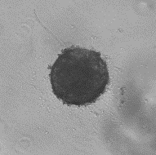
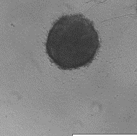
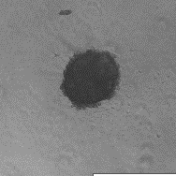
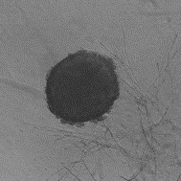
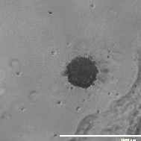
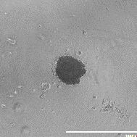
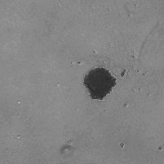
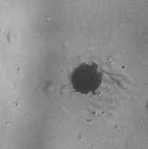
Targeting DNA double strand break repair in head and neck cancer cells with photons and protons
Day 3
Day 10
Day 10 + protons
Control
DMSO
ATMi
ATRi
DNA-Pkcsi
DMSO
ATMi
ATRi
DNA-Pkcsi
UMSCC74A
UMSCC6
UPCI-SCC090
ATMi
ATRi
DNA-Pkcsi
UMSCC74A
DMSO
Inhibitor
  Vitti and Parsons (2020) Cancers
IR
Inhibitor+IR

