Slide 1


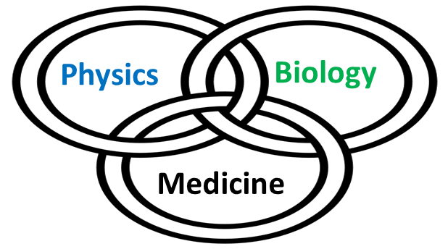
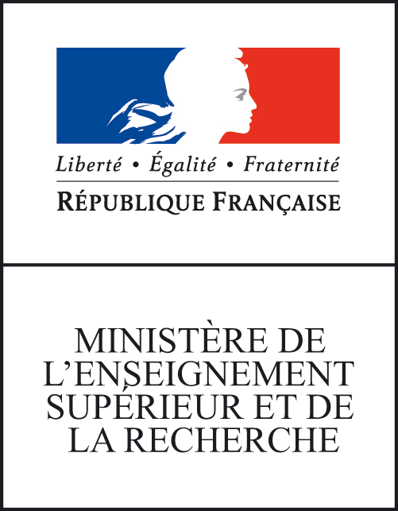



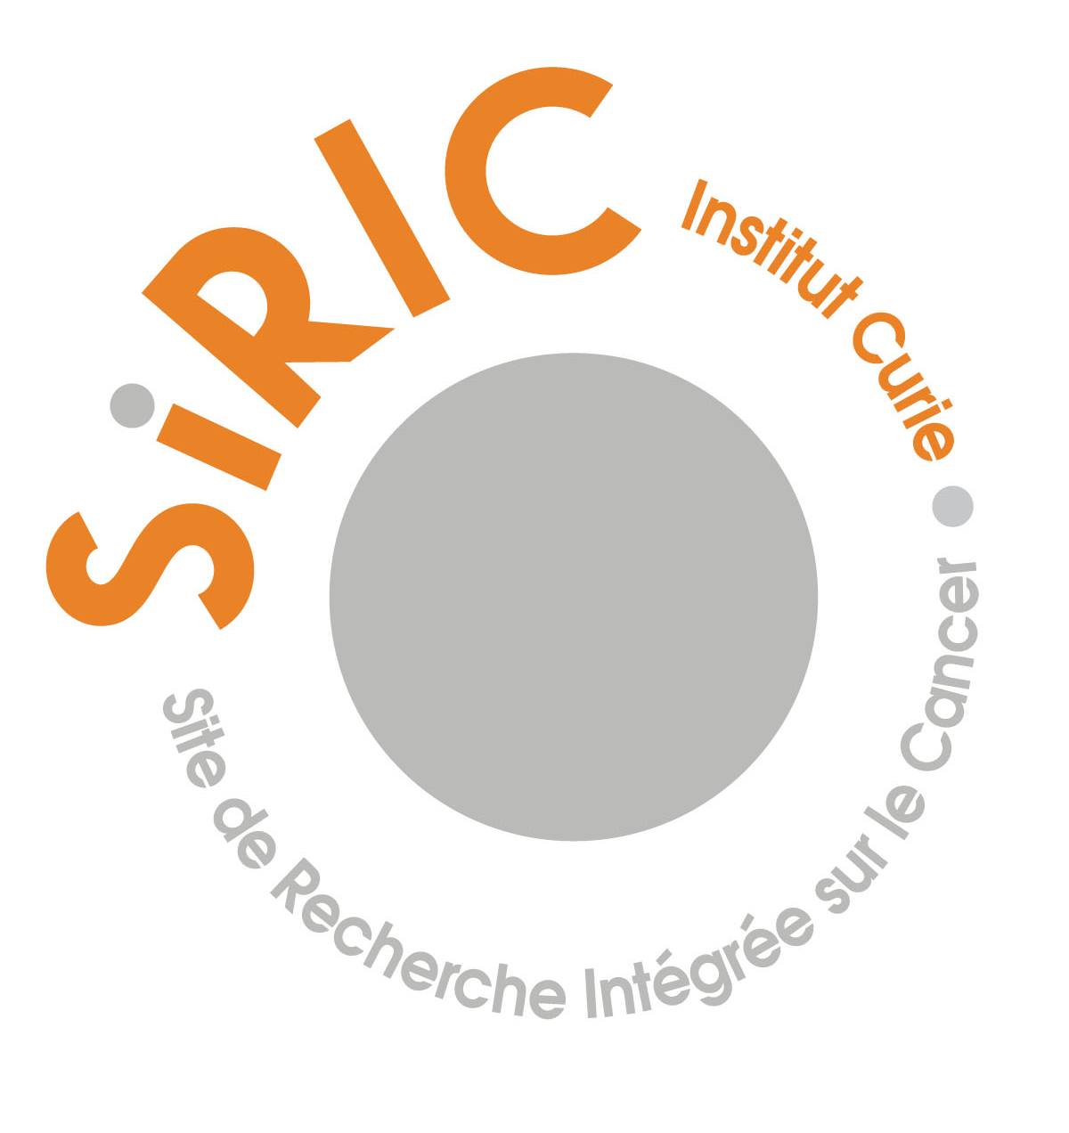

Yolanda Prezado
New approaches in radiation
therapy

Slide 2
Radiotherapy (RT)
Medical use of ionizing radiation for treatment of cancer and some other types of benign lesions, like arterious-venous malformations.
Example of a rapid technological transfer
  1895: Roentgen discovers X-rays
  1895: First RT treatment (recurrent breast cancer,
  Grubbe, Chicago)
  1896: Stomach cancer treatment (Freund, Viena).
At least 50 % of all cancer patients will receive radiotherapy at some stage during the course of their illness (Delanay et al., 2005).

Slide 3
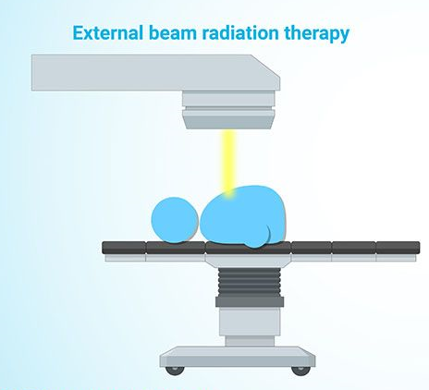

Radiotherapy types

Slide 4
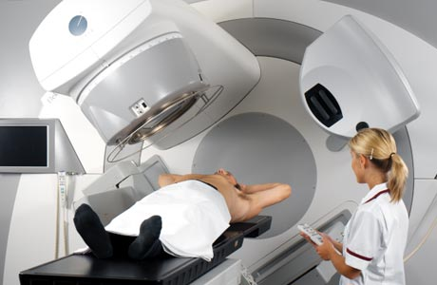
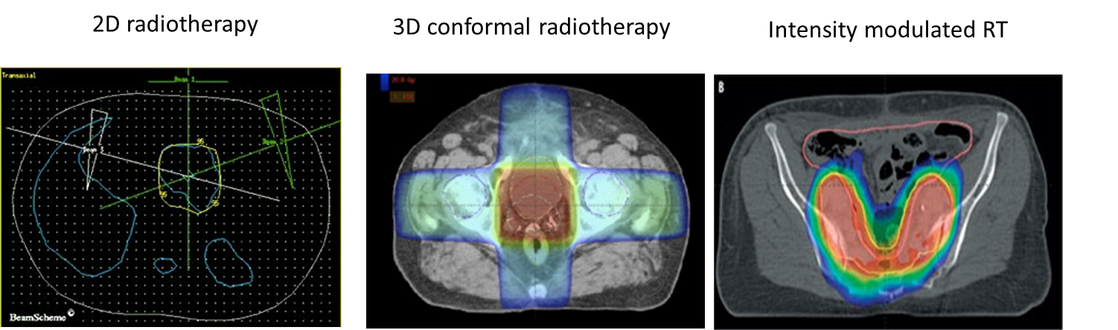
External radiotherapy
Medical lineal accelerators (RF)
Mainly 6 and 18 MV photons.
“Large field sizes” (several squared cm)
& homogenous dose distributions
Temporal fractionation of the dose
Dose rates around 2 Gy/min
2 Gy/session, 1 session/day,
5 sessions per week, 5-6 weeks
Notes:
Algun video?

Slide 5
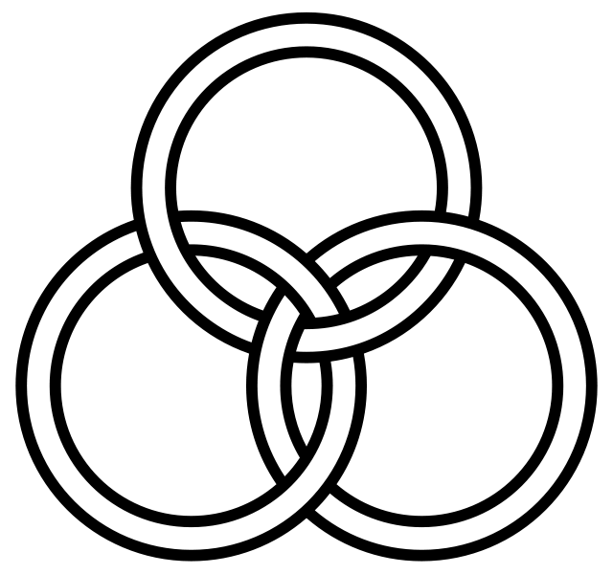
New approaches in Radiotherapy: why?
Radiotherapy is one of the most important methods for cancer treatment.
Remarkable technical advancements BUT the same few temporal and spatial dose distributions
Main limitation in radiotherapy : normal tissue tolerances
Unsatisfactory treatment of radioresistant tumors (i.e. gliomas)
& pediatric cancers
Physics
Biology
Medicine

Slide 6

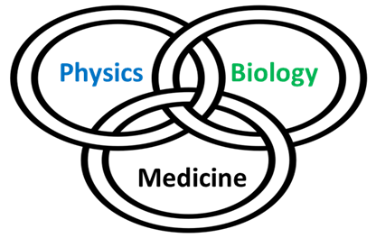
Rethink radiation therapy

Slide 7
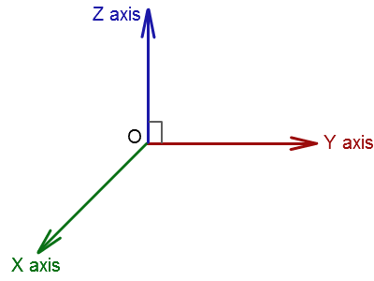
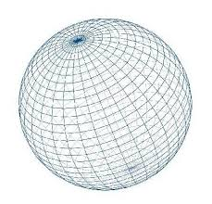
Using physics to modulate the biological response
Time
Homogeneous dose distributions
Large field sizes
Mostly photons
Time fractionaction: 2 Gy/fraction,
1 fraction/day, 30-35 fractions
Standard RT
Space
Energy/particle

Slide 8
Using physics to modulate the biological response
Time
Standard RT
Space
Energy/particle

Slide 9

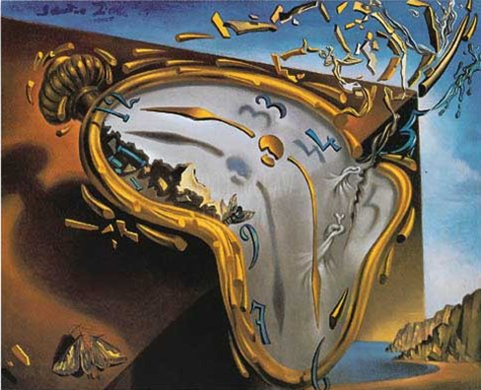
Temporal fractionation of the dose
Common scheme: 2 Gy/session, 1 session/day, 5 days week, 5-6 weeks
Tumor control
Normal tissue preservation
– Reoxygenation
– Reassortment
– Repair of sublethal damage
– Repopulation of cells

Slide 10
Temporal fractionation of the dose
Other schemes being explored
Hypofractionation (higher doses-less days)
benefit for some prostate, breast, lung cancers
Hyperfractionation (lower doses, twice per day, more days)
advantageous for some head-and-neck and cervical squamous cell cancers
Continuous hyperfractionated accelerated radiation therapy (three small sessions per day)→ used to treat lung cancer
TIME MATTERS

Slide 11
High single dose can estimulate immune system
High single dose radiation (30 Gy) increases CD8⁺ T cells in the stroma of tumors with induced remissions
BALB/c mice. CT26 & MC38 colon tumors
Baker et al, Clin. Cancer research 2015

Slide 12
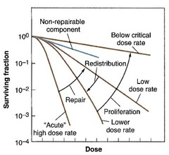
Dose rate
In general dose rate cells killing (time to repair)
However, in some cases of low dose rates→ inverse dose rate effect.
No systematic evaluations performed at very high dose rates.
Notes:
MEJORARLAAA

Slide 13
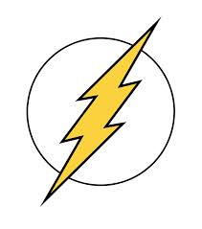
Time: Dose rate
FLASH irradiation the dose is given at ultrahigh dose rate (> 40 Gy/s)
Differential effect tumor-healthy tissues
    Equivalent tumor control to standard RT
    Significantly reduces side effects in
    normal tissues.
    The advantage of Flash radiotherapy confirmed in mini-pig
    and cat-cancer patients. Clin. Cancer Research 2018.
    Main challenge: dosimetry with ultrahigh dose rate
Favaudon et al. 2014

Slide 14
Using physics to modulate the biological response
Time
Standard RT
Space
Energy/particle

Slide 15
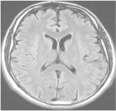
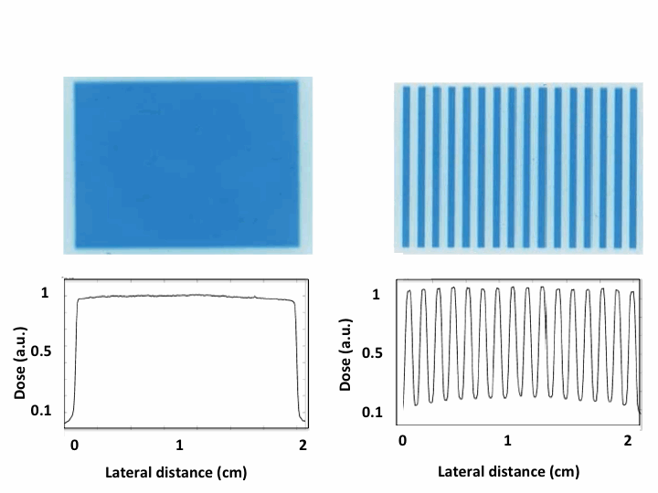
Addressing a clinical need with a new paradigm
Standard radiotherapy
Spatial fractionated radiotherapy
x-rays minibeam radiation therapy
Large beam sizes
(> 1 cm²)
Homogeneous
dose distributions
Narrow beam sizes spaced by areas of low dose
+
Heterogeneous distributions
< 1 mm
+
> 1 cm
1-2 mm

Slide 16
Addressing a clinical need with a new RT paradigm
Standard RT
Spatial fractionated radiotherapy
x-rays minibeams radiation therapy
Large beam sizes
(> 1 cm²)
Homogeneous
dose distributions
< 1 mm
> 1 cm
+
1-2 mm
Distinct biological mechanisms not yet understood
Remarkable increase of normal rat brain resistance.
Dilmanian et al. 2006, Prezado et al., Rad. Research 2015
Dose escalation in the tumor possible→ higher tumor control

Slide 17
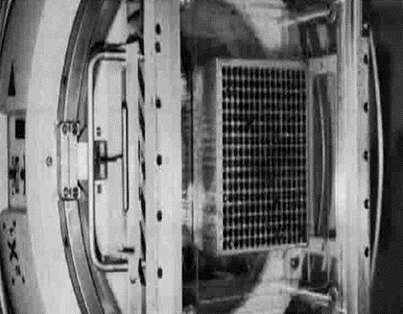
The GRID approach
1909 Alban Köhler used a “perforated screen” in orthovoltage machines→ Skin toxicity reduction
GRID therapy with megavoltage radiation beams (LINACS)
Mainly for palliative treatment of bulky, massive tumors
Beam widths ≥ 1 cm²
Single fraction 15-20 Gy
TNF-α induction (Sathishkumar et al, 2002)
Meigooni et al, Med. Phys. 2006

Slide 18
The GRID approach
LINAC-based GRID therapy: “limits”
-Relative small output→
Beam sizes > 1 cm²
-Important scattering of MV beams →
Small peak-to-valley dose ratio: 2 to 5
(high PVDR favor tissue sparing)

Slide 19

Moving forward

Slide 20
Moving forward

Slide 21
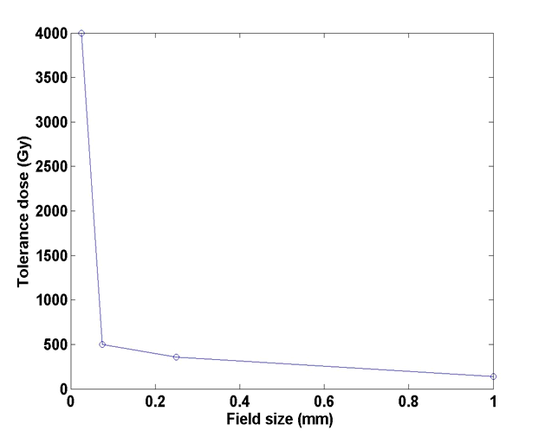
Playing with the beam size
Dose-volume effect: the smaller the field size is, the higher the tolerance
Zeman et al., Science (1959)

Slide 22
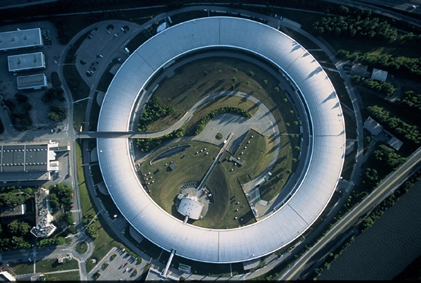
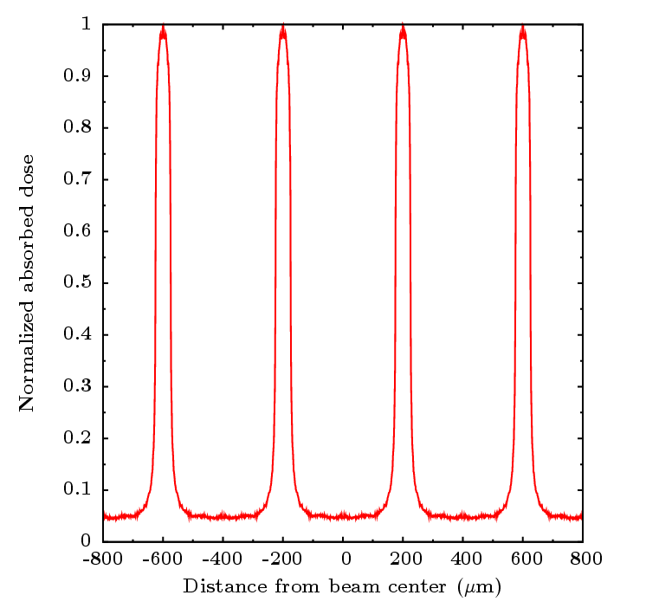
Synchrotron micro and minibeam radiation therapy
The medical beamline ID17
White beam dose rate 10000 Gy/s
Negligible divergence
Low Energy X-rays
~ 300 m
European synchrotron radiation facility

Slide 23
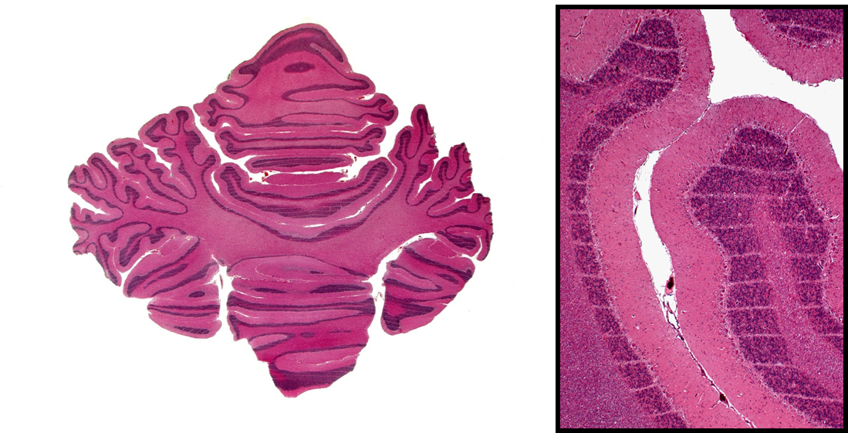
Microbeam Radiation therapy
MRT uses 50 µm-wide beams, spaced by 400 µm
Slatkin et al. Med. Phys. 1992
Differential effect normal tissue versus tumor observed in animal experiments
Normal (brain) is able to withstand
more than 300 Gy/one fraction
Tumor control effectiveness in glioma-bearing rodents
600 Gy
Laissue et al, SPIE 2001
Laissue et al, Int.J. Cancer 1998

Slide 24

Drawbacks of MRT
Requires extremely high dose rates
Scarce beamtime at synchrotrons
Difficult realization of clinical trials
Not favourable dosimetry (low-energy X-rays)
High doses to control tumors 300-600 Gy.
Good compromise: Minibeam radiation therapy
Dilmanian et al., PNAS 2006

Slide 25
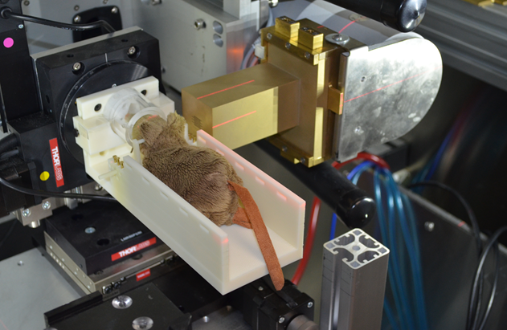
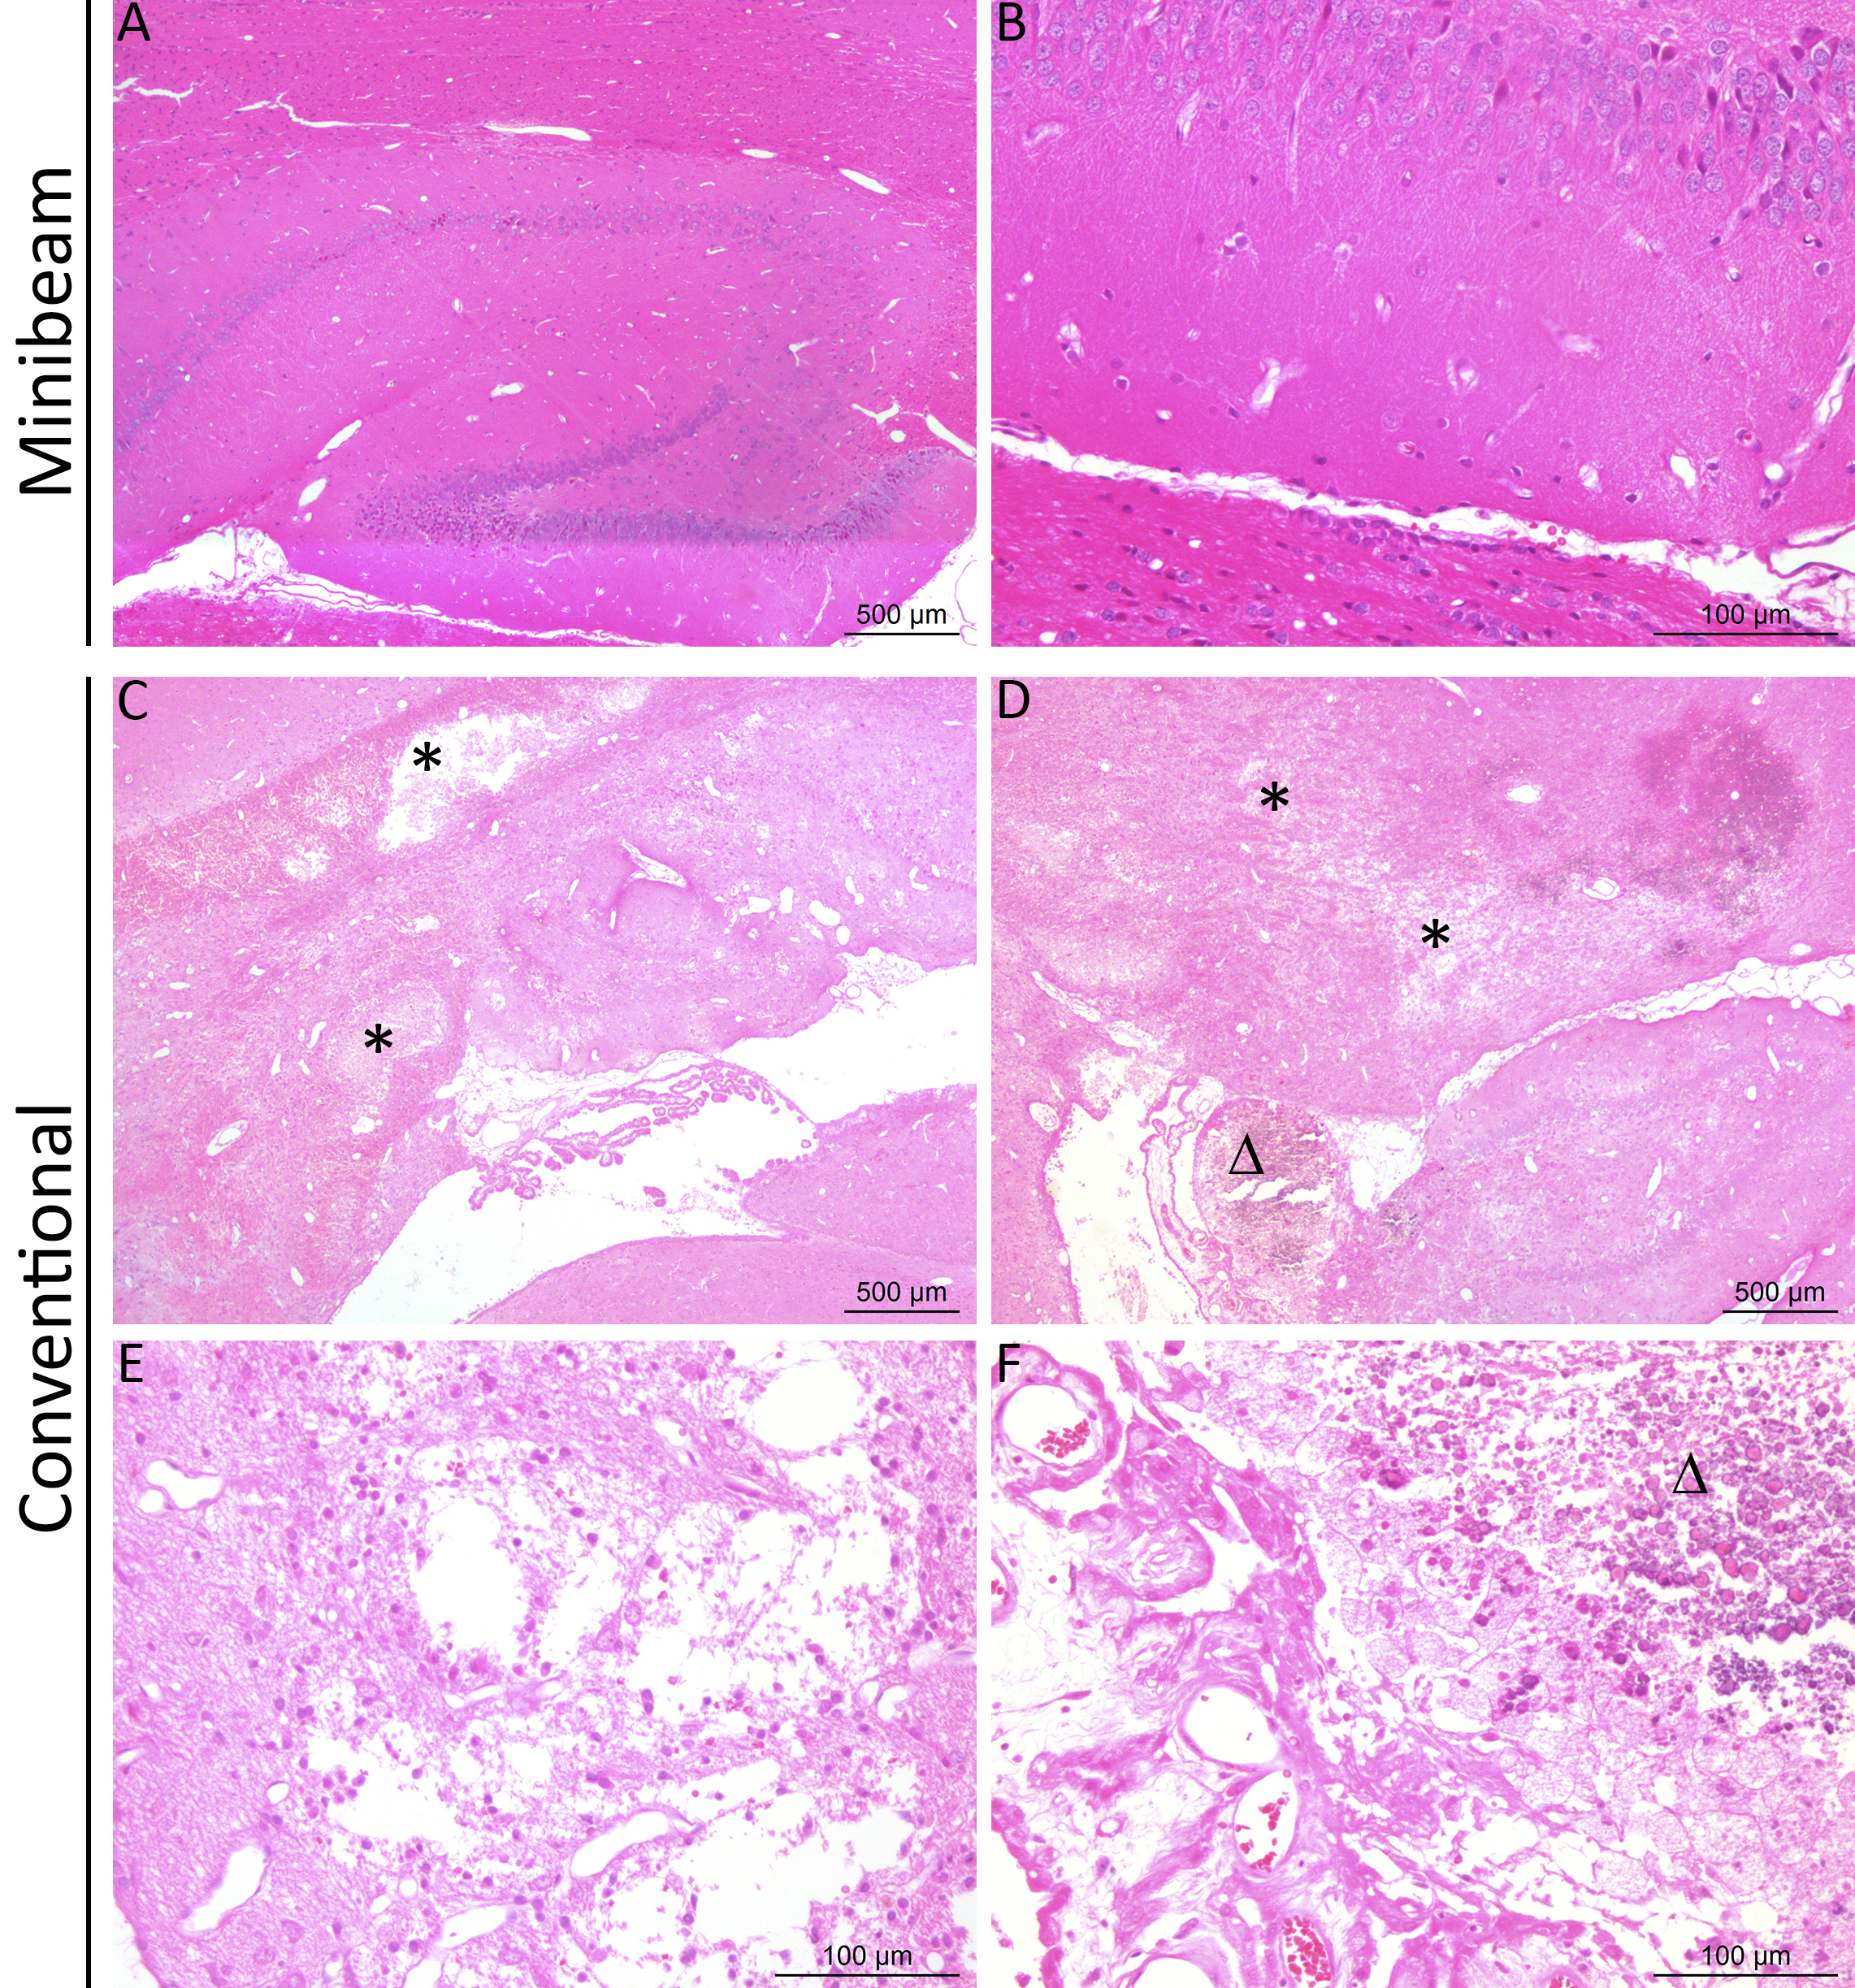
Minibeam radiation therapy: a good compromise
Beam widths: 500-700 µm → transfer to low cost equipment possible
Prezado & Dos Santos et al. Scie. Reports 2017
Proof of concept
Gain in normal tissue tolerances
Whole rat brain irradiation (20 Gy average)
Tumor control effectiveness
F98 glioma-bearing rats
25
25

Slide 26

Moving forward…
Proton minibeam radiation therapy (PROTONMBRT)

Slide 27
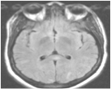
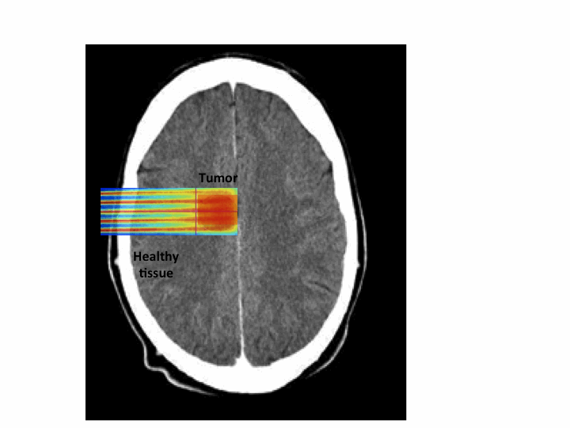
PROTONMBRT: an innovative therapeutic approach
Minibeam radiation therapy
Protons and their specific physics and biology
Proton minibeam radiation therapy
Prezado et al. Med. Phys.2013
Tumor
First implementation worldwide at a Orsay proton therapy centre (I. Curie)
(Peucelle, Martinez,… and Prezado, Med. Phys. 2015)

Slide 28
PROTONMBRT
Proof of concept

Slide 29
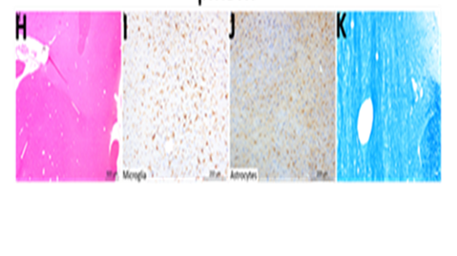
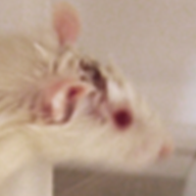
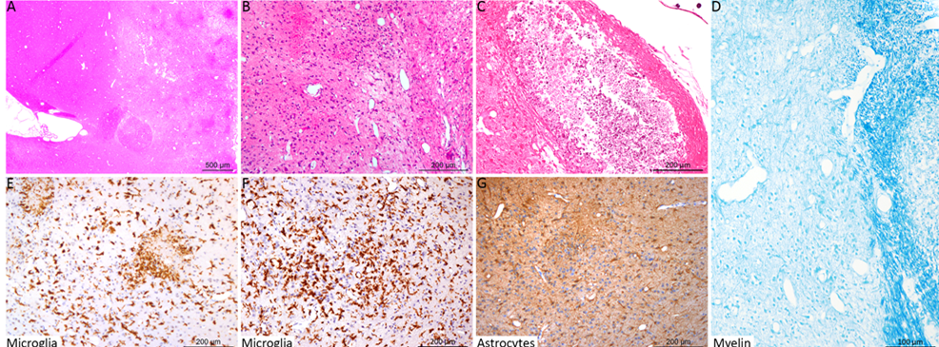
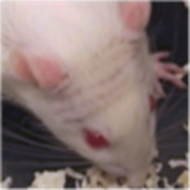
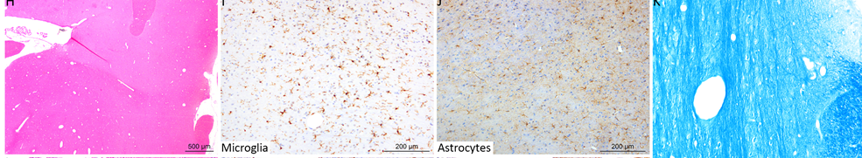
Proton minibeam radiation therapy spares normal brain
First evaluation of normal brain response (Prezado et al. Scie. Rep. 2017)
Whole brain irradiations (normal rats, 7-weeks old). Long-term follow up (6 m)
Standard PT (25 Gy/one fraction)
pMBRT (25 Gy average dose-
58 Gy peak dose/one fraction)
VERSUS
Skin: moist desquamation
Permanent epilation
Important brain damage
No skin damage
Reversible epilation
No brain damage observed
No cognitive effects observed
NET REDUCTION IN NEUROTOXICITY

Slide 30
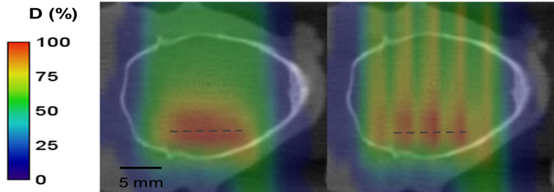
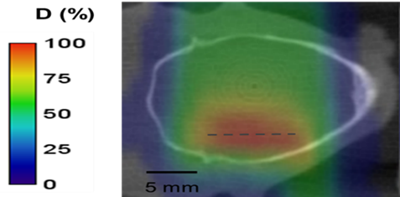
Tumor control effectiveness in glioma (RG2) bearing rats
Standard PT
Tumor
pMBRT
pMBRT → 67 % of long-term survivals (free of tumor).
Among the best results ever obtained with radiotherapy alone
Prezado et al., Red Journal 2019
Tumor
25 Gy/one fraction

Slide 31
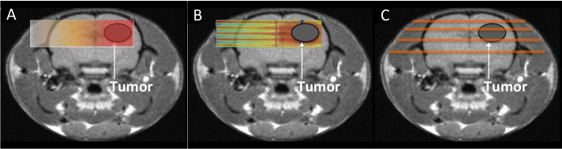
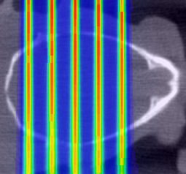
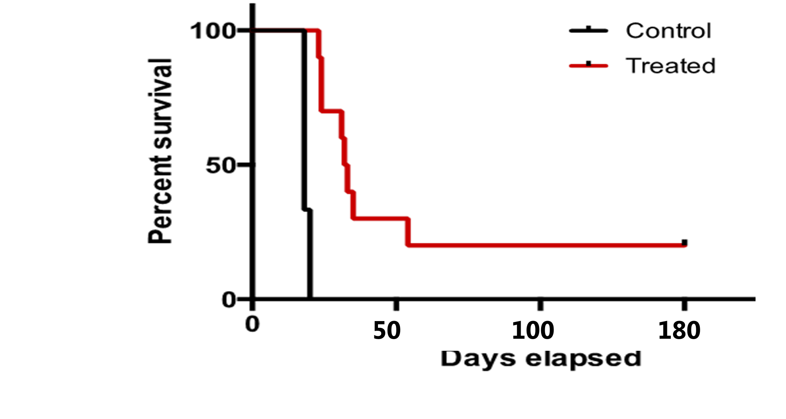
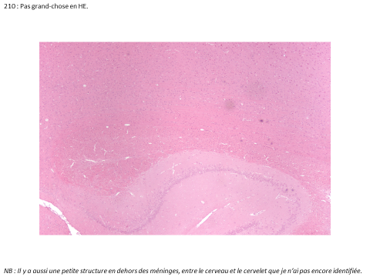
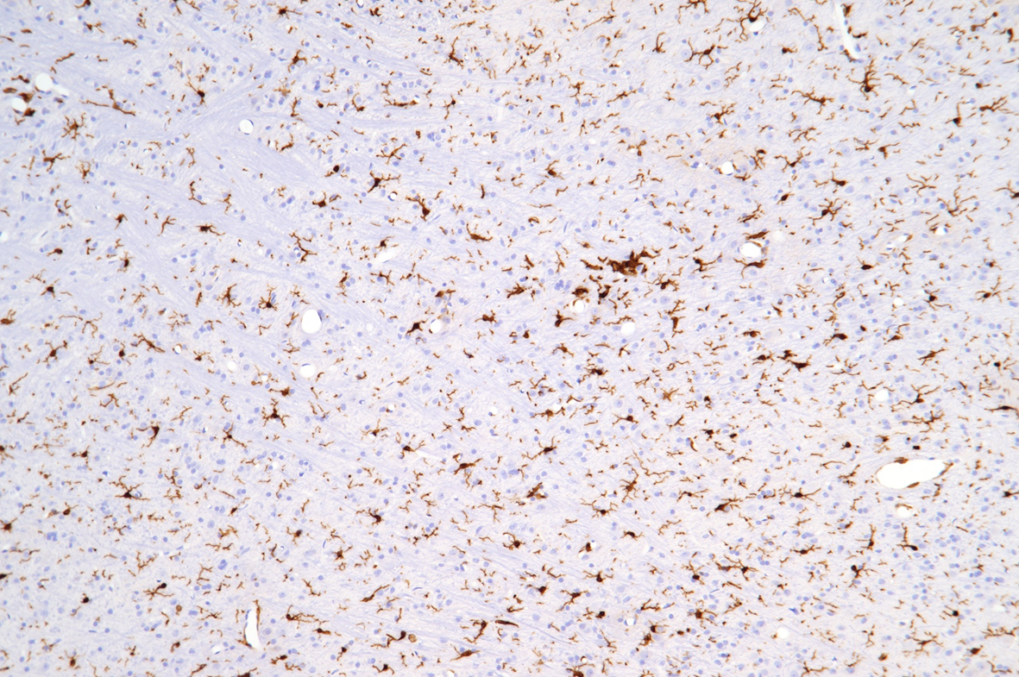
pMBRT provides tumor control even with highly heterogeneous dose distributions
INHOMOGENOUS dose distribution
70 Gy in the peak → 30 Gy average
Whole brain irradiation, 8 days after implantation (n=10)
Without significant toxicity
Prezado et al. Scie. Reports 2018

Slide 32
Proton minibeam radiation therapy widens the therapeutic window for gliomas

Slide 33

Short term objectives (3-5 years)
To reach Phase I/II clinical trials
PROTONMBRT
Proof of concept in
small animals
Clinical trials
ERC consolidator grant (2019-2024)
Generation of intense minibeams at a clinical center
Challenging dosimetry (extremely small field sizes)
Radiobiology
  -To find the physical parameters maximizing the therapeutic index
  -To unravel the biological mechanisms

Slide 34
PROTONMBRT
A novel radiotherapy concept to solve an urgent medical need
The increase of the tolerance doses of normal tissue by pMBRT offers
  Potential benefit for paediatric oncology → Reduced risk of complications
  Allows dose escalation → Efficient treatment of radioresistant tumors
  Cost reduction:
  -pMBRT enables hypofractionation schemes
  -Reduced requirements of targeting
  Reflection on first I clinical trials

Slide 35
Moving forward…
Heavy ions minibeam radiation therapy

Slide 36
Heavy ions MBRT: Advantages
Reduced MSC →high PVDR in normal tissue
Narrow beams possible (500 µm)
Gonzalez, Peucelle and Prezado, Med. Phys 2017
Possible synergies of MBRT effects with the higher capacity of ions to inhibit angiogenesis and activate immune system

Slide 37
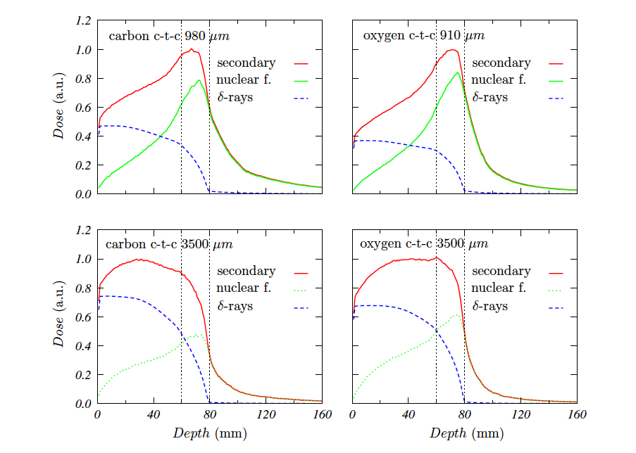
Heavy ions MBRT: impact on valleys
Large beam spacing (ctc) minimize
the contribution of high LET fragments to the valleys
Heavier fragments
are dominant in the valleys at the target position, which might favor tumor control.
Tumor
Larger Beam spacing
Tumor
Gonzalez, Peucelle and Prezado, Med. Phys 2017

Slide 38
Heavy ions MBRT: disentangling molecular and cellular effects with infrared microspectroscopy
U87 cells irradiated with Carbon MBRT or conventional broad beams @ HIT
I. Martinez et al., in preparation

Slide 39

Very heavy ions MBRT
Ne, Si and Ar ions used in the past, extremely efficient for the treatment of hypoxic tumors (Castro 1994)
HOWEVER, abandoned due to important side effects in normal tissues
Our hypothesis
Very heavy ions (low OER) + MBRT (sparing of normal tissue)
Improvement of therapeutic index
Peucelle, Martinez and Prezado, Med. Phys. 2015

Slide 40
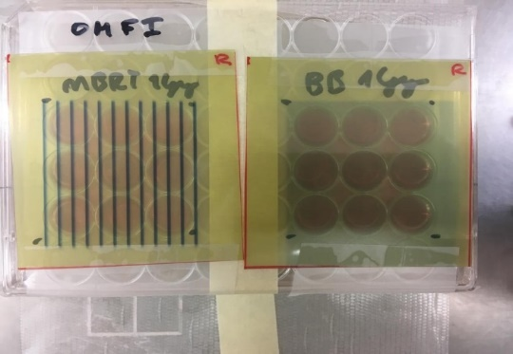
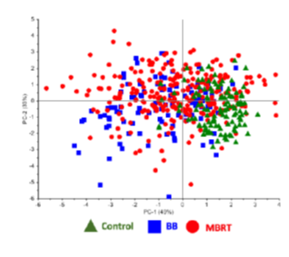
Ne ions MBRT at HIMAC (Japan)
BJ human foreskin fibroblasts irradiated with
230 MeV/A Ne ions
First results indicate higher DNA damage in standard RT (infrared spectroscopy)
Different cytokine expression (ongoing analysis)
First in vivo experiment planned January 2020
Notes:
Exper HIMAC

Slide 41
Using physics to modulate the biological response
Time
Standard RT
Space
Energy/particle

Slide 42
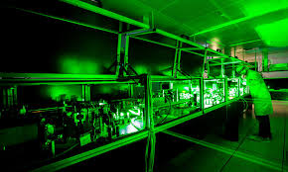
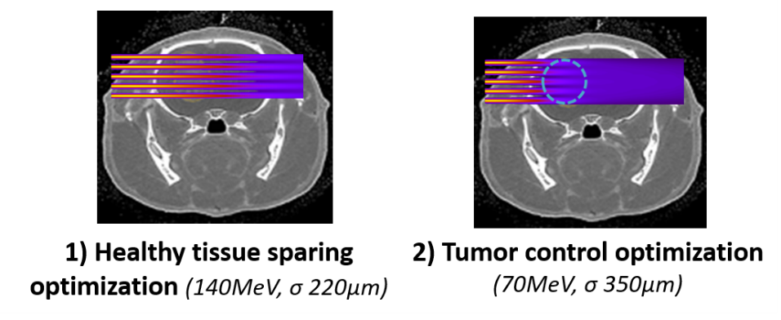
Very high energy electrons (VHEE) therapy
VHEE therapy (70-250MeV) is considered as a potential cost-effective approach to improve cancer treatments.
Collaboration with Laser-LOA
VHEE grid therapy approach
Martinez, Fois and Prezado, Med. Phys. 2015

Slide 43
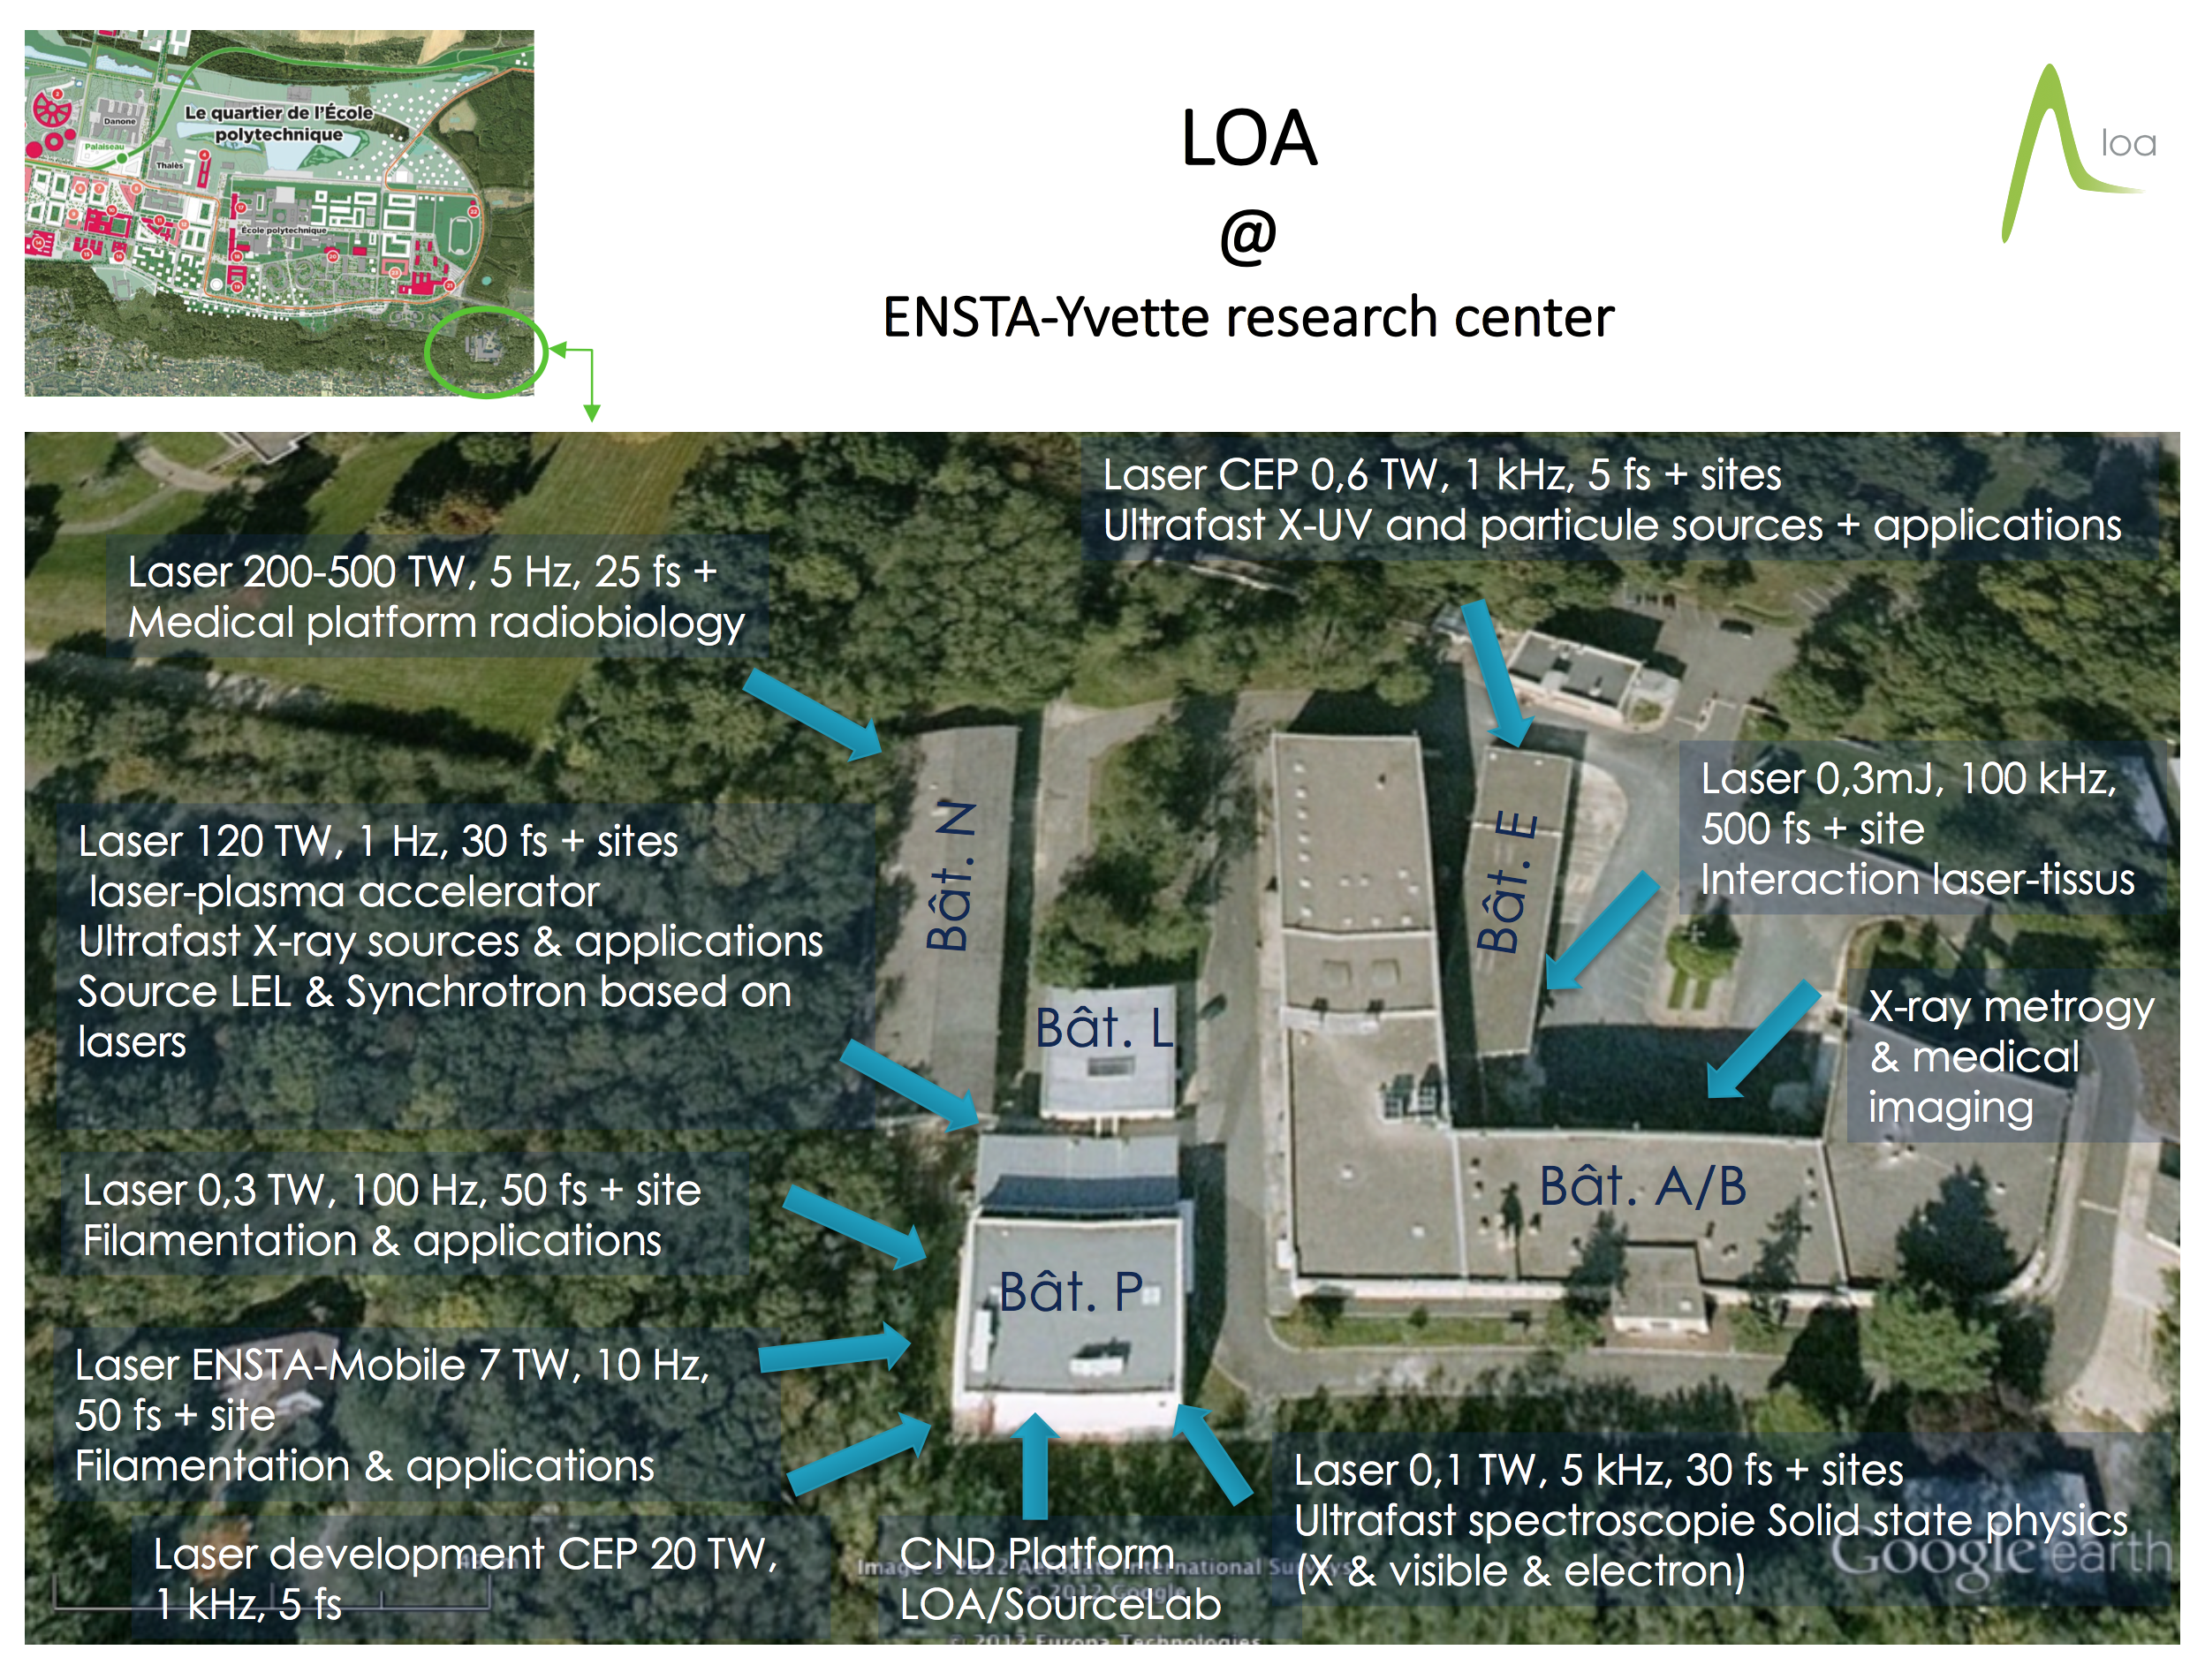

Slide 44

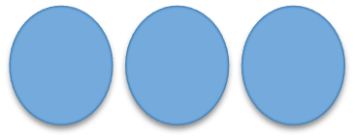
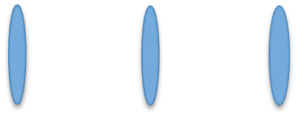
Dose rate effects: FLASH
Impact of different beam structure and energy on FLASH effect:
Laser-LOA
Oriatron-
Inst. Curie
0
7 MeV
70 MeV
300 MeV
µs
fs
Bunch width
Repetition rate

Slide 45

Final reflections
The dose delivery method may have an important impact on biological response.
Not need to deposit a lethal dose in each of the tumor cells to kill it.
Non-targeted effects can play a major role in RT treatments
Charged particles (p, heavy ions) allow to fully profit from the advantages of spatially fractionated radiotherapy

Slide 46
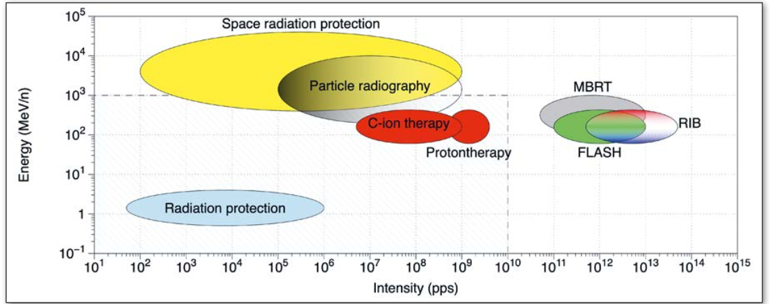
International Biophysics collaboration
Why?
  New accelerators under construction worldwide, very expensive facilities who plan biomedical research.
  Important to coordinate the efforts to avoid duplications and instead have synergistic interactions for biomedical research
New beams: higher energy, higher intensity, different beam structure

Slide 47
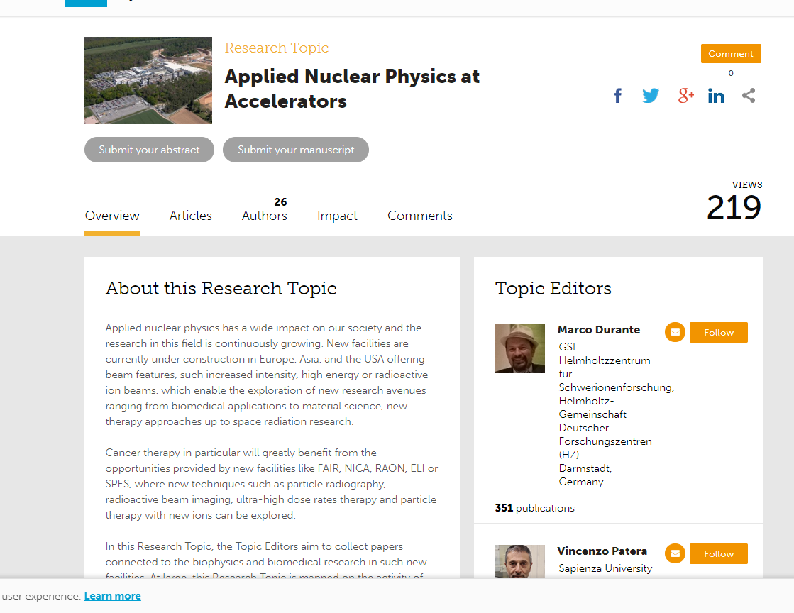
Frontiers in Physics: research topic issue
Recruiting papers

Slide 48
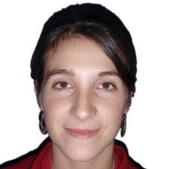


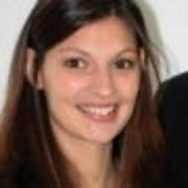

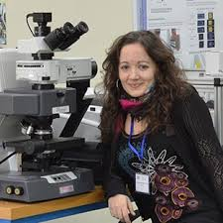
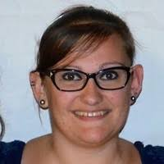



NARA team
Acknowledgments
C. Guardiola
C. Lamirault
R. Delorme
T. Schneider
I. Martinez
M. Dos Santos
J. Bergs
C. Peucelle
W. Gonzalez
Biology Service of IMNC: M. Juchaux

Slide 49




Acknowledgments
Institut Curie
Institut Pasteur
G. Jouvion
D. Hardy
Orsay Proton
therapy Center
A.Patriarca
L. De Marzi
C. Nauraye
R. Dendale
E. Hierso
Experimental RT
platform
F. Pouzoulet
D. Labiod
C. Roulin
IR4M
C. Sebrie

Slide 50
Thank you very much for your attention!
yolanda.prezado@curie.fr

