Slide 1
Development of side-coupled linacs for radiotherapy at Lancaster University
Prof Graeme Burt, Lancaster University / Cockcroft Institute
Thanks to STELLA and Probe Collaborations

Slide 2


Slide 3
Need by 2035 in Lower-Middle Income Countries
Globally 15 million (2015) to 25 million in (2035):
12,600 megavolt-class treatment machines
30,000 radiation oncologists
22,000 medical physicists
80,000 radiation technologists

Slide 4
Reality in numbers……
No radiotherapy in 36 countries
HIC have over 60% of all teletherapy machines and 16% of the world population
LIC and LMIC have less than 10% of teletherapy machines which serve 50% of the world
Around 70% cancer patients do not have access globally
Atun et al, Lancet Oncology. 2015

Slide 5
Current Global Challenge: how to go from no radiotherapy to high quality radiotherapy in Challenging Environments

Slide 6
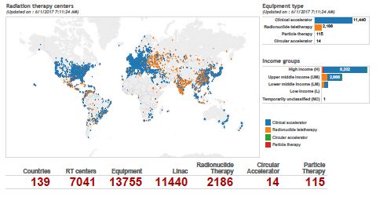
World wide radiotherapy coverage

Slide 7

2012

Slide 8


Slide 9
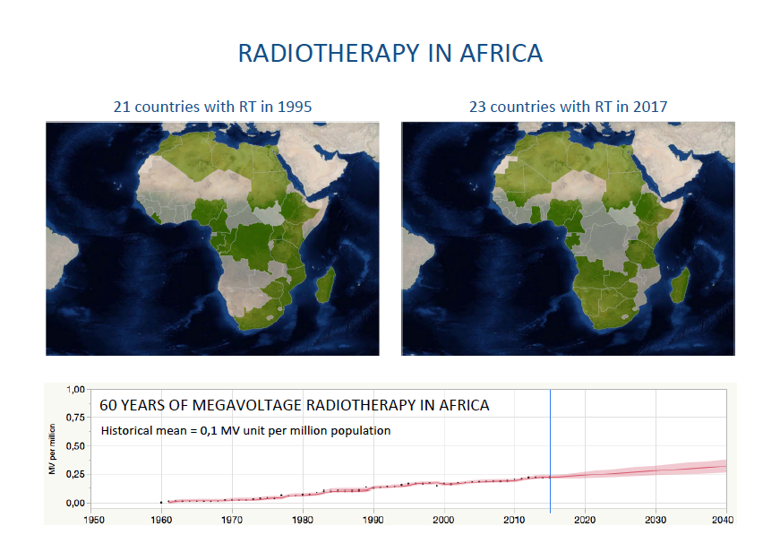

Slide 10
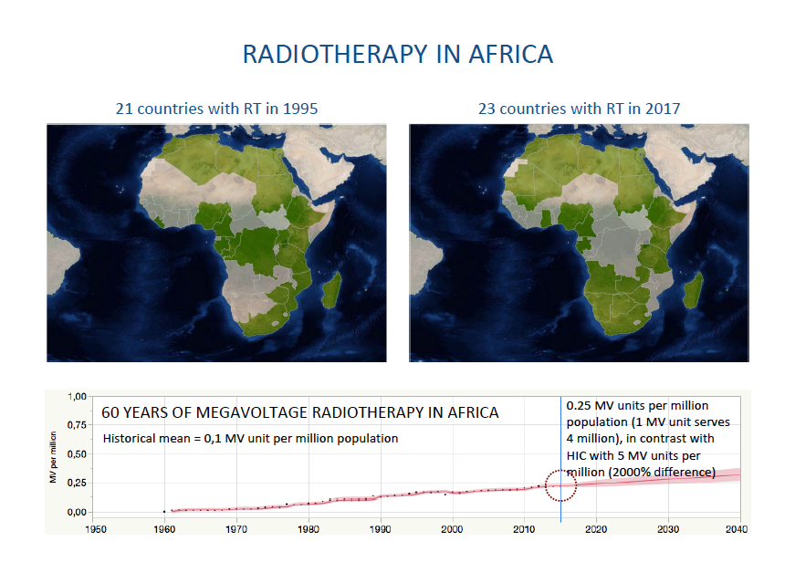
IAEA, 2017

Slide 11




1st workshop on:
“Design Characteristics of a Novel Linear Accelerator for Challenging Environments”
Norman Coleman, David Pistenmaa (ICEC) Manjit Dosanjh (CERN)
http://indico.cern.ch/event/560969/
European Organization for Nuclear Research (CERN)
International Atomic Energy Agency (IAEA)
James Martin Center for Nonproliferation Studies (CNS)
National Aeronautics and Space Administration (NASA)
National Nuclear Security Administration (NNSA)

Slide 12
1st Workshop addressed:
the role of radiotherapy in treating cancer in challenging environments such as in many low- and middle-income countries (LMICs) and the related security concerns of medical radiological materials,
the design requirements of linear accelerators and related technologies for use in challenging environments,
the education, training and mentoring of the sustainable workforce needed to utilize novel radiation treatment systems
the costs of and financing for the implementation of the recommendations from the workshop.

Slide 13



Outcome resulted in 3 Task Forces
Technology (“Bury the Complexity)
Develop optimal design requirements for a novel high-quality, lower-cost treatment solution that leverages existing linac technologies and incorporates intelligent software designed for robust operation in a range of challenging environments
Education, Training, and Mentoring
Identify 1) the education and training requirements for current as well as future radiotherapy equipment and treatment systems worldwide, 2) the current extent of education and training program resources and 3) the education and training needed to fill the gaps.
Global Connectivity and Development
Develop and implement a strategy for securing financial support in client countries as well as from governmental, academic and philanthropic organizations and individuals to insure success of the effort to make excellent near-term and long-term RT systems.
David Jaffray, ICARO 2017

Slide 14
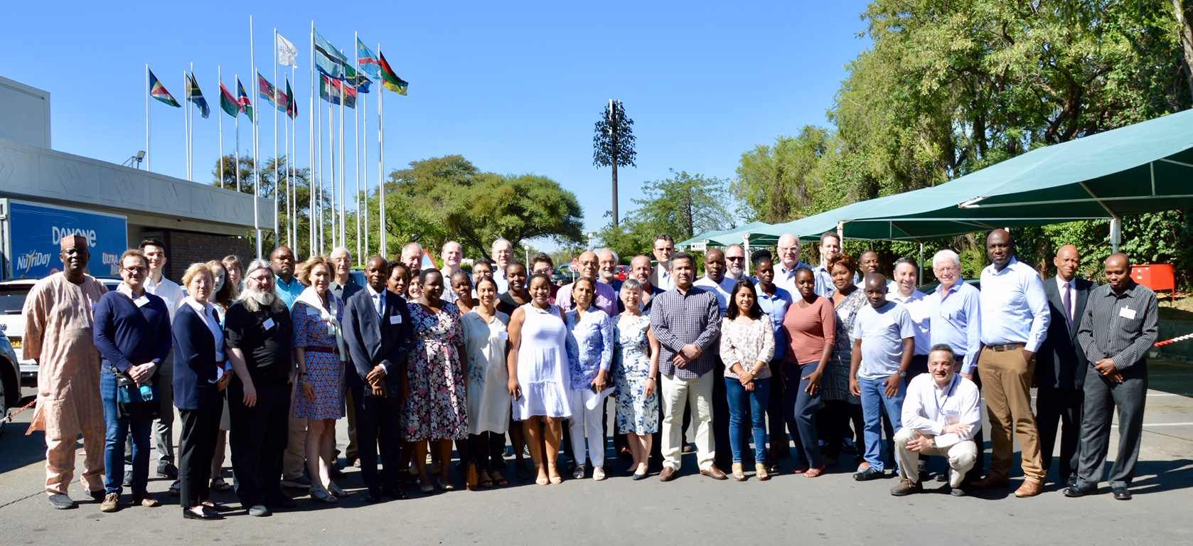
Meeting in Botswana: March 2019
Understanding problem together with discussion, agreed strategy

Slide 15
Biggest issues in LMIC hospitals
Delays in repairs
Lack of funds for regular maintenance
Lack of trained engineer’s
Fluctuating electrical supply
Corruption
What isn’t wanted
Cheap, poorly made linacs
Reliability/Lifetime/ maintenance cost
What African clinicians really want
Capital Cost
Performance
Where everyone in the West thinks African’s prioritise

Slide 16
Component lifetime: Varian Unique
Component | Lifetime [years]
Machine | 10
Thyratron | 3
Ion chamber | 15
Accelerator structure | 10
Magnetron | 5
Field light | 1
aSi portal imager | 7
Source:
http://www.medwow.com/med/linear-accelerator/varian/unique/51445.model-spec
We have been informed (anonymously) from a western hospital that the main problems with the linac resulting in downtime are with the vacuum, and IT (treatment planning) system. The main RF failures relate to the gun and magnetron, but are rare and mostly fairly minor repairs. The main failures relate to moving parts (MLC, gantry bearings etc).
Note: this may not be true for ODA recipient countries as they have different needs and environmental conditions (Hubert to give more information in the next talk)

Slide 17
Failure statistics (courtesy Sheehy Melbourne/Oxford)
But not all failures and repairs are created equal.
Nigeria has far longer repair times that in the UK, the repair hub is normally in a different continent or South Africa and maintenance is often not to the same standard
Interestingly Botswana which is a fairly affluent country and pay manufacturer warranty, service and repair has similar downtime but more faults
MLC has the most faults but diagnostics, RF and vacuum contribute to the largest downtime

Slide 18
Desirable features regarding LINACs designed for LICs
(Pomper MA et al. The Stanley Foundation, CNS, February 2016)
A developing-world LINAC with modular enhancements, as capability increases: an option for LINAC companies to consider.
Costs could be phased in by starting with a basic unit, and options could be provided for:
  new technology,
  remote diagnosis and adjustment,
  a long-term maintenance contract with the vendor.
David Jaffray, ICARO 2017

Slide 19
Improving Access to Radiation Therapy Globally
PROJECT STELLA
Smart Technologies to Extend Lives with Linear Accelerators
Notes:
Tecnologie intelligenti per estendere le vite con acceleratori lineari projetto per Migliorare l'accesso alla radioterapia a livello globale

Slide 20
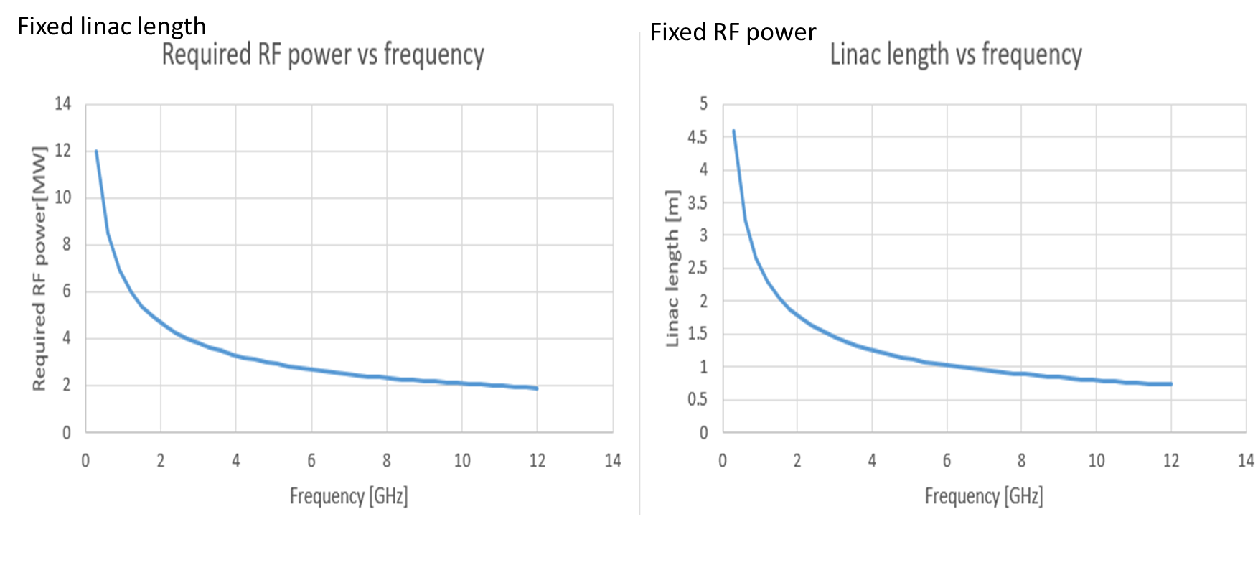
Scaling length and power with frequency
The surface resistance of a copper cavity increases with frequency square and shunt impedance drops with aperture faster at higher frequency, so you would imagine that lower frequencies are better
But the higher the frequency the shorter each cell is, hence the more cells you can fit in per meter
Shunt impedance is proportional to number of cells hence the shunt impedance scales with the square of the frequency and is proportional to length

Slide 21
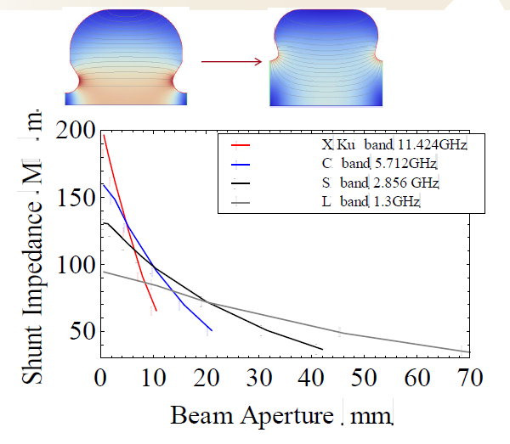
Higher frequencies
There are three issues however when increasing the frequency
The shunt impedance drops with the ratio of the aperture to wavelength, a/λ
Precision manufacturing 15 μm (3 GHz)
Diamond tipped lathes 5 μm (12 GHz)
This is related to frequency errors by the ratio to the tolerances to the wavelength, Δx/λ
This is the main limit on going to higher frequency linacs.
A good machine shop can get tolerance appropriate up to S-band (3 GHz), higher frequencies need more precision and therefore cost more (~400%).
Smaller sizes (higher frequency) means less surface area for removing heat (limits duty cycle)
From S. Tantawi

Slide 22
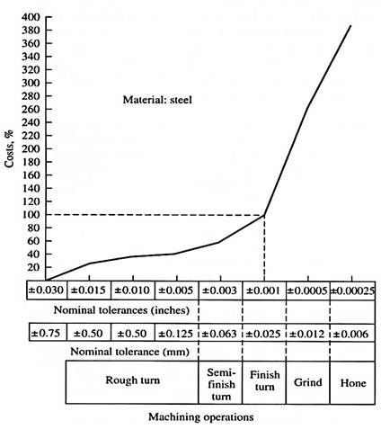
Cost for tolerances
Costs increase with tolerances for machining (showing for steel opposite but believed to be similar for copper)
C-band is 200% more expensive than S-band, X-band is 400% more expensive for machining only.
Open structures will recover some of this in brazing and tuning costs
Also for S-band you need a cheaper CMM metrology machine and brazing alignment is easier
C-band
6 GHz
S-band
3GHz
X-band
9 or 12 GHz

Slide 23
Travelling or Standing wave structures
Travelling wave
Linacs | Power no beam (MW) | Power inc Beam (MW) | Filling time (ns) | Length
X-band 2p/3 Cu | 2.55 | 3.35 | 199 | 0.3
X-band 5p/3 Cu | 2.6 | 3.4 | 208 | 0.3
X-band 2p/3 Al | 3.3 | 4.1 | 178 | 0.3
X-band 5p/3 Al | 3.5 | 4.3 | 181 | 0.3
C-band 5p/3 Cu | 4.4 | 5.2 | 313 | 0.3
S-band 2p/3 Cu | 5.3 | 6.1 | 405 | 0.3
The Varian ring gantry has a 30cm RF structure so we know that works. The total linac length including everything is 65cm so that would be the max if everything else was zero length.
Compact Klystron is 3 MW, magnetron is 2-3MW and large klystron is 6 MW at X-band.
Future compact S-band klystrons will reach 6 MW and magnetron is 7 MW.
Travelling wave
Assuming a 30cm structure, 8 MV only copper X-band and S-band are feasible for ring gantries using TWS but at reduced beam current.
Essentially TWS are only better if long structures can be used.
Standing wave
f | Rs/L (Mohm/m) | Power | Power with beam | N | Length
3 | 93.4 | 1.28 | 2.08 | 6 | 0.3
6 | 115 | 1.04 | 1.84 | 12 | 0.3
9.3 | 123 | 0.97 | 1.77 | 18.6 | 0.3
Standing wave
Unlike the TWS all options are feasible at 30 cm (this is why all current ring gantry RTT machines use TWS
However will need a circulator and cannot use a pulse compressor

Slide 24
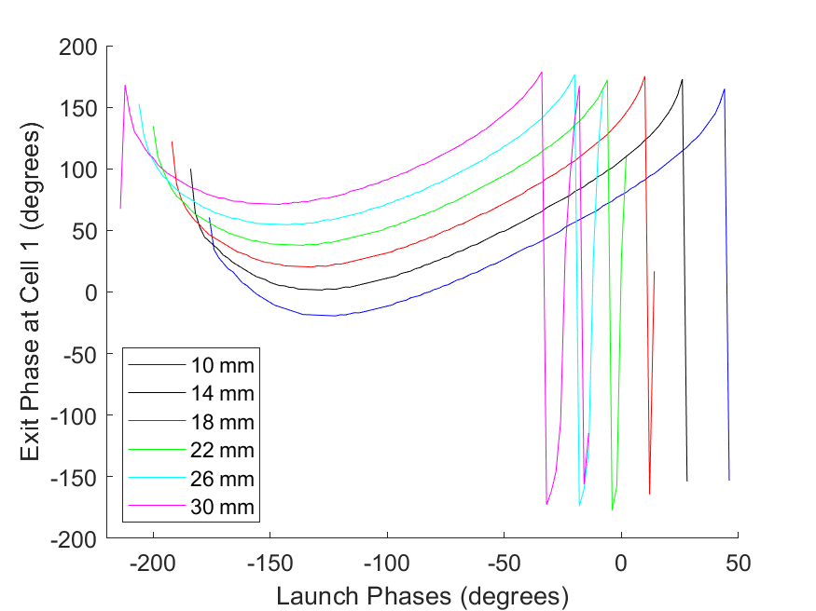
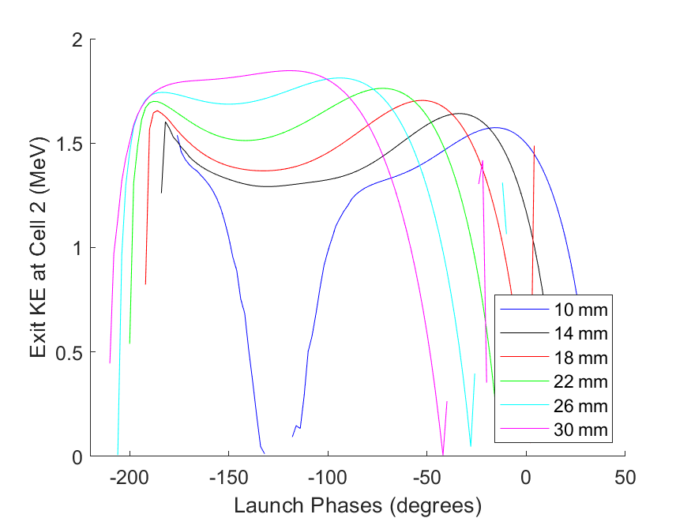
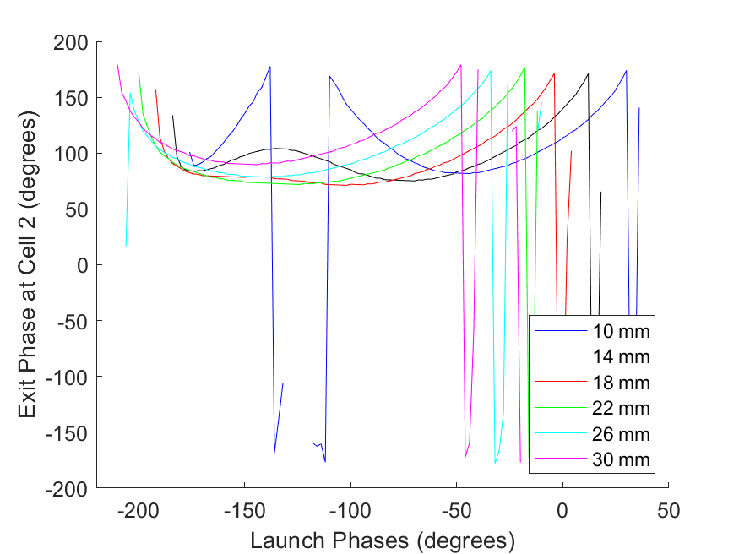
Optimisation of cell length
The linac needs to first bunch the electrons into bunches then accelerate. This process is typically inefficient and 1/3rd of electrons are lost on the linac walls.
We have developed a new code to optimise this to reduce wall losses (also in parallel looking at short pulse guns, see Deepa’s talk)
Borrow a concept from klystron design (from Igor at CERN) by looking at arrival/exit time functions.
Can optimise the arrival function for each cell 1 by one.
Ideal bunch has exit phases for all electrons within 40 degrees of each other.
The first cell see’s electrons at all phases so it bunches at the zero crossing (when field flips from + to -)
We can they vary the cell length to ensure the bunch arrives at the 2nd cell at the ideal phase.

Slide 25
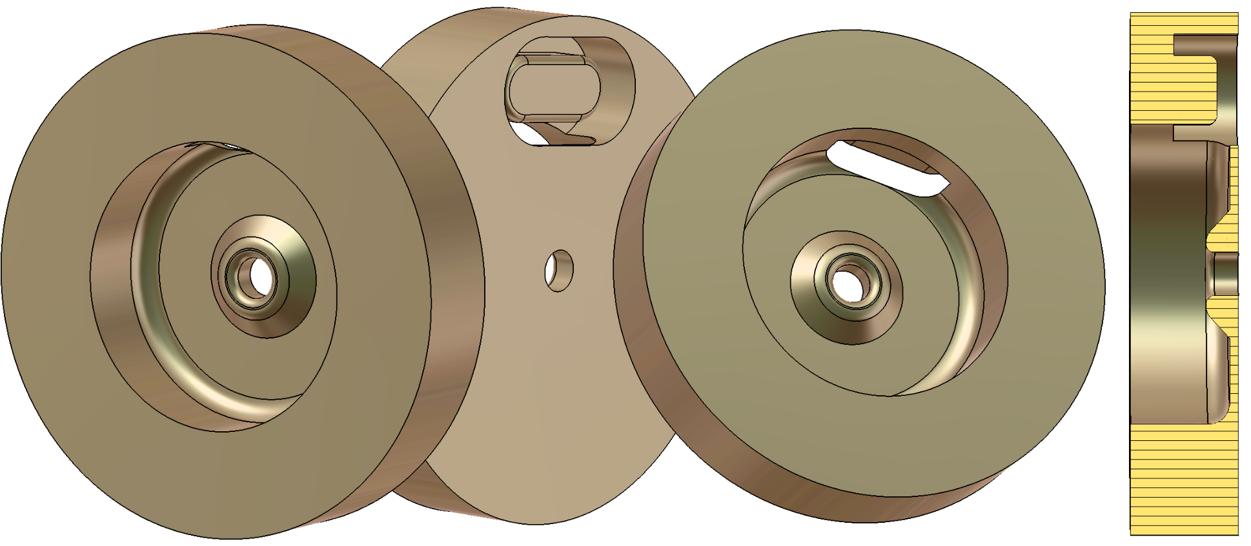
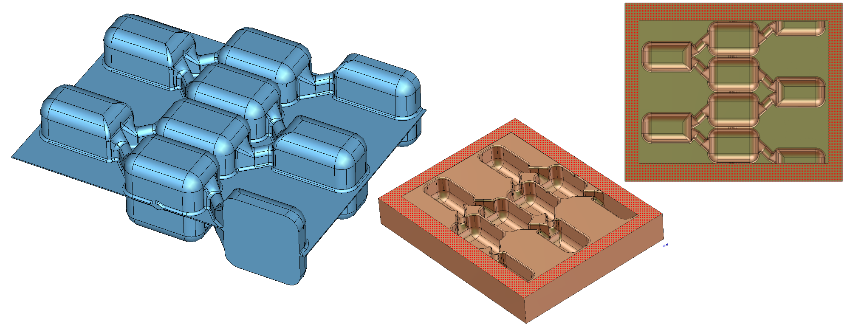
Manufacturing options: Milling in Halves
Normally each cell is made in 2 parts plus 2 parts for the coupler. This is a lot of parts which increases cost
Each part must be carefully aligned in the lathe/milling machine when machined
Alignment when stacking to braze must also be done with care
Making in two halves could simplify manufacture and reduce costs
Studies on open structures at CERN found leaving a small gap between the two halves is better for structure conditioning

Slide 26
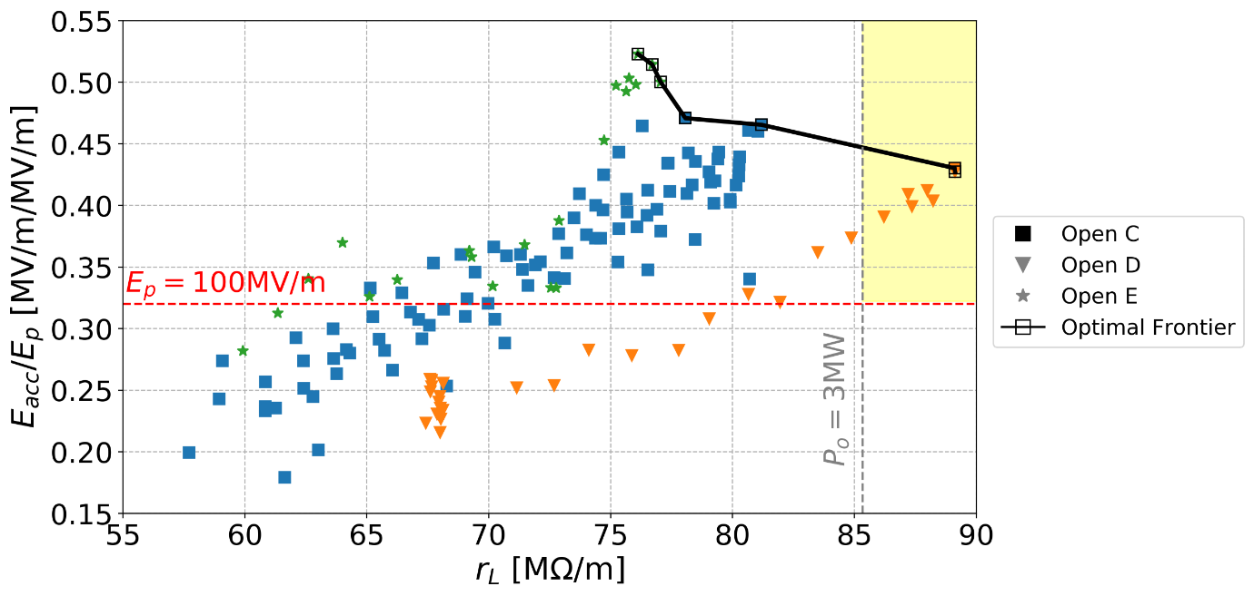
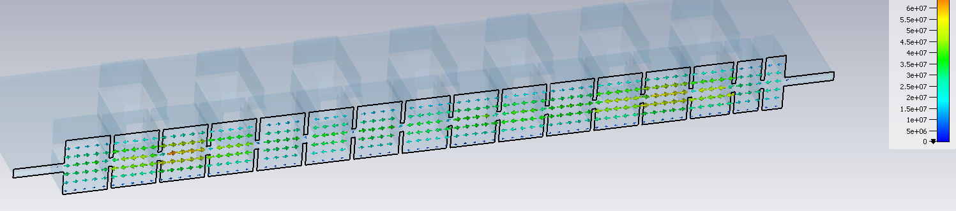
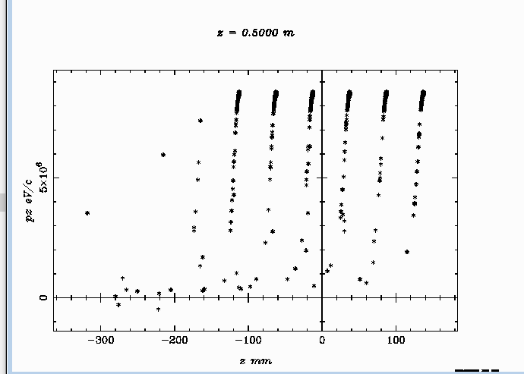
C-band 8 MeV design
Emax on axis = 60 MV/m
Power required = 2.66 MW so can use a small and cheap magnetron, or the smaller C-band klystron
Gradient = 24 MV/m
70% of electrons captured giving more dose than S-band system
Can be optimised further

Slide 27
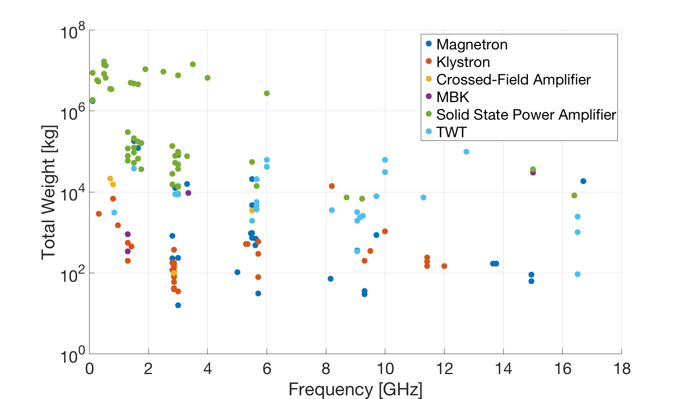

Can we use Solid State Amplifiers? No
Significant spread in data:
  Magnetrons and klystrons present lowest weight across frequency range.
  SSPA are largest weight.
Data represents weight of the source only:
  Does not account for cooling, magnets, power supply, waveguide, power combiners, etc…
  Total installation weight could be much larger.
$$Total Weight=N_{device}∗Weight$$

Slide 28
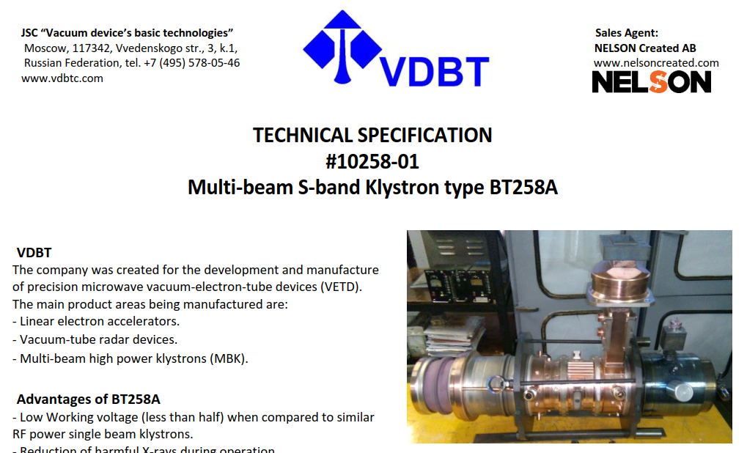
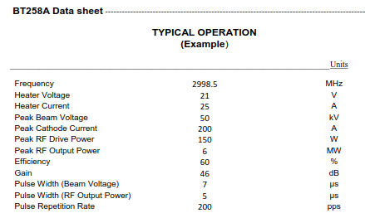
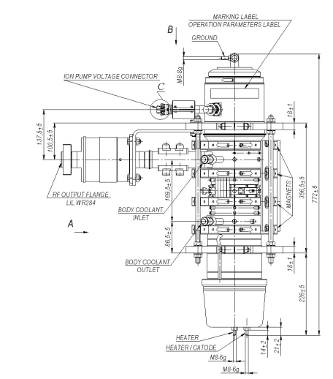
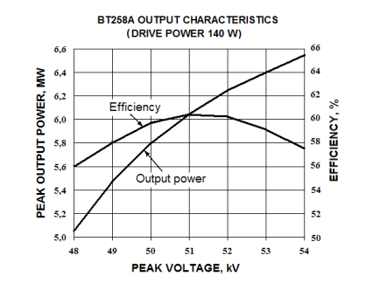
Multiple-Beam Klystron (MBK) Example
I. Syratchev, “Personal overview of special issues of the robust/reliable medical accelerator,” CERN-ICEC-STFC Workshop on Innovative, Robust and Affordable Medical Linear Accelerators for Challenging Environments, 2017.
0.72m long
92 kg (incl. PPM solenoid)
No oil tank.
Positioning: arbitrary (rotation possible)
Modulator required.
Data sheet: https://nelsoncreateddotcom.files.wordpress.com/2017/05/vdbt-bt258a-b.pdf

Slide 29
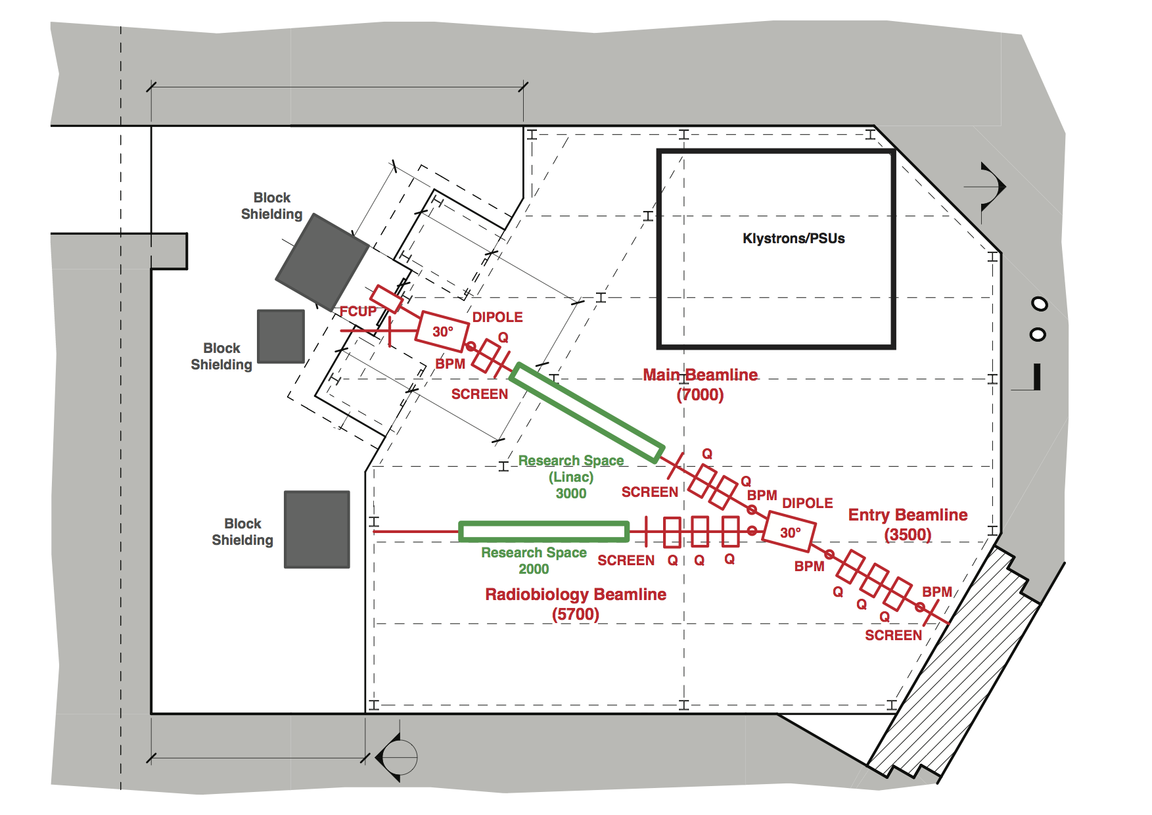
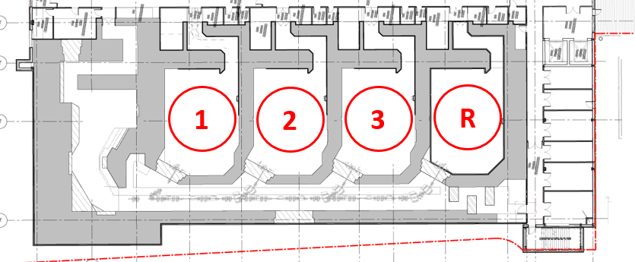
Introduction to PROBE
ProBE: Proton Boosting Extension
  Booster linac that can be fitted to a proton cyclotron
    Allows treatment and imaging from the same beam
  Plan to test prototype cavity at Christie Hospital, Manchester, UK
    4th treatment room will initially be used as a research beam line
      Later will install full 3 m long booster in transport line into 4th room
Proposed location for final booster

Slide 30
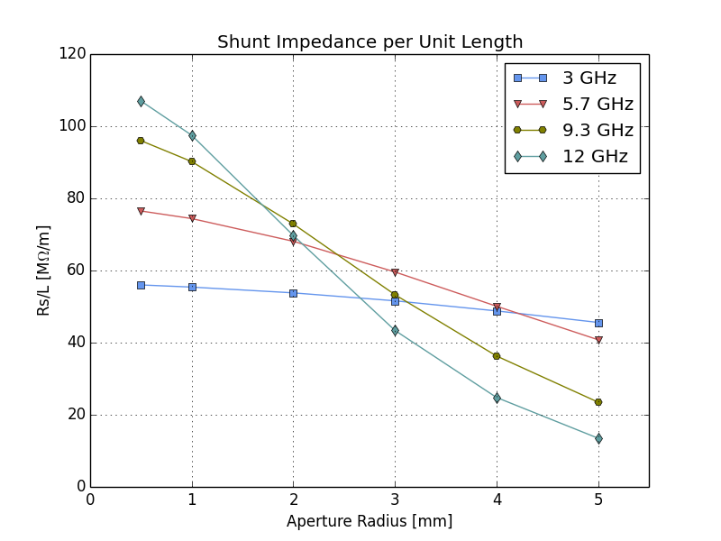
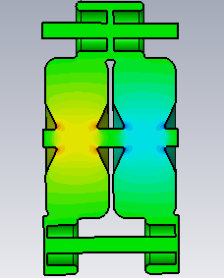
Small Aperture High Gradient scheme
Shunt impedance per metre increases with frequency with no beampipe as we have smaller surface area hence less losses
However the shunt impedance drops faster with aperture size as the radio of aperture to wavelength increases
This means that for a given aperture size there is an optimum frequency, for e+e- colliders its 12 GHz but what is it for proton therapy linacs?
Notes:
The amount of coupling required between cells significantly degrades x-band shunt impedance and gradient.
1mm septum thickness is a risky manufacturing challenge. + the graph on the previous slide had a s-band septum of 4mm and x-band 1mm (thinner septum higher Rs)
Epeak limit is 200 MV/m. peaking on the nose cone/aperture. There is no advantage to a smaller aperture at s-band, shunt impedance stays almost constant as we increase aperture. So Epeak can be optimised.
Hpeak limit is 273 kA/m. Both utilise magnetic coupling – this is why X-band is higher due to more coupling. However s-band is closer to limit and can be optimised.
The Gradient in both of these cases is limited by the modified pointing vector (Sc)
An X-band Traveling wave structure reached 58MV/m in simulation.
Considering all of these results, it makes sense to open the aperture of the s-band structure, thus requiring less focussing magnets between structures, fitting in an extra structure, and lowering the required gradient. This then allows for optimisation lowering the peak fields.

Slide 31
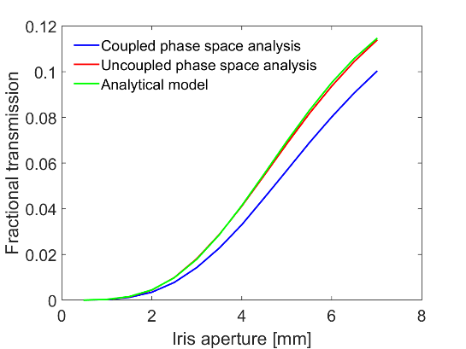
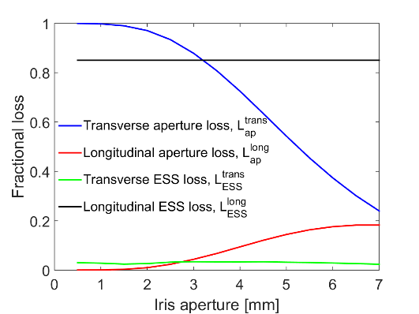
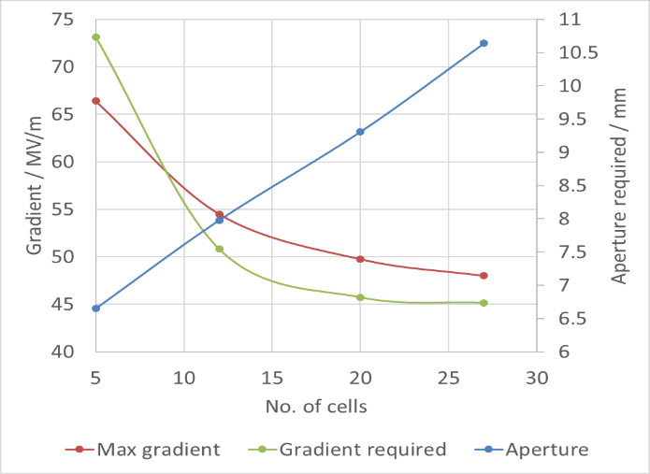
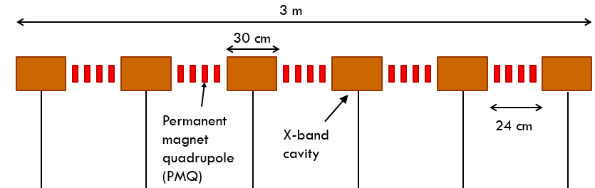

Beam transport
Detailed studies of particle transmission through the booster and energy selection system
  Combined with cavity RF studies to determine optimal cavity design
Move to 8 mm aperture
Larger aperture requires less focussing magnets between structures.
Smaller matching section means we can fit 7 structures in 3 metres instead of 6.
2.1m acceleration=55MV/m
Total transmission vs aperture radii
Distribution of losses vs aperture radii

Slide 32
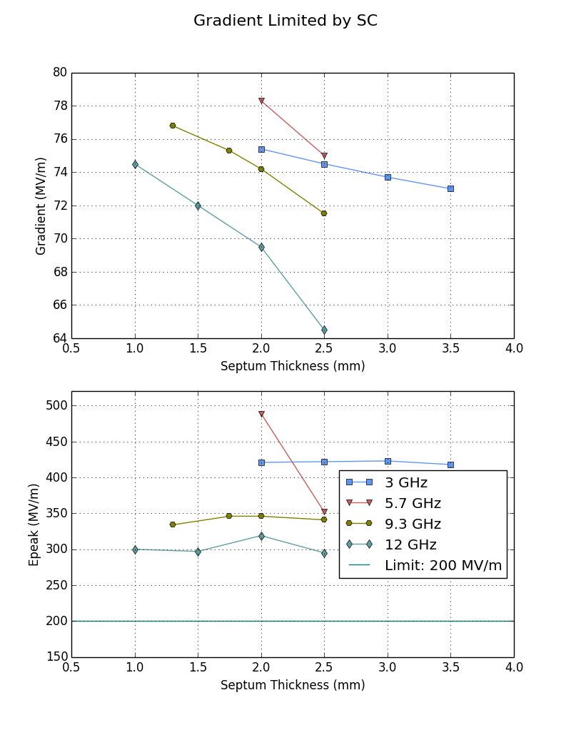

Septum thickness
The septum thickness is limited by the deformation of the nosecone under gravity while grazing
However the thicker the septum the lower the gradient
  High gradient initially chosen to be limited by modified pointing vector only.
  Epeak was however above acceptable limit. We were not brave enough to go against common beliefs that much
  Had tp re-optimise for with Epeak as gradient limit.
  Chose 2mm septum, C & S-Band.
Notes:
Before moving on with large aperture phase we looked at septum again because the plot before was scaled septum and it has significant impact.
Moved forward with c and s band because of high coupling required at x-band.
Relative cell diameters.
Baring in mind the coupling issue at x-band
Add a plot that demonstrates septum and nose cone

Slide 33
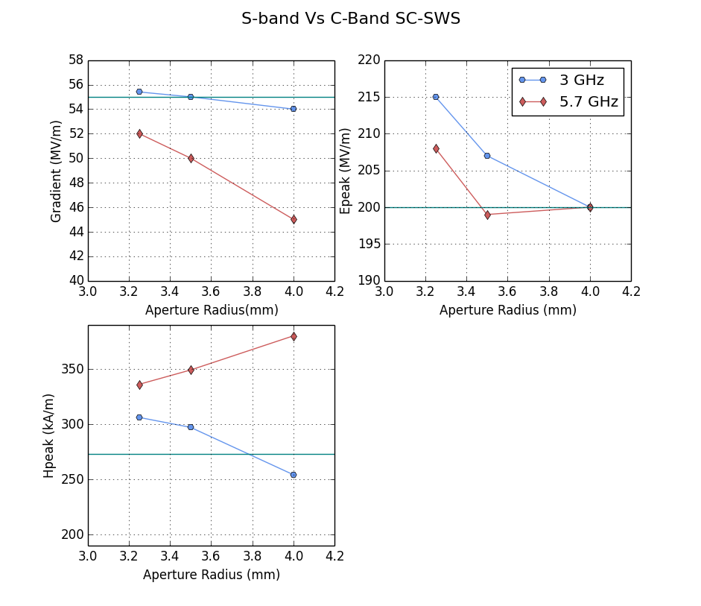
C (6 GHz) Vs. S (3 GHz) band
Taking into account coupling also lowers the gradient as there are high fields near the coupling slot
As C-band has more cells it requires twice the coupling
With a 4 mm aperture radius only S-band meets the field limits (Sc is now very low)
Notes:
Moved forward with c and s band because of high coupling required at x-band.
Rans some multi cells cavity simulations at c & sband.
Re-optimise to meet all gradient constraints

Slide 34
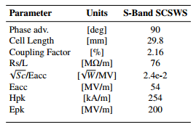
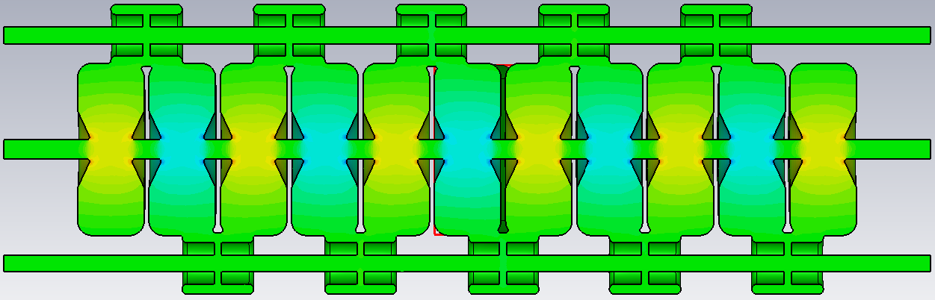
3GHz side coupled standing wave Structure
Side coupled 54MV/m
Aggressive gradient limits
  Epeak < 200MV/m
Thin septum (2mm)
π/2 mode
Travelling wave <52MV/m

Slide 35
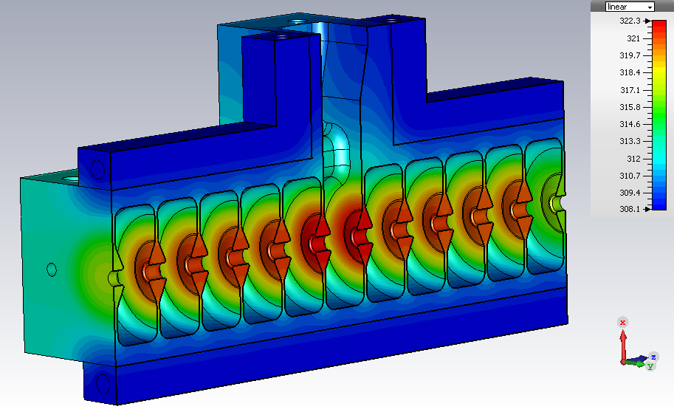
Average power
Imaging or treatment time is limited by duty cycle
Average power limited to around 2kW by heat transfer through thin iris.
Temperature gradient across the structure causes operational detuning.
Structure must stay within bandwidth (±1MHz).
14K between cooling and iris.
14MW at 4.5µs long pulse.
Rep rate 34Hz = 2kW Average power.
Imaging current = 2.5pA.
Notes:
Need <2pA is sufficient for imaging (image generated in about 1 minute

Slide 36
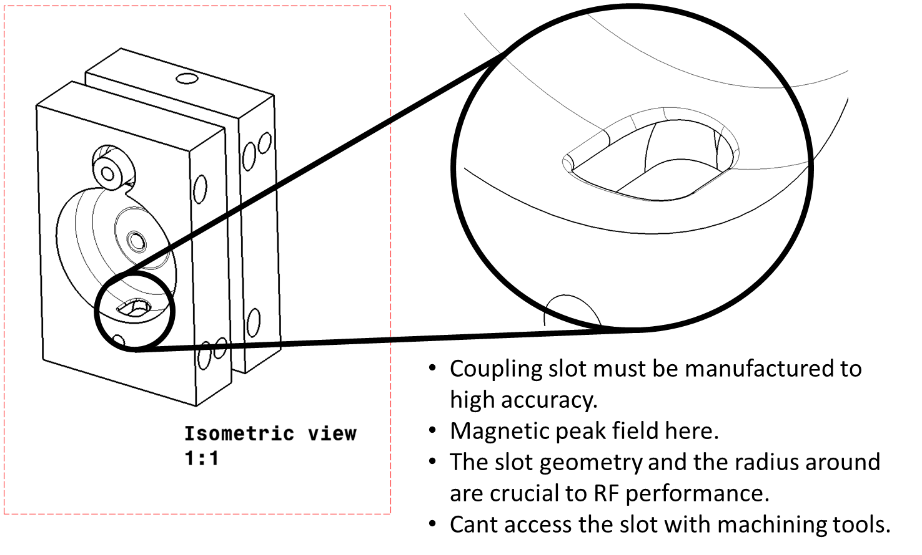
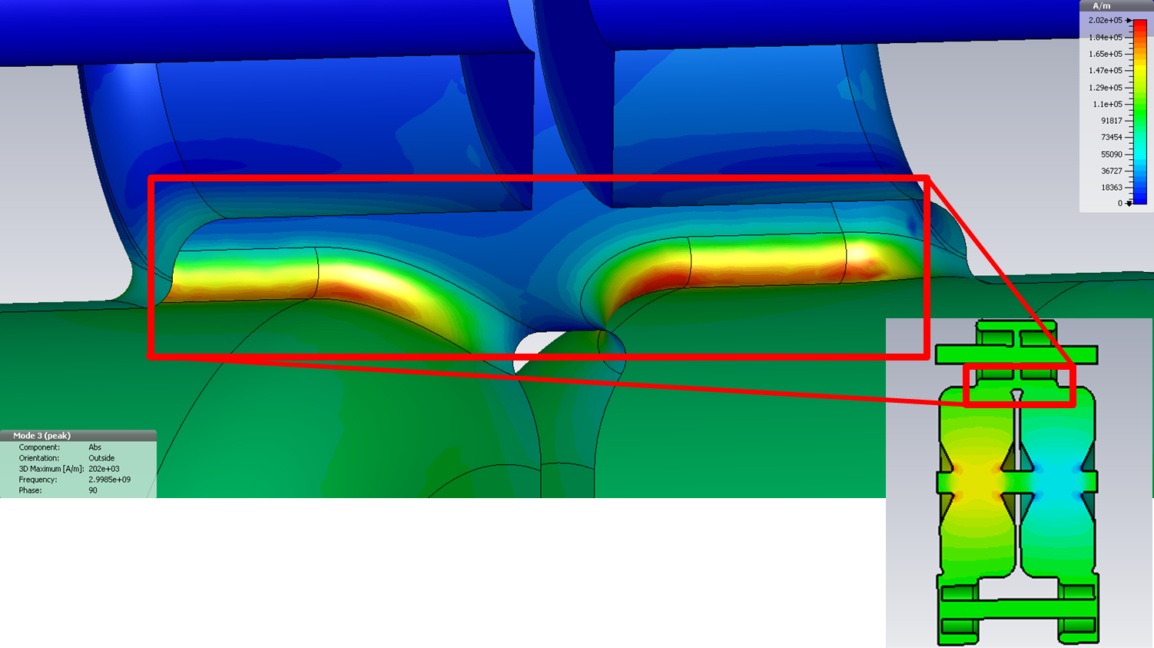
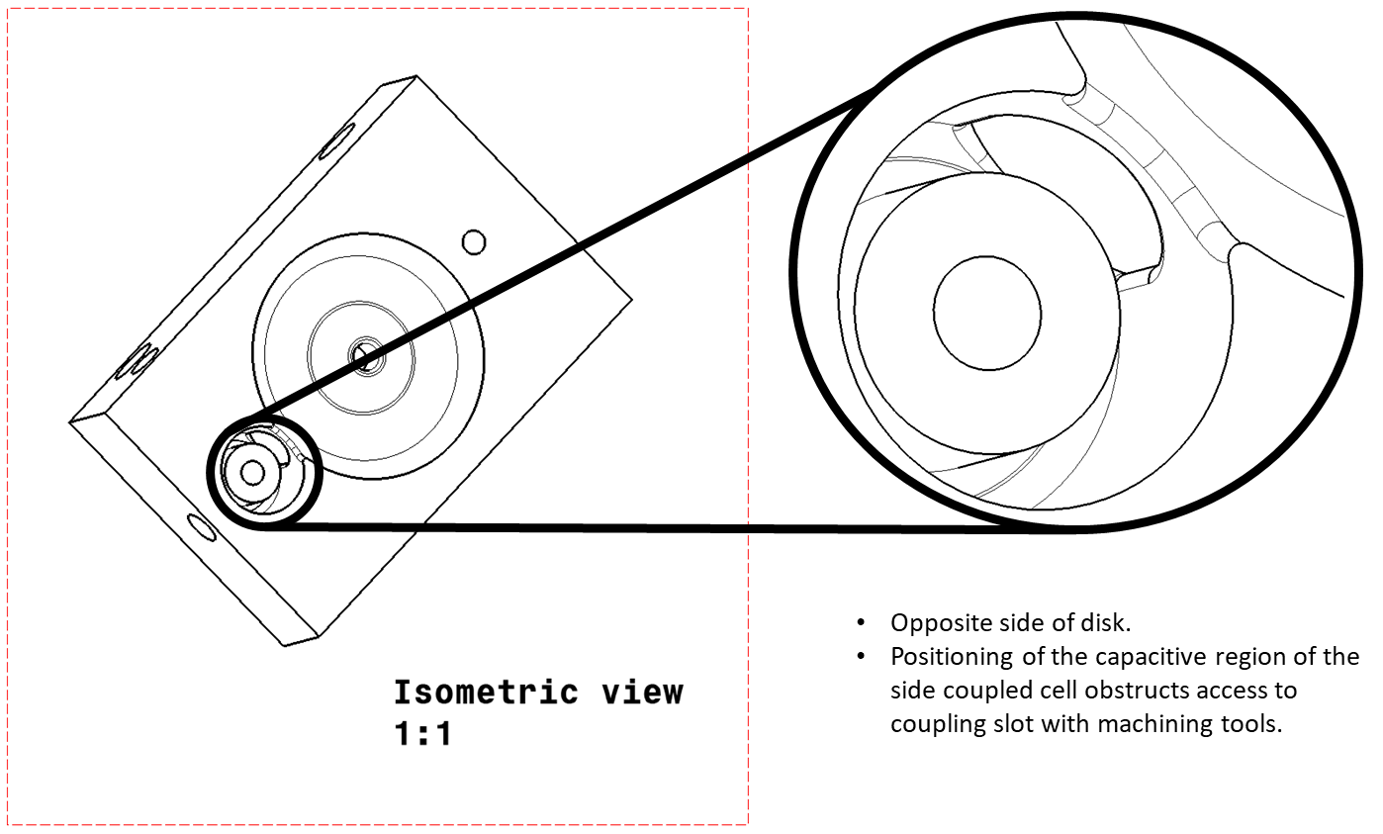
Issues with the slot

Slide 37
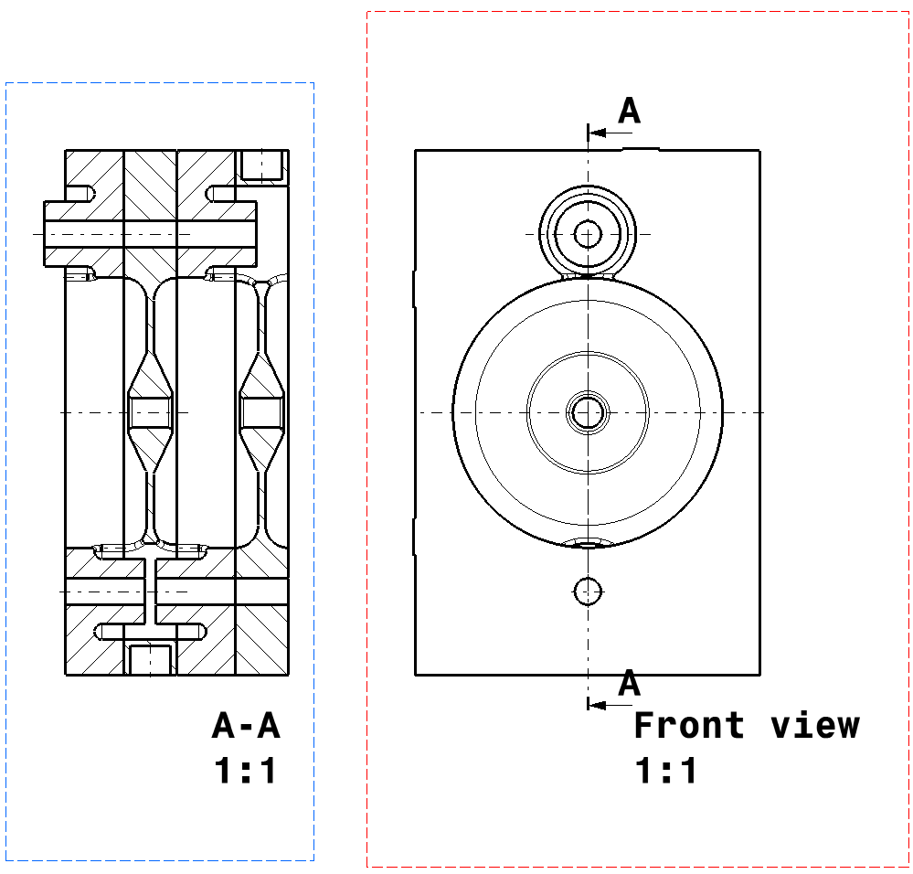
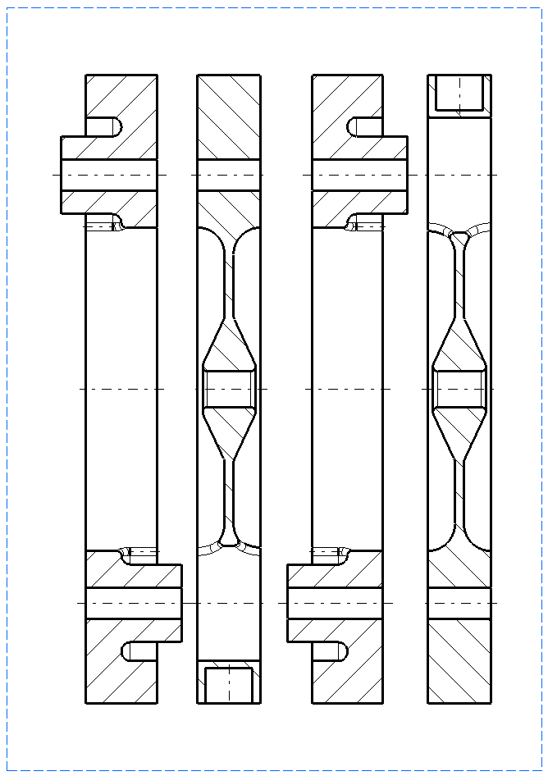
Patented solution to the slot

Slide 38
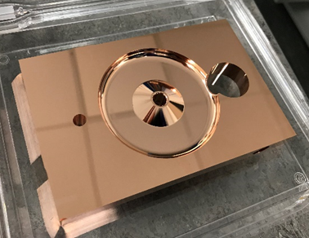
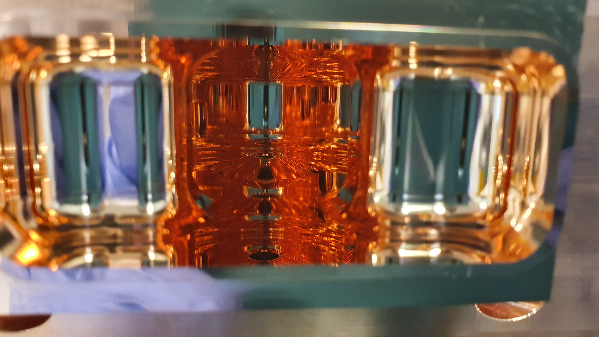
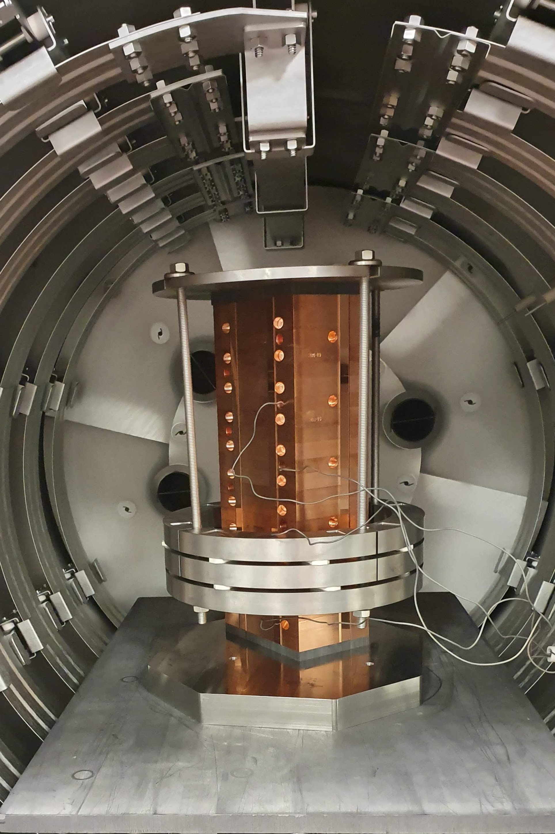
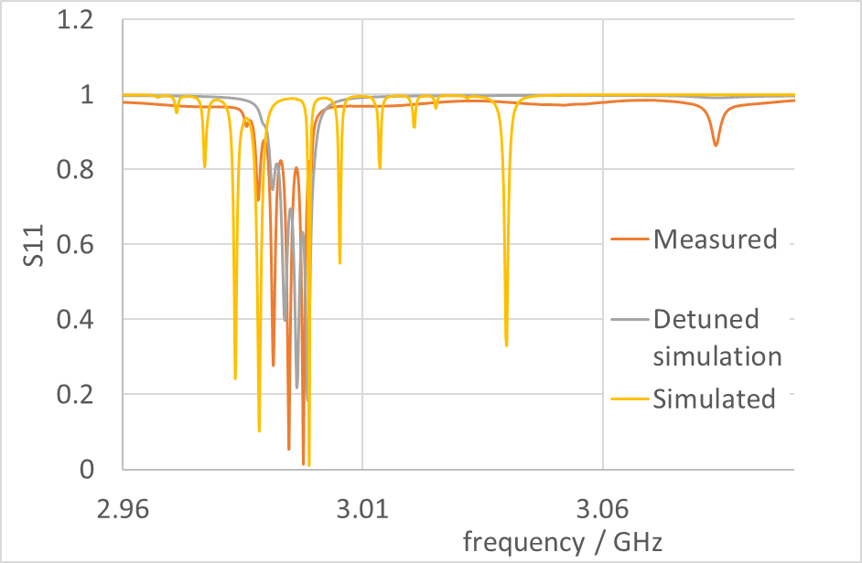
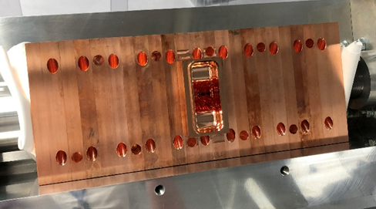
Clamp test measurements and brazing

Slide 39
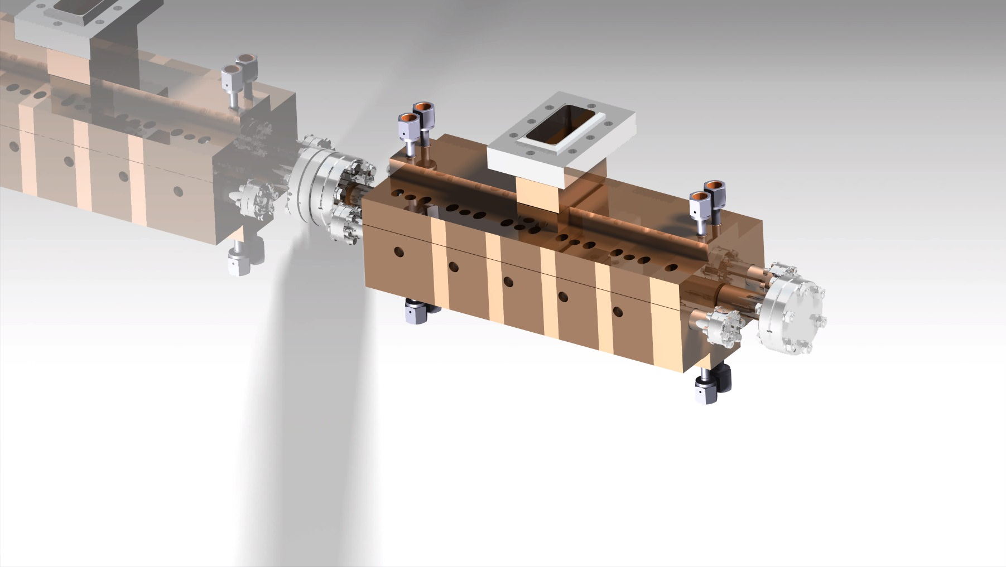
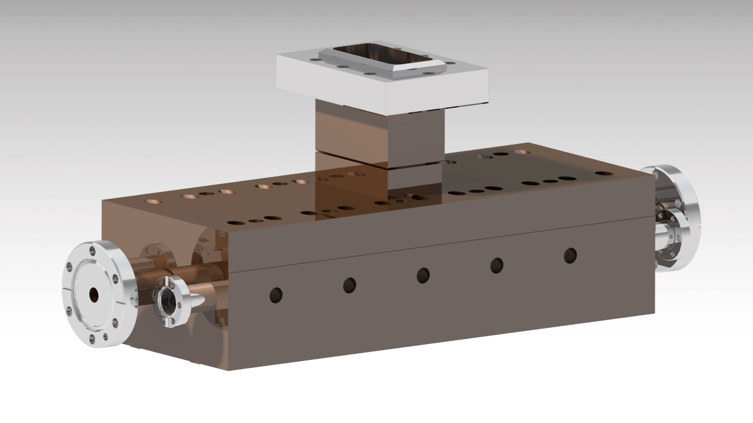





Thank you for your attention

