Slide 1
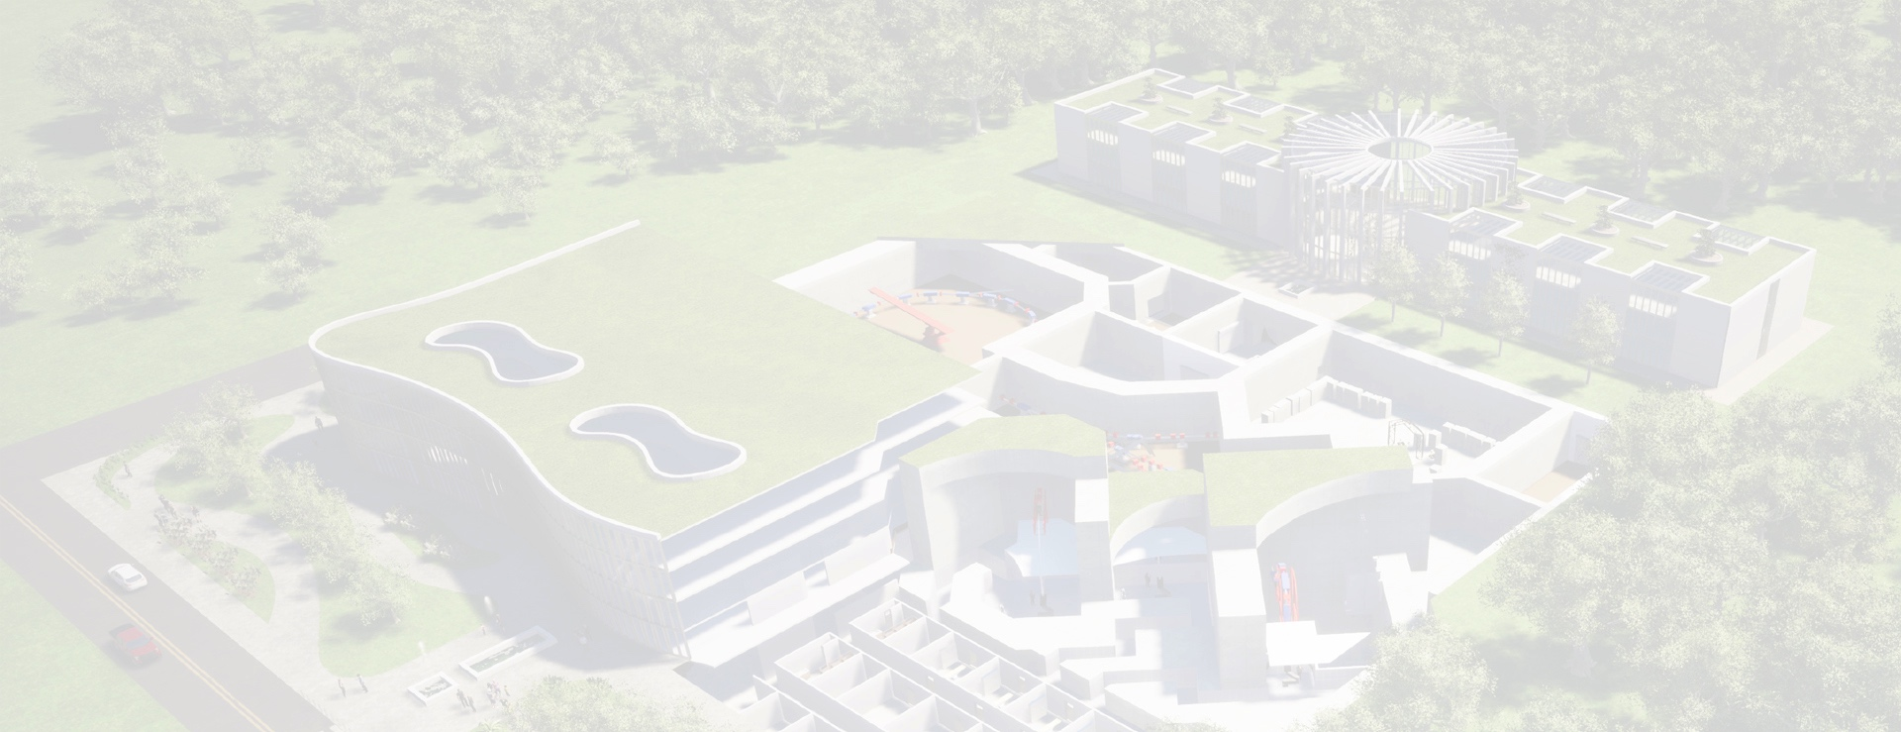



Accelerator challenges for the CERN Next Ion Medical Machine Study (NIMMS)
Elena Benedetto, SEEIIST Association
8th June 2022, CCAP Seminar – Imperial College
Special acknowldgement:

Slide 2
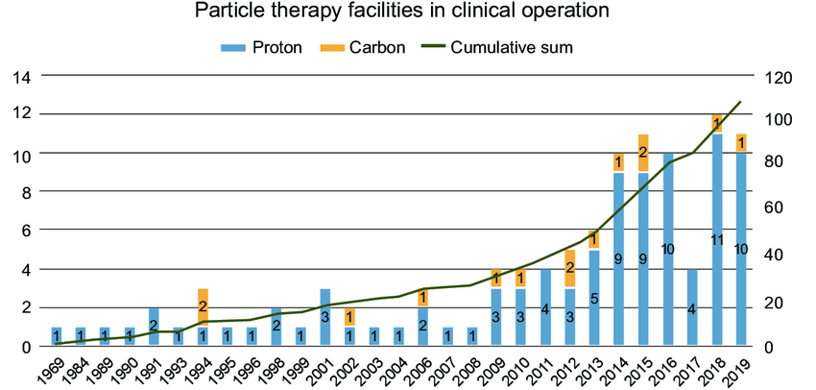
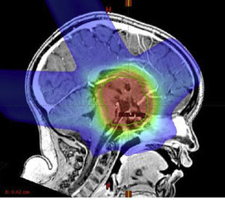
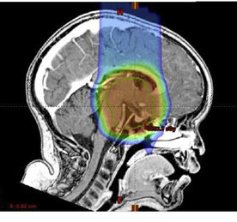
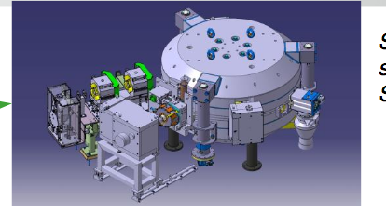
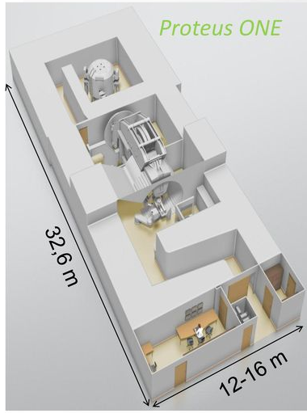
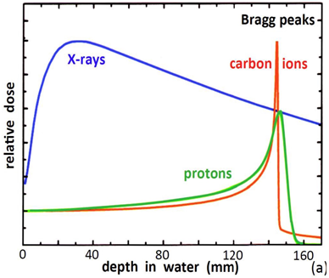
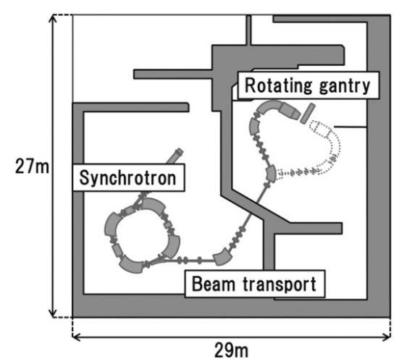
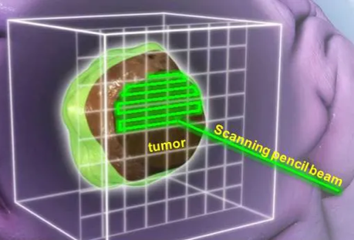
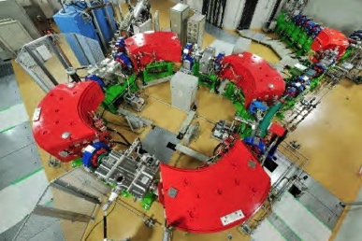
Proton (ion) radiation therapy
DOI:10.1016/j.ijrobp.2016.06.2446
IBA SynchroCyclotron
photons IMRT
protons
110 particle - proton therapy facilities,
30 in Europe (Vs. 14’000 X-ray facilities)
Bragg Peak: charged particles deposit energy @ specific depth, depending on the beam energy
3D beam scanning
HITACHI Synchrotron

Slide 3
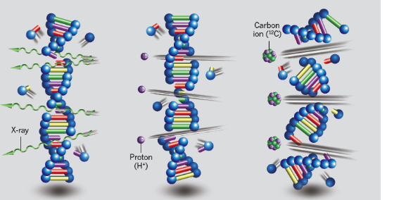
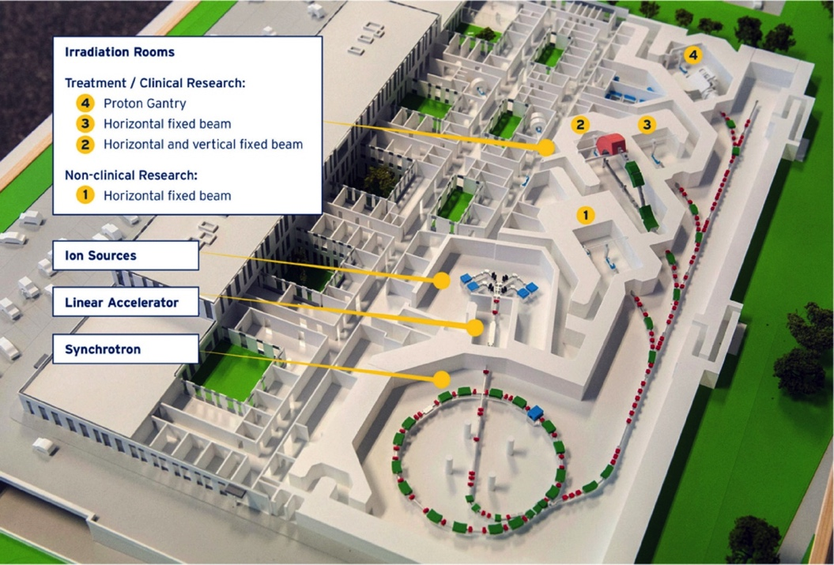
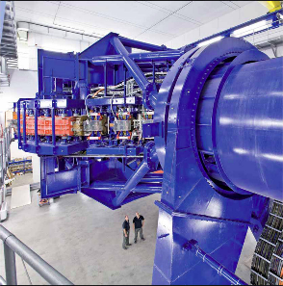
Carbon (and other) ions therapy
Range 3 mm to 300 mm in water-equivalent (Bragg Peak)
Protons: 60 - 250 MeV (Bρ = 2.42 Tm )
Carbon: 100 – 430 MeV/u (Bρ = 6.6 Tm)
X-ray
Proton
Carbon
~2.7x beam rigidity, i.e. more difficult to bend
Facility becomes larger and more expensive
~200 MEur
Marx, Nature, 2014
Single-strand breaks (easy to repair) vs. double-strand breaks (not reparable)
3x more damage (RBE)
also in oxygen-depleted “radioresistant” tumours
MedAustron, 25 m diameter synchrotron, 3 treatment rooms, no C-ion gantry
Helium and Oxygen ions also of interest for treatment
HIT C-ion gantry (600 tons)

Slide 4
Carbon ion synchrotrons – new developments
Superconducting (SC) magnets to reduce dimensions, weight (and cost) of the facility
  compact synchrotron and gantry
Higher (x10) beam intensity stored:
  to deliver full beam in one cycle and overcome limitation of long SC magnet ramping rates
  to be ready for FLASH treatment modalities
I’ll talk about:
  What is NIMMS, SEEIIST, HITRIplus
  New developments and studies @ NIMMS

Slide 5

The CERN Next Ion Medical Machine Study (NIMMS) leverages on CERN expertise to develop a portfolio of technologies (…a “toolbox”) for a new generation of medical accelerators with ion beams
PIMMS in 2000 gave birth to CNAO/MedAustron
NIMMS launched (funded) as a Knowledge Transfer initiative in 2019.
Open to collaborations internal and worldwide:
  SEEIIST, TERA Foundation, GSI, INFN, Imperial College, U. Manchester, Cockcroft Institute, U. Melbourne, CIEMAT, CNAO, MedAustron, Riga University, DKFZ, U.Thessaloniki,…
Support from EU programs: HITRIplus and iFAST.
Input from medical/scientific community via ENLIGHT and the International Biophysics Collaboration.
Bi-weekly (Friday) seminars attended by ~30 participants
HF Linac
Synchrotron
Gantry
Magnets
AI/ML*
R-isotopes*
* in preparation
https://indico.cern.ch/event/956260/
(M. Vretenar KT seminar Oct’20)

Slide 6
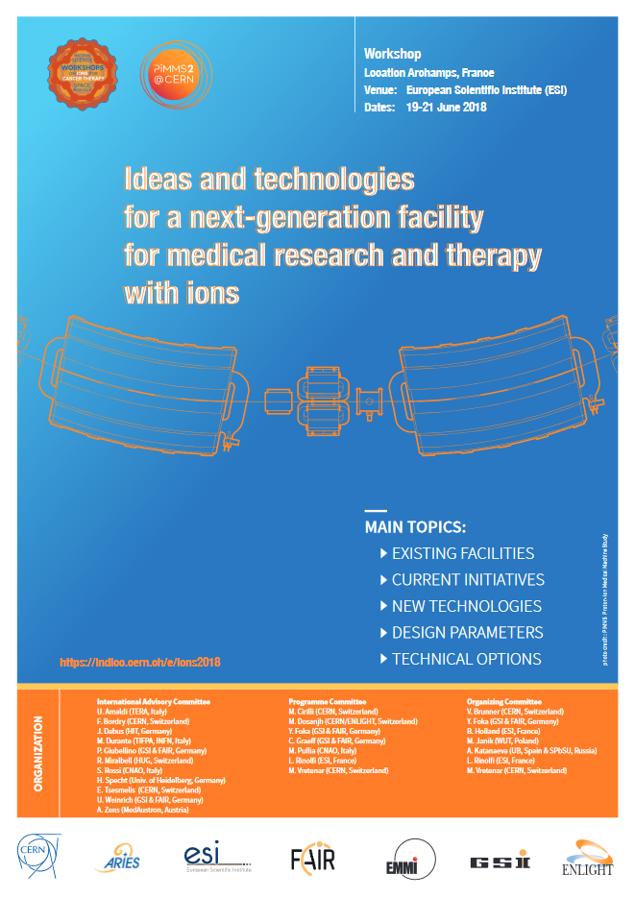
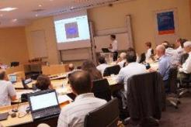
NIMMS - Specifications from the scientific community
Archamps Workshop, June 2018
Delivery
Using multiple ions (Carbon, Helium and others);
Fast dose delivery;
Equipped with a SC gantry;
With range calibration and diagnostics online.
Accelerator
Higher beam intensities than present in EU (~10¹⁰ C-ions);
Reduced footprint, to about 1’000 m²;
Lower cost, compared to present (~120 M€);
Lower running costs.

Slide 7
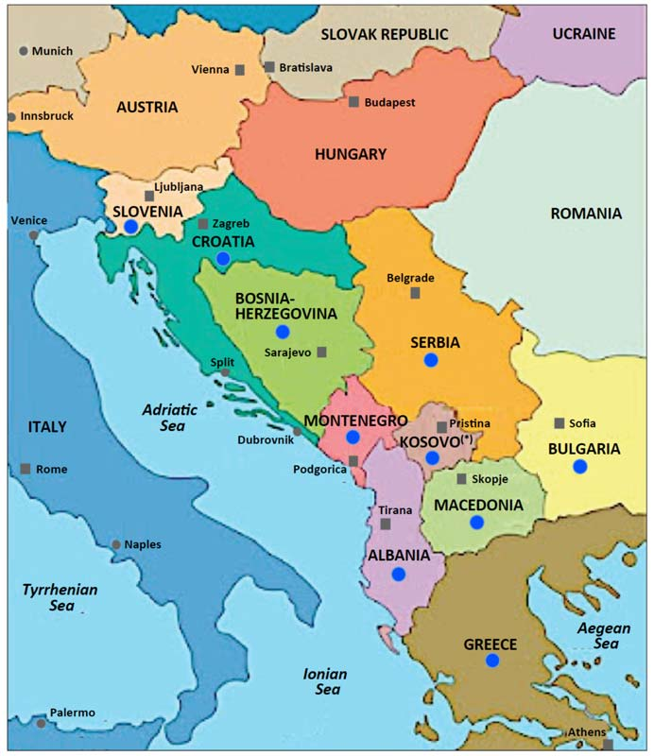

SEEIIST as strategic partner and reference user
Science for peace
Scientific excellence
Education & Training
Green infrastructure
SEEIIST: South East Europe International Institute for Sustainable Technologies
Consortium of 10 countries, to construct a facility for cancer Research & Therapy in South East Europe.
Science for Peace: to build international cooperation and scientific capacity.
Initiated in 2017 by H. Schopper, former DG of CERN, and S. Damjanovic, physicist and (ex) Minister of Science.
2008 Yellow Book, by U. Amaldi et al.
Accelerator design studies started in 2019 at CERN, supported by EU and continue now within HITRIplus (Apr’2021), in tight collaboration with CERN and EU partners.

Slide 8
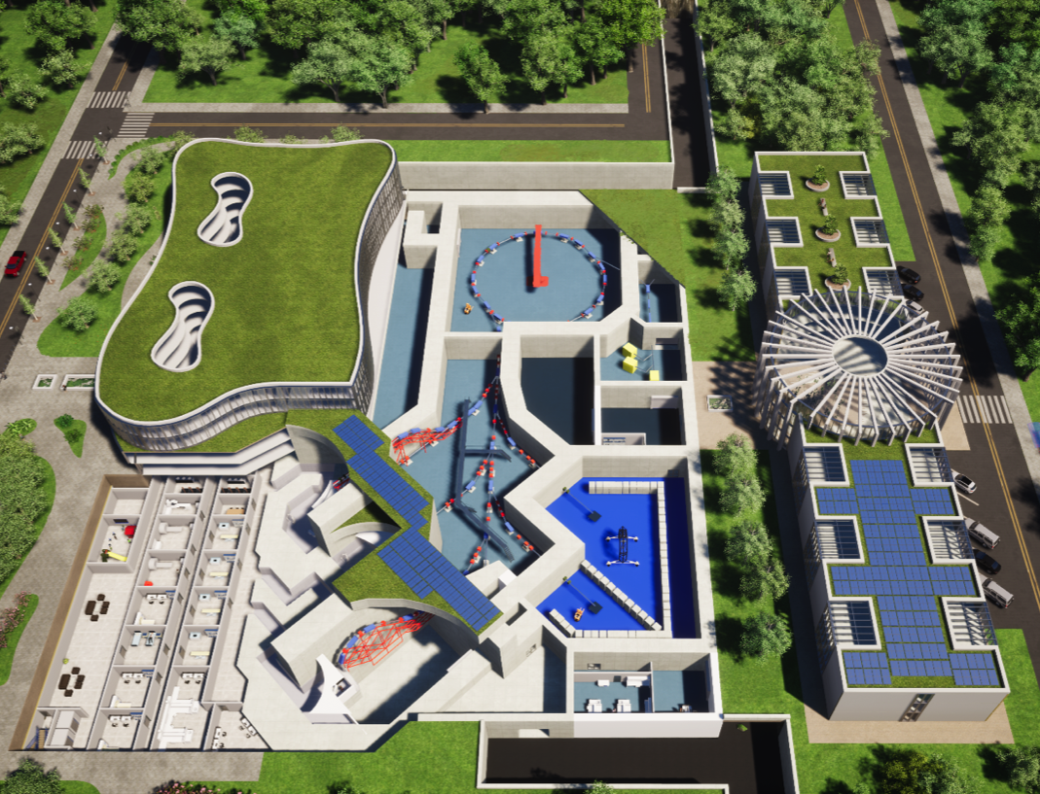
SEEIIST advanced accelerator
Research and therapy with ions: p, He, C, O,…up to Ar
Flexible extraction modality (multi-energy slow resonant extraction and FLASH)
Intensity x20(*) European facilities
Baseline layout is a NC-magnet synchrotron (like CNAO/MedAustron)
Option of a compact SC-magnet synchrotron
(*)To deliver 2 Gy to 1 liter in one cycle
 | p | He | C
Intensity | 2.6 e11 | 8.2 e10 | 2.0 e10
Injection Energy (MeV/u) | 7-10 | 5 | 5
Extract Energy (MeV/u) | 60-250 | 60-250 | 100-430
Beam rigidity max (Tm) | 2.42 | 4.85 | 6.62
Synchrotron diameter (m) | ~25m
Spill duration (s) | 0.1 - 60
Spill ripple @1 kHz (I_{max}/I_{ave}) | <1.5
Technologies e.g. advanced injection/extraction are developed for both normal conducting (NC) and super conducting (SC) -magnet synchrotrons.

Slide 9
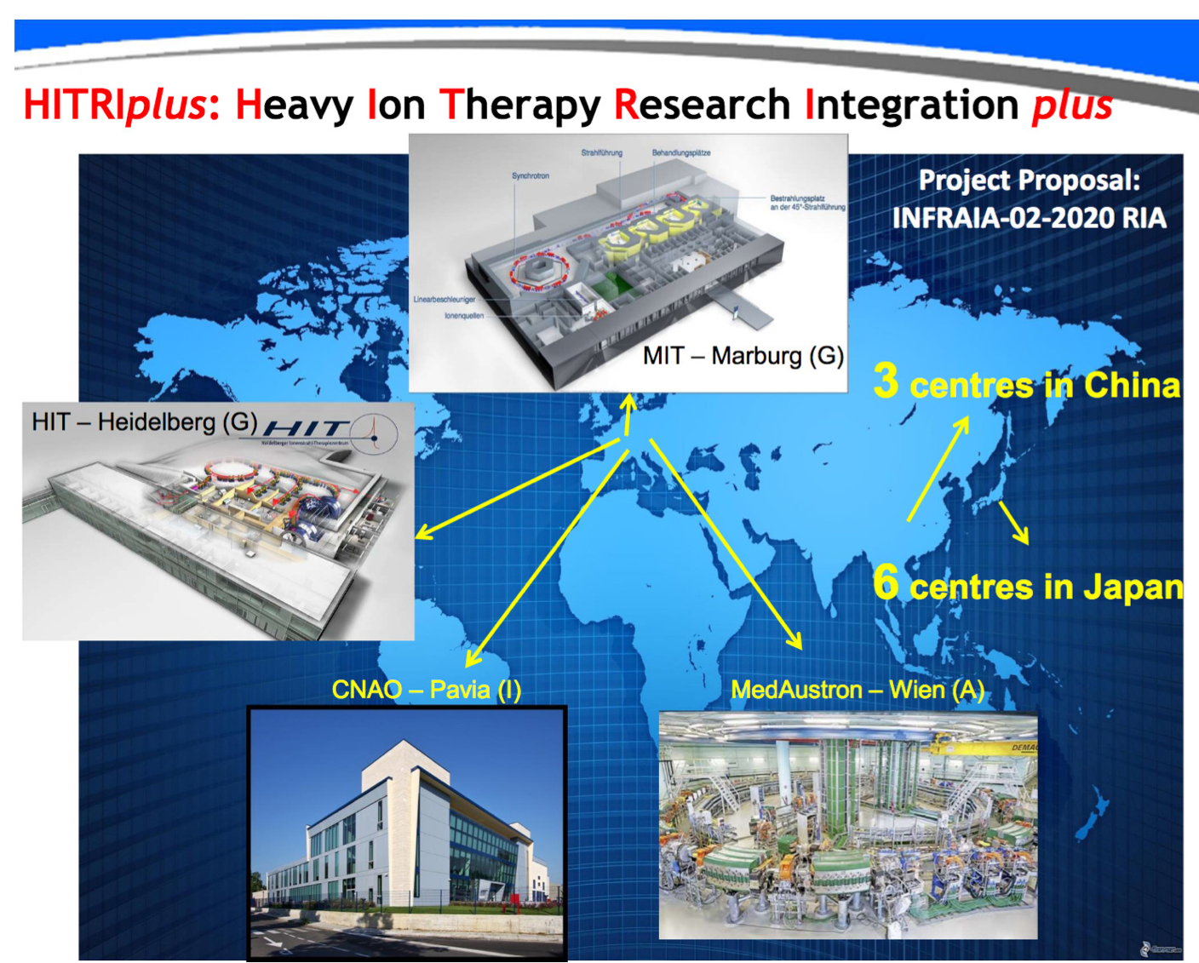
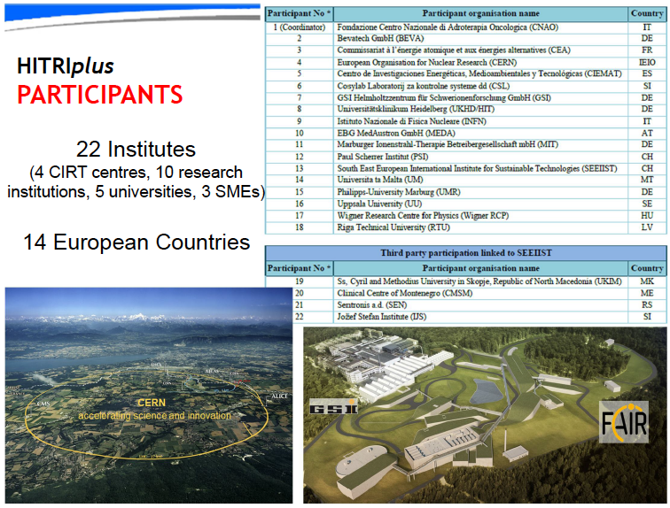

HITRIplus
Starting Community Integrating Activity of the Horizon 2020 EC Framework Programme covering 04/2021-03/2025,
5 M€ total EC contribution, 1.2 M€ for accelerator studies to SEEIIST, CERN, Bevatech, CNAO, MedA, INFN, CEA, CIEMAT, PSI, UU, Wigner
Courtesy S. Rossi

Slide 10
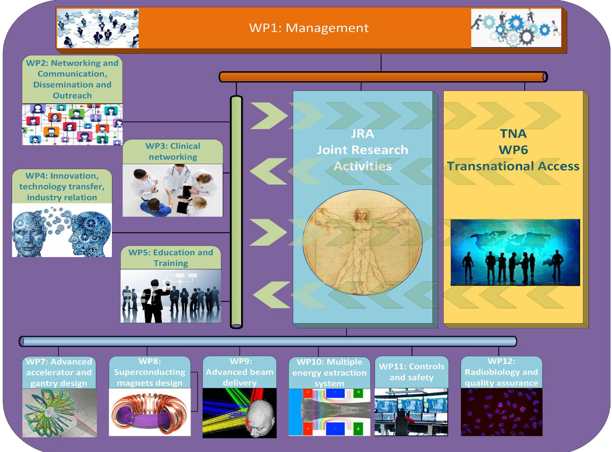
HITRIplus structure
8/6/2022 – CCAP Seminar Imperial College

Slide 11
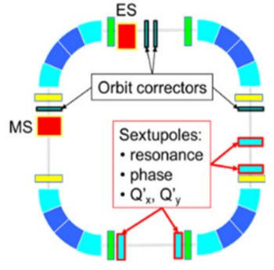
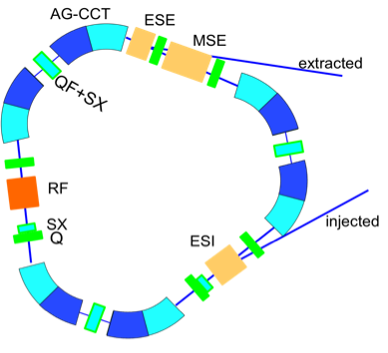
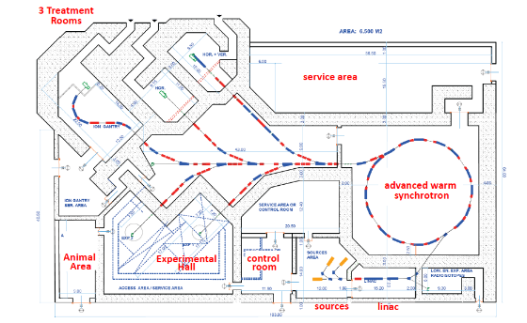
NIMMS: three synchrotrons designs for medical ions
  Compact (C=27m), with SC-magnets AG-CCT
  PIMMS-lattice (C=75m), intensity x20 (SEEIIST baseline)
  Helium-only, warm
M. Vretenar et al., IPAC22
E. Benedetto, U. Amaldi et al. @ TERA
https://arxiv.org/abs/2105.04205
*To deliver 2 Gy to a 10x10x10 cm³ in one cycle
 | p | He | C
Intensity* | 2.6 e11 | 8.2 e10 | 2.0 e10
Inj. E (MeV/u) | 7-10 | 5 | 5
Extr. E (MeV/u) | 60-250 | 60-250 | 100-430
Bρ max (Tm) | 2.42 | 4.85 | 6.62
Spill ripple I_{max}/I_{ave} @1 kHz | <1.5
Spill duration (s) | 0.1 - 60
SEEIIST layout, https://cds.cern.ch/record/2748083

Slide 12
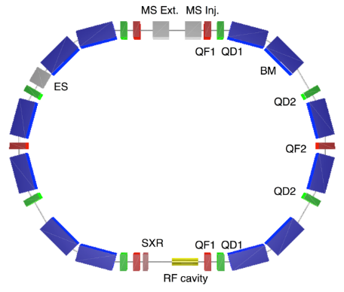
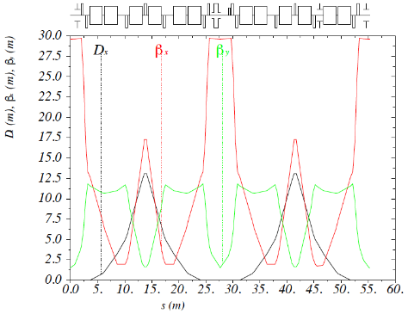
1) SEEIIST baseline
Research and treatment:
50% day-time devoted to research: radio-biology, veterinary, material science, …
Separation between clinical and experimental area
Experimental area is modular
Linac and sources separated from synchrotron
Potentially expanded to for radio-isotope production (from linac)
  PIMMS-lattice (C=75m), intensity x20 (SEEIIST baseline)
Collaboration w. U. Melbourne
SEEIIST layout, https://cds.cern.ch/record/2748083
X. Zhang, alternative lattice based on DBA

Slide 13
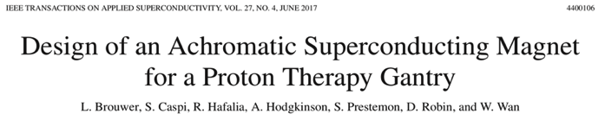
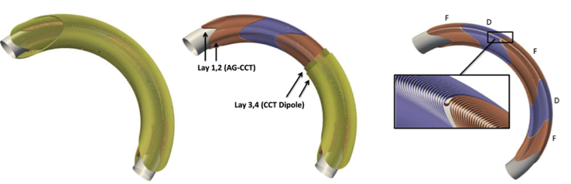
2) SC-magnets compact ring for C-ions
Evolved to triangular, to “ease” magnets design
Optics is preliminar, inj/ext to be designed yet
Based on 3.5T 60 deg AG-CCT
https://arxiv.org/abs/2105.04205
@TERA

Slide 14
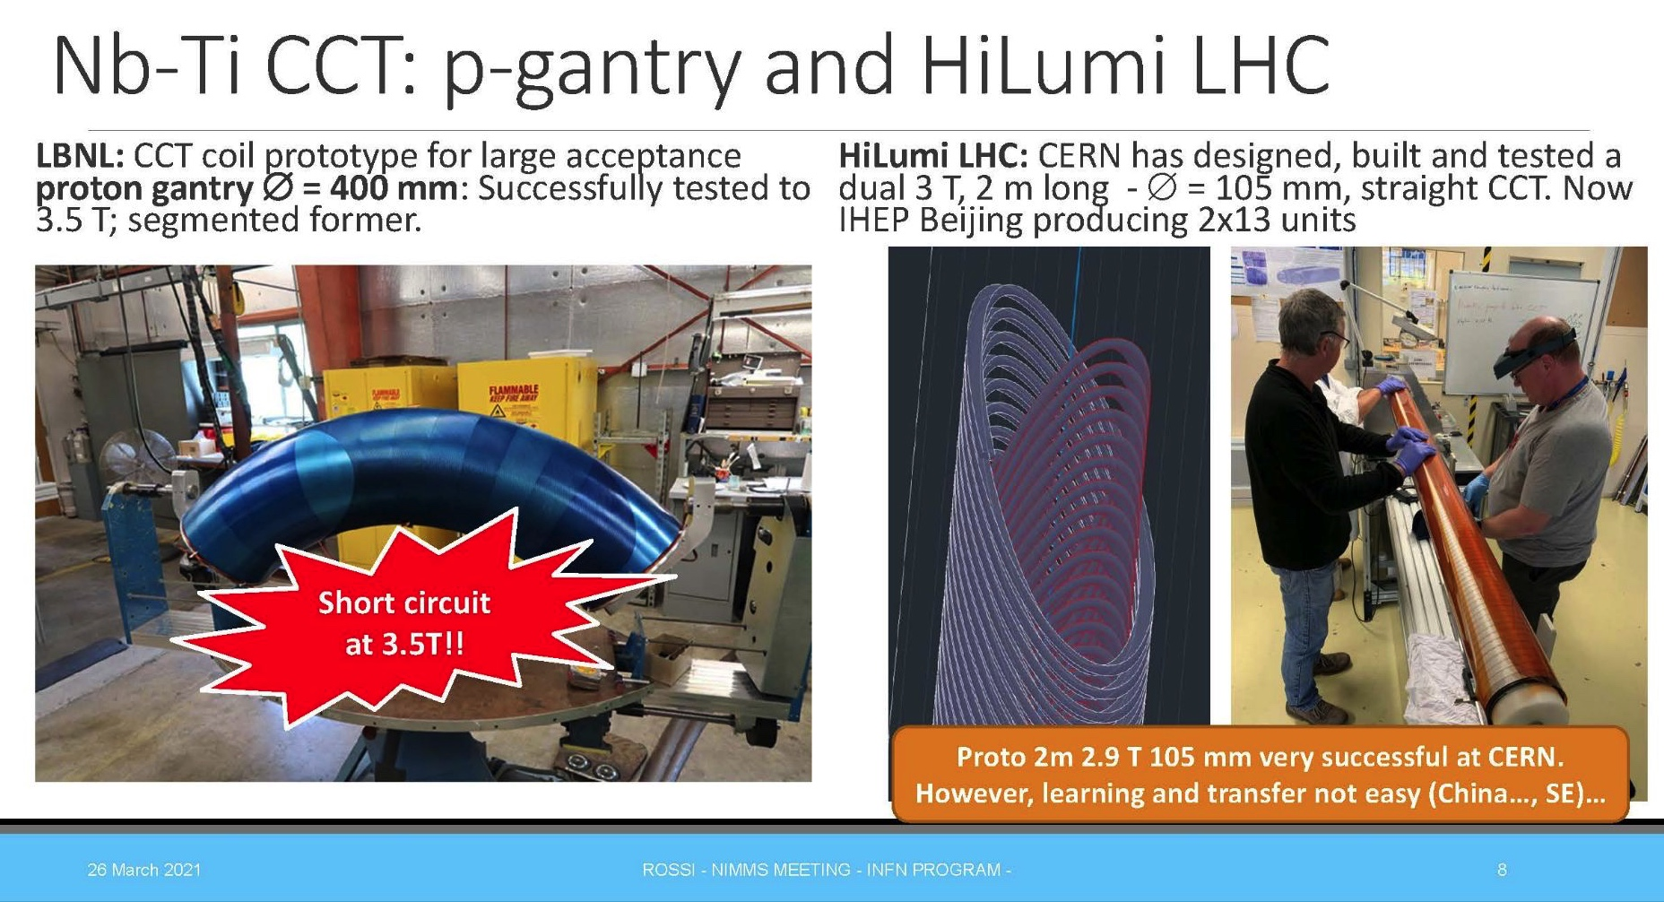
Strongly curved CCT magnets challenges
Collaboration w. INFN, partners in HITRIplus and iFAST and U.Manchester
Magnet Parameters for HITRIplus
Parameter | Synchrotron magnet | Prototype Magnet
Bρ (Tm) | 6.6 | 6.6
B₀ dipole (T) | 3.0 | 4-5
Coil apert. (mm) | 70-90 | 60 (90)
Curvature radius (m) | 2.2 | 2.2 , ∞
Ramp Rate (T/s) | 1 | 0.15-1
Field Quality (10⁻⁴) | 1-2 | 10-20
Deflecting angle | 90° | 0 - 45°
Alternating-Gradient | yes (triplet) | N/A
Quad gradient (T/m) | 40 | 40
B_{quad} peak (T) | 1.54- 1.98 | 1.2
B_{peak} coil (T) | 4.6 - 5 | 5.6-7
Operating current (kA) | < 6 | < 5
Type of Superconductor | NbTi (Nb₃Sn) | NbTi (curved), HTS (straight)
Operating temperature (K) | 5 (8) | 5 (20)
Lucio Rossi

Slide 15
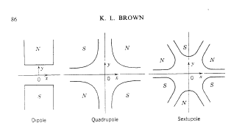
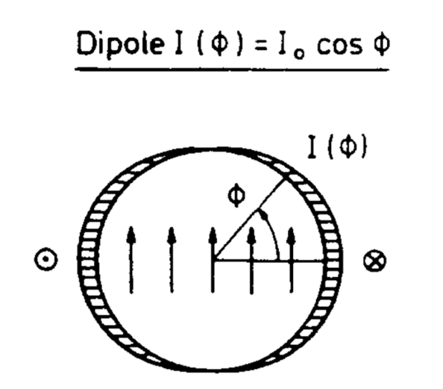
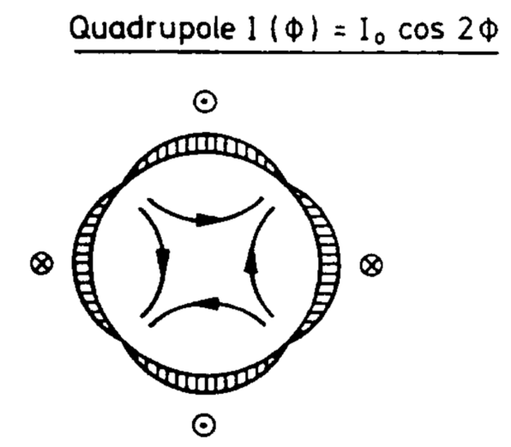
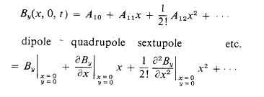
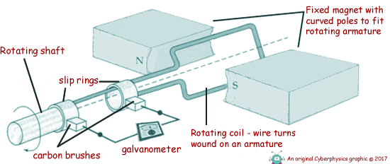
Field Quality for curved magnets 1/3
EB and D. Barna, WG – field quality
Collaboration w. INFN, partners in HITRIplus and iFAST, U.Manchester, CERN ABP
Vs.
Multipole expansion, FFT on a reference radius
Only in straight geometry the coefficients are the same…
Rotating coil method
We define FQ using field derivatives, not multipoles

Slide 16
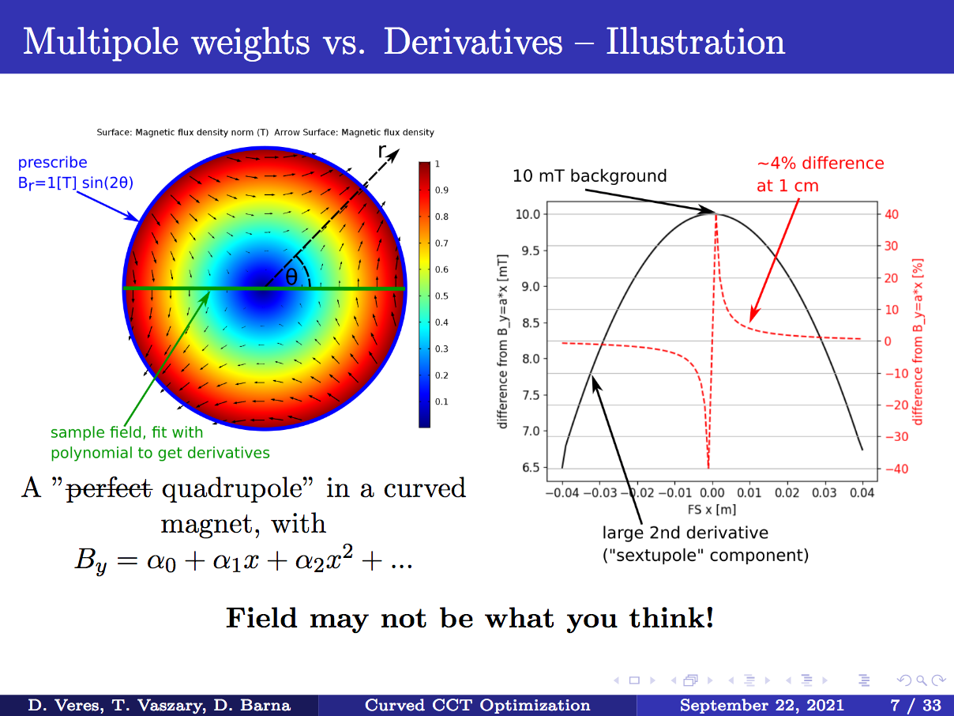
Field Quality for curved magnets 2/3
EB and D. Barna, WG – field quality
d^{n}By/dx^{n} /B1 x R^{n}_{ref}
B0 | 1.50E-02
B1 | 1.00E+00
B2 | -4.60E-03
B3 | -1.11E-03
B4 | 8.52E-03
In straight geometry only B1!
D. Veres, D. Barna

Slide 17
Field Quality for curved magnets 3/3
EB and D. Barna, WG – field quality
Open questions:
  What/how to measure field quality?
  How to generate gradients → D. Barna & D. Veres algorithm for CCT winding
  Integrated vs. Fringe field?
  How to qualify magnet / How to model !!!

Slide 18
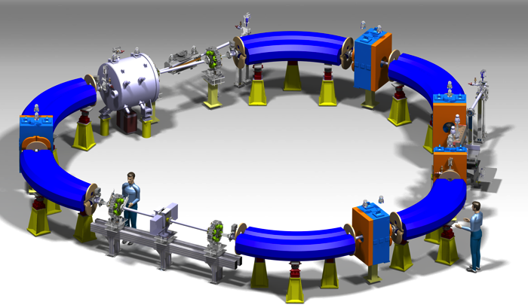
1) Helium warm synchrotron
He is interesting in-between protons and C-ions:
  sharper Bragg peak and fall-off to protons,
  but less scattering and nuclear fragmentation compared to carbon.
  Lower neutron dose than protons or carbon.
  Improved RBE to protons, less damaging LET than carbon.
Max 220 MeV/u (30 cm range)
Brho=4.5 Tm
Magnet design
1.65 T dipoles of length 2.65 m and 140 mm x 70 mm aperture.
Water-cooled with 13 A/mm2 current density.
Coil space is compatible for superconducting upgrades for carbon.
Corrector magnets with dipole, quadrupole and sextupole fields.
Pickups in dipoles to save space.
Proven technology, compact & upgradable
M. Vretenar et al., IPAC22

Slide 19
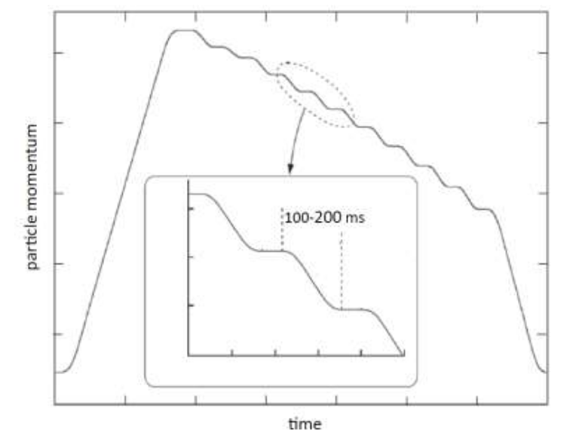
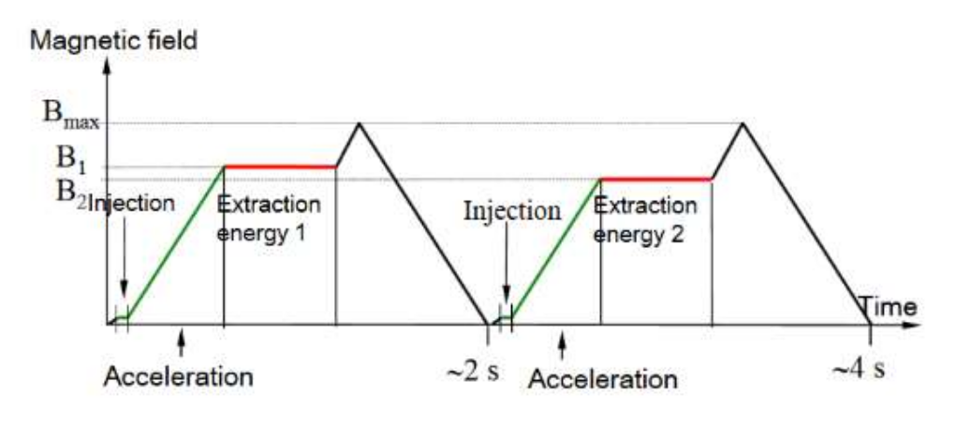
Delivery of 2 Gy in a 1liter tumour: HOW?
Courtesy MedAustron
HIMAC, Iwata et al, NIM-A
TODAY: Every change of energy → A different cycle
TODAY in Japan: Multi-Energy Extraction (going down or up) within same cycle
TOMORROW(?) … deliver the entire *high intensity* beam in <500 ms for FLASH irradiation
Collaboration w. CNAO, MedAustron, HIT, CERN ABT

Slide 20
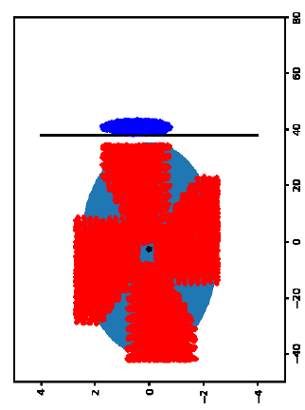
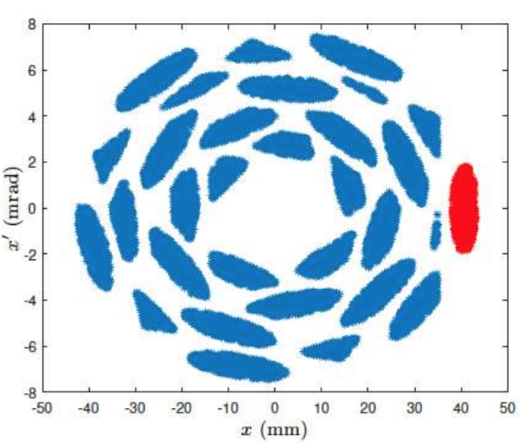
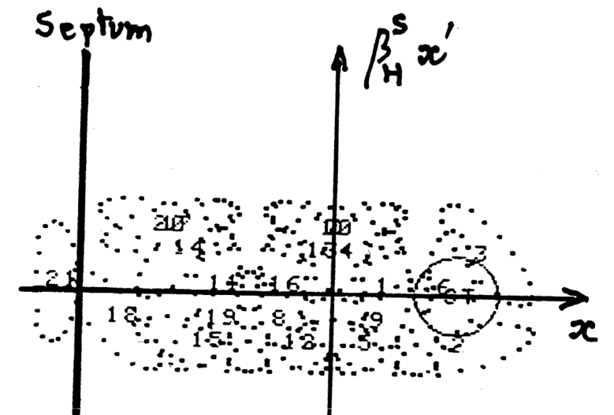
Multi-turn injection of 2e10 C-ions
~similar #turns for He-ions
(source 1mA)
ECR source ~200 uA C+4
Next generation ECR (e.g. AISHA, Catania) ~600 uA C+4 (in 0.3 mm mrad rms)
Injecting @ 5 MeV/u in a 70 m circumference
Assume 90% (high!) efficiency from source to injection → 13 “effective turns” needed (30 for the compact 30m)
Collaboration w. INFN, Bevatec, CNAO, MedAustron
A. Advic, U. Sarajevo (2019)
EB, playing to increase brightness
LEIR injection (S.Maury, C.Carli, D. Mohl)

Slide 21
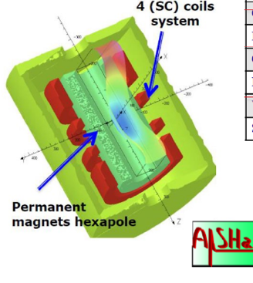
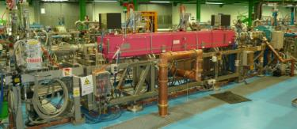
New Linac Design
New injector linac (than the EU facilities) for lower cost, higher intensity
Defined optimal injection energy to the synchrotron
  5 MeV/u for C, He ions
  10 MeV/u for p
Advanced source AISHA (INFN Catania)
Radioisotopes production: feasible with small changes in the baselines
    duty cycle 10%
    staged Linac
Within HITRIplus partners and new EU calls
RI supported by several communities: HITRIplus, INFN, new EU calls

Slide 22
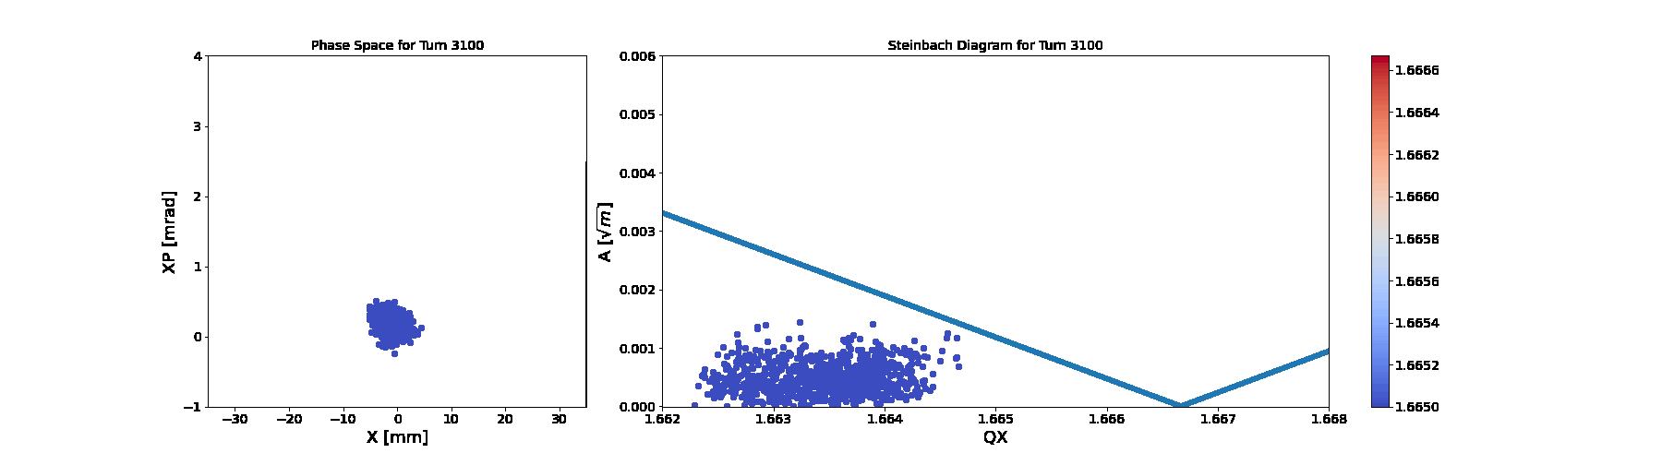
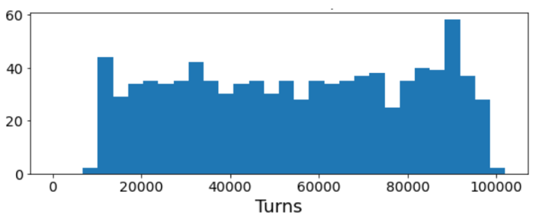
Slow extraction on the 3rd order resonance
Simulations for benchmark with PIMMS (CNAO, MedAustron)
Obtained using pyNAFF!
Go to slideshow for the animation
Collaboration w. CERN ABT, CNAO, MedAustron, HIT
Spill Quality
Courtesy Rebecca Taylor
https://indico.cern.ch/event/1076027/timetable/#20211006

Slide 23
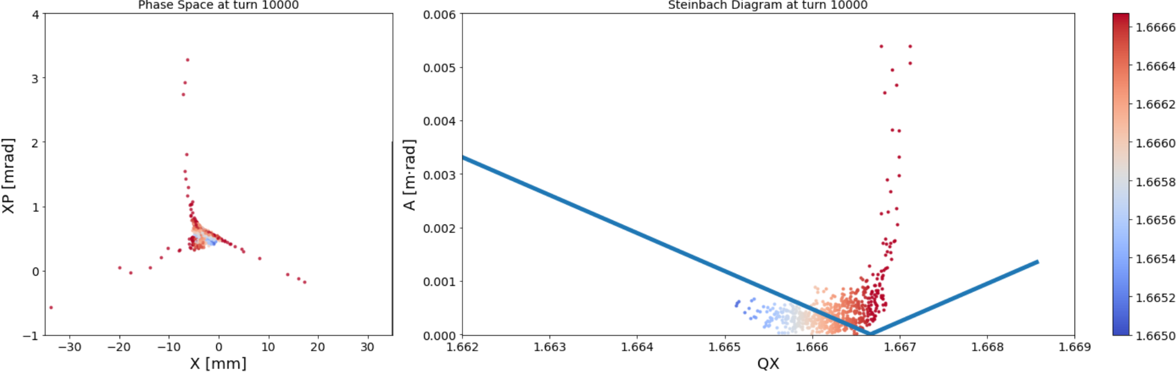
Slow extraction on the 3rd order resonance
Simulations for benchmark with PIMMS (CNAO, MedAustron)
Obtained using pyNAFF!
Collaboration w. CERN ABT, CNAO, MedAustron, HIT
Spill Quality
Courtesy Rebecca Taylor
https://indico.cern.ch/event/1076027/timetable/#20211006

Slide 24
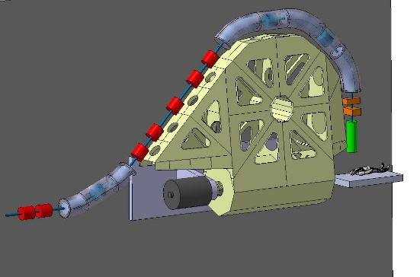
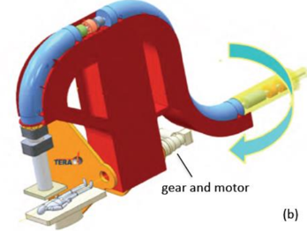
SC-magnet gantry development
Supported by different collaboration schemes, HITRIplus, iFAST, INFN,…
  Gantries for Carbon ions are huge and heavy. Only one SC gantry in operation at NIRS, some studies in Europe.
  Objective: Develop a superconducting gantry with weight lower than 100 tons and length below 16 metres.
  Subject: a «SIGRUM» type gantry, as selected by an expert committee in Dec. 2020.
M. Pullia, HITRIplus
“U. Amaldi, et. al, TERA and CERN,
CERN-ACC-NOTE-2021-0014 ; NIMMS-Note-002

Slide 25
Other studies…
Beam dynamics
  Preliminary analysis of acceleration
  Beam stability
  Space charge (very small for Carbon, important for protons, reasonable for Helium)
  Intra-beam scattering
  Collimation/ machine protection
Operation
  Reliable, reproducible, easy-to-operate, easy-to-maintain, medical device
  Fast & safe switching between lines and settings (hardware & controls)

Slide 26
Summary
NIMMS started 20y after “PIMMS” (which gave birth to CNAO and MedAustron), to enable a next generation of medical facilities.
A toolbox of CERN core technologies and competencies, with impact on society - medicine: Superconducting magnets, Mechanics, Linac, Beam dynamics and AI/ML
Users are existing medical facilities and potential new centers, such as SEEIIST, in the South-East Europe
Rich program profiting of collaborations!

Slide 27
Questions?
elena.benedetto@cern.ch

