Slide 1

K. Long (ICL/STFC) 8 February, 2022

Slide 2
Scientific vision
CCAP mission
"Develop the technologies, systems, techniques and capabilities necessary to deliver a paradigm shift in the clinical exploitation of particles."
Scientific advancement:
  Radiobiology underpins the efficacy of
  radiotherapy
  Exciting results over the past 3 to 5 years
  indicate:
    Biological impact of γ, e—, proton, and ion beams differ
    Novel beams lead to better treatments:
      Ultra-high dose rate, FLASH
      Mini-micro beams
    Ionising radiation triggers biological, healing, processes,
    e.g. immune response
Taking the science to the next stage requires the CCAP’s multidisciplinary approach

Slide 3

Creating capability
CCAP mission
"Develop the technologies, systems, techniques and capabilities necessary to deliver a paradigm shift in the clinical exploitation of particles."
Seek to transform clinical practice of radiotherapy by:
  Delivering systematic and definitive radiobiology programme:
    Short term: exploit repurposed cLinac at the Hammersmith Hospital
    Medium/long term: create “LhARA”:
      The Laser-hybrid Accelerator for Radiobiological Applications
  Proving the feasibility of the laser-hybrid approach
  Laying the foundations for a transformation of ion-beam therapy
    Fully automated, patient-specific:
      Implies triggerable source, online imaging, integrated fast feedback and control

Slide 5
Centre for the Clinical Application of Particles; details
Institutional composition, structure & leadership remains the same
Host Department: Physics
Departments involved:
Faculty of Medicine:
  Division of Cancer in the Department of Surgery and Cancer
Imperial Academic Health Science Centre
Imperial College NHS Healthcare Trust:
  Department of Radiation Physics and Radiobiology
Department of Physics:
  High Energy Physics Group
  Plasma Physics Group
Imperial CRUK Cancer Centre
Institute of Cancer Research
John Adams Institute
Oxford Institute for Radiation Oncology
Kenneth Long (Physics)
Ajit Kurup (Physics)
Date of approval: July 2017

Slide 6
Centre for the Clinical Application of Particles; details
Composition remains the same
Management Board
Eric Aboagye (Dept. of Surg. & Cancer, FOM)
Iain McNeish (Head Division of Cancer, Dept. of Surg. & Cancer, FOM)
Daniel Elson (Dept. Surgery and Cancer, FoM))
Uwe Oelfke (ICR, Deputy Head Div. of Rtherapy and Imaging,
Head Joint Dept. of Physics; ICR and Royal Marsden NHS Trust)
Jamie Meredith (Director of Operations, Imperial/ICR Convergence Science Centre)
Dorothy Gujral (Consultant clinical oncologist, IC NHS H/c Trust)
Claire Hardiman (Head of Rad. Phys. & Rbio Dept. at IC H/c NHS Trust)
Matthew Williams (Consultant clinical oncologist, IC NHS H/c Trust)
Philip Burrows (JAI, Oxford)
Juergen Pozimski (Physics, HEP, JAI)
Amato Giacca (Director, OIRO)
Frank van den Heuvel (OIRO)
Zulfikar Najmudin (Physics, Plasma)
Jaroslaw Pasternak (Physics, HEP)

Slide 7
Centre for the Clinical Application of Particles; details
International Advisory Board
Michael Lamont (CERN, Director of Accelerators and Computing, Chair)
Paul Bolton (LMU, laser-plasma scientist, retired)
Michael Baumann (Chairman and Scientific Director, DKFZ, Heidelberg)
Britta Sorensen (Dept. of Clinical Medicine, DCPT, Arhuus)

Slide 8
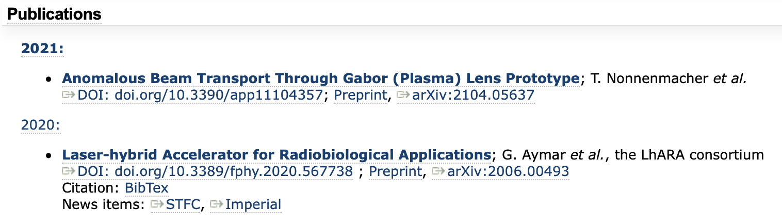
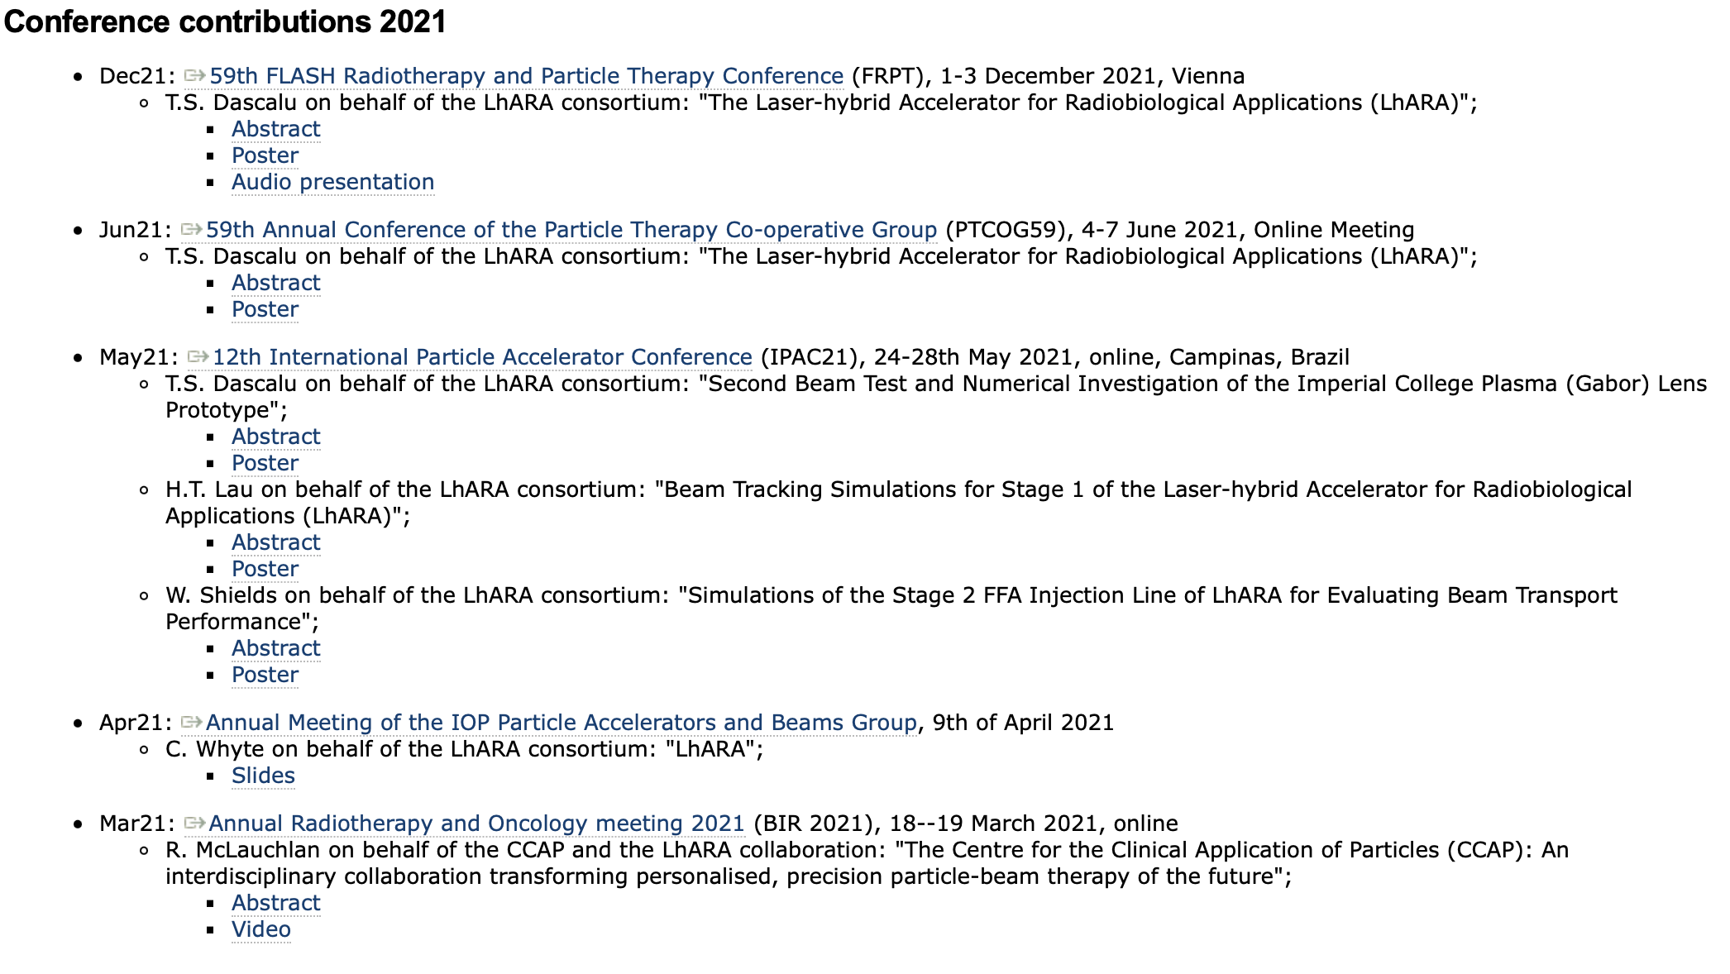
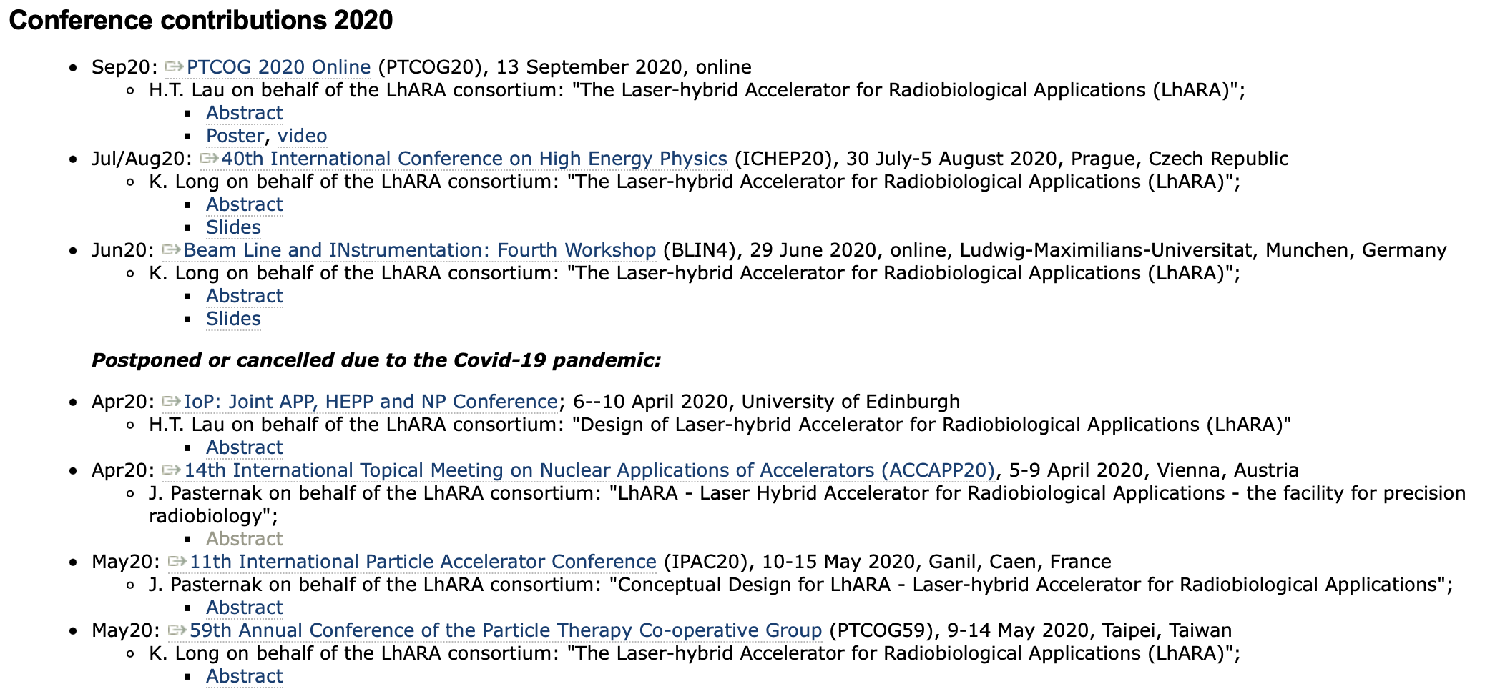
Overview of activity past two years
Please summarise the 5 most relevant activities undertaken since Centre of Excellence status approval
2 publications in peer-reviewed journals
10 conference presentations

Slide 9
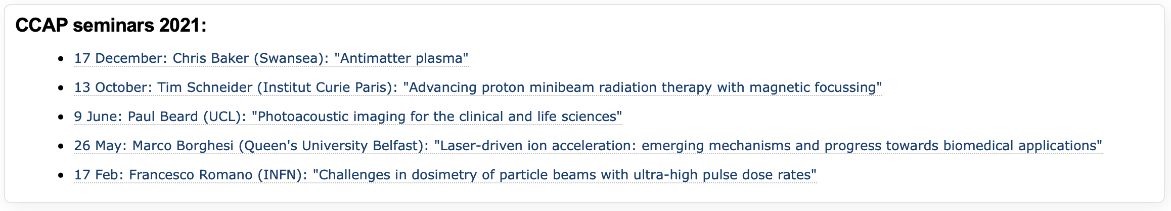
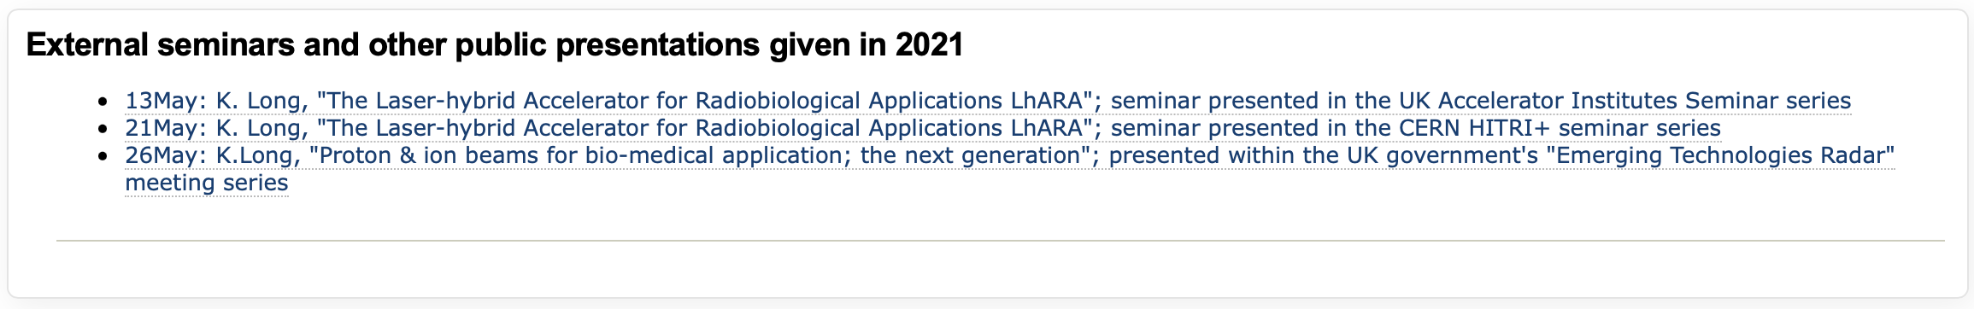
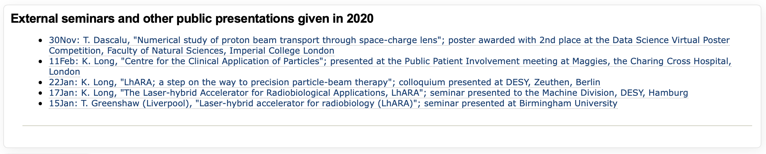
Overview of activity past two years
7 seminars presented at ICL or ICR
7+1 seminars presented at external institutions

Slide 10
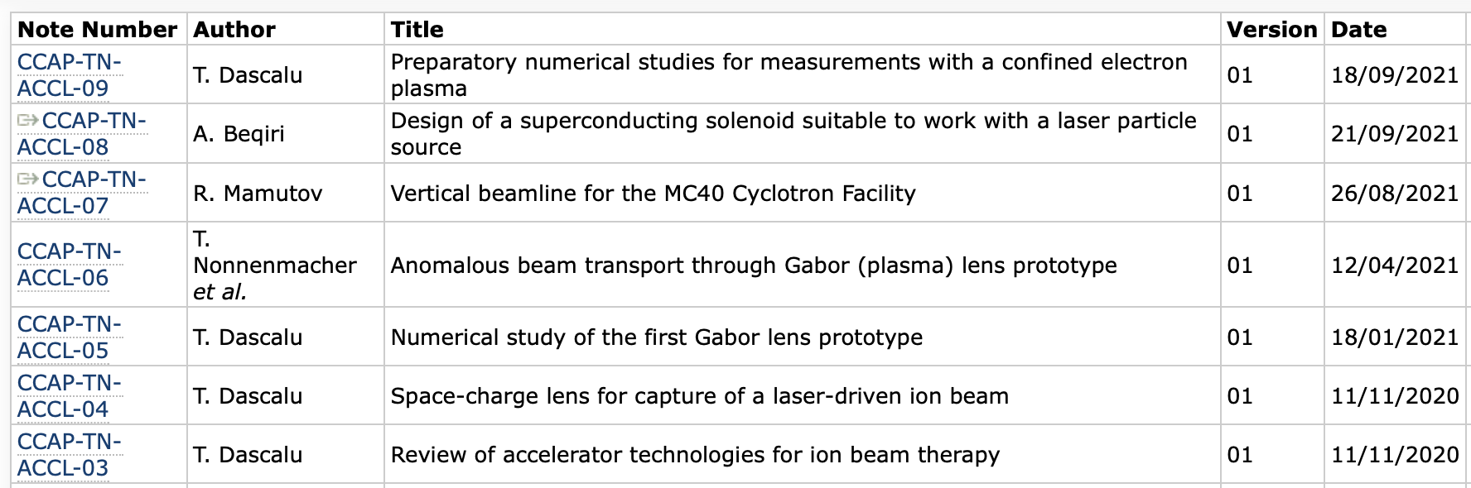
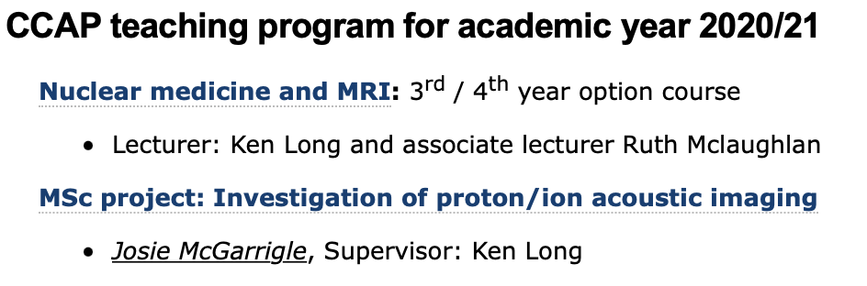
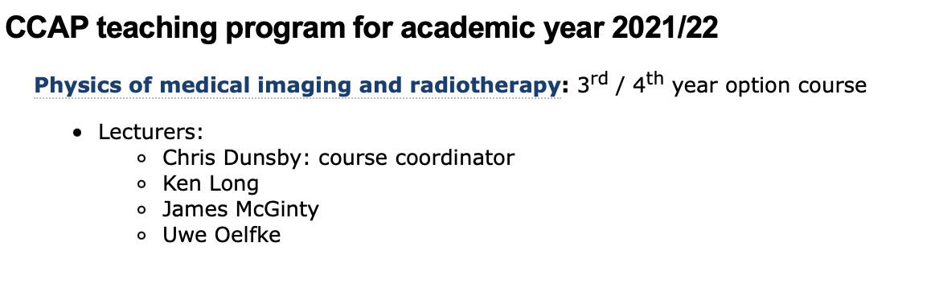
Overview of activity past two years
4 PhD students (one to be vivaed this month)
1 MSc student
Contributions to evolution of Physics u/g degree programme
Graduate students:
HT Lau: 2017 start; submitted 06Dec21
T.S. Dascalu: 2019 start; Class of 64
M. Maxouti; 2021 start; JAI/PPD
J. McGarrigle; 2021 start; ICL/CNRS Institut Curie
Passed viva:
03Feb22

Slide 11
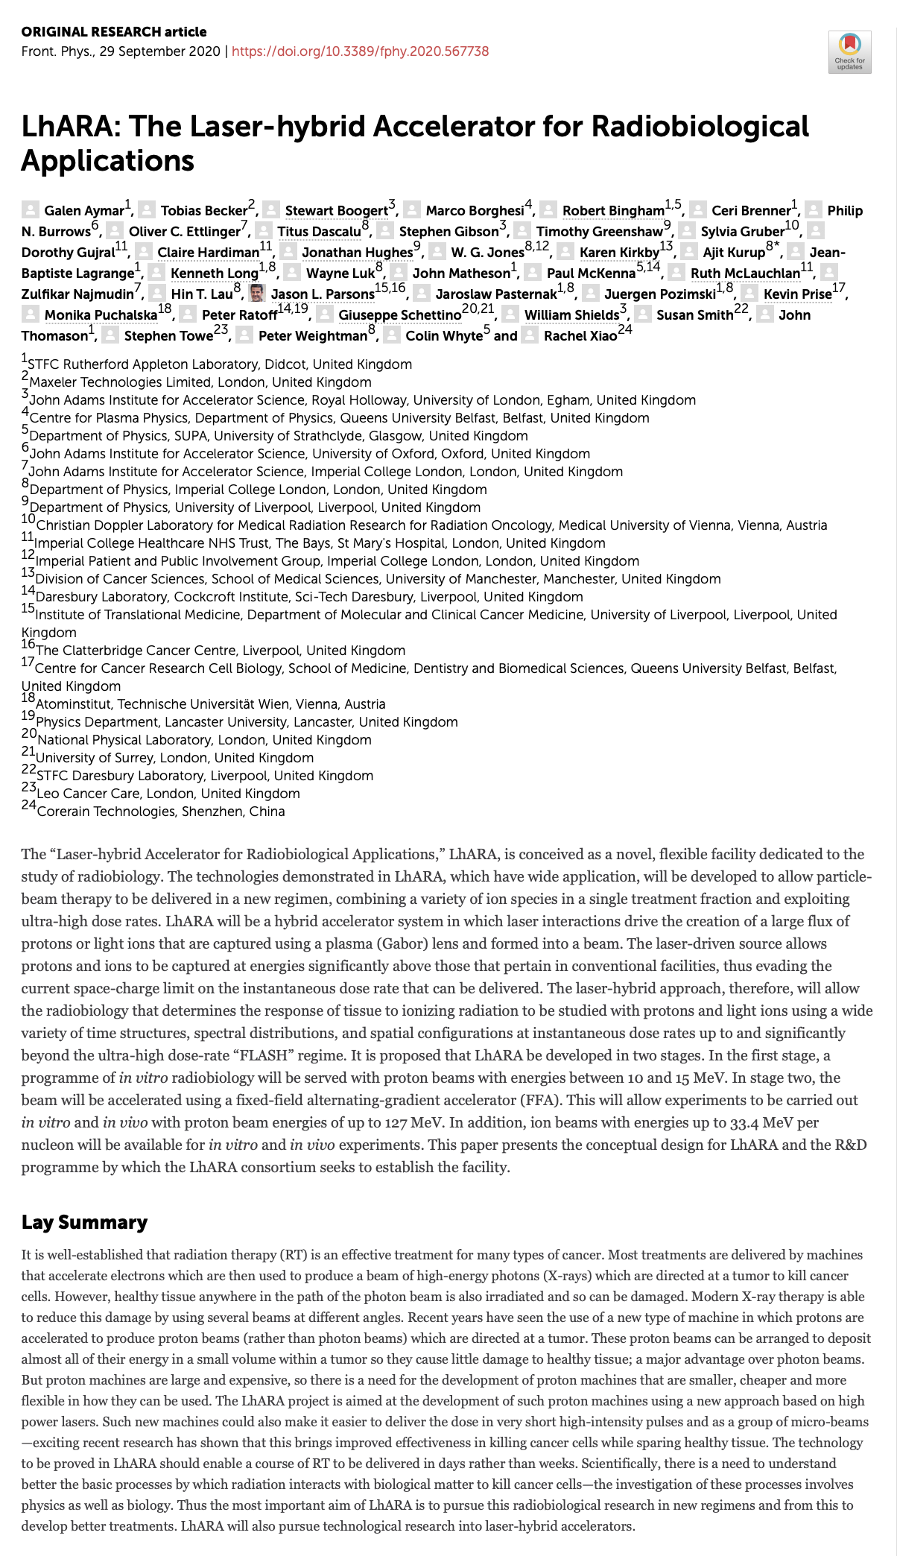
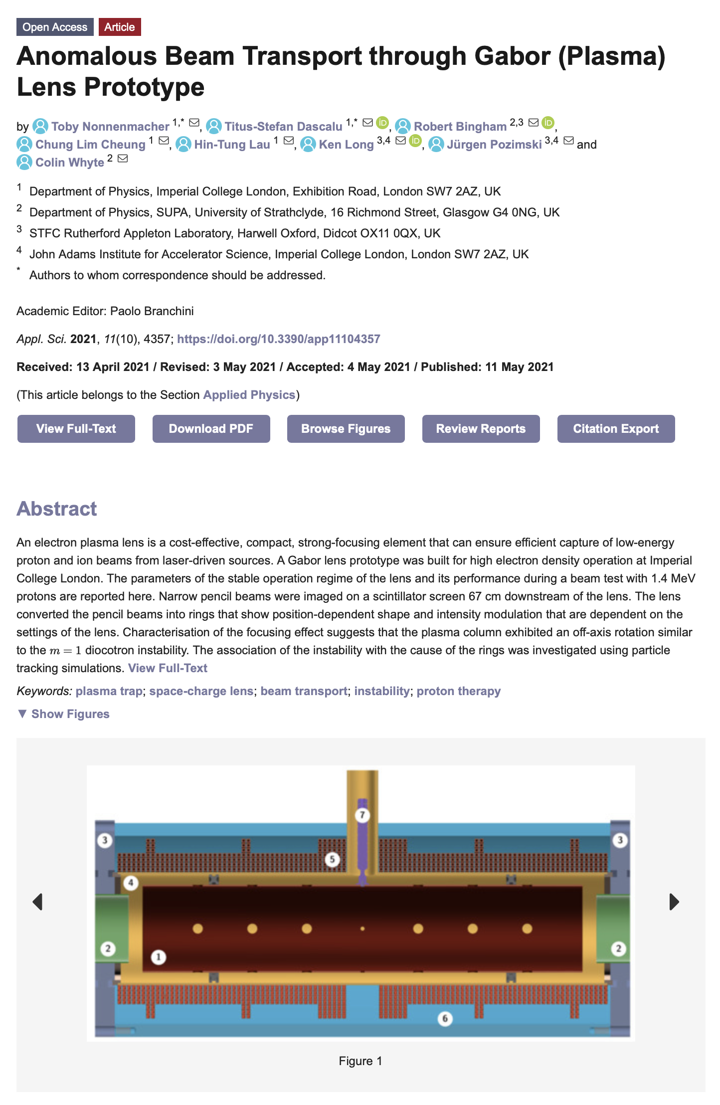
Research highlights past two years
Please highlight 3 exemplar activities and up to 5 publications that result from collaboration across centre members and include a narrative around the centre role in these outputs since last review or inception if no review has taken place yet
(Successful?) proposal to UKRI
Infrastructure Advisory Committee

Slide 12
Outline of proposed activities for the following 2 years
Please describe the vision and activities for the next couple of years
Principal themes:
Development of research capability in electron FLASH RT:
  Hardiman/McLauchlan (Dept. of Rad. Phys & Rbio, IC H/c NHS Trust):
    Opportunity to re-purpose a cLinac for electron and photon FLASH radiobiology
    Exploitation:
      CCAP (Div of Cancer, Physics, ICR, OIRO) but also
      Liverpool Institute of Systems, Molecular and Integrative Biology
Development of LhARA initiative:
  Develop LhARA initiative “within the framework of the ITRF”:

Slide 13
Opportunity
Please describe any barriers or obstacles that the Centre has encountered that may prevent or slow progress
Centre status has been crucial:
  Nucleus of the multidisciplinary collaboration;
  Framework to reach out to & partner with strong national and international laboratories
Significant proposal in preparation, strong CCAP leadership
CCAP: overall leadership
and lead 4 of 5 technical
workpackages
Co-chairs: T. Greenshaw (Liv)
Y. Presado (Inst. Curie)
CNRS partner
Co-spokes: A. Giacca (OIRO)
K. Long (IC/STFC)
Co-PMs: J. Parsons (Liv)
C. Whyte (Strath)
E. Boella (Lanc)
N. Dover (ICL)
R. Gray (Strth)
M. Charlton (Swns)
W. Bersche (Man)
J. Bamber (ICR)
E. Harris (ICR)
J. Matheson (PPD)
R. McLauchlan (CXH)
T. Price (Brm)
C. Welsch (Liv)
N. Bliss (DL)
J. Pasternak (ICL)

Slide 14
Opportunity at Imperial’s new White City Campus
CCAP central to multi-institute multi-discip. radiobiology/biomed. physics intiative:
  Working to develop cLinac at Hammersmith Hospital for research in the short term
  Driving force behind the LhARA initiative in the medium and longer terms
CCAP strengths:
  Physics, medical physics, clinical oncology
At the moment, CCAP (at Imperial) is less strong in:
  Radiation biology and biomedical physics to bridge the gap between physics and clinic
Ambition:
  Short term:
    Build cLinac exploitation and LhARA initiative into substantial multidisciplinary programme
  Medium/long term:
    Establish CCAP & Imperial as the intellectual leader in the radiation biology and biomedical physics of the LhARA programme
Opportunity:
  Build up a radiation biology and biomedical physics activity/institute in the White City
    Exploit co-location with Hammersmith Hospital, Dept. of Chemistry facilities in the White City
  Engaging now with emerging discussion of the development of the White City Campus

Slide 15
First steps …
LhARA within the ITRF:
  Now working with STFC to understand how £2M for Preliminary Phase should be invested
  Clear need for an independent review of LhARA proposal prior to its finalisation:
    Would the IAB be willing to take this on and form the nucleus of the review panel?
CCAP/LhARA activity proposed for development in the White City:
  Initial discussions underway
  If the initiative develops as hoped, IAP advice will be essential in its development
Looking forward to working with you all …

Slide 17
ITRF proposal to IAC
ITRF:
Unique, compact, single-site national research infrastructure
High-dose-rate ions from protons through oxygen
Energies sufficient for both in-vitro and in-vivo studies
Bespoke end stations ... great flexibility in the spatial, temporal, and spectral characteristics of the ion beams
Fundamentally new biological mechanisms ... will be elucidated
Exploitation will promote the disruptive ... technologies
Place the UK at the forefront of the science and technology of PBT

Slide 18
Overview
Understanding the collaboration and the lab programmes ...
… a work in progress …
Co-chairs: T. Greenshaw (Liv)
Y. Presado (Inst. Curie)
Co-spokes: A. Giacca (OIRO)
K. Long (IC/STFC)
Co-PMs: J. Parsons (Liv)
C. Whyte (Strath)

Slide 19
Mapping onto ITRF proposal
Multidisciplinary collaboration comes together to create proposal
Lab (ASTeC, CLF, PPD, TD), HEIs from across the 4 nations,
accelerator institutes, key international partners
CDR/TDR development – WP6
End-station specification, design – WP5
Exploit/benefit from Brm ambition to create vertical beamline
Scientific measurement and prototype test and commission
Programme to address key technical risks – WP2, WP3, WP4:
WP2: Source
WP3: Capture
WP4: Realtime, shot-by-shot, non-destructive dose-mapping

Slide 20
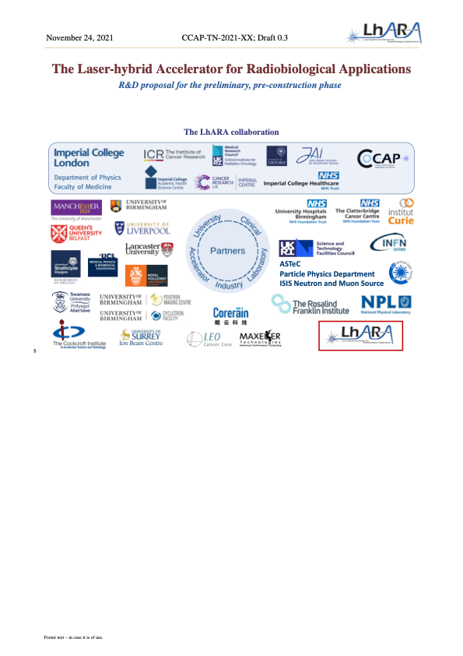
Next steps
Ambition: draft of proposal by LhARA collaboration meeting: 15Dec21
  Not quite going to make it
Draft ready to share with “internal review” panel by end of 2021:
Review
  Panel:
    CCAP IAC: M.Lamont (CERN, Chair), P.Bolton (LMU, retired), M.Baumann (DKFZ), B.Sorensen (Arhuus)
      Plus I.Robson (STFC, retired)
  Target date for review:
    Feb22

Slide 21
WP2: Laser-driven proton and ion source
Boella (CI/Lanc),
Dover (JAI/ICL),
Gray (CI/Strath)
Key expertise:
CLF, ICL, Lanc, QUB,
Strath, JAI, CI, …
SLAC

Slide 22
WP3: Proton and ion capture
Bertsche (CI/Mnch),
Charlton (Swns),
Baker (Swns)
Yr2:
Measurements
of non-neutral
plasma to inform
design of second
prototype
Yr5:
Second prototype
design ready for
commissioning
and test
Key expertise:
Swansea, CI/Manch,
JAI/ICL, …
Berkeley, SLAC

Slide 23
WP4: Ion-acoustic dose mapping
Bamber (ICR),
Harris (ICR),
Matheson (PPD)
Key expertise:
ICR, PPD, UCL,
ICL, …

Slide 24
WP5: Novel end-station development
McLauchlan (IC NHS H/c Trst),
Price (Brm),
Welsch (CI/Liv)
Key expertise:
Brm, ICR, Manch, ICL,
Liv, NPL, QUB, RFI, …
… & across collaboration
CNRS IC, INFN Ctnia

Slide 25
WP6: Facility Design and Integration
N. Bliss (TD),
Pasternak (JAI/IC)
Key expertise:
ASTeC, TD, CI, JAI, Strth,
…
CERN

