Slide 1

K. Long (ICL/STFC) and A. Giacca (OIRO, OU) 12 January, 2022

Slide 2
Scientific vision
CCAP mission
"Develop the technologies, systems, techniques and capabilities necessary to deliver a paradigm shift in the clinical exploitation of particles."
Scientific advancement:
  Radiobiology underpins the efficacy of
  radiotherapy
  Exciting results over the past 3 to 5 years
  indicate:
    Biological impact of γ, e—, proton, and ion beams differ
    Novel beams lead to better treatments:
      Ultra-high dose rate, FLASH
      Mini-micro beams
    Ionising radiation triggers biological, healing, processes,
    e.g. immune response
Taking the science to the next stage requires the CCAP’s multidisciplinary approach

Slide 3

Creating capability
CCAP mission
"Develop the technologies, systems, techniques and capabilities necessary to deliver a paradigm shift in the clinical exploitation of particles."
Seek to transform clinical practice of radiotherapy by:
  Delivering systematic and definitive radiobiology programme:
    Short term: exploit repurposed cLinac at the Hammersmith Hospital
    Medium/long term: create “LhARA”:
      The Laser-hybrid Accelerator for Radiobiological Applications
  Proving the feasibility of the laser-hybrid approach
  Laying the foundations for a transformation of ion-beam therapy
    Fully automated, patient-specific:
      Implies triggerable source, online imaging, integrated fast feedback and control

Slide 5
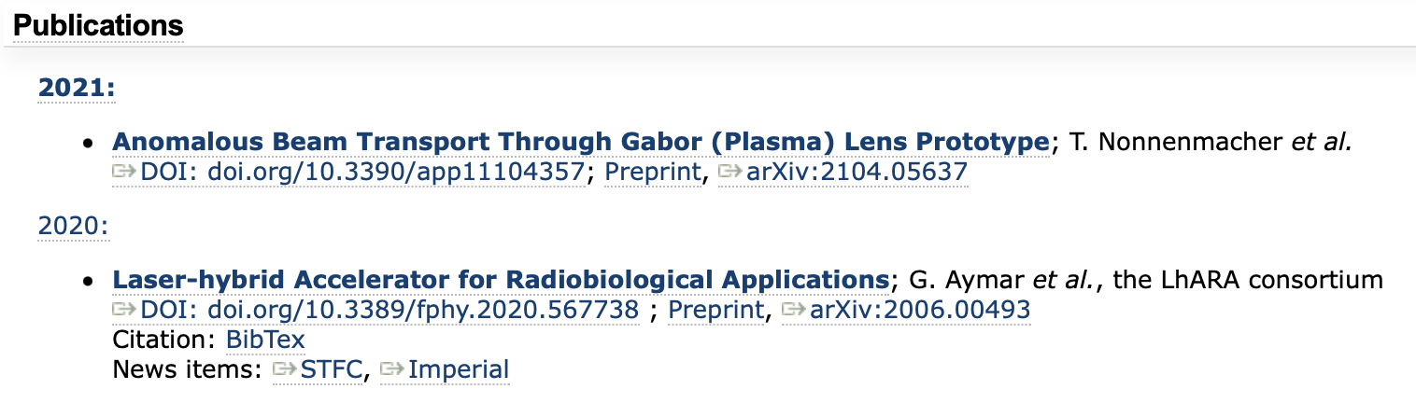
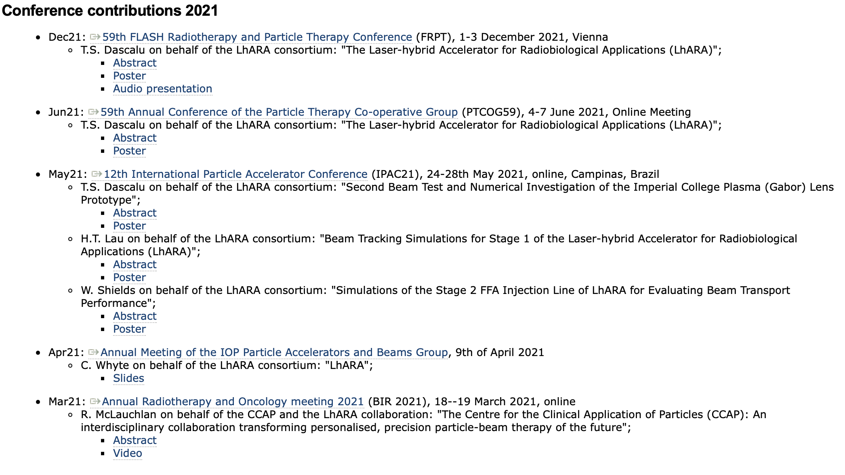
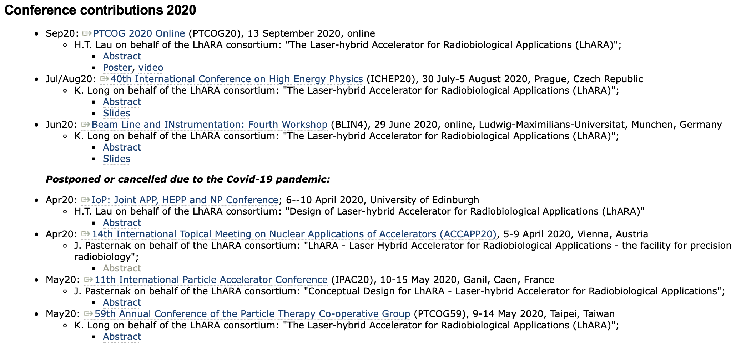
3. Overview of activity undertaken
Please summarise the 5 most relevant activities undertaken since Centre of Excellence status approval
2 publications in peer-reviewed journals
10 conference presentations

Slide 6
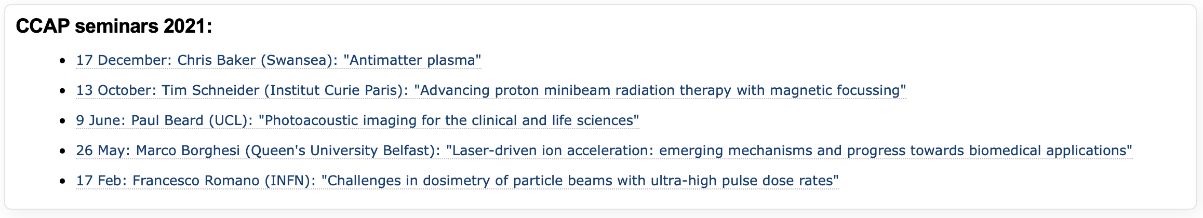
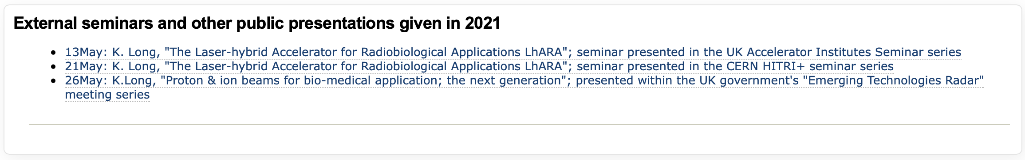
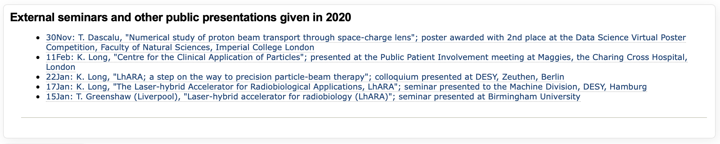
3. Overview of activity undertaken
7 seminars presented at ICL or ICR
7+1 seminars presented at external institutions

Slide 7
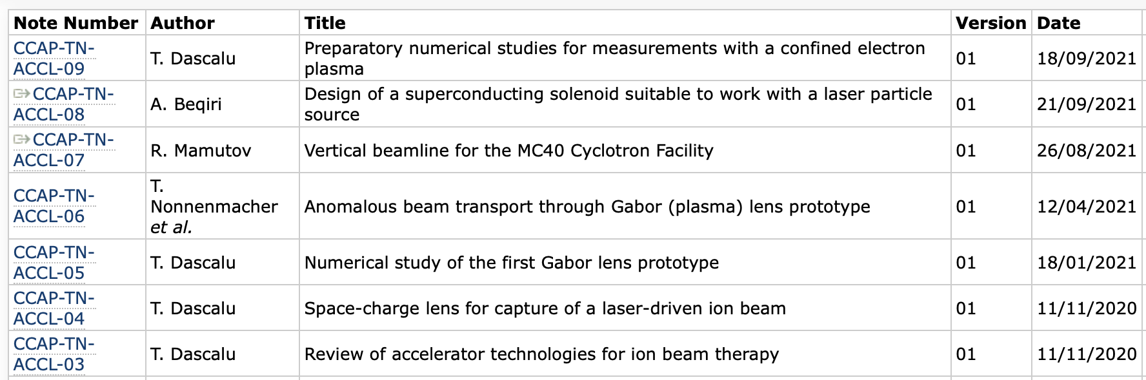
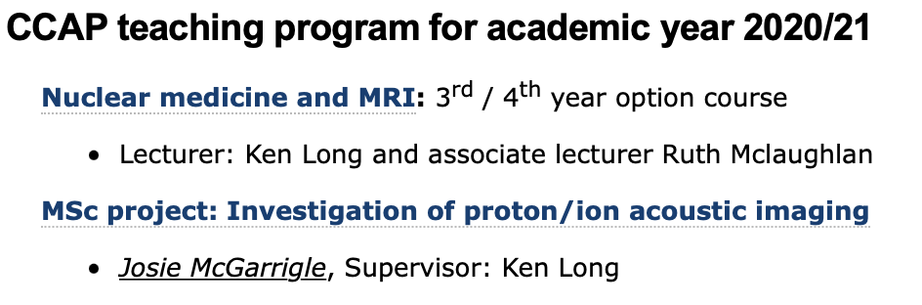
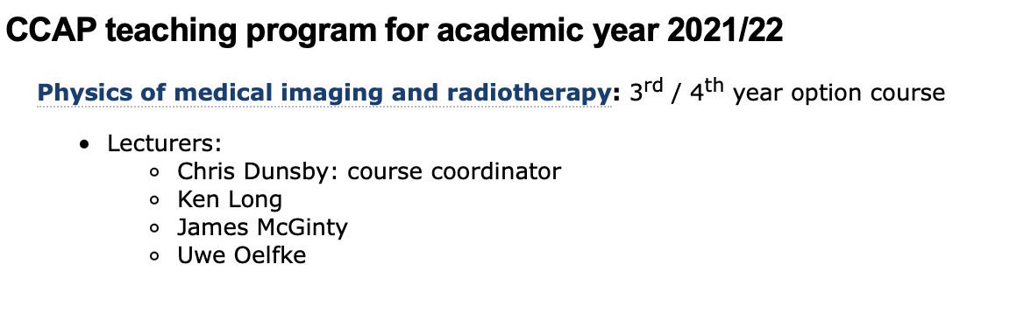
3. Overview of activity undertaken
4 PhD students (one to be vivaed this month)
1 MSc student
Contributions to evolution of Physics u/g degree programme
Graduate students:
HT Lau: 2017 start; submitted 06Dec21
T.S. Dascalu: 2019 start; Class of 64
M. Maxouti; 2021 start; JAI/PPD
J. McGarrigle; 2021 start; ICL/CNRS Institut Curie
Submitted
06Dec21

Slide 8
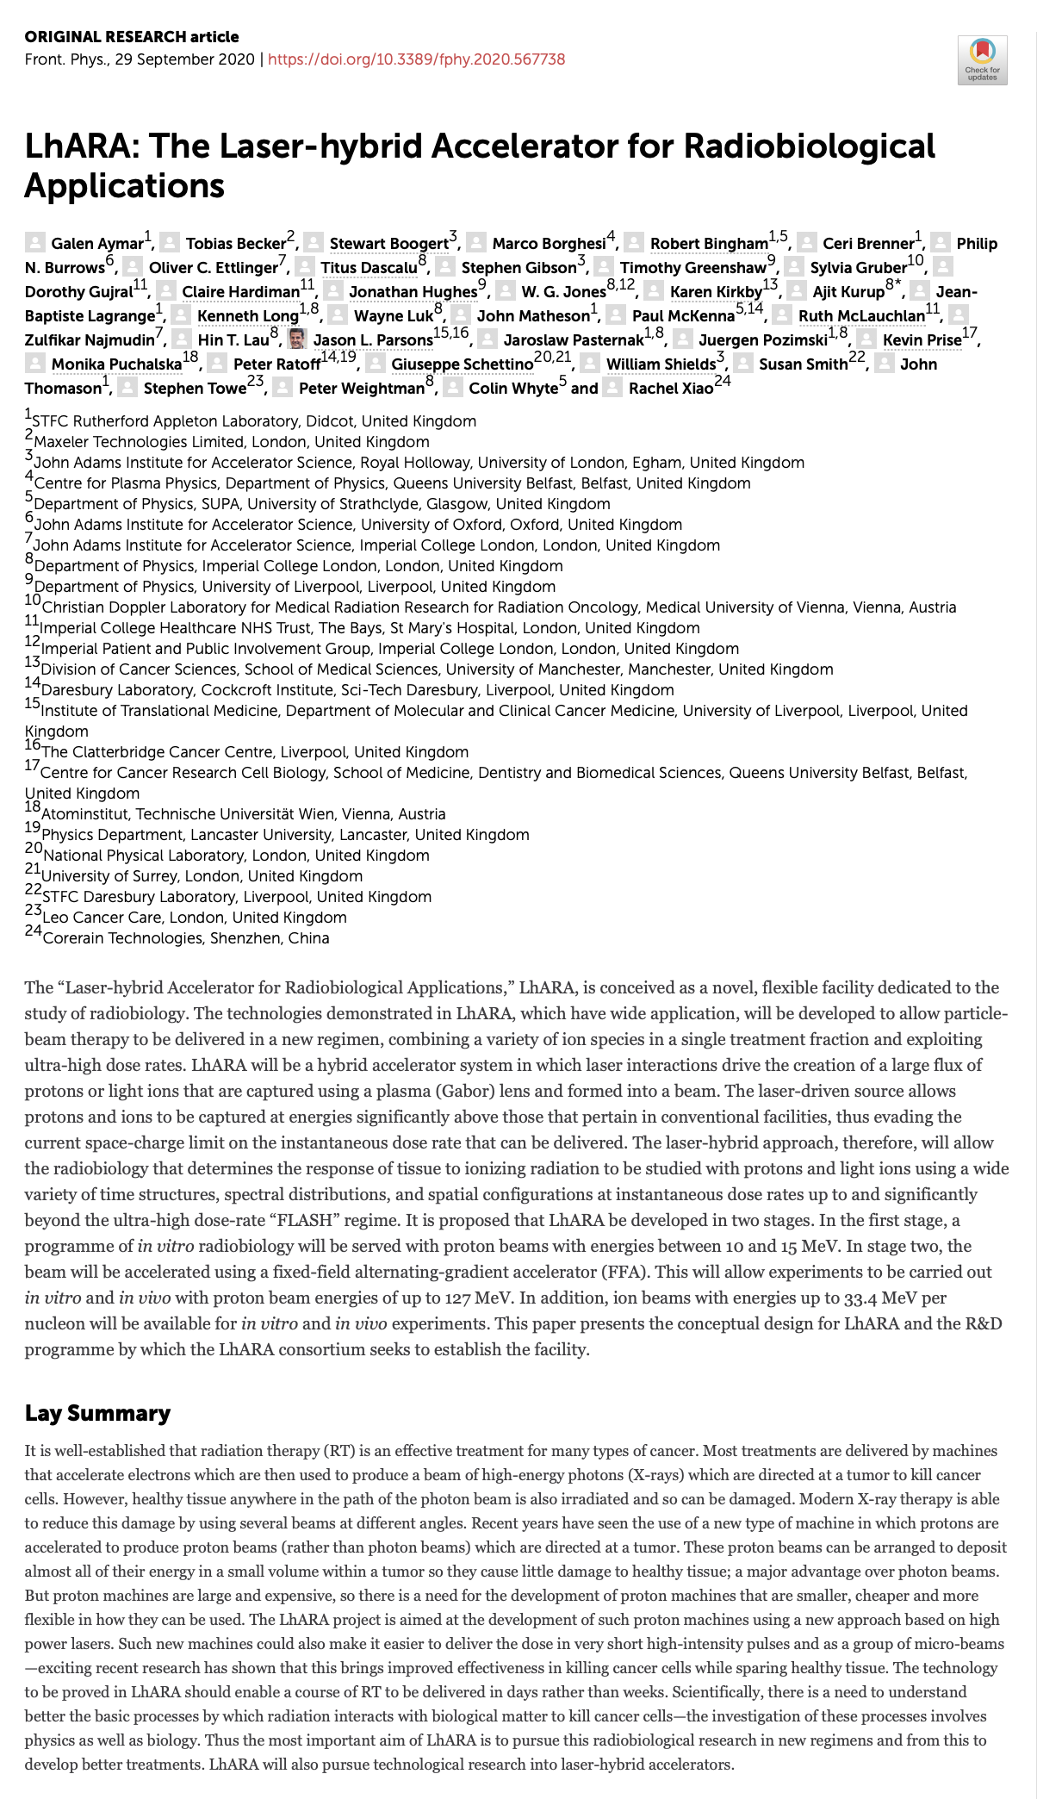
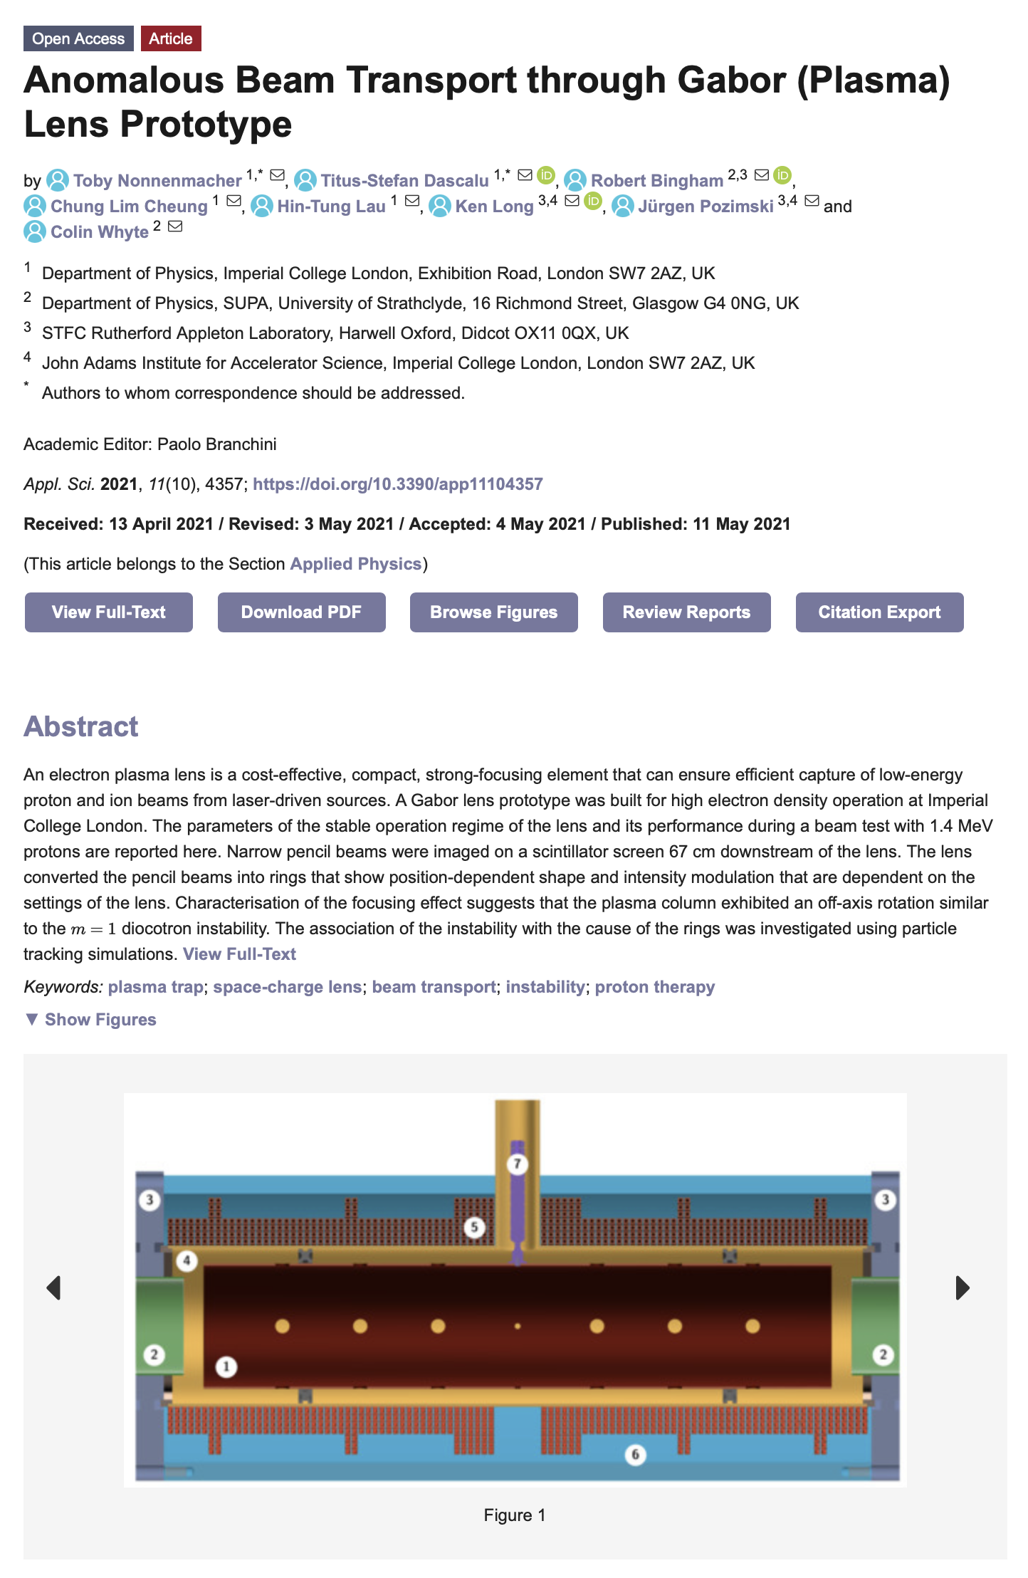
4. Research highlights
Please highlight 3 exemplar activities and up to 5 publications that result from collaboration across centre members and include a narrative around the centre role in these outputs since last review or inception if no review has taken place yet
(Successful?) proposal to UKRI
Infrastructure Advisory Committee

Slide 9
6. Outline of proposed activities for the following 2 years
Please describe the vision and activities for the next couple of years
Principal themes:
Development of research capability in electron FLASH RT:
  Hardiman/McLauchlan (Dept. of Rad. Phys & Rbio, IC H/c NHS Trust):
    Opportunity to re-purpose a cLinac for electron and photon FLASH radiobiology
    Exploitation:
      CCAP (Div of Cancer, Physics, ICR, OIRO) but also
      Liverpool Institute of Systems, Molecular and Integrative Biology
Development of LhARA initiative:
  Develop LhARA initiative “within the framework of the ITRF”:

Slide 10
5. Centre funding
Please list up to 5 grants awarded in the last couple of years that resulted from collaboration across centre members and explain the centre role in securing these
Energetic in seeking resource:
  Programme requires substantial infrastructure
    Less easy to secure such resource
Funding secured to:
  Complete LhARA preCDR
  Maintain and build CCAP graduate-student programme
Present focus:
  Development of significant (~£10M across collaboration) programme through the UKRI IAC
    £2M Preliminary Phase award not announced but being discussed with STFC Daresbury Laboratory personnel
Hardiman et al. IC NHS H/c Trust:
  Seek permission, then resource, to repurpose cLinac

Slide 11
7. Barriers to success – Opportunity
Please describe any barriers or obstacles that the Centre has encountered that may prevent or slow progress
Centre status has been crucial:
  Nucleus of the multidisciplinary collaboration;
  Framework to reach out to & partner with strong national and international laboratories
Significant proposal in preparation, strong CCAP leadership
CCAP: overall leadership
and lead 4 of 5 technical
workpackages
Co-chairs: T. Greenshaw (Liv)
Y. Presado (Inst. Curie)
CNRS partner
Co-spokes: A. Giacca (OIRO)
K. Long (IC/STFC)
Co-PMs: J. Parsons (Liv)
C. Whyte (Strath)
E. Boella (Lanc)
N. Dover (ICL)
R. Gray (Strth)
M. Charlton (Swns)
W. Bersche (Man)
J. Bamber (ICR)
E. Harris (ICR)
J. Matheson (PPD)
R. McLauchlan (CXH)
T. Price (Brm)
C. Welsch (Liv)
N. Bliss (DL)
J. Pasternak (ICL)

Slide 12
7. Opportunity at the White City
CCAP central to multi-institute multi-discip. radiobiology/biomed. physics intiative:
  Working to develop cLinac at Hammersmith Hospital for research in the short term
  Driving force behind the LhARA initiative in the medium and longer terms
CCAP strengths:
  Physics, medical physics, clinical oncology
At the moment, CCAP (at Imperial) is less strong in:
  Radiation biology and biomedical physics to bridge the gap between physics and clinic
Ambition:
  Short term:
    Build cLinac exploitation and LhARA initiative into substantial multidisciplinary programme
  Medium/long term:
    Establish CCAP & Imperial as the intellectual leader in the radiation biology and biomedical physics of the LhARA programme
Opportunity:
  Build up a radiation biology and biomedical physics activity/institute in the White City
    Exploit co-location with Hammersmith Hospital, Dept. of Chemistry facilities in the White City
  Engaging now with emerging discussion of the development of the White City Campus

Slide 14
1. Centre for the Clinical Application of Particles; details
Institutional composition, structure & leadership remains the same
Host Department: Physics
Departments involved:
Faculty of Medicine:
  Division of Cancer in the Department of Surgery and Cancer
Imperial Academic Health Science Centre
Imperial College NHS Healthcare Trust:
  Department of Radiation Physics and Radiobiology
Department of Physics:
  High Energy Physics Group
  Plasma Physics Group
Imperial CRUK Cancer Centre
Institute of Cancer Research
John Adams Institute
Oxford Institute for Radiation Oncology
Kenneth Long (Physics)
Ajit Kurup (Physics)
Date of approval: July 2017
Latest annual report: November 2019

Slide 15
1. Centre for the Clinical Application of Particles; details
Composition remains the same
Management Board
Eric Aboagye (Dept. of Surg. & Cancer, FOM)
Iain McNeish (Head Division of Cancer, Dept. of Surg. & Cancer, FOM)
Daniel Elson (Dept. Surgery and Cancer, FoM))
Uwe Oelfke (ICR, Deputy Head Div. of Rtherapy and Imaging,
Head Joint Dept. of Physics; ICR and Royal Marsden NHS Trust)
Jamie Meredith (Director of Operations, Imperial/ICR Convergence Science Centre)
Dorothy Gujral (Consultant clinical oncologist, IC NHS H/c Trust)
Claire Hardiman (Head of Rad. Phys. & Rbio Dept. at IC H/c NHS Trust)
Matthew Williams (Consultant clinical oncologist, IC NHS H/c Trust)
Philip Burrows (JAI, Oxford)
Juergen Pozimski (Physics, HEP, JAI)
Amato Giacca (Director, OIRO)
Frank van den Heuvel (OIRO)
Zulfikar Najmudin (Physics, Plasma)
Jaroslaw Pasternak (Physics, HEP)

Slide 16
1. Centre for the Clinical Application of Particles; details
New: IAB becoming established to preform “internal” review of substantial LhARA proposal
International Advisory Board
Michael Lamont (CERN, Director of Accelerators and Computing, Chair)
Paul Bolton (LMU, laser-plasma scientist, retired)
Michael Baumann (Chairman and Scientific Director, DKFZ, Heidelberg)
Britta Sorensen (Dept. of Clinical Medicine, DCPT, Arhuus)
Being set up; projected first meeting Jan22

Slide 17
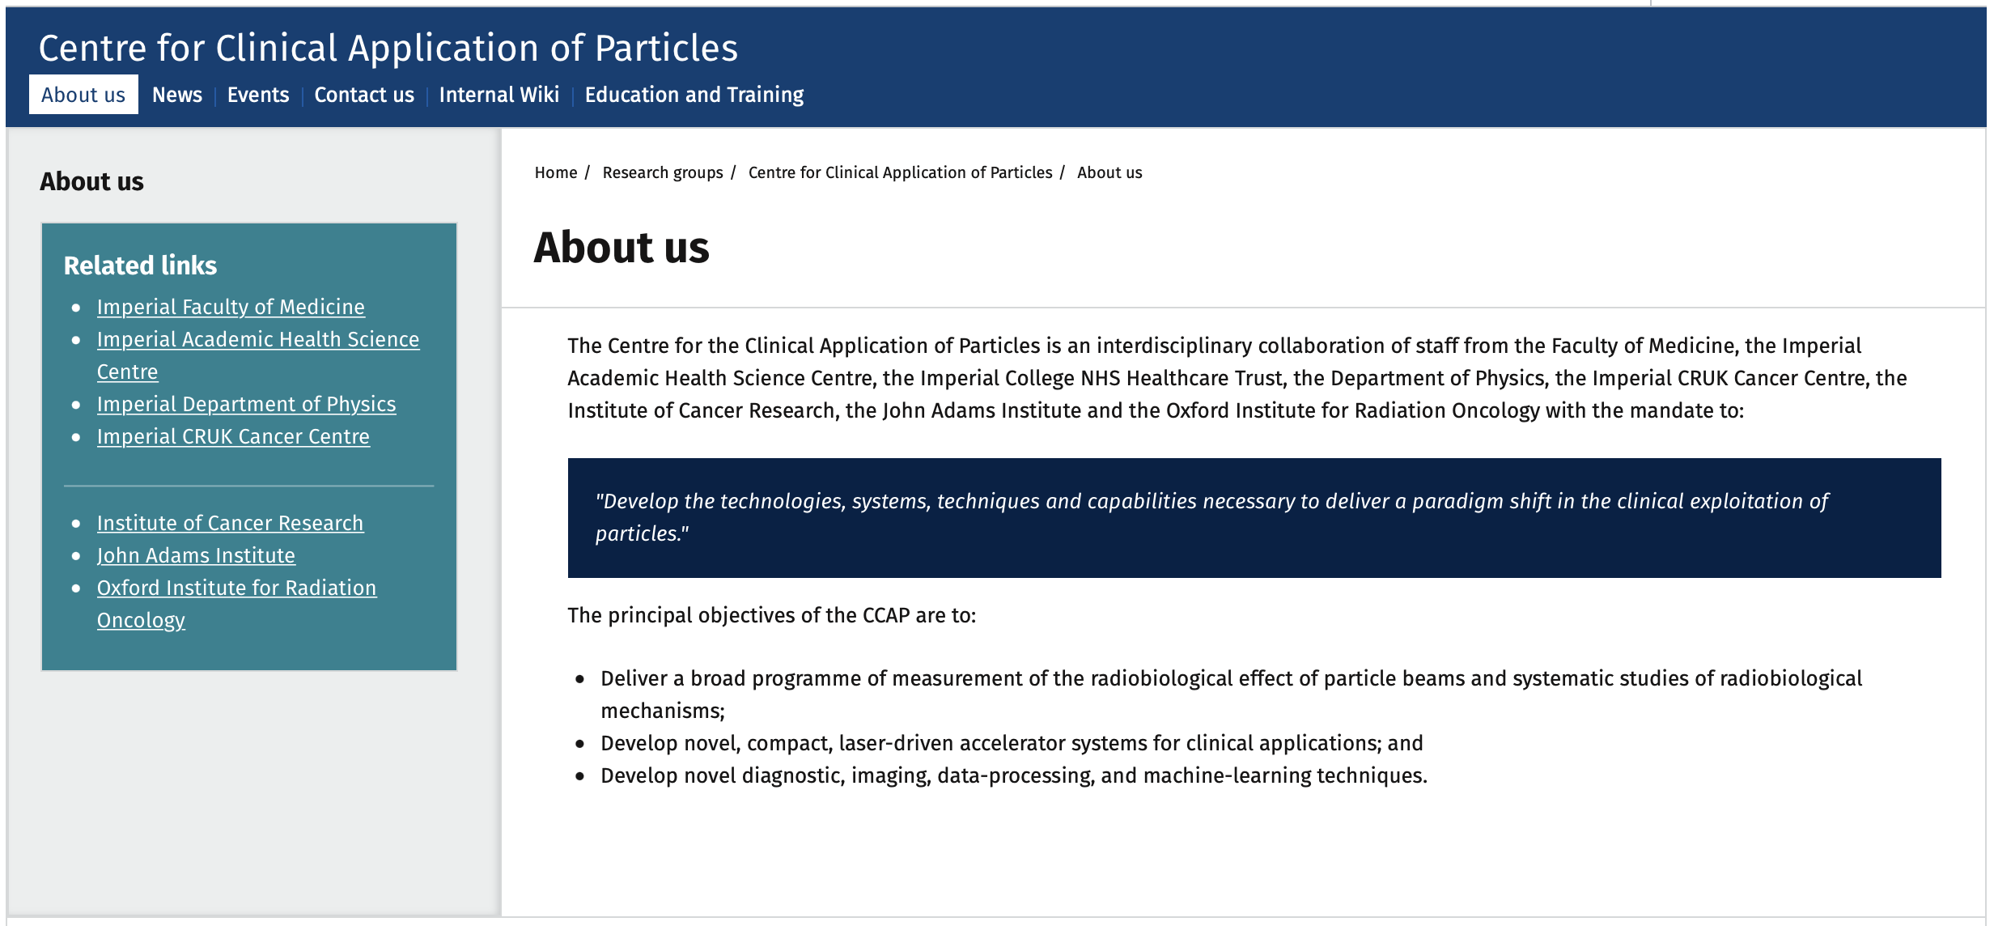
2. Scopes and objectives; unchanged
Mission, aims and objectives remain the same

