Slide 1
LhARA – CAD SCHEME 2
Floor Plan 30m x 14m
24/07/2019

Slide 2
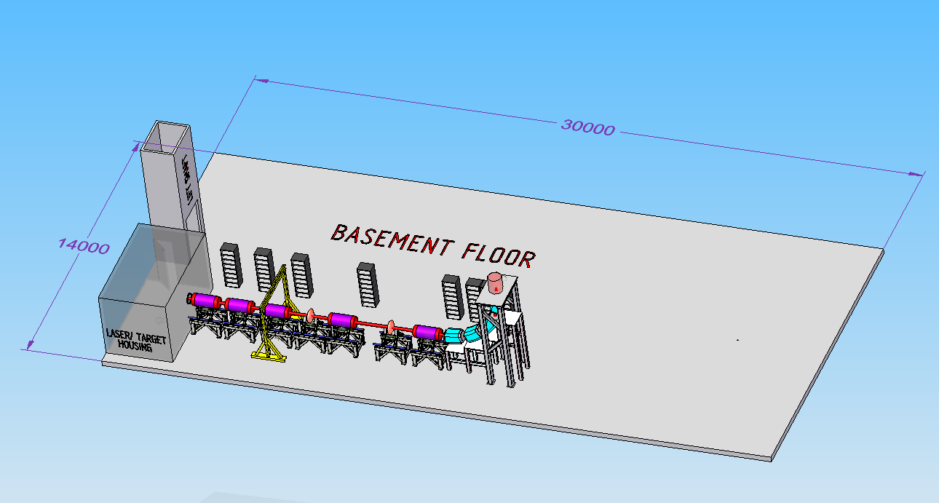
IN-VITRO BEAMLINE

Slide 3
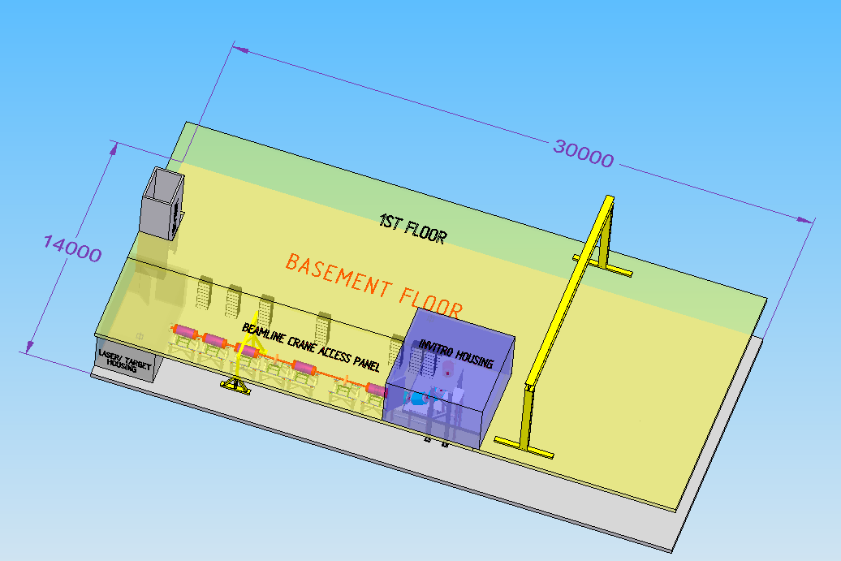
IN-VITRO, 1ST FLOOR/CRANE

Slide 4
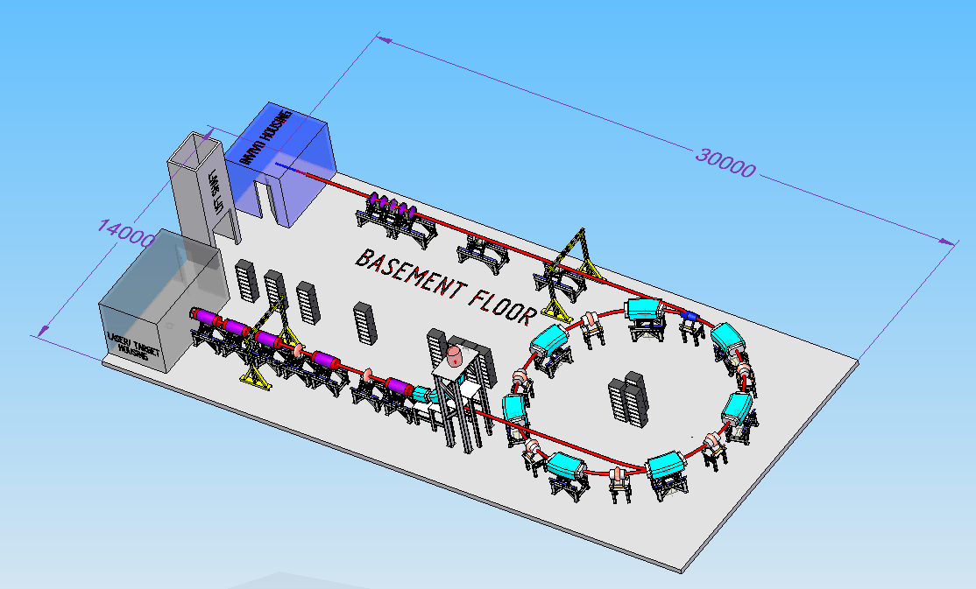
IN-VITRO & IN-VIVO LINES

Slide 5
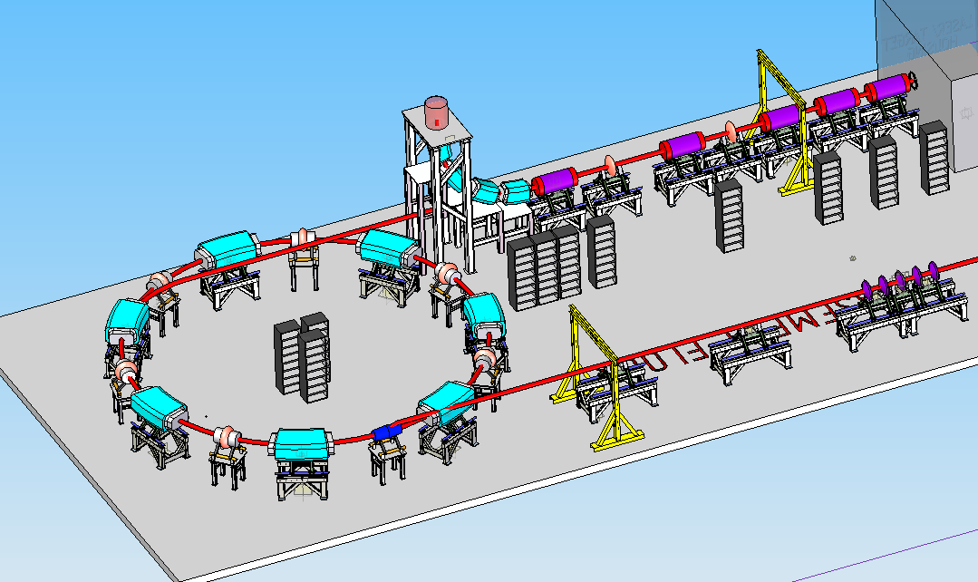

Slide 6
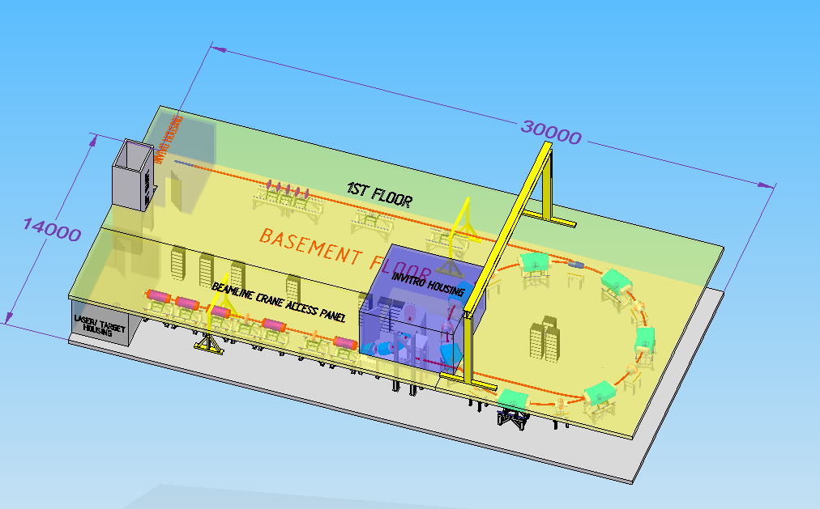
BASEMENT & 1ST FLOOR - NO SHIELDING

Slide 7
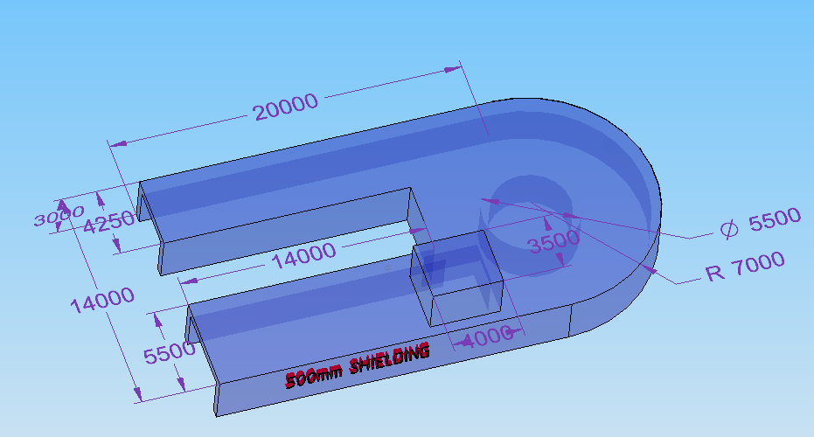
SHIELDING – 500MM

Slide 8
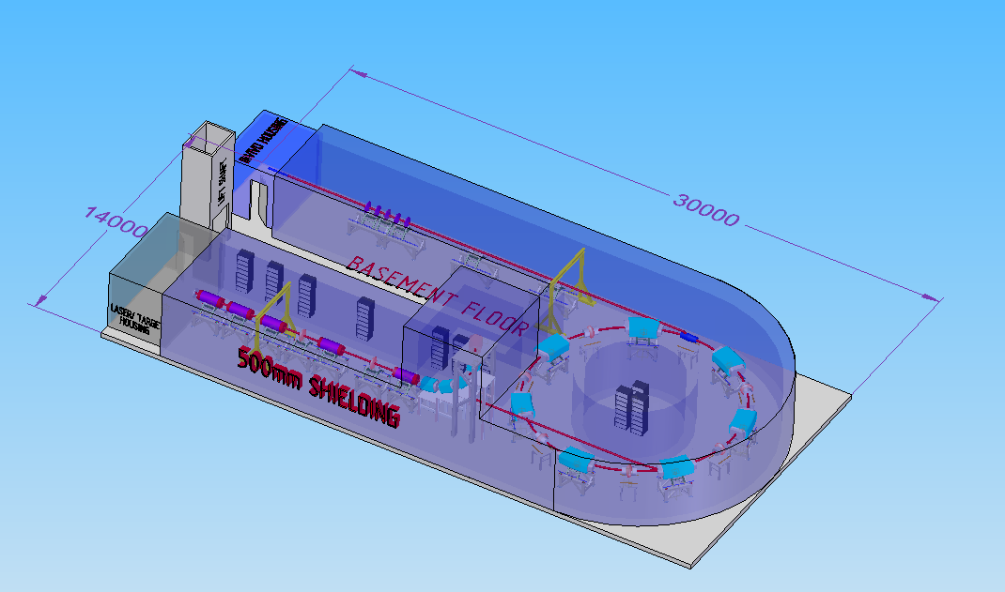
BEAMLINES WITH SHIELDING

Slide 9
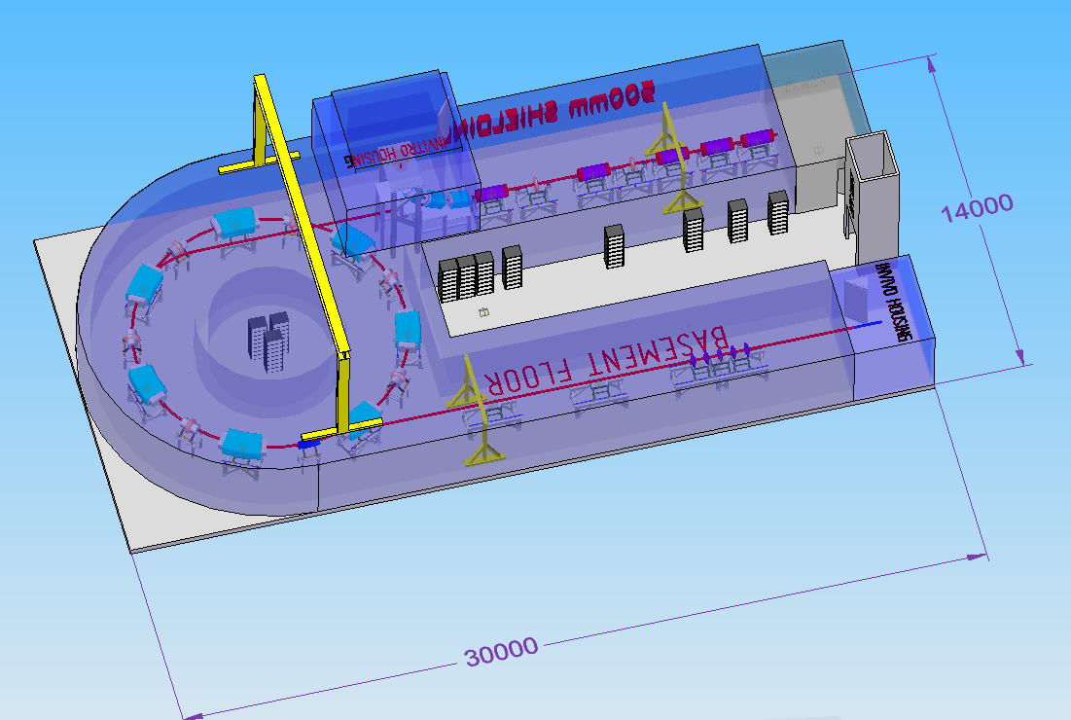

Slide 10
