Slide 1
LhARA – CAD SCHEME

Slide 2
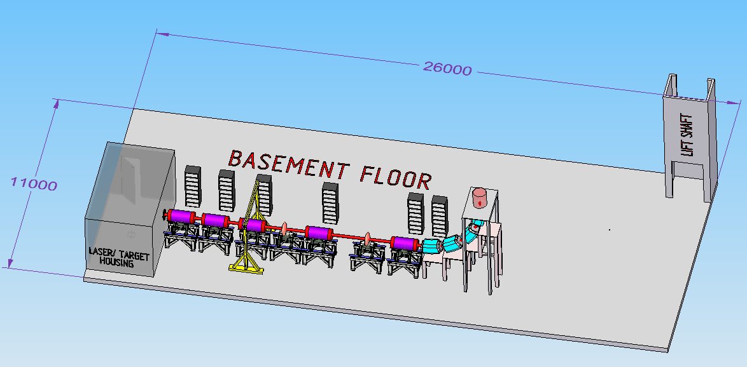
IN-VITRO BEAMLINE
Notes:
Power sources for laser and cavities?

Slide 3
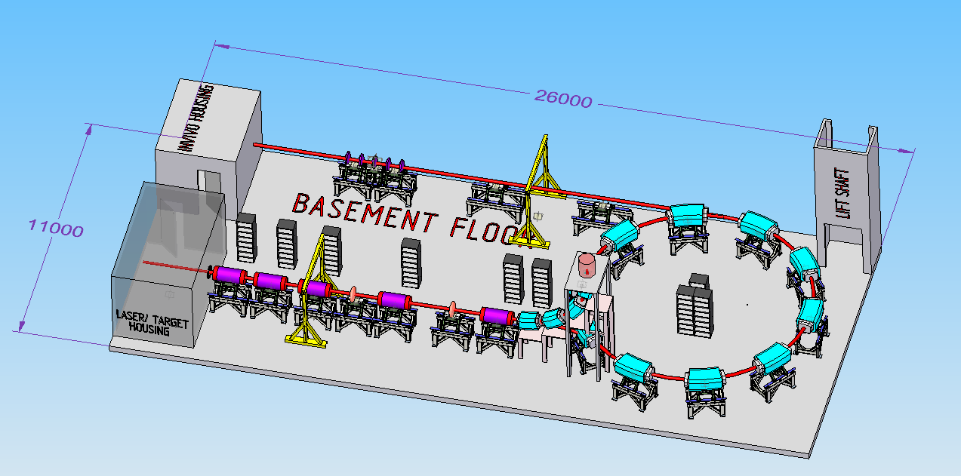
IN-VITRO & IN-VIVO LINES
Notes:
Power sources as before. Is there a need for a lens system to deliver beam to in-vitro end station. Also no kicker to separate beams to in-vitro and to ring or for extraction. Implication is that distance from last Gabor lens to ring has to increase which increases the size of the hall. No cavity in the ring.

Slide 4
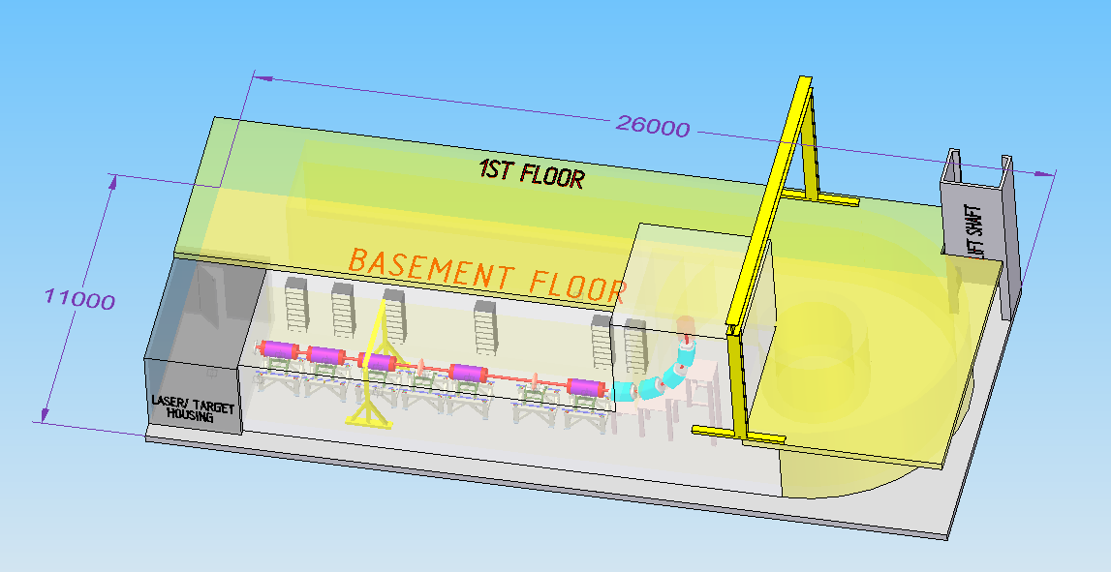
IN-VITRO, 1ST FLOOR/SHIELDING/CRANE

Slide 5
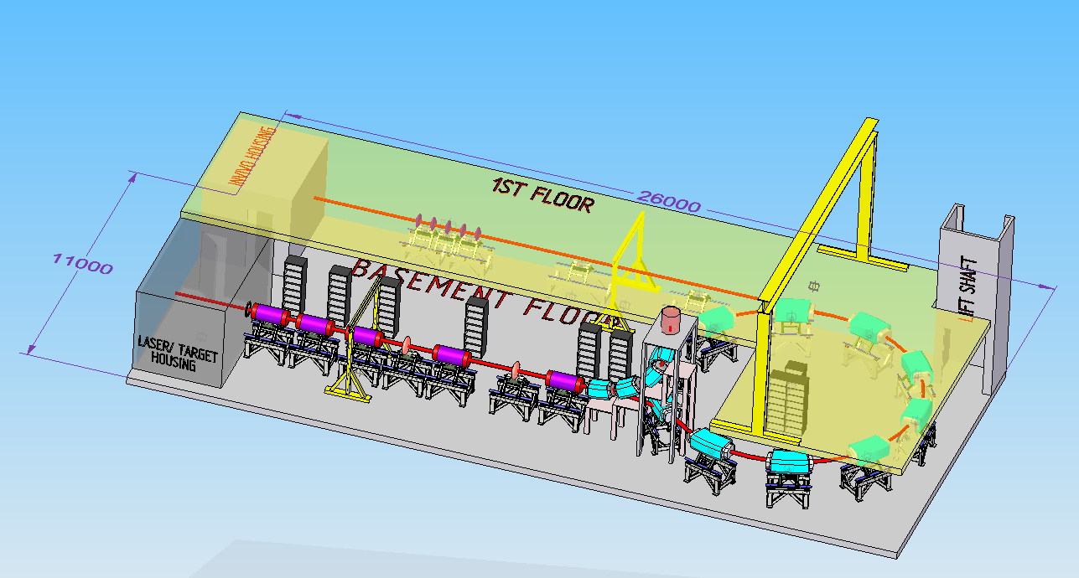
NO SHIELDING

Slide 6
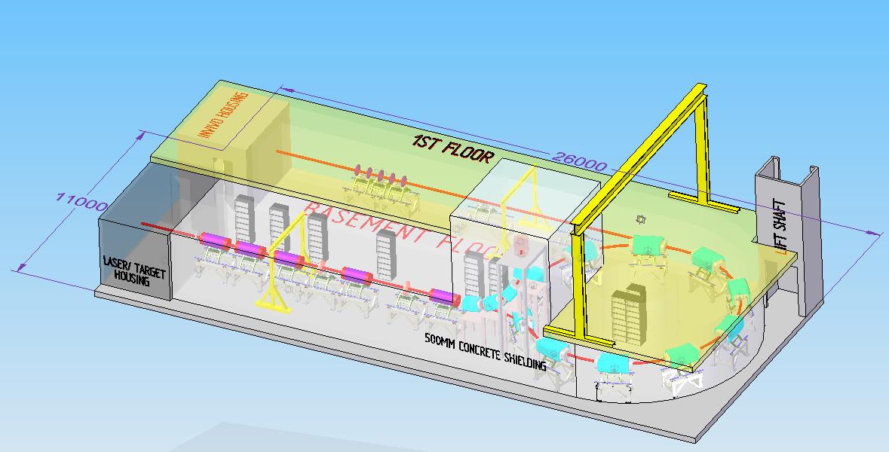
WITH SHIELDING

