Slide 1
Status of FFA Ring for LhARA Stage 2
08/10/2019

Slide 2
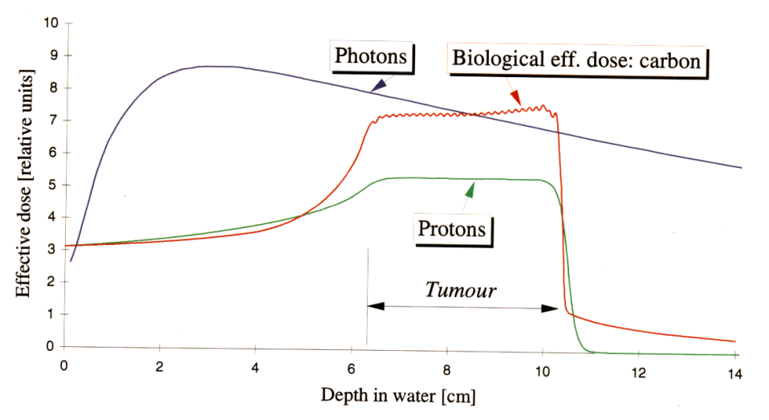
Motivations for a Medical/Radiobiological FFA (Fixed Field Accelerator)
Hadrontherapy shows up to be more effective for cancer treatment comparing
to the conventional radiotherapy!
Advantages of FFA for medical/radiobiological applications:
- High/variable dose delivery (high rep rate – 10-100 Hz)
- Variable energy operation without enegy degraders
- Compact size and low cost
- Simple and efficient extraction
- Stable and easy operation
Multiple extraction ports
Bunch to Pixel treatment.
Multiple ion capability

Slide 3
Energy for LhARA Step 2
FFA accelerator can typicaly accelerate by a factor of 3 in momentum (or more). This allows to easily achieve 127.4 MeV (starting from 15 MeV).
  Acceleration by a factor of 4 would be possible. This corresponds to 217 MeV protons.
This would correspond to 33.4 (58.7) MeV/u for C6+.
… and this is still not a lot with respect to penetration depth in water…

Slide 4
FFA types
Scaling single spiral type
  RACCAM project
  Cost effective
Scaling double spiral type
  Two magnets per cell, higher flexibility
  Considered for ISIS upgrade at RAL
Vertical Scaling
  Under study at RAL for ISIS upgrade
Tilted Sector Type
  Concept under development

Slide 5
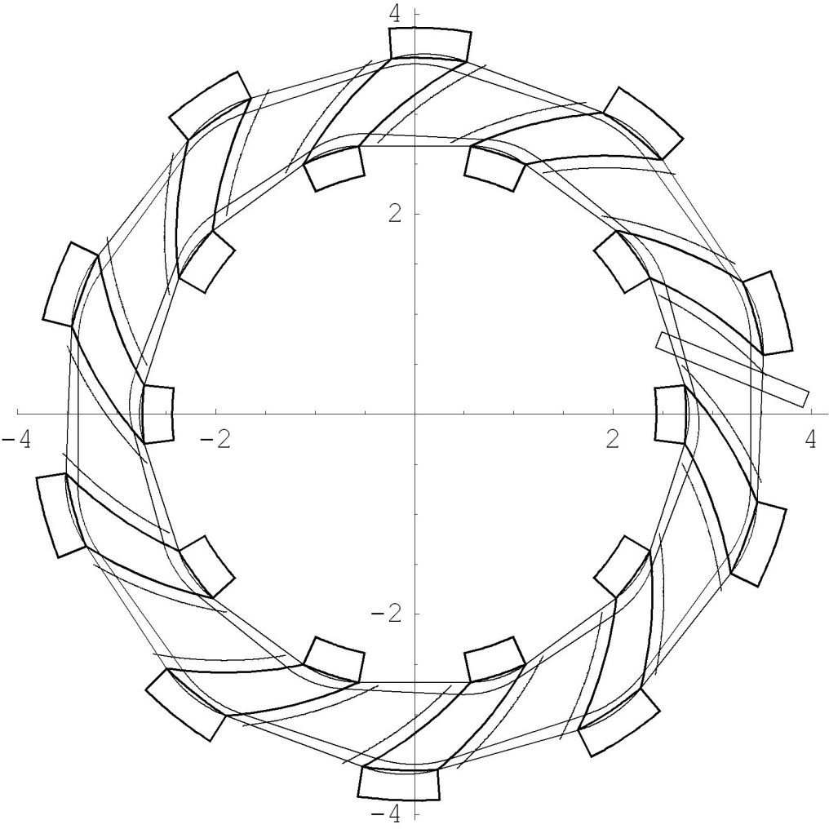
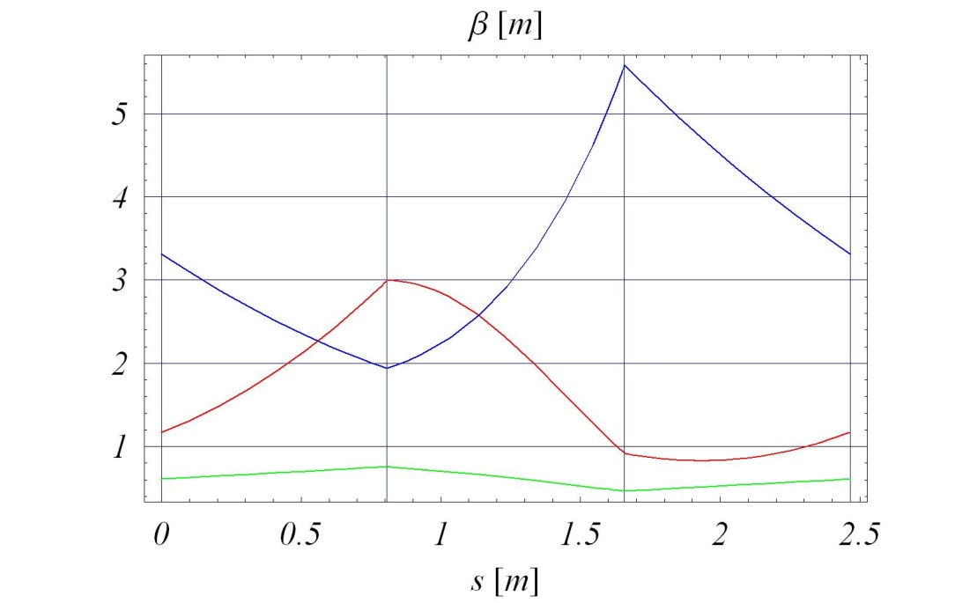
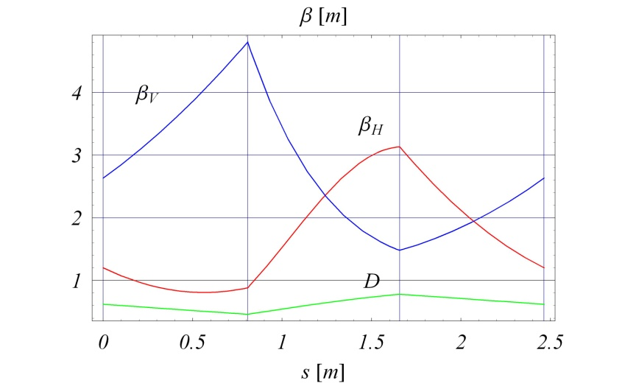
Original RACCAM Machine Parameters
N 10
k 5.
Spiral angle 53.7°
R_{max} 3.46 m
R_{min} 2.8 m
(Qx, Qy) (2.77, 1.64)
B_{max} 1.7 T
p_{f} 0.34
Injection energy 6-15 MeV
Extraction energy 75-180 MeV
h 1
RF frequency 1.9 – 7.5 MHz
Bunch intensity 310⁹ protons

Slide 6
LhARA Ring Parameters
N 10
k 5.19
Spiral angle 47.64°
R_{max} 3.49 m
R_{min} 2.92 m
(Qx, Qy) (2.82, 1.23)
B_{max} 1.4 T
p_{f} 0.34
Max Proton injection energy 15 MeV
Max Proton extraction energy 127.4 MeV
h 1
RF frequency
for acceleration (15-127.4MeV) 2.89 – 6.48 MHz
Bunch intensity few10⁸ protons
Range of other extraction energies possible
Other ions also possible

Slide 7
Magnet Types Considered for RACCAM
Magnet with distributed conductors:
Parallel gap – vertical tune more
stable,
Flexible field and k adjustment,
„Gap shaping” magnet:
Developed by SIGMAPHI
Initialy thought as more difficult
Behaves very well!
Chosen for prototype
construction!
For LhARA magnet with parallel gap with distributed windings (but single current) would be of choice. Concepts like an active clamp could be of interest too.

Slide 8
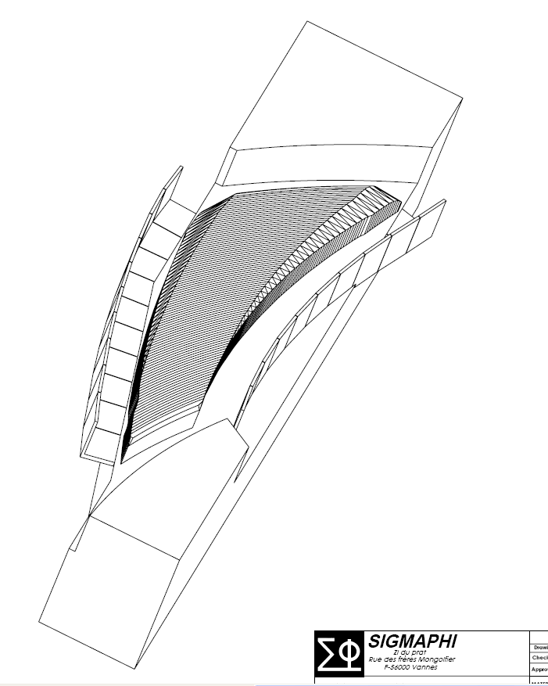
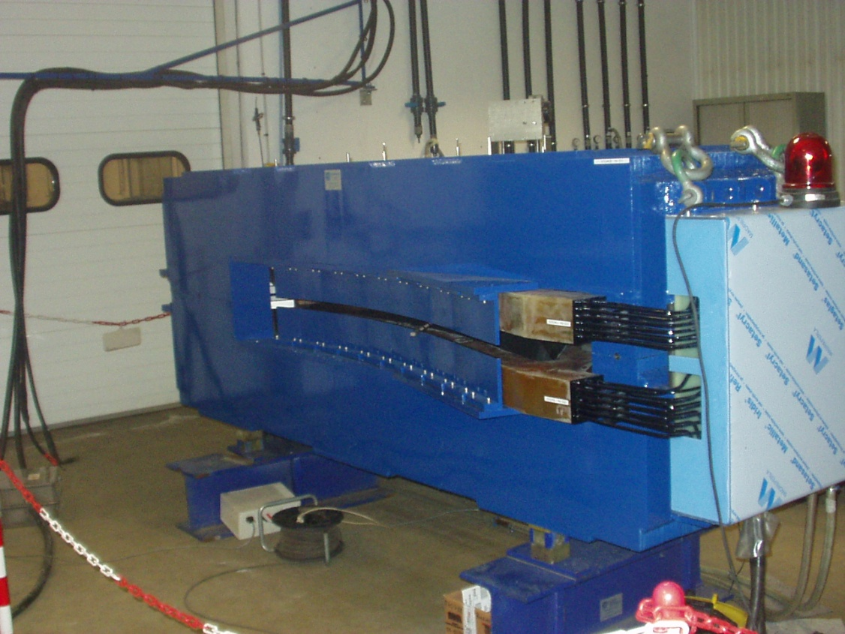
RACCAM Spiral FFAG Magnet
Prototype magnet parameters have been successfully designed and constructed in collaboration with SIGMAPHI!
Magnet uses combination of variable chamfer and field clamp to stabilize the tune.
Special shape chosen in order to optimize the mass (16 t).
Power consumption 18 kW
Magnet is of the laminated type for energy variability.
Costructed in 2008.

Slide 9
Summary
LhARA at Stage 2 can use FFA-type ring accelerator enabling variable energy beam of various types of ions
It will allow for in-vivo studies with protons and other types of ions + further in-vitro studies with ion beams
Various types of FFA can be considered for the LhARA ring
Single spiral-type seems the most cost effective at the moment
Baseline design based on adjusted RACCAM parameters is a solid choice for further studies

