Slide 1
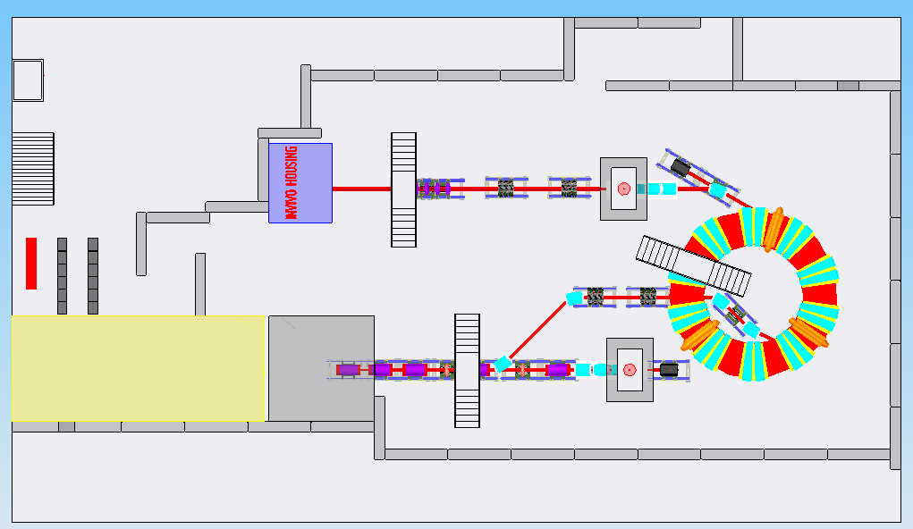
Moveable shield block for easy access of equipment
Manipulation area
Loading area
Beamline into in-vitro station
Labyrinth shielding for emergency exit
lift
Stairs for emergency exit
Racks and power supplies
Beam dump
Laser room
Chimney for vertical beamline section
Laser target
Stairs over beamline

Slide 2
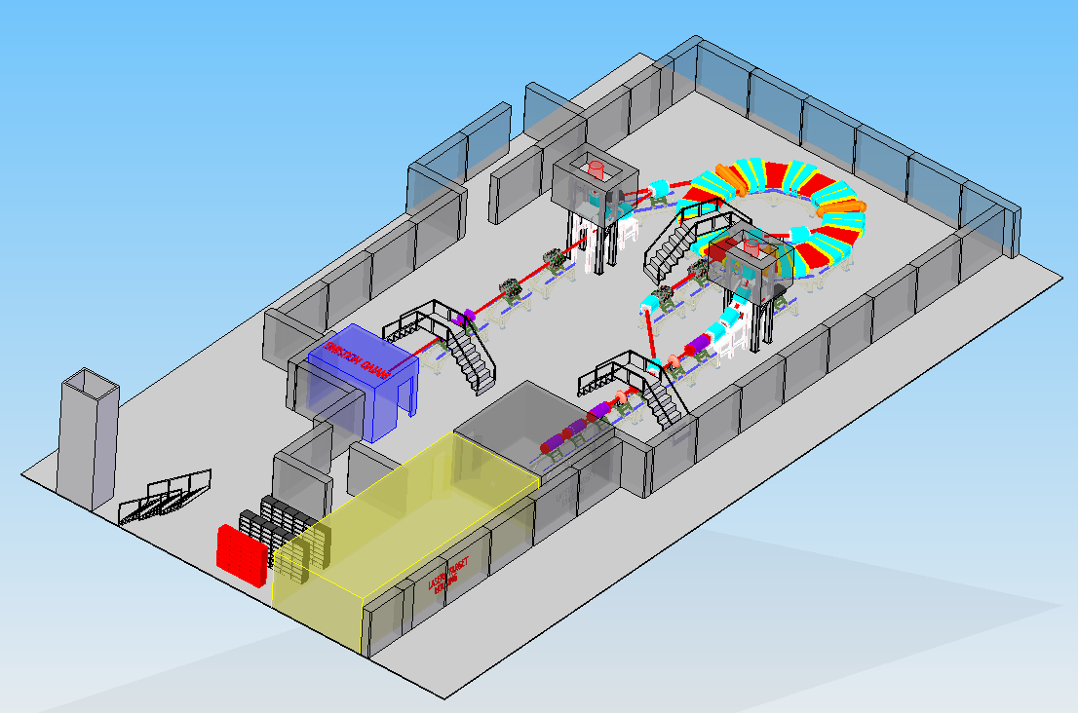
Doors for laser and in-vivo room inside labyrinth

Slide 3
