Slide 1
The Laser-hybrid Accelerator for Radiobiological Applications
LhARA
arXiv:2006.00493

Slide 2
Acknowledgements
The LhARA consortium
To be updated!

Slide 3
Challenges and opportunities
The Laser-hybrid Accelerator for Radiobiological Applications (LhARA)

Slide 4
Radiotherapy; the challenge
Cancer: second most common cause of death globally
  Radiotherapy indicated in half of all cancer patients
Significant growth in global demand anticipated:
  14.1 million new cases in 2012 ⇢ 24.6 million by 2030
  8.2 million cancer deaths in 2012 ⇢ 13.0 million by 2030
Scale-up in provision essential:
  Projections above based on reported cases (i.e. high-income countries)
  Opportunity: save 26.9 million lives in low/middle income countries by 2035
Provision on this scale requires:
  Development of new and novel techniques … integrated in a
  Cost-effective system to allow a distributed network of RT facilities
Atun, Lancet Oncol. 2015 Sep;16(10):1153-86

Slide 5
The benefit of particles
Maximise therapeutic benefit by:
  Maximising damage to tumour
  Minimising damage to healthy tissue
X-ray therapy:
  Modality used in most radiotherapy
  Dose falls exponentially with depth
  Proximity of sensitive organs limits dose to tumour

Slide 6
Particle-beam therapy
Proton and ion-beam therapy:
  Bulk of dose deposited in Bragg peak
  Significant normal-tissue sparing (entry)
  Almost no dose beyond the Bragg peak

Slide 7
The need for a step-change in capability
Growing recognition of benefits of PBT worldwide:
  70 PBT centres in operation;
  40 under construction
‘Incremental’ development
of technique
  Existing suppliers
  New initiatives
Exciting indications of benefits of novel beams …

Slide 8
LhARA … the vision
The execution of the LhARA programme will:
Create the capability to deliver particle-beam therapy in completely new regimes
  Flexibility!
    Combine a variety of ion species in a single treatment fraction and exploiting ultra-high dose rates in novel spatial- and spectral-fractionation schemes.
Make "best in class" treatments available to the many
  Automated, triggerable system:
    Demonstrate in operation a system incorporating dose-deposition imaging in a fast feedback-and-control system thereby reducing the requirement for a large gantry.

Slide 9
Radiobiology
The Laser-hybrid Accelerator for Radiobiological Applications (LhARA)

Slide 10
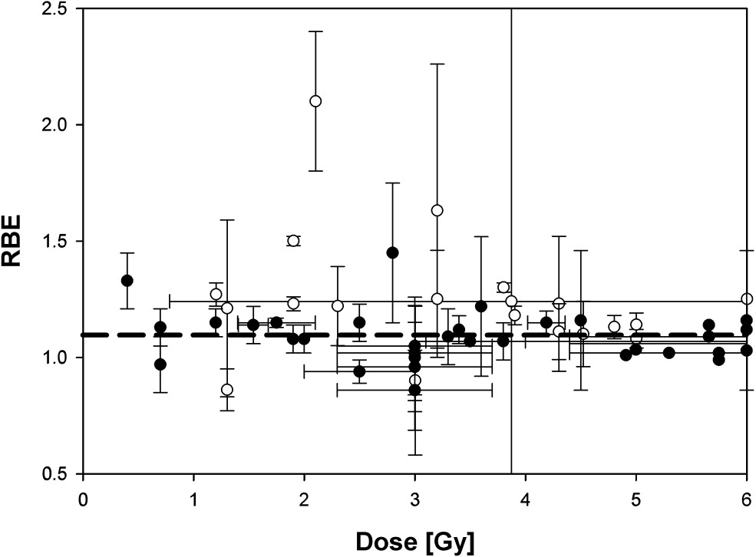
The radiobiology needs to be understood
RBE:
Ratio of dose required to gain
same biological response as
reference photon beam
Treatment planning:
  Based on ‘Relative Biological Effectiveness (RBE)
    Proton-treatment planning uses RBE = 1.1
    Effective values are used for C⁶⁺
Paganetti, van Luijk
Sem. Rad. Oncol (2013)
RBE known to depend on:
Energy, ion species
Dose & dose rate
Tissue type
Biological endpoint
Essential: improved, fundamental, understanding of radiobiology

Slide 11
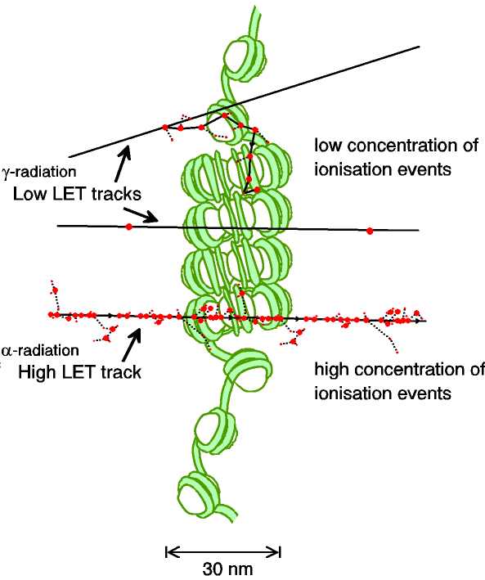
Biological impact ^{from the} physics of ionisation
Low-LET radiation:
  Repairable single/double
  strand breaks
High-LET radiation:
  Complex DNA lesions
    Multiple DNA pathways
    More difficult to repair
    Enhances cell death
Programmatic approach:
  Dynamic studies of impact of radiation
  Interpret with advanced computer models (e.g. G4DNA)

Slide 12
Radiobiology in new regimens

Slide 13
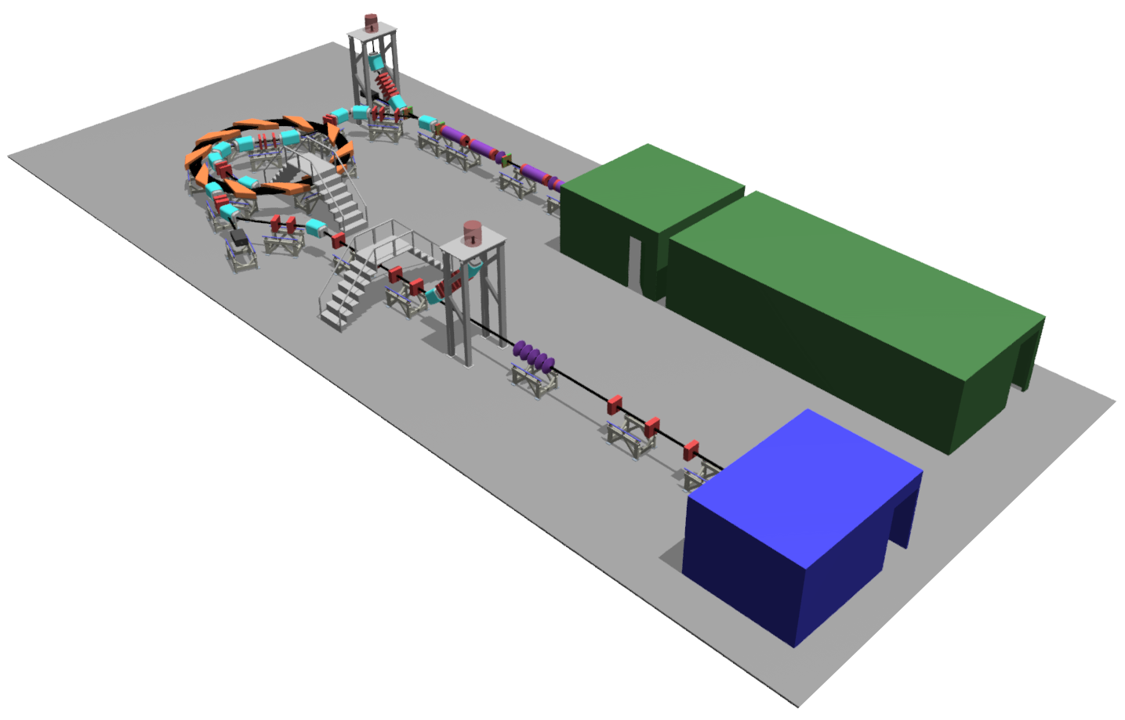
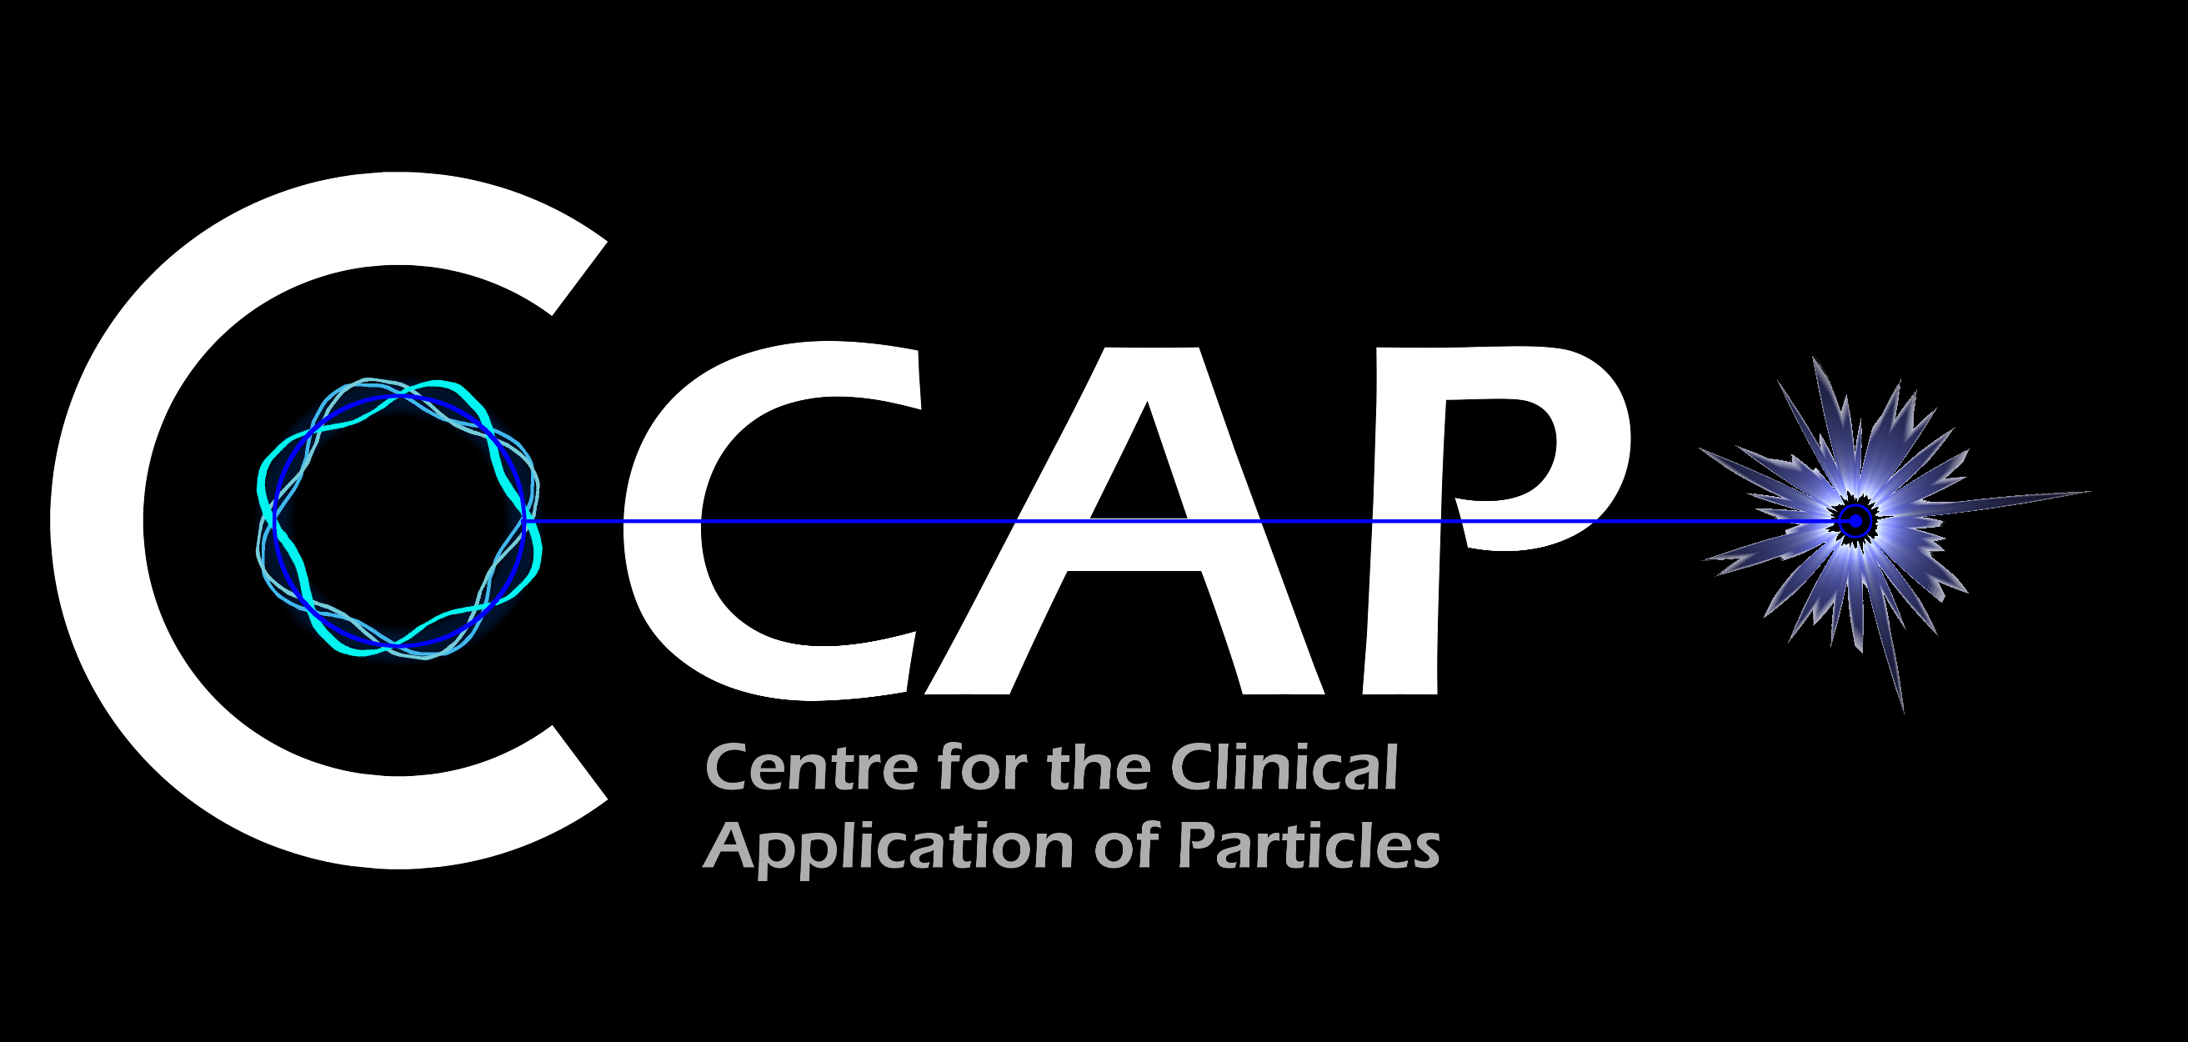
Laser-hybrid Accelerator for Radiobiological Applications
LhARA; a novel, hybrid, approach:
High-flux, laser-driven proton/ion source:
  Overcome instantaneous dose-rate limitation
  Delivers protons or ions in very short pulses:
    Pulse length 10 – 40 ns
  Can provide arbitrary pulse structure
Novel plasma-lens capture & focusing
Fast, flexible, fixed-field post acceleration
  Variable energy
  Protons up to ~15—127 MeV p;
  Ions up to ~5—34 MeV/u
Staged implementation:
  Stage 1: In vitro studies with protons at energies up to 15 MeV
  Stage 2: In vivo & in vitro studies with protons up to 127 MeV and ions up to 34 MeV/u
→ compact, uniquely flexible facility
arXiv:2006.00493
LhARA consortium

Slide 14
LhARA consortium’s ambition
LhARA will be a uniquely-flexible, novel system that will:
Deliver a systematic and definitive radiobiology programme
Prove the feasibility of the laser-driven hybrid-accelerator approach
Thereby lay the technological foundations for transformation of PBT
  automated, patient-specific: implies online imaging & fast feedback and control

Slide 15
LhARA
The Laser-hybrid Accelerator for Radiobiological Applications (LhARA)

Slide 16
LhARA
arXiv:2006.00493

Slide 17
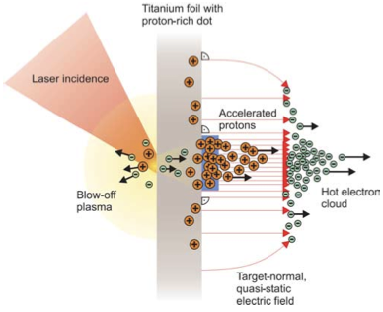
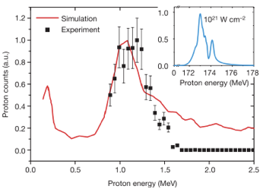
Sheath acceleration
Laser incident on foil target:
  Drives electrons from material
  Creates enormous electric field
Field accelerates protons/ions
  Dependent on nature of target
First observation ~2000
Active development:
  Laser: power and rep. rate
  Target material, transport
Schwoerer, H. et al., 2006; Nature, 439(7075).

Slide 18
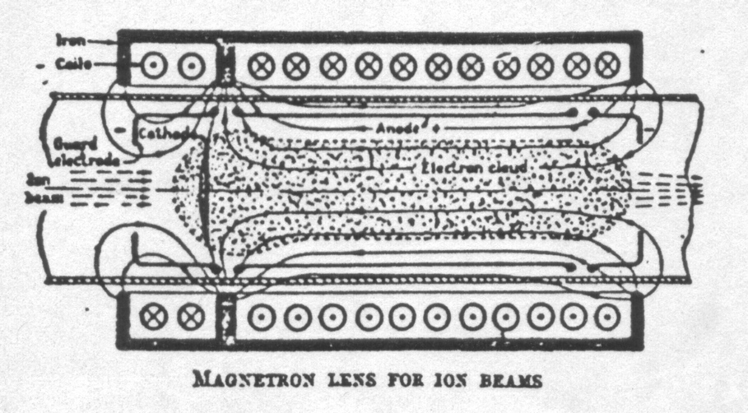
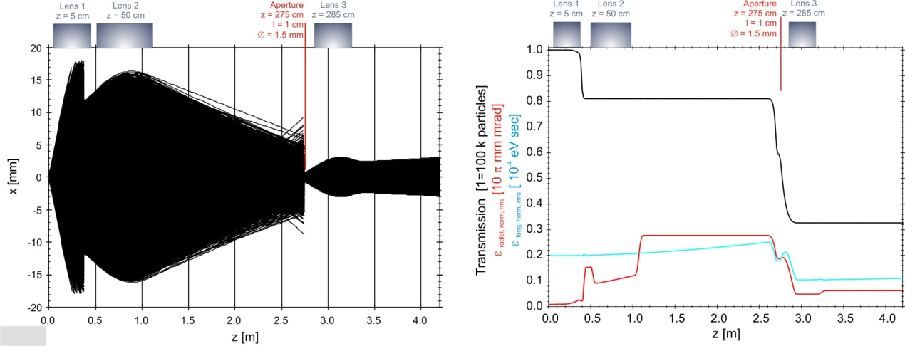
Beam capture/production principle
Posocco, Pozimski
Plasma (Gabor) lens:
  Strong focusing exploiting
  electron plasma in solenoid
Gabor
1957

Slide 19
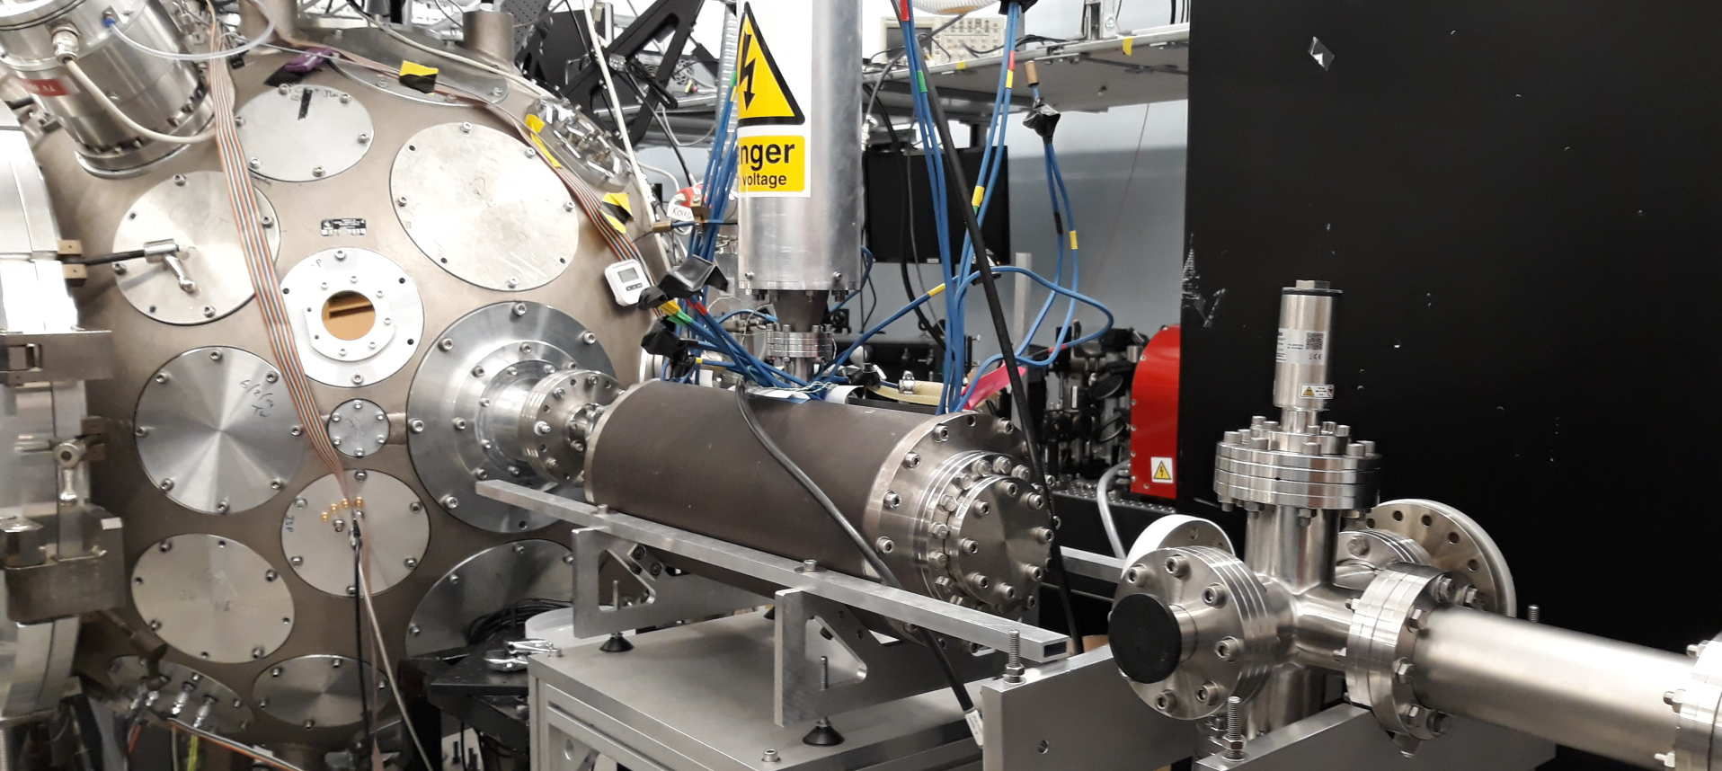
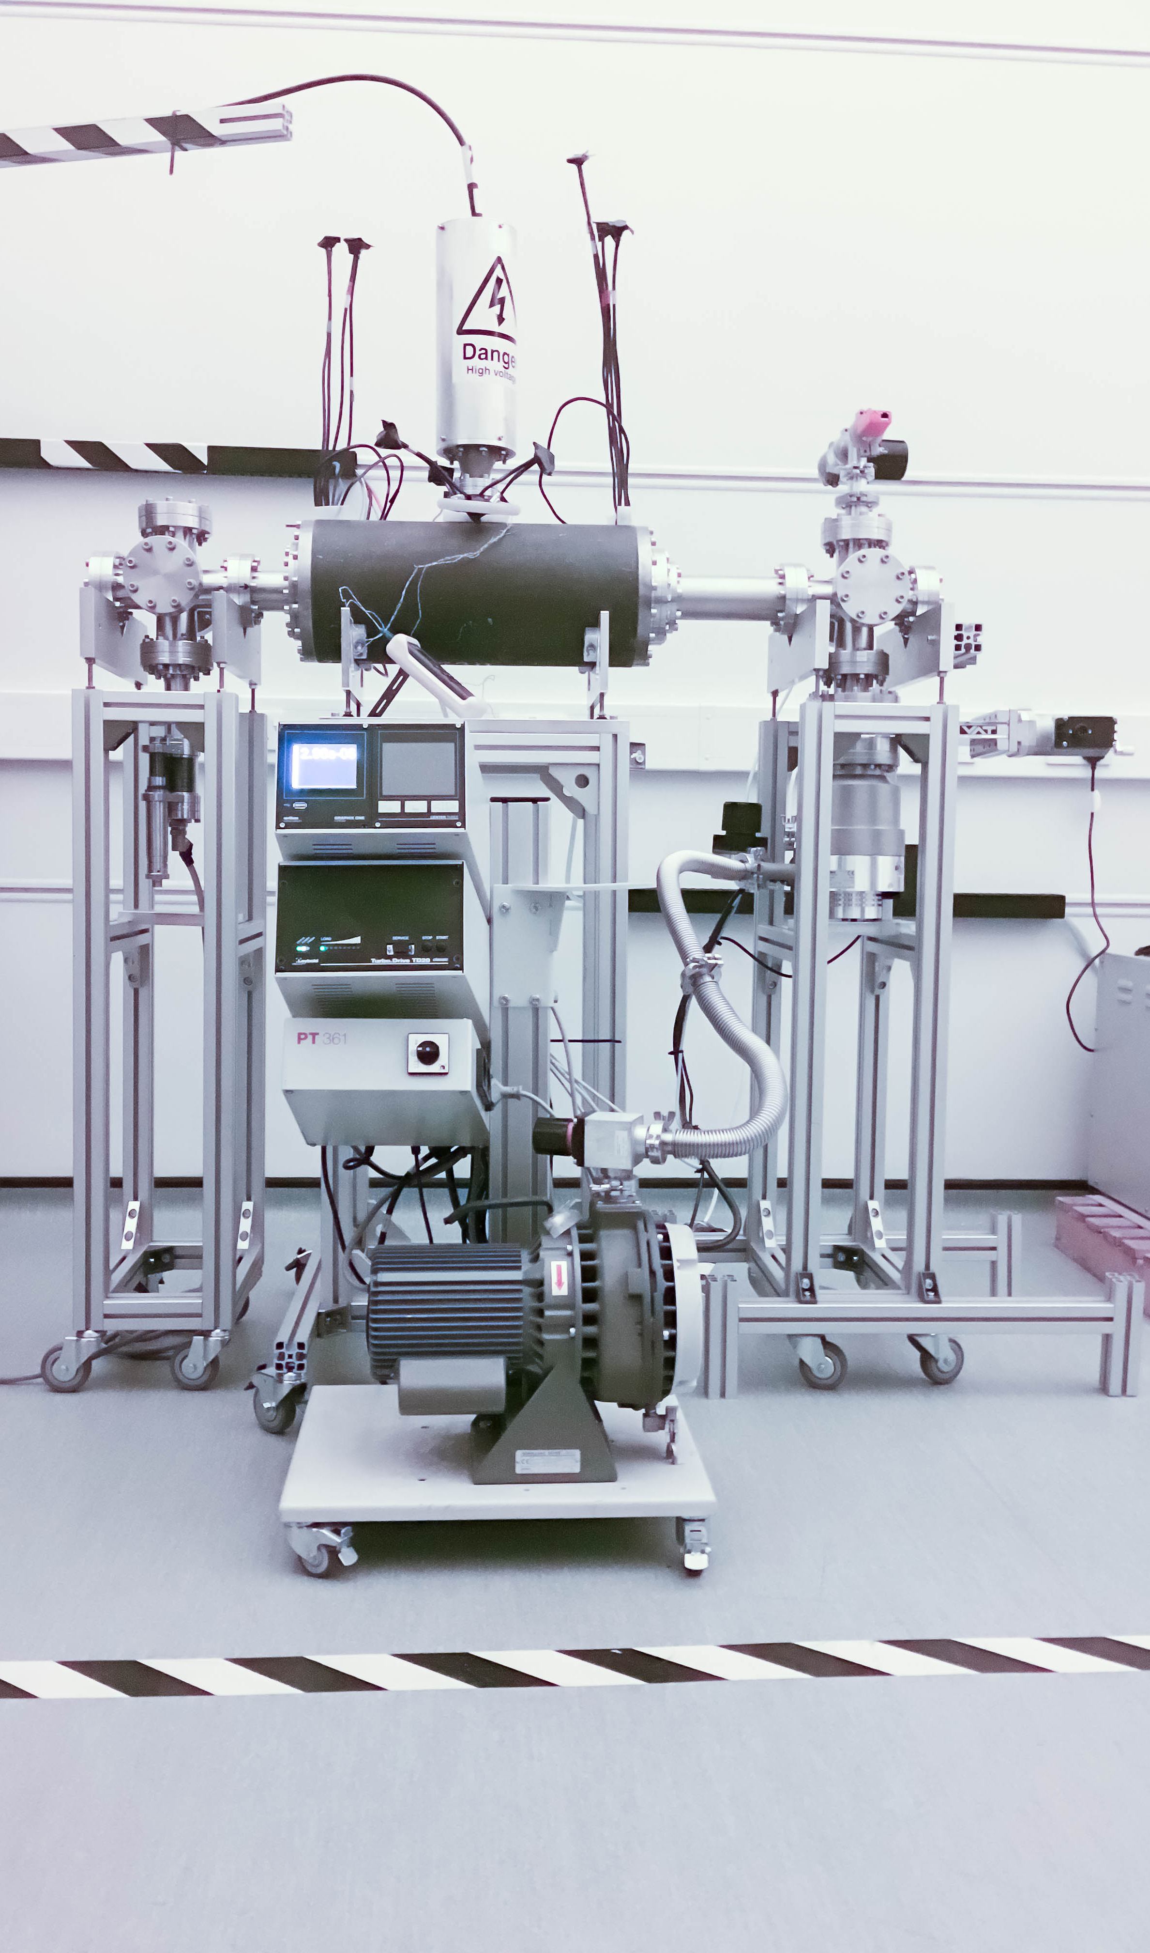
LhARA: ion-source development
Capture
Laser source/capture test
Electron plasma:
  Strong focusing
  of +ve ions
1st prototype:
  1 MeV protons
  Surrey Ion Beam
  Centre
  Aberrations
  observed
Upgraded
prototype:
  Under development
  Imperial
Integration test:
  Integration test on Imperial Cerberus Laser
Plan:
  “Now”: prepare to validate lens with α
  Next: test using laser-driven source

Slide 20
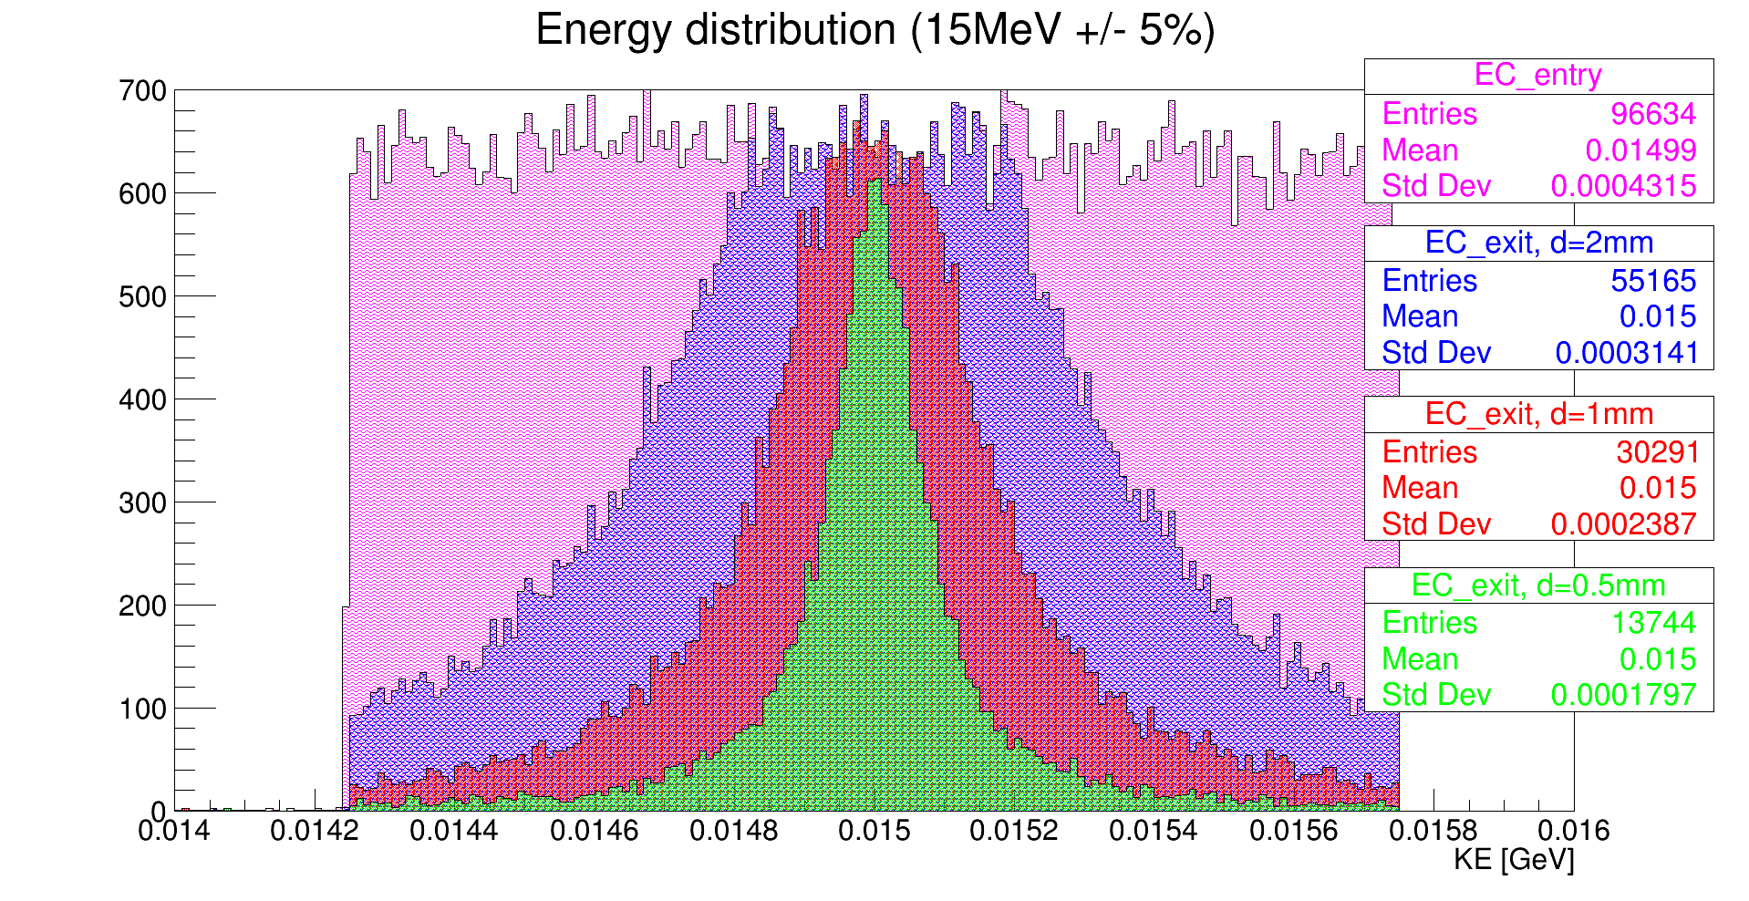
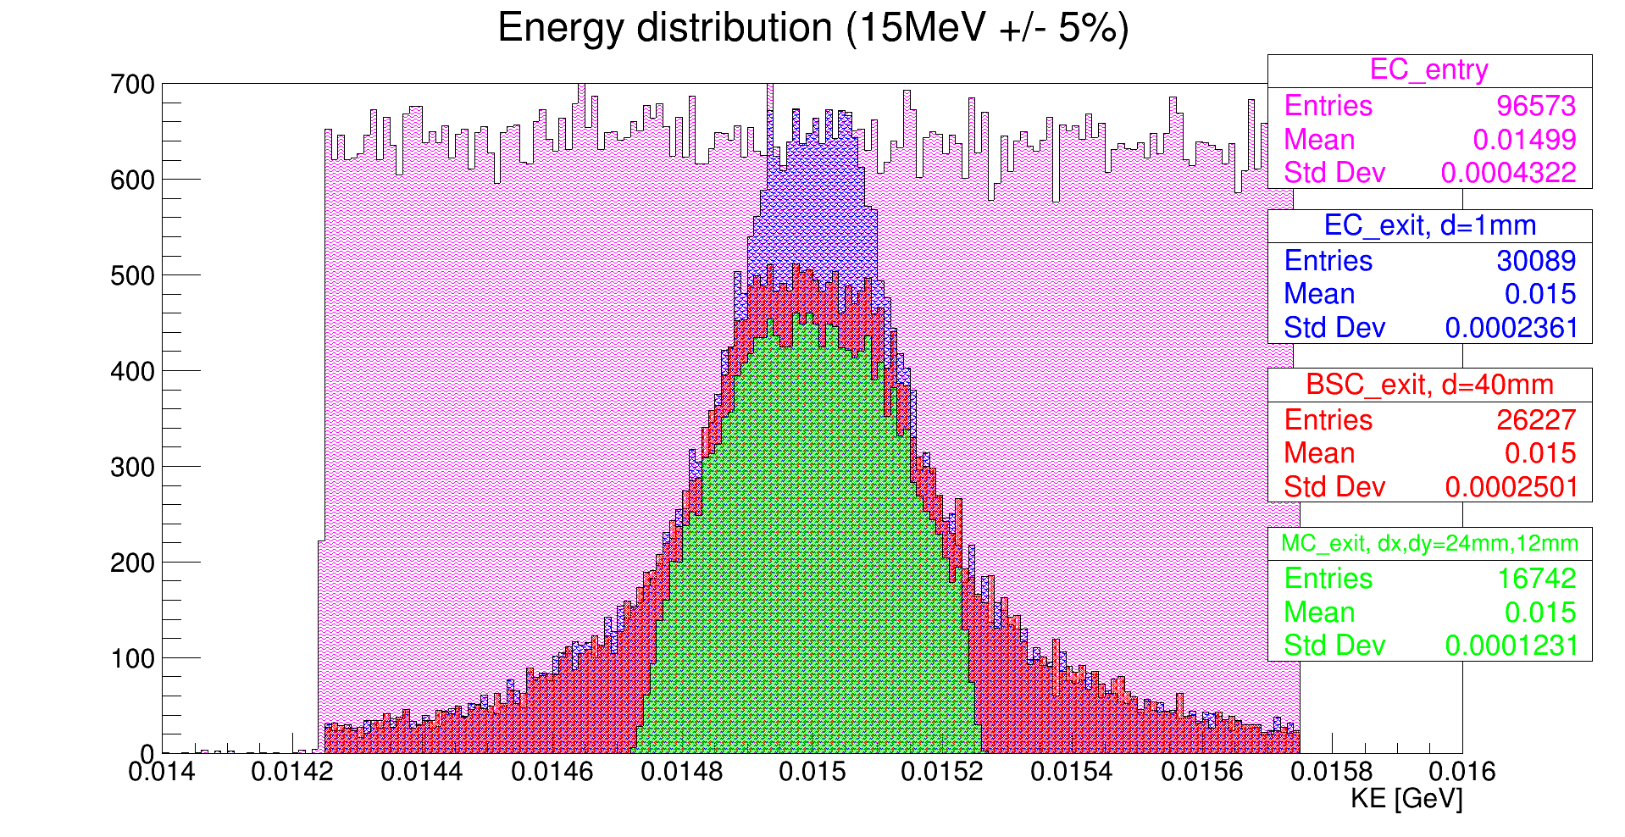

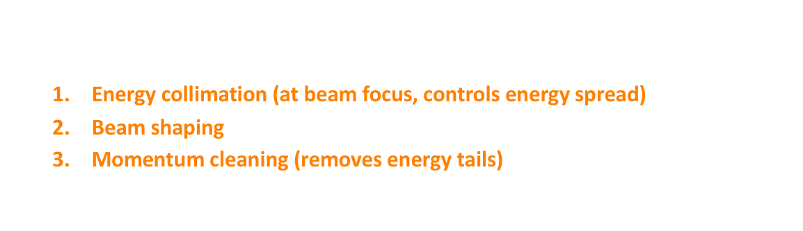
Energy collimation
1
1
0
3
2
$$±2\%$$
Flat initial energy profile $15 MeV±15\%$ (labelled “0”)
3 collimators
  Energy collimation (at beam focus, controls energy spread)
  Beam shaping
  Momentum cleaning (removes energy tails)
LhARA Stage 1 beamline
0

Slide 21
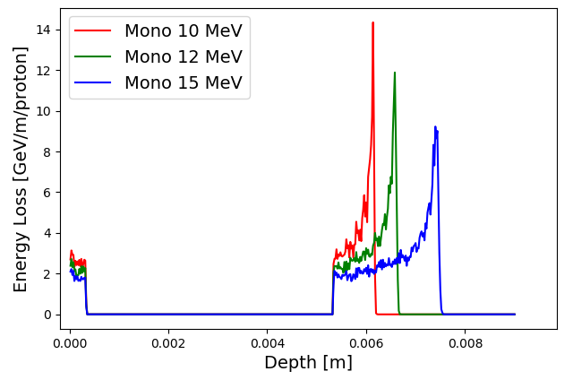
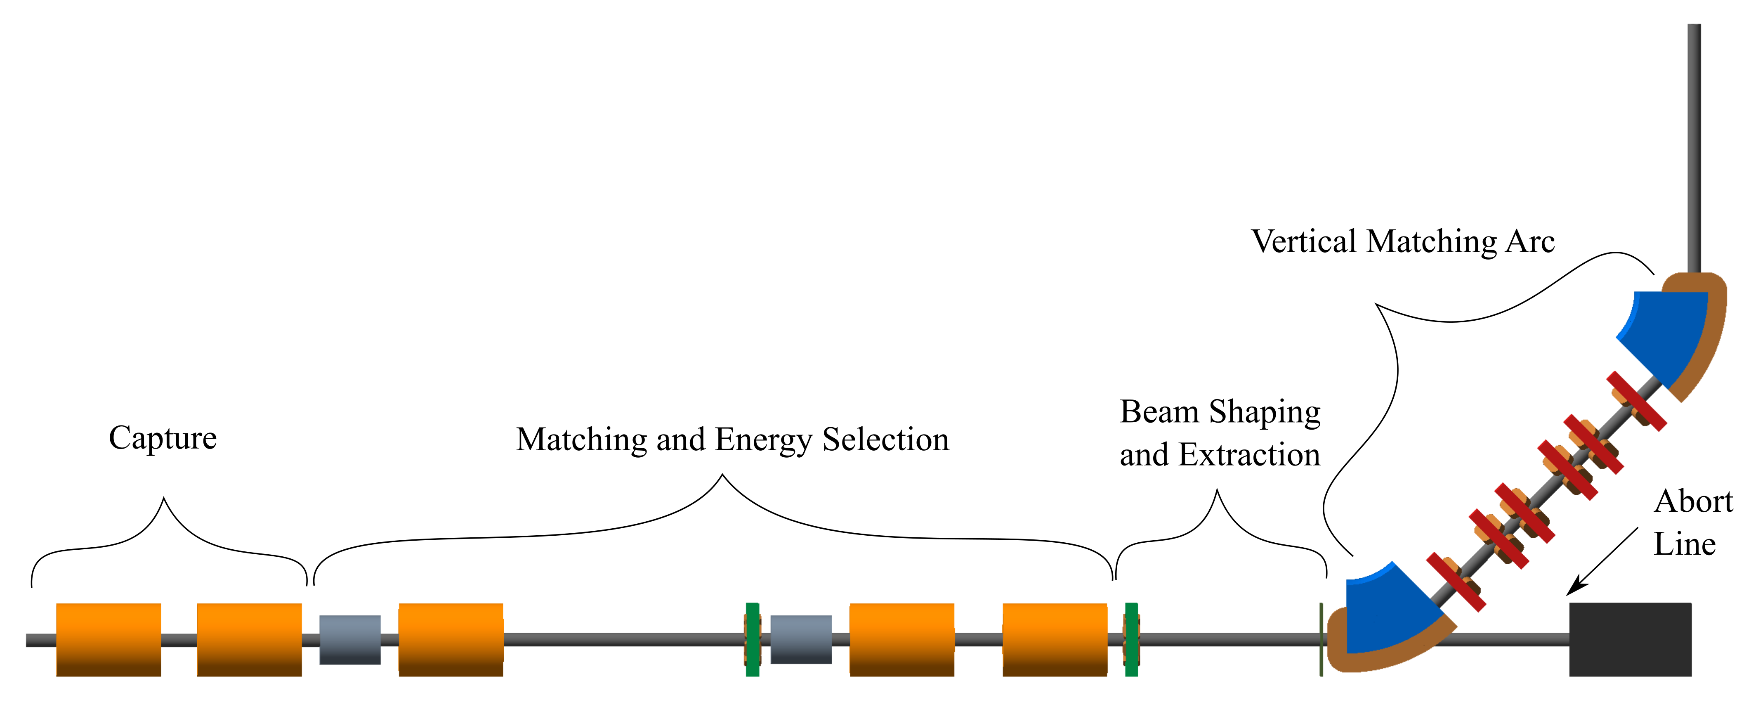
LhARA; stage 1
Pasternak
Dose uniformity
at end station
arXiv:2006.00493
arXiv:2006.00493

Slide 22
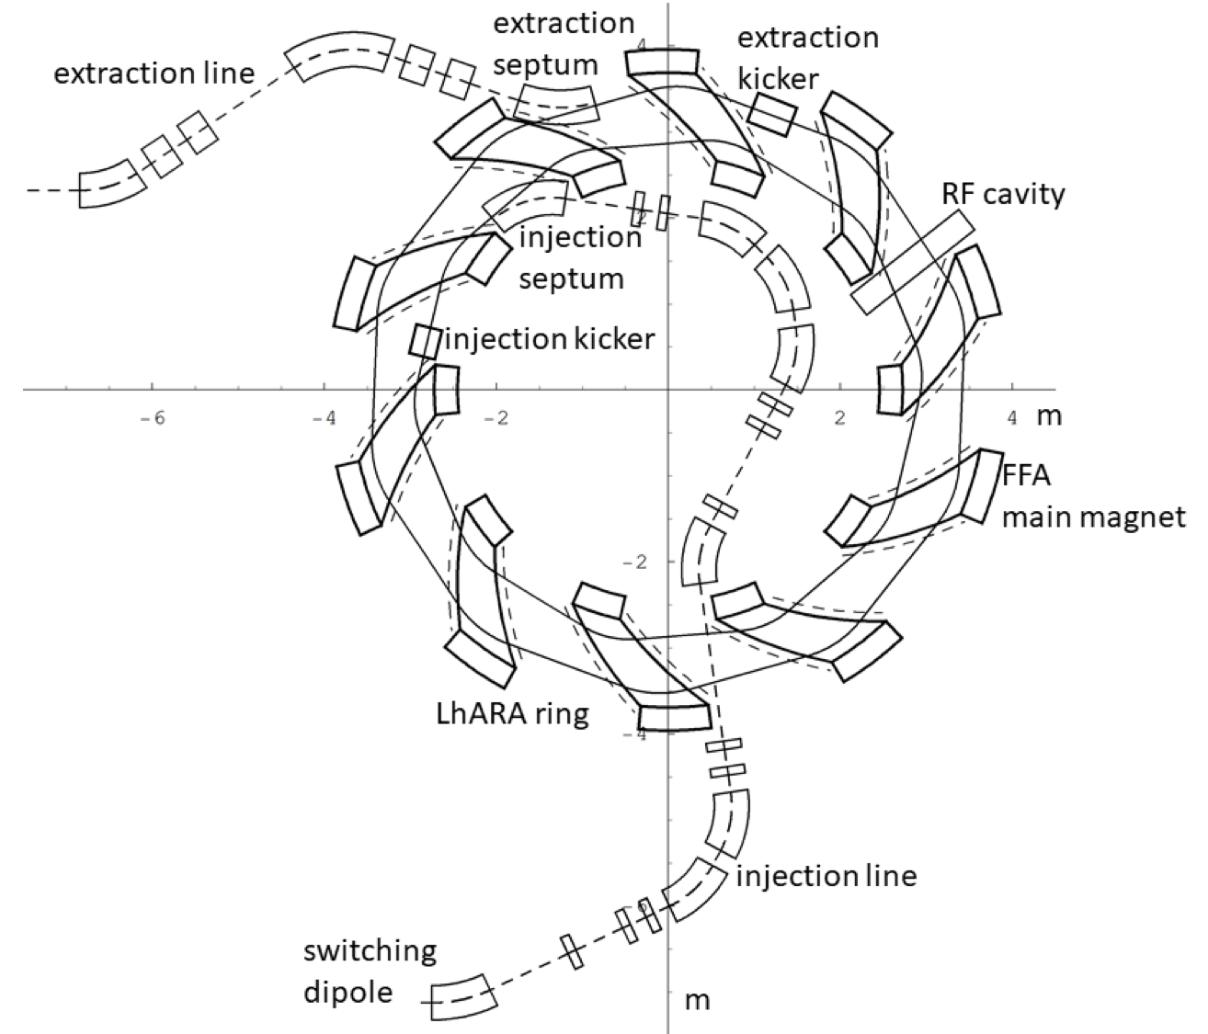
LhARA – Stage 2
In-vitro radiobiology using animal models:
  Post-acceleration required
Baseline: fixed field accelerator:
  x3 increase in momentum
    15 MeV protons accelerated to 127 MeV
    3.8 MeV/u carbon 6+ ions accelerated to 33 MeV/u
arXiv:2006.00493

Slide 23
Fixed Field Accelerator
Bending magnetic fields do not vary in time.
  Rapid acceleration.
Alternating gradient gives strong focussing.
Very large acceptance.
  Useful, e.g. to accelerate muon beams.
Advantages over conventional medical cyclotron
  Variable energy operation without energy degraders
  Operation with different ions
  Multiple extraction ports possible

Slide 24
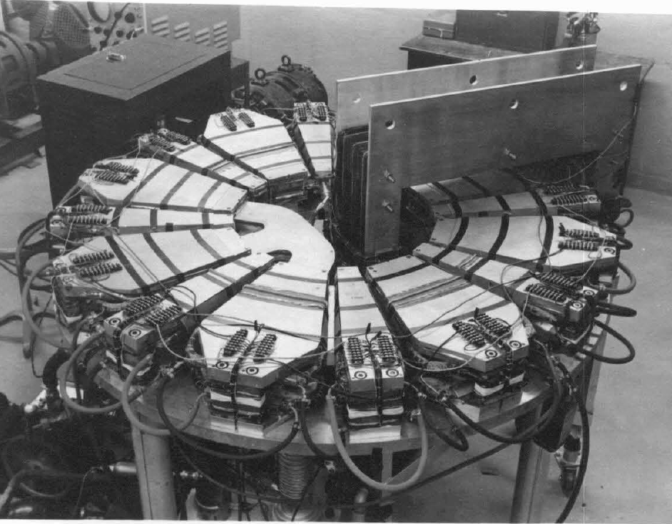
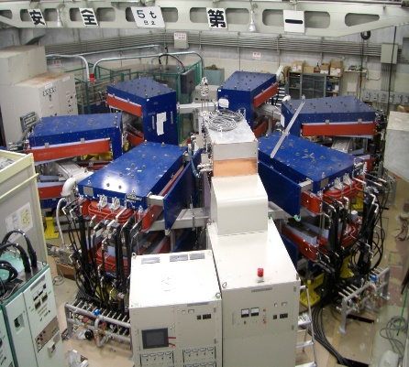
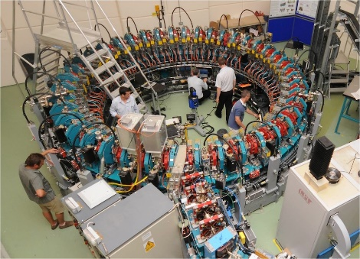
FFA potted history
Early 1950s, FFAG developed independently:
  Japan by Tihiro Ohkawa
  US by Keith Symon
  Russia by Andrei Kolomensky.
The first prototype was operated in 1956
  Jones, Terwilliger, Technical Report MURA-LWJ/KMT-5
  (MURA-104), April 3, 1956.
Not much activity until first proton accelerator in 2000
The Michigan Mark I FFA 400KeV electron accelerator was the first operational FFA.
500 keV Proton proof-of-principle FFA at KEK.
PRISM muon beam phase rotation demonstration ring at Osaka.
Kyoto University FFA for ADSR
EMMA at Daresbury

Slide 25
LhARA FFA
arXiv:2006.00493

Slide 26
Next steps; 5-year R&D plan
arXiv:2006.00493
5-year plan presented in pre-CDR designed to:
  Address technical risks presented in pre-CDR
    Especially source and plasma-lens capture
    Instrumentation and diagnostics
  Deliver technical designs for the LhARA facility
  End stations.
    Automation, sample handling, imaging
    Simulation, including impact on tissue/tissue response
→ Capability to start Stage 1 in-vitro programme

Slide 27
Radiobiology in new regimens

Slide 28
Conclusions
The Laser-hybrid Accelerator for Radiobiological Applications (LhARA)

Slide 29
Conclusions
Laser-hybrid approach has potential to:
  Overcome dose-rate limitations of present PBT sources;
  Deliver uniquely flexible facility:
    Range of ion species, energy, dose, dose-rate
  Disruptive/transformative approach to PBT ‘for 2050’ …
Opportunity:
  Develop and prove novel systems in operation;
  Deliver research facility dedicated to radiobiology;
  Contribute to study of biophysics of charged-particle beams
First and next steps:
  Initial concept developed and prototype evaluation underway
  Seeking resources to execute R&D programme laid out in ‘pre-CDR’
  Wonderful opportunity to build novel techniques to ‘spin back in’!

