Slide 1
Notes on first EPSRC briefing on Transformative Healthcare Technology call
… and some preliminary observations

Slide 2

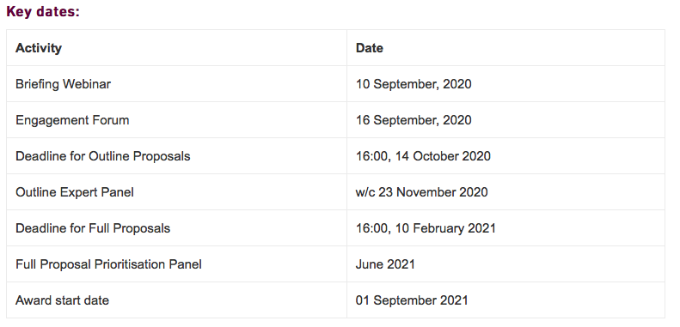
The call

Slide 3
Key facts
Phased approach:
  Phase 1: Development phase – 18 months:
    Modest resource to work towards possible “programme-grant” scale proposal
  Phase 2: Project phase:
    Have the opportunity towards the end of Phase 1 to bid for project funding at the level of a “programme grant”
Budget for Phase 1:
  EPSRC wishes to invest £6M in 15—20 projects:
    Implies budget for Phase 1 bid ~£300k

Slide 4

From presentations at the briefing

Slide 5
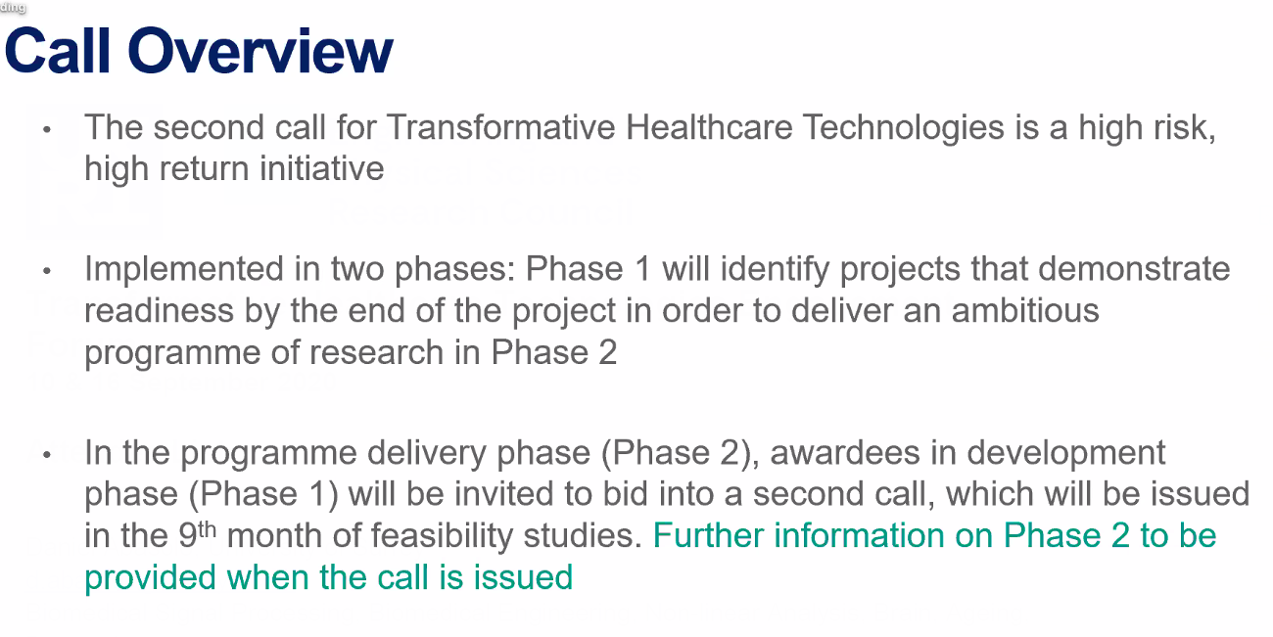
From presentations at the briefing

Slide 6
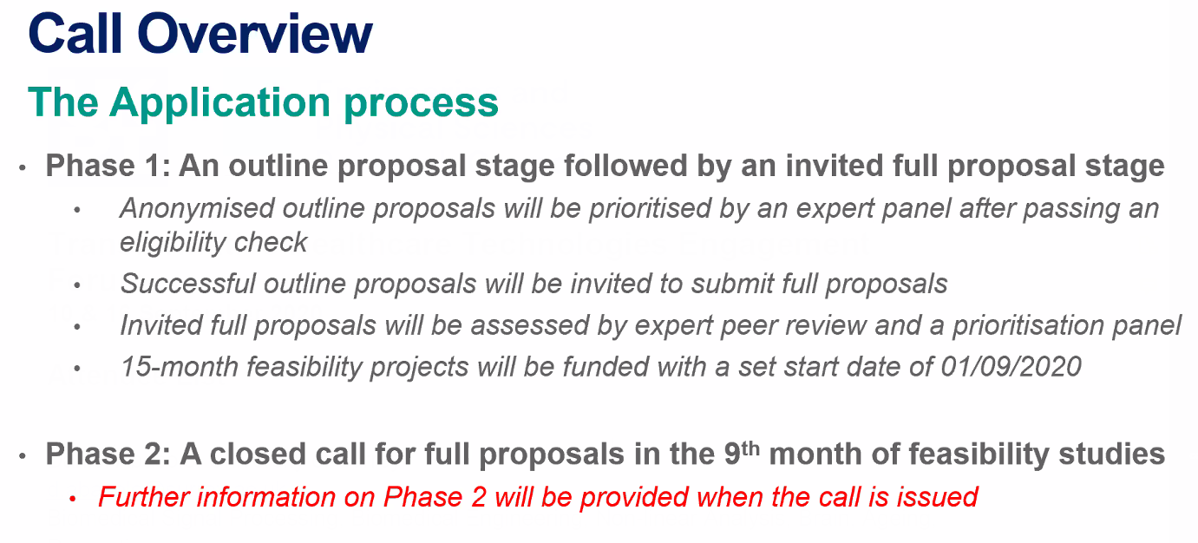
From presentations at the briefing

Slide 7
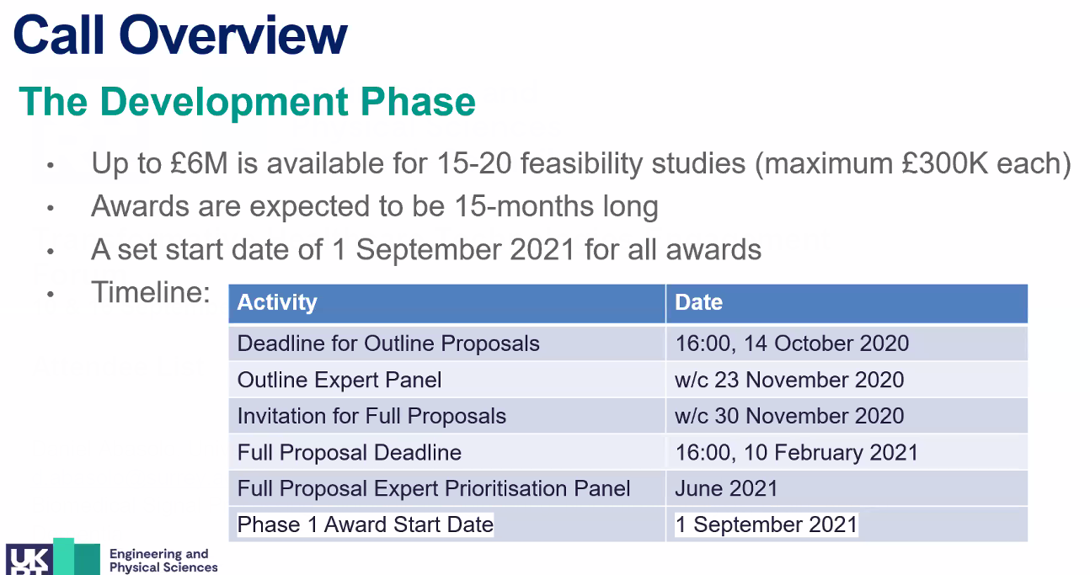
From presentations at the briefing

Slide 8
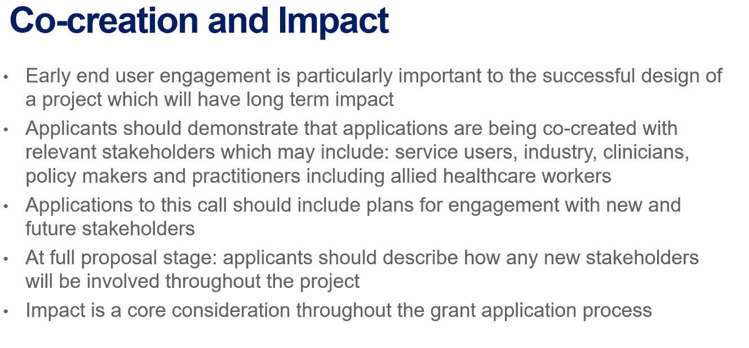
From presentations at the briefing

Slide 9
Preliminary observations
Phase 1: comparable mission to STFC Opportunities 2019 call
  Must present full LhARA vision; rbio and PBT paradigm shift
£300k for Phase 1:
  Implies we need to take a “creative” approach;
    Must position LhARA collaboration to drive forward through Phase 2
Possible approach:
  Focus EPSRC THT bid on end-station & impact on PBT
  Approach STFC to co-fund if EPSRC THT bid is successful:
    STFC funds 18 month essential (risk mitigating) accelerator R&D programme
    How? E.g.:
      Repurpose travel element of STFC Opportunities 2019 to support staff
      “Modest” additional funds so that STFC resource matches
    Contact with STFC initiated
Second EPSRC briefing tomorrow, 16Sep20

