Slide 1





The biological effect of ionising radiation
Dr Jason Parsons
Cancer Research Centre
Department of Molecular and Clinical Cancer Medicine

Slide 2
Factors affecting the biological response to ionising radiation
Inherent radiosensitivity of the cells/tissues.
DNA repair capacity and efficiency of cells.
Degree of hypoxia (reduced oxygenation).
Cell proliferation and repopulation rates.
Immune microenvironment.
Physical factors (e.g. dose, dose rate, particle type, LET)
4 R’s of radiobiology:- Repair of DNA damage, Redistribution of cells in the cell cycle, cell Repopulation, and Reoxygenation of previously hypoxic tumours (Withers, 1975).

Slide 3
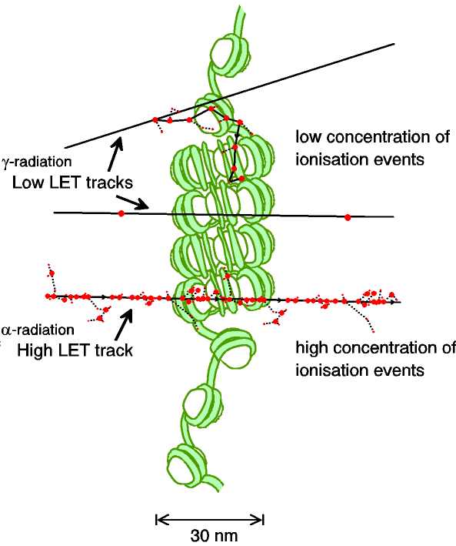
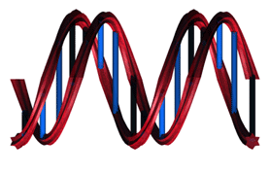
The critical cellular target for IR is DNA and damage complexity is dependant on ionisation density
Repair time
<1 h
<2 h
>2 h
-Base damage/SSB/DSBs

Slide 4
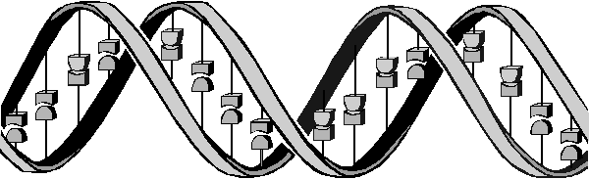
Oxidative DNA base damage,
abasic sites, SSBs
CDD
DSBs
(A) BER
(B) Classical-NHEJ or (C) alternative-NHEJ (G_{o}/G₁)
(D) HR (S/G₂)
DNA glycosylase
DSB
DSB
DSB
Abasic site
Ku70/80
MRN
MRN
APE1/PARP-1
dRP
DNA-Pkcs
XRCC4-Lig IV
PARP-1
RPA/RAD51
Pol β
XRCC1-Lig IIIα/
Lig I
RAD52/RAD54
XRCC1-Lig IIIα
  Vitti and Parsons (2019) Cancers

Slide 5

  Proton beam therapy (PBT) radiobiology
Tumour
Bragg peak
Distal fall-off
Relative dose
LET
Proton energy
Taken from Paganetti and van Luijk (2013) Sem Rad Oncol
Depth in tissue
Vitti and Parsons (2019) Cancers
  Further research exploiting the biological impact of PBT is vital for establishing RBE and optimal clinical treatment for tumours.

Slide 6
  Relatively high-LET protons cause a decrease in cell survival due to increased complex DNA damage
  HeLa
HeLa
Enzyme-modified (CDD)
****
*
  SF2, p<0.02; RBE=1.7
***
**
  UMSCC6
  *p<0.02, **p<0.01, ***p<0.005, ****p<0.001
  SF2, p<0.01; RBE=1.9
  58 MeV (1 keV/μm); 11 MeV (12 keV/μm)
  Carter et al., (2018) Int J Rad Oncol Biol Phys
  Fabbrizi et al., (2021) Methods Protocol

Slide 7
Modulation of proton-induced cellular sensitivity following DUB siRNA knockdown
58 MeV protons
  HeLa
11 MeV protons
  Carter et al., (2019) Int J Rad Oncol Biol Phys

Slide 8
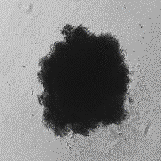
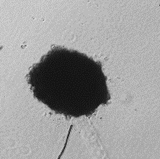
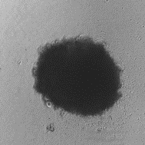
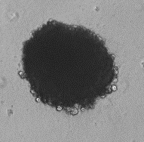
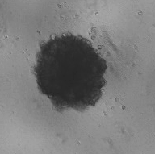
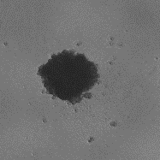
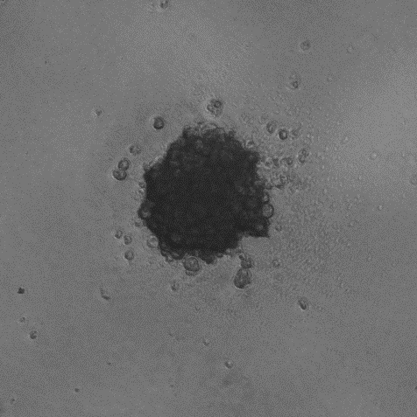
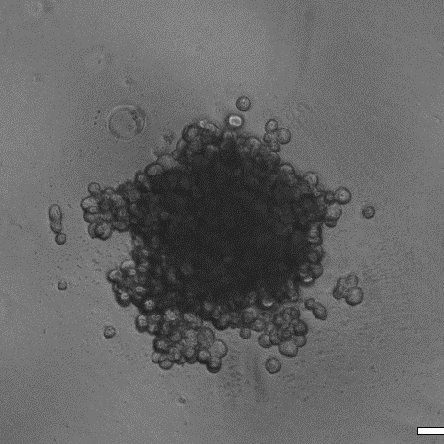
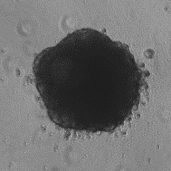
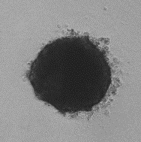
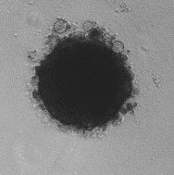
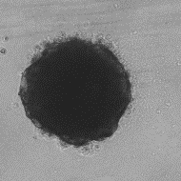
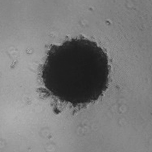
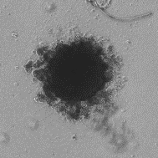
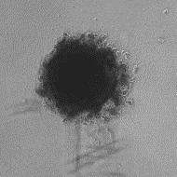
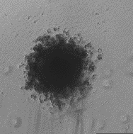
Targeting DNA double strand break repair in 2D/3D HNSCC models with photons and protons
X-rays
Protons
UMSCC6
UMSCC6
Day 3
Day 10
Day 10 + x-rays
Control
DMSO
ATMi
ATRi
DNA-Pkcsi
DMSO
ATMi
ATRi
DNA-Pkcsi
UMSCC74A
UMSCC6
  Vitti et al (2020) Cancers
KU-55933 (ATMi); VE-821 (ATRi); KU-57788 (DNA-Pkcsi)

Slide 9
Radiobiology Research Working Group Meeting (8th January 2021)
Present:
Jason Parsons (University of Liverpool; Chair)
Ken Long (Imperial College London)
Karen Kirkby (University of Manchester)
Yolanda Presado (Institut Curie)
Amato Giaccia (University of Oxford)
Mark Hill (University of Oxford)
Kristoffer Petersson (University of Oxford)
Giuseppe Schettino (National Physics Laboratory/University of Surrey)
Apologies:
Kevin Prise (Queen’s University Belfast)

Slide 10
Remit:- Discussion was centred around identification of novel radiobiological aspects and questions that could be critically addressed with the LhARA facility.
Key discussion points
Provides a reproducible, stable and reliable beam critical for acquiring accurate radiobiological data, and for performing systematic evaluations of the biological response.
Beam which is flexible, easily accessible, and potentially high throughput, unlike clinical facilities.
In vitro and in vivo end-stations both for routine cell culture experiments, but also animal irradiations.
Stimulate the analysis of more complex biological end-points; potential for live cell imaging.
Enable clinically-relevant dose fractionation experiments, and combinatorial treatments (e.g. targeted drugs/inhibitors).
Delivery of ultra high dose rates (FLASH) and the biology behind this phenomenon.
Unique ability to combine proton minibeam with FLASH.

