Slide 1
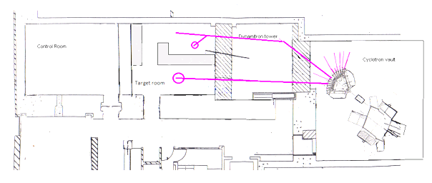
A vertical beamline for radiobiology at the Birmingham MC40 Facility
Dr Tony Price*, Prof. Phil Allport, Prof. Stuart Green, Dr Tzany Kokalova Wheldon, Dr Carl Wheldon, Dr Ben Phoenix, Prof. David Parker, Dr Jason Parsons
LhARA ½ Day
10th June 2020

Slide 2
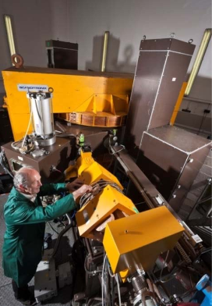
MC40 Accelerator
The Scanditronix MC40 was purchased at auction from the Veterans Affairs Medical Centre, Minneapolis in 2002 and following transfer and commissioning has been operational at UoB since 2004.
Capable of accelerating beams of:
  Protons (3-38 MeV)
  Deuterons (5.5-19 MeV)
  Helium-3 (9-53 MeV)
  Helium-4 (11-37 MeV)
Currents of fA to μA are possible dependant on beam line and experiment.

Slide 3
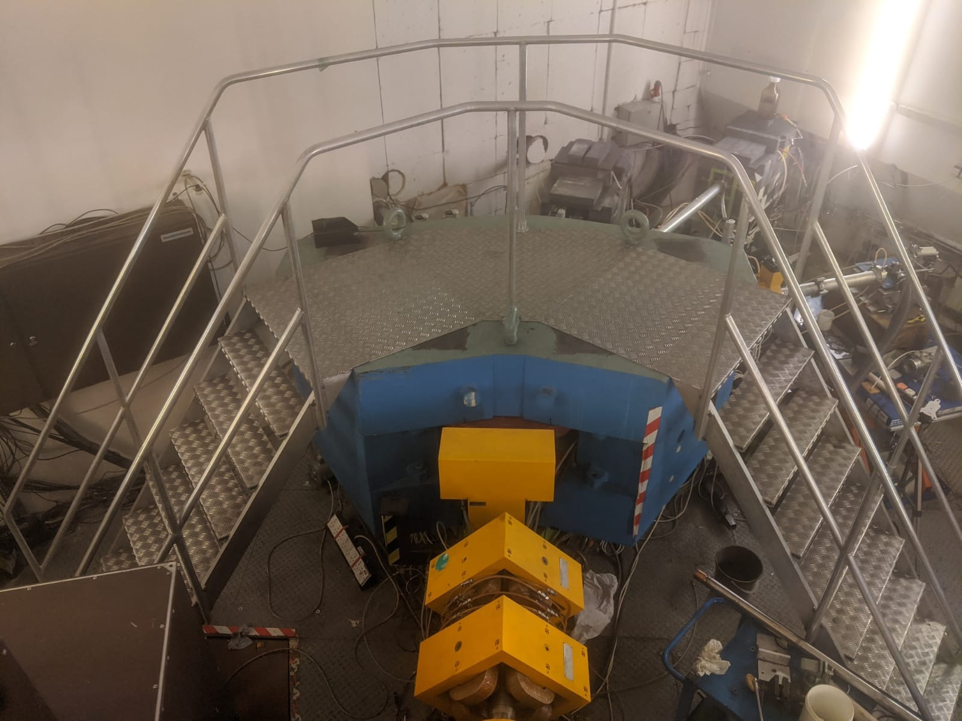
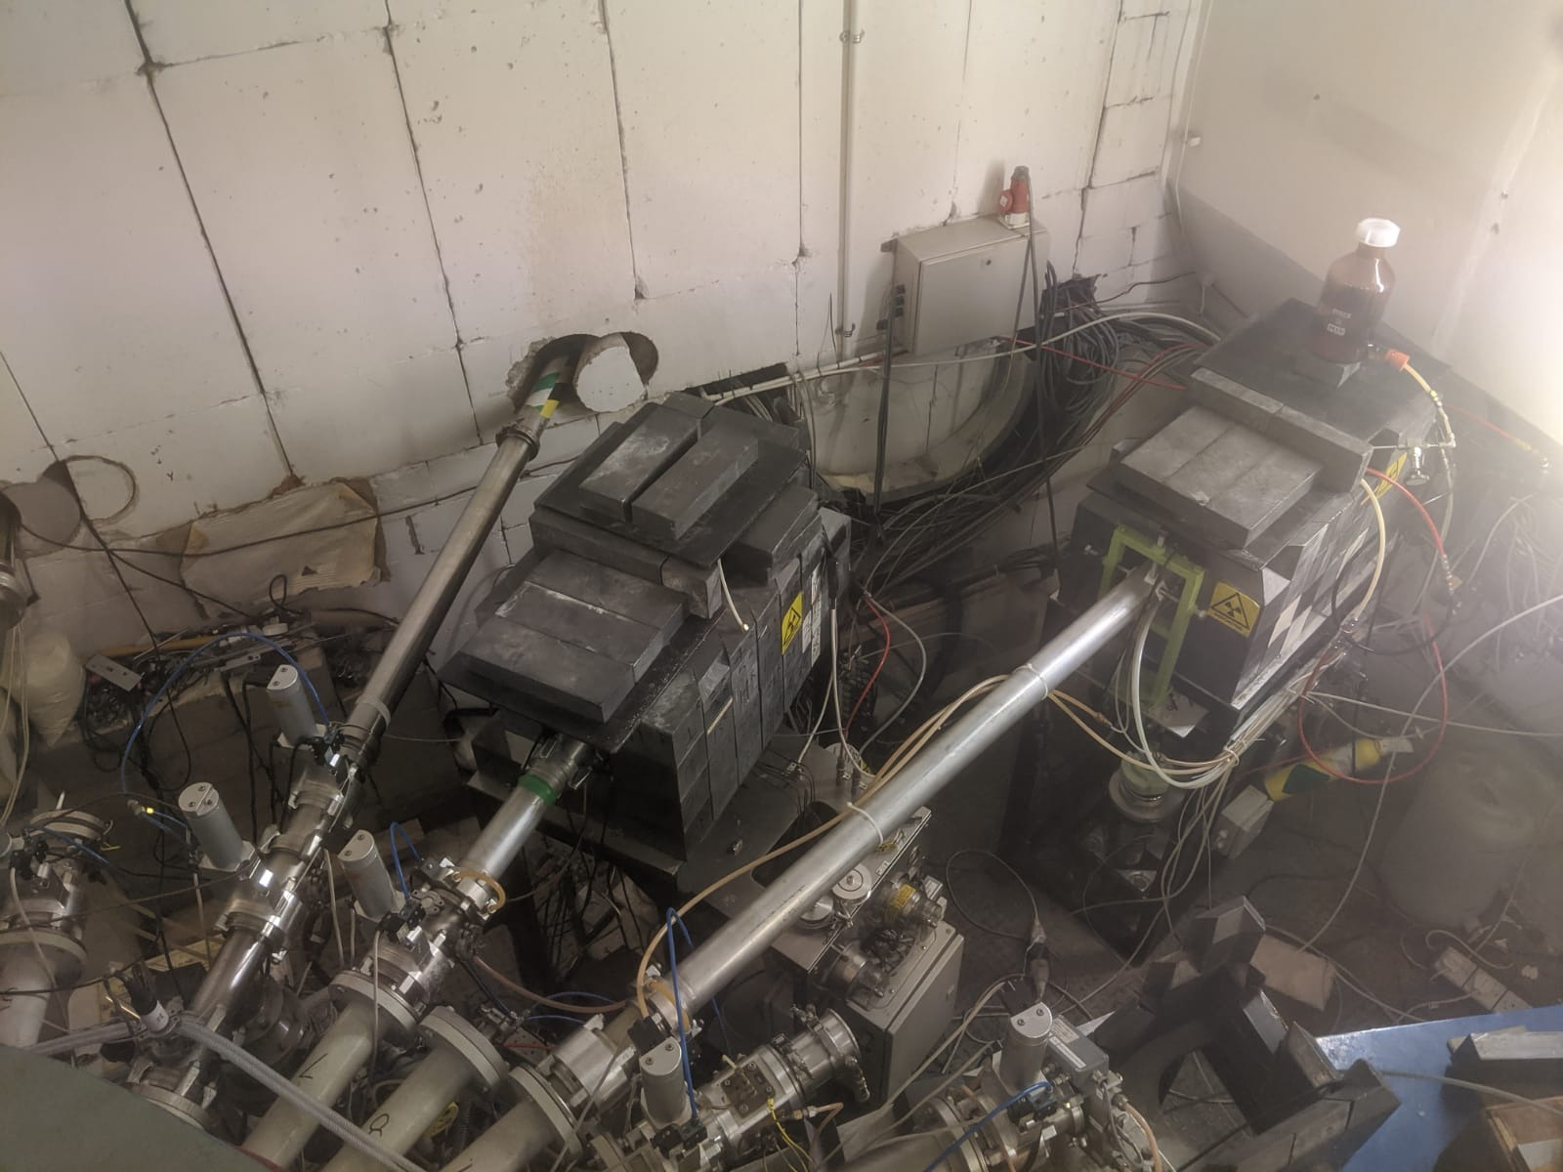
Switching Magnet
Switching Magnet selects one of 12 potential experimental beam lines including
Production of rubidium-81 five evenings a week for medical imaging of lungs at NHS trusts across the UK.
Daily production of fluorine-18 for use at the UKs only Position Emission Particle Tracking Facility in the Positron Imaging Centre (Director Tz Kokalova Wheldon).
Industrial component irradiation.
High intensity particle physics component irradiation facility (BL6)
Nuclear and Medical Beam line (BL4)
Potential of using BL5 for a vertical beam line

Slide 4
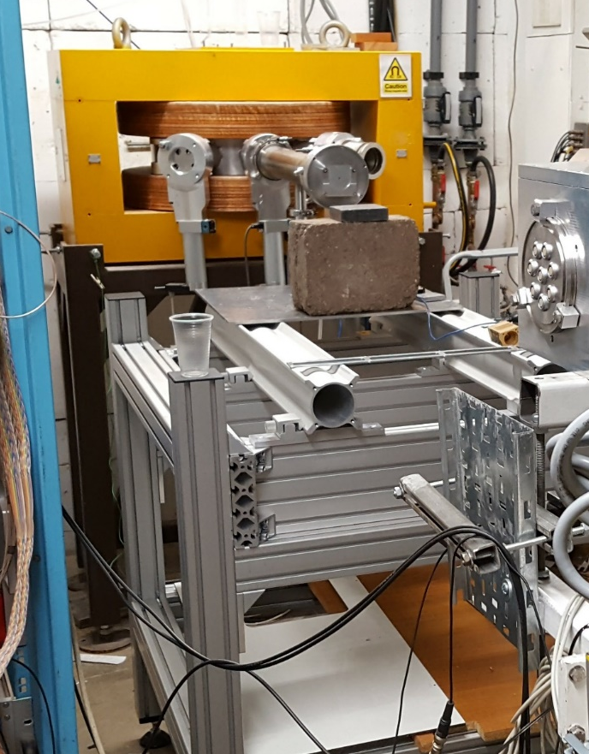
Medical Physics Research
Beam is 50 mm diameter and 95 % dose uniformity is possible due to a double scattering system on BL4
Beam current monitored via Ionisation chambers and doses calibrated using Markus Chambers.
Currents down to fA to test detectors for pCT and up to 100s of nA for FLASH dose rates.
Radiobiological experiments and facilities currently under development but horizontal beamline has implications for cell handling

Slide 5
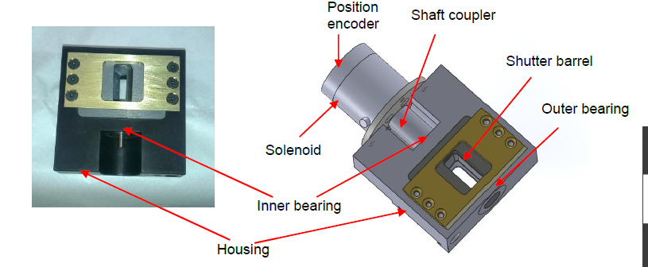
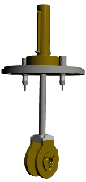
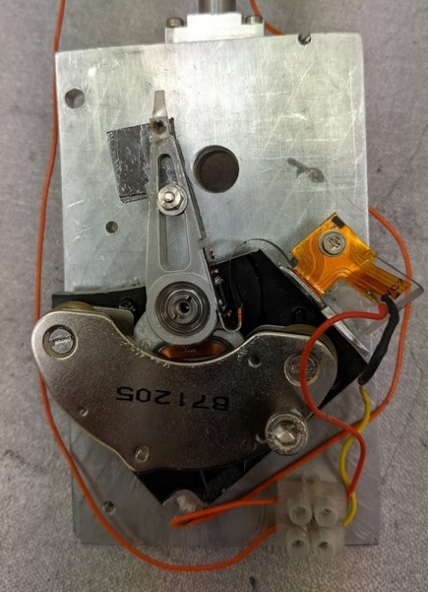
FLASH
Masters project of Edward Taylor developed a v1 FLASH delivery system for the Medical Physics Beamline
Voice coil actuator from 3.5 inch hard disk with a transit time (open and closed) < 6ms
Experiments in collaboration with QEHB on FLASH effects in our ionisation chambers
In discussion with Kristoffer Petersson and Mark Hill at Oxford to adapt their SARRP fast shutter
Open time programmable on the ms timescales
PA Imaging needs short beams, is ms short enough? Do we need to go shorter? R&D may be required to deliver the relevant beams

Slide 6
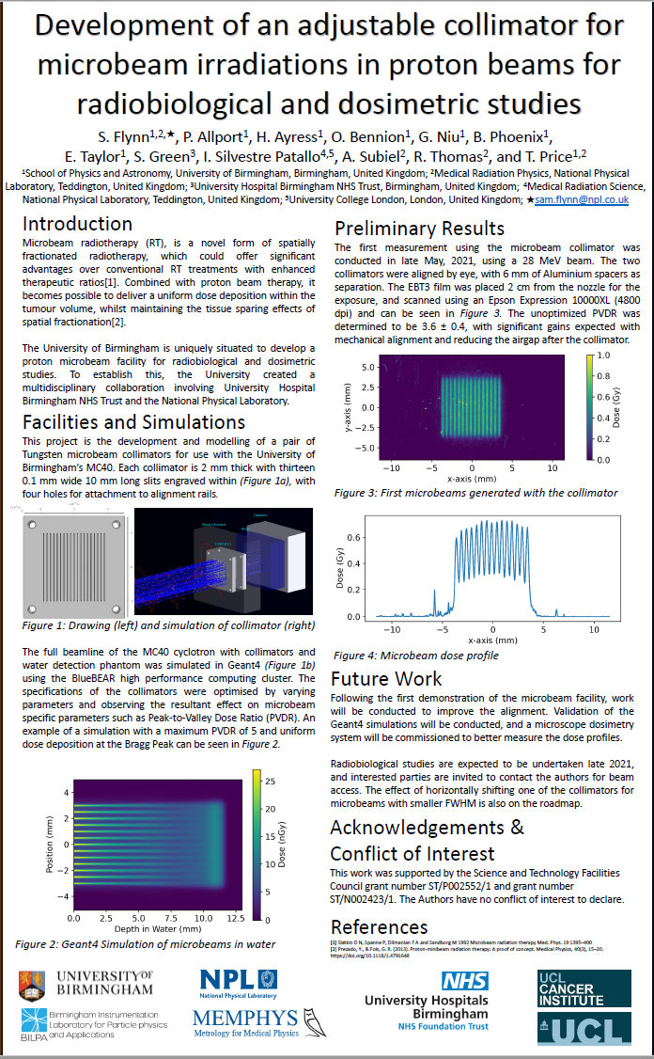
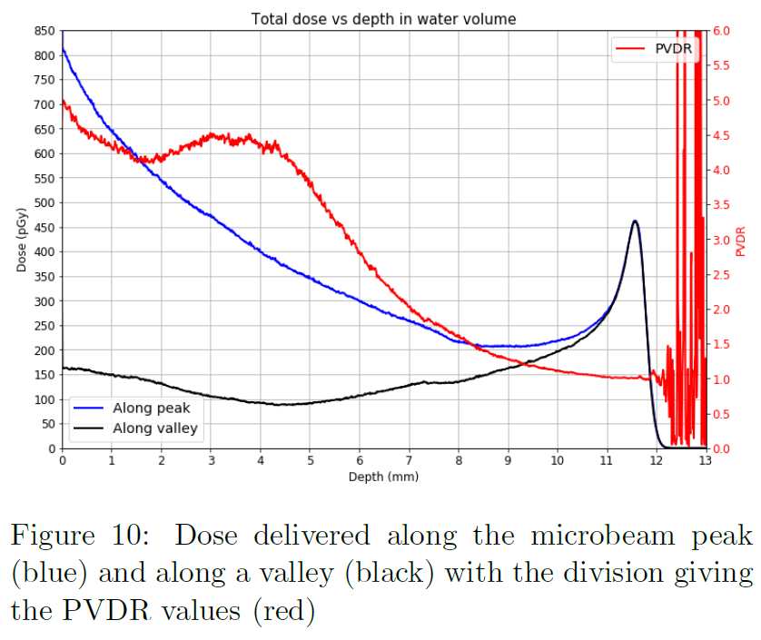


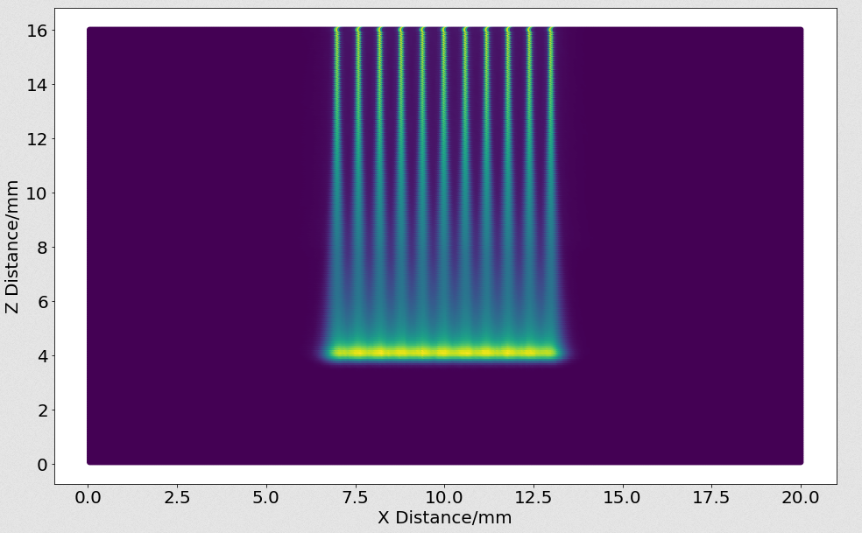
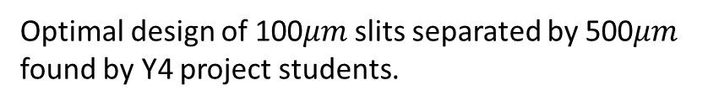
Proton Microbeams
Spatially fractionated beams have the potential to control radiosensitive tumours as higher doses can be delivered without damaging healthy tissue.
Proton micro-beams are spatially fractionated but can scatter to provide a uniform dose to tumour.
Project funded by STFC Advanced Radiotherapy Network+ to develop a micro-beam collimator.
Geant4 simulation with realistic beam parameters
O. Ayress & H. Bennion
Optimal design of 100$μm$slits separated by 500$μm$ found by Y4 project students.

Slide 7
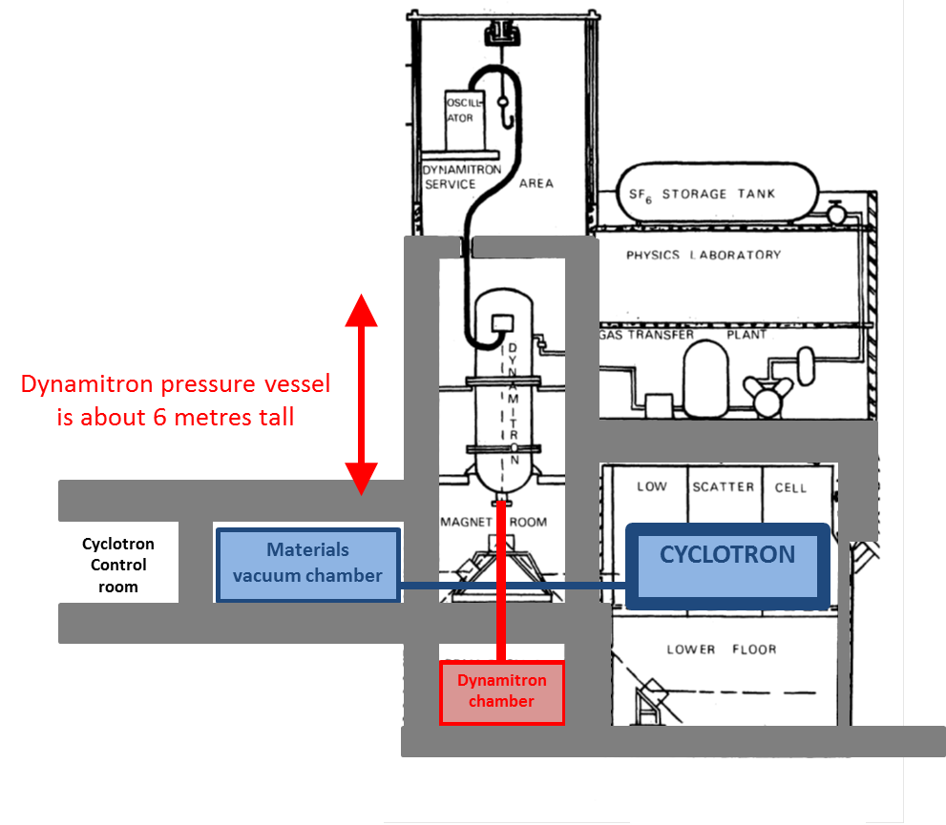
A dedicated vertical beam line
Potential of up to 3 locations for dedicated radiobiology room and BL
Could contain all the things Jason et al need
They could use µ-beams, FLASH, short pulses, ions
But needs money to achieve
3
Pull a new BL into middle of room and bend up/down
2
1
New building and accelerator based neutron source
New target room is below the cyclotron
Committed to a downwards beam

