Slide 1

DEPARTMENT OF MEDICAL PHYSICS
AND BIOMEDICAL ENGINEERING
Ionacoustics:
forward modelling & beam tomography
Ben Cox

Slide 2
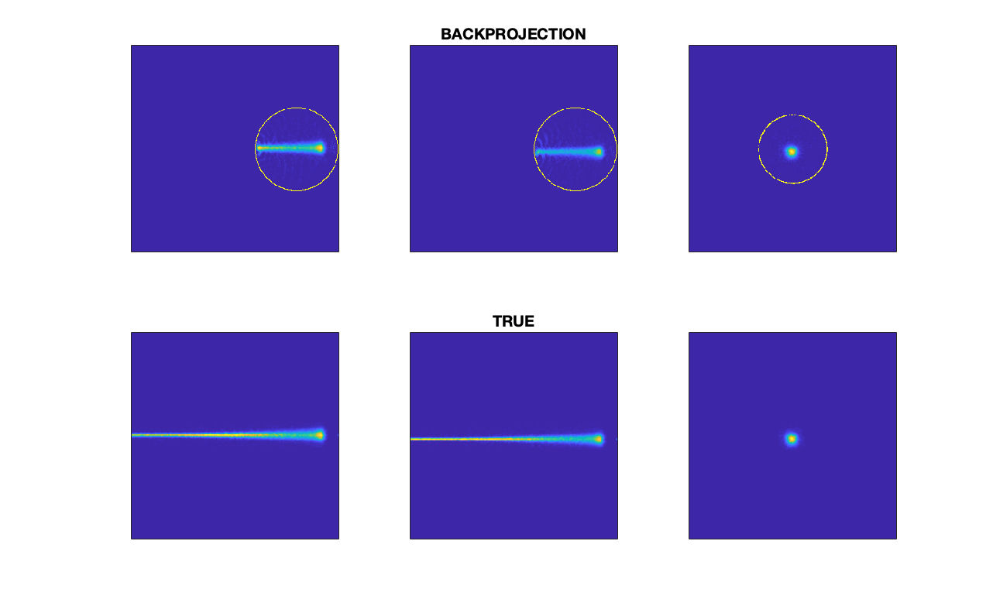
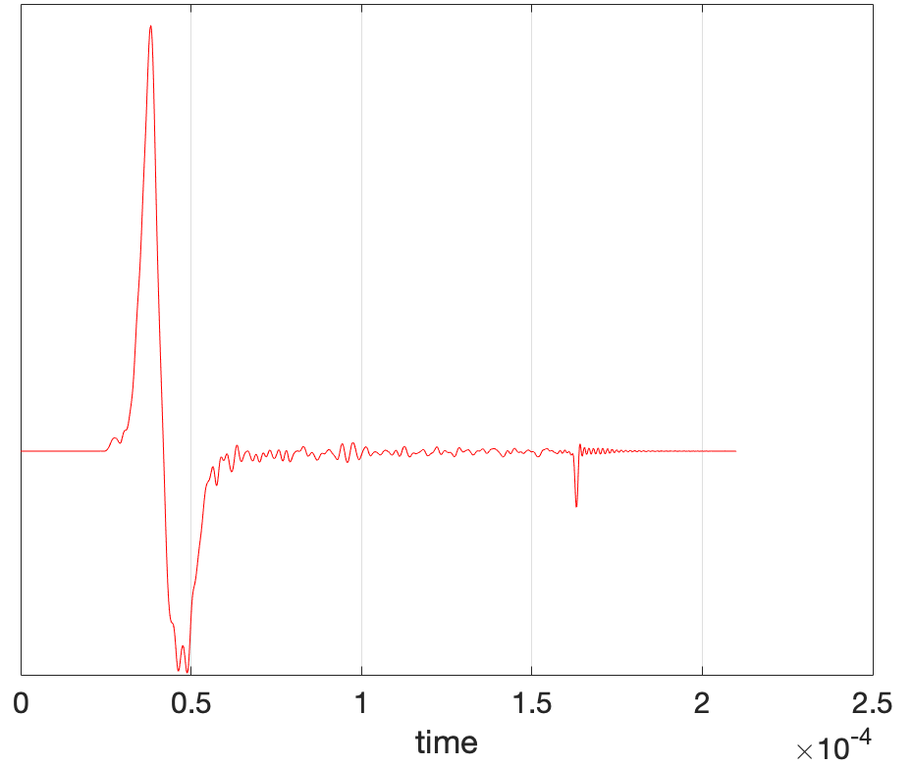
Acoustic modelling
Geant4: compute the volume rate of heat deposition
Ionacoustic wave equation for acoustic pressure :
Broadband simulation using k-Wave, software designed for photoacoustics and ultrasound modelling
thermal expansion coefficient
specific heat capacity
Notes:
\mathcal{H}(\mathbf{x},t)
\frac{1}{c^2}\frac{\partial^2 p}{\partial t^2} - \nabla^2 p = \frac{\beta}{C_p} \frac{\partial \mathcal{H}}{\partial t}

Slide 3
2009: First release for photoacoustics
2010: Linear ultrasound simulation
2011: Nonlinear ultrasound simulation
2012: Native C++ code
2013: MPI code optimised for clusters
2014: Elastic simulation
2015: Native GPU code
2016: Multi-GPU code
2017: Thermal simulation
2018: Source convergence improved
2019: Axisymmetric code
2020: Off-grid sources / receivers implemented
2021...
Open-source acoustic modelling toolbox
Time domain models of broadband acoustic wave propagation in 1D, 2D, 3D
Collocation models exploiting FFTs
Matlab with optimised C++ & CUDA kernels
>11,000 registered users
~40 downloads per week
>3000 forum posts
Notes:
Mathematical background to k-space models, and to the correction factors that k-Wave uses to improve convergence

Slide 4
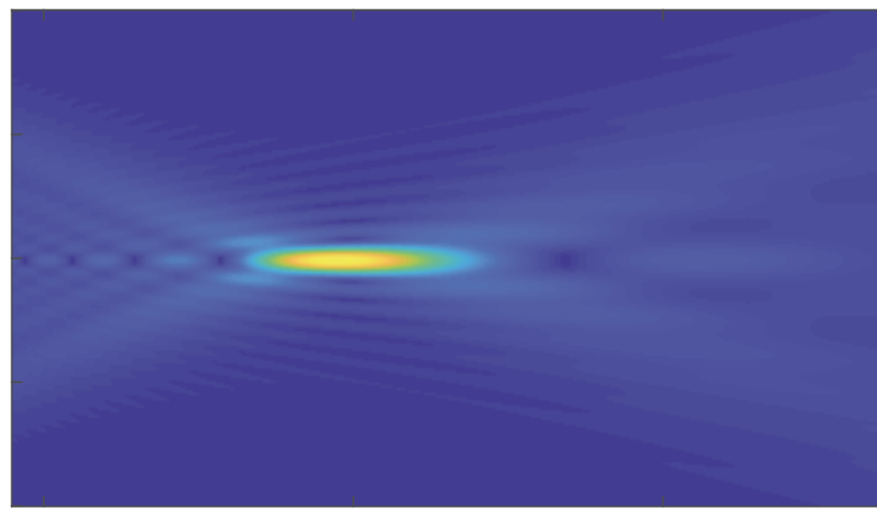
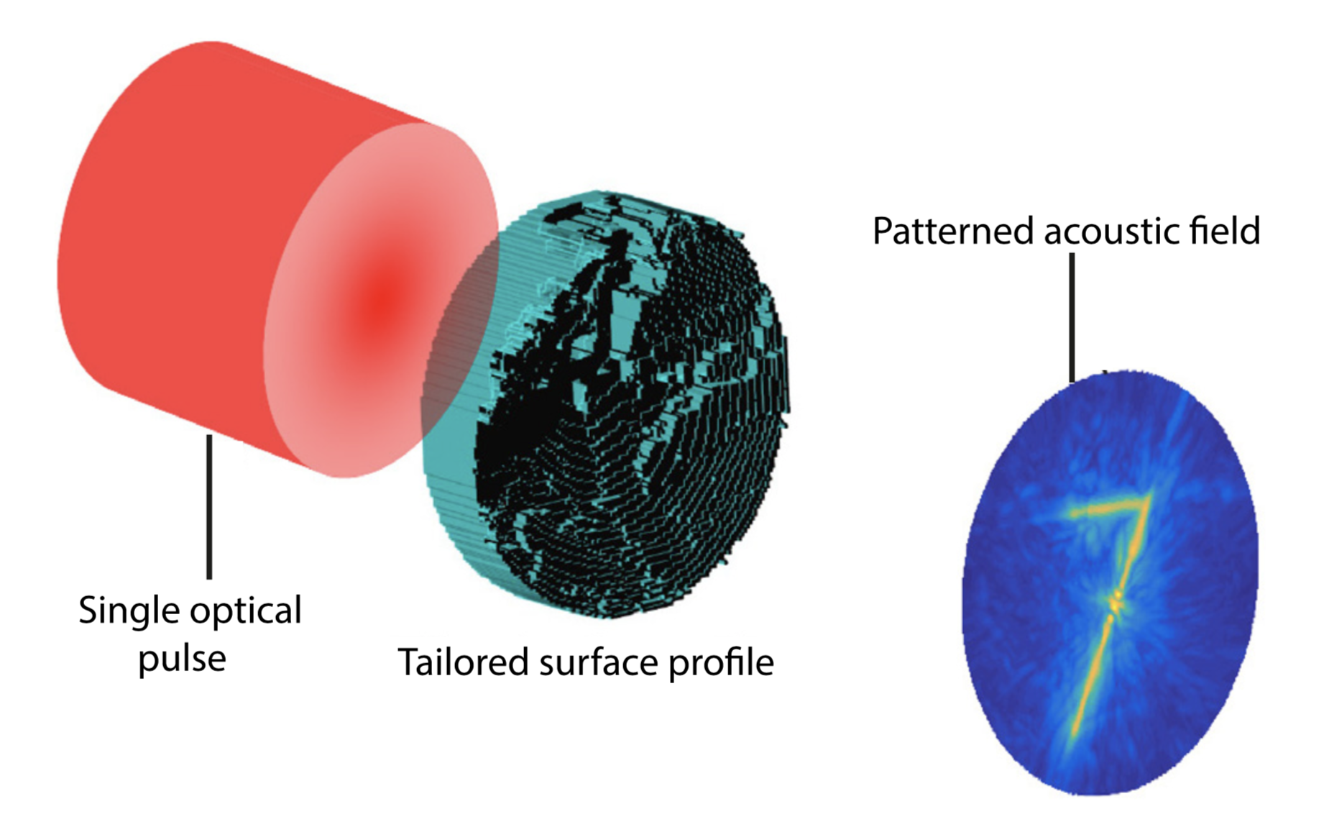
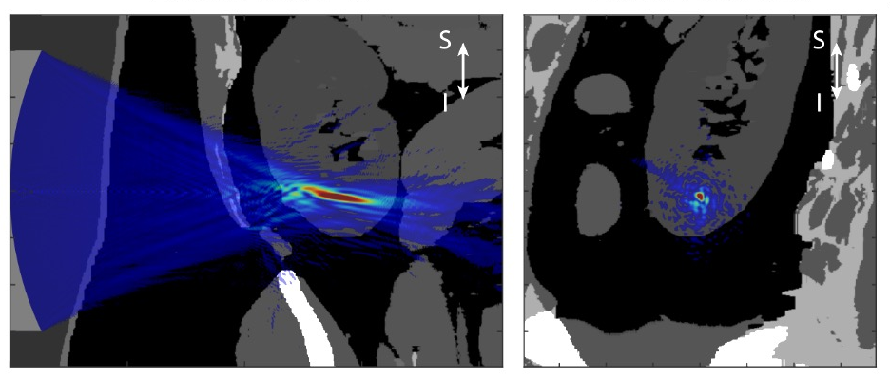
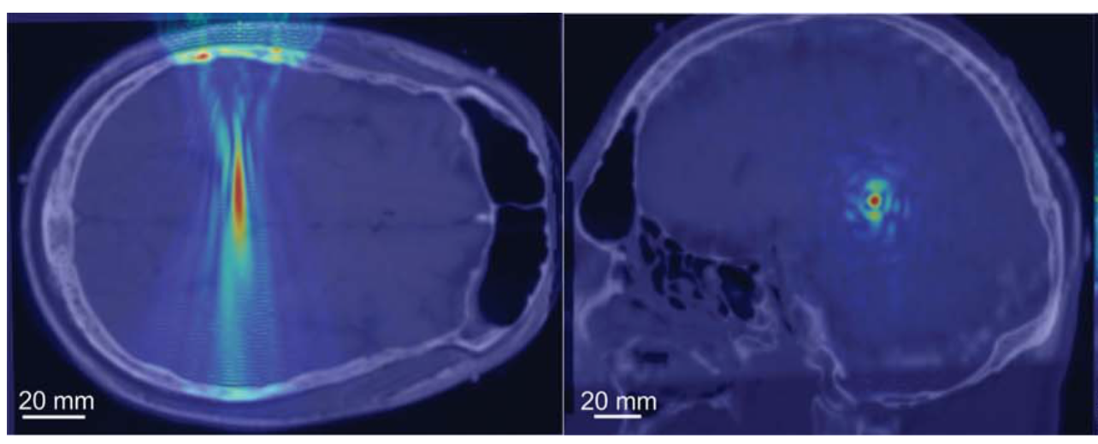
Some k-Wave applications
photoacoustic tomography
novel ultrasound sources
source characterisation
focused ultrasound surgery
ultrasonic deep brain stimulation

Slide 5
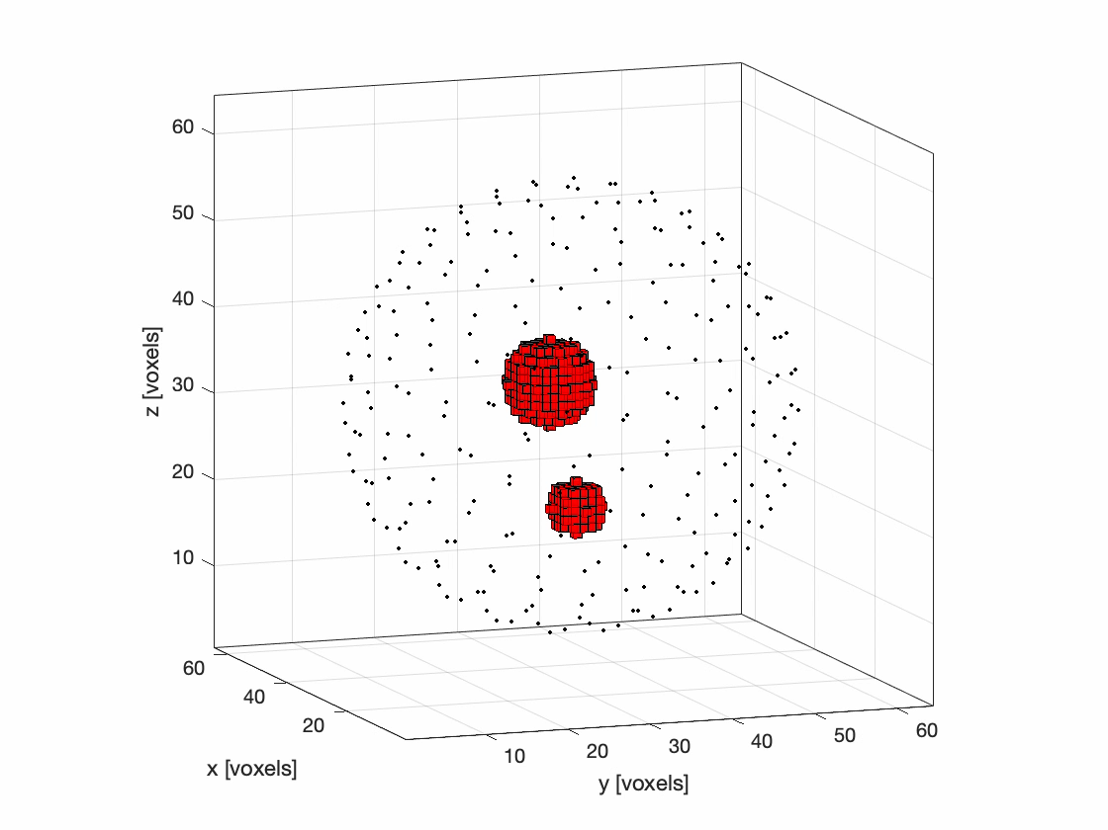
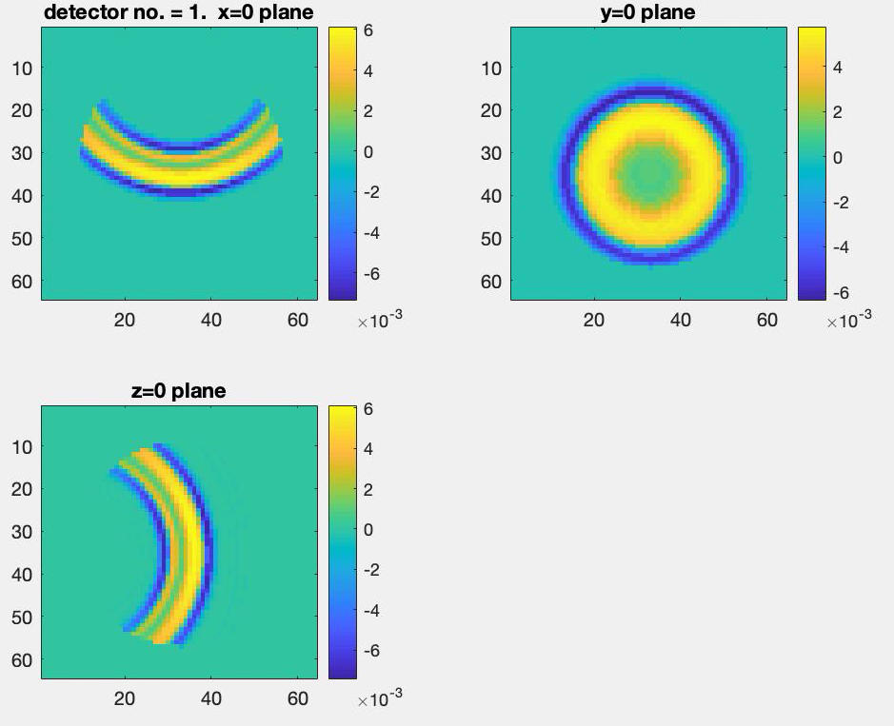
Inverse problem
Locating the Bragg peak needs just one time series measured on-axis beyond the Bragg peak
Challenge: find a 3D image of the beam (the deposited energy density) given acoustic time series measured at an array of positions around the beam
Many methods available when there is full data (full-view, fully-sampled, omnidirectional detectors)
  backprojection
  time reversal
  direct matrix approach
  iterative cost-function minimisation
Notes:
\frac{1}{c^2}\frac{\partial^2 p}{\partial t^2} - \nabla^2 p = \frac{\beta}{C_p} \frac{\partial \mathcal{H}}{\partial t}

Slide 6
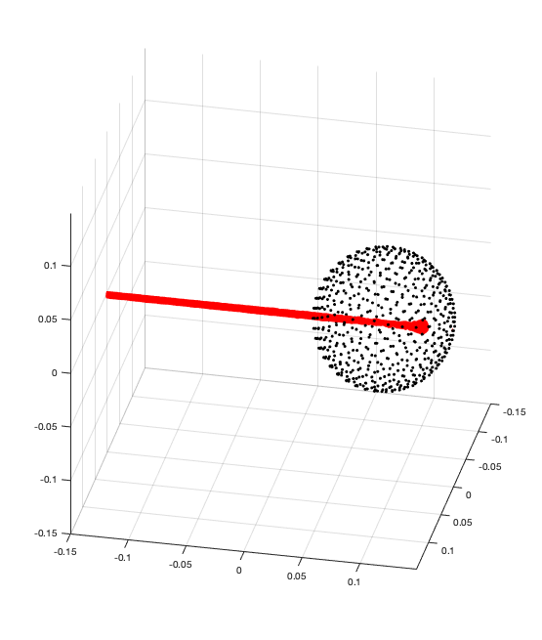
Beam tomography

Slide 7
Questions & challenges
What do we want? Bragg peak location? Image of whole beam? Quantitative image?
How long do we have for (a) data acquisition, (b) image formation?
Where would it be best to place the sensors?
Incomplete data
  Signal-to-noise considerations may necessitate large-area sensors, which are directional
  Possible limited-view detection (< 4 pi steradians) due to access issues, array geometry
  Sparse array may be needed to reduce cost, system complexity, total data acquisition time
Reconstruction from incomplete data
  use strong prior that the beam shape always similar?
  eg. learned prior in iterative minimiser of cost function based on data-model discrepancy?
Fast reconstruction: Backprojection using dedicated FPGAs? Fully–learned?
Biggest concern is low signal-to-noise ratio!

