Slide 1
News

Slide 2
Ongoing
Discussions with Hywel Owen ITRF PI:
  LhARA ITRF alignment
  Good progress on:
    Budget:
      Agreement that LhARA programme funded @ ~90%—95% of allocation
        Issue: overheads attracted on STFC staff; being addressed by H.Owen and J. Clarke
    Organogram / Org chart:
      Proposed organizational structure that respects both LhARA collaboration and STFC project-management requirements
Continued preparation for next ITRF AC: 30Mar22

Slide 3
Breaking
Maurizio Vretenar:
  “The collaboration agreement came out of the CERN Legal Service but is now stuck with the KT that has to stamp it. What a pain… I’ll shake them up.”
This is close now!

Slide 4
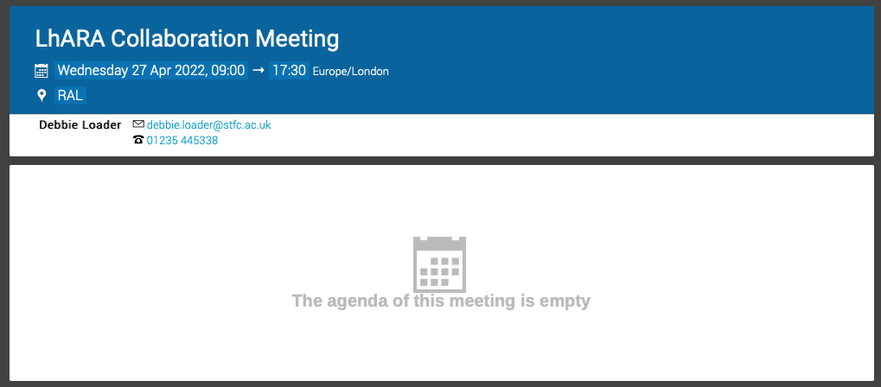
Future
Next LhARA collaboration meeting: 27Apr22
One day workshop on
Future accelerators for biomedical applications
  28Apr22
  Rutherford Lecture on LhARA initiative at 14:00: KL and AG
CR12/13 booked
Holding 10 rooms in
Ridgeway House
Time to develop
the agenda now!

