Slide 1
Proposal, next steps, summer 2022

Slide 4
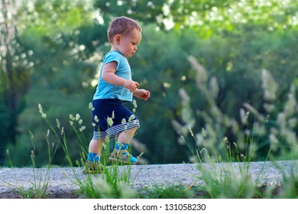
Summer 2022:
Opportunities:
Start technical programme
Push on search for resource

Slide 5
Review of proposal by CCAP IAC
CCAP IAB have agreed to review the proposal:
  CCAP IAB:
    M.Lamont (CERN, Chair)
    P.Bolton (LMU, retired)
    M.Baumann (DKFZ)
    B.Sorensen (Arhuus)
Split into two parts focussing on:
  The machine and associated technology
    Proposed chair: Gianluigi Arduini
    Proposed additional experts: Malek Haj Tahar (PSI), Christian Carli (CERN)
  Radiobiology and longer-term ambitions
    Chair/additional experts: to be confirmed
Timeline:
  To be agreed, but, looking at July/August

Slide 6
Next steps
Dissemination; need to start now:
  Consider “glossy” printed version of proposal for the coffee table
  Need “2-page” document defining “key parameters” and ”key outcomes”:
    For ourselves; coordinating our communication
    For busy people to whom we wish to communicate our pitch
Agree programme funded by “ITRF line”
Agree goals for summer 2022

