Slide 1
Getting started …

Slide 2
Preparations underway for start-up in October
Assumption:
  ITRF resource will become available Oct22
    To be confirmed …
Consequence:
  Planning now for programme that will be delivered funded from the ITRF Infrastructure Fund line
Implication:
  Preparing Addendum to proposal that:
    Defines “ITRF funding line” deliverables precisely
    Presents the fEC of the project funded by the ITRF funding line

Slide 3
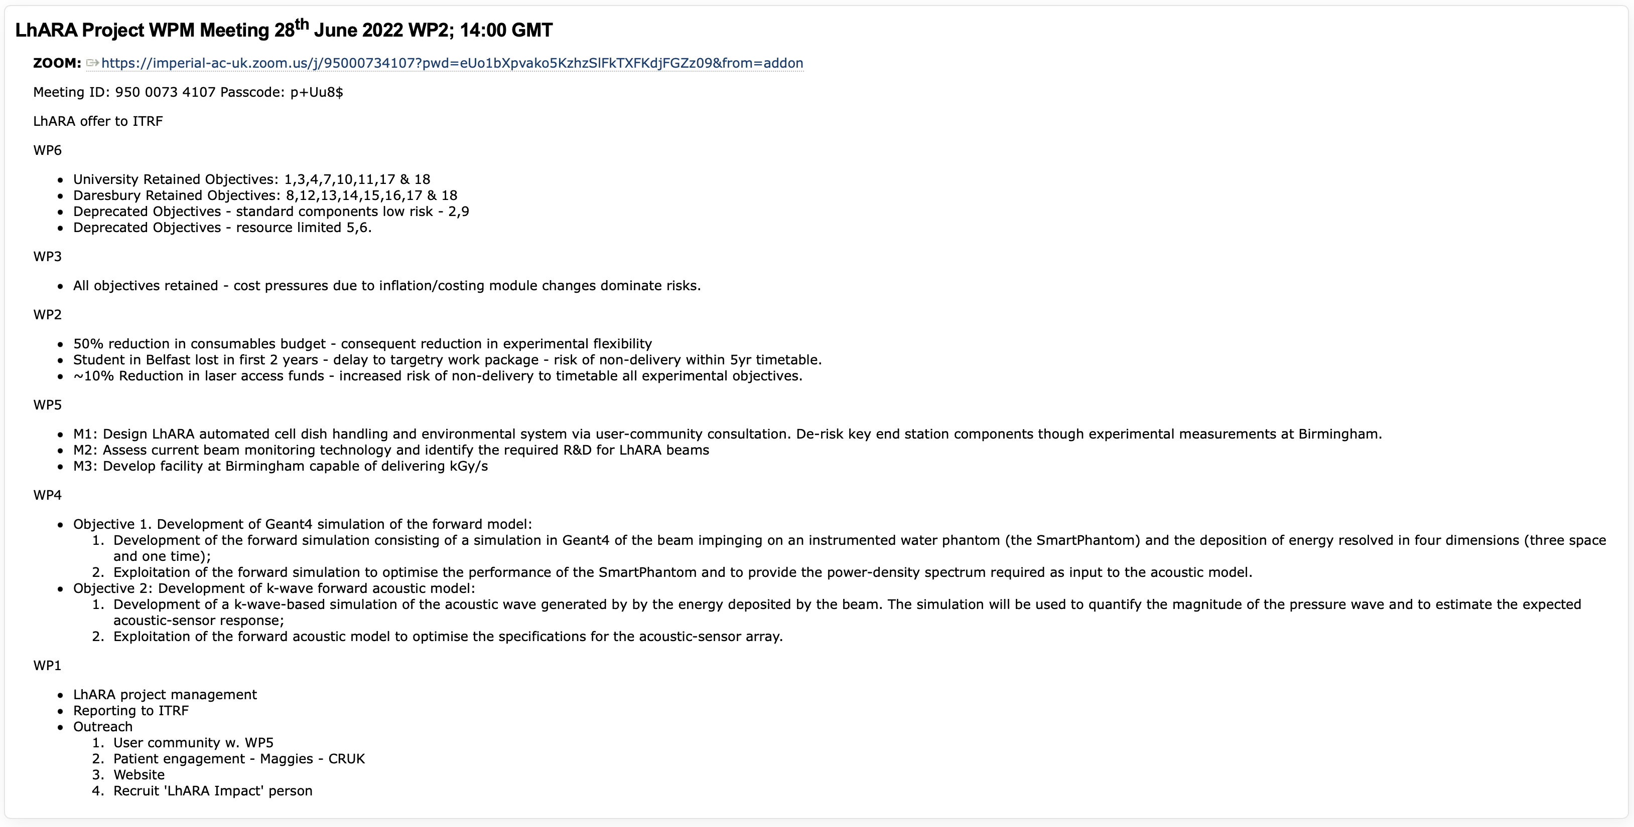
Progress in defining the deliverables

Slide 4
ADDENDUM SKELETON

Slide 5
Next steps
Addendum preparation, JeS forms etc.:
  Now – goal to complete end July 2022
For your diaries:
  Next LhARA collaboration meeting; 14Oct22
    Propose to meet in Liverpool
  Subsequent collaboration meeting pattern:
    Jan/Feb23
    Then six monthly
Ca commence!

