Slide 1
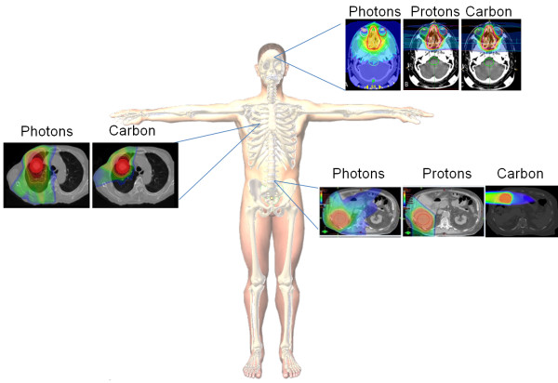
Hadron Therapy-UK
Superior Dose Distribution and Biological Effectiveness of Carbon Ions Compared to Protons and Photons

Slide 2
Laser Driven Ion Accelerator for the UK
Hadron Therapy while highly effective is expensive to build, run and service and requires greater technical experience
High powered laser interaction with solid (foil) targets can generate significant magnetic and electric fields to accelerate ions
State of the art currently is 2 digit MeVs at a high yield (10¹⁰-10¹²/pulse)
Technology is still developing and needs work on energy bandwith, spatial profile uniformity, and repeat stability
Major goal is to improve particle beam characteristics in a more reliable and streamlined manner that is more cost effective and efficient in a production type facility
Ultimately, we want to develop a laser driven ion accelerator that can generate stable, well characterised and reliable beams that can be used for research and ultimately clinical purposes

Slide 3
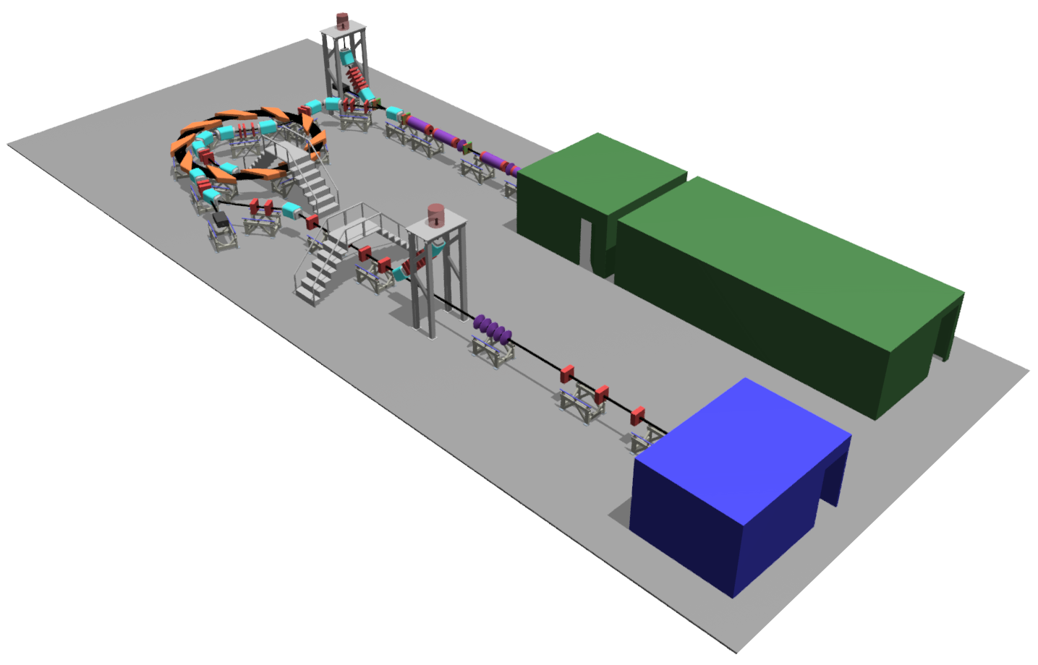
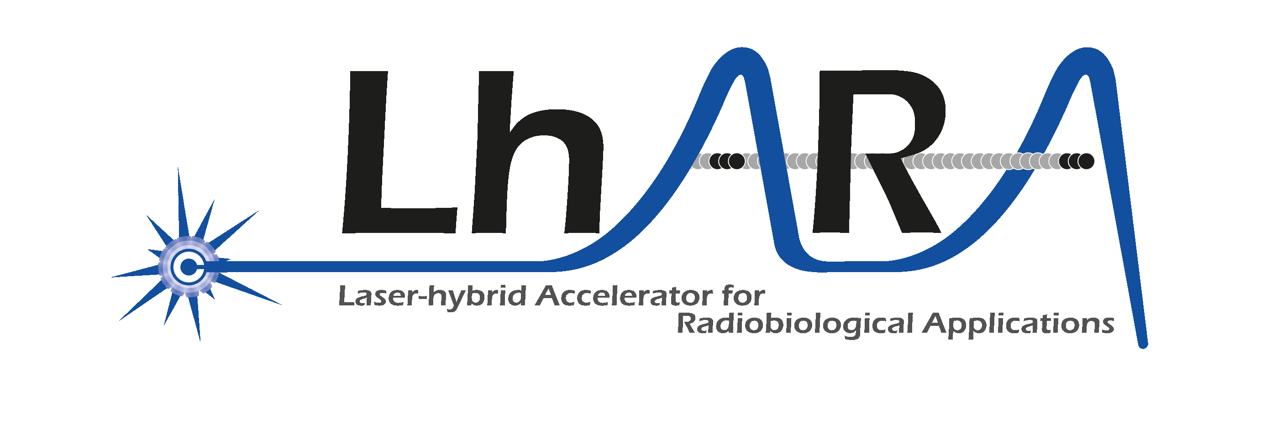
Front. Phys., 29 September 2020; DOI: 10.3389/fphy.2020.567738

Slide 4
LhARA:Laser-hybrid Accelerator for Radiobiological Applications
Laser-driven, high-flux proton/ion source
  Overcome instantaneous dose-rate limitation
    Capture at >10 MeV
  Delivers protons or ions in very short pulses
    Bunches as short as 10—40 ns
  Triggerable; arbitrary pulse structure
Novel “electron-plasma-lens” capture & focusing
  Strong focusing (short focal length) without the use of high-field solenoid
Fast, flexible, fixed-field post acceleration
  Variable energy
    Protons: 15—127 MeV
    Ions: 5—34 MeV/u
Front. Phys., 29 September 2020; DOI: 10.3389/fphy.2020.567738

Slide 5
Radiobiological Research Directions
-
-Advantages and disadvantages of different ways of beam delivery- FLASH, Minibeams, etc
-Increased generation of neoantigens
-Ion interaction with normal tissues
-Identifying genetic mutations where Ion beam is most effective
-Microenvironment
-CSCs

Slide 6
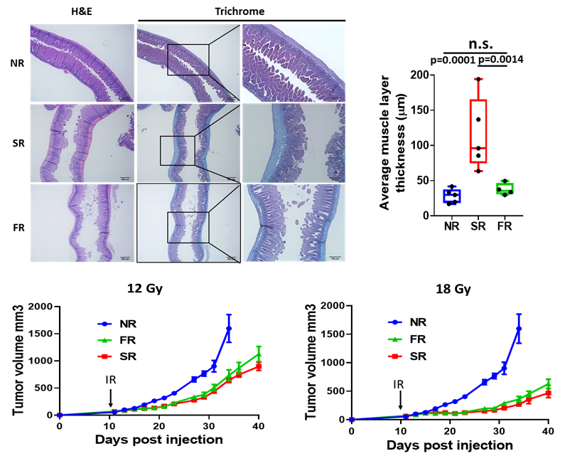
Flash-Proton Radiotherapy Highly Effective in Controling Pancreatic Tumor Growth and Reduces Normal Tissue Toxicity
Koumenus et al, unplublished

Slide 7
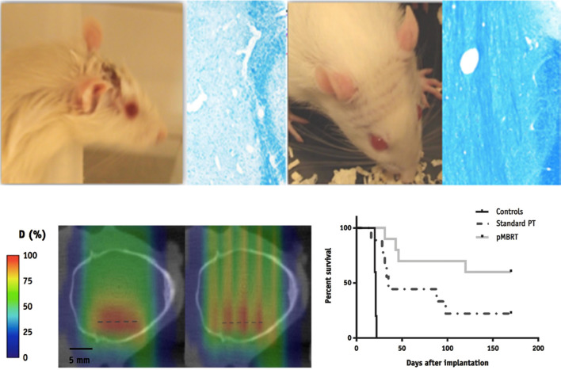
Response to Proton Minibeam Irradiation
Br J Radiol. 2020 Mar; 93(1107)
Notes:
Response to minibeam irradiations : (a) normal tissues: while there is a moist desquamation and a permanent epilation with conventional irradiation, there is no skin damage and a reversible epilation with minibeams (Prezado, personal comm.), In blue: destruction of the myelin after conventional irradiation and normal myelin organization after minibeams irradiation¹⁰⁴ . (b) evaluation of tumour control: coronal 2D dose distributions in the computed tomography images of a rat’s head corresponding to a conventional (seamless) irradiation (left) and a proton minibeam radiation therapy (pMRBT) irradiation (right). (c) Survival curves for the controls, standard PT and pMBRT irradiated tumour-bearing rats.
“proton minibeam radiation therapy” (pMBRT)⁹⁵ offers the possibility to (a) maintain the spatial fractionation of the dose at the entrance of the beam and in the beam path; (b) produce a more uniform dose than synchrotron radiation in a target at depth (where the multiple scattering of protons makes a wider minibeam); (c) achieve a higher dose at any depth than in the path; and (d) preserve tissues after the target by the inherent property of a determined range of proton beams^{95–98}

Slide 8
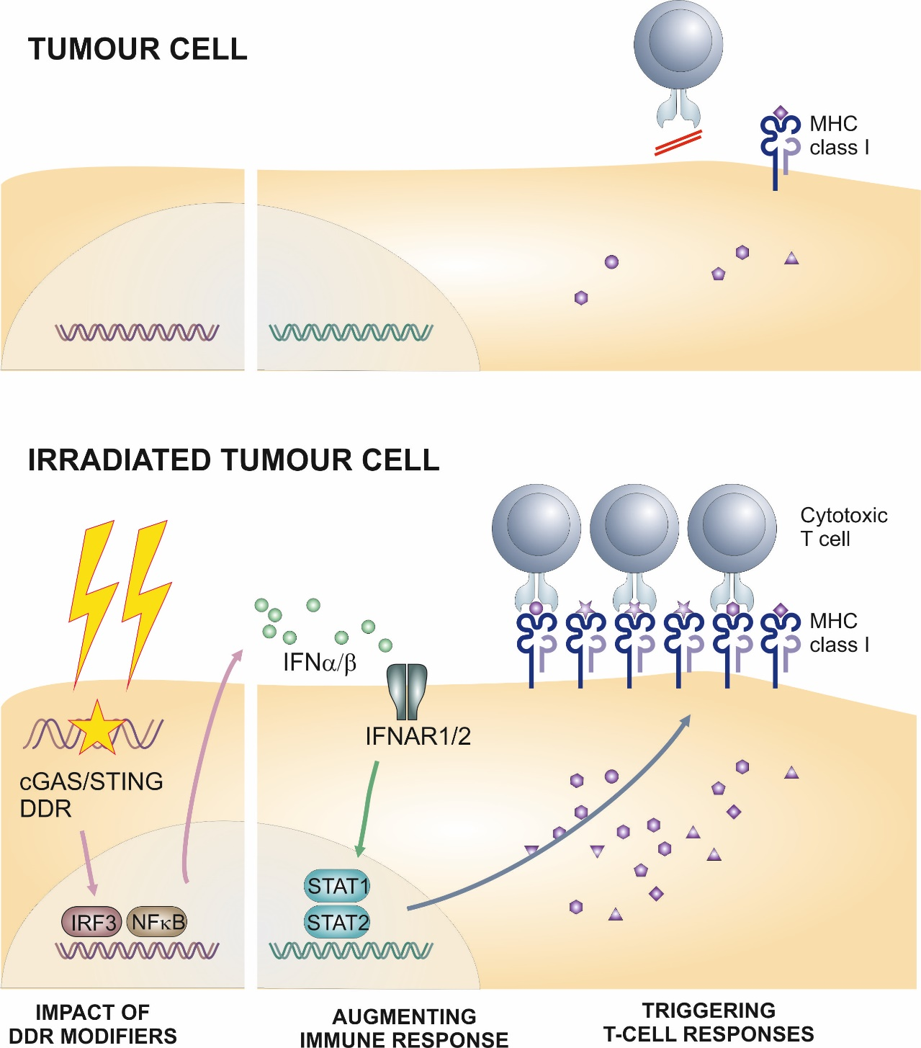
Increasing Tumor Antigen/Neoantigen Formation after Heavy
Ion Exposure

Slide 9
Nrf2-Keap1 Pathway
Notes:
Nrf2/Keap1 signaling pathway. Under basal conditions, Nrf2 binds to Keap1 by its two motifs (ETGE and DLG) and activates Cul3‐mediated ubiquitination followed by proteasomal degradation. Under stress conditions, due to the modification of Keap1 cysteine residues, Nrf2 dissociates from Keap1 and translocates into the nucleus. Nrf2 then forms a heterodimer with sMaf protein and binds to ARE to initiate the transcription of various downstream genes

Slide 10
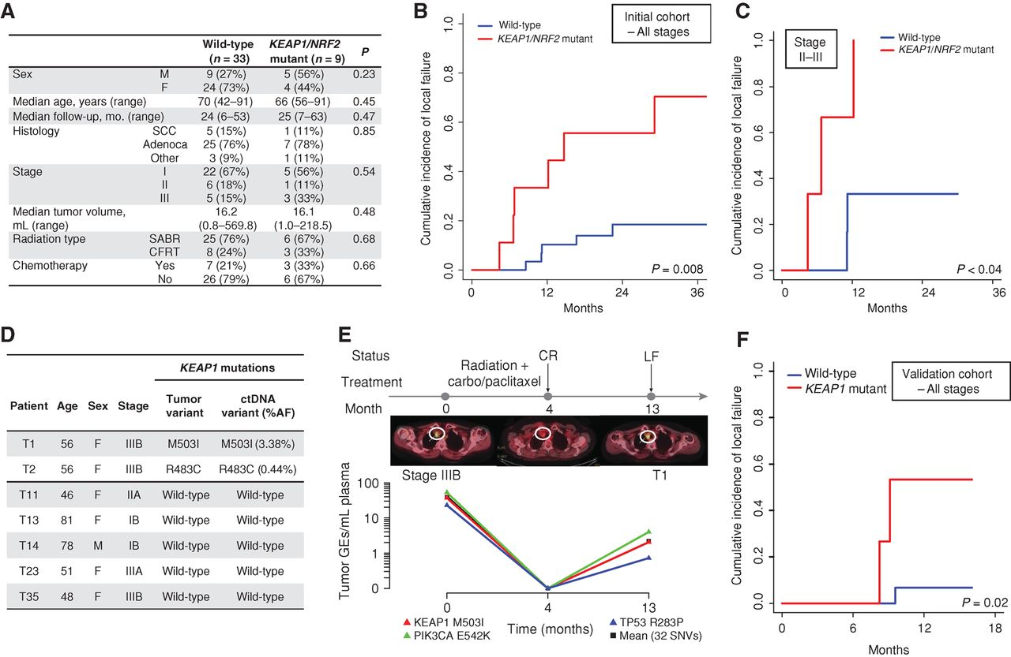
KEAP1/NRF2 Mutation Status Predicts Local Failure after Radiotherapy in Human NSCLC
Youngtae Jeong et al. Cancer Discov 2017;7:86-101
Notes:
KEAP1/NRF2 mutation status predicts local failure after radiotherapy in human NSCLC. A, Clinical characteristics of a cohort of patients with stage I–III NSCLC treated with curative intent RT and analyzed for KEAP1/NRF2 mutation status using targeted next-generation sequencing. B and C, Association of KEAP1/NRF2 mutations with local failure in patients with NSCLC treated with RT. B, Entire cohort. C, Stage II–III patients treated with conventionally fractionated radiotherapy or chemoradiotherapy. D, Noninvasive identification of KEAP1 mutation status in ctDNA isolated from pretreatment plasma samples of 7 patients from the cohort in A using CAPP-Seq. E, Monitoring of ctDNA in a KEAP1-mutant patient from D treated with chemoradiation. CR, complete response; LF, local failure; carbo, carboplatin. F, Clinical characteristics of a validation cohort of patients with stage I–III NSCLC treated with curative intent RT and analyzed for KEAP1/NRF2 mutation status using targeted next-generation sequencing.

Slide 11
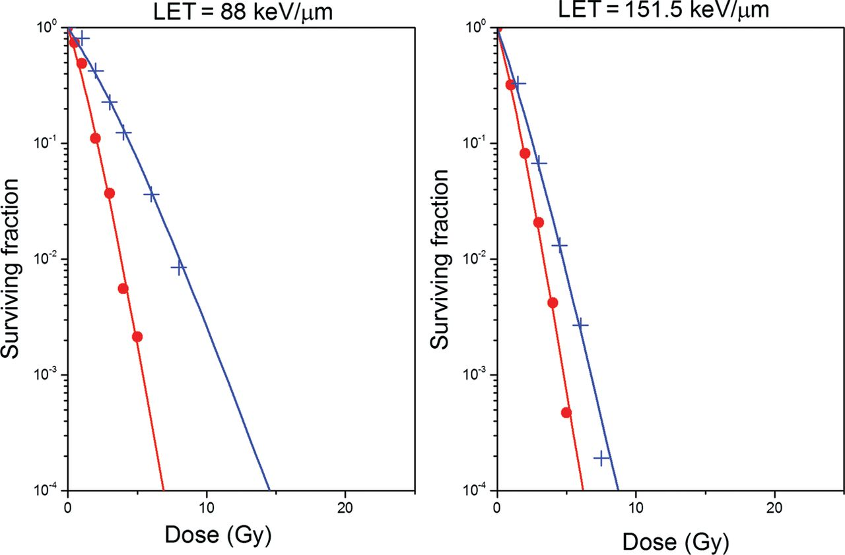
Survival of Cells Irradiated with Carbon Ions
in Oxic (red curves) and Hypoxic conditions (blue curves)
for Two Different LETs
Antonovic L et al. J Radiat Res 2013;54:18-26
Notes:
Survival curves for V79 cells irradiated with carbon ions in oxic (red curves) and hypoxic conditions (blue curves) for two different LETs predicted by the RCR parameterized model described by Equations 2–7.

Slide 12
What Does Hadron Mean to UK
UK is a unique place that could lead by bringing a laser driven technology to produce ions to the clinic: strengths in physics, engineering, science, and medicine
Hadrons can solve the problem of how to deliver a higher RBE particle, increase tumor control & spare normal tissue at the same time
If we don’t embark on this opportunity now, we risk missing the opportunity to be leaders in the revolution of particle therapy for solid tumors & will struggle to be passengers
Strategically, we would be in a more advantageous position than relying solely on protons, which may ultimately may be best suited for pediatric and certain tumors

Slide 13
Superior Dose Depth Distribution
& Physical Beam Characteristics
Increasing the
Patient Experience
-Higher LET
-Superior RBE
-Low OER
-Narrow penumbra
-New Lhara Ion therapy
-Less toxicity
-Given in short period of time
-Cost effectiveness research
Physics
Clinical Biology Research
-Beam characterization
-Beam heterogeneity
-Dose limitations
-Toxicity
-Which tumor histologies benefit most
-Does it overcome tumor microenvironment
-Development of new clinical trial design
Multidisciplinary
UK
Lhara- Ion
Therapy
Program
Radiobiological Research
-Development of radioprotectors
-Carbon ion interaction with diff tissues
-Metabolism
-Microenvironment
-CSCs
Clinical Physics Research
-Dose and treatment planning
-Development of IMCT
-Absorbed Dose Calculations
-Modeling RBE
Engineering
-Gantry design
-Miniaturization
STFC/UKRI/ITRF
Material Science
Radiology
-Beam Production
-Beam Delivery
-Accelerator miniaturization
-Active and Passive Beam Shaping
-Target Production
-Substance lighter than
concrete, but just as effective
-Ionacoustic Imaging
-Positron imaging
-Dose distribution

