Slide 1
News/Update

Slide 2
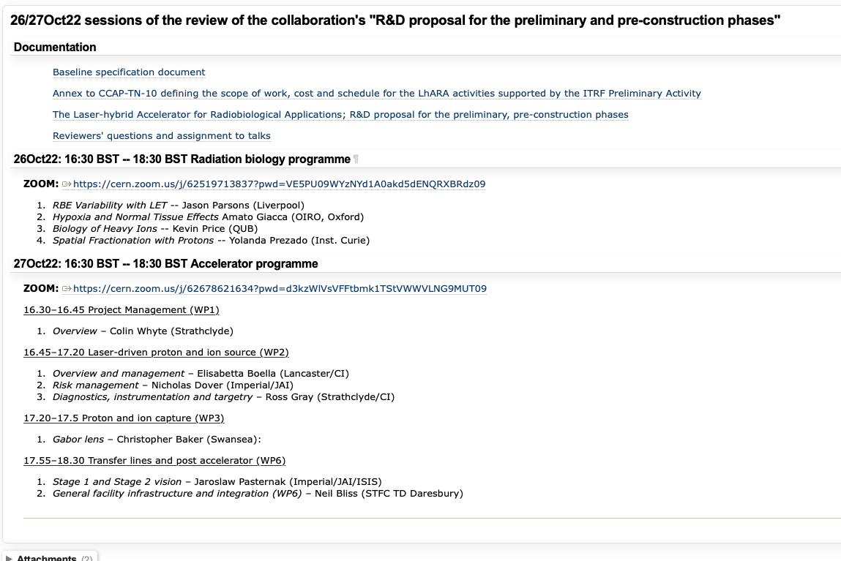
https://ccap.hep.ph.ic.ac.uk/trac/raw-attachment/wiki/Research/LhARA/Documentation/TN/Governance/LhARA-Gov-Rev-2022-01.pdf

Slide 3
https://ccap.hep.ph.ic.ac.uk/trac/raw-attachment/wiki/Research/LhARA/Documentation/TN/Governance/LhARA-Gov-Rev-2022-01.pdf

Slide 4
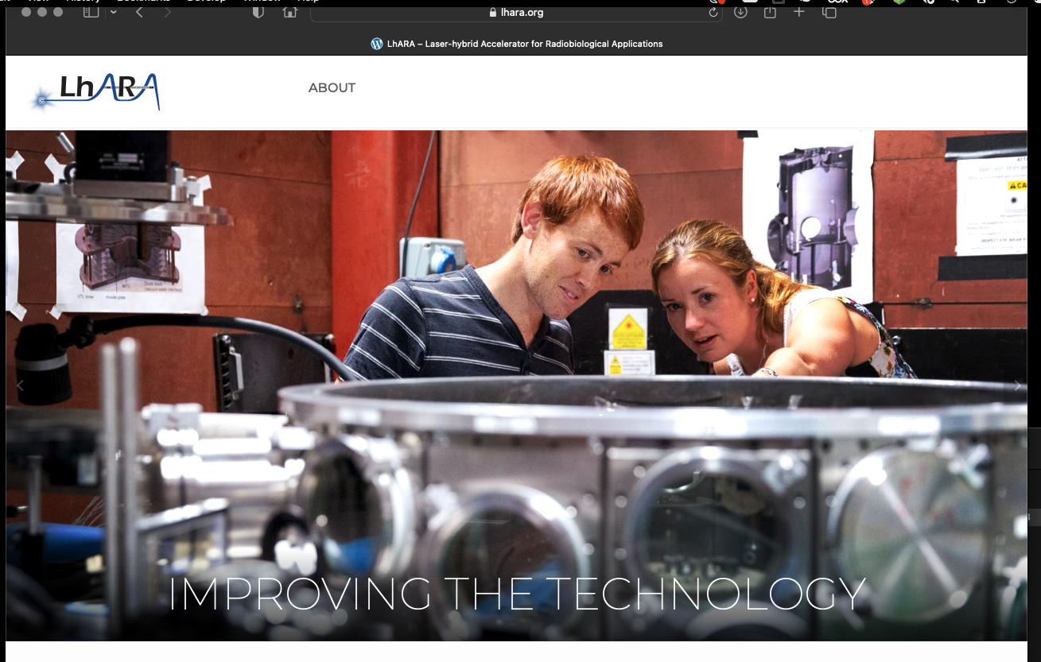
Need to develop!

Slide 5
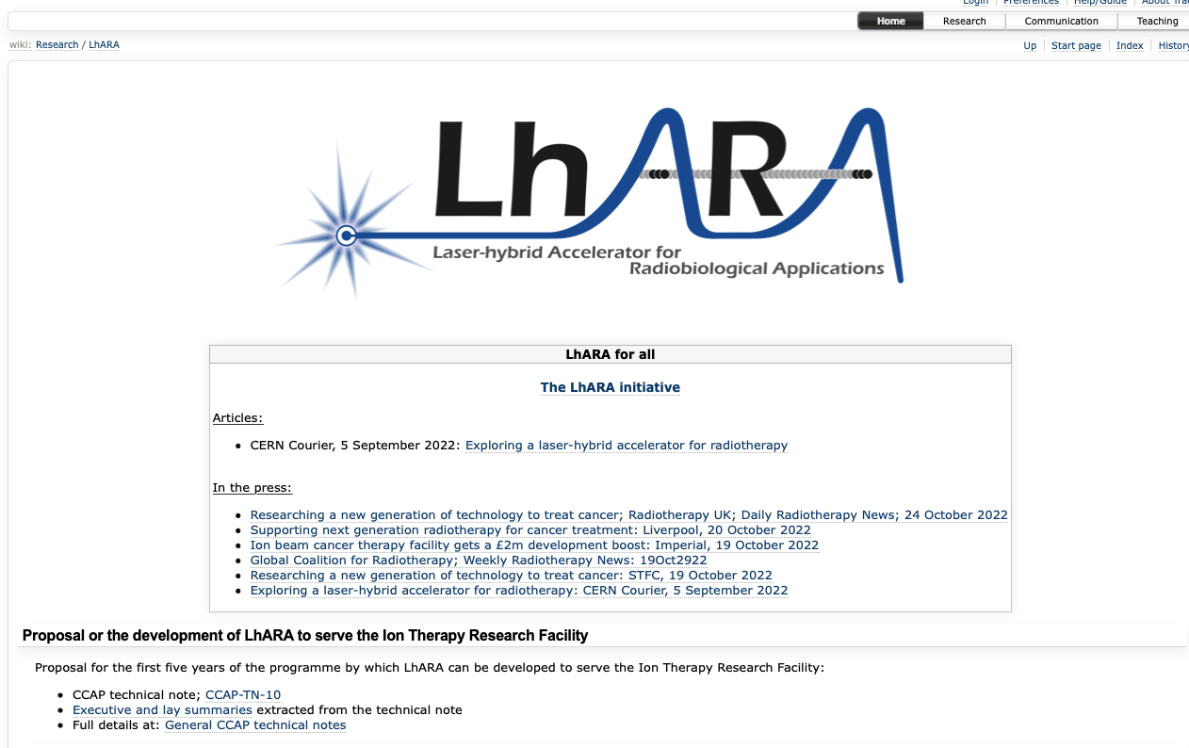
Reorganisation/streamlining in progress …

