Slide 1
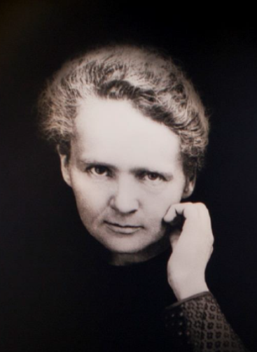







Lhara endstation: needs for in vivo experiments
Yolanda Prezado, PhD, HDR

Slide 2
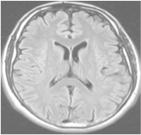
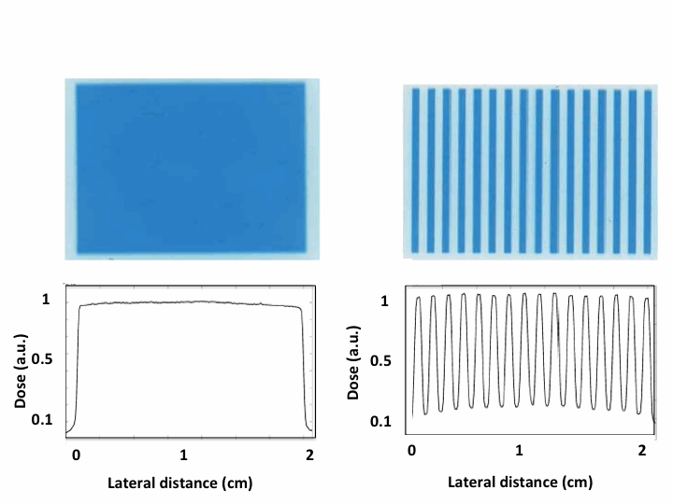
Spatial fractionation of the dose in Radiation Therapy
Standard radiotherapy
Spatial fractionated radiotherapy
x-rays minibeam radiation therapy
Large beam sizes
(> 1 cm²)
Homogeneous
dose distributions
Narrow beam sizes spaced by areas of low dose
+
Heterogeneous distributions
< 1 mm
+
> 1 cm
1-2 mm

Slide 3
Spatial fractionation of the dose in Radiation Therapy
Standard RT
Spatial fractionated radiotherapy
x-rays minibeams radiation therapy
Large beam sizes
(> 1 cm²)
Homogeneous
dose distributions
< 1 mm
> 1 cm
+
1-2 mm
Distinct biological mechanisms not yet understood
Remarkable increase of normal rat brain resistance.
Dilmanian et al. 2006, Prezado et al., Rad. Research 2015
Dose escalation in the tumor possible→ higher tumor control

Slide 4
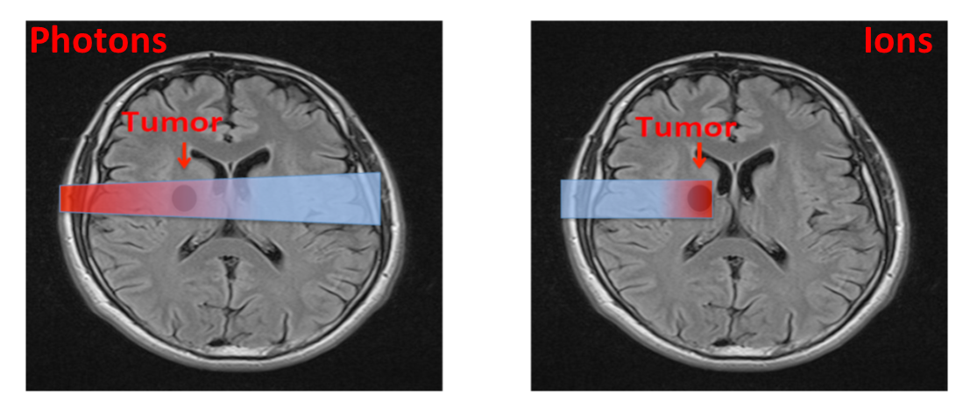
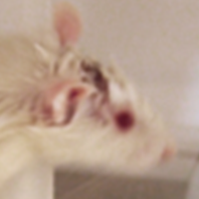

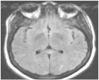
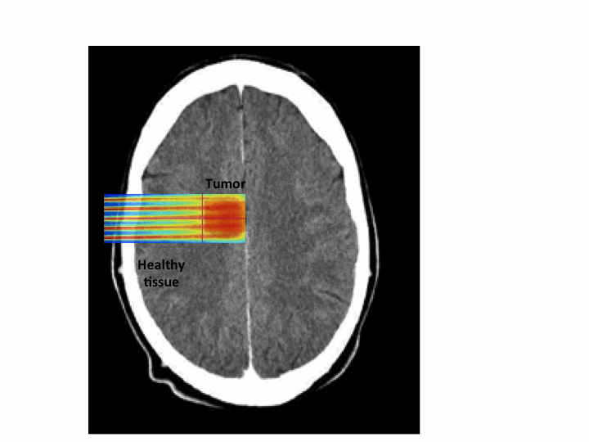
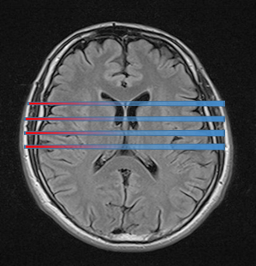
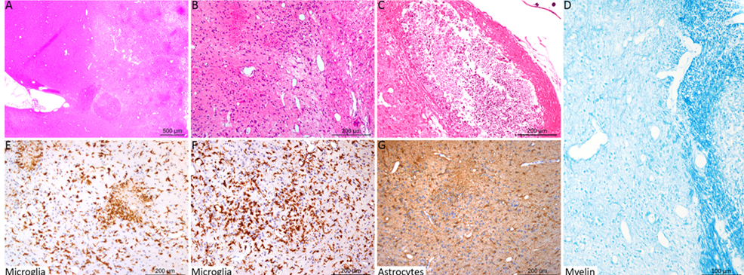
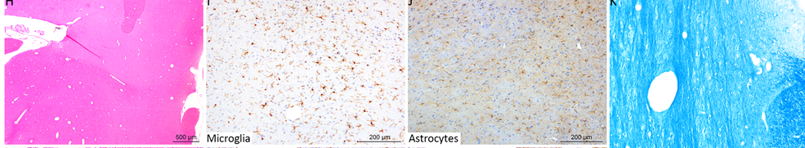
Proton minibeam radiation therapy: an innovative therapeutic approach
Reduction of skin toxicity
Girst et al 2015, Prezado et al 2017
Reduction of neurotoxicity
Standard PT
pMBRT
Proton MBRT
Charged particles
Tumor
Prezado et al. 2013
Zoblinskaya et al 2013
Standard PT
pMBRT
Minibeam radiation therapy (MBRT)
Prezado et al. 2017, Scie. Reports 2017
Lamirault et al. Scie. Reports 2020

Slide 5
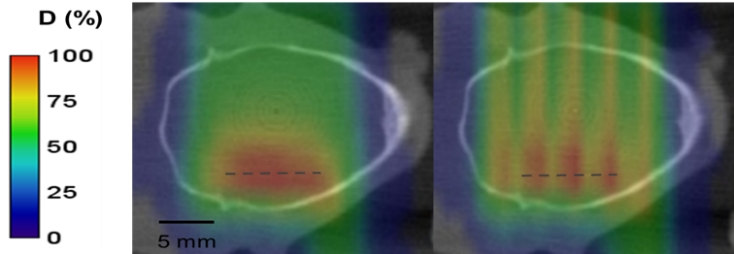
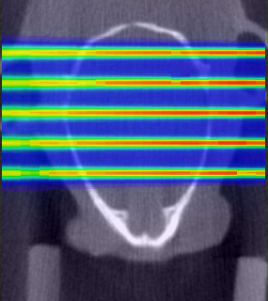
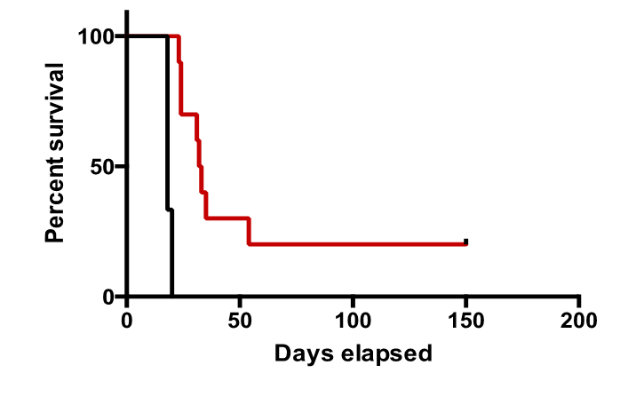
Tumor control effectiveness in glioma (RG2) bearing rats (one fraction)
Standard PT
pMBRT
pMBRT (heterogeneous)
3,5 mm
Beam spacing
--Controls
-- pMBRT (heterogeneous)
Prezado et al. IJROP 2019
Prezado et al. Scie. Reports 2018

Slide 6
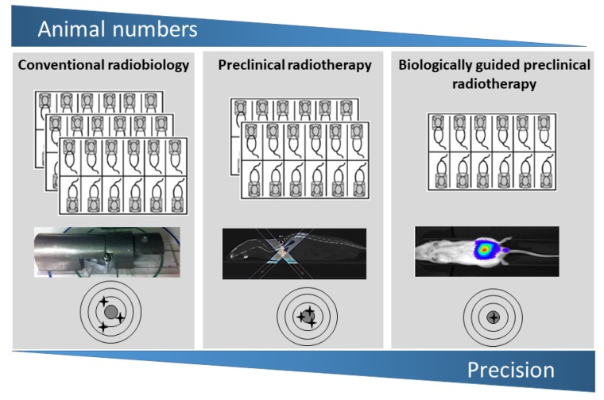
In vivo experiments: needs
Reliable beam conditions and dosimetry
Positioning and immobilization
Suitable animal space:
stabulation/animal facilities
M. Guita et al. Cancers 2019

Slide 7
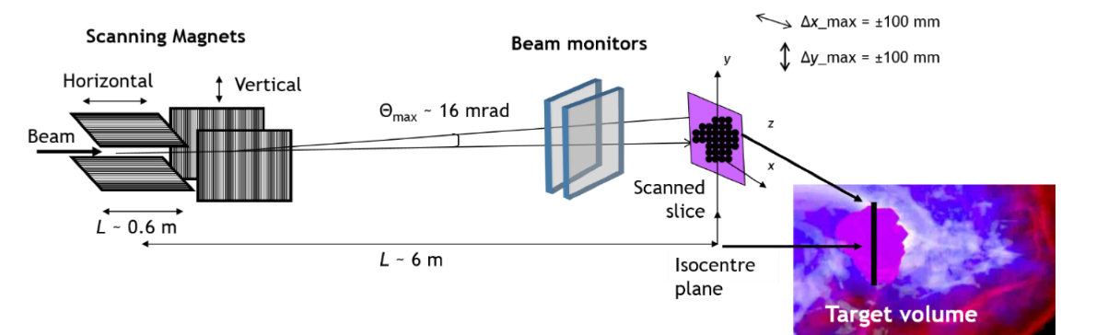
1. Reliable beam and dosimetry/safety
Ultra fast rate expected in Lhara→ adapted fast shutter.
Suitable beam monitors: gold standard Ionisation chambers
likely not to be adequate for FLASH

Slide 8
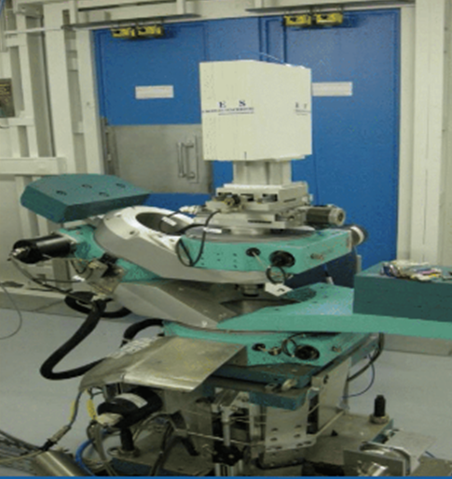
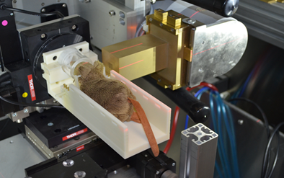
2. Positioning & immobilization
A system with high-mechanical precision allowing movements in several degrees of freedom to allow multiple ports irradiations & precise re-irradiation
Immobilization/anesthesia
Goniometer
Triggered/connected with the shutters in the beamline

Slide 9
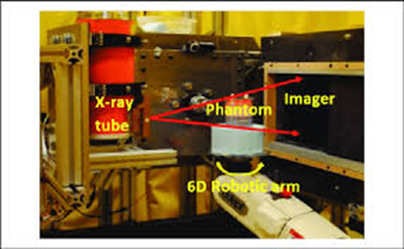
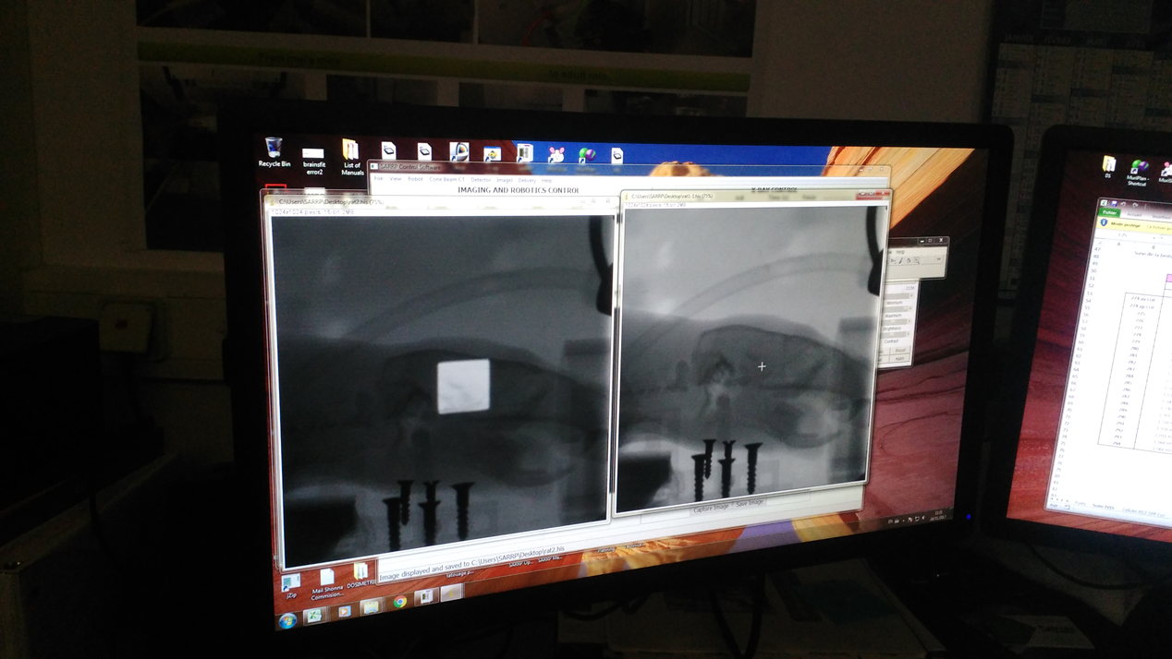
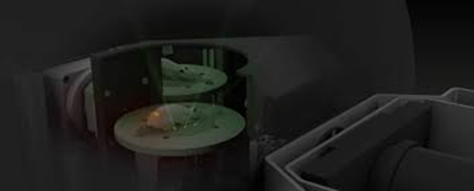
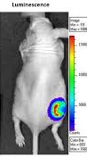
2. Positioning & immobilization
Imaging!!!
The basic: Cone beam CT or X-rays radiography
More sophisticated: CBCT + optical imaging with bioluminescence (co-registration)

Slide 10
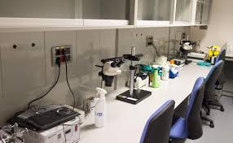
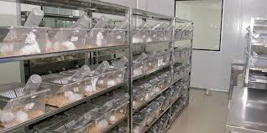
3. Suitable animal space: stabulation
Small animal facility or a stabulation space with adapted spaces to lodge short term, anesthesia and euthanasia
Requirements depends on the country legislation
Word caution: check UK’s legislation on the circuit the animals will follow/circulation of animals has some rules!

Slide 11
Requirements for magnetically focused minibeams

