Slide 1


Status of preparations for the LhARA pre-CDR
LhARA Steering Group Meeting
Ajit Kurup
28th November 2019

Slide 2
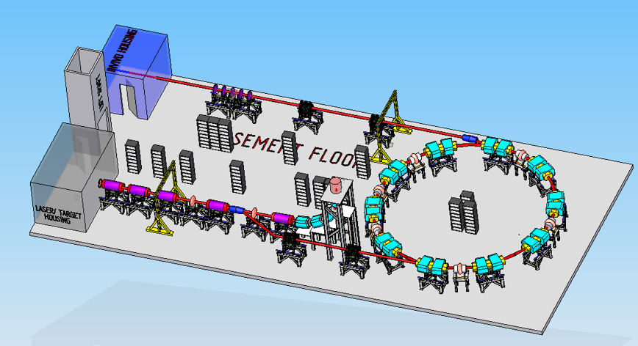
Introduction
Overview of the preparations for the LhARA pre-CDR.
  https://ccap.hep.ph.ic.ac.uk/trac/wiki/Research/DesignStudy/PreCDR
Organisation and the WBS.
First deadline at the end of the week to define the first version of the baseline design for the pre-CDR.
Definition of the version of the LhARA baseline.
  Floor plan.
  System interfaces.
  Parameter table.
R&D plan.
Schedule and deadlines.

Slide 3
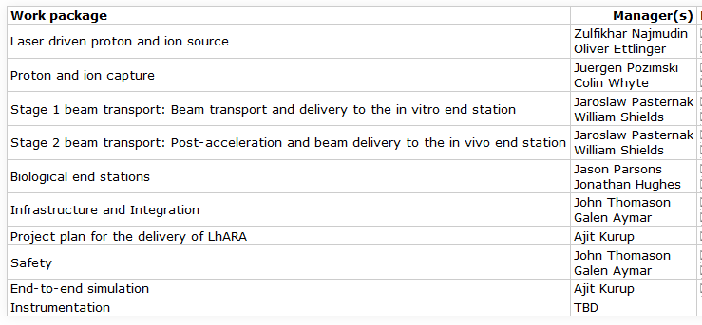
Organisation and the WBS
Work breakdown structure https://ccap.hep.ph.ic.ac.uk/trac/raw-attachment/wiki/Research/DesignStudy/PreCDR/2019-11-05-WBS.pdf
  Also defines the sections of the pre-CDR and what should be included.
Work package managers https://ccap.hep.ph.ic.ac.uk/trac/wiki/Research/DesignStudy/PreCDR#Workpackagemanagers

Slide 4
Floor plan
Version 0 of the floor plan.
  https://ccap.hep.ph.ic.ac.uk/trac/attachment/wiki/Research/DesignStudy/PreCDR/FloorPlan-v0.png
  Details of updates:
    https://ccap.hep.ph.ic.ac.uk/trac/wiki/Research/DesignStudy/PreCDR#Floorplan
RAL will provide an engineer to draw the floor plan of the final version of the LhARA facility to go in the pre-CDR.
  Due in February.
Design will be frozen by the end of January.

Slide 5
System interfaces
https://ccap.hep.ph.ic.ac.uk/trac/raw-attachment/wiki/Research/DesignStudy/PreCDR/2019-11-15-Interfaces.pdf
Mostly straight-forward.
Detail at the laser-capture interface being discussed to work out some of the technical issues with radiation shielding, exit route for the laser and ensuring a good vacuum.

Slide 6
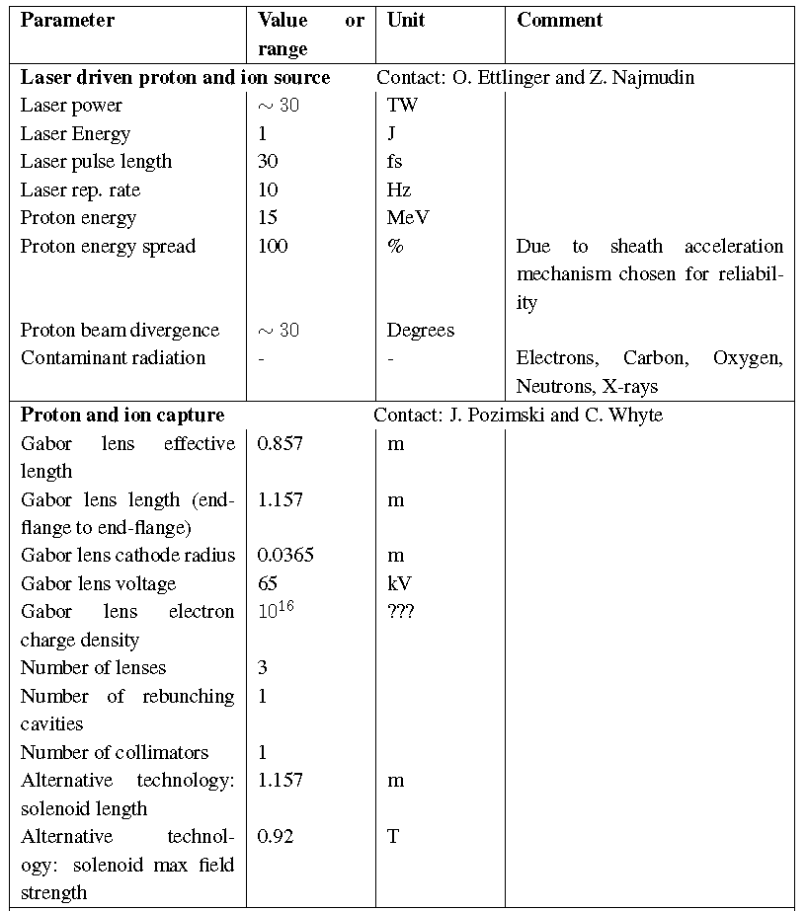
Parameter table
https://ccap.hep.ph.ic.ac.uk/trac/raw-attachment/wiki/Research/DesignStudy/PreCDR/LhARA_parameter_list-v2.pdf

Slide 7
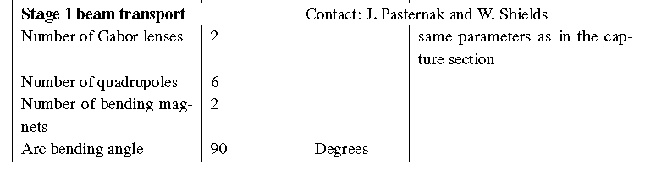
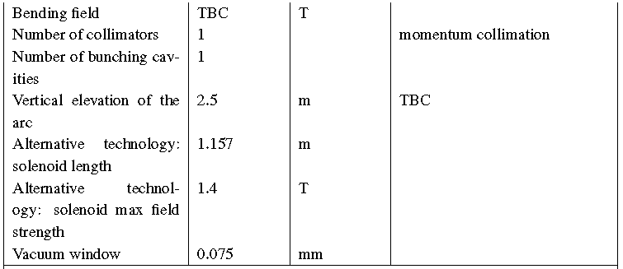
Parameter table

Slide 8
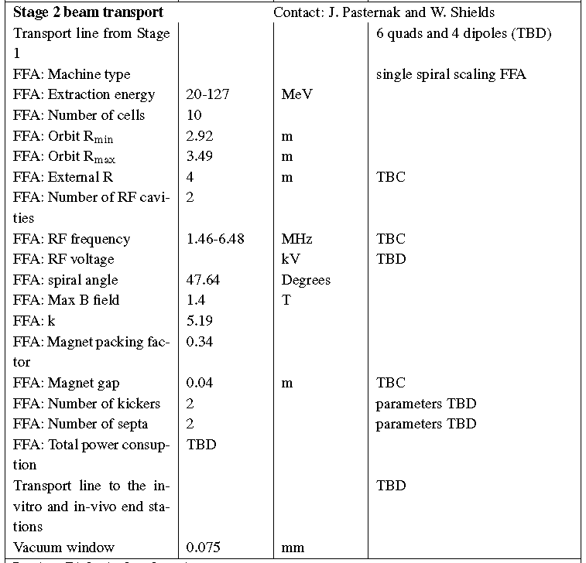
Parameter table

Slide 9
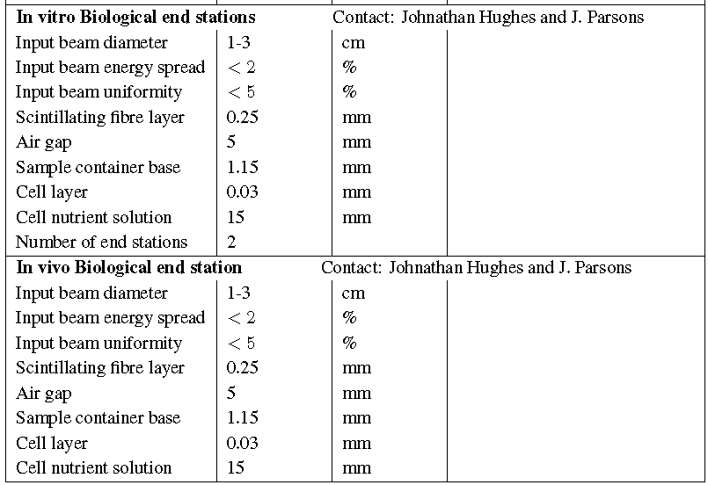
Parameter table

Slide 10
R&D plan
https://ccap.hep.ph.ic.ac.uk/trac/wiki/Research/DesignStudy/PreCDR#RDPlan
Laser
  No major R&D needed for the laser since it will be a commercial system.
  Target particle production.
Proton and ion capture.
  Gabor lens prototype development and performance verification.
Stage 1 beam transport.
  No major R&D needed.
Stage 2 beam transport.
  FFA: Magnet design and prototyping.
  FFA: RF cavity performance verification.
End station
  Automation.
Instrumentation.
  Dose calibration for high-intensity beams.
  Online dose monitor.
  Online beam monitor for low energy beam.

Slide 11
Schedule and deadlines
https://ccap.hep.ph.ic.ac.uk/trac/wiki/Research/DesignStudy/PreCDR#Keydates
29 Nov 2019: First issue of the baseline. This will include lists from the various systems of what needs to be updated on the existing floor layout, WBS, interfaces document and the parameter table.
31 Dec 2019: First end-to-end tracking simulation.
31 Jan 2020:
  Design of the facility will be frozen.
  First view of the costs.
  R&D programme needed to realise LhARA and be able to write a technical design report will be defined.
28 Feb 2020: Complete the write-up of the pre-CDR.
Mar 2020: External review of pre-CDR in advance of publication.

