Slide 1


Status of the development of the pre-CDR
LhARA Steering Group Meeting
Ajit Kurup
17th December 2019

Slide 2
Introduction
Overview of the preparations for the LhARA pre-CDR.
  https://ccap.hep.ph.ic.ac.uk/trac/wiki/Research/DesignStudy/PreCDR
First version of the baseline design.
Progress on the end-to-end simulation.
R&D plan update.
Schedule and deadlines.

Slide 3
Version 1 of the baseline

Slide 4
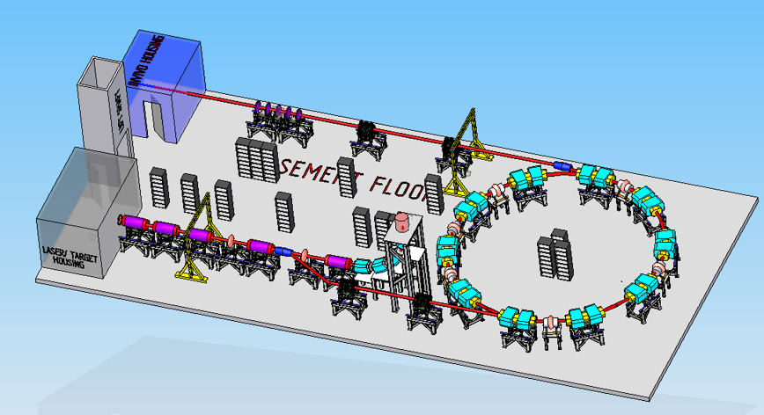
Floor plan
Version 0 of the floor plan.
  https://ccap.hep.ph.ic.ac.uk/trac/attachment/wiki/Research/DesignStudy/PreCDR/FloorPlan-v0.png
Details of updates:
  https://ccap.hep.ph.ic.ac.uk/trac/wiki/Research/DesignStudy/PreCDR#Floorplan

Slide 5
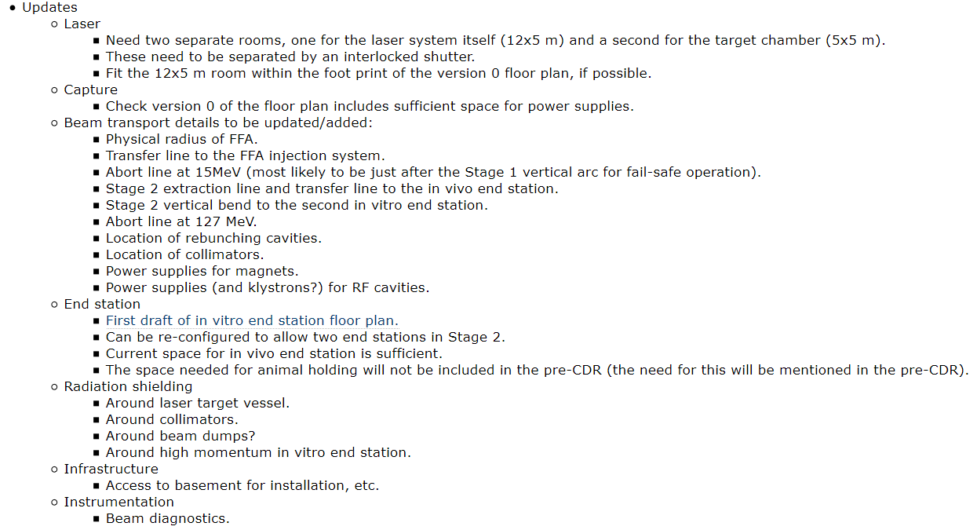
Floor plan

Slide 6
System interfaces
https://ccap.hep.ph.ic.ac.uk/trac/raw-attachment/wiki/Research/DesignStudy/PreCDR/2019-11-15-Interfaces.pdf
Interfaces document has not changed.
Detail at the laser-capture interface being discussed.
  Space needed for laser diagnostics after the target could push the first Gabor lens downstream.
  Aperture of the differential pumping plate at the interface with the Gabor lens could reduce the intensity of the beam entering the Gabor lens.
  Discussion scheduled for Friday.

Slide 7
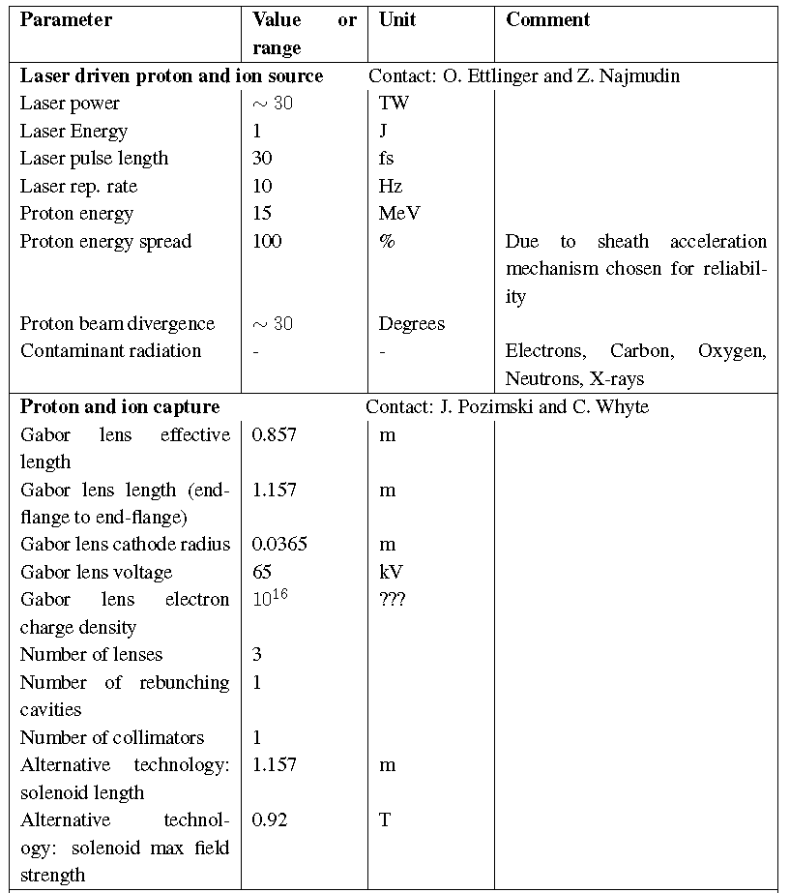
Parameter table
https://ccap.hep.ph.ic.ac.uk/trac/raw-attachment/wiki/Research/DesignStudy/PreCDR/LhARA_parameter_list-v3.pdf

Slide 8
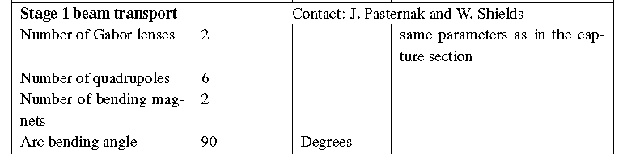
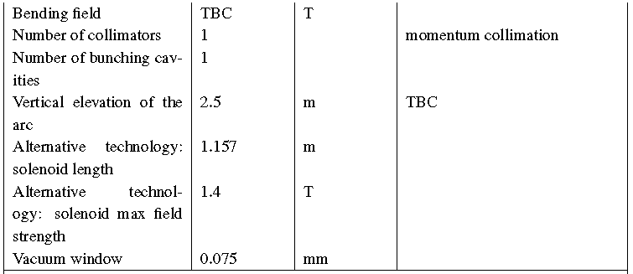
Parameter table

Slide 9
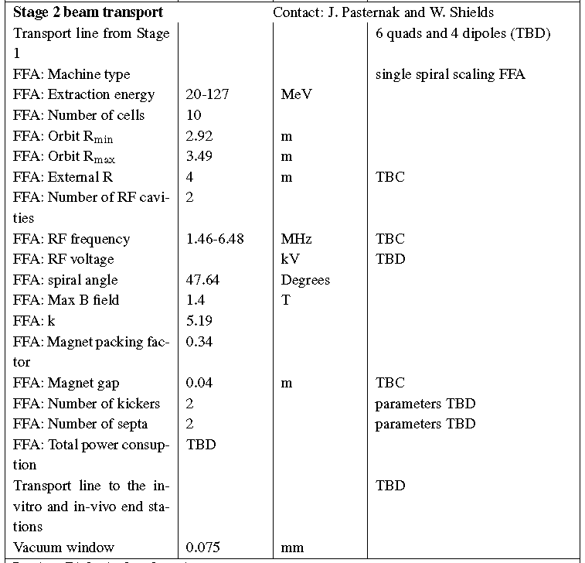
Parameter table

Slide 10
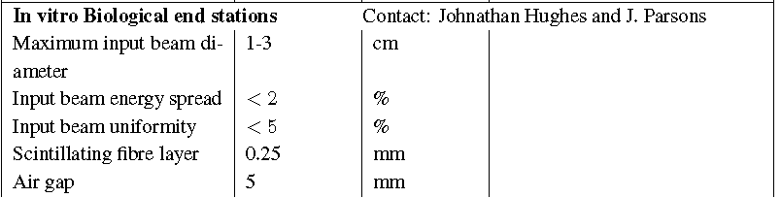
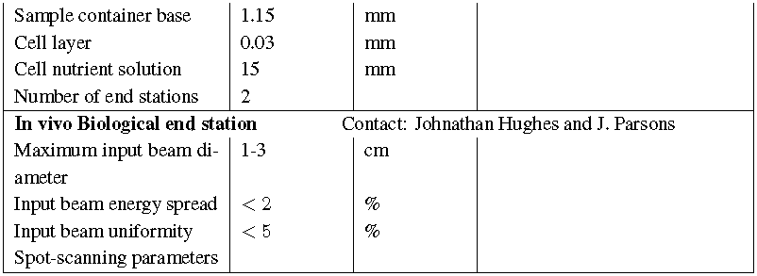
Parameter table

Slide 11
End-to-end simulations

Slide 12
End-to-end simulation
The simulation of the LhARA facility will be broken down into different parts:
  Definition of the input beam generated by the laser target interaction.
    With the option to collimate part of this beam due to the differential pumping plate.
  Stage 1 tracking using GPT
    From the target for a drift of 5cm without space charge and then with space charge through to just before the vacuum window.
  Stage 1 tracking using BDSIM
    5cm from the target through the end station.
  Stage 2 tracking using BDSIM
    From the end of the last Gabor lens through a switching dipole that bends the beam away from the 90 deg vertical bend and into the injection transfer line of the FFA up to just before the septum.
  Stage 2 simulation using Zygoubi
    The beam at the end of the Stage 2 injection simulation (using BDSIM) will be parameterised and then propagated through the FFA.
    Beam parameters after the extraction septum will be used to generate a beam for tracking downstream.
  Stage 2 tracking using BDSIM
    Tracking from after the extraction septum, through the extraction line and switching magnet to the vertical bend and through the in vitro end station.
  Stage 2 tracking using BDSIM
    Tracking from after the extraction septum, through the extraction line and switching magnet to the transfer line for the in vivo end station (including the option for sweeper magnets for spot scanning) and through the in vivo end station.

Slide 13
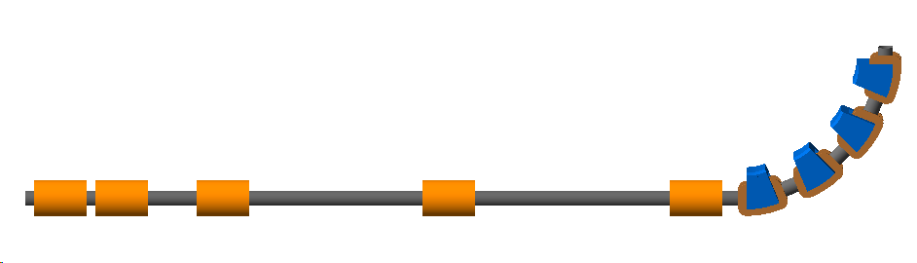
Current status
Repository for the code https://ccap.hep.ph.ic.ac.uk/trac/browser/ccap-sim
CCAP-v4.0
CCAP-v4.1
  Alternative vertical bend using dipoles and quadrupoles design by summer student Theo Keseman.

Slide 14
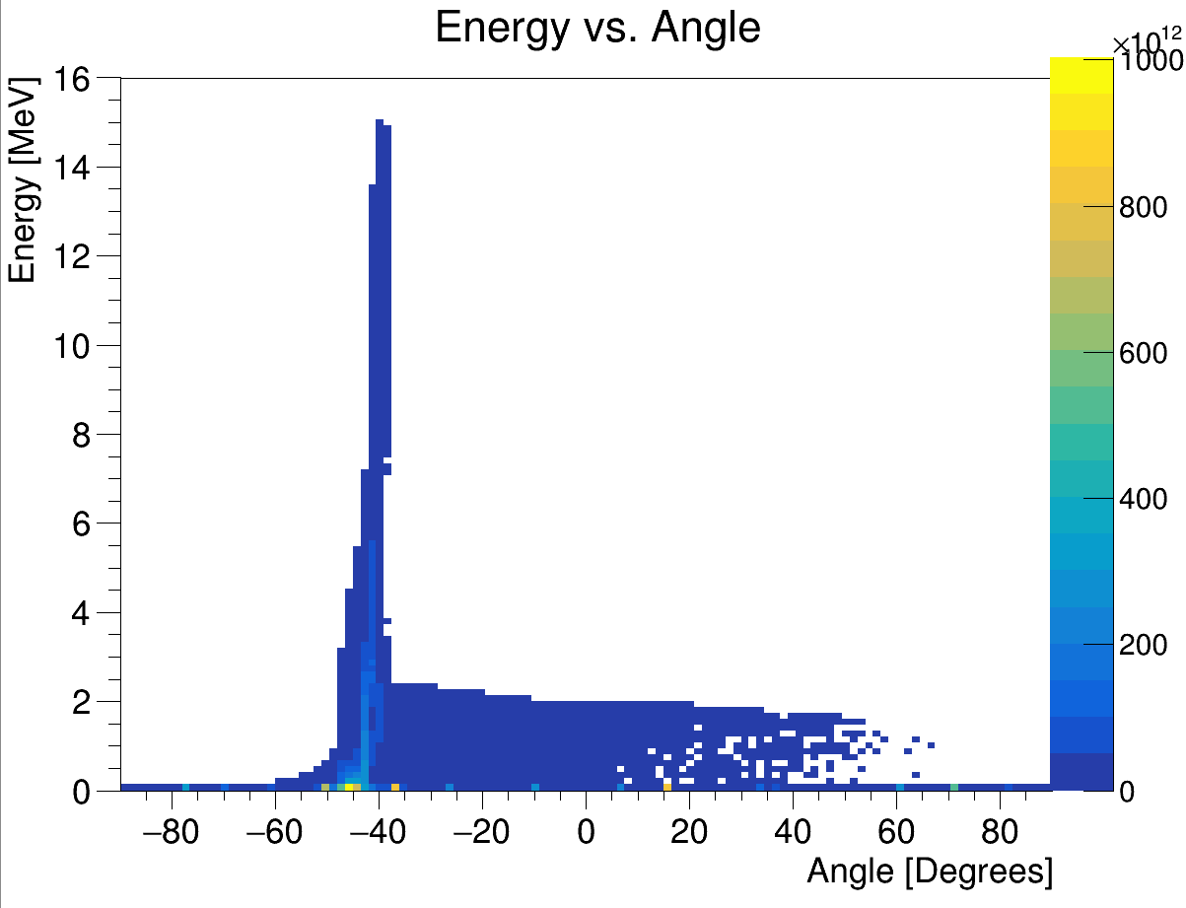
Current status
Input beam
  2D data from Ollie.
  HT Lau looking at transforming this into a 3D distribution.
  Ideally would like to use 3D particle coordinates from Smilei.
    Being worked on by Oliver Ettlinger and George Hicks.
Energy vs angle with respect to laser beam direction
Laser driven ion beam simulation using EPOCH.

Slide 15
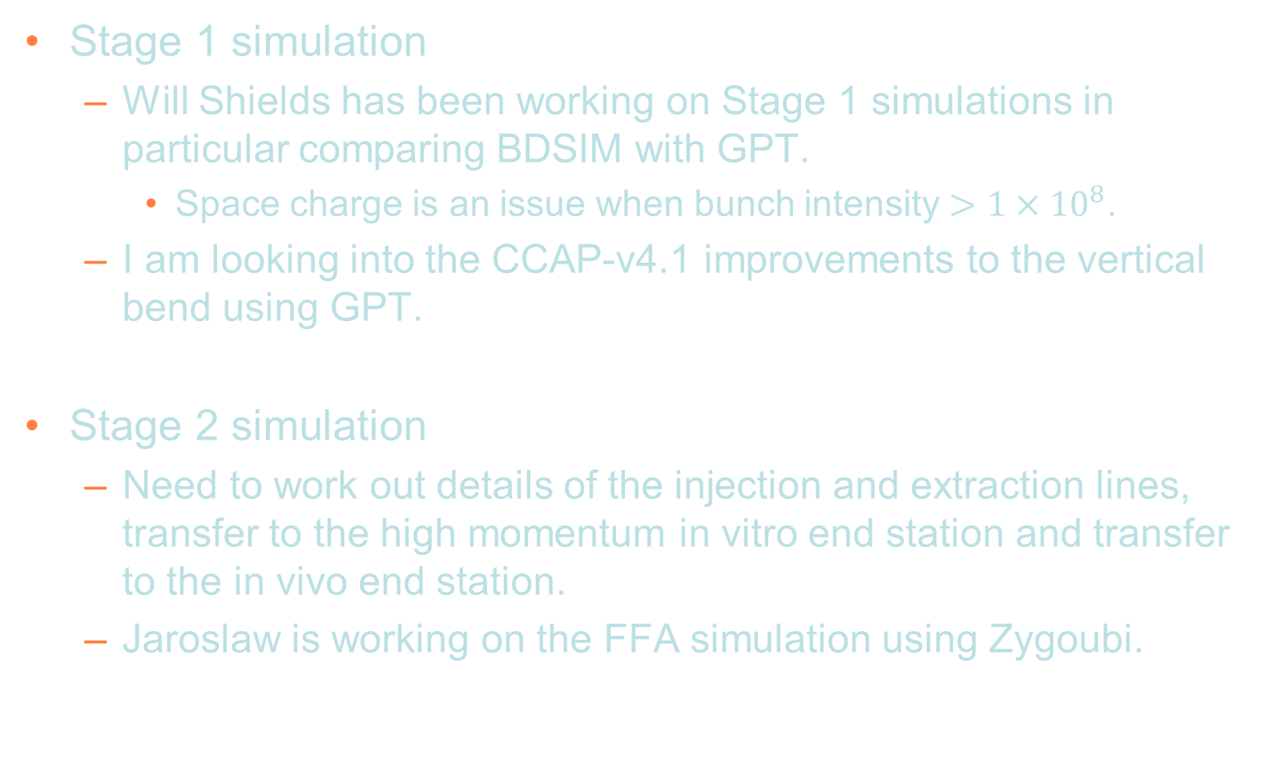
Current status
Stage 1 simulation
  Will Shields has been working on Stage 1 simulations in particular comparing BDSIM with GPT.
    Space charge is an issue when bunch intensity $>1×{10}^{8}$.
  I am looking into the CCAP-v4.1 improvements to the vertical bend using GPT.
Stage 2 simulation
  Need to work out details of the injection and extraction lines, transfer to the high momentum in vitro end station and transfer to the in vivo end station.
  Jaroslaw is working on the FFA simulation using Zygoubi.

Slide 16
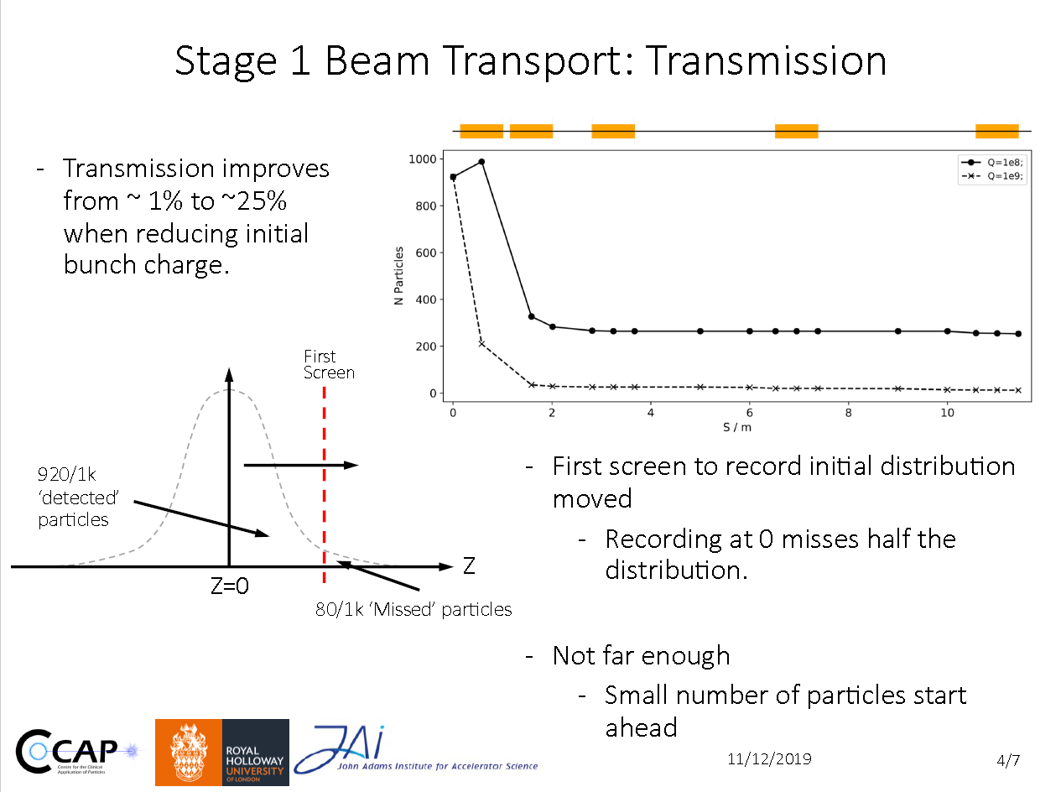
PM5 presentation by Will Shields
https://ccap.hep.ph.ic.ac.uk/trac/raw-attachment/wiki/Communication/Plenary/2019-12-11/20191211_wshields.pdf

Slide 17
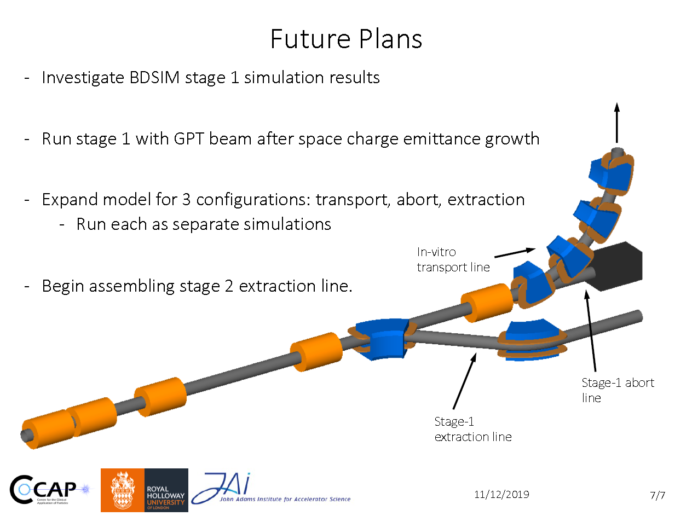
PM5 presentation by Will Shields

Slide 18
R&D plan
https://ccap.hep.ph.ic.ac.uk/trac/wiki/Research/DesignStudy/PreCDR#RDPlan
Laser
  No major R&D needed for the laser since it will be a commercial system.
  Target particle production and diagnostics.
Proton and ion capture.
  Gabor lens prototype development and performance verification.
Stage 1 beam transport.
  No major R&D needed.
Stage 2 beam transport.
  FFA: Magnet design and prototyping.
  FFA: RF cavity performance verification.
End station
  Automation.
Instrumentation.
  Dose calibration for high-intensity beams.
  Online dose monitor.
  Online beam monitor for low energy beam.
  Fast feedback monitoring and control.

Slide 19
Schedule and deadlines
https://ccap.hep.ph.ic.ac.uk/trac/wiki/Research/DesignStudy/PreCDR#Keydates
29 Nov 2019: First issue of the baseline. This will include lists from the various systems of what needs to be updated on the existing floor layout, WBS, interfaces document and the parameter table.
31 Dec 2019: First end-to-end tracking simulation.
31 Jan 2020:
  Design of the facility will be frozen.
  First view of the costs.
  R&D programme needed to realise LhARA and be able to write a technical design report will be defined.
28 Feb 2020: Complete the write-up of the pre-CDR.
Mar 2020: External review of pre-CDR in advance of publication.

