Slide 1
Do it in 2D?

Slide 2
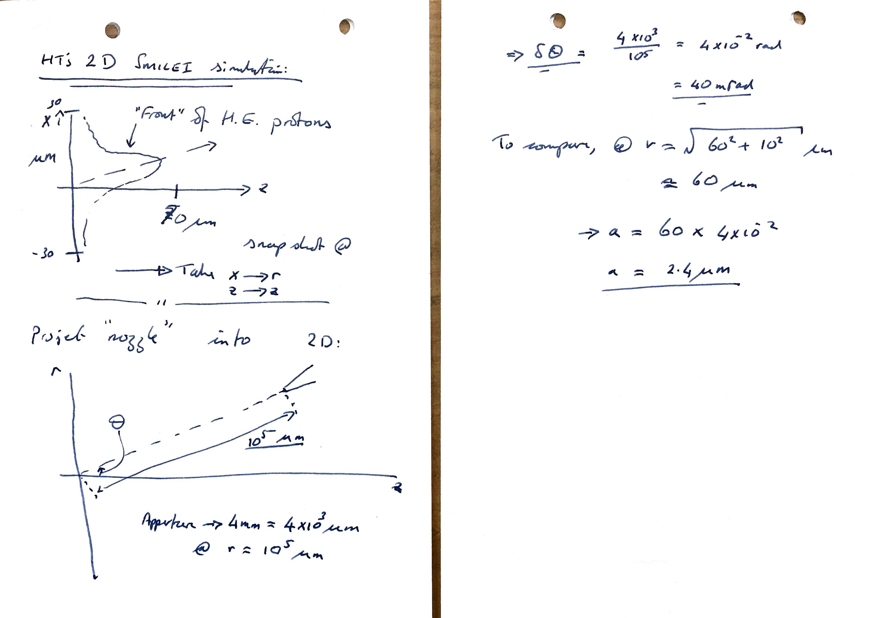

Slide 4
Suggestion for discussion …
2D space:
  Longitudinal coordinate “z” (surface normal) and a radial coordinate “r” in the surface;
Project the aperture of the nozzle onto this “r,z” plane;
Track in 2D put to the nozzle;
For those macro particles that are accepted into the nozzle in 2D:
  Take p_z, p_r … and create (p_x, p_y) such that p^2_x + p^2_y = p^2_r;
  Generate a uniform position distribution across the circular aperture of the nozzle;
  Scale the momenta so that the energy is scaled by 2/3 (“phase space” argument)

