Slide 1
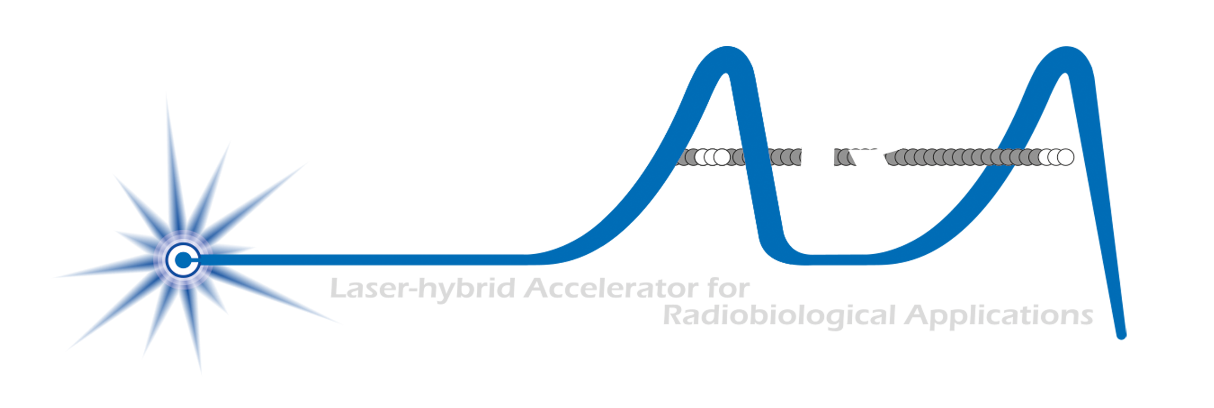
Intro/motivation

Slide 2
Particle source
S. Laurie
S. Laurie
Extraction energy:
  30—80 keV
    Limited by extraction voltage
Instantaneous flux (current or dose):
  Determined by acceptance of first accelerator structure
    Limited by mutual repulsion of protons (ions) … “space-charge effect”

Slide 3
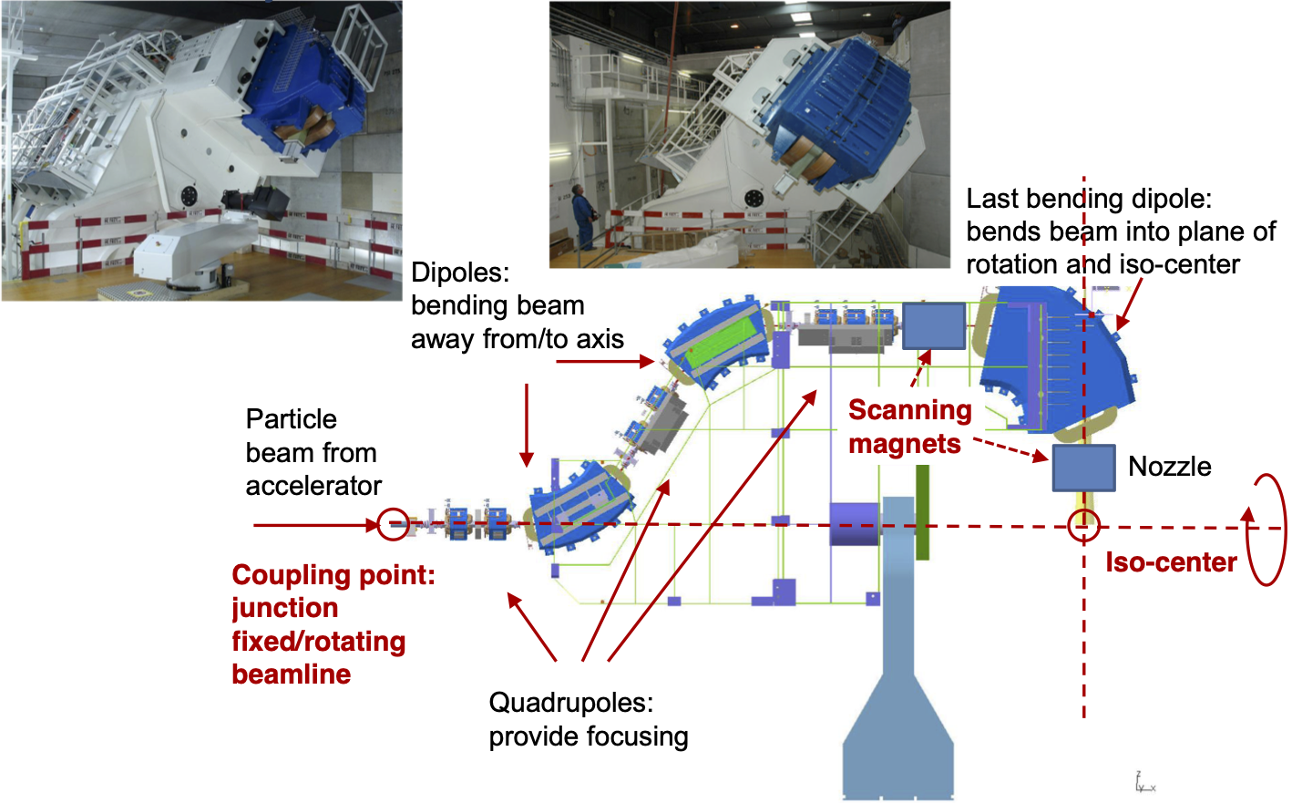
Beam delivery
PSI gantry
PSI gantry
  Engineering tour de force!
  360-degree irradiation
  At a price:
  Size, complexity, maintenance
H. Owen

Slide 4
Laser-driven sources are disruptive
Laser-driven sources have the potential to:
Create the capability to deliver particle-beam therapy in completely new regimens
  Flexibility!
    Combine a variety of ion species in a single treatment fraction, exploiting ultra-high dose rates in novel spatial- and spectral-fractionation schemes
Make "best in class" treatments available to the many
  Automated, triggerable system → remove requirement for large gantry:
    System incorporating dose-deposition imaging in fast feedback-and-control system; track movement, deliver dose at optimum tissue alignment

Slide 5
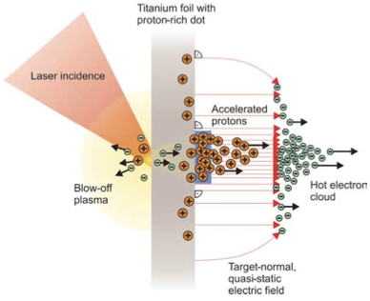
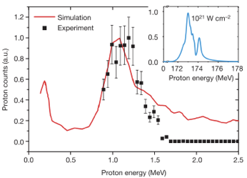
Sheath acceleration
Laser incident on foil target:
  Drives electrons from material
  Creates enormous electric field
Field accelerates protons/ions
  Dependent on nature of target
Active development:
  Laser: power and rep. rate
  Target material, transport
Schwoerer, H. et al., 2006; Nature, 439(7075).

Slide 6

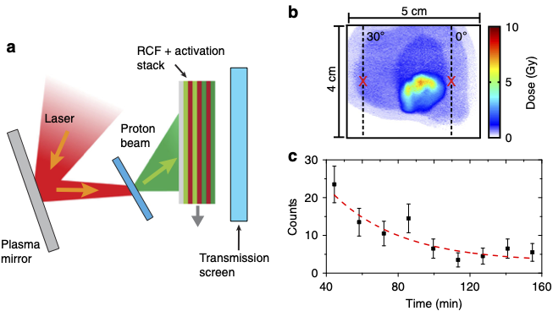
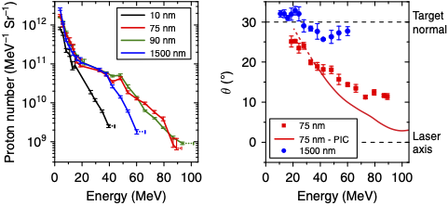
Advances
(2018)9:724 DOI: 10.1038/s41467-018-03063-9
Vulcan
Production: ⁶³Cu(p,n)⁶³Zn
⁶³Zn – β⁺decay
Ultrathin foil irradiated by "long", linearly-polarised laser pulse
Mechanism:
  Radiation-pressure/target-normal sheath acceleration
  High-energies confined to narrow angular range by radiation-induced transparency

Slide 7
Advantages
Protons (and ions) produced at “high energy”:
  e.g. 15 MeV → 250 times energy of conventional proton source
    High energy substantially reduced impact of space charge
      Allows evasion of instantaneous dose-rate limitation of today’s sources
Pulsed operation “natural”:
  Discharge sources are DC; accelerator imposes time structure
  Pulsed operation determined by laser:
    A triggerable, “on demand”, source
Critical issues:
  Efficient capture of divergent, high-energy ion flux
  Transformation of captured flux into useful beam

Slide 8
ELIMAIA-ELIMED
Quantum Beam Sci. 2018, 2, 8; doi:10.3390/qubs2020008
Frontiers in Phys. Med. Phys. & Imag. – doi: 10.3389/fphy.2020.564907
Extreme Light Infrastructure, Prague, Czech Republic:
ELI Multidisciplinary Applications of laser-Ion Acceleration (ELIMAIA)
  ELI MEDical and multidisciplinary applications (ELIMED)
    ELIMAIA section dedicated to ion focusing, selection, characterization, and irradiation
  Proton energies from 5 to 250 MeV transported to in-air section

Slide 9
Many initiatives in Americas, Europe, Asia
Applications in biological research, ambition to push toward clinical application …
  Phys Lett A. (2002) 299:240–7. doi: 10.1016/S0375-9601(02)00521-2
  Med Phys. (2003) 30:1660–70. doi: 10.1118/1.1586268
  Med Phys. (2004) 31:1587–92. doi: 10.1118/1.1747751
  Science. (2003) 300:1107–111
  New J Phys. (2010) 12:85003. doi: 10.1088/1367-2630/12/8/085003
  Phys Med Biol. (2011) 56:6969–82. doi: 10.1088/0031-9155/56/21/013
  Appl Phys Lett. (2011) 98:053701. doi: 10.1063/1.3551623
  Appl Phys Lett. (2012) 101:243701. doi: 10.1063/1.4769372
  AIP Adv. (2012) 2:011209. doi: 10.1063/1.3699063
  Appl Phys B. (2013) 110:437–44. doi: 10.1007/s00340-012-5275-3
  Appl Phys B. (2014) 117:41–52. doi: 10.1007/s00340-014-5796-z
  Radiat Res. (2014) 181:177–83. doi: 10.1667/RR13464.1
  Phys Rev Acceler Beams. (2017) 20:1–10. doi: 10.1103/PhysRevAccelBeams.20.032801
  J Instrum. (2017) 12:C03084. doi: 10.1088/1748-0221/12/03/C03084
  A-SAIL Project. (2020). Available online at: https://www.qub.ac.uk/research-centres/A-SAILProject/
  Vol. 8779. Prague: International Society for Optics and Photonics. SPIE (2013). p. 216–25.
  Vol. 11036. International Society for Optics and Photonics. SPIE (2019). p. 93–103.
  Nuovo Cim C. (2020) 43:15. doi: 10.1393/ncc/i2020-20015-6
  10th International Particle Accelerator Conference. Melbourne, VIC (2019). p. TUPTS005.
Opportunity …
A selection …

Slide 10
Opportunity; a hybrid approach
Create protons (ions) at “modest” energy:
  Consider 10—15 MeV; high flux, “plateau” region
Capture and manipulate proton (ion) flux:
  Inject into post accelerator for biomedical applicaction
High Energy Density Physics 37 (2020) 100847

Slide 11
Laser-hybrid Accelerator for Radiobiological Applications
A novel, hybrid, approach:
Laser-driven, high-flux proton/ion source
  Overcome instantaneous dose-rate limitation
    Capture at >10 MeV
  Delivers protons or ions in very short pulses
    Bunches as short as 10—40 ns
  Triggerable; arbitrary pulse structure
Novel “electron-plasma-lens” capture & focusing
  Strong focusing (short focal length) without the use of high-field solenoid
Fast, flexible, fixed-field post acceleration
  Variable energy
    Protons: 15—127 MeV
    Ions: 5—34 MeV/u
Front. Phys., 29 September 2020; DOI: 10.3389/fphy.2020.567738

Slide 12
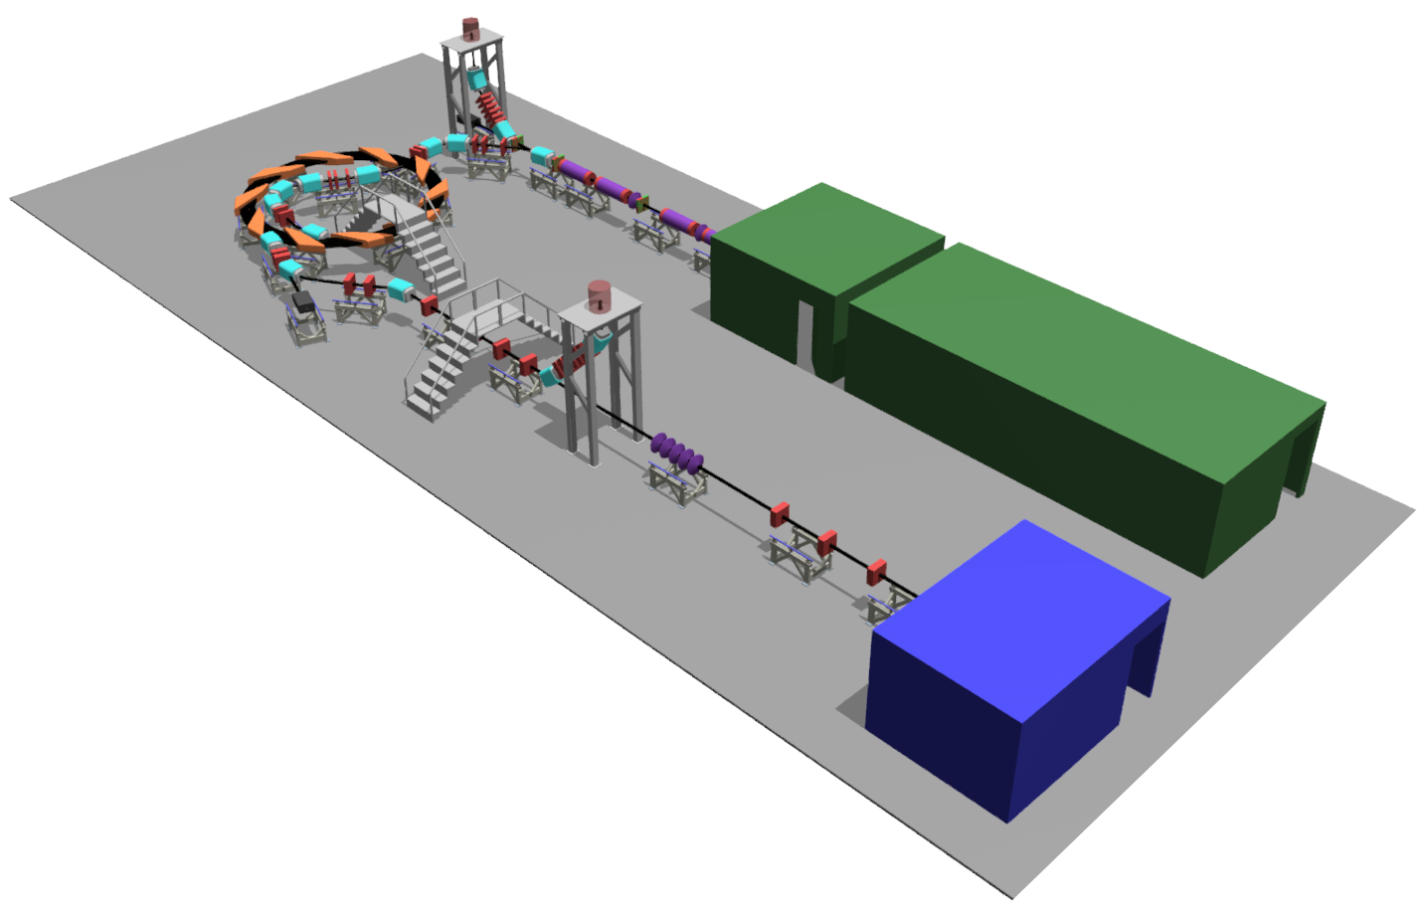

Front. Phys., 29 September 2020; DOI: 10.3389/fphy.2020.567738

Slide 13
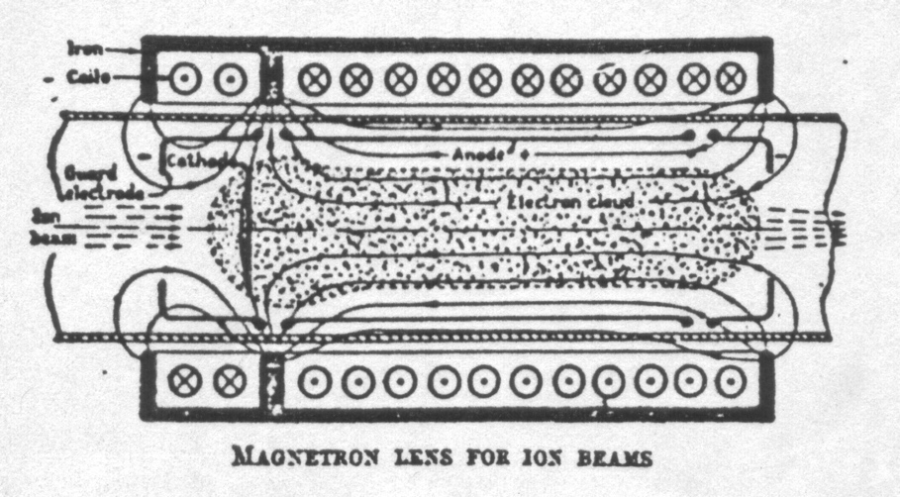
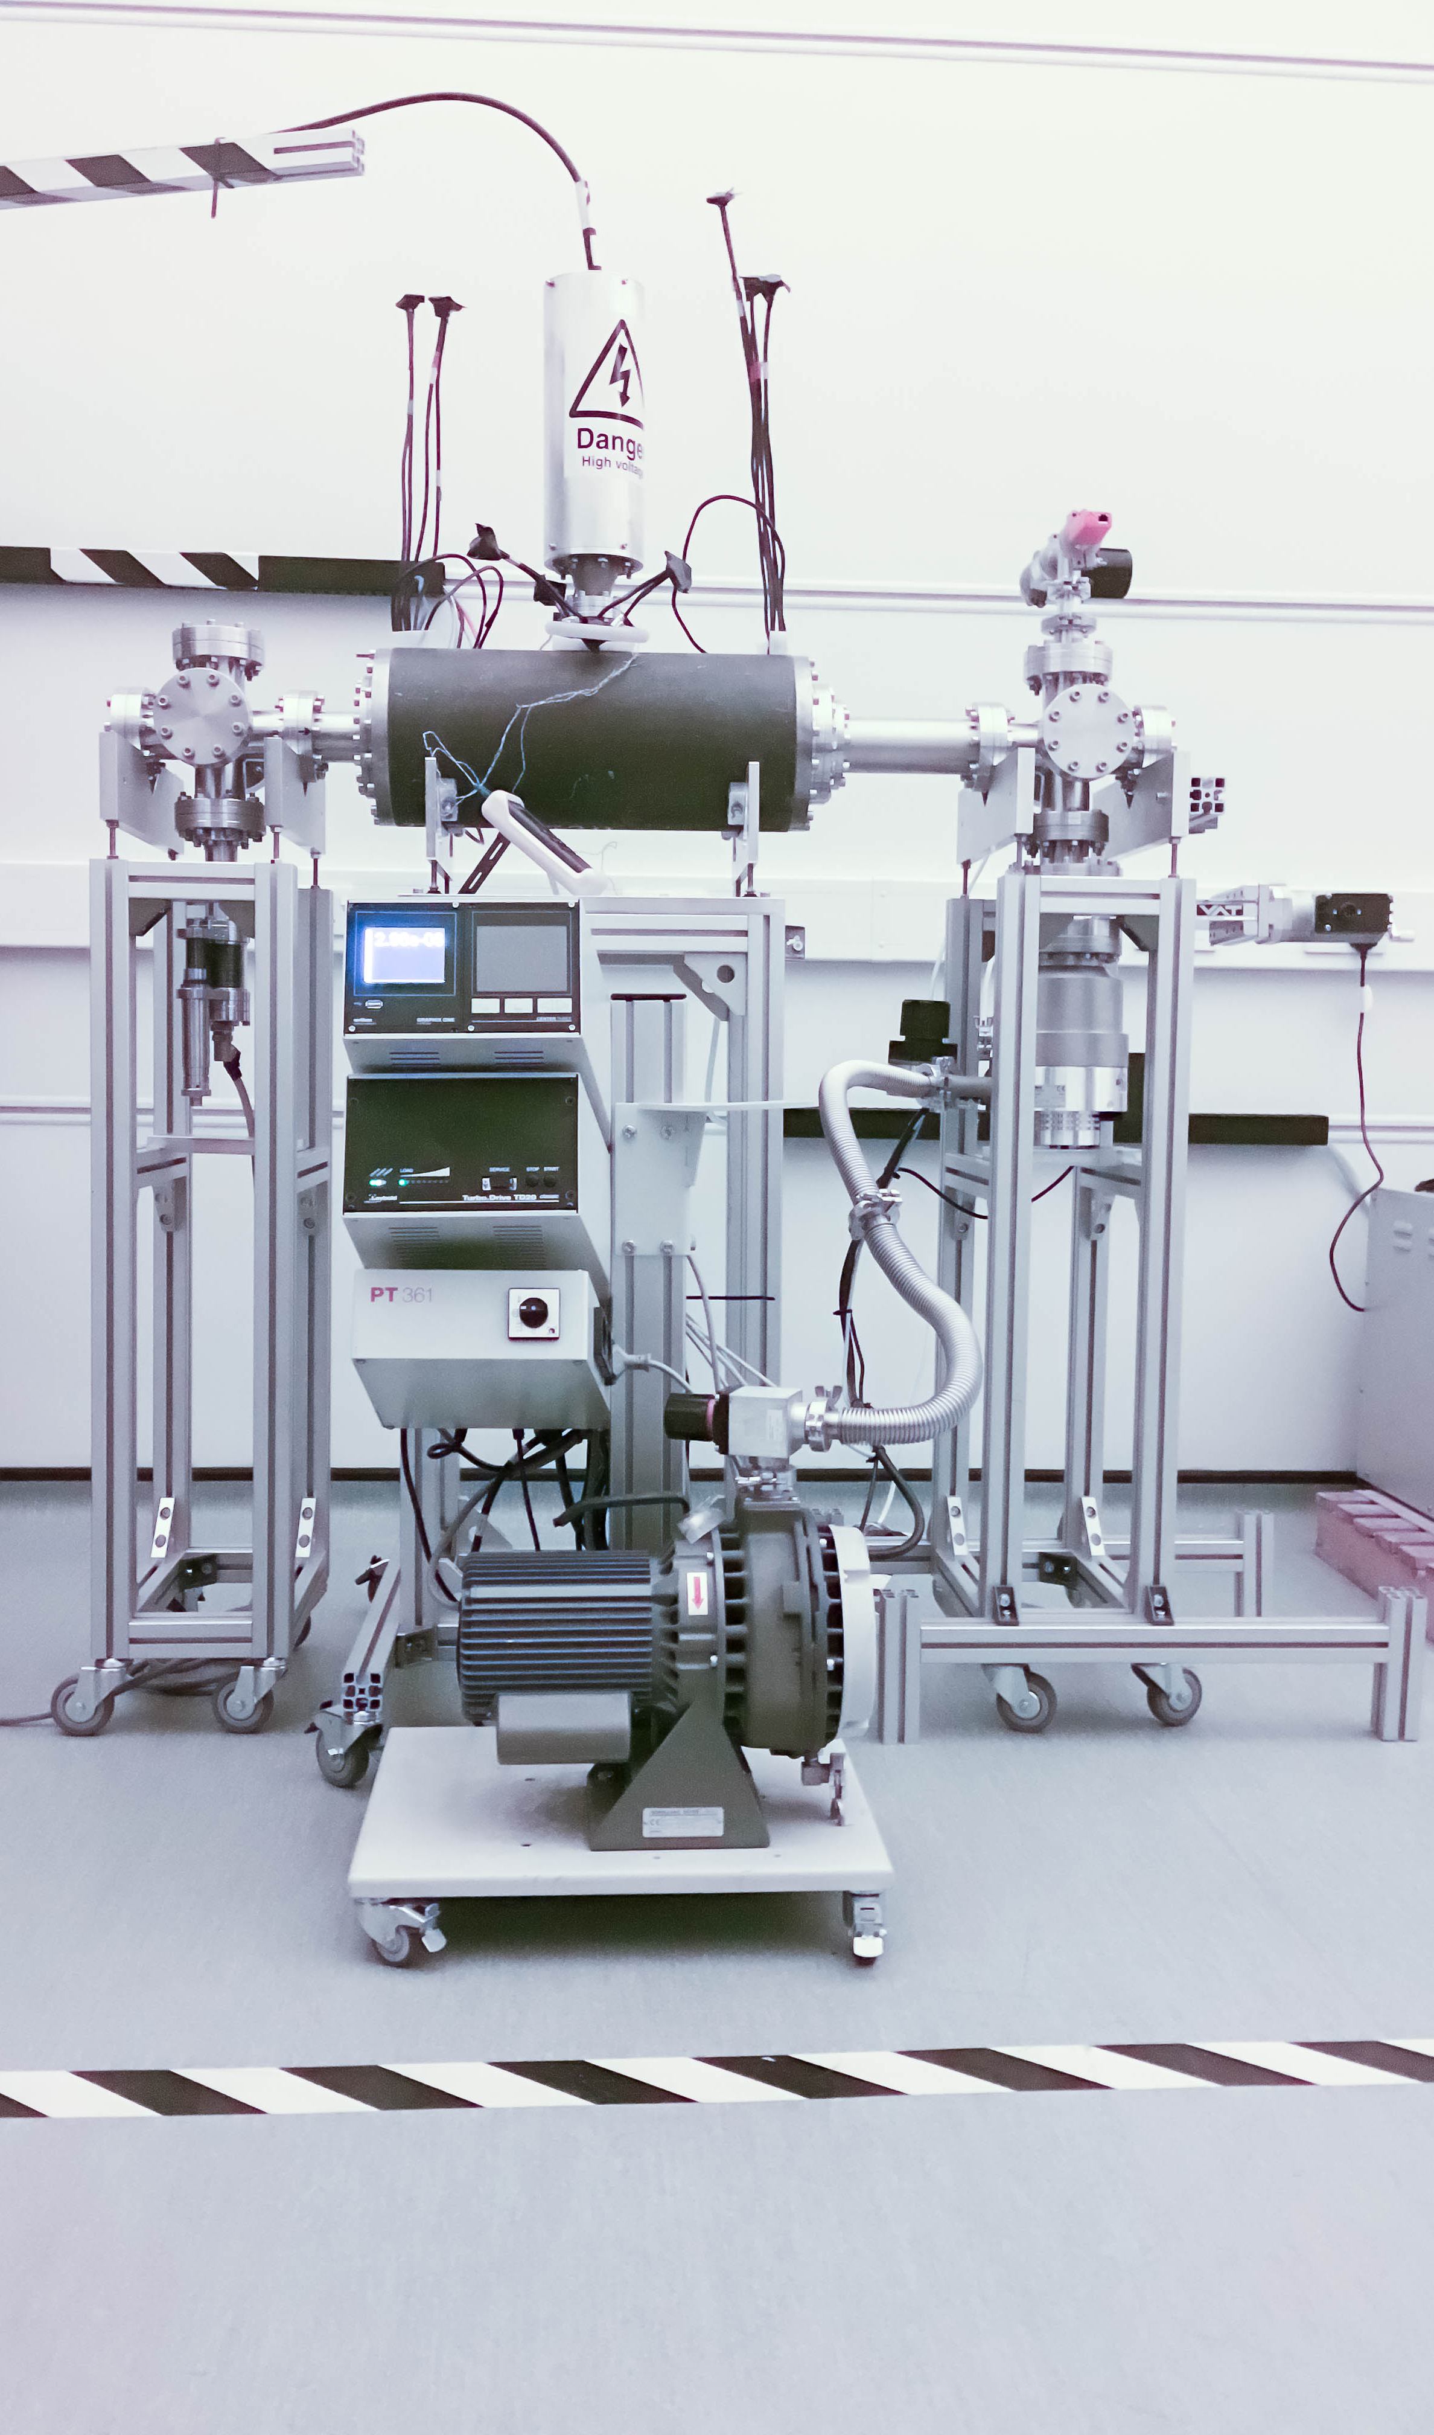
Beam capture/production principle
Posocco, Pozimski
“Electron-plasma” (Gabor) lens:
  Strong focusing exploiting electron
  gas in “Penning/Malmberg” trap
Gabor
1957
Front. Phys., 29 September 2020; DOI: 10.3389/fphy.2020.567738

