Slide 2
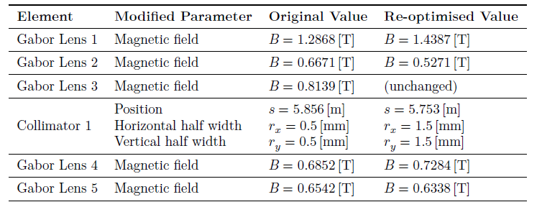
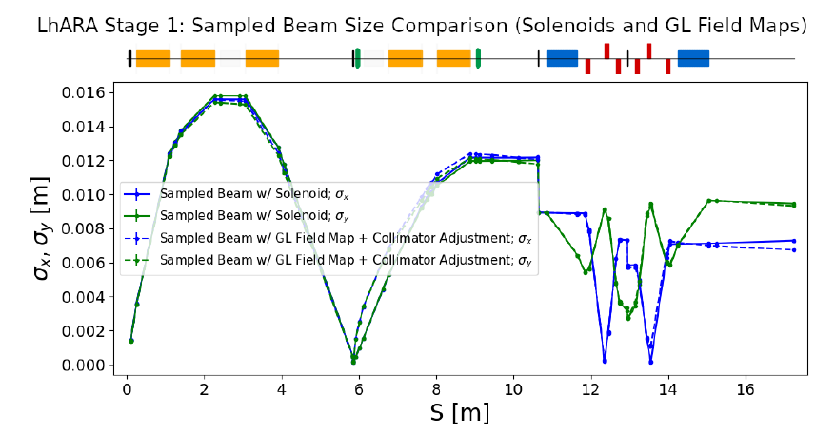
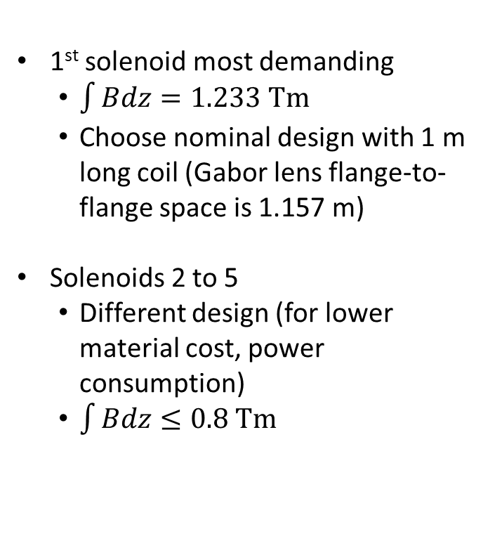
Solenoid requirements
1st solenoid most demanding
$\int{Bdz=1.233 Tm}$
Choose nominal design with 1 m long coil (Gabor lens flange-to-flange space is 1.157 m)
Solenoids 2 to 5
Different design (for lower material cost, power consumption)
$\int{Bdz≤0.8 Tm}$
Equivalent field of a solenoid

Slide 3
Choice of material
Normal conducting
Superconducting
(Hollow copper conductor)
Very common design in many accelerator magnets
Efficient cooling
water in direct contact with the source of heat
Coils potted in resin are typically very robust
Each cable has to be insulated
adds complexity and requires more space
Weight of the coils is typically high
Cooling and electric circuits are interwoven, but need separation at the their ends
pressure drop leads to complex cooling circuits for large coils + increased risk of water leakages
Very high current density compared to conventional conductors
Negligible power consumption
Complicated structure: rigid coil former + insulating cryostat (large space requirement around the coil)
The cryostat/cooling infrastructure needs careful maintenance
Cost of superconducting coils is significantly higher than the cost of conventional conductor
Aim of this design exercise: evaluate the requirements and performance of a normal-conducting solenoid that is suitable for LhARA

Slide 4
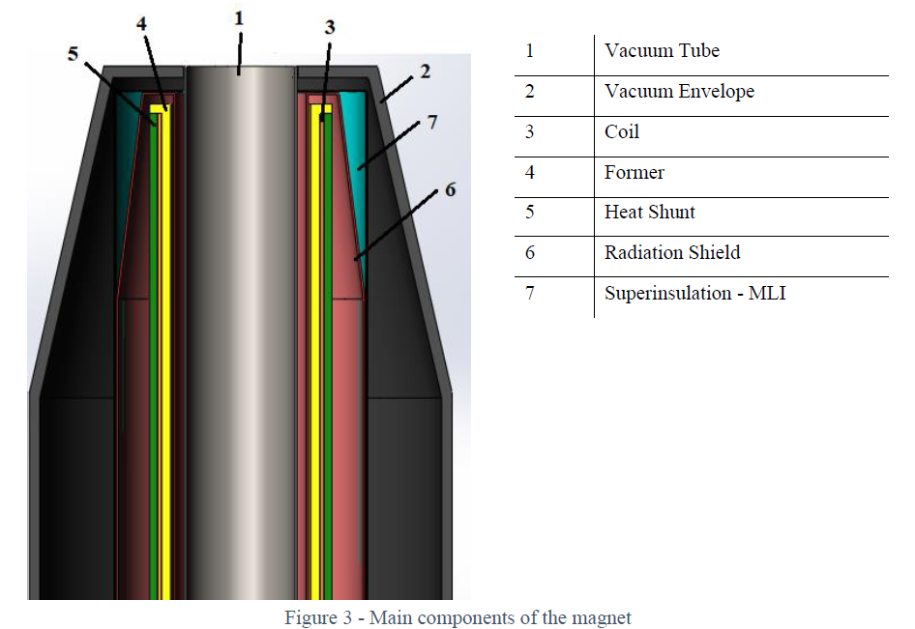
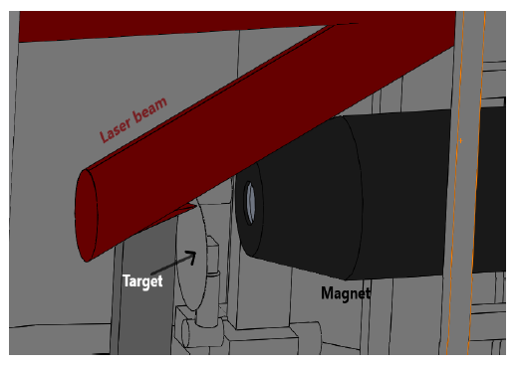
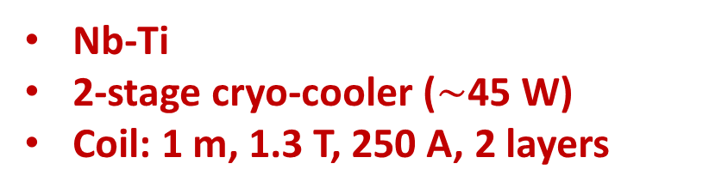
SC solenoid for LhARA
Preliminary design and analysis (A. Beqiri)
Nb-Ti
2-stage cryo-cooler ($\sim$45 W)
Coil: 1 m, 1.3 T, 250 A, 2 layers

Slide 5
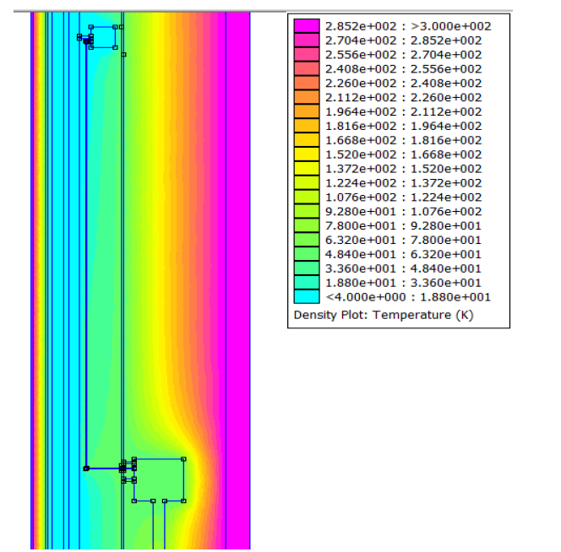
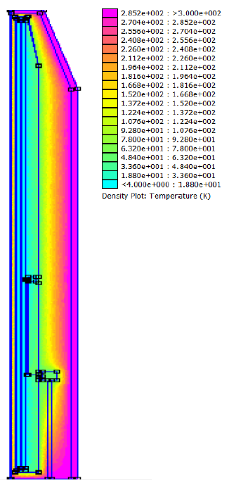
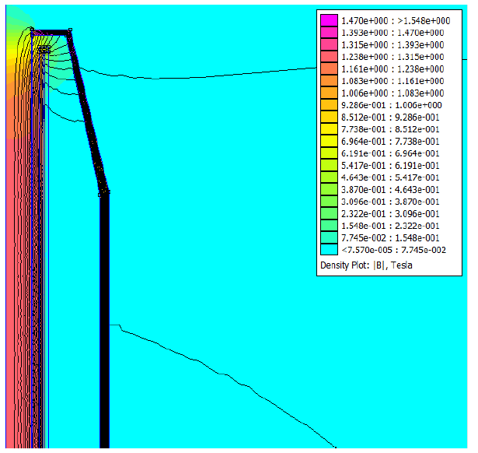
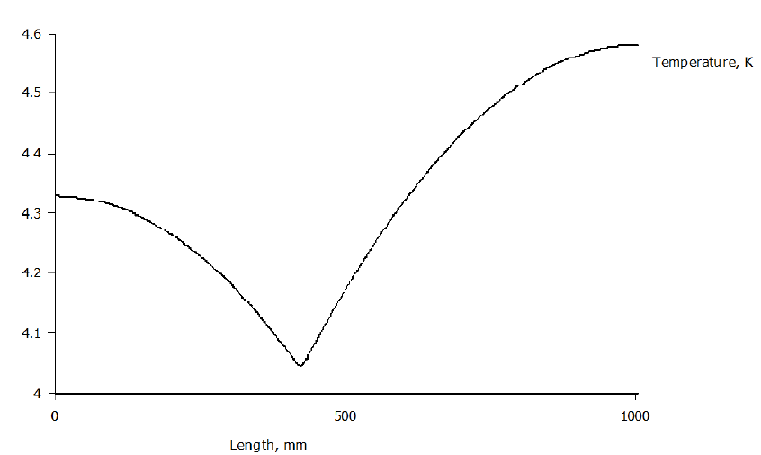
SC solenoid for LhARA
2-D magnetic and thermal model

Slide 6
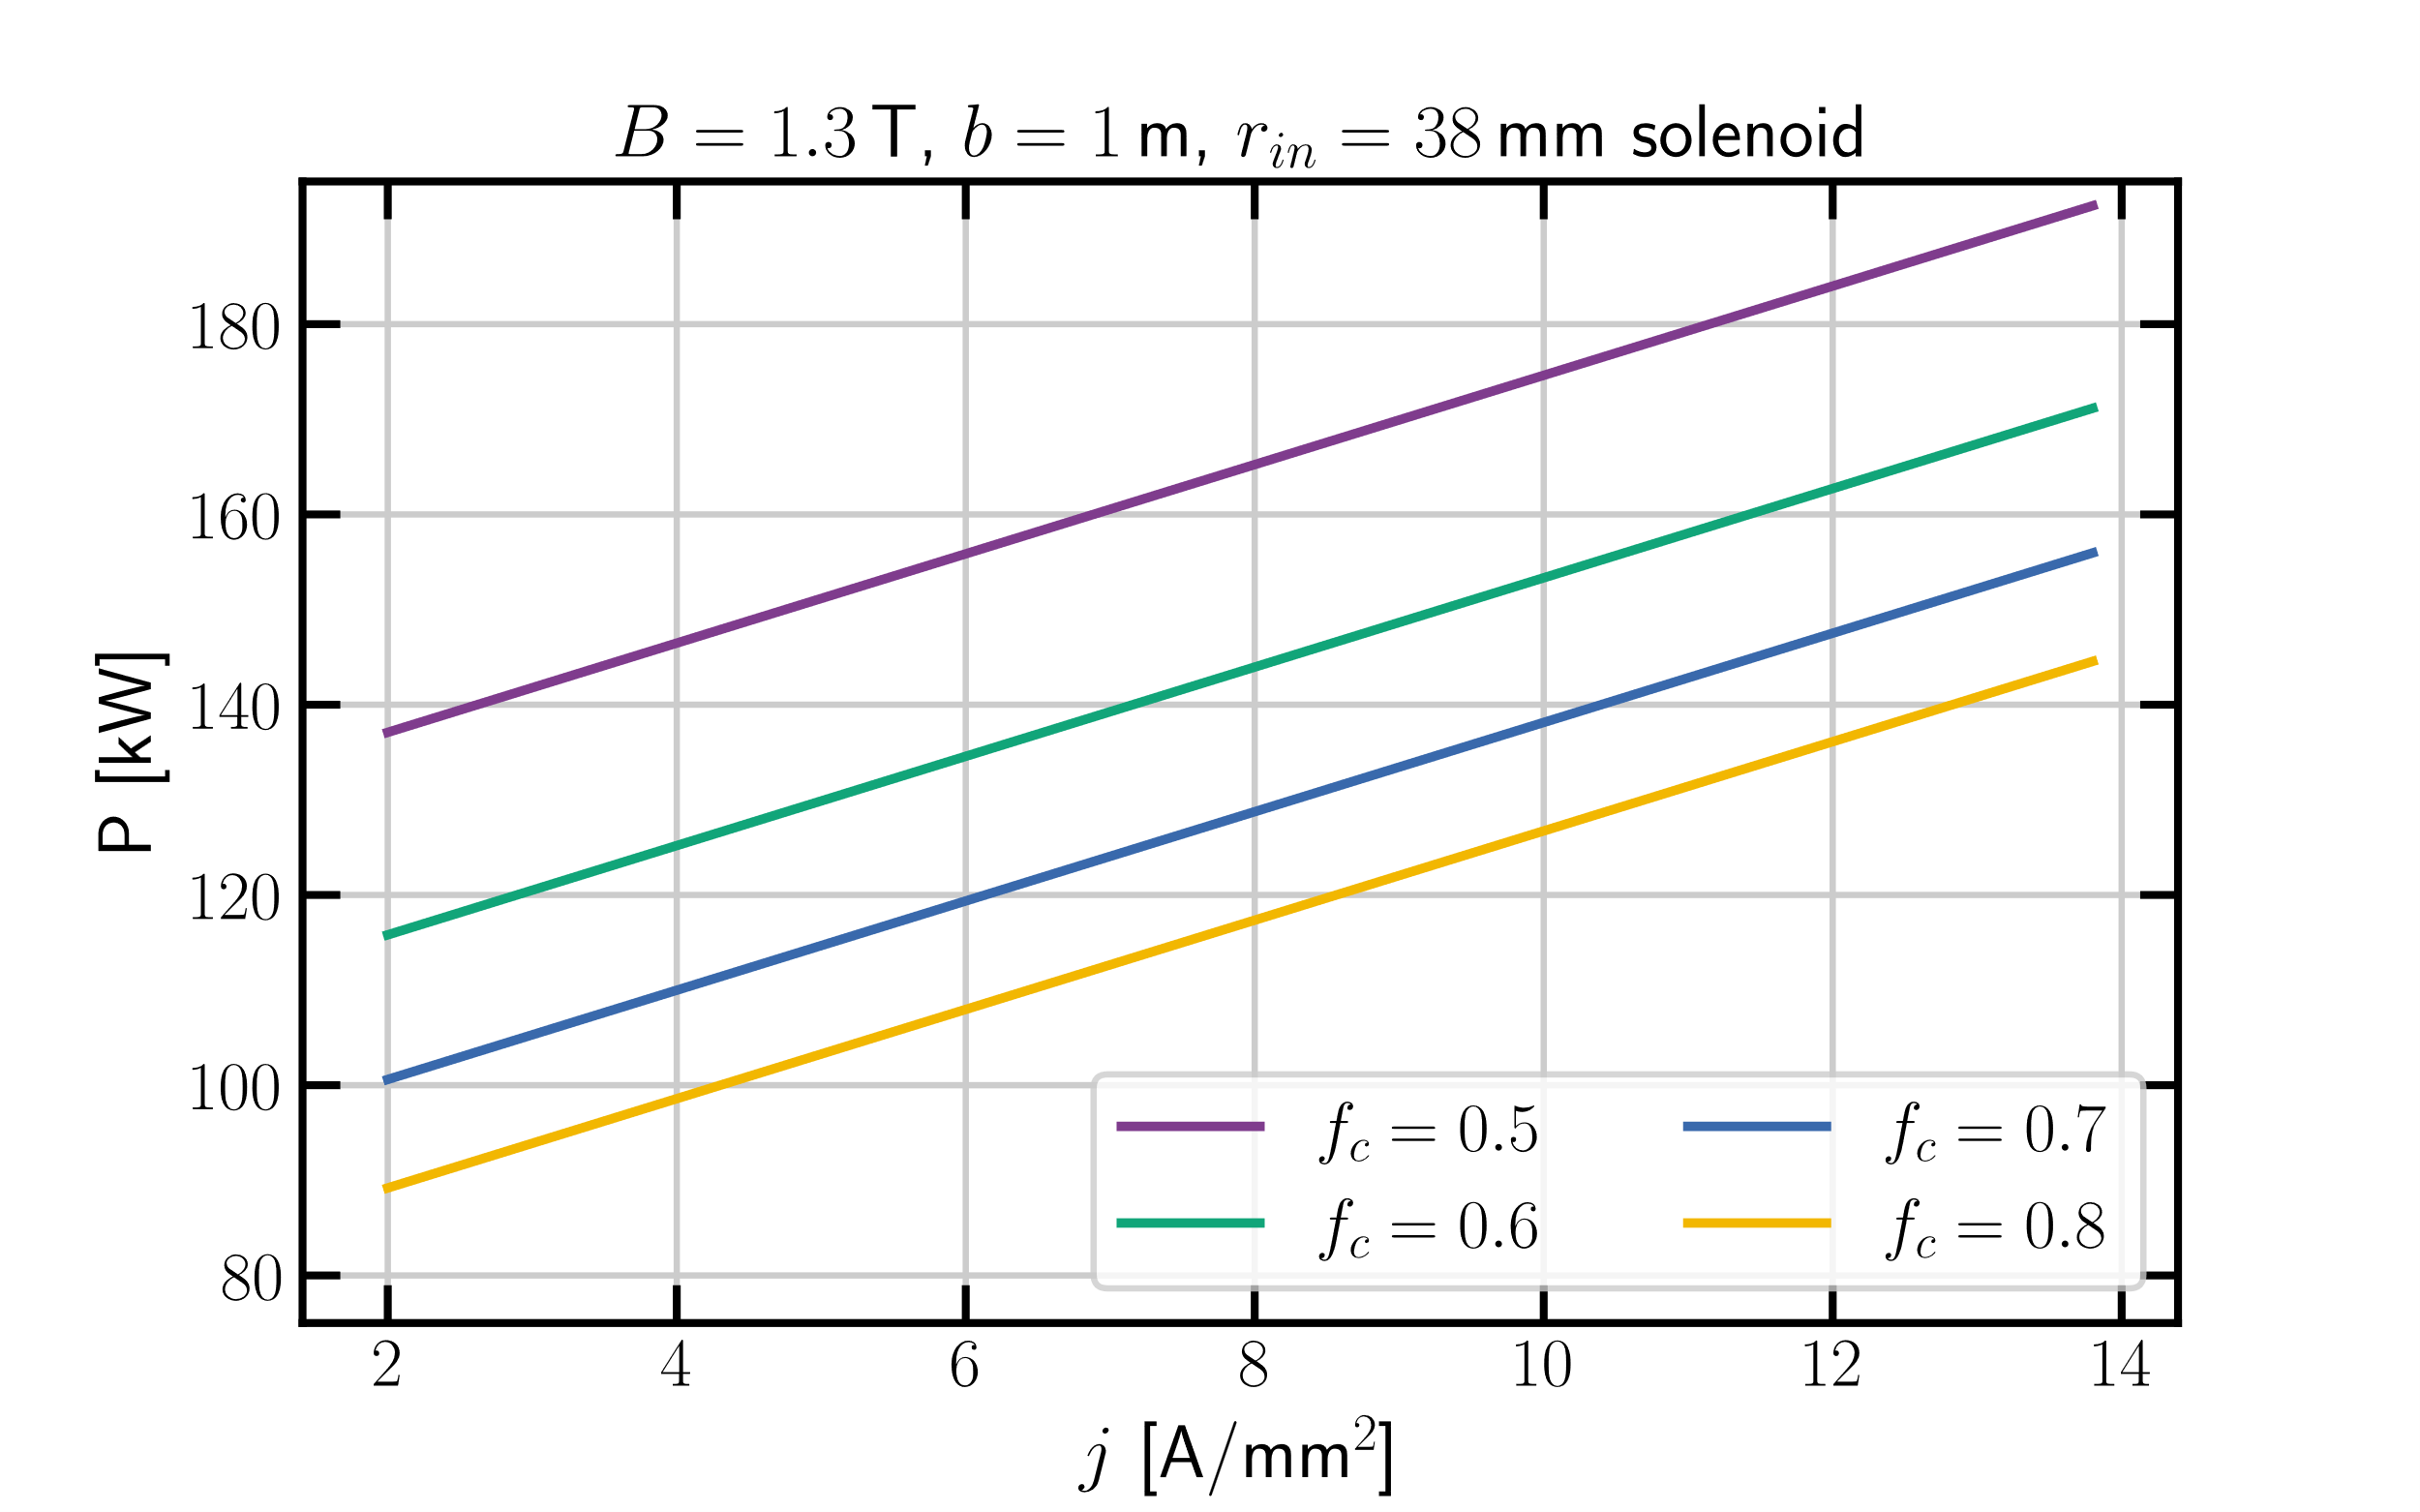
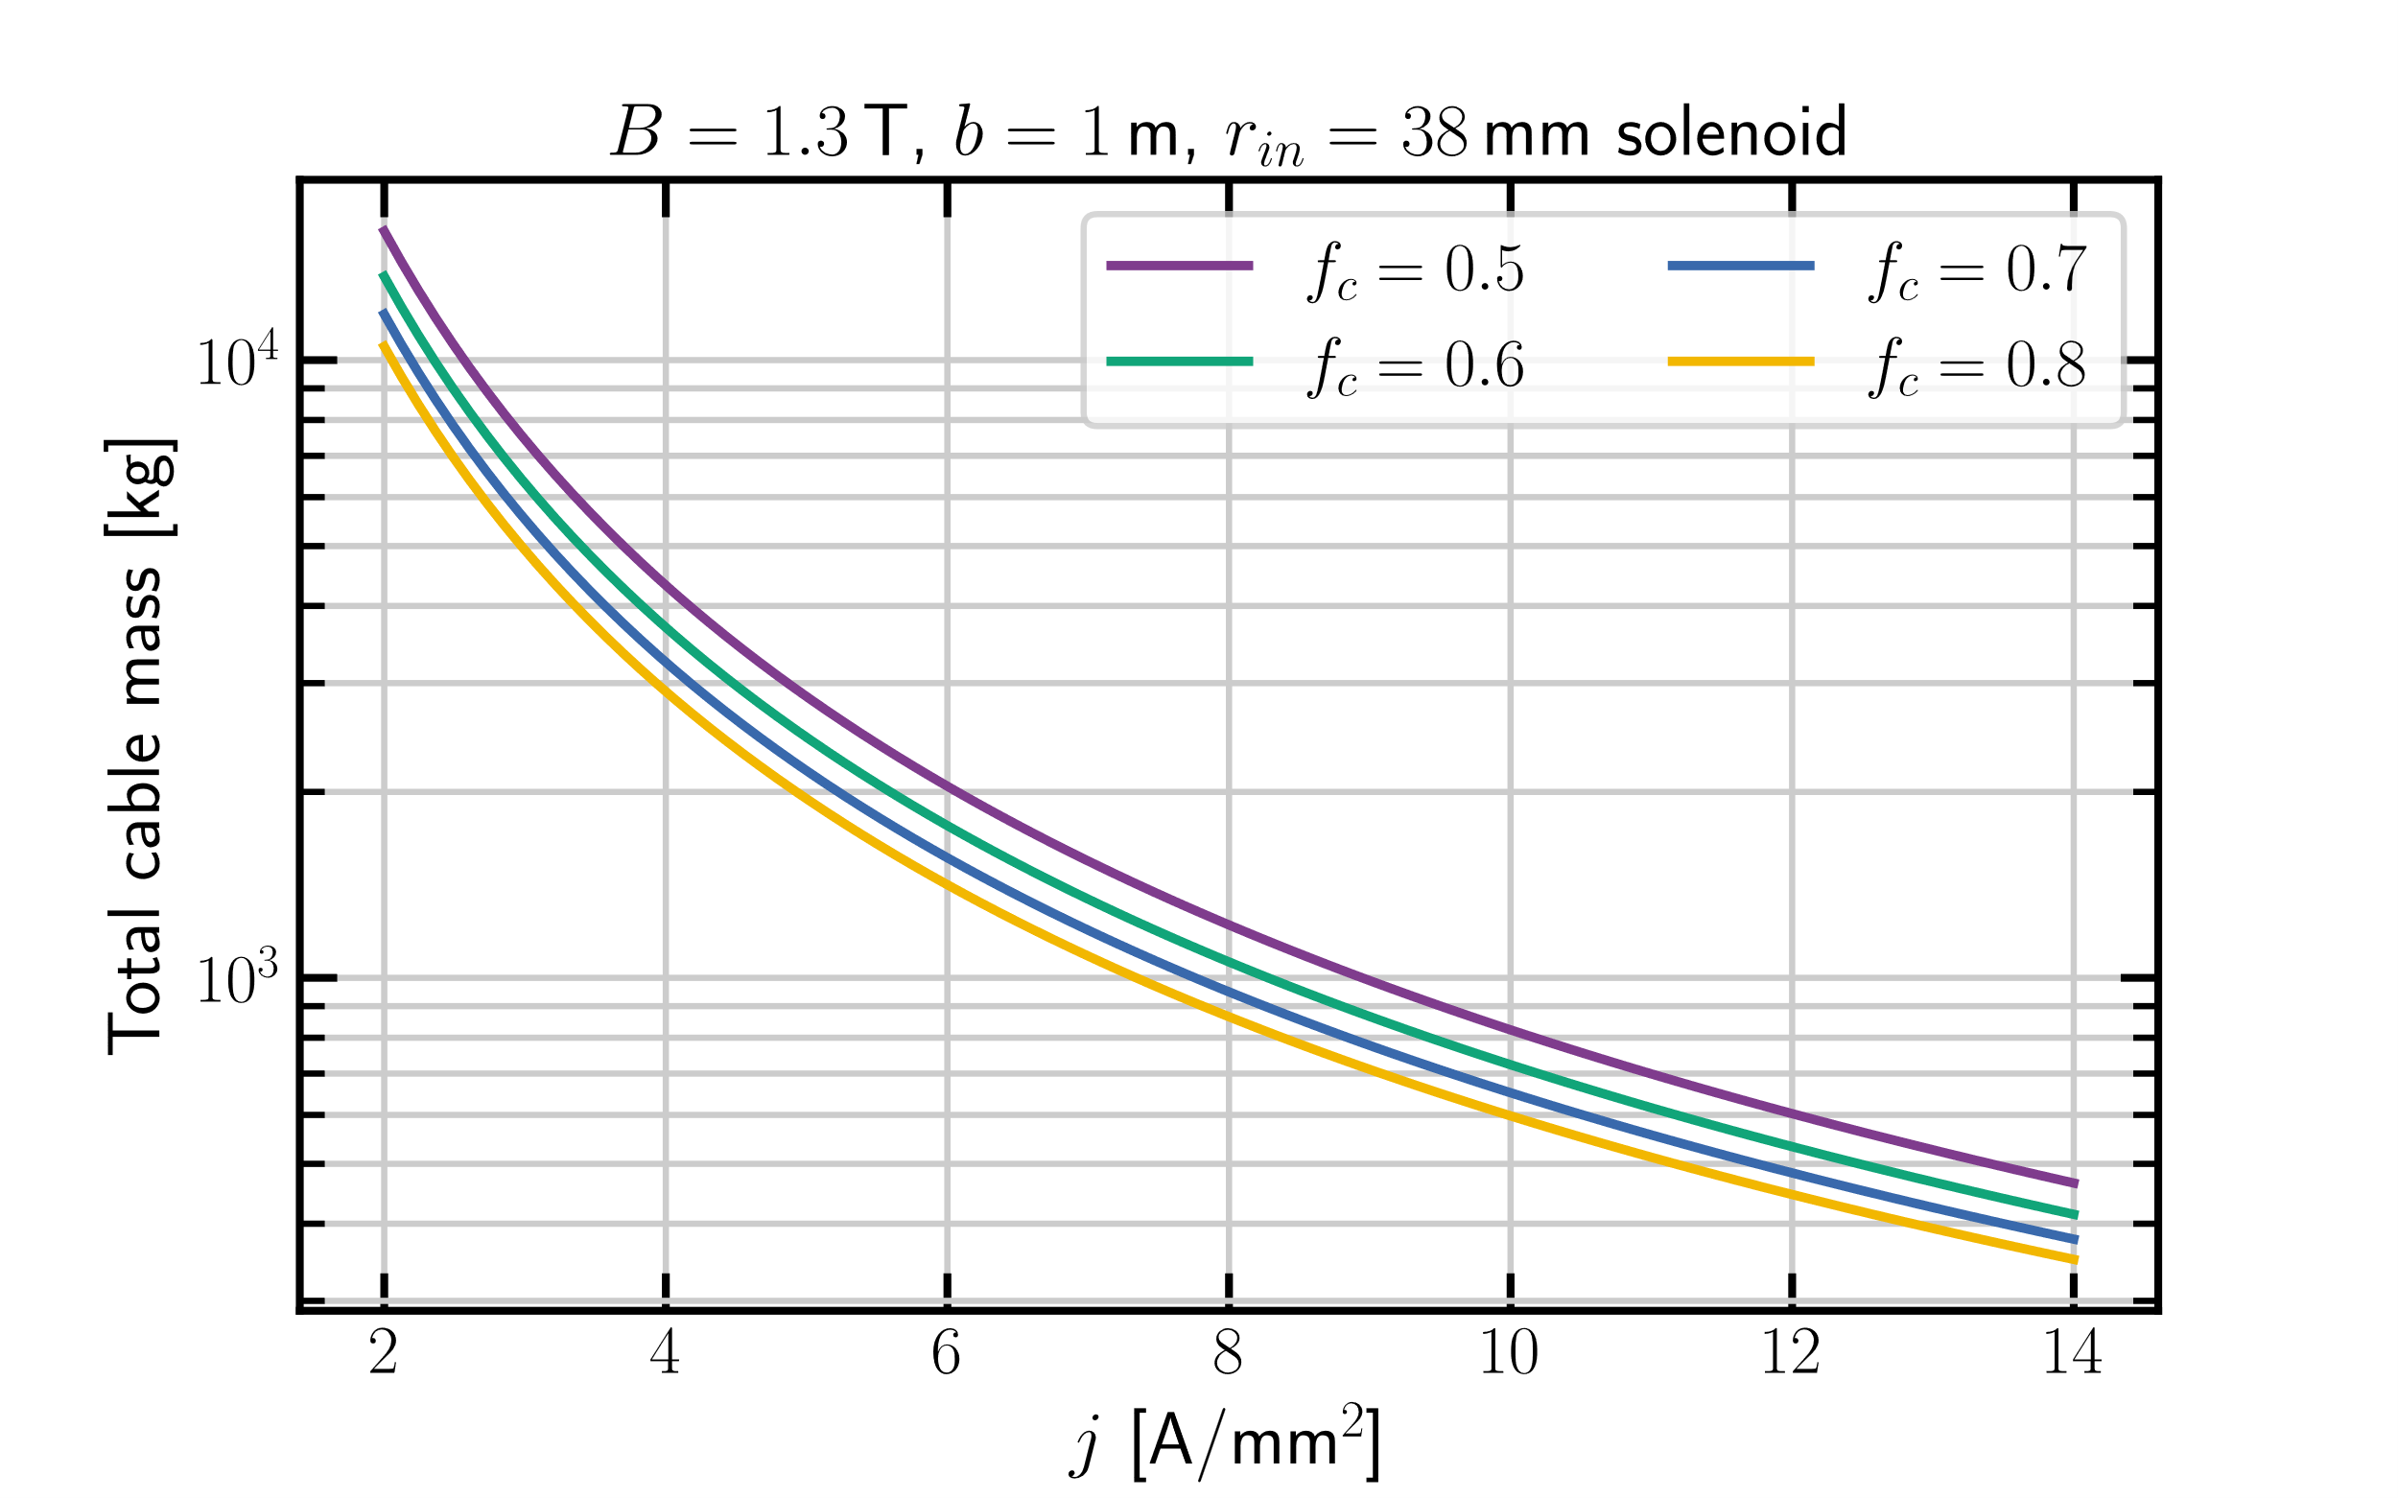
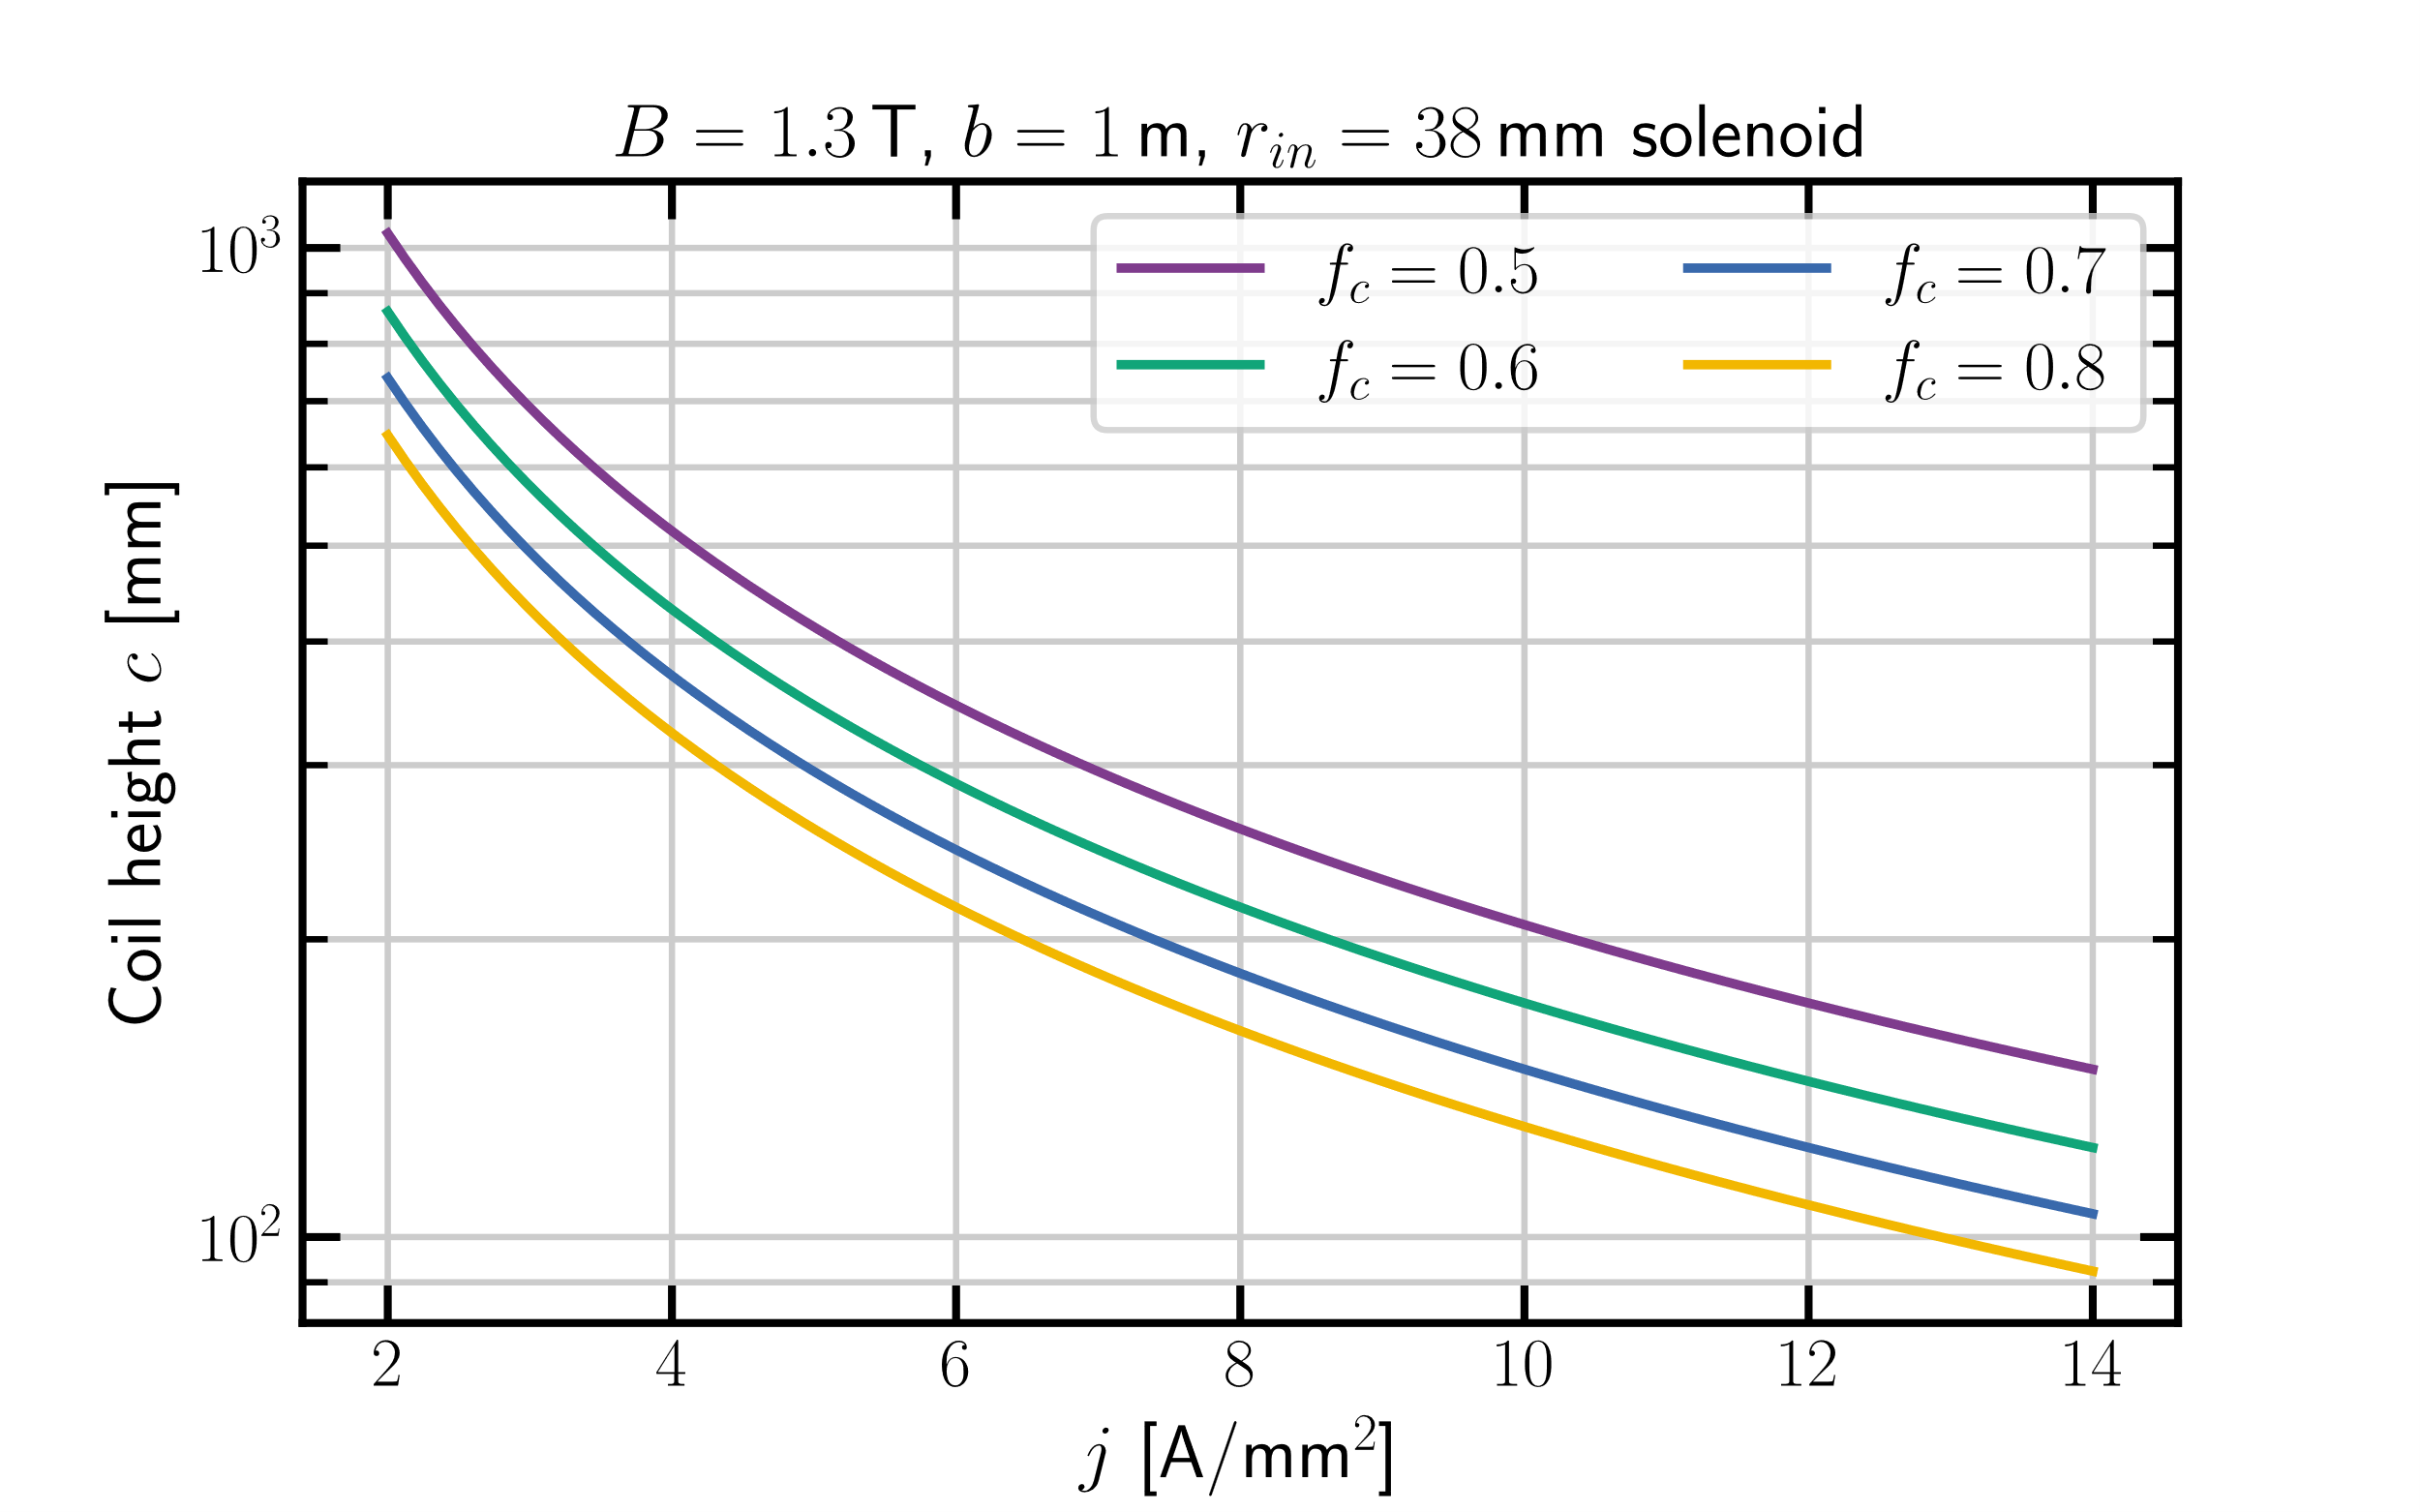
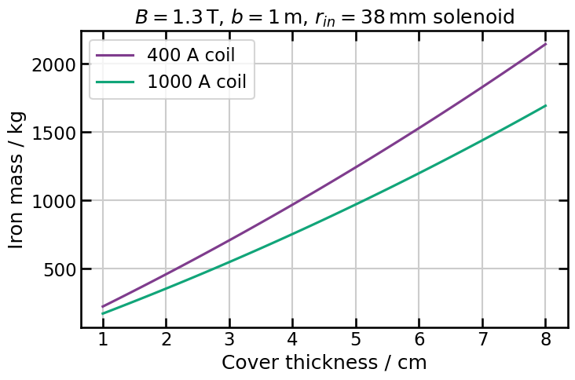
NC Solenoid–param. space

Slide 7
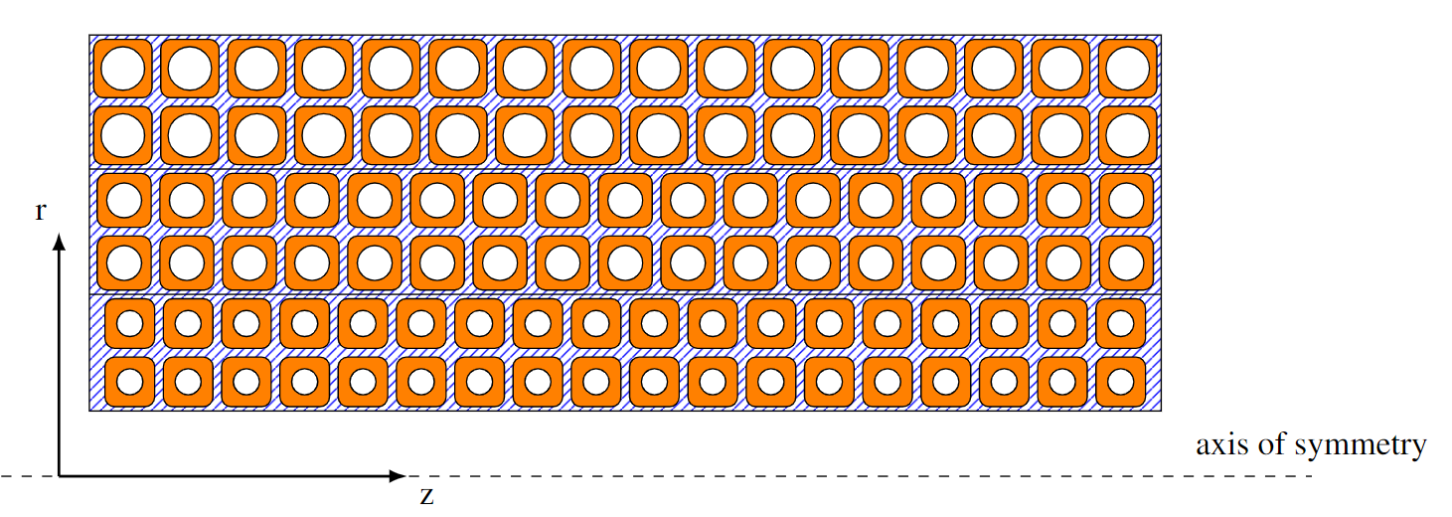
NC Solenoid–Graded coil design
C
A
B
Use more than one transverse size for the copper cable
Increase the diameter of the cooling channel in the layers further away from the bore
by keeping the conducting area constant
2 layers, cable size C
2 layers, cable size B
2 layers, cable size A

Slide 8
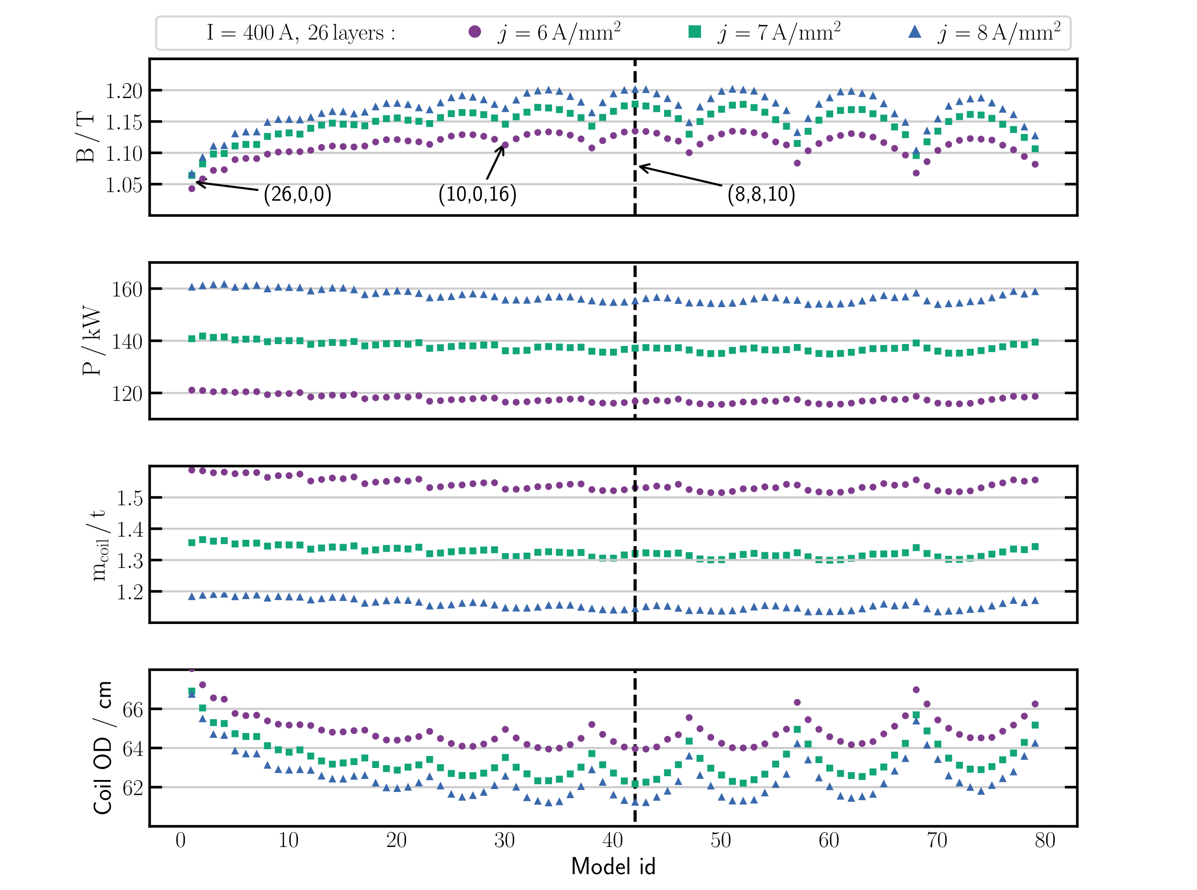
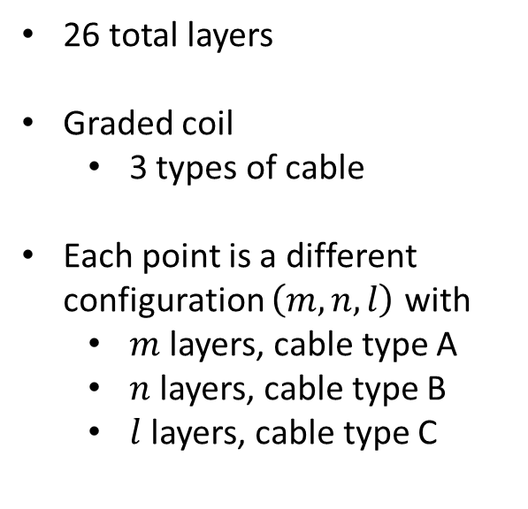
400 A NC Solenoid
26 total layers
Graded coil
3 types of cable
Each point is a different configuration $\left(m,n,l\right)$ with
$m$ layers, cable type A
$n$ layers, cable type B
$l$ layers, cable type C

Slide 9
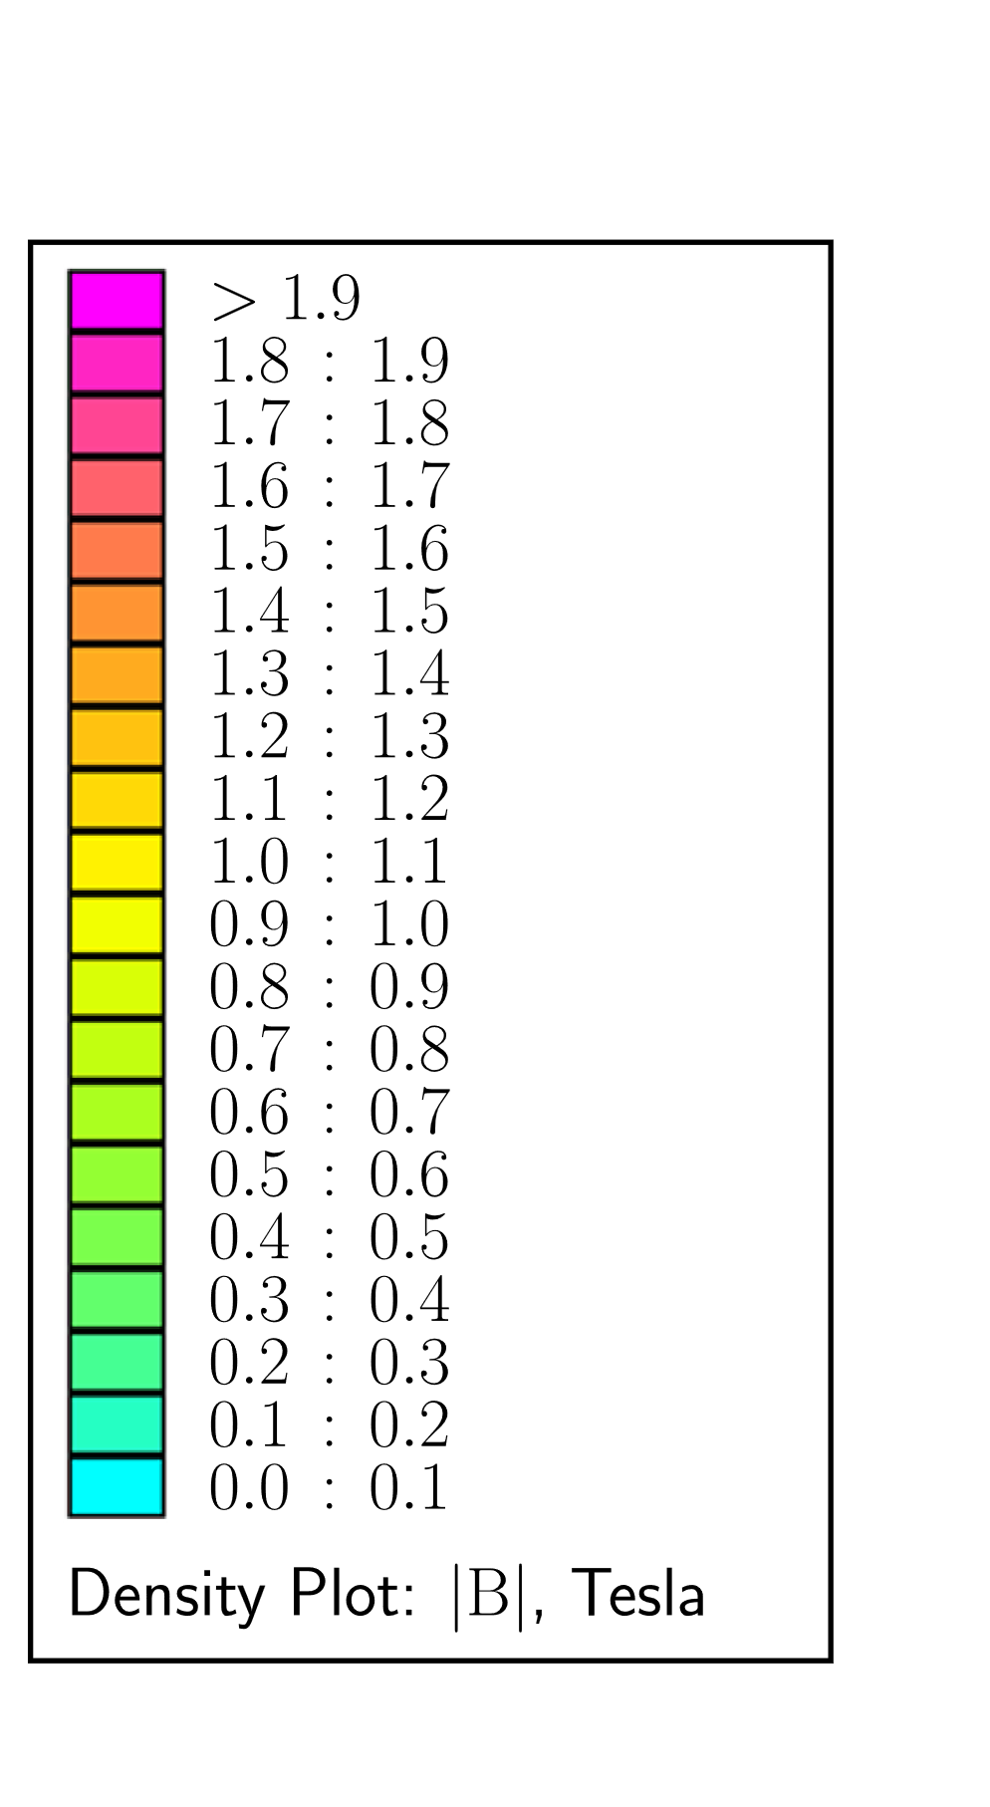
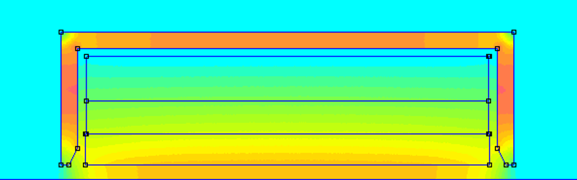
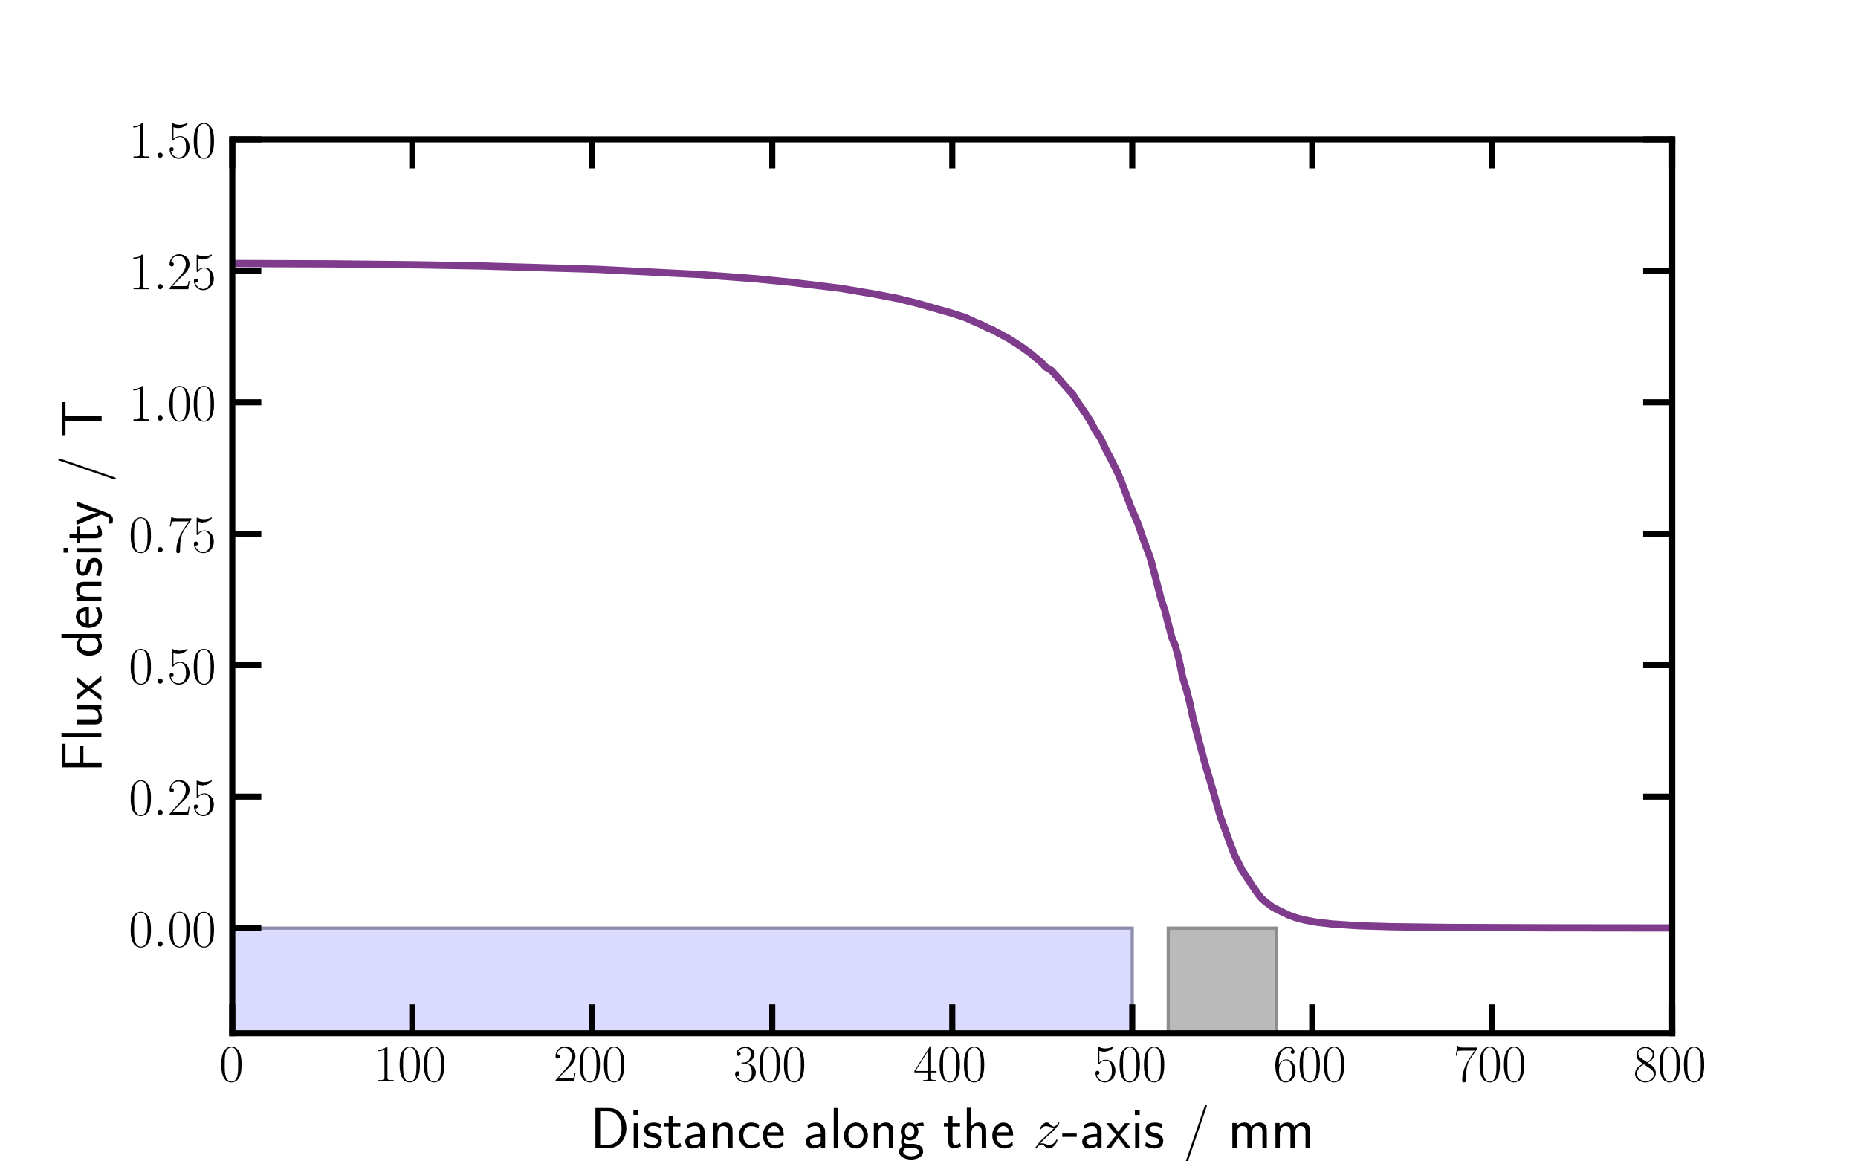
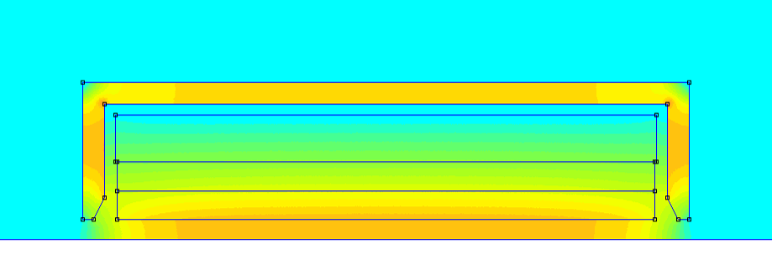

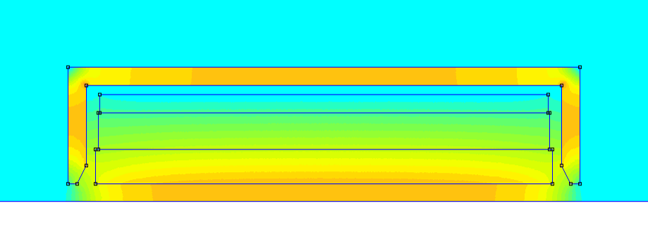
NC Solenoid–2D FEMM Models
Field on axis
400 A
400 A
coil
cover
1000 A
1000 A
2000 A

Slide 10
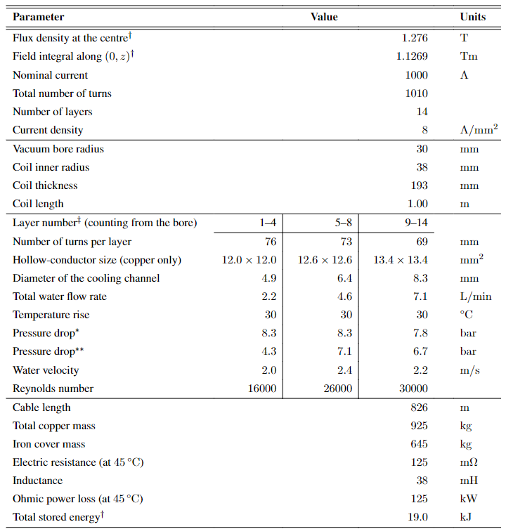

1000 A NC Solenoid–specifications
$B=1.28$ T
19 cm thick coil
925 kg
125 kW

Slide 11
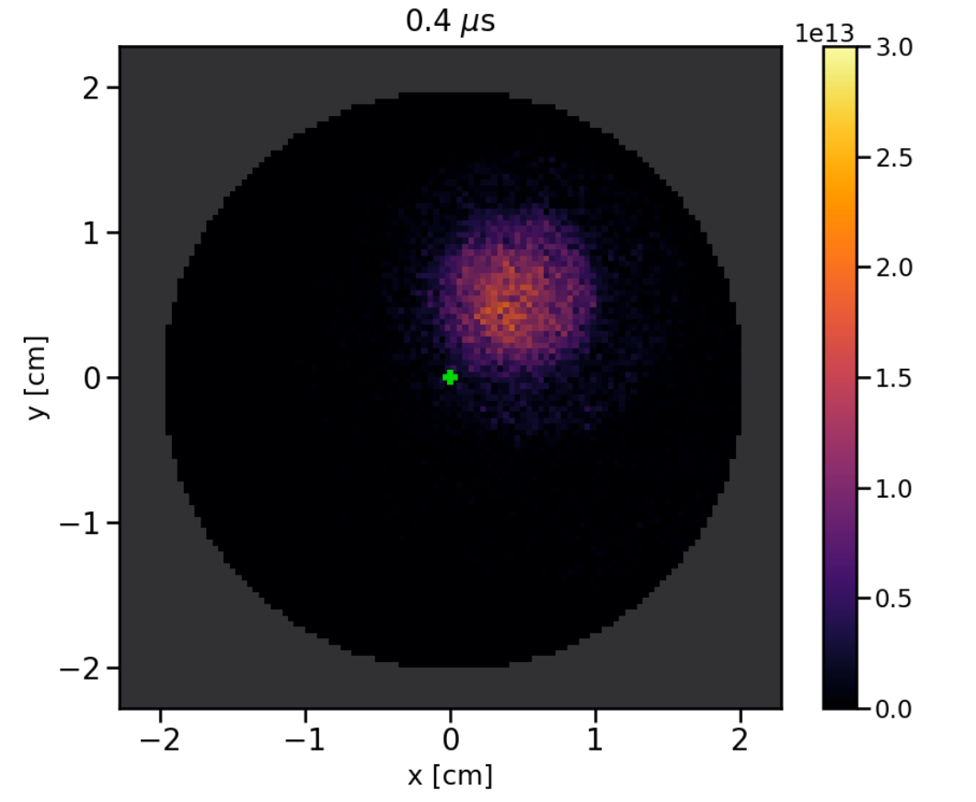
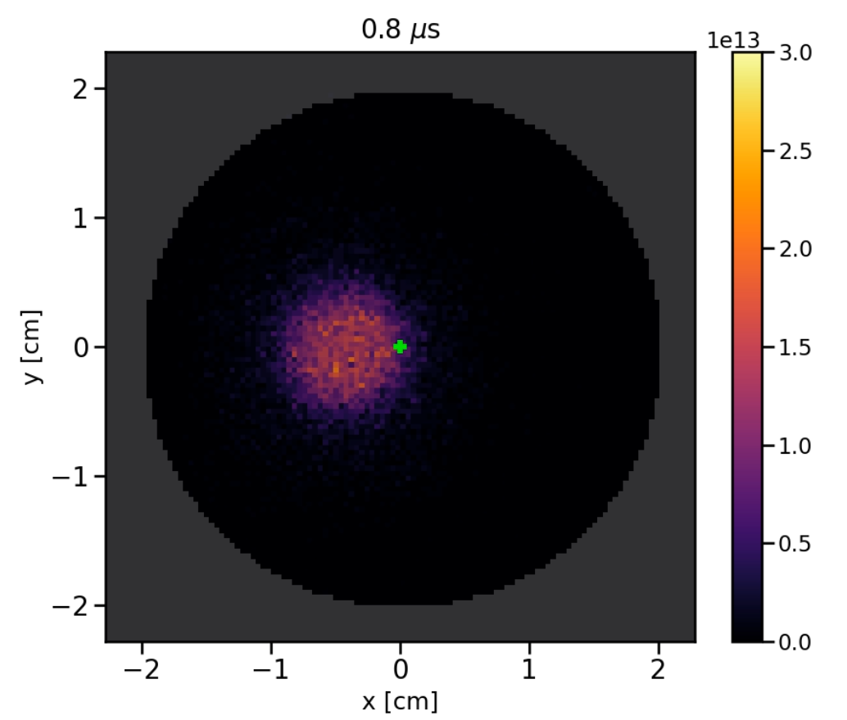
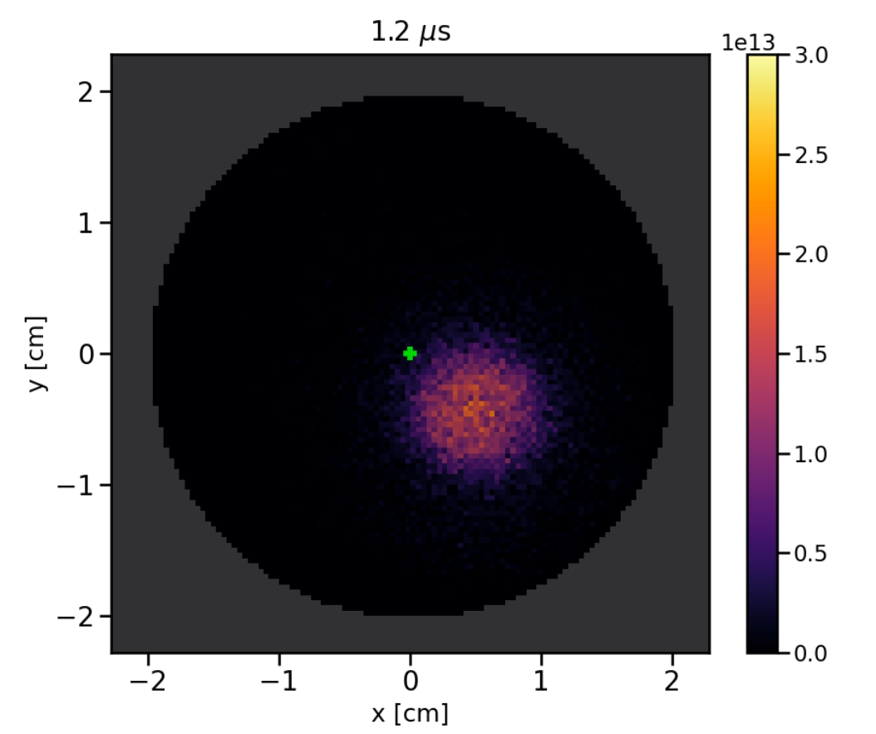
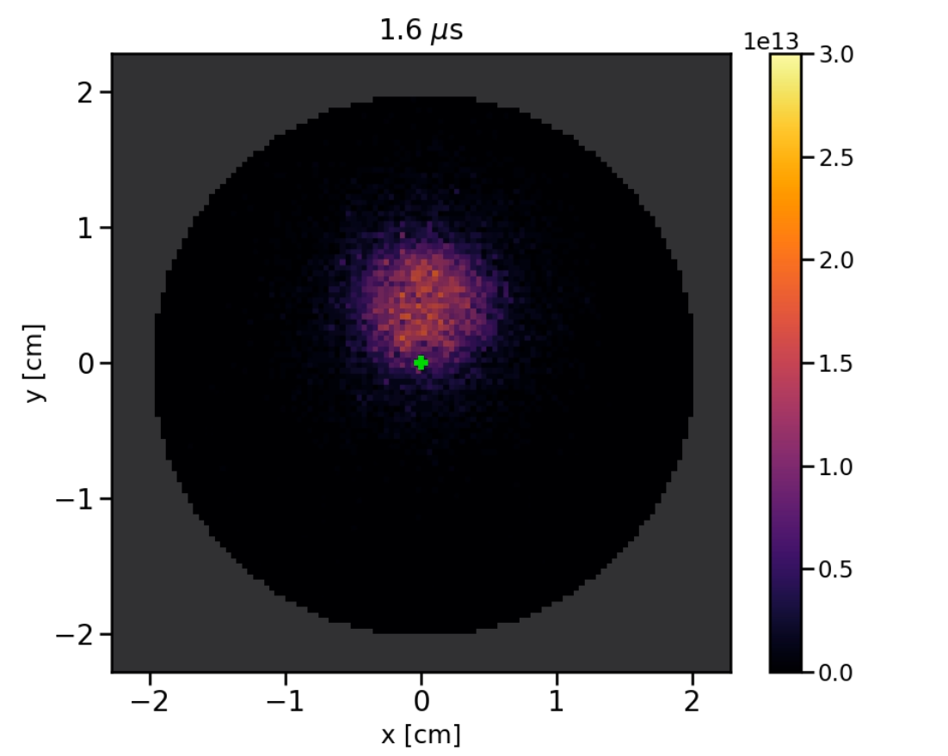
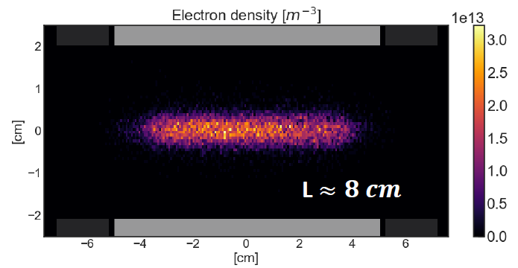
Plasma Simulations
(A) Diocotron mode
Simulation capabilities
The instability was observed in PIC simulations
Range of plasma lengths and densities limited by CPU time
Analytical model also available
Several critical parameters
Number of electrons
Plasma length and radius
Plasma temperature

Slide 12
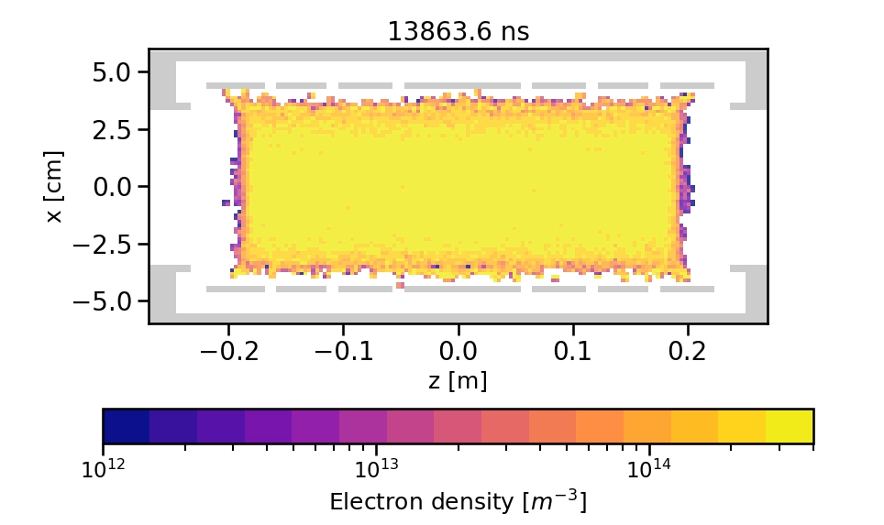
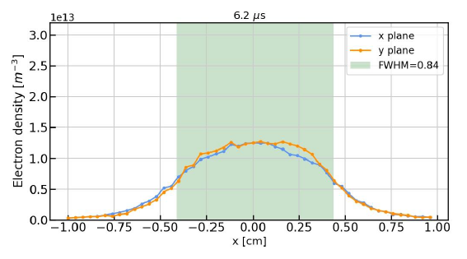
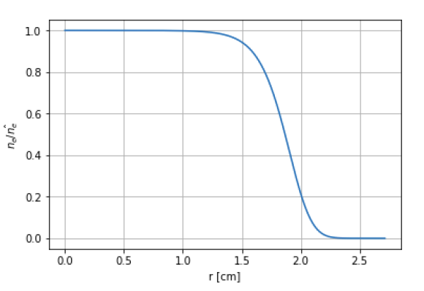
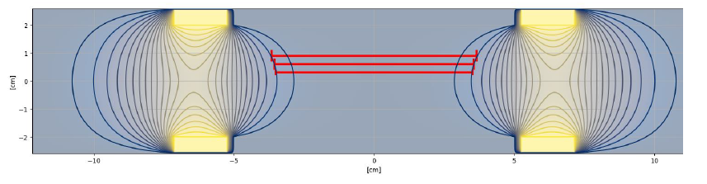
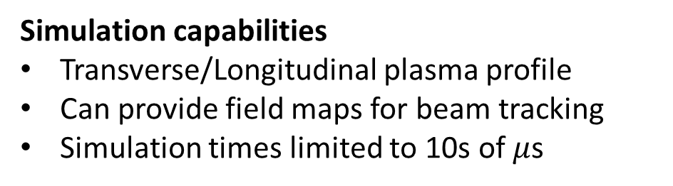
Plasma Simulations
(B) Stable electron plasma
Simulation capabilities
Transverse/Longitudinal plasma profile
Can provide field maps for beam tracking
Simulation times limited to 10s of $μ$s
Analytical models also available:
Plasma radial profile
Plasma length

Slide 13
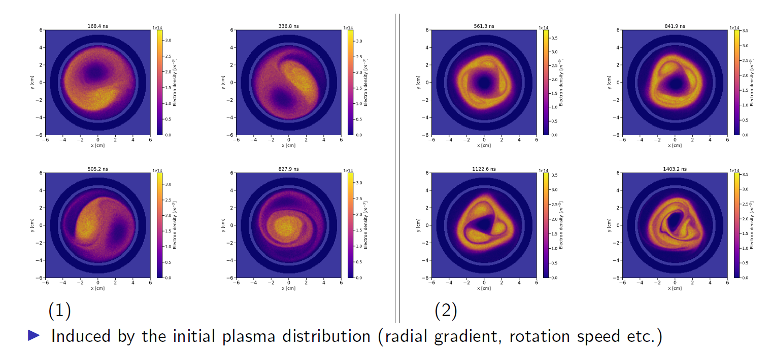
Plasma Simulations
(C) Instabilities

Slide 14


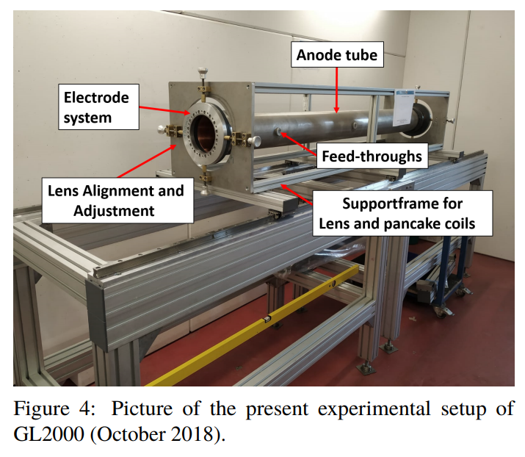
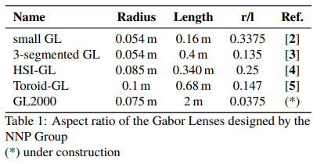

>20 years of investigations in Frankfurt
Aim: focus high intensity ion beams–improve focusing quality and reduce the emittance growth
(+ space-charge compensation)
GL tested so far:
<30 keV Ar-, He- beams
<130 keV, 35 mA Ar1 beams
$$φ_{A}$$
6 kV
6.5 kV
50 kV
(r_{p}=5 cm)
30 kV
“The formation of an electron cloud in the GL2000 is expected to take at least longer than in the previously investigated lenses.”
http://dx.doi.org/10.23732/CYRCP-2020-007.143

Slide 15
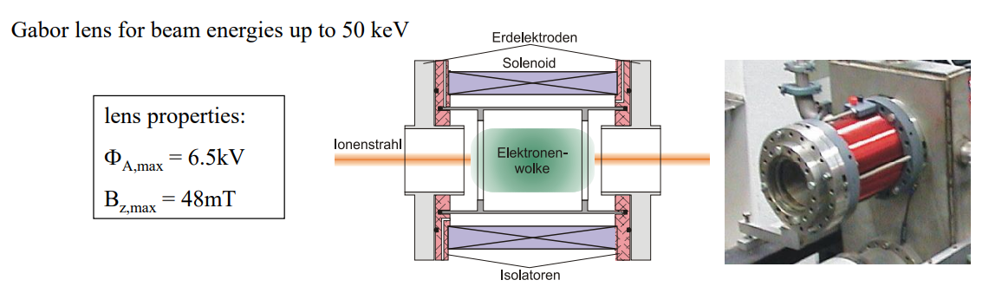
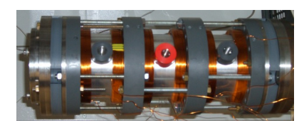
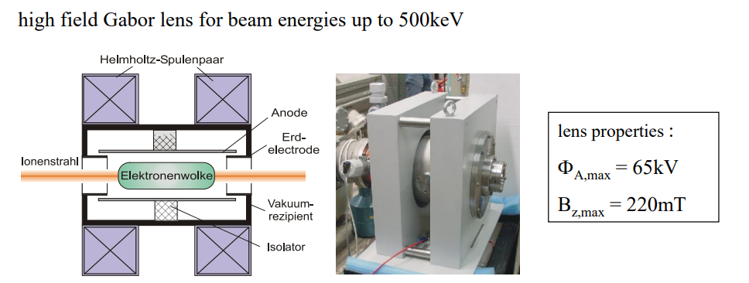
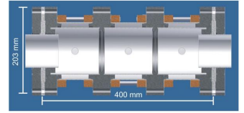
Types of lenses at IAP, Frankfurt
O. Meusel, 2010
K. Schulte, 2006

Slide 16
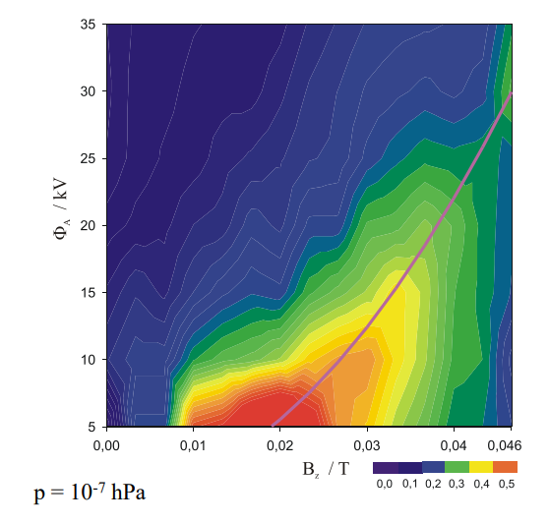
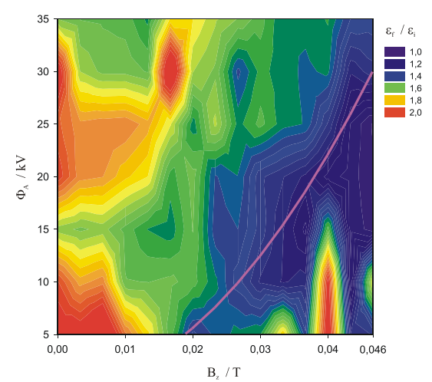

Beam transport measurements
1.2 mA, 440 keV, He⁺ beam
Lens filling degree
Beam emittance growth
O. Meusel, HIAT2012

Slide 17
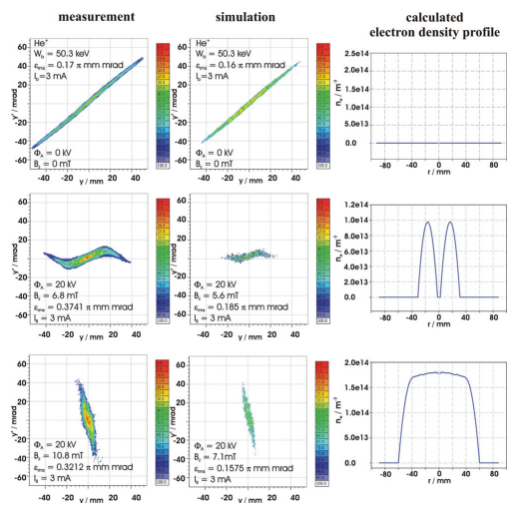
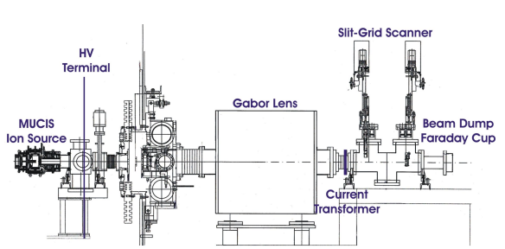
Beam transport measurements
GSI, 2012
IPAC2013, THPWO021
aberrations
He⁺ beam, emittance dominated transport (test performance of the lens as focusing device)

Slide 18

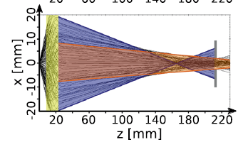
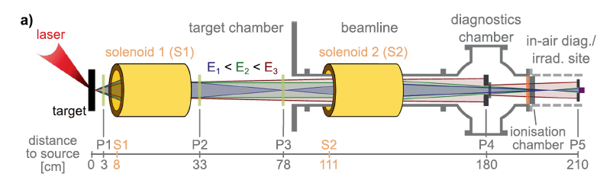
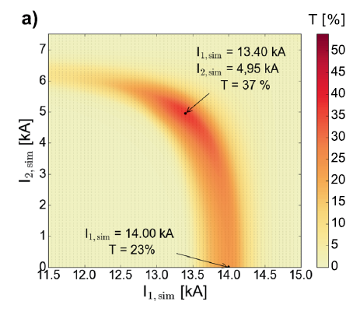
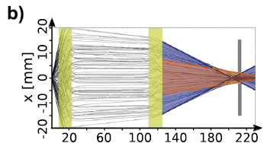

Pulsed high-field solenoids
$5.7×{10}^{9}$ protons at source (25$±$1 MeV)
Particle loss due to single solenoid
Limited aperture
Spherical aberrations (highly divergent protons travel closer to the windings)
< 19.5 T, 2 or 3 pulses/min.
S1, S2: 40 mm bore diameter
14° half-angle geometrical acceptance
Measured transmission (18.6 MeV protons)
50.6% (dual solenoid)
28.6% (single solenoid)
GPT sim.
https://doi.org/10.1038/s41598-020-65775-7

Slide 19


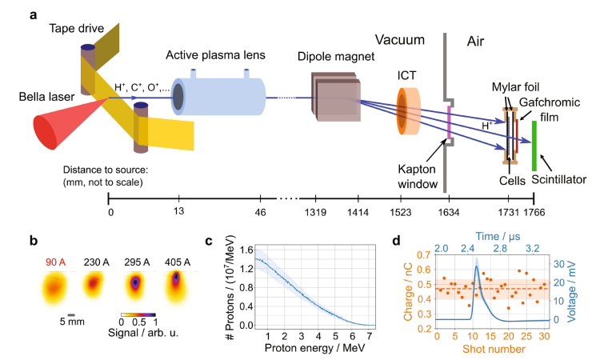
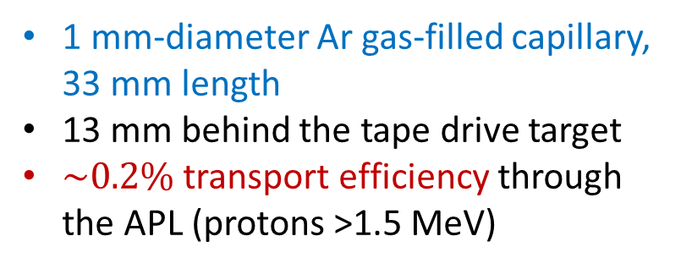
Active plasma lenses
https://www.nature.com/articles/s41598-022-05181-3
1 mm-diameter Ar gas-filled capillary, 33 mm length
13 mm behind the tape drive target
$\sim 0.2\%$transport efficiency through the APL (protons >1.5 MeV)
APL
DOI: 10.1103/PhysRevLett.115.184802

