Slide 1


Modelling the Laser-hybrid Accelerator for Radiobiological Applications (LhARA)

Slide 2

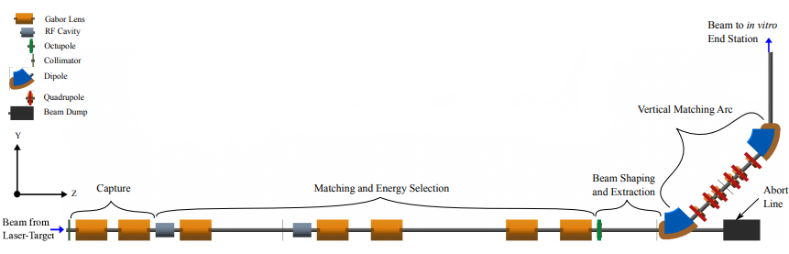
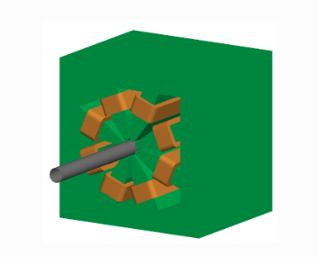
Octupole
AIM: FLAT DOSE DISTRIBUTION AT END STATION
Is this the best positioning for it?
Does it have long enough to have a strong enough effect on End Station 1
What strength does it need to be
Is this strength feasible?

Slide 3
Moving the octupole to just after drift 29
2 metres back from end station

Slide 4
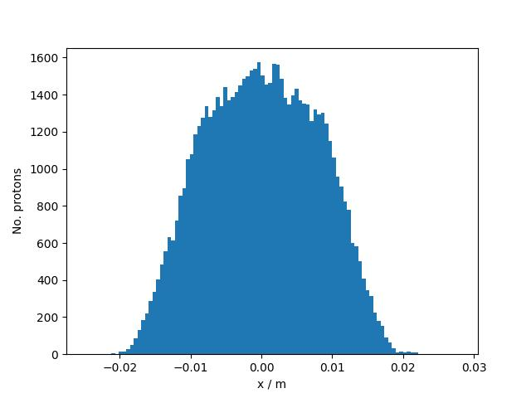
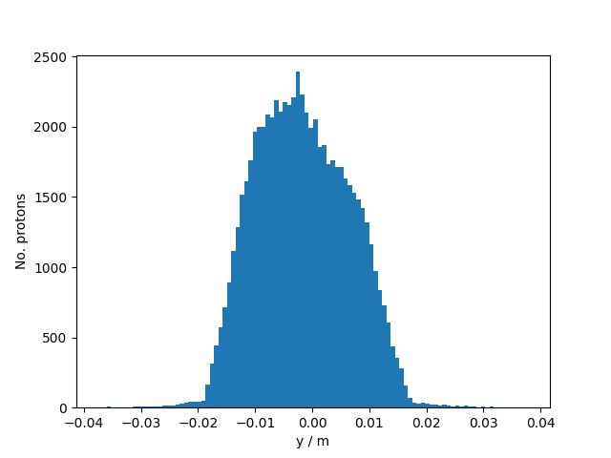
K3=20,000
P=68k

Slide 5
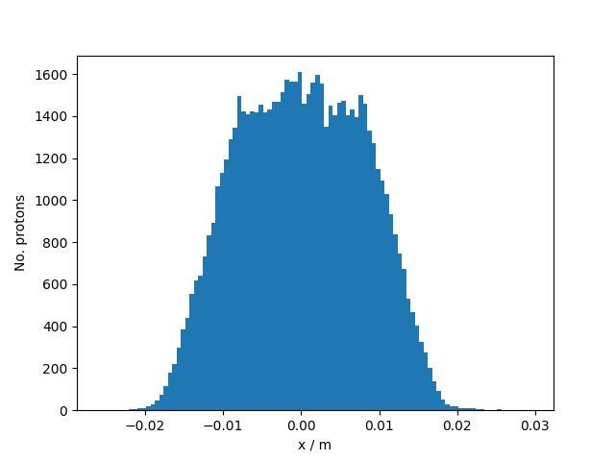
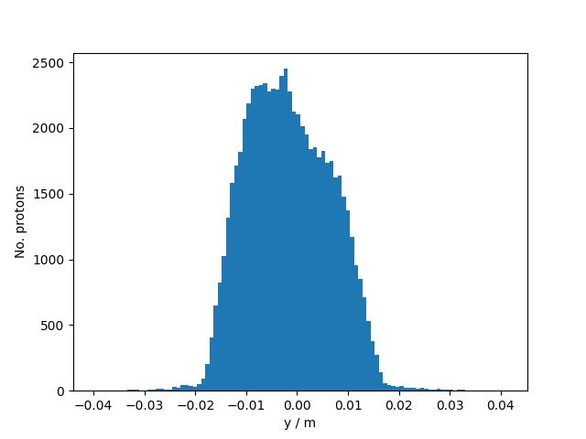
K3=27500
P=68k

Slide 6


K3=30,000
P=68k

Slide 7
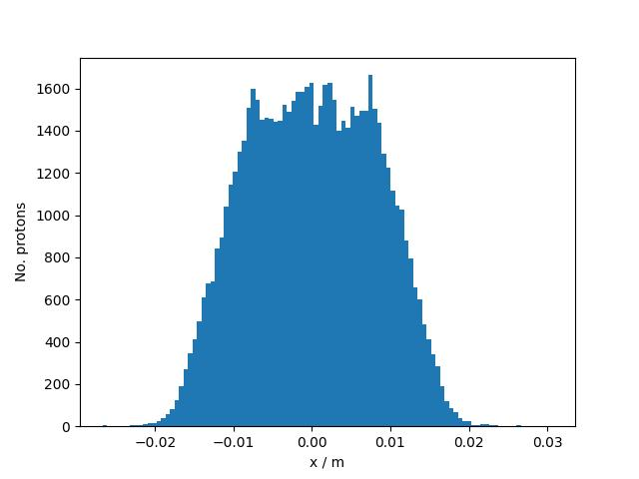

K3=32500
P=68k

Slide 8
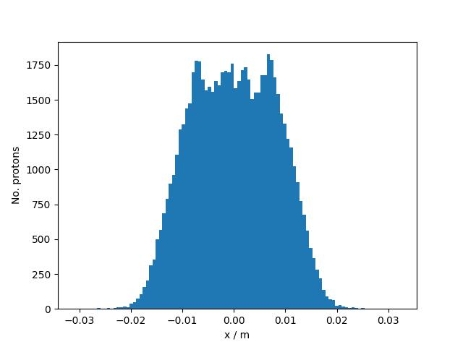
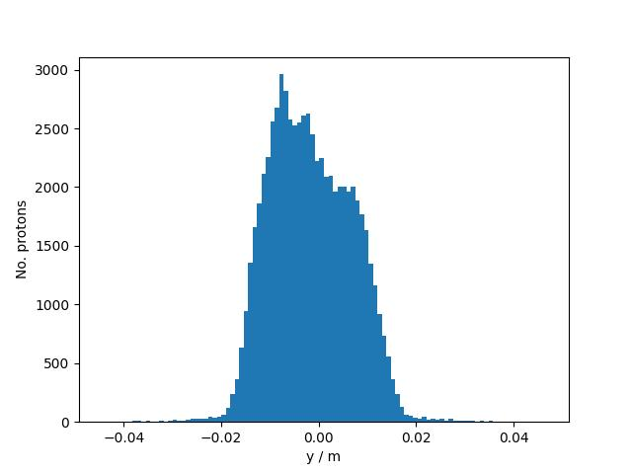
K3=40,000
P=68k

Slide 9
Additional graphs

Slide 10
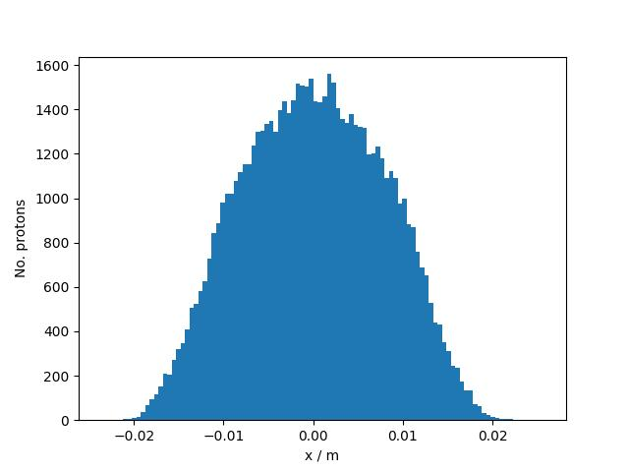
K3=10,000
P=68k

Slide 11
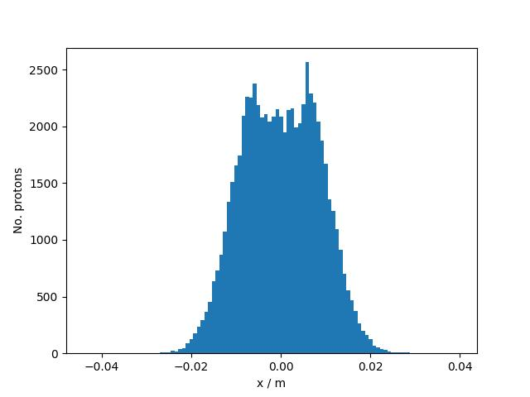
K3=60,000
P=68k

Slide 12
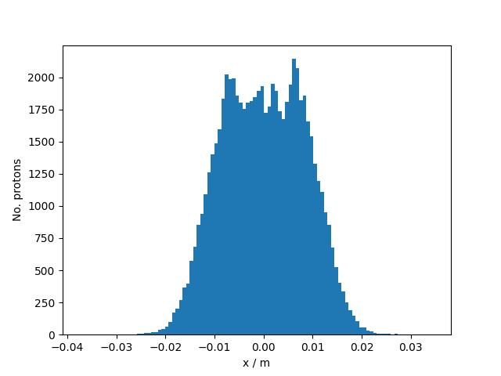
K3=50,000
P=68k

Slide 13
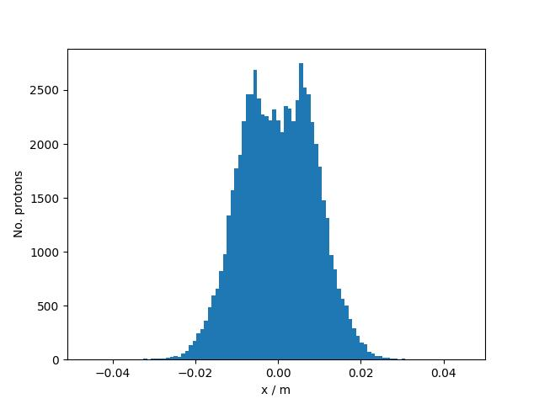
K3=70,000
P=68k

Slide 14
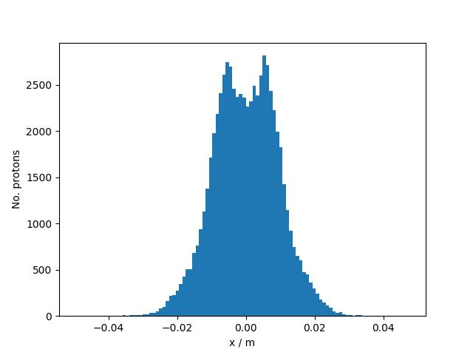
K3=90,000
P=68k

Slide 15

K3=80,000
P=68k

Slide 16
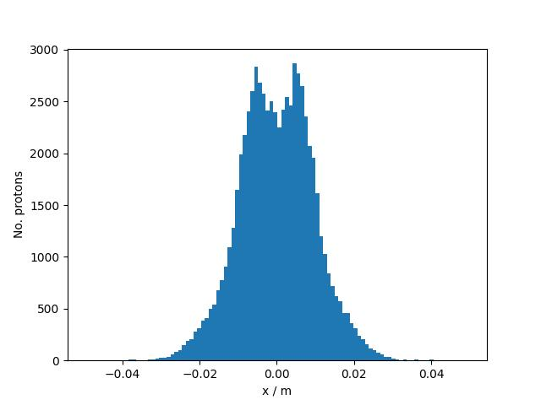
K3=100,000
P=68k

