Slide 1


Modelling the Laser-hybrid Accelerator for Radiobiological Applications (LhARA)

Slide 2

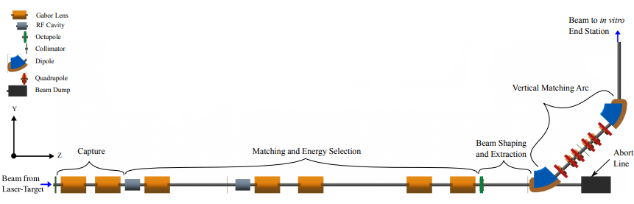
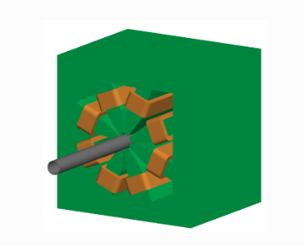
Octupole
AIM: FLAT DOSE DISTRIBUTION AT END STATION
Is this the best positioning for it?
Does it have long enough to have a strong enough effect on End Station 1
What strength does it need to be
Is this strength feasible?

Slide 3
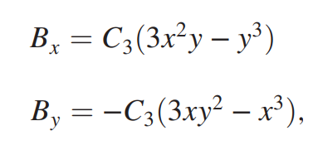
Calculating field strength
For K3= 20,000 with the un-optimised beam, calculations got us +0.2… T and -0.2… T for the x and y components of the B field.
This means that if we need to increase B according to new calculations with optimised beam this could still be feasible
General K3 equation
untitled (aps.org)

Slide 4
Two octupoles
One at end of vertical arc
One in original positioning
Two tests:
One where the first octupole has reversed polarity
The second where the first octupole is tilted at 22.5 degrees
Our hope is that this will give us a more uniform distribution in y, as we have not been seeing this so far
  We have only been seeing uniformity in x up until now

Slide 5
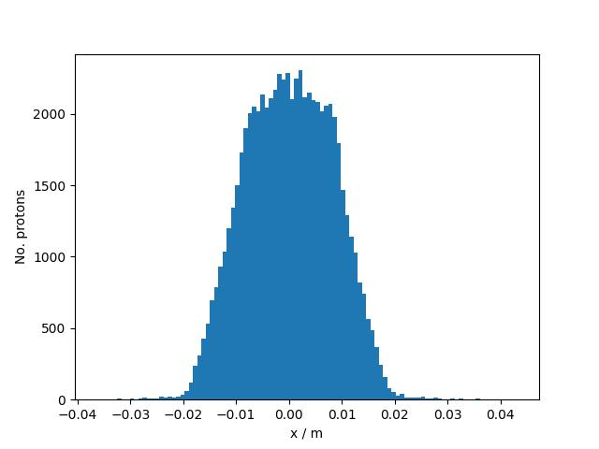
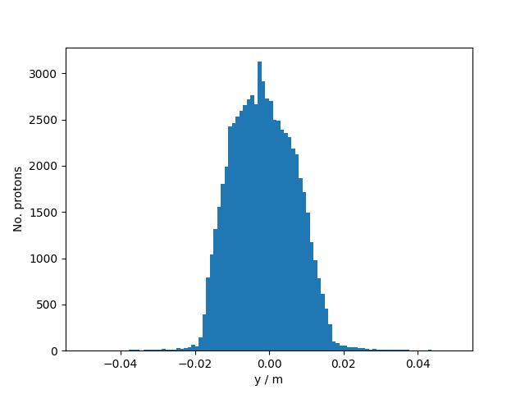
Two octupoles, one with reversed polarity
-10000 K3 at octupole 1 and 30000 K3 at octupole 2

Slide 6
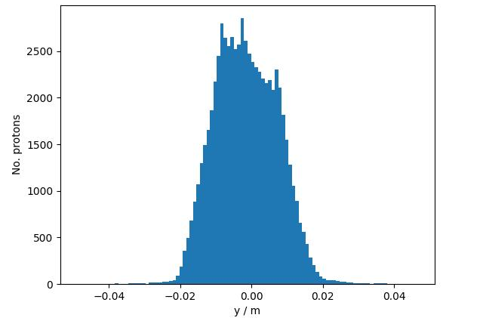
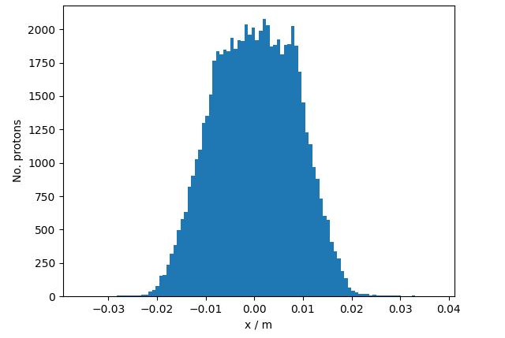
This is with octupole 1 at k3 9000 and octupole 2 at k3 20000
Two octupoles, the first one tilted (22.5 degrees)

Slide 7
Conclusions
We have found that it can be moved to the end of the vertical arc and still produce a uniform effect
Adding a second octupole so that there is one at the end of the vertical arc and one in the original spot (and either tilting one, or reversing the polarity of one) has a negligible effect.
The range of K3 value which seems the most reliable at creating a uniform beam between the varying positionings I have tried of octupoles is between 10000 and 30000.
Which is around 0.2 T (20000) which is feasible.

Slide 8
Collimators
AIM: CLIP OFF THE BEAM SUCH THAT IT BECOMES MORE UNIFORM
-Three collimators
-What apertures would be needed for each respective collimator to create the best flat dose distribution at the end station.

Slide 9
Collimator
Clips off parts of the beam based on aperture size
We want to vary the aperture size and see what the energy distribution looks like after the collimator and at the end station
We want the distribution to be within +/-2%
There are three collimators (in the version will has given me) but we are focusing on the first one currently

Slide 10
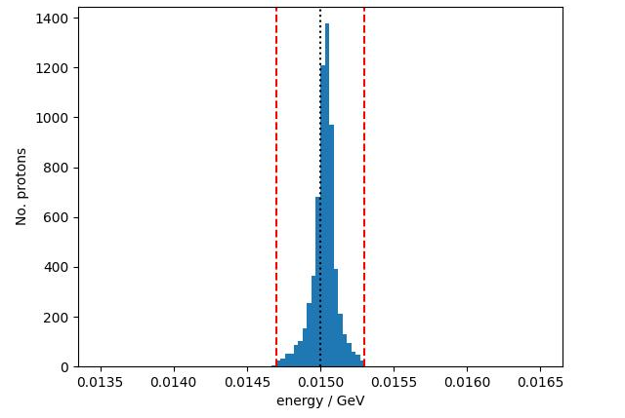
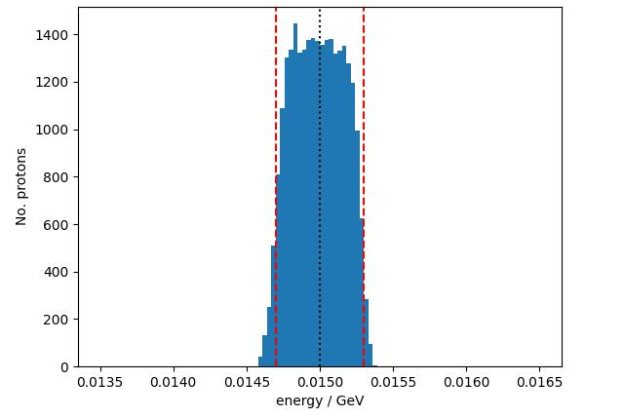
Do we want to priotitise the 2% limit or a higher number of particles
0.0002m vs 0.007m at end station

Slide 11
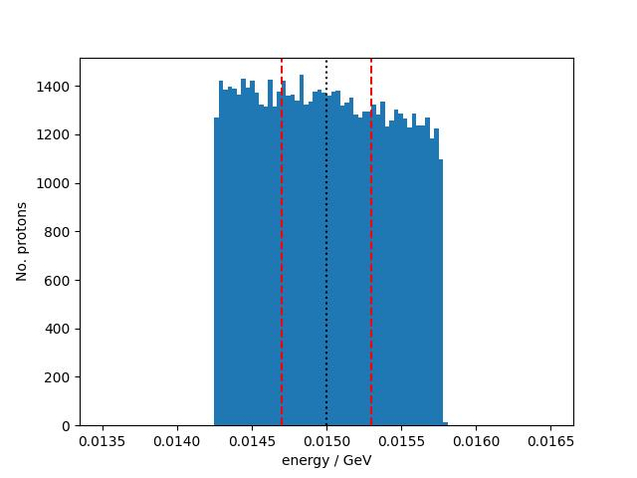
This is energy 1 and 2 for 0.007m, this shows that all of the work is being done by the collimator in the vertical arc

