Slide 1
Initial file(s) for source term

Slide 2
Promised to bring “standard” source distribution
M. Maxouti & N. Dover:
  Standard parameterisation:
    “exponential” energy spectrum with h/e cut off
    Gaussian, pointing 𝜃, flat 𝟇
M. Maxouti

Slide 3
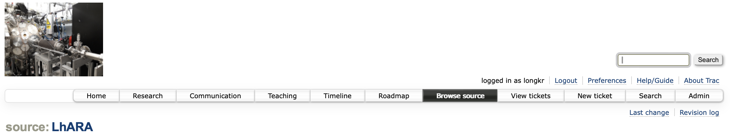
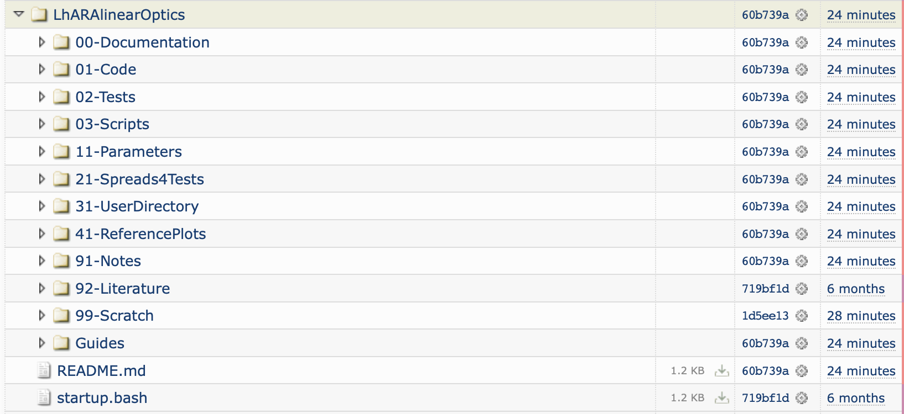
Code
CCAP/LhARA repository:
https://ccap.hep.ph.ic.ac.uk/trac/browser/LhARA#LhARAlinearOptics
Some, rudimentary
documentation

Slide 4
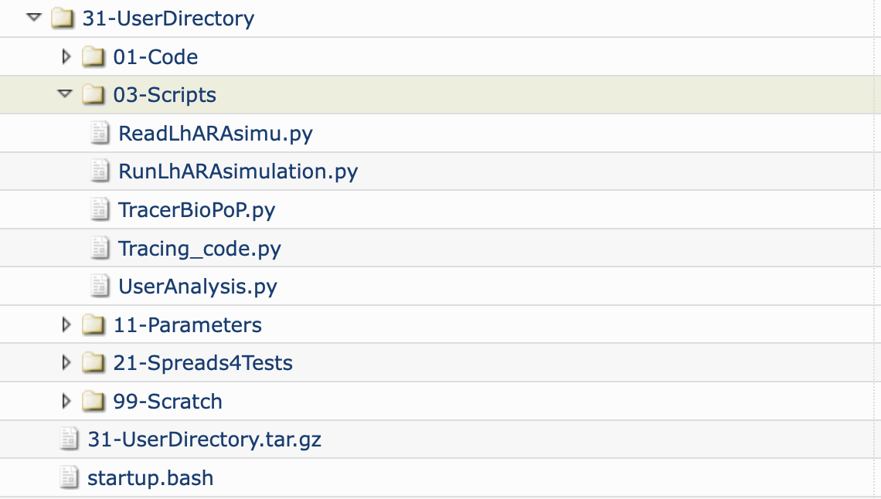
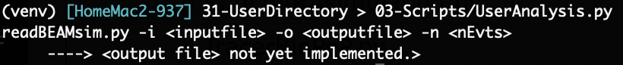
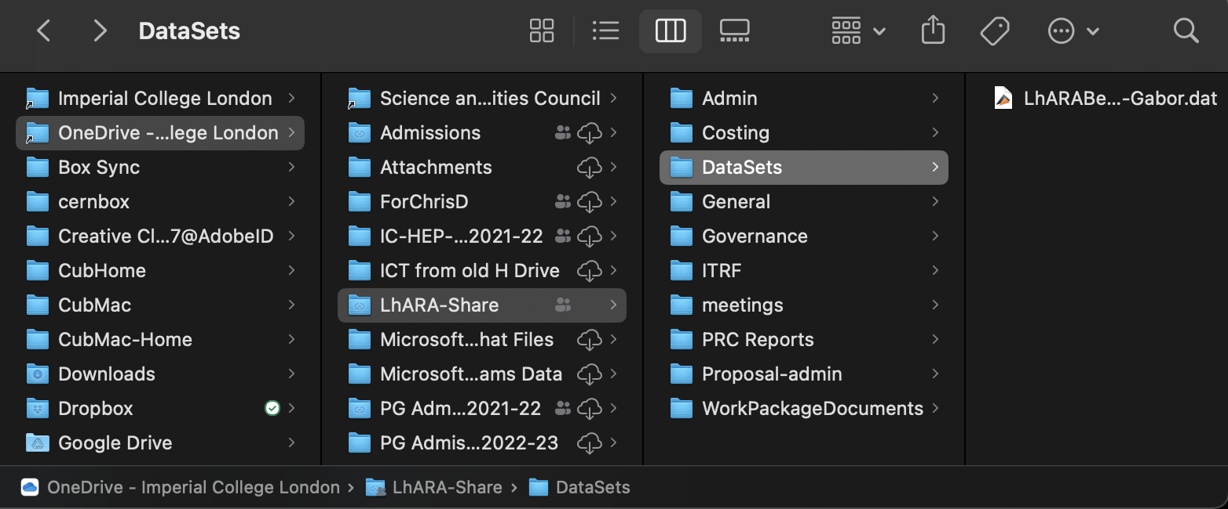
User code to read

Slide 5
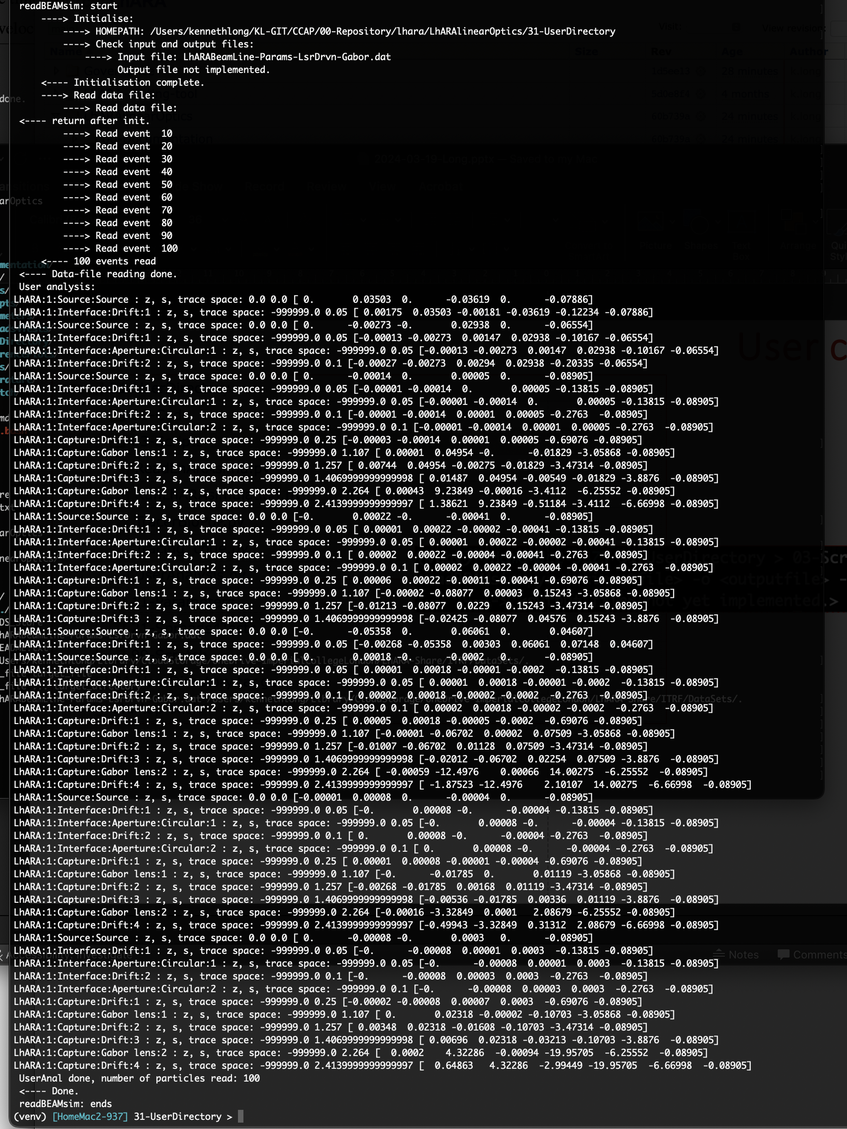
UserAnal framework
Placeholder, but:
  Provides example of looping through particle instances
  Trace space at each element:
    Source, nozzle, …
    Transformation to lab will be provided
      Source distribution felt to be most valuable

