Slide 1
FFA Magnets 3D
04/06/24
Ta-Jen Kuo
Supervisor: Jaroslaw Pasternak, Jean-Baptiste Lagrange
Imperial College London, STFC

Slide 2
LhARA Singlet

Slide 3
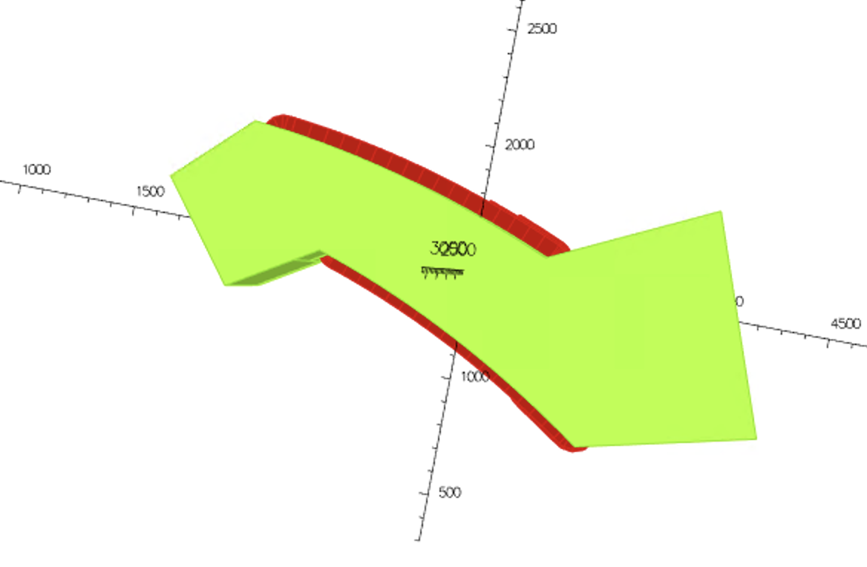
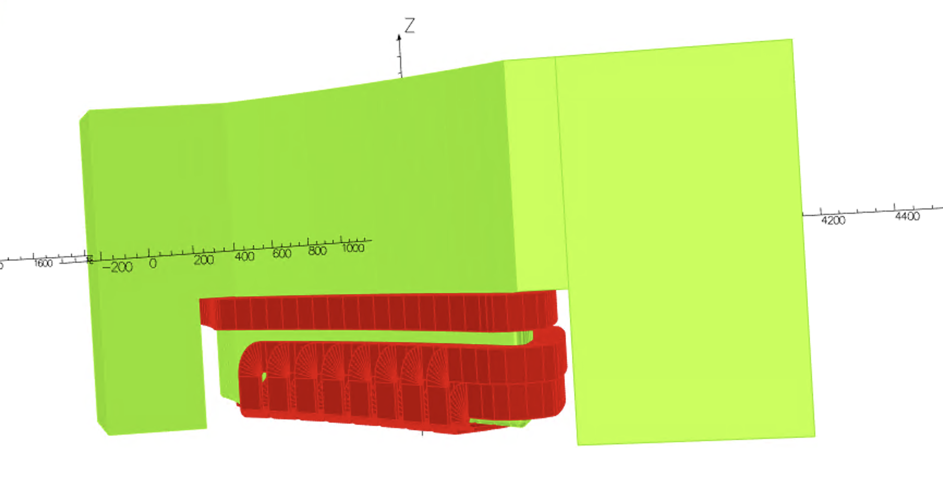
Pictures of the spiral magnet
Top View
Conductors shown in red
Iron shown in green
Side View
(Only top half of the magnet shown)

Slide 4
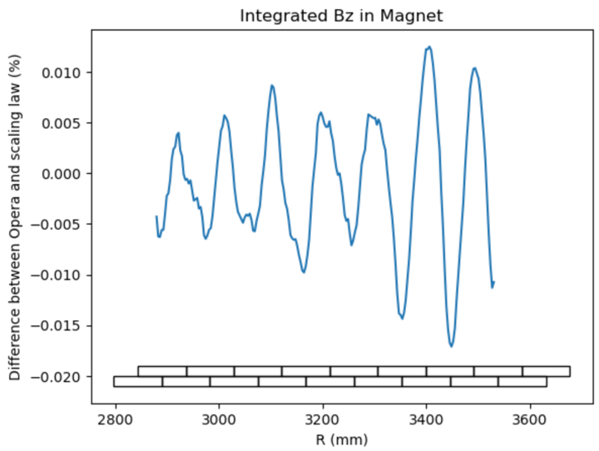
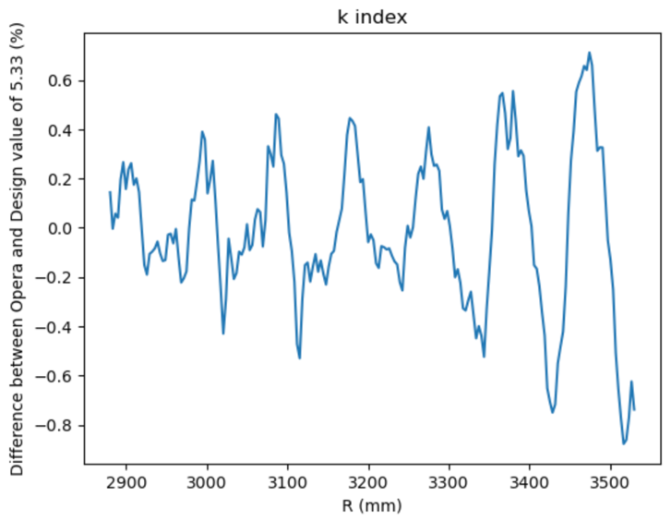
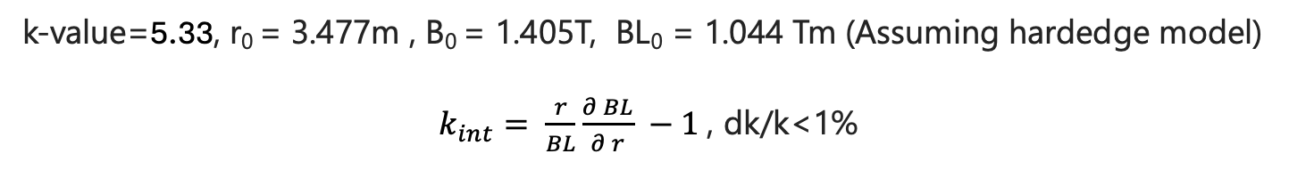
Integrated B Field
k-value=5.33, r₀ = 3.477m , B₀ = 1.405T, BL₀ = 1.044 Tm (Assuming hardedge model)
$k_{int}= \frac{r}{BL}\frac{∂ BL}{∂ r} −1$, dk/k<1%

Slide 5
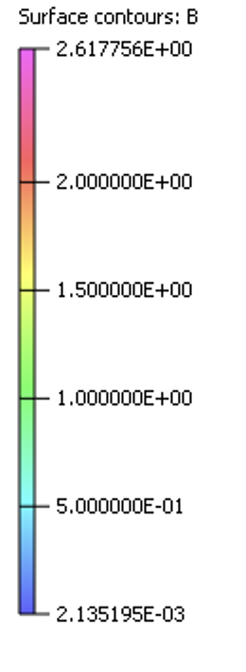
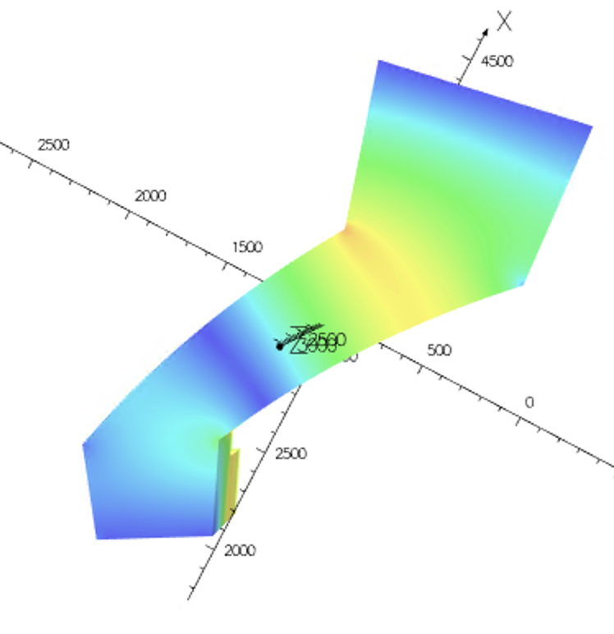
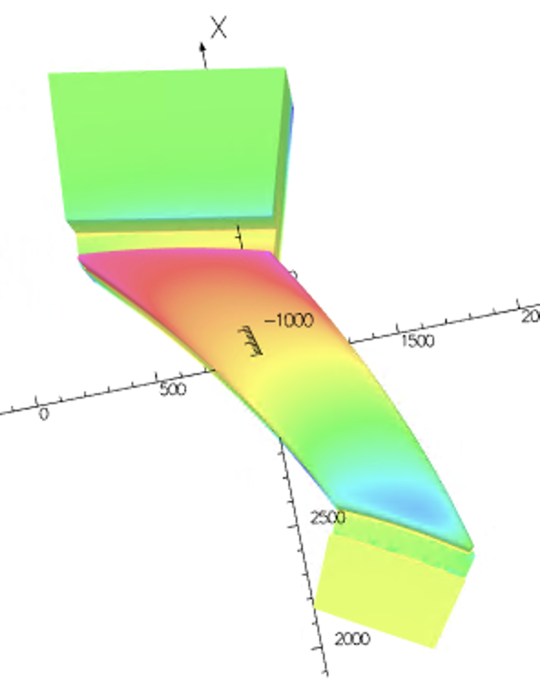
Saturation level of pole face
Reaches 2.6 T at the
outer radii of the pole
Pole Face
Return Yoke

Slide 6
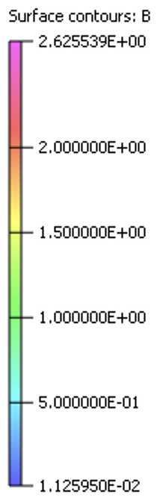
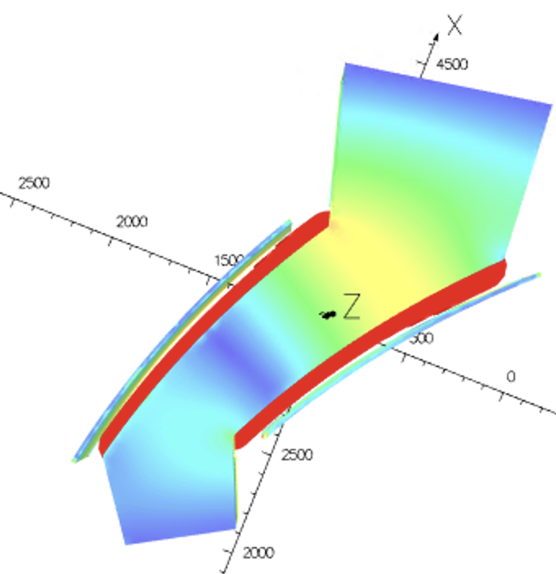
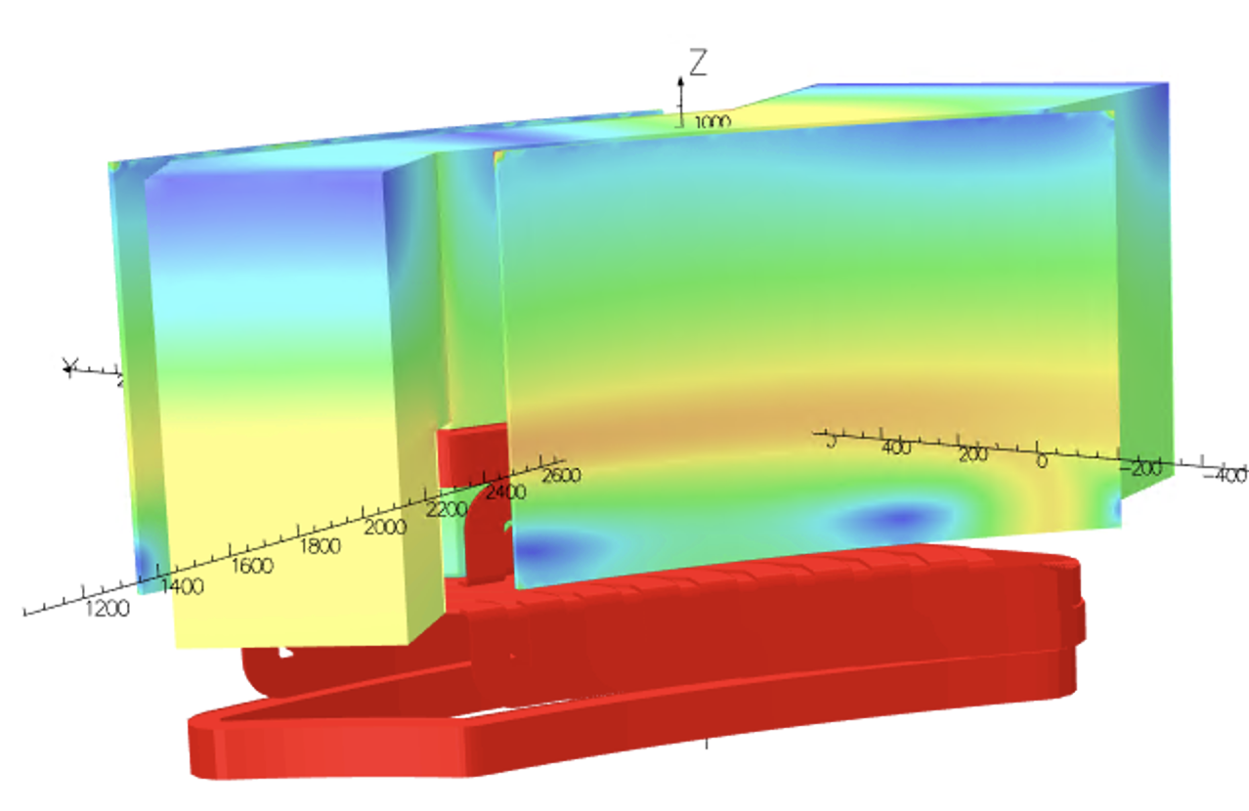
Added clamps 25 mm thickness on either side

Slide 7
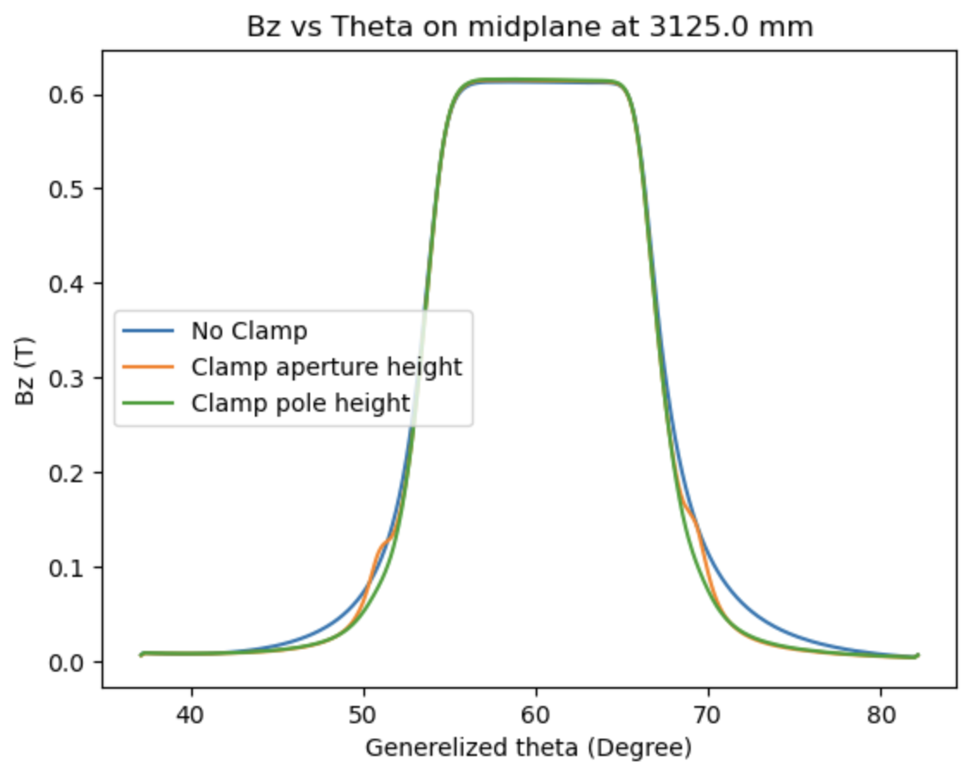
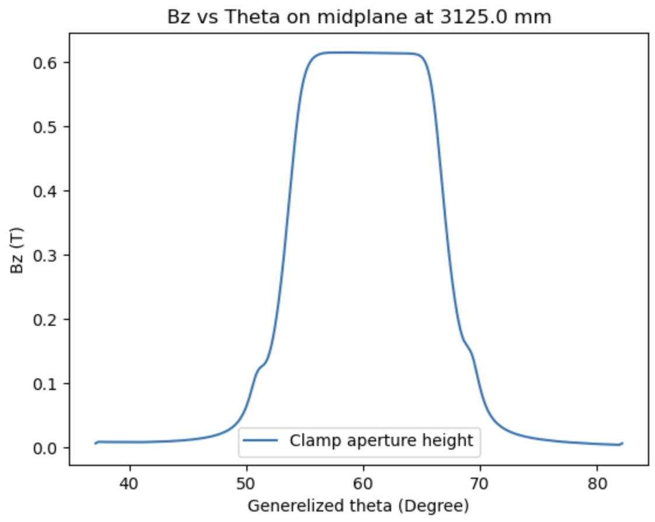
Bz vs theta
Thickness of clamps 25 mm
Varying gap height of the clamps

Slide 8
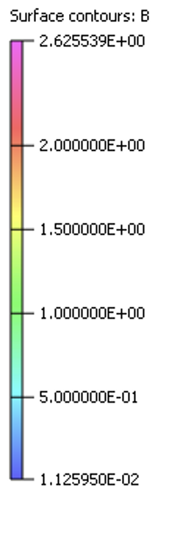
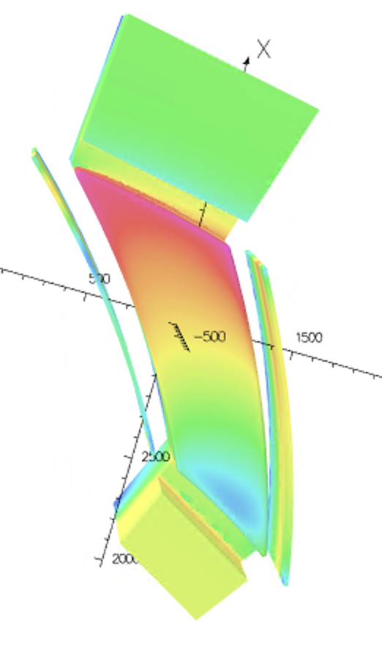
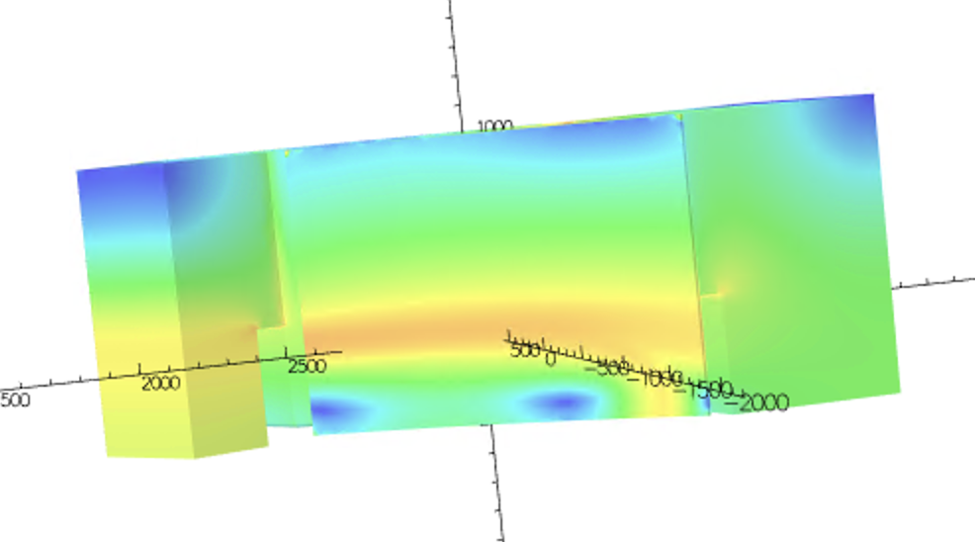
Saturation level
Clamp at aperture height

Slide 9
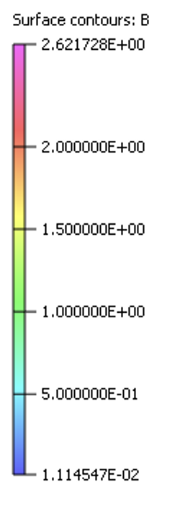
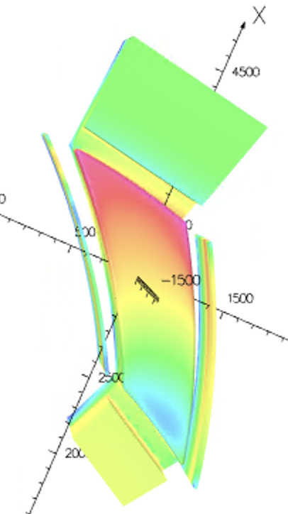
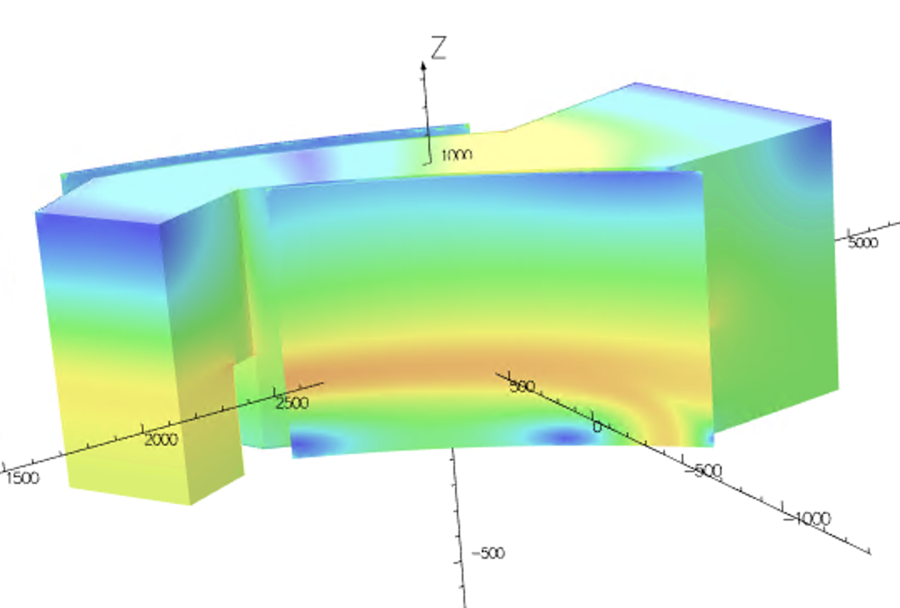
Saturation level
Clamp at pole height

Slide 10
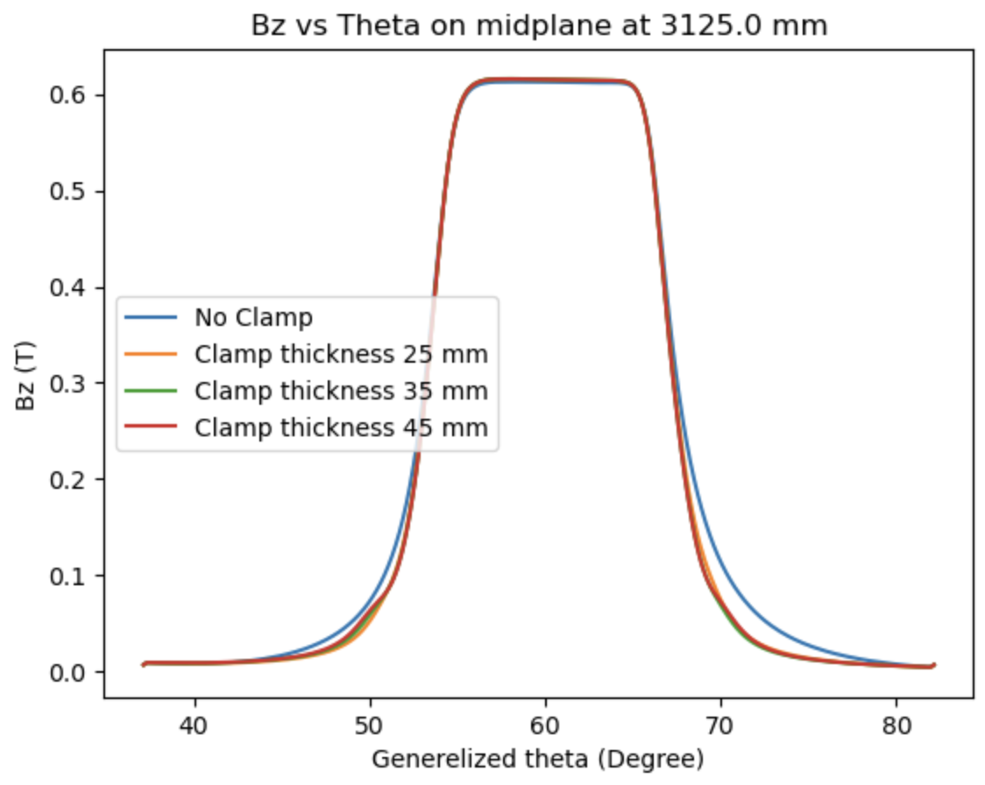
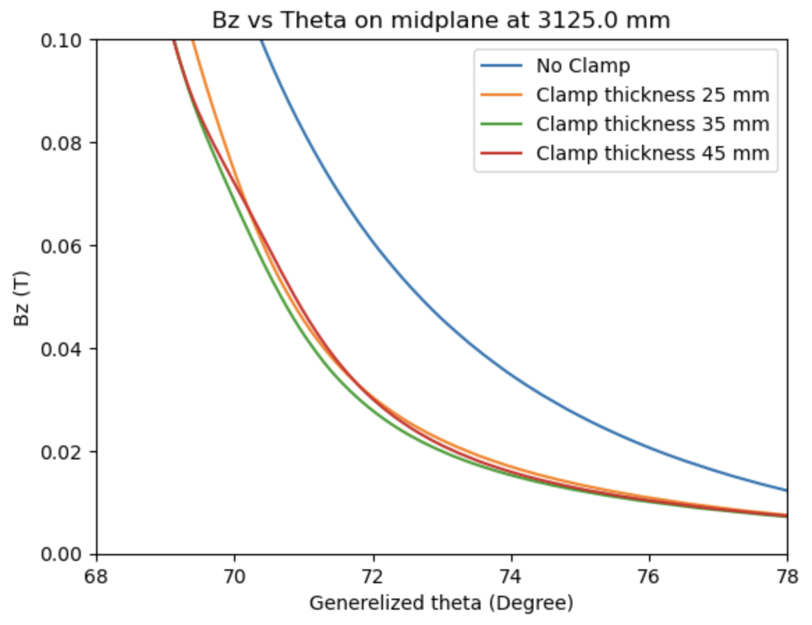
Bz vs theta
Keeping clamp gap height at 48 mm
Varying thickness of the clamps

Slide 11
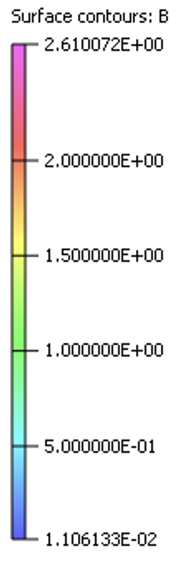
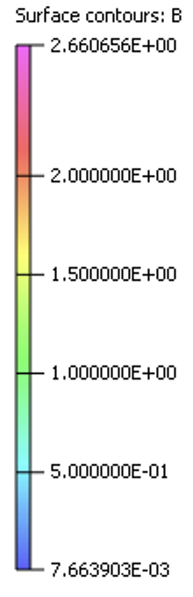
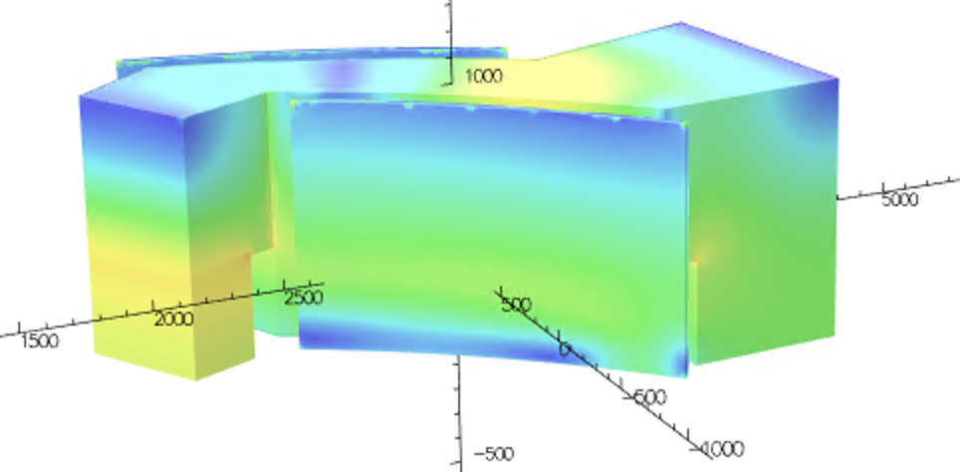
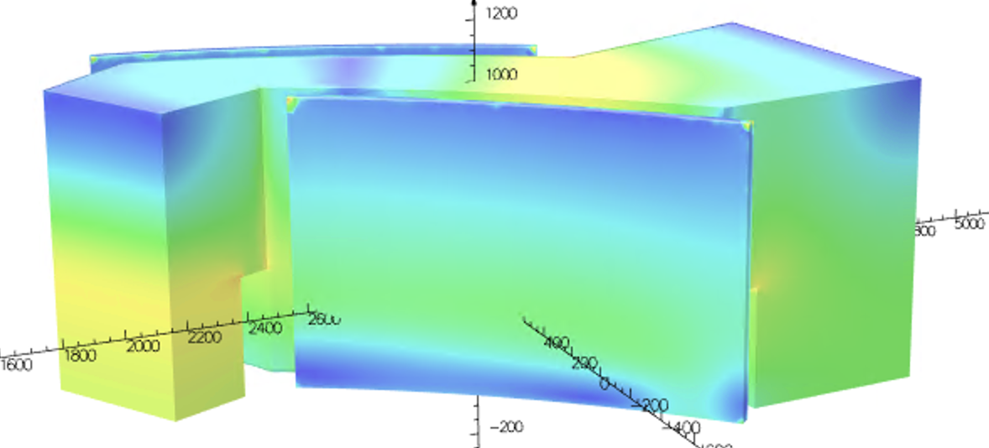
Saturation in clamp with increasing thickness
Clamp thickness 35mm
Clamp thickness 45mm

Slide 12

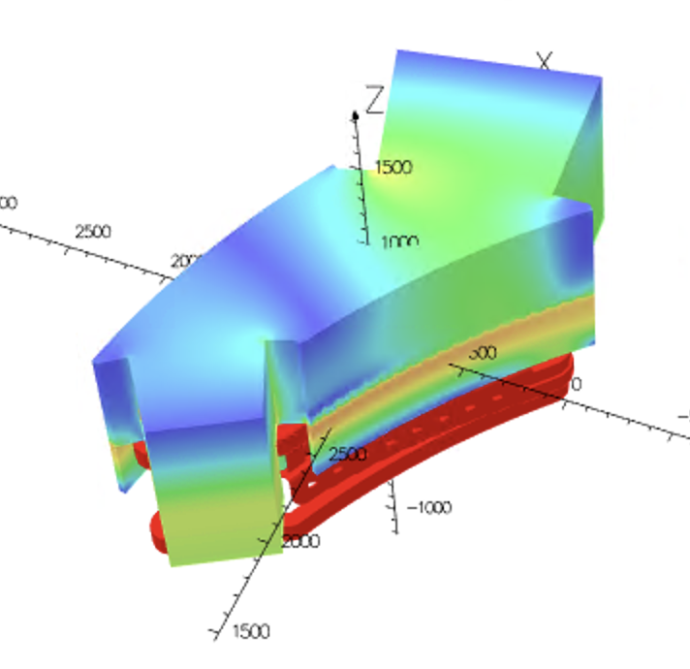
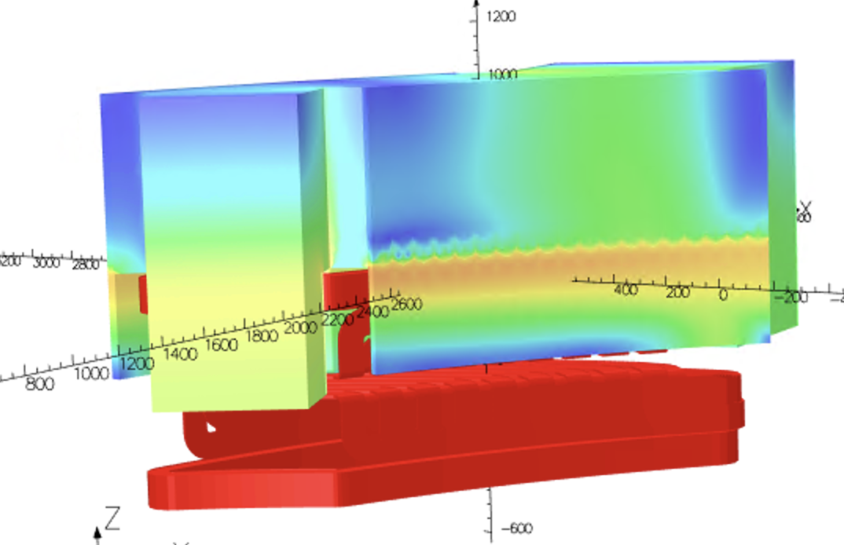
Connecting the clamps with yoke

Slide 13
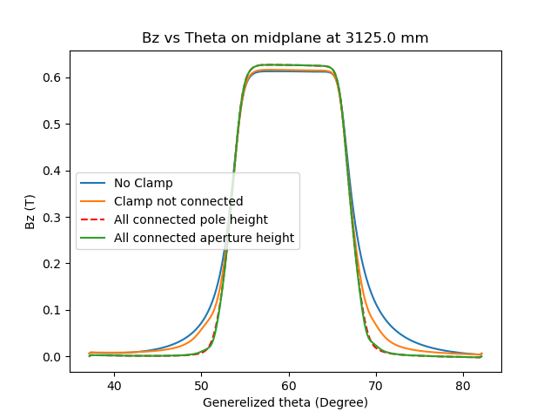
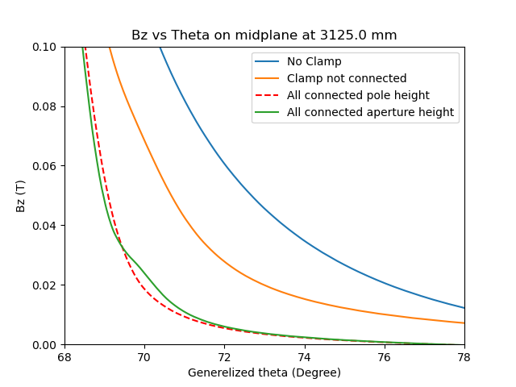
Bz vs theta
Keeping clamp gap height at 48 mm
Thickness of clamp 35 mm

Slide 14
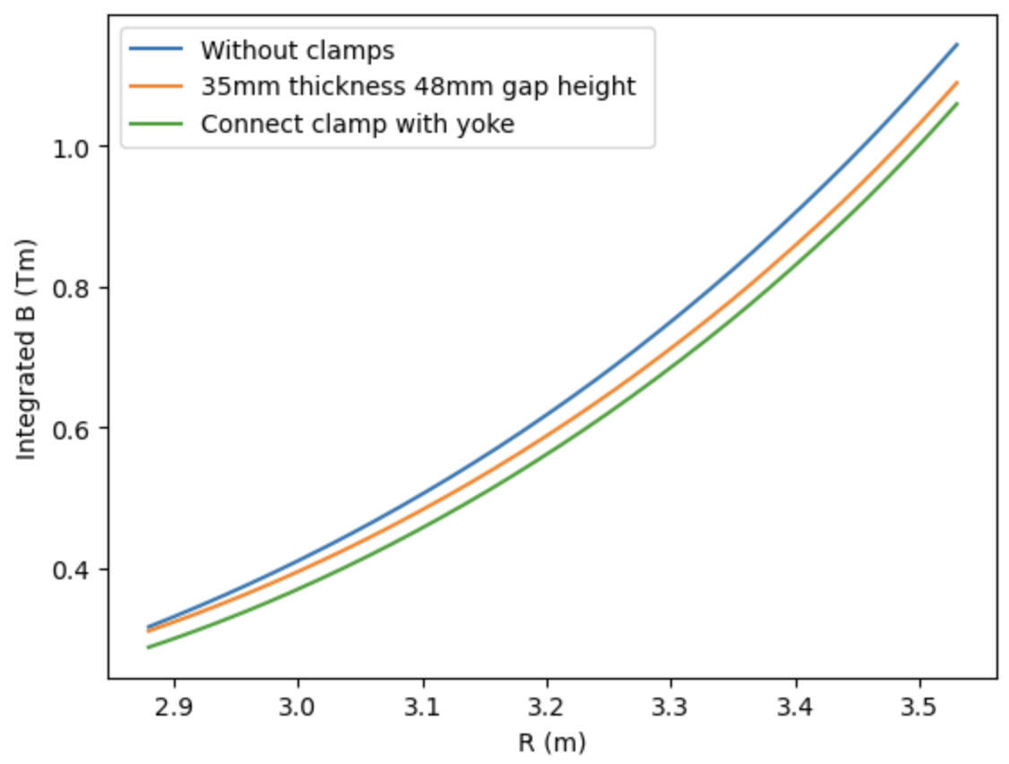
With the same current settings, how does the integrated field change

Slide 15
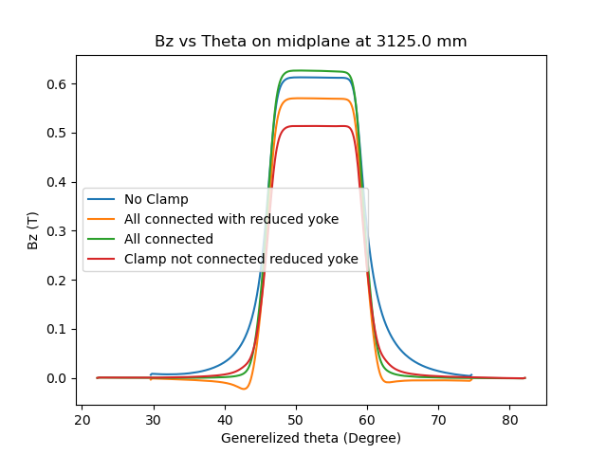
Bz vs theta
Reducing the thickness of return yokes
Inner yoke 200mm, Outer yoke 400mm, Yoke height 400mm

Slide 16
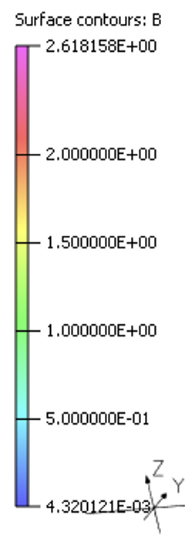
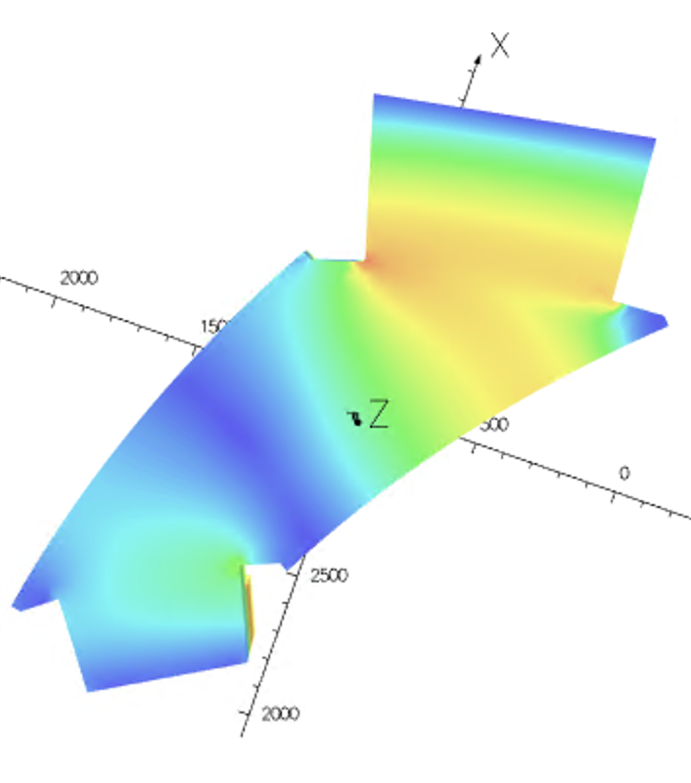
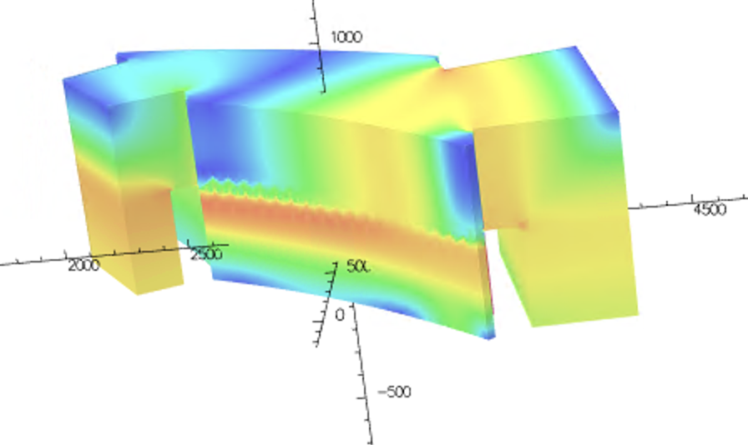
Saturation level
Reduced Yoke

Slide 17
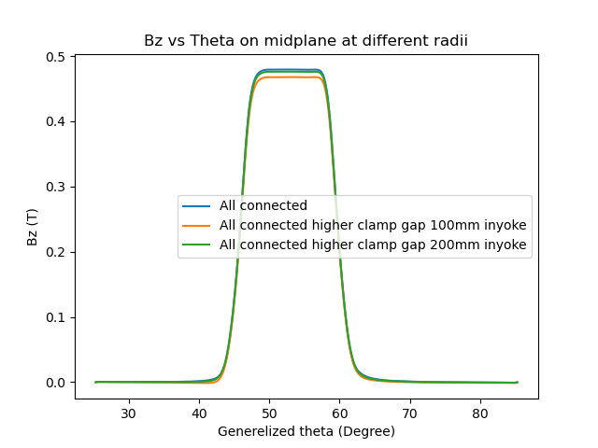
Bz vs theta
Only reducing the thickness of inner yoke
Outer yoke 600mm, Yoke height 600mm

Slide 18
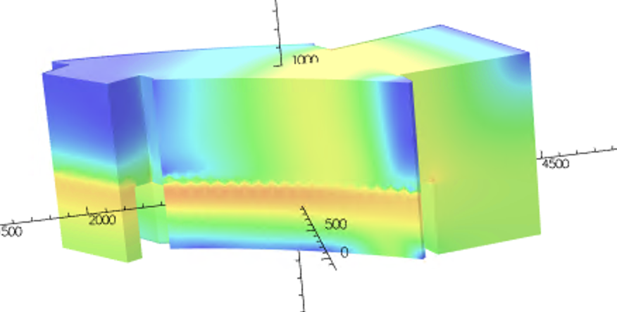
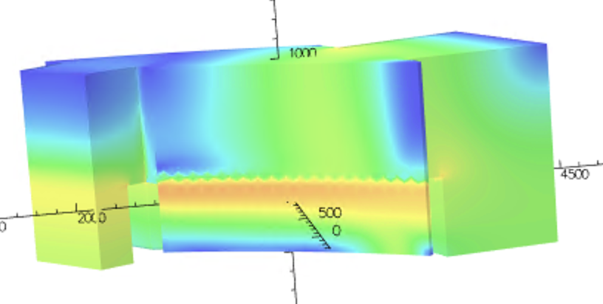
Saturation level
Reduced Yoke
100mm inner yoke
200mm inner yoke

Slide 19
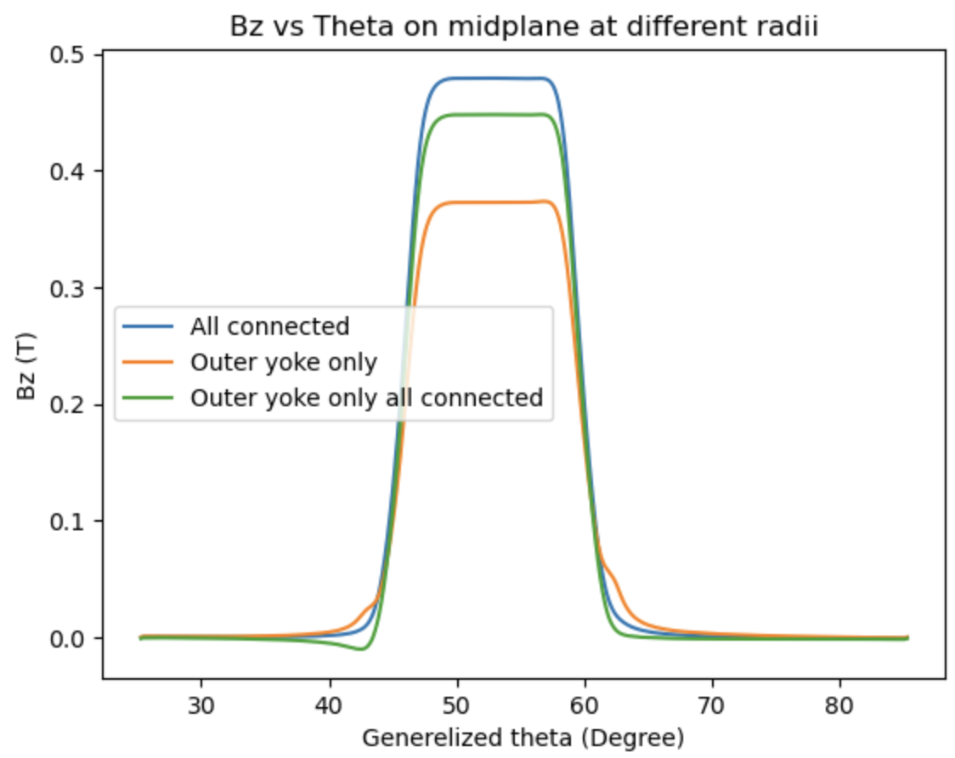
Bz vs theta
Do we need an inner yoke?
Outer yoke 600mm, Yoke height 600mm

Slide 20
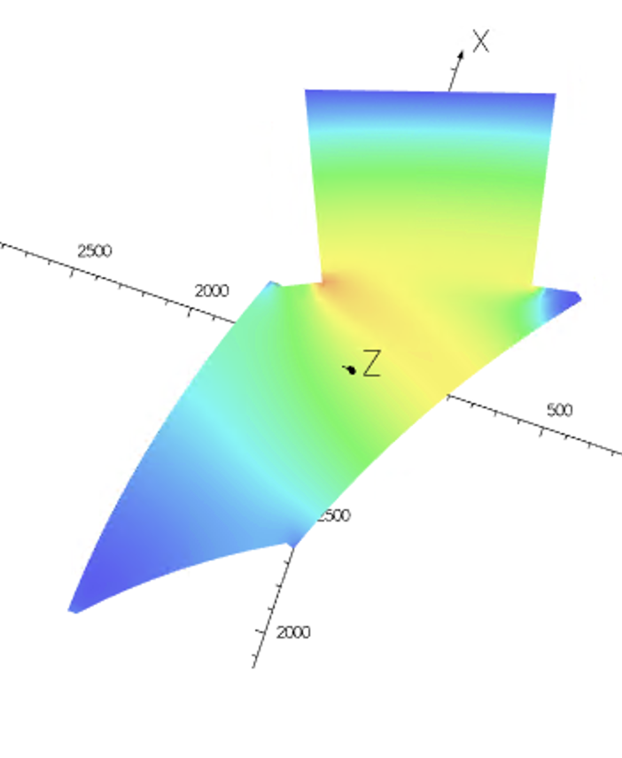
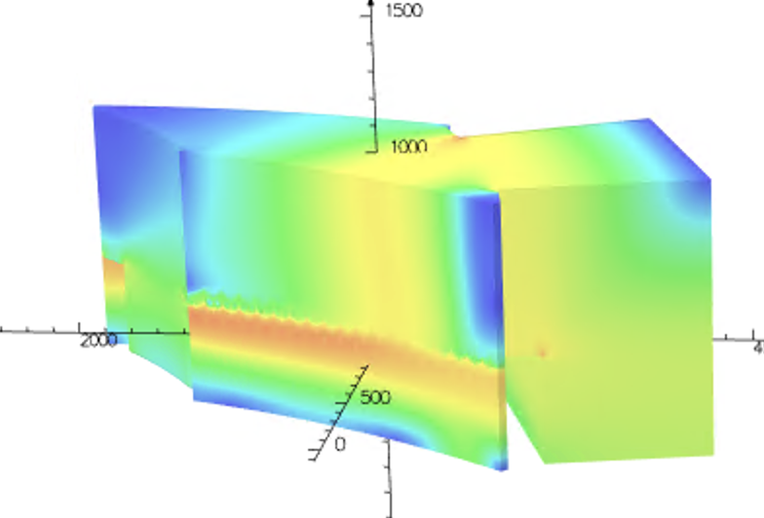
Saturation level
Reduced Yoke

