Slide 1
FFA Magnets 3D
12/11/24
Ta-Jen Kuo
Supervisor: Jaroslaw Pasternak, Jean-Baptiste Lagrange
Imperial College London, STFC

Slide 2
LhARA singlet

Slide 3
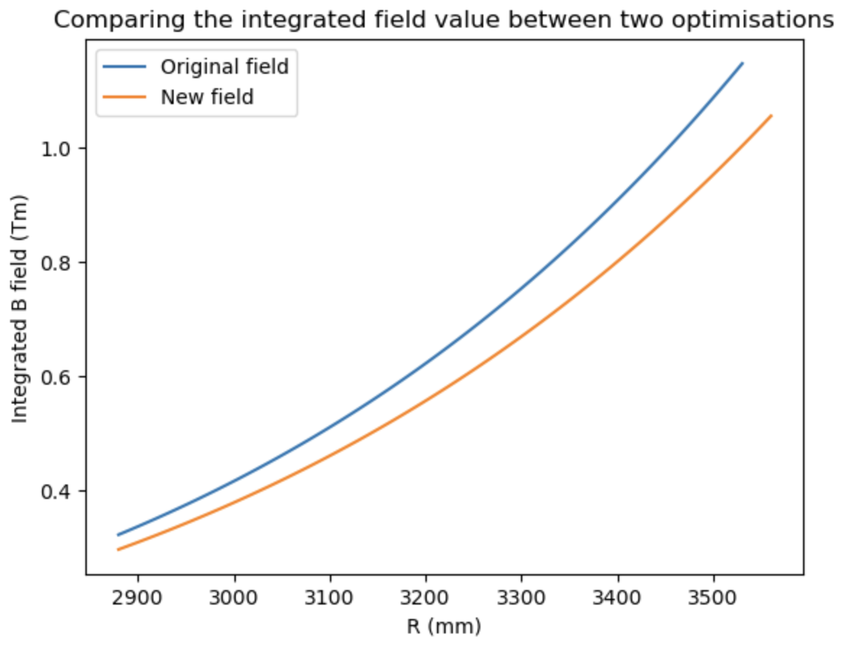
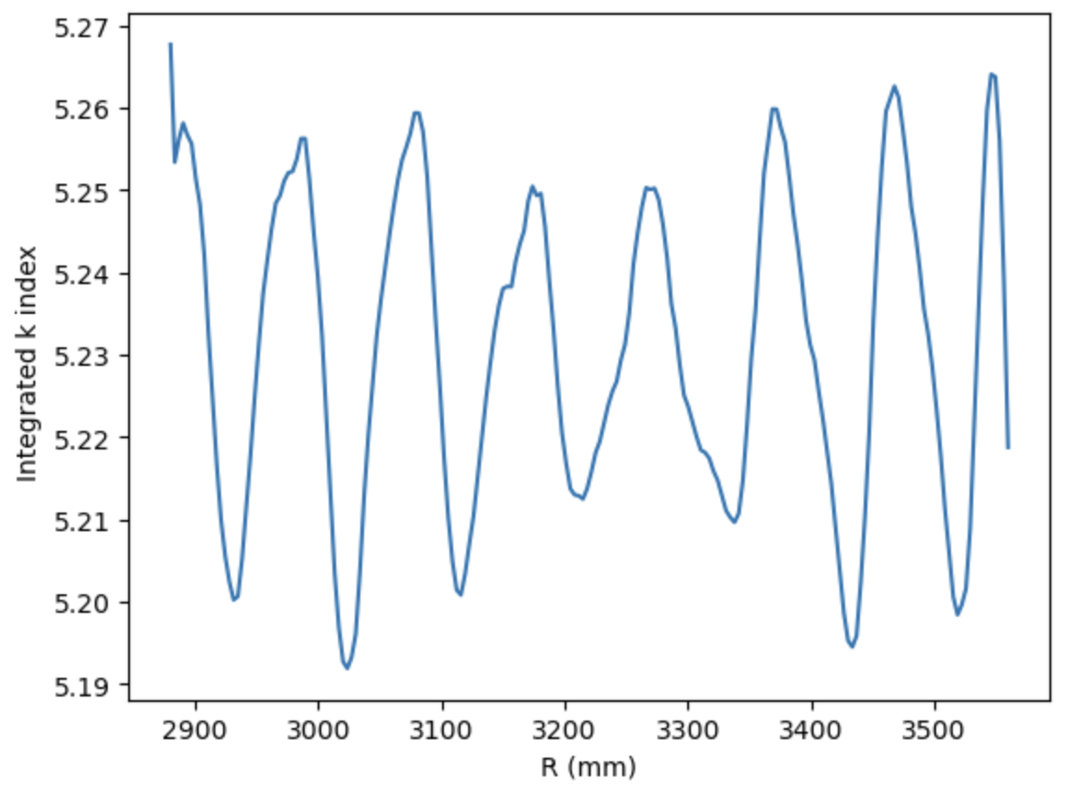
Previously the field in LhARA only contained closed orbits for 17-127 MeV beam.
Scaled the field down, slightly larger GFR and reoptimized.

Slide 4
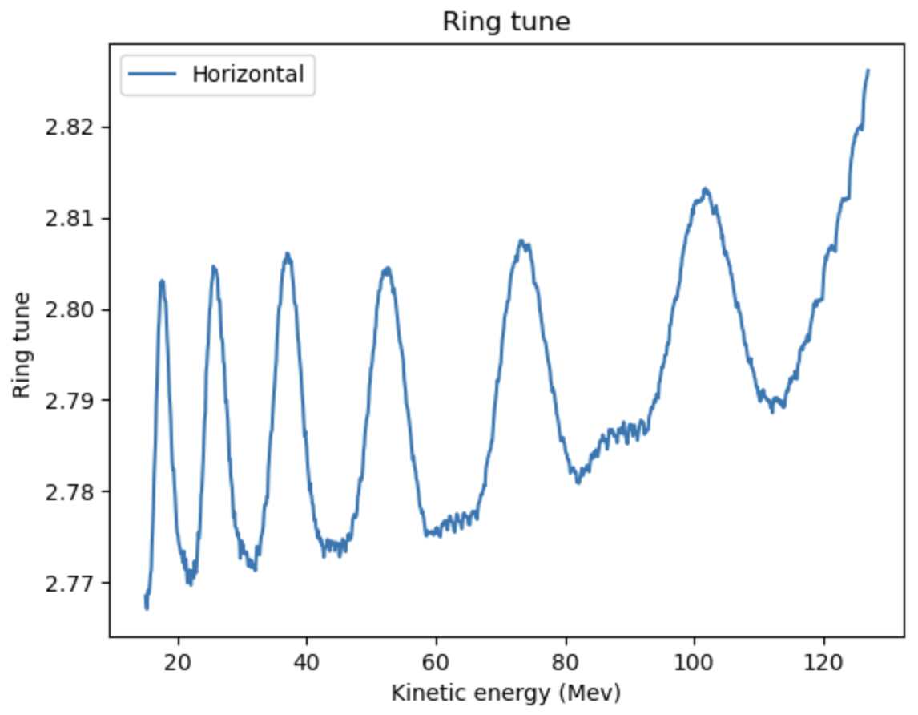
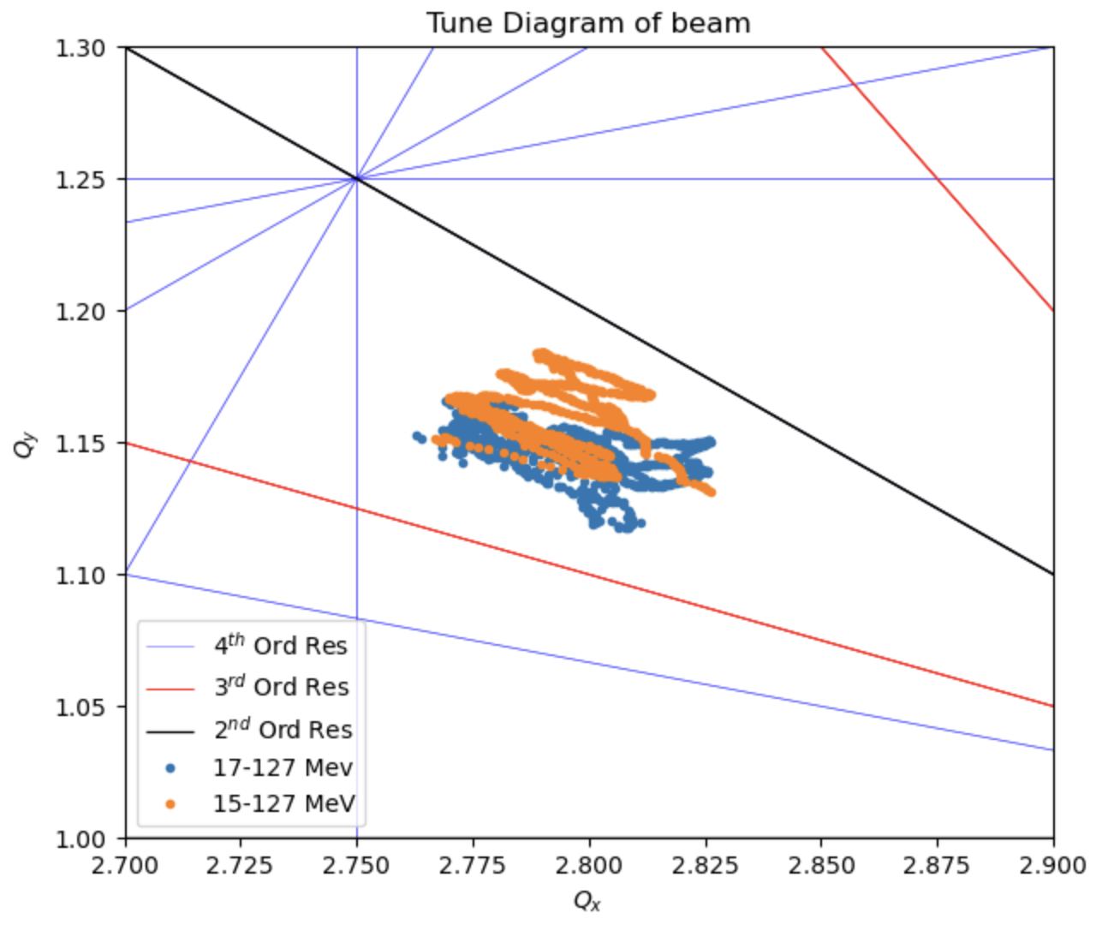
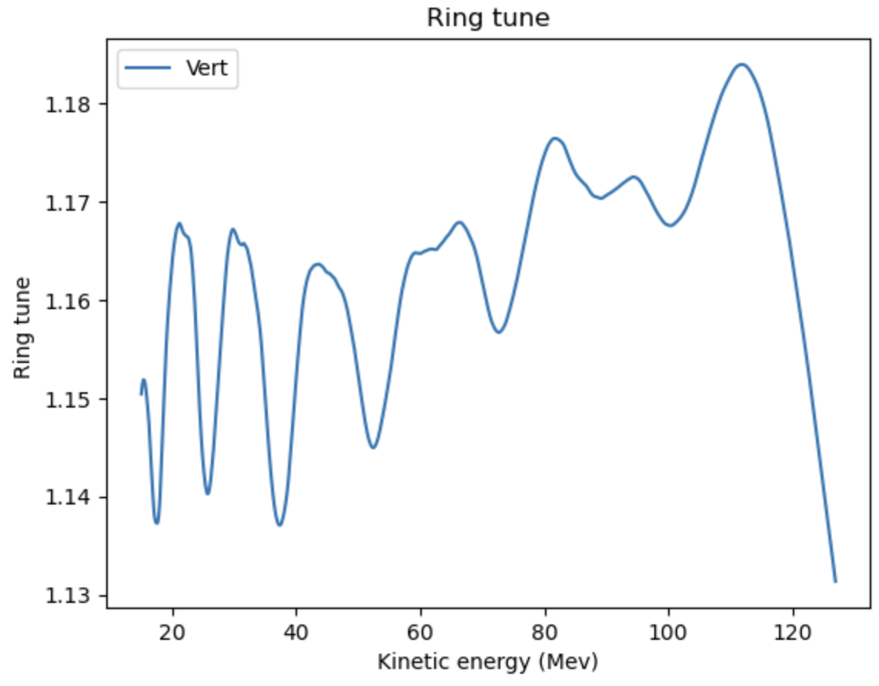
Vertical tune variation smaller in 17-127 MeV
As I shaped the clamps accordingly (Yet to carry
Out for 15-127 MeV case)

Slide 5
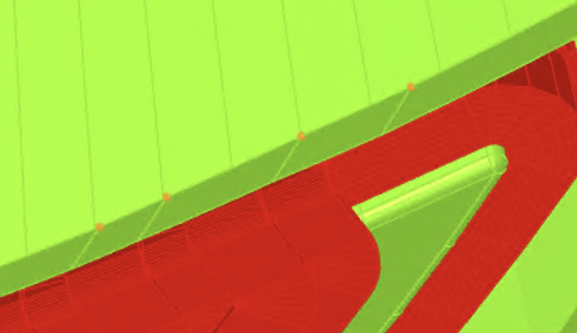
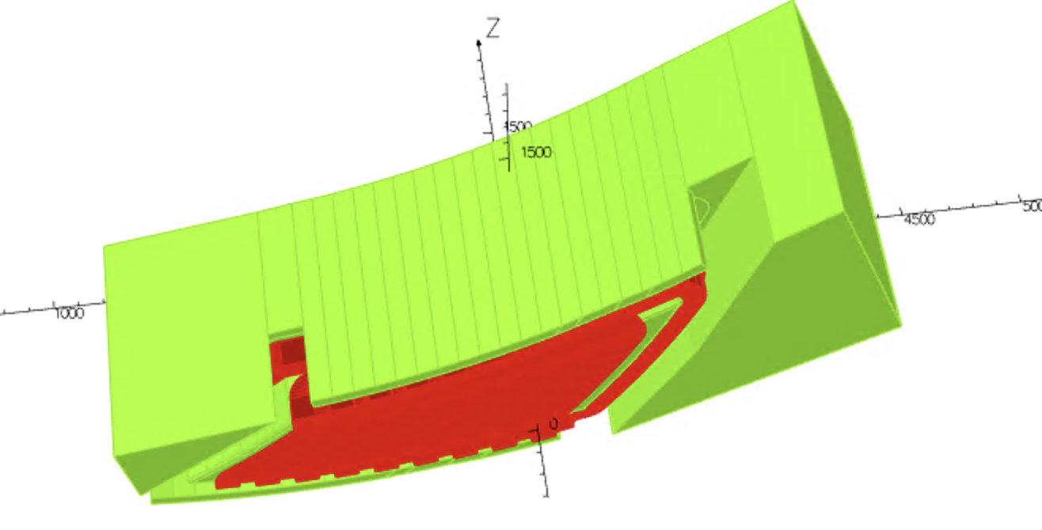
Clamp height varies
Between 52mm to 56.5 mm off the midplane
Stays at 52 mm off the midplane everywhere
else

Slide 6
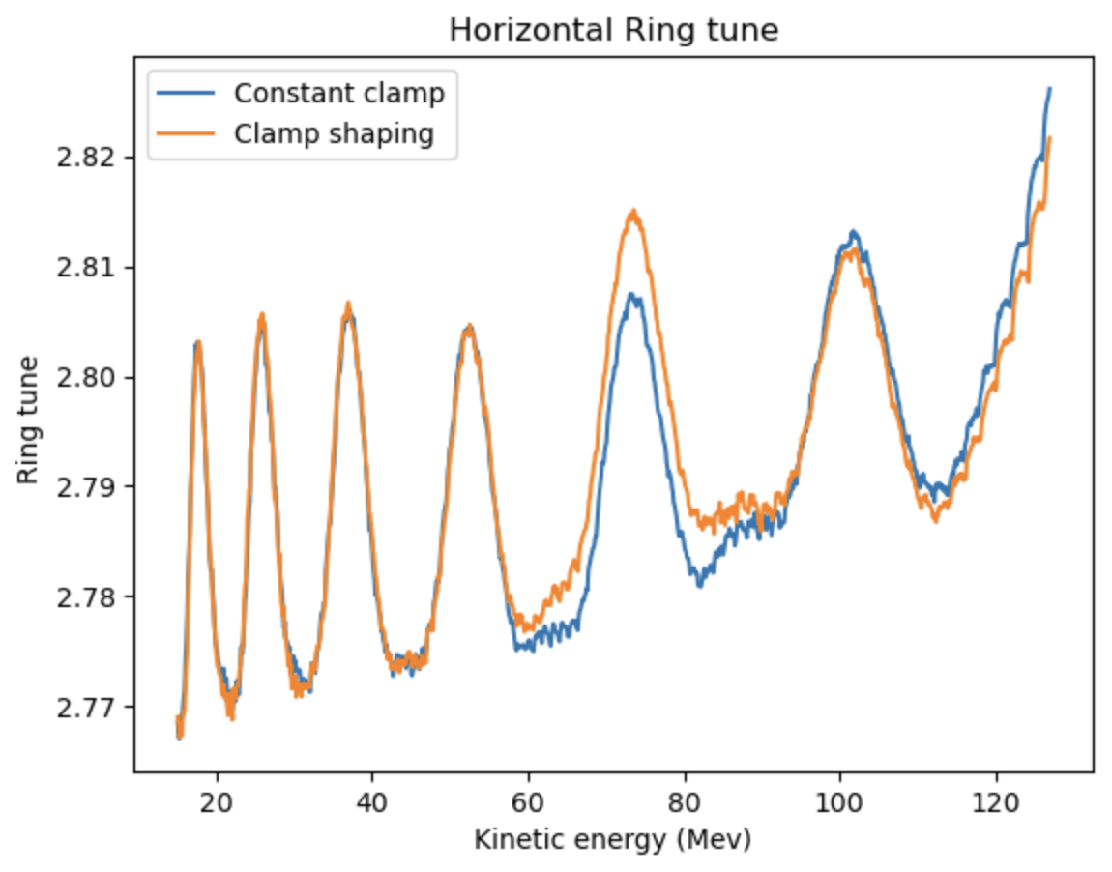
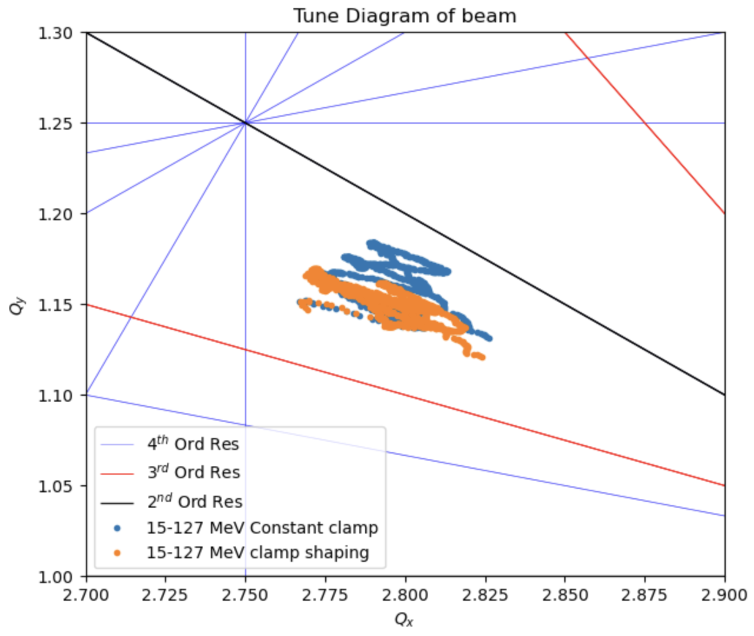
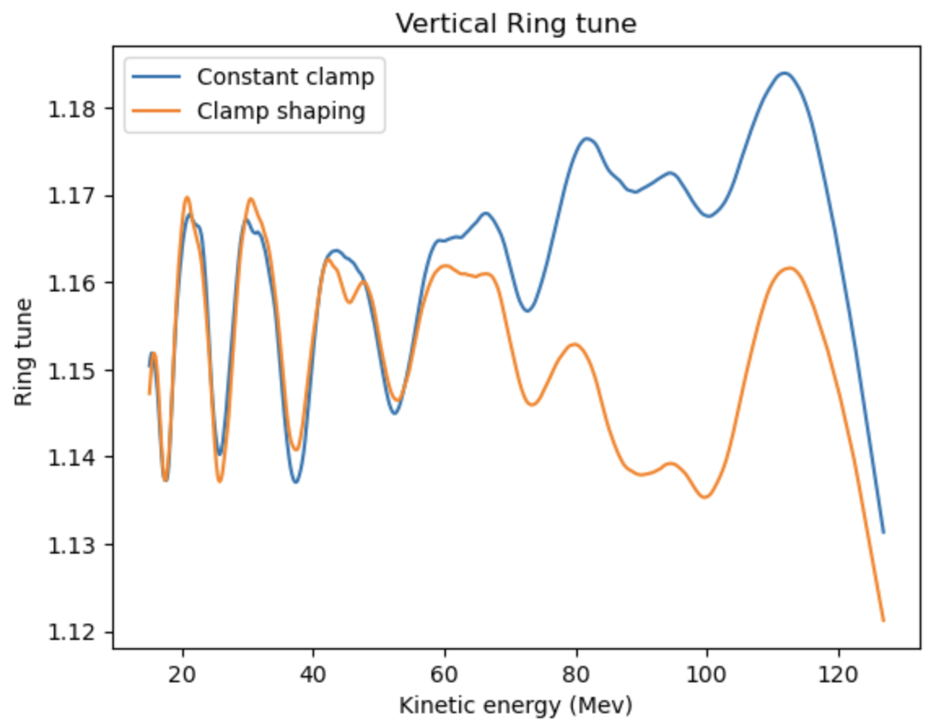
Ring tune after clamp shaping. Will carry out a similar study for lower energy
range to see if the tunes are similar

Slide 7
Trim |  |  |  | Main
Coil width | 0.01 | m |  | Coil width | 0.075 | m
Coil height | 0.0925 | m |  | Coil height | 0.117 | m
Coil area | 0.000648 | m^2 |  | Coil area | 0.006143 | m^2
Cu Resistivity | 1.68E-08 | Ohm.m |  | Cu Resistivity | 1.68E-08 | Ohm.m
Trimcoil | Length (m) | Current (AT) |  | Resistance (Ohm) |  | Power (W)
0 | 4.812 | 15013.86 |  | 1.32E-05 |  | 2.97E+03
1 | 2.37 | 5302.91 |  | 6.14E-05 |  | 1.73E+03
2 | 2.61 | 3923.03 |  | 6.77E-05 |  | 1.04E+03
3 | 2.85 | 3252.98 |  | 7.39E-05 |  | 7.82E+02
4 | 3.09 | 2733.86 |  | 8.02E-05 |  | 6.00E+02
5 | 3.33 | 2331.47 |  | 8.65E-05 |  | 4.70E+02
6 | 3.58 | 2004.73 |  | 9.28E-05 |  | 3.73E+02
7 | 3.82 | 1740.58 |  | 9.90E-05 |  | 3.00E+02
8 | 4.06 | 1515.34 |  | 1.05E-04 |  | 2.42E+02
9 | 4.30 | 1335.54 |  | 1.12E-04 |  | 1.99E+02
10 | 2.77 | 5302.91 |  | 7.20E-05 |  | 2.02E+03
11 | 3.02 | 3923.03 |  | 7.82E-05 |  | 1.20E+03
12 | 3.26 | 3252.98 |  | 8.45E-05 |  | 8.94E+02
13 | 3.50 | 2733.86 |  | 9.08E-05 |  | 6.78E+02
14 | 3.73 | 2331.47 |  | 9.69E-05 |  | 5.27E+02
15 | 3.98 | 2004.73 |  | 1.03E-04 |  | 4.15E+02
16 | 4.22 | 1740.58 |  | 1.10E-04 |  | 3.32E+02
17 | 4.46 | 1515.34 |  | 1.16E-04 |  | 2.66E+02
18 | 4.70 | 1335.54 |  | 1.22E-04 |  | 2.18E+02
 |  |  |  |  |  | Total Power (W)
 |  |  |  |  |  | 1.53E+04
New power estimate:
15.3 kw x 2 x 10
= 306 kW magnet power
for the whole ring
Comparing to 432 kw previously

