Slide 1



Injection Line Update
William Shields
(william.shields@rhul.ac.uk)
WP6 Weekly Meeting
28th January 2025

Slide 2

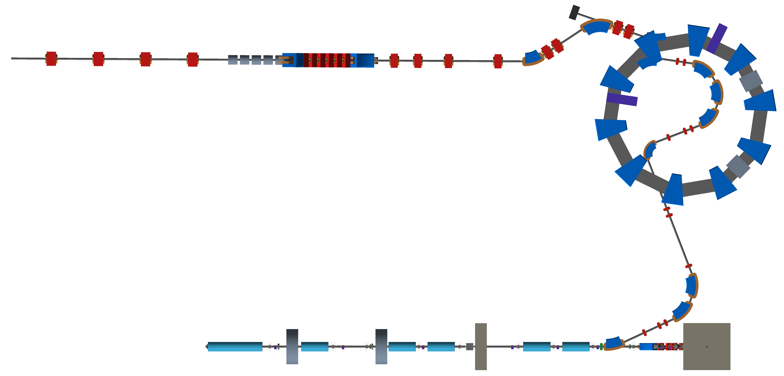
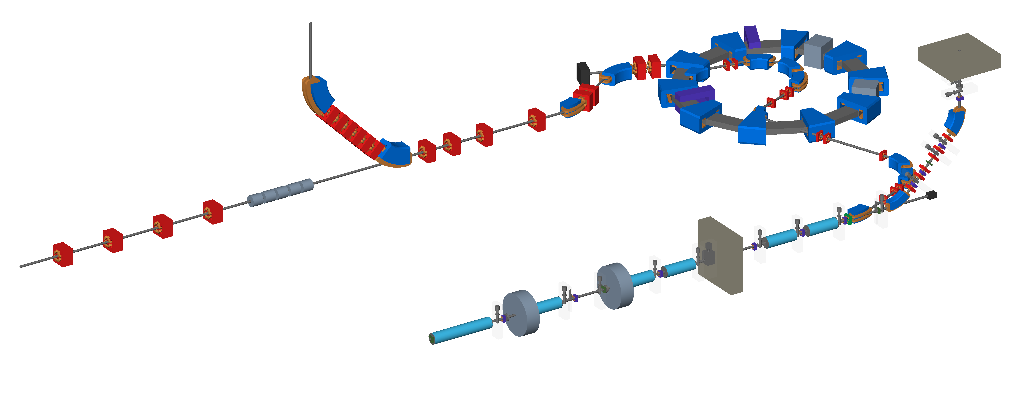
Layout & Engineering
New injection line converted to BDSIM
Updated magnet geometry needed from Ta-Jen
  New spiral angle
BDSIM model to be updated from CAD
  Magnet + RF
Angled shielding wall to be added.
Next iteration to add shutter, PMs, vacuum valves, etc.

Slide 3
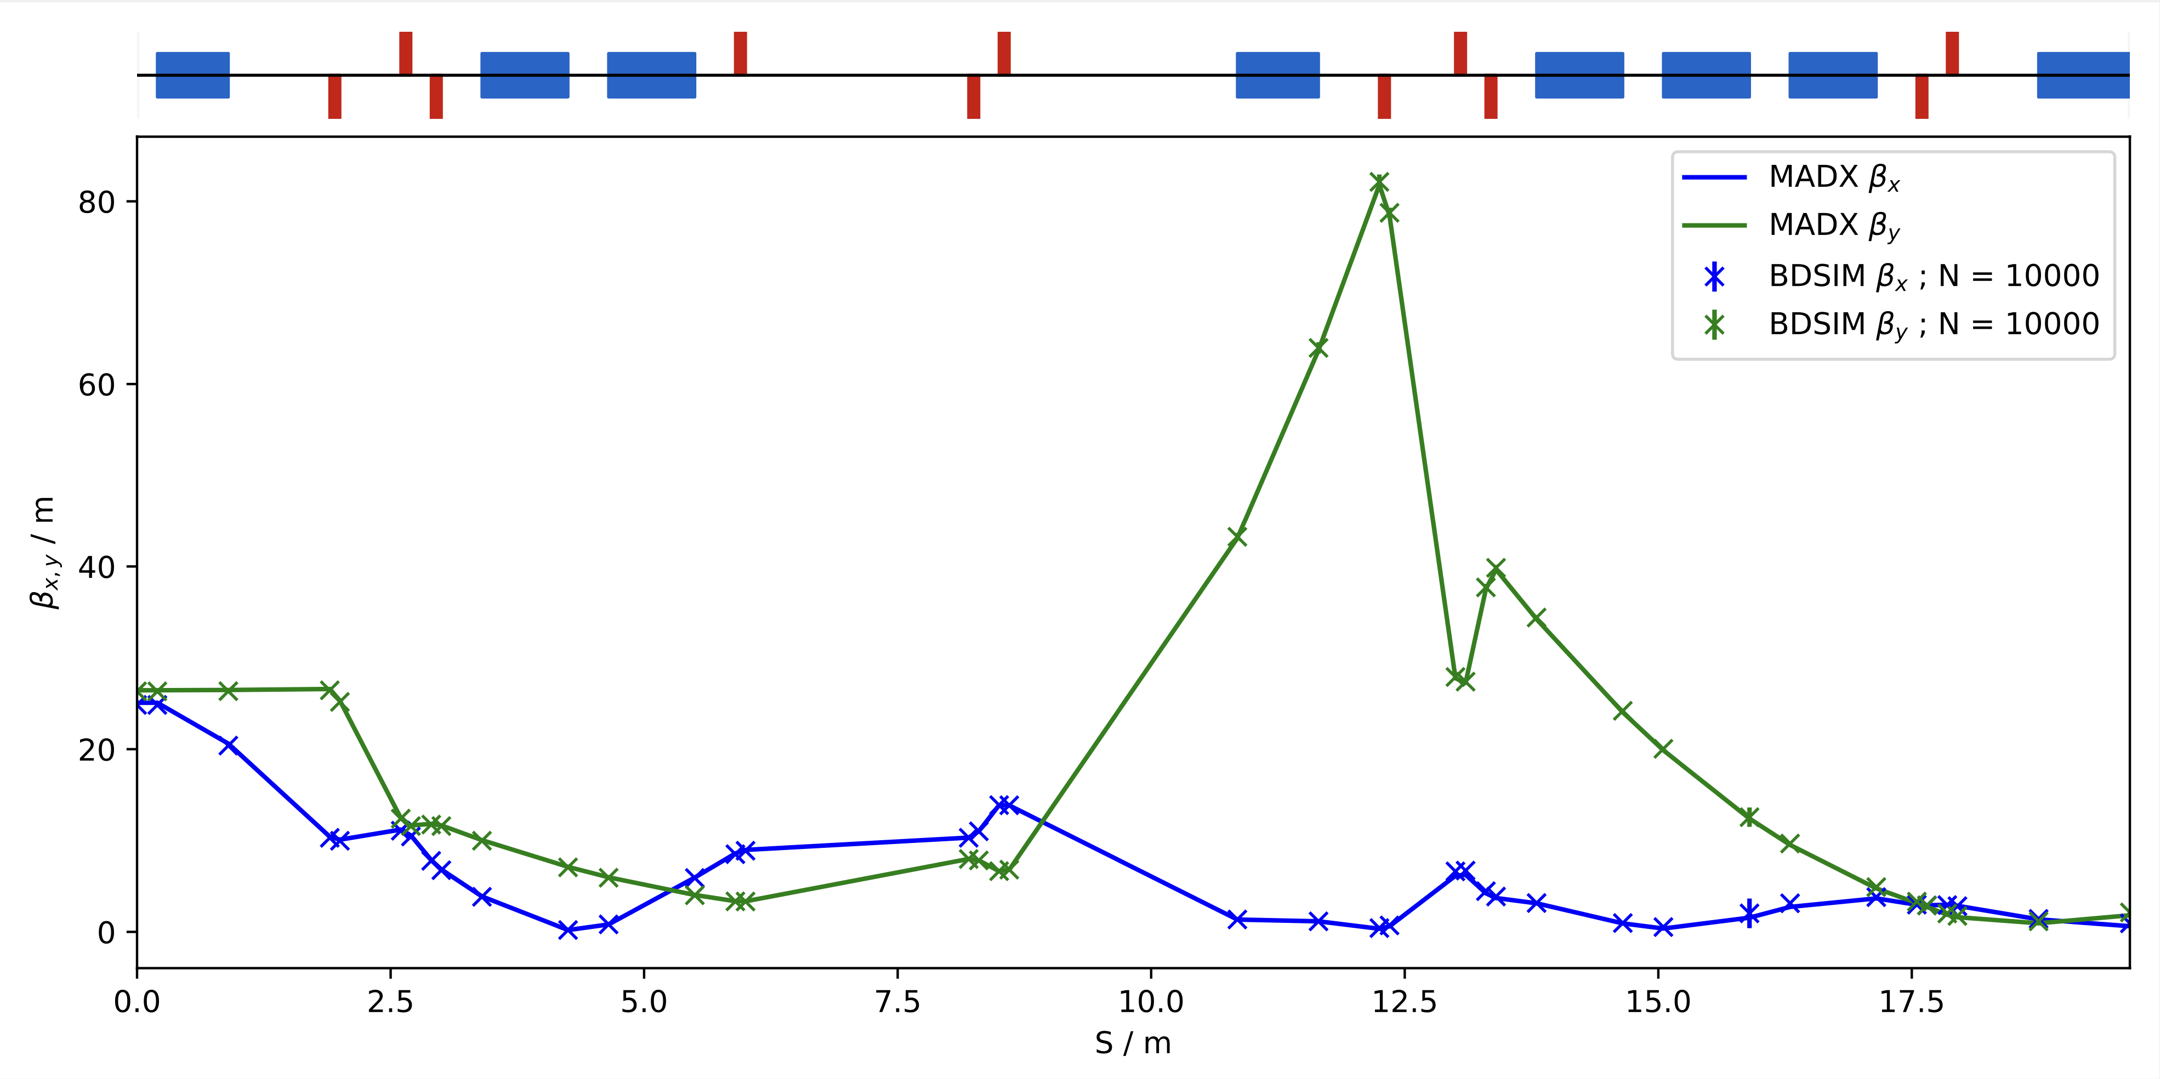
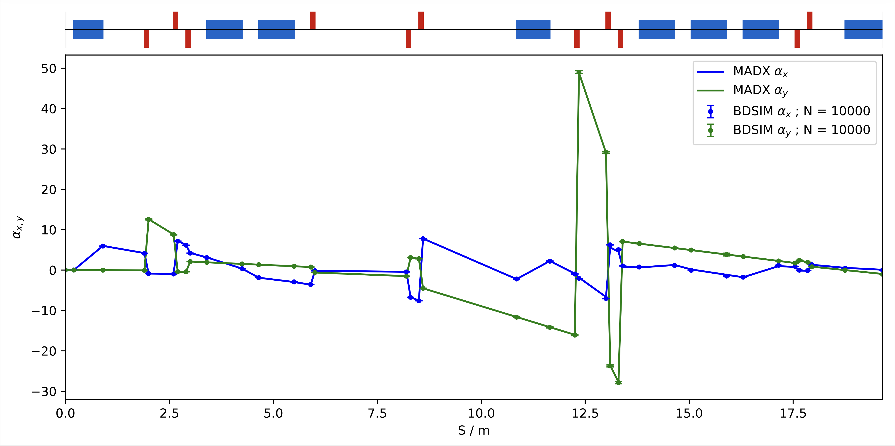
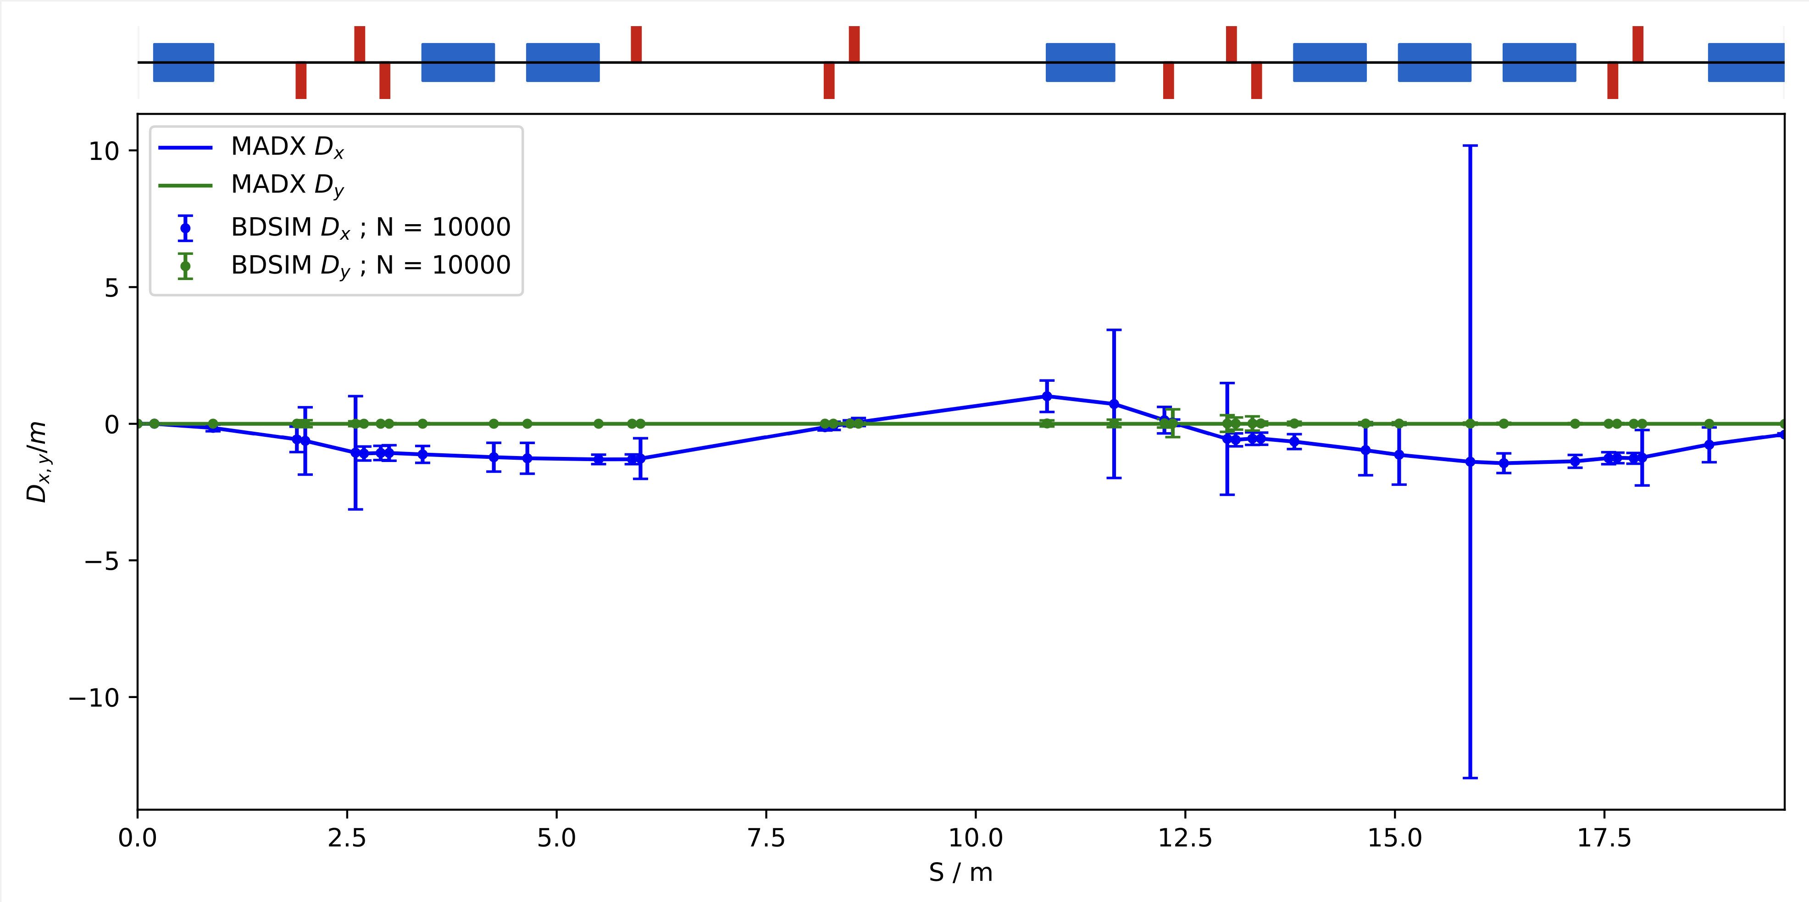
Optics Performance
Beam at the injection magnet exit:
ε_{x} : 4.12e-06
ε_{y} : 4.08e-06
⍺_{x} : -0.00082
⍺_{y} : -1.03171
β_{x} : 0.934
β_{y} : 2.129
D_{x} : -0.400
D_{y} : -0.003
Good MADX & BDSIM model agreement.
GPT model still in development.

Slide 4
Aperture & Collimation
Wide aperture needed (8cm minimizes losses)
  Max beam radius (1σ): 2cm
Collimator envisaged at either:
  S~10.5m - close to FFA magnet
  S~4.5m - close to dipoles

