Slide 1
FFA Magnets 3D
24/06/25
Ta-Jen Kuo
Supervisor: Jaroslaw Pasternak, Jean-Baptiste Lagrange
Imperial College London, STFC

Slide 2
Research plan for simulation work
Control the fringe field extent by varying the clamp gap height.
Due to saturation in LhARA FFA, optimize for highest energy case.
2. With the fitted parameters, create field model in 2D and track. Compare tune
results with 3D field map. How well is the fit? How much do I need to vary the
Parameters by to reduce tune spread?
(Wanted to have a formula to better predict tune, first approximation to how much
I need to vary the parameters by)
3. Optimize for fringe field with possible need to reoptimize k.
4. Check dynamic aperture

Slide 3
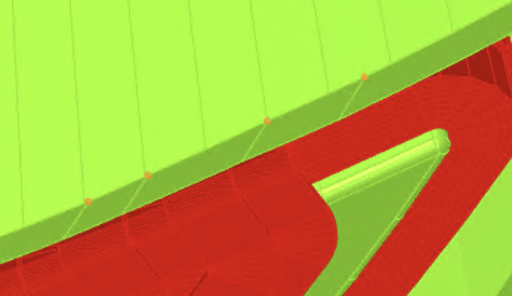
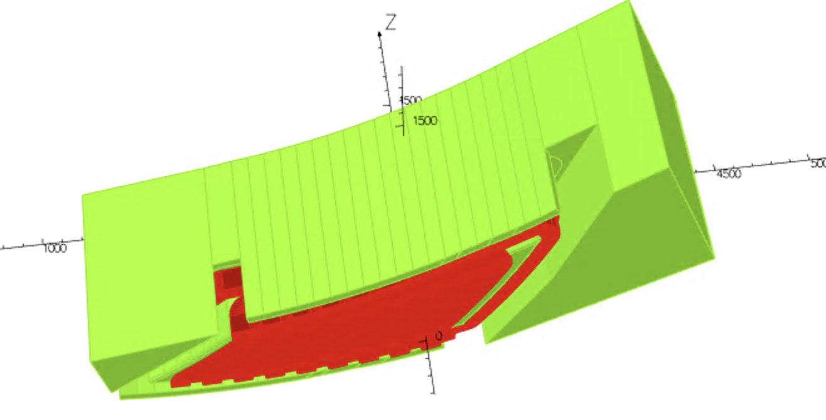
Previously adjusted the vertical tune by
Adjusting the vertical aperture of the clamps
Clamp height varies
Between 52mm to 56.5 mm off the midplane
(Both entrance and exit clamps)

Slide 4
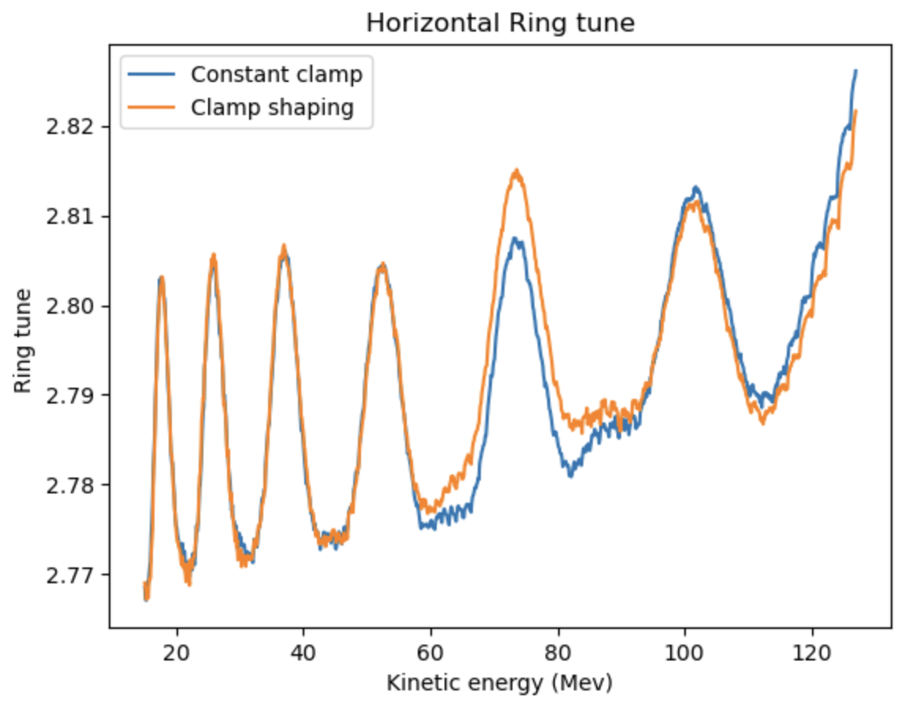
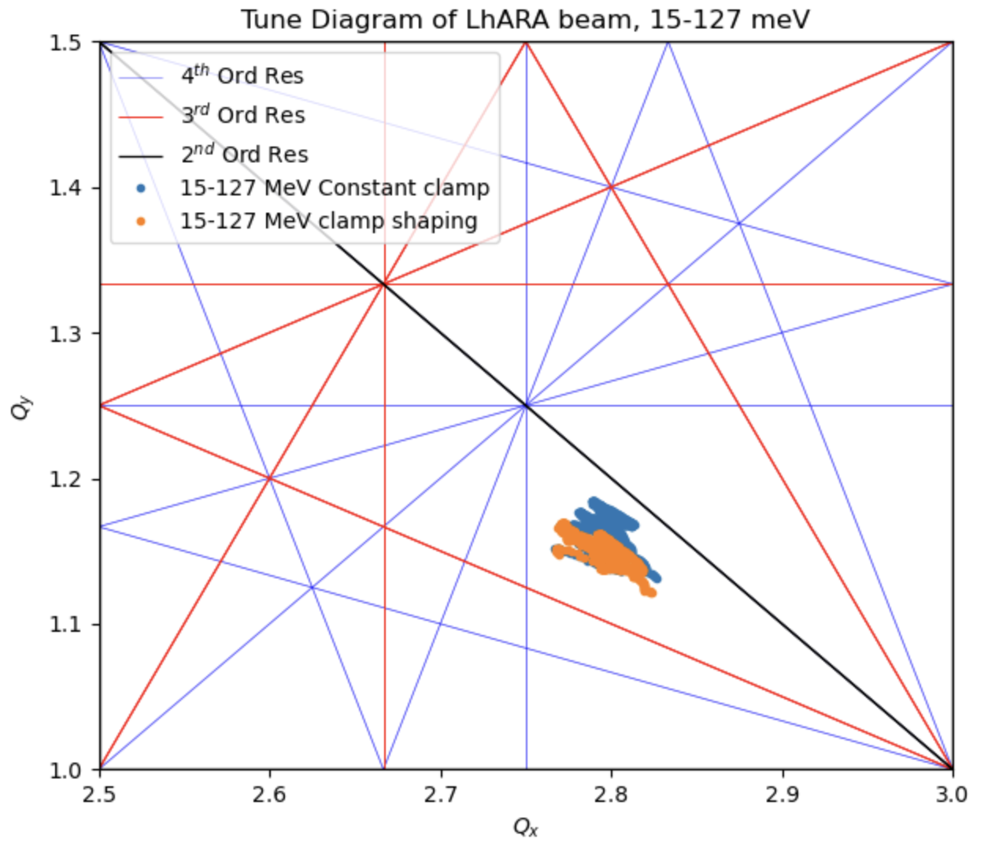
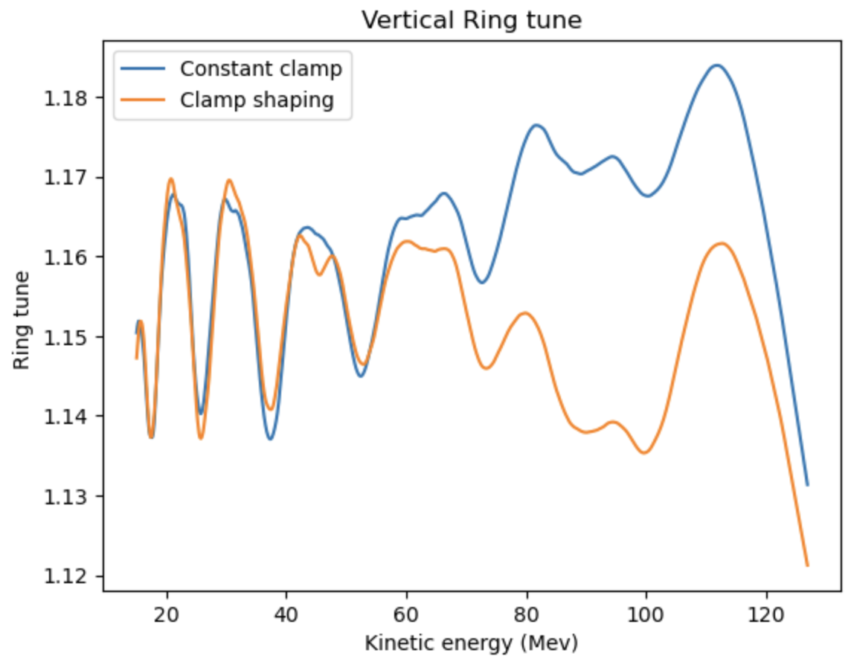
That decreased the vertical tune spread but I wasn’t sure why.
Calculate spiral angles and C1 coefficients to see how they vary

Slide 5
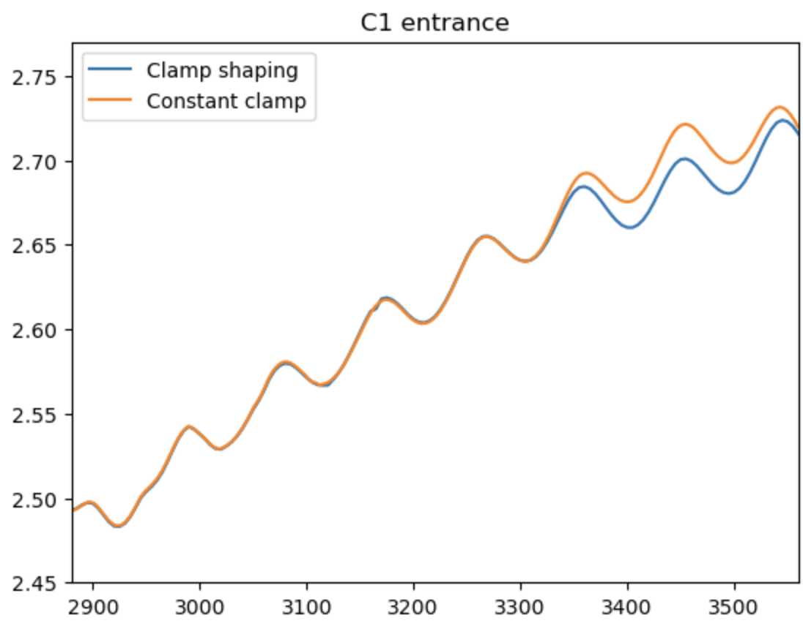
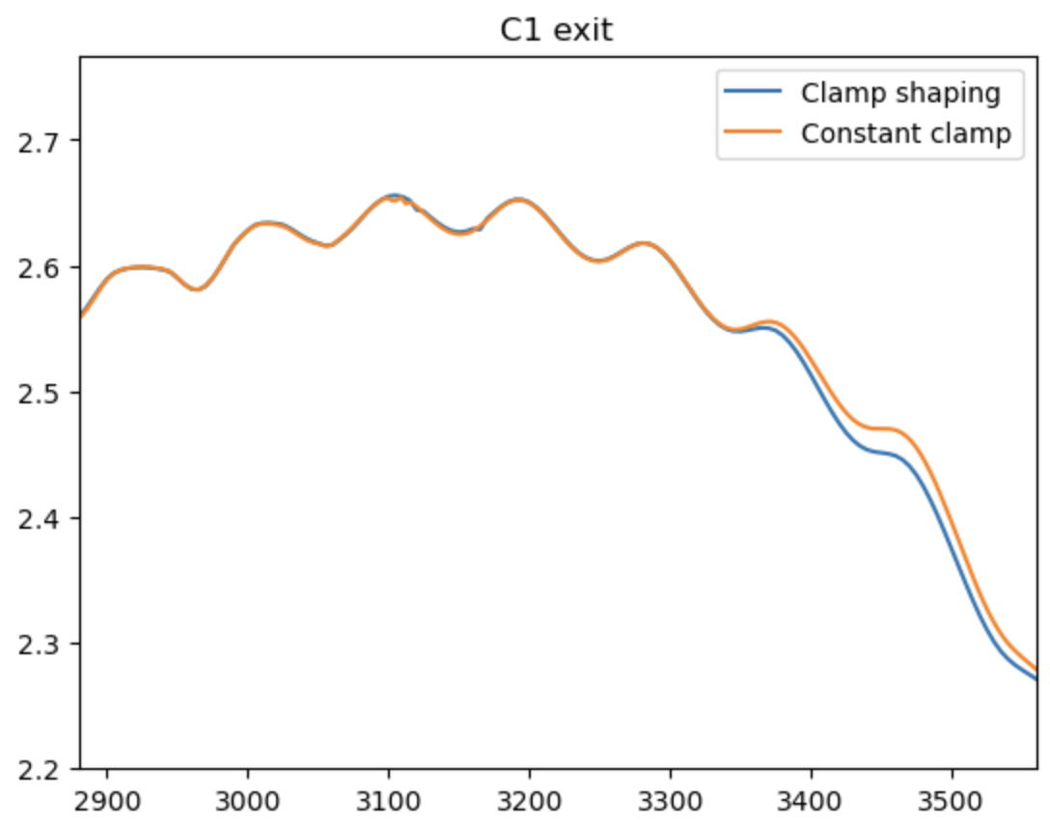
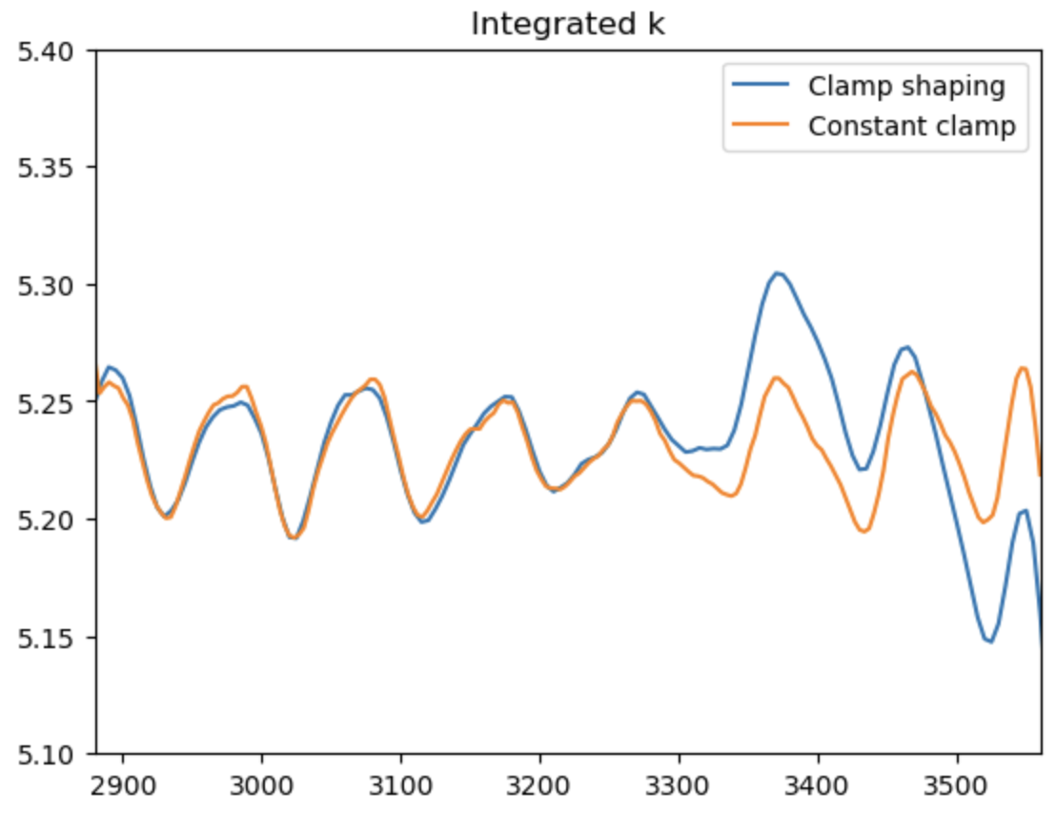
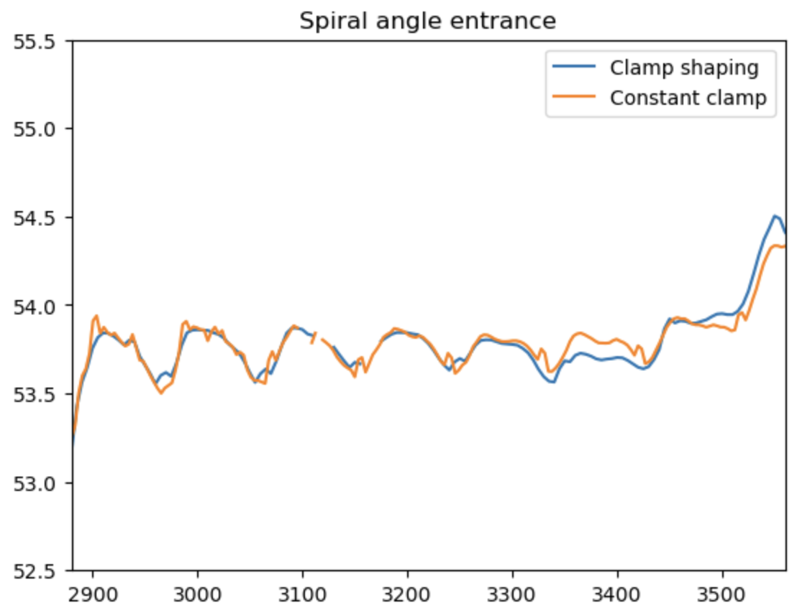
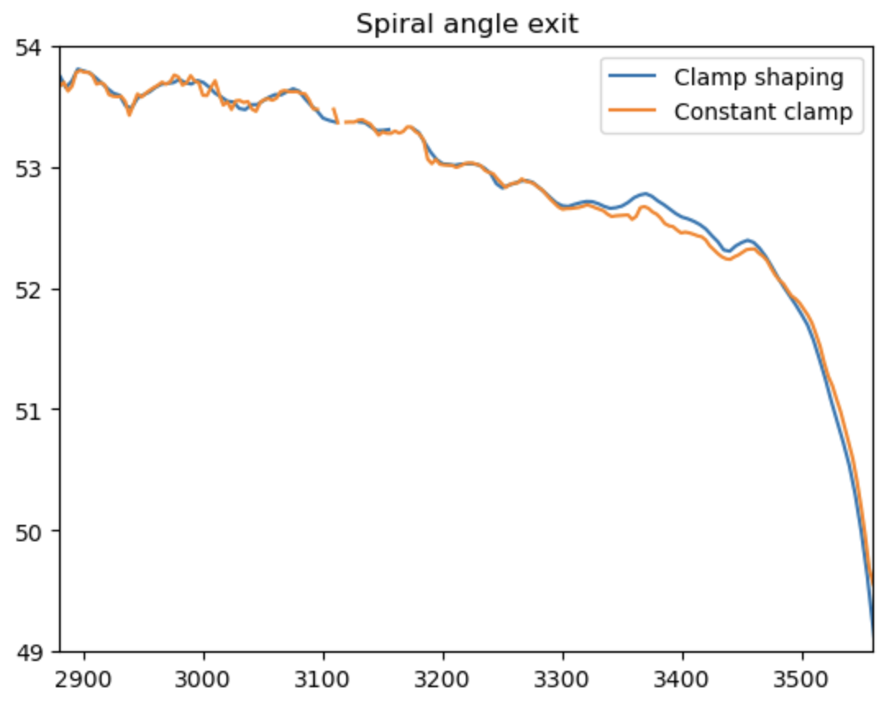
Think I got lucky that this certain combination of parameters
Resulted in smaller tune spread

Slide 6
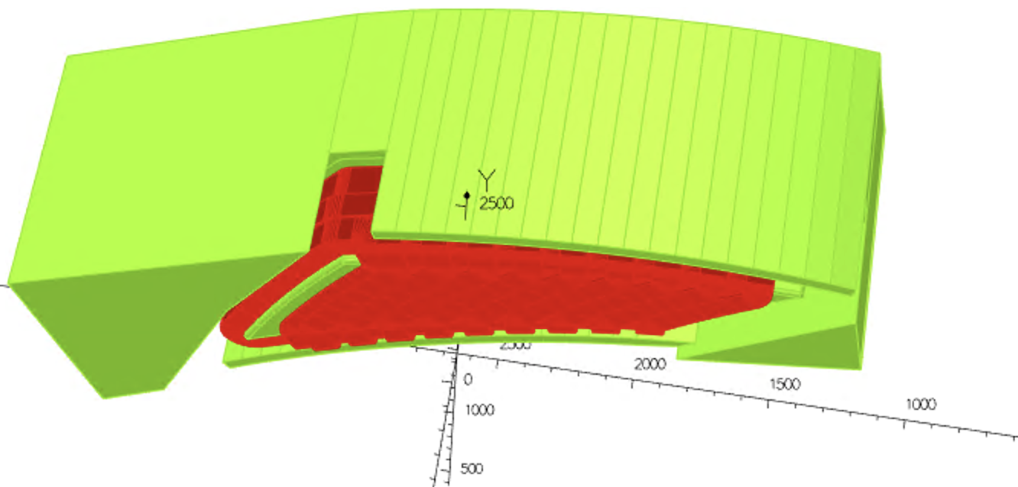
Instead I would like to vary the clamp gap height in a way that it changes
The fringe field extend. Keep current setting the same and vary clamp gap height:
Constant clamp gap:
52 mm off the midplane
Linear clamp gap:
En clamp height varies
From 35 mm to 71 mm off the midplane

Slide 7
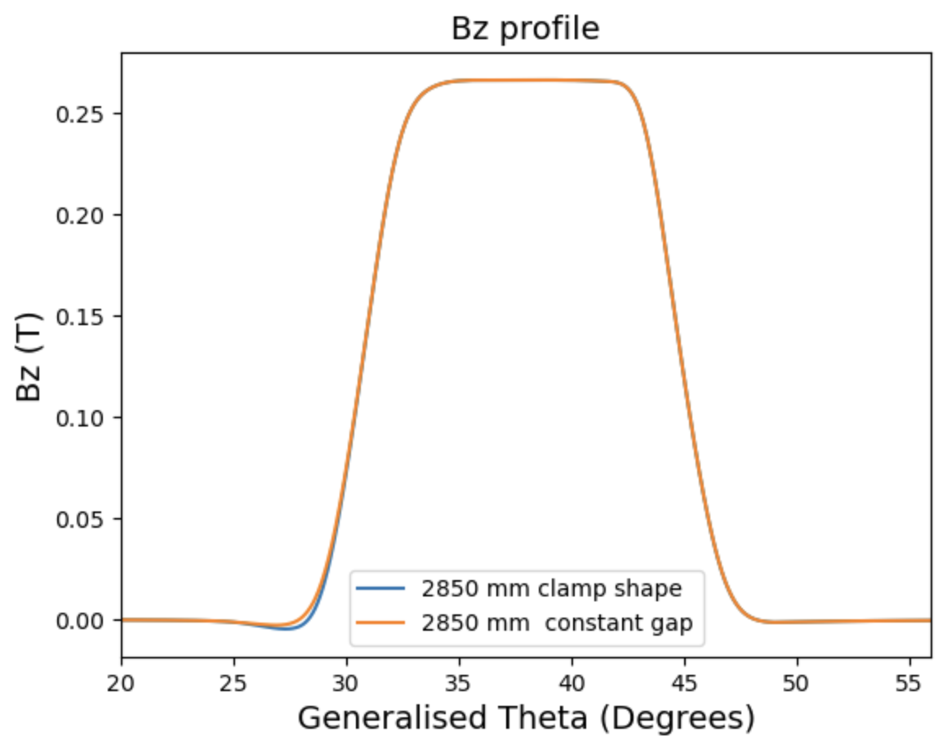
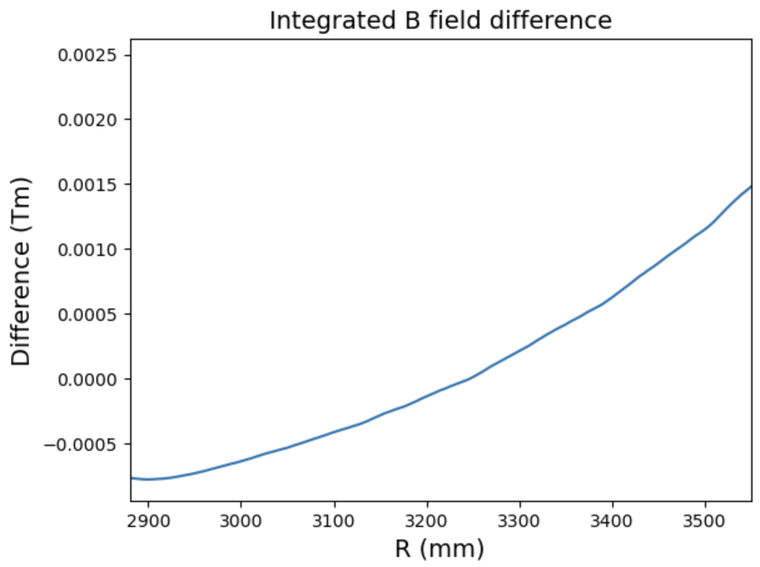
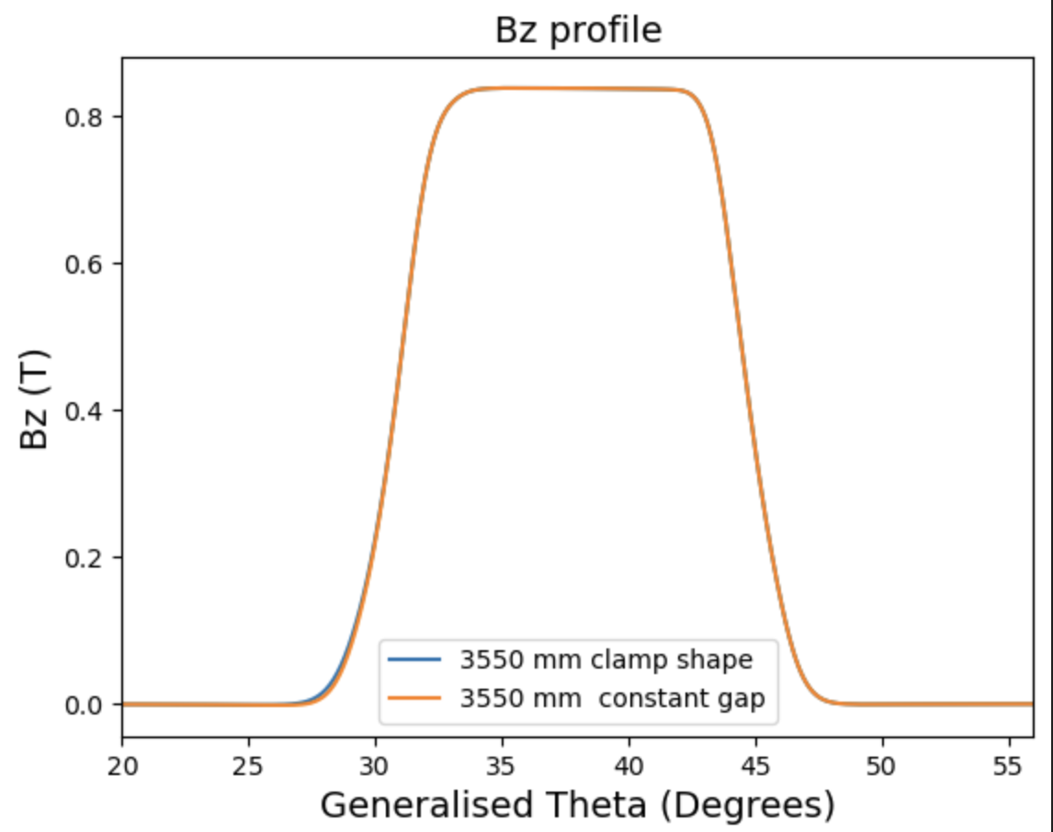
Adjusting the vertical aperture of the clamps, same current setting in both

Slide 8
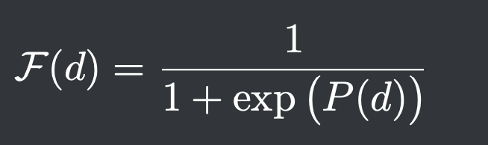
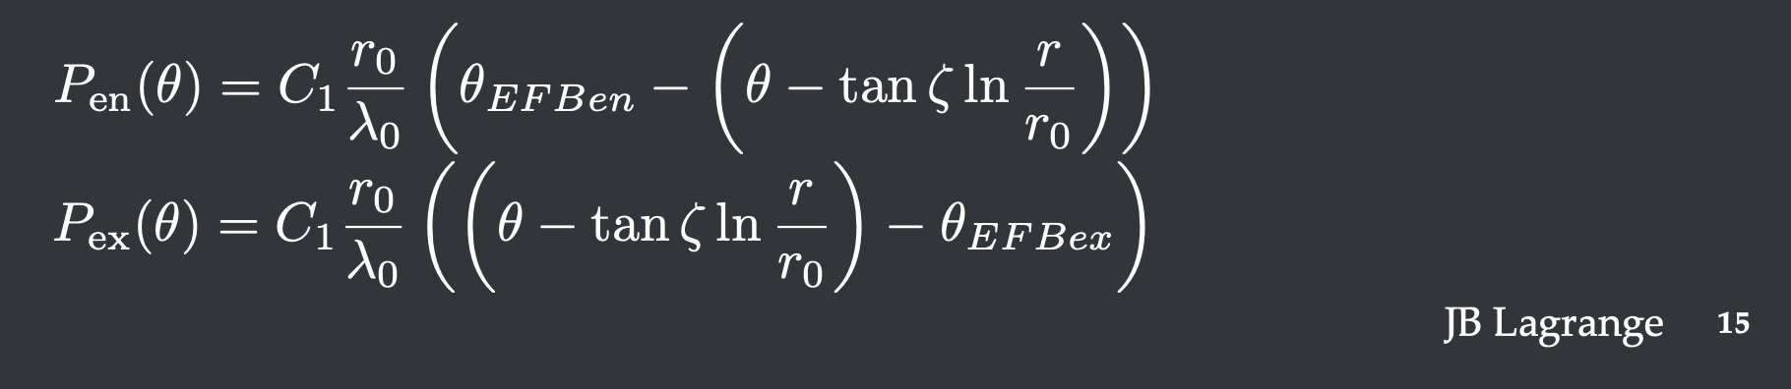
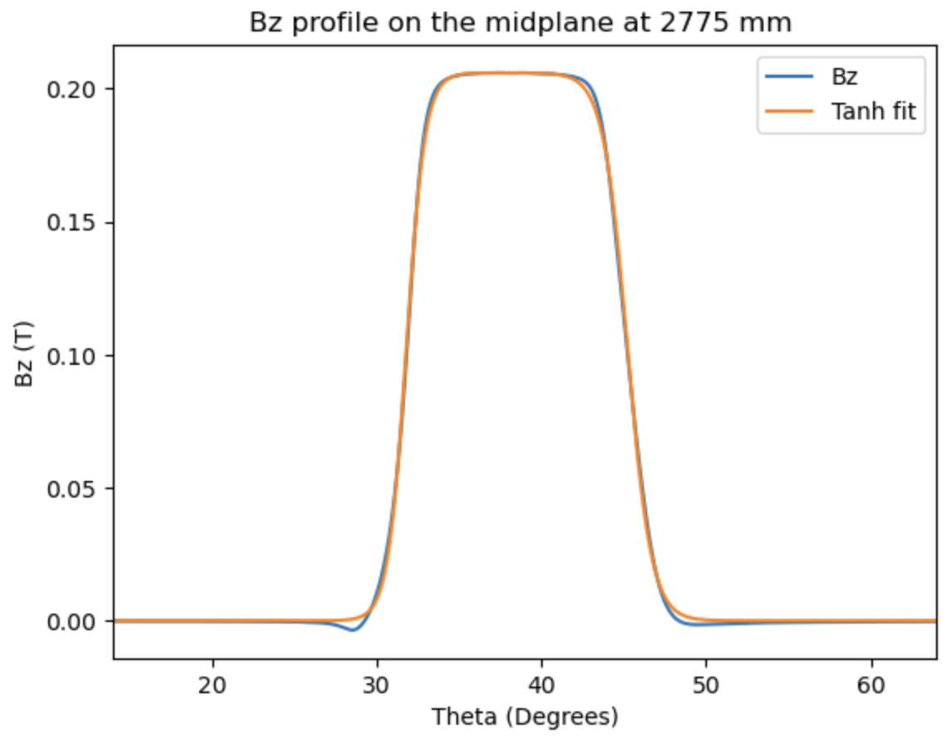
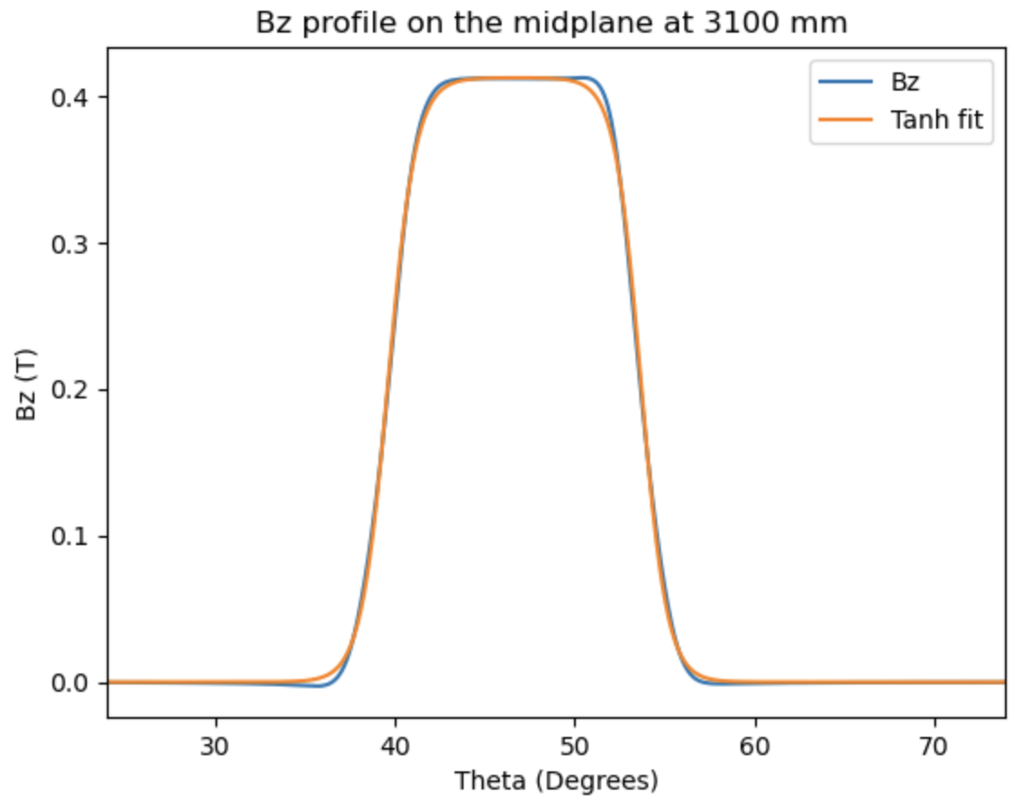
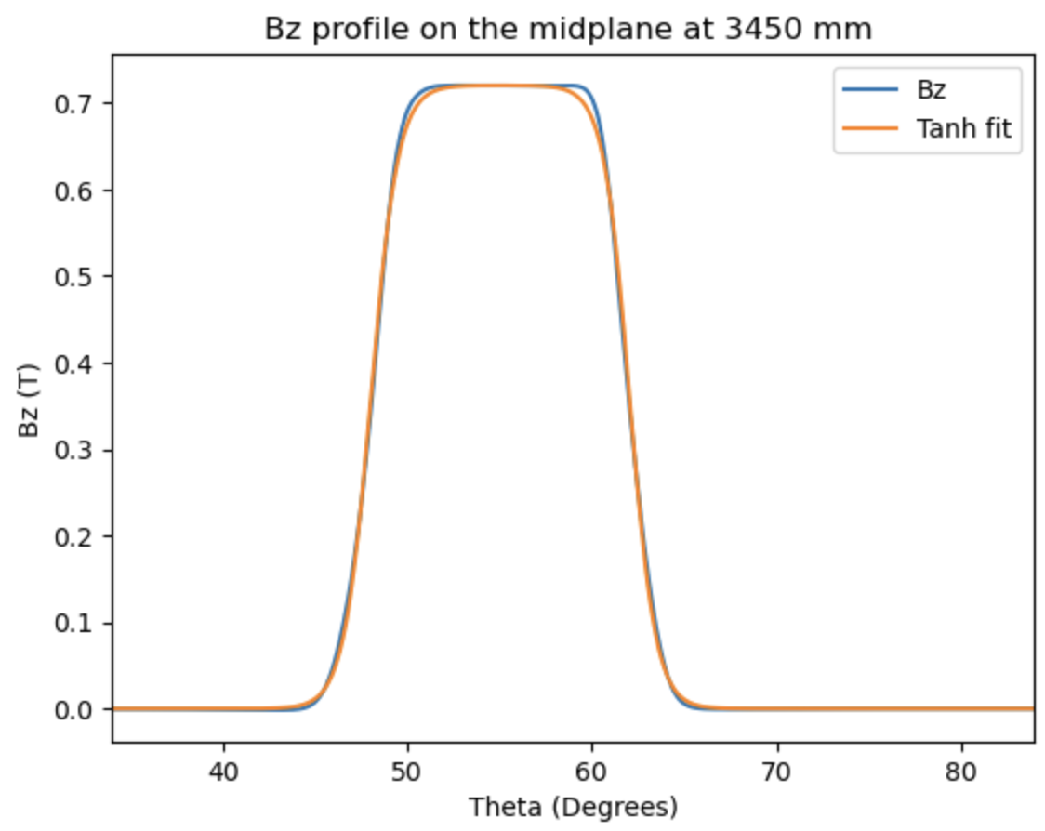
Fit C1 en and C1 ex with tanh model

Slide 9
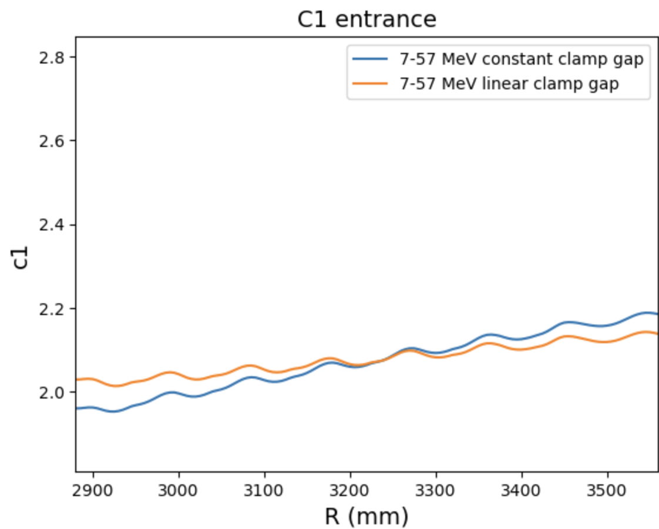
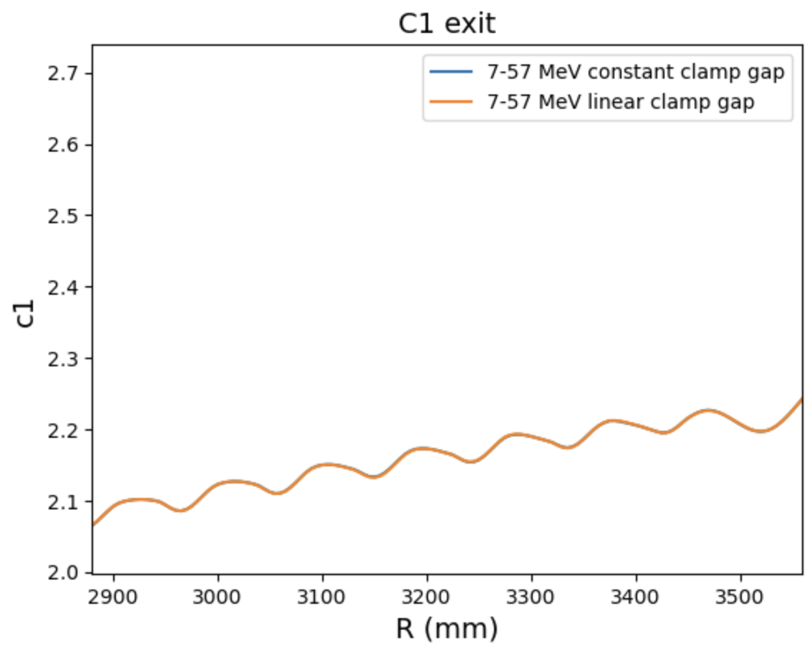
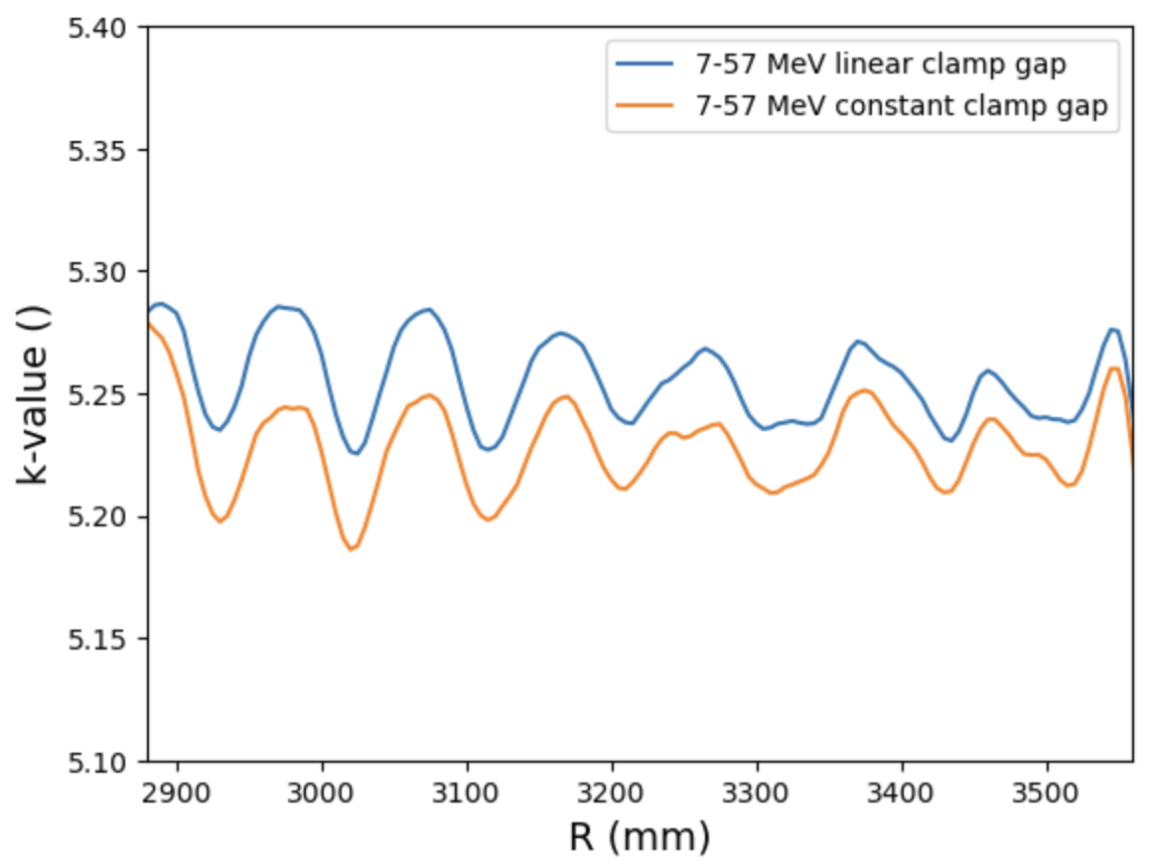
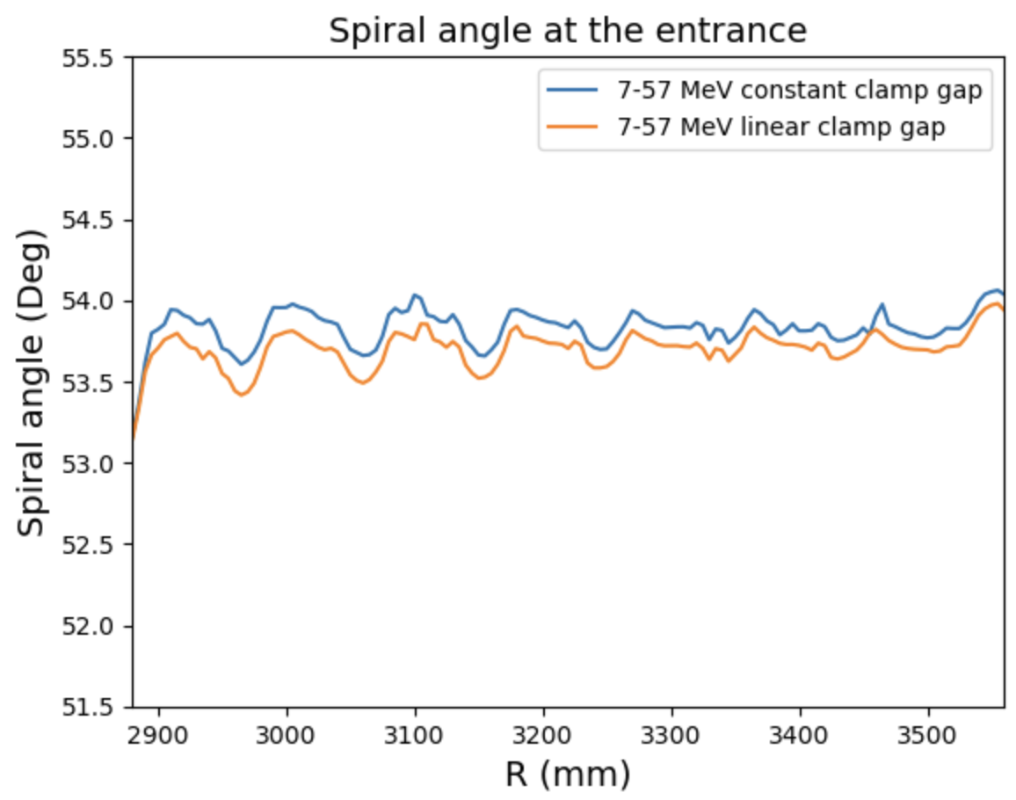
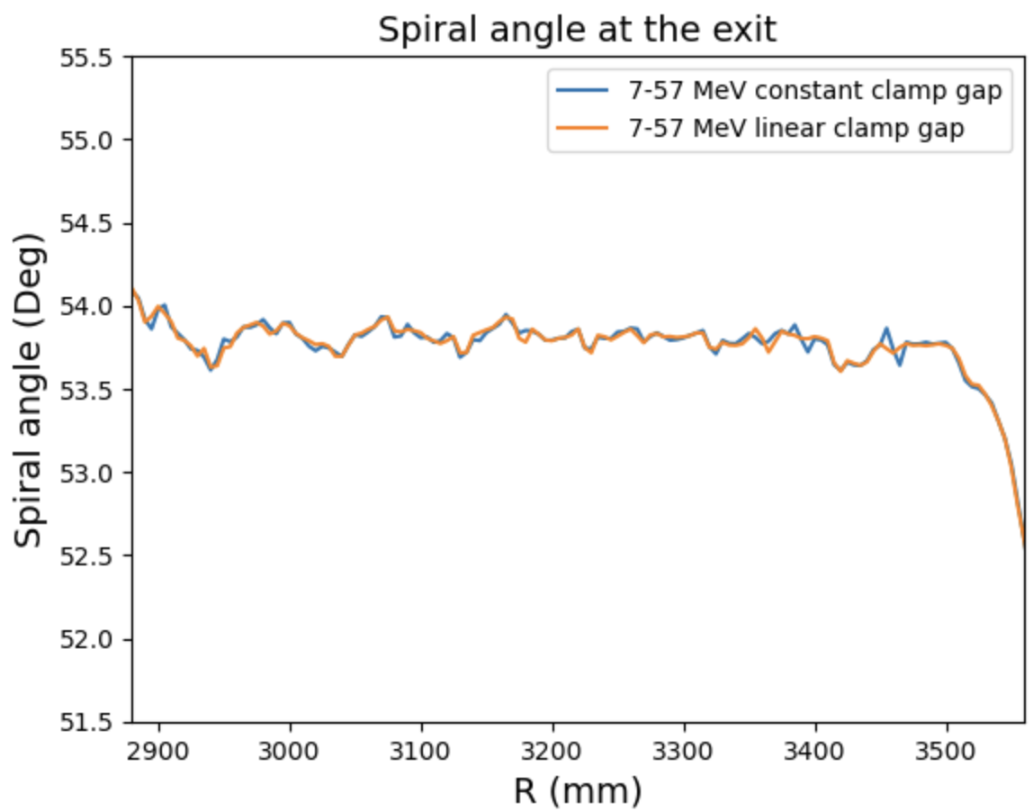
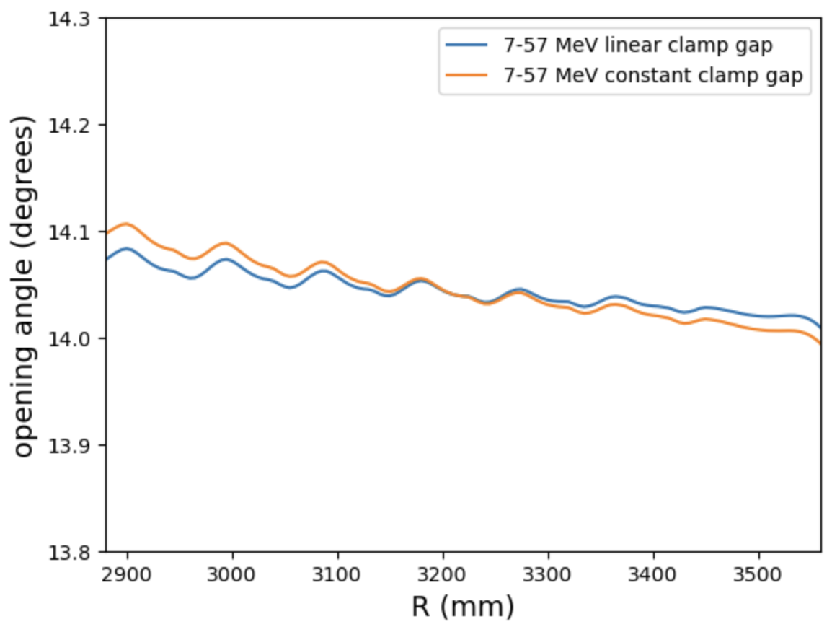
Comparing the coefficients before and after clamp shaping
Lower energy case: 7-57 MeV as opposed to 15-127MeV

Slide 10
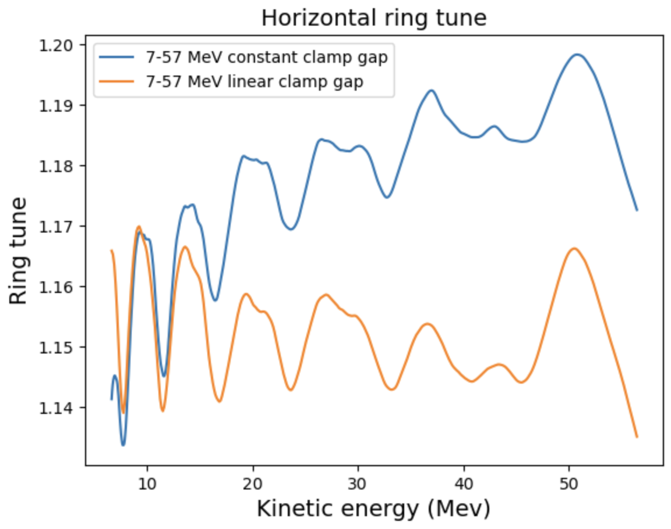
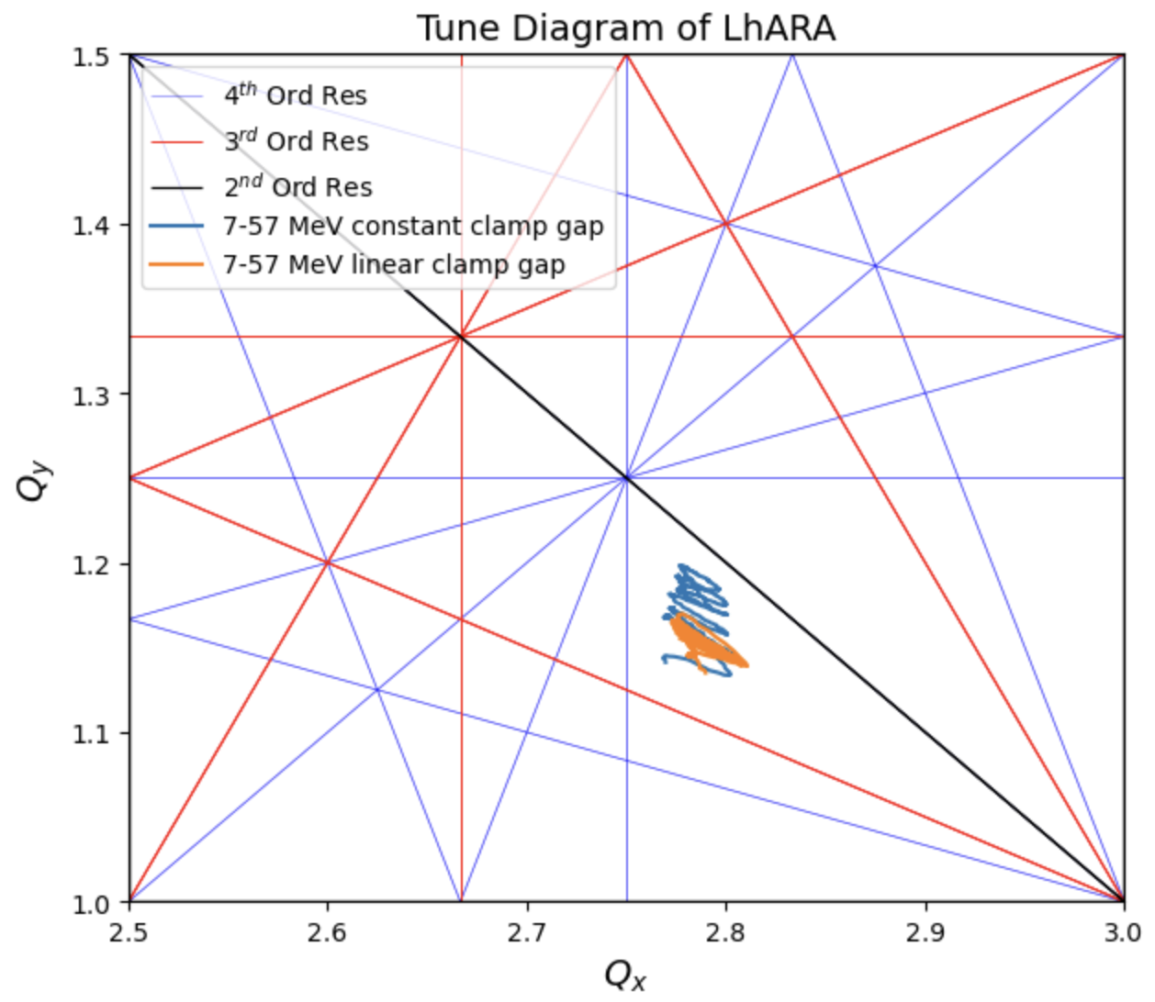
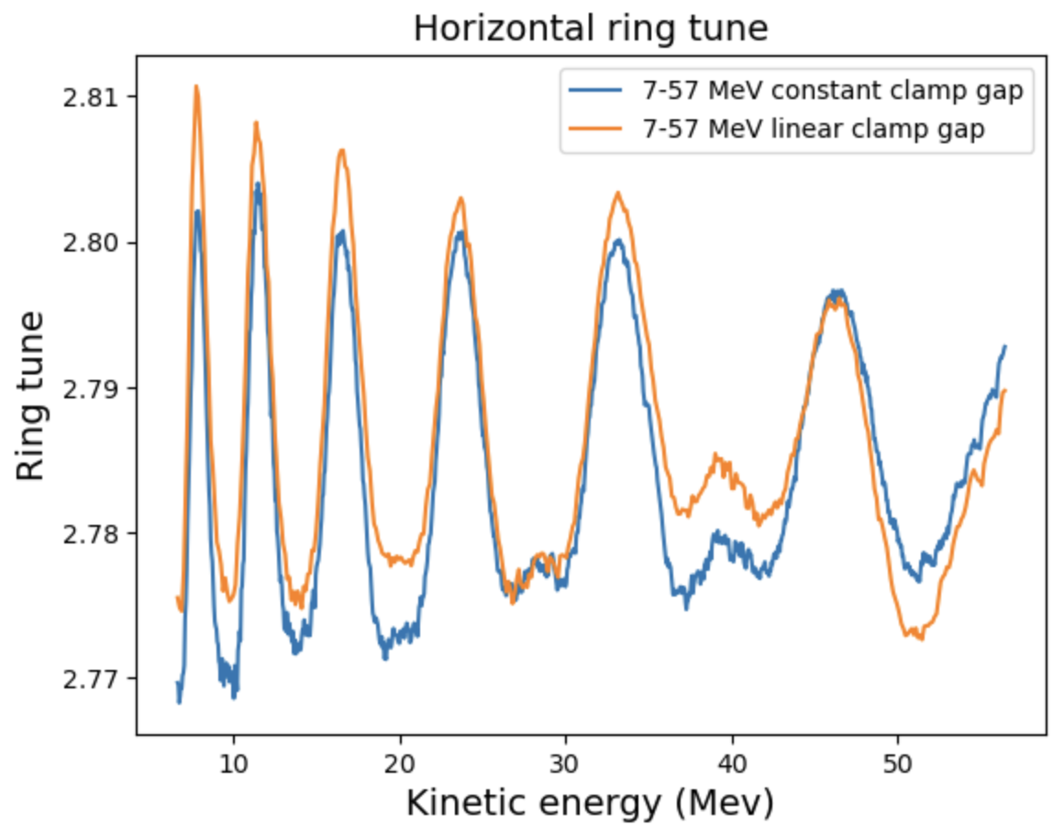
Vertical tune spread decreased with horizontal tune not changing much

Slide 11
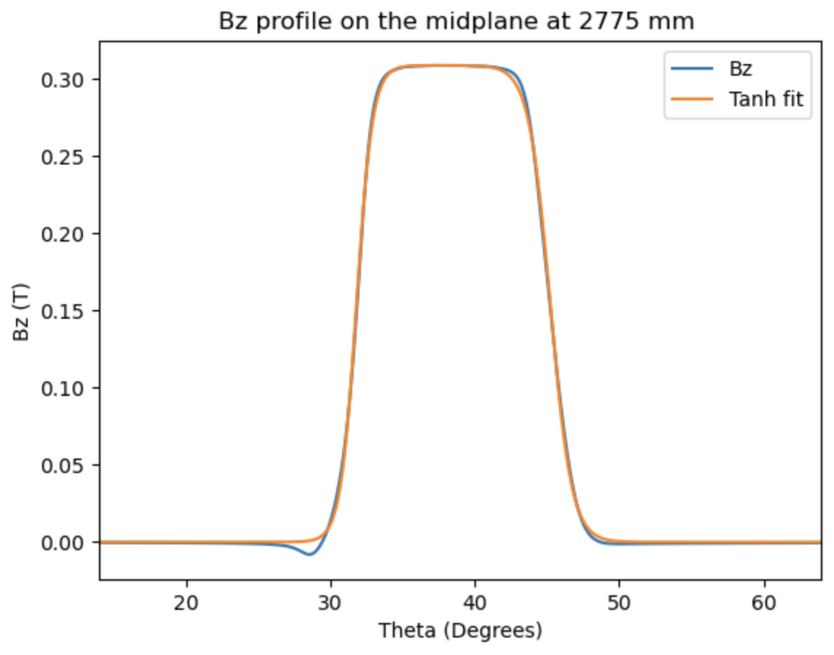
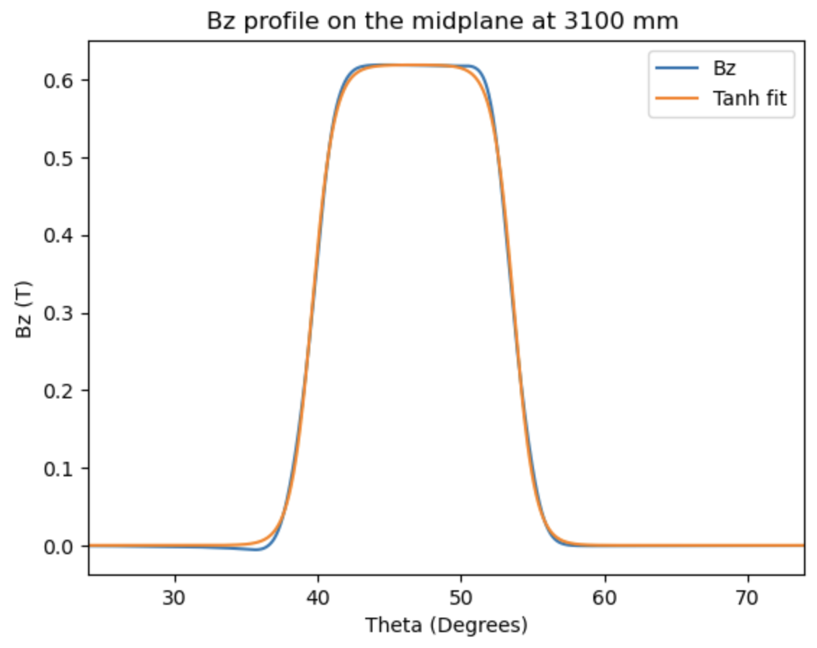
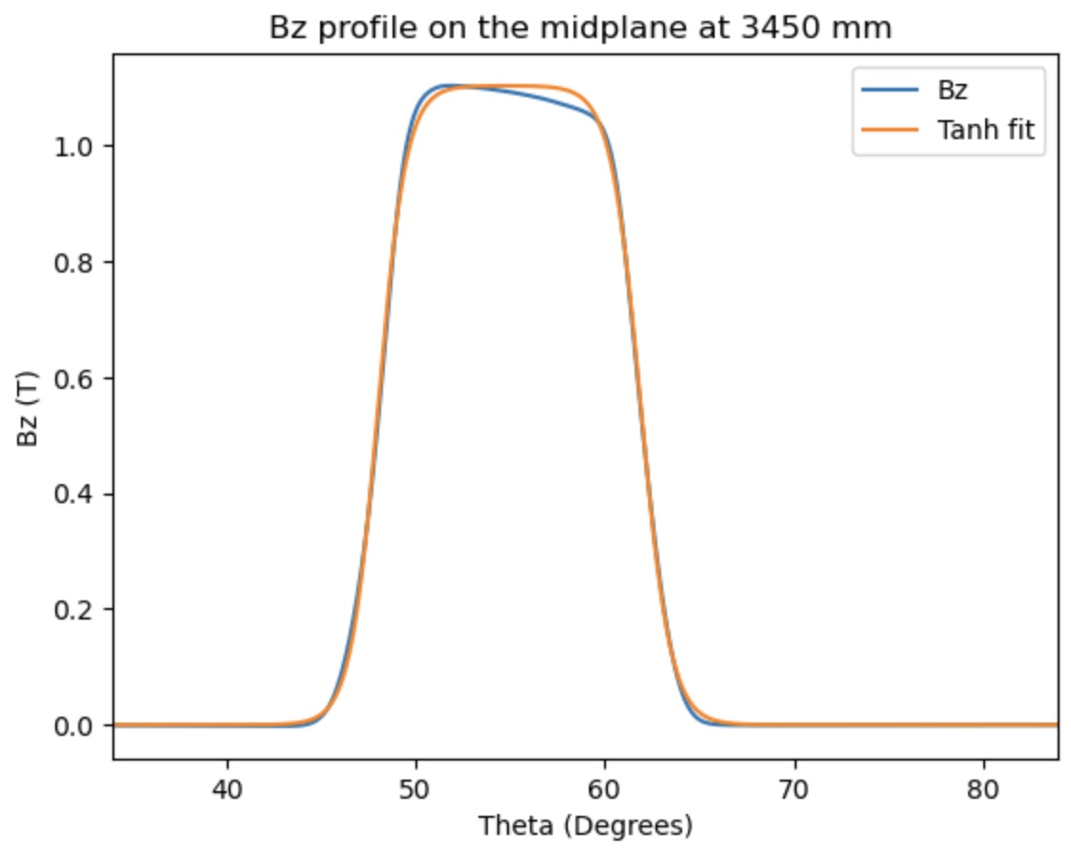
Comparing the coefficients before and after clamp shaping
Max energy case: 15-127MeV

Slide 12
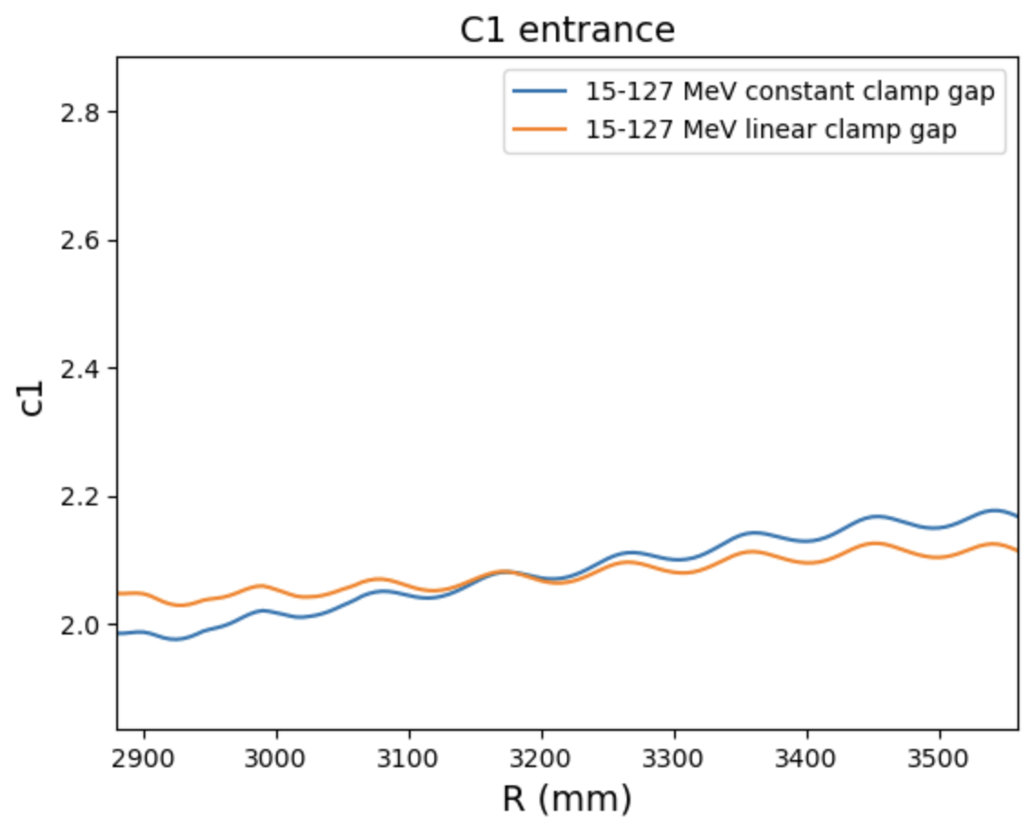
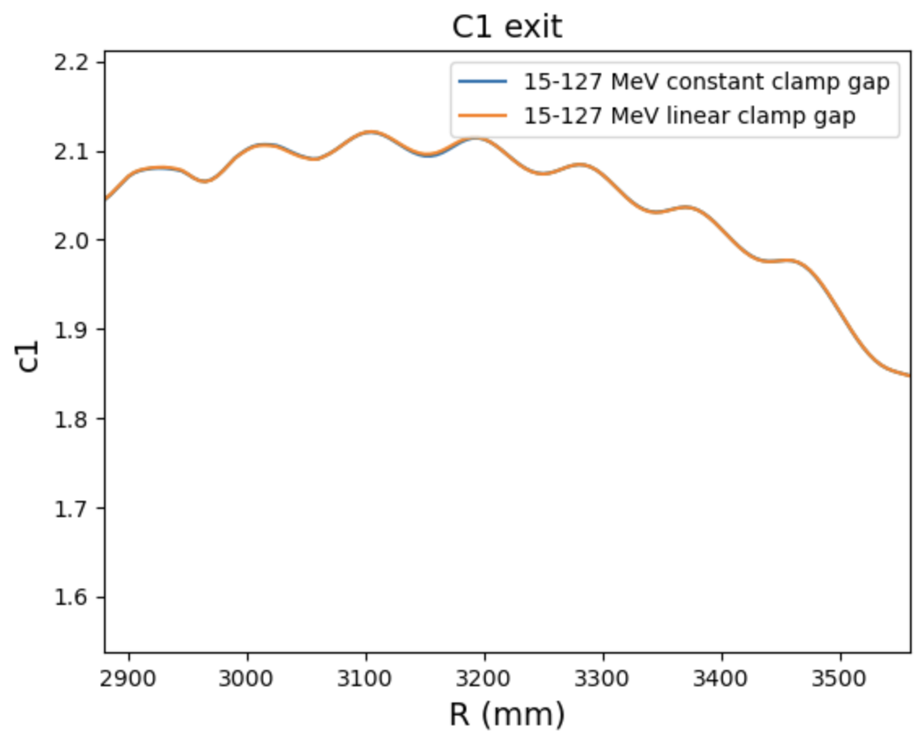
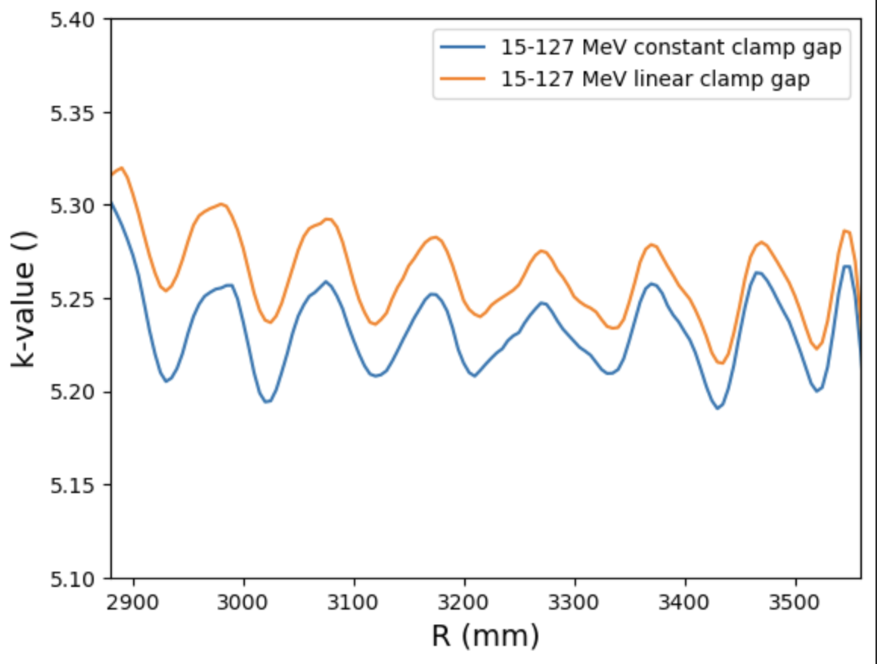
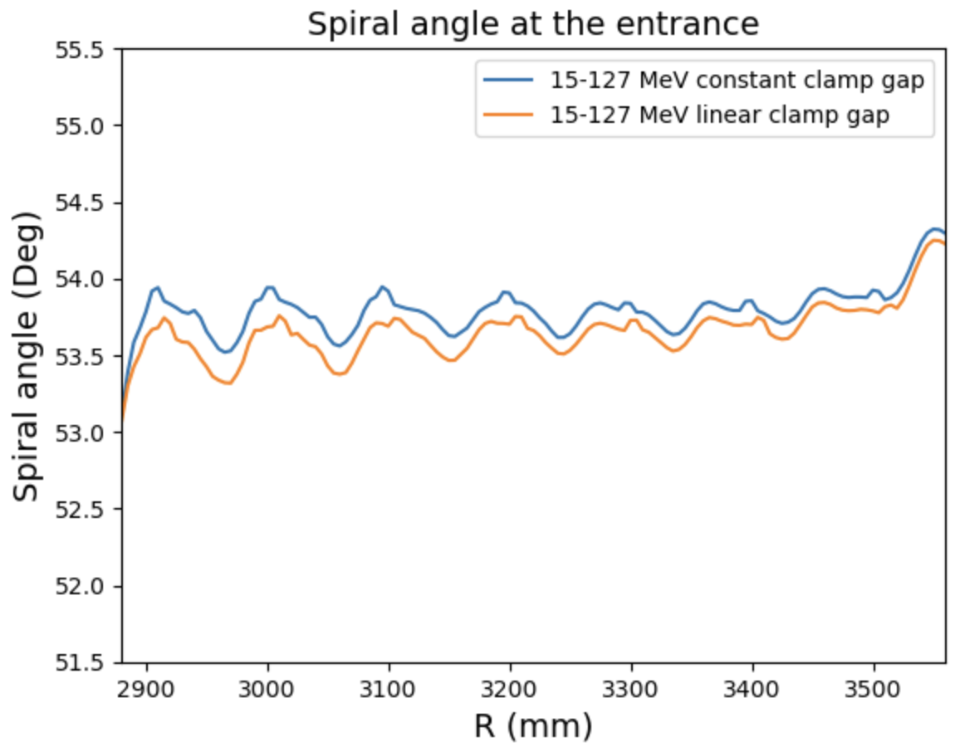
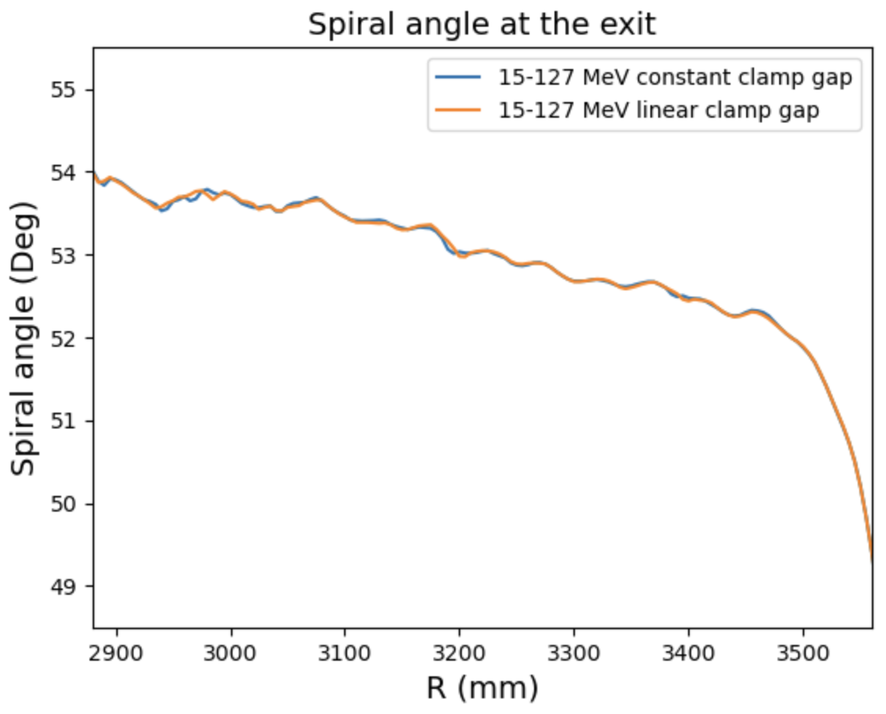
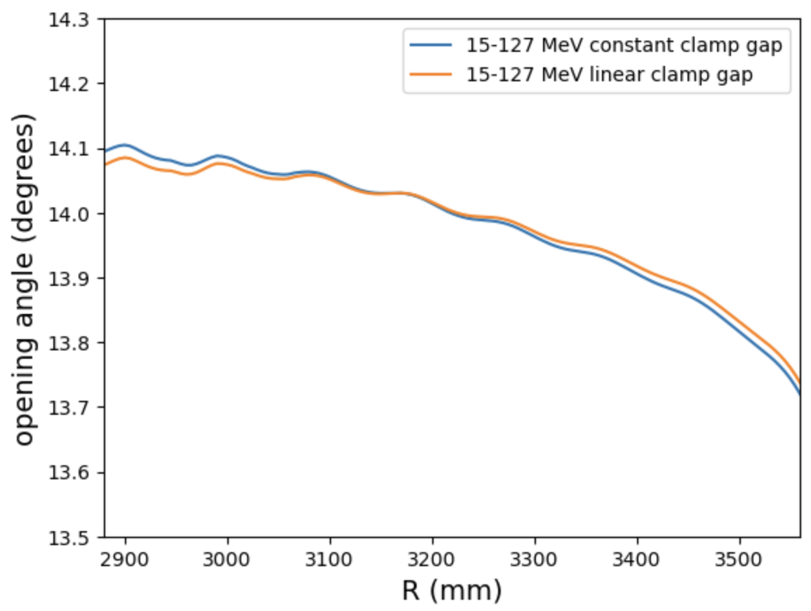
Comparing the coefficients before and after clamp shaping
Max energy case: 15-127MeV

Slide 13
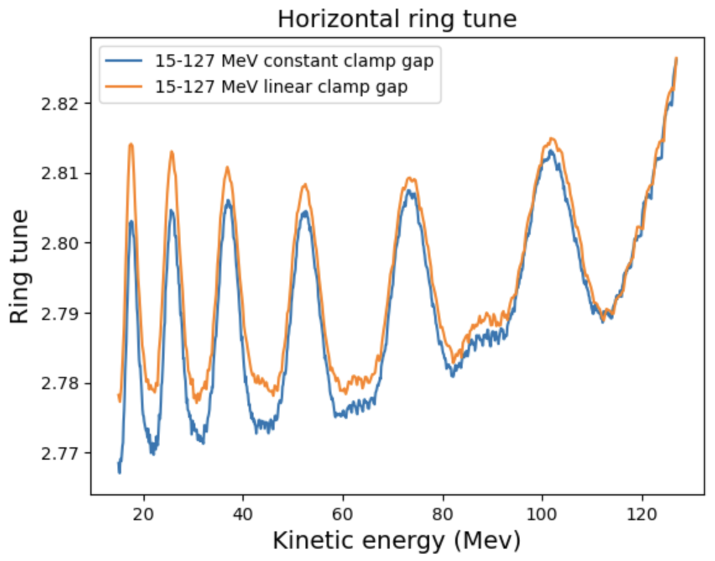
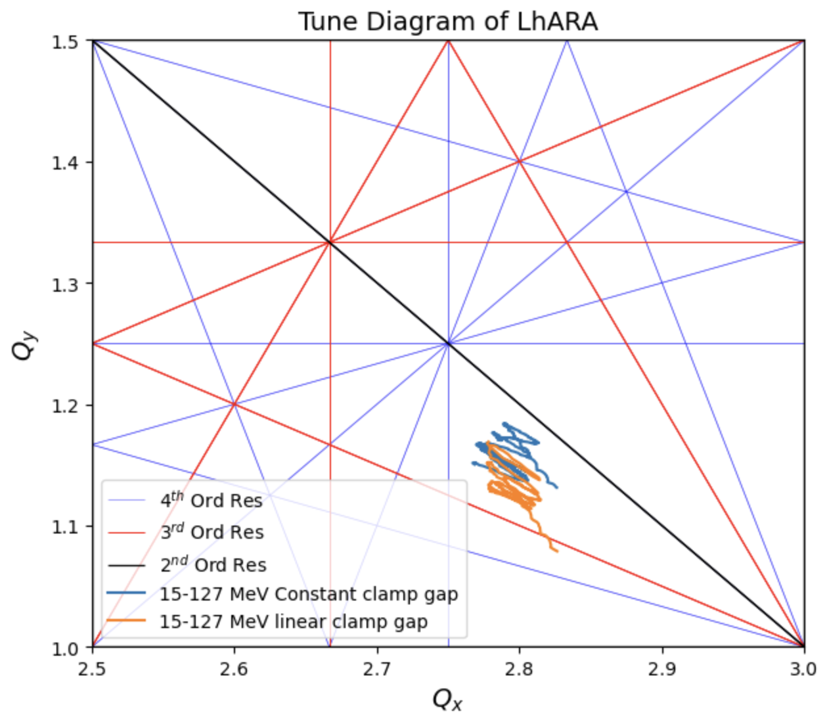
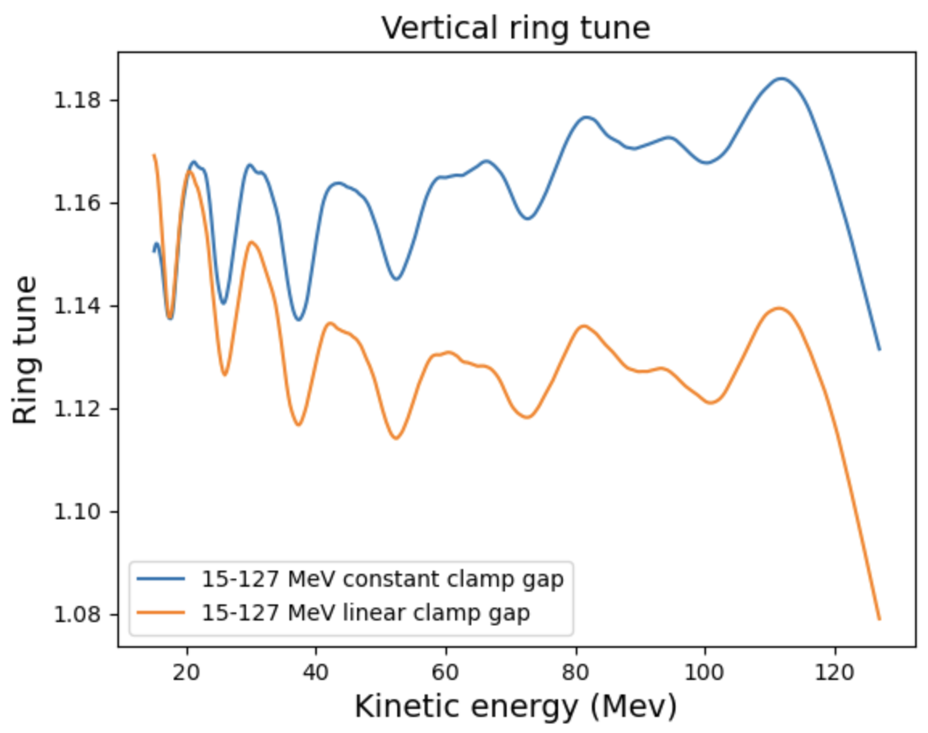
Results in overcorrection in vertical tune as the trend is different at max energy

