Slide 1
3D modelling of FETS-FFA main magnet
19/08/25
Ta-Jen Kuo
Supervisor: Jaroslaw Pasternak, Jean-Baptiste Lagrange
Imperial College London, STFC

Slide 2
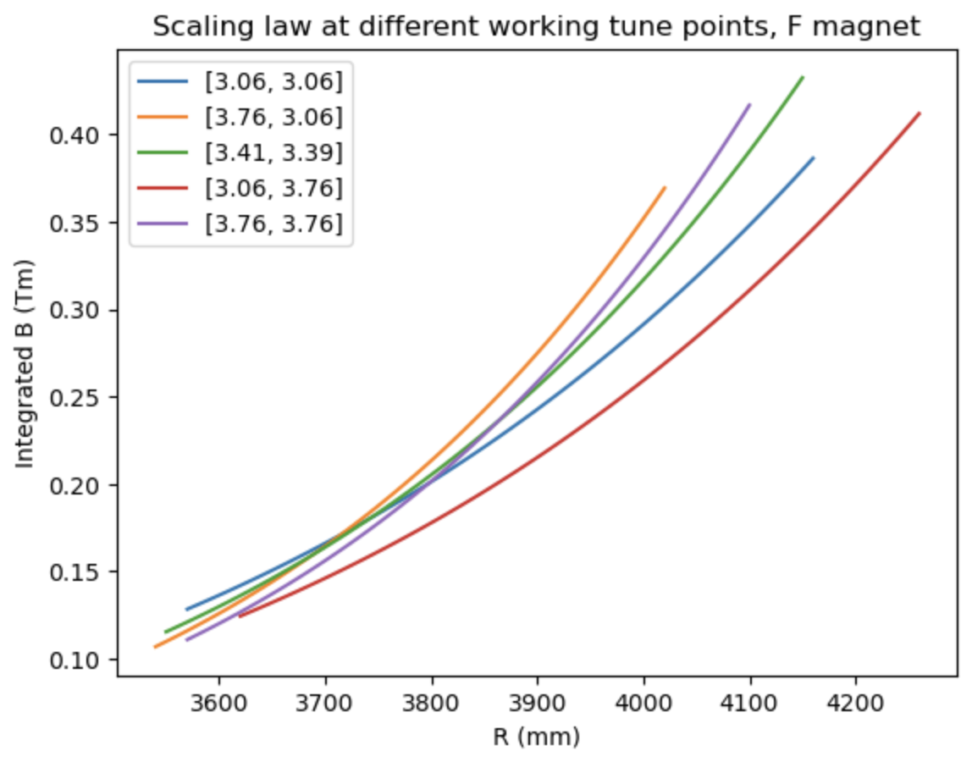
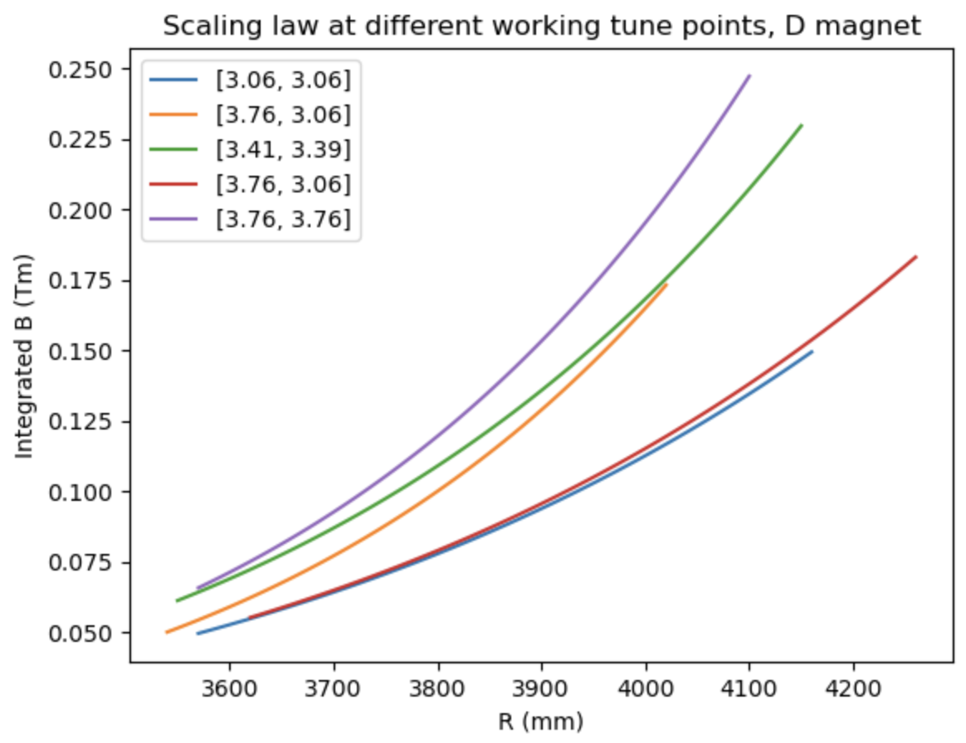
Central tune point [3.41,3.39] and the four working tune points at the
Corners of this table was investigated

Slide 3
Variation in cell tune
Target cell tune variation: +/- 0.000625

Slide 4
Variation in cell tune, target +/- 0.000625

Slide 5
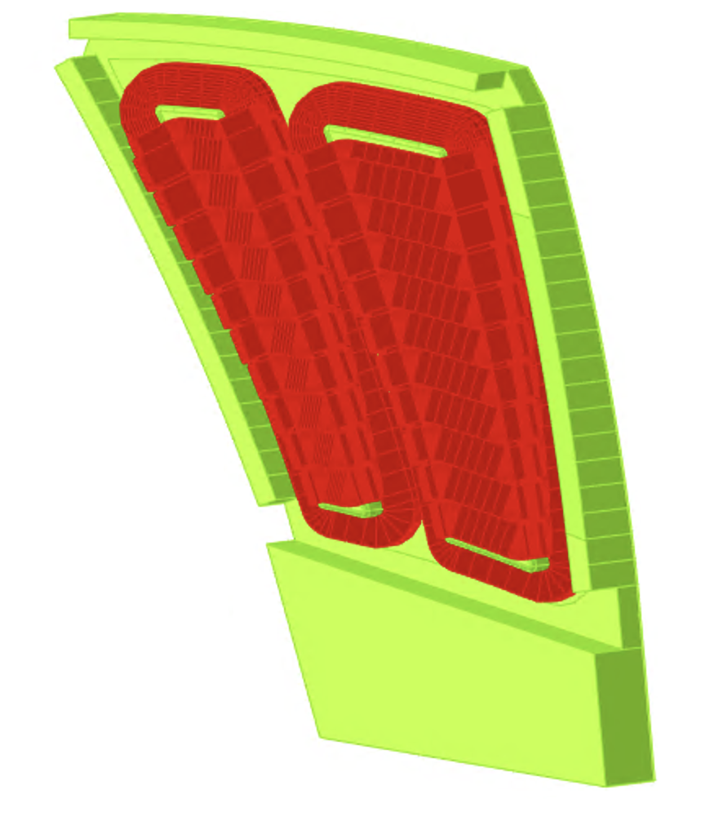
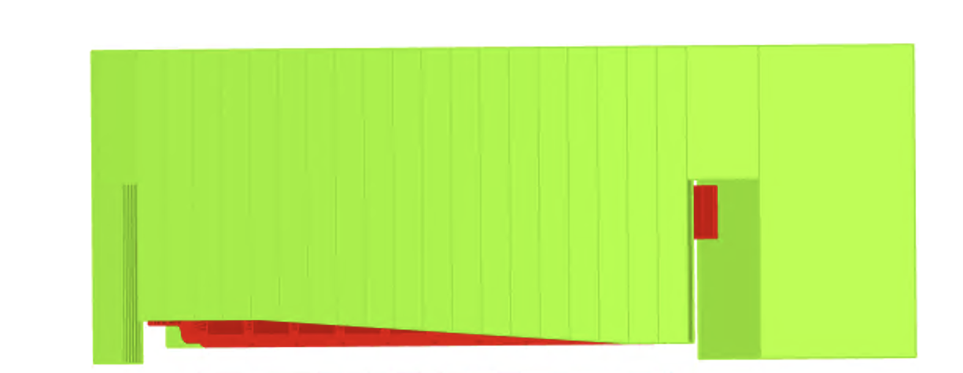
Variation in vertical tune has an increasing trend for every working tune point.
Vary entry clamp gap height linearly and reoptimize current
For [3.41,3.39] tune point

Slide 6
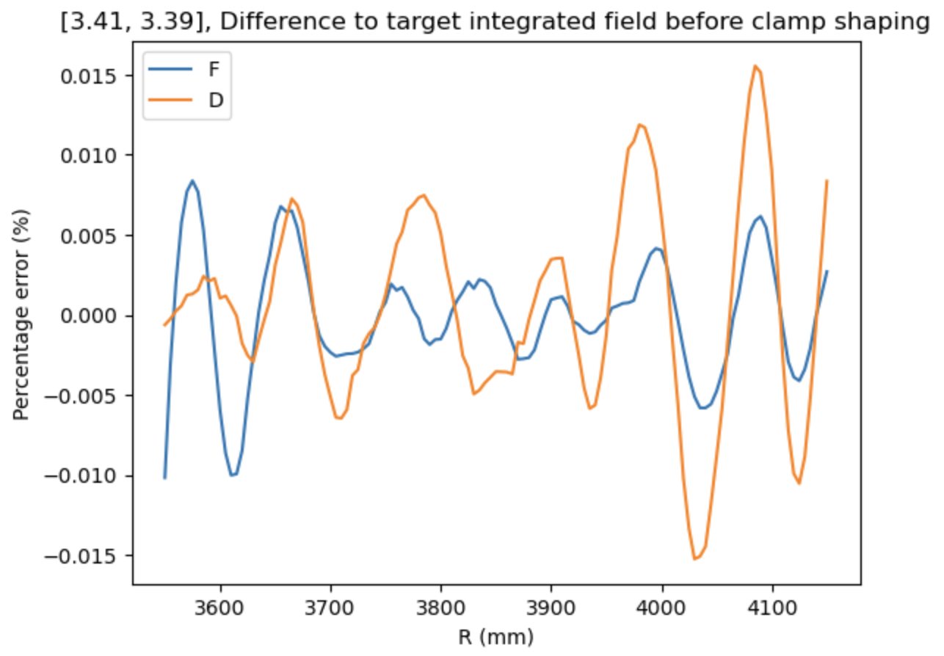
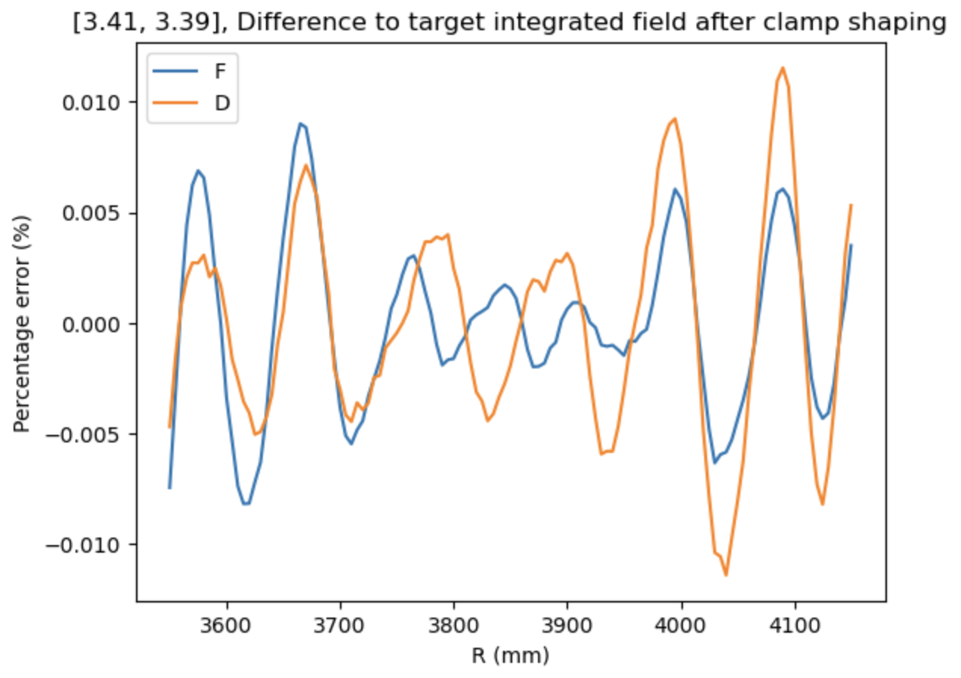
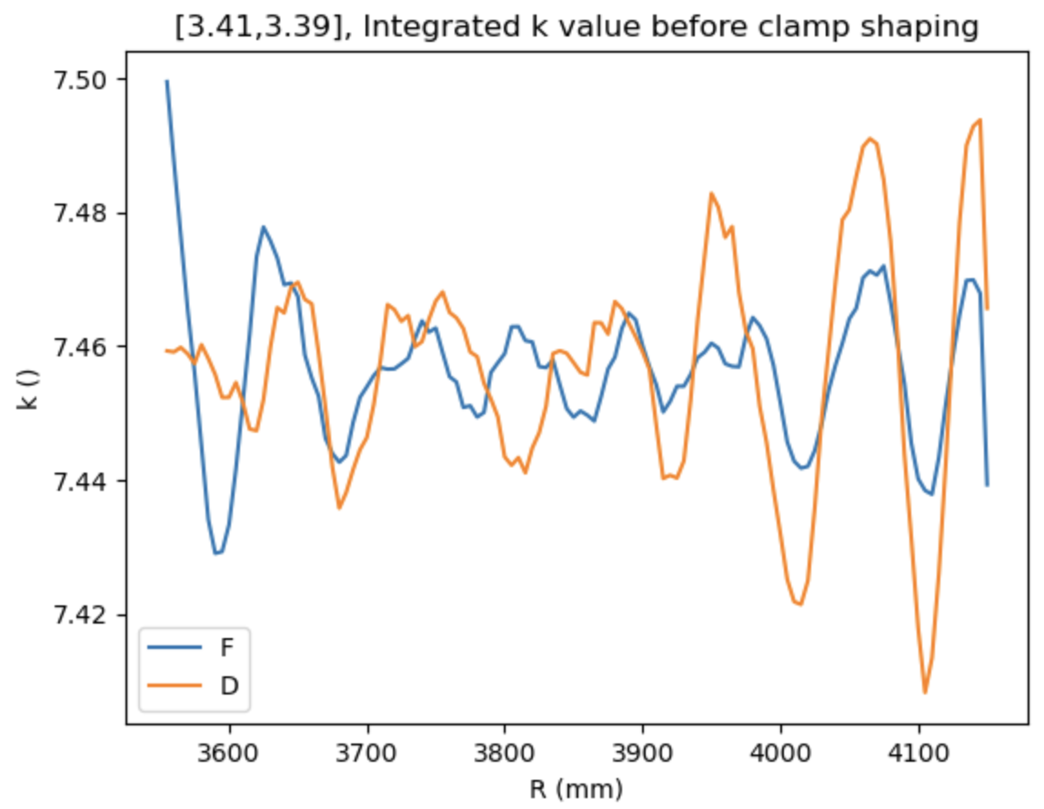
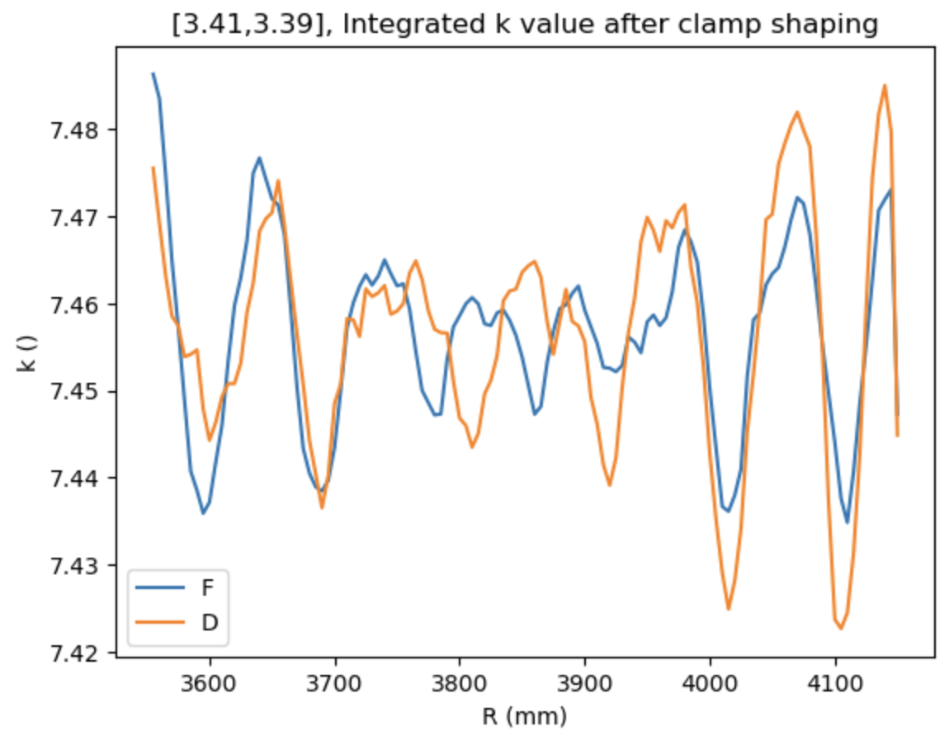
Comparing integrated B field before and after clamp shaping

Slide 7
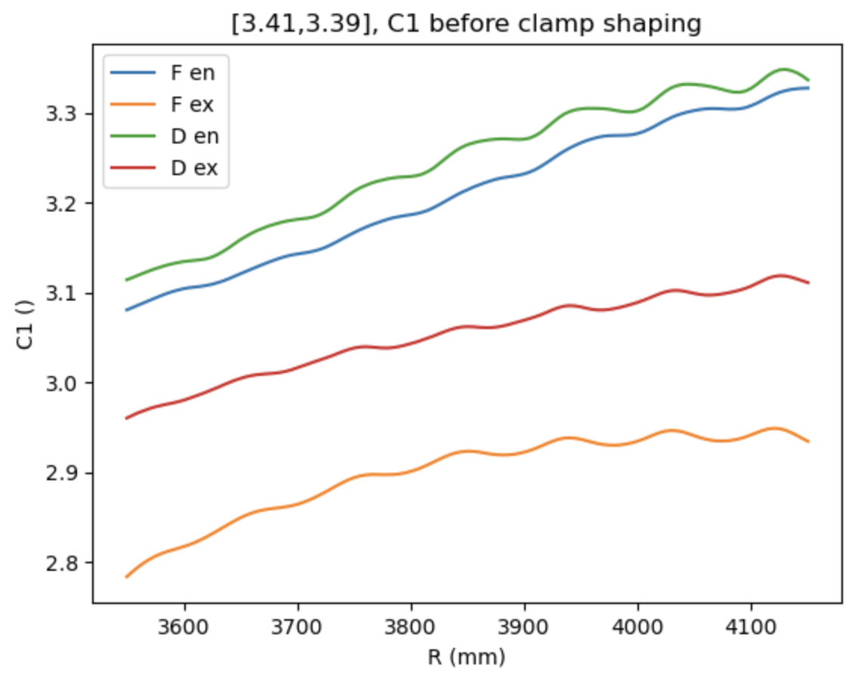
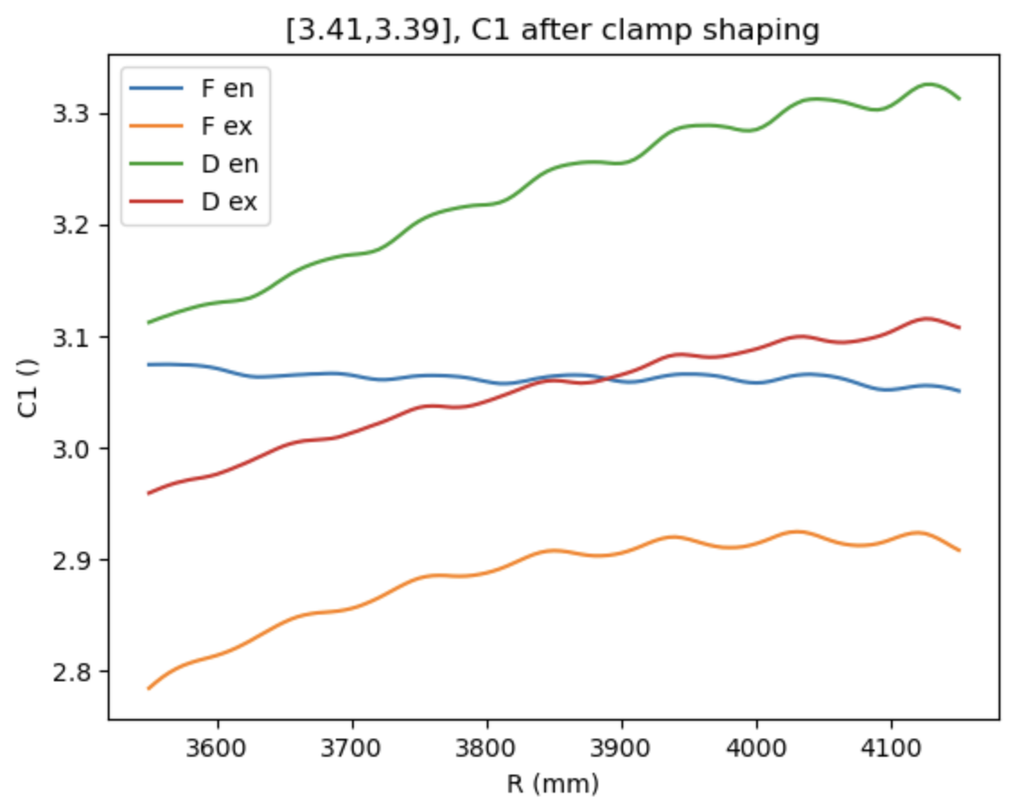
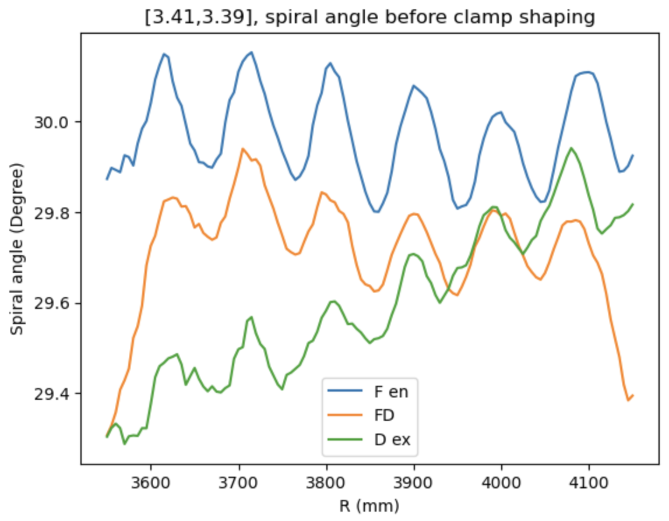
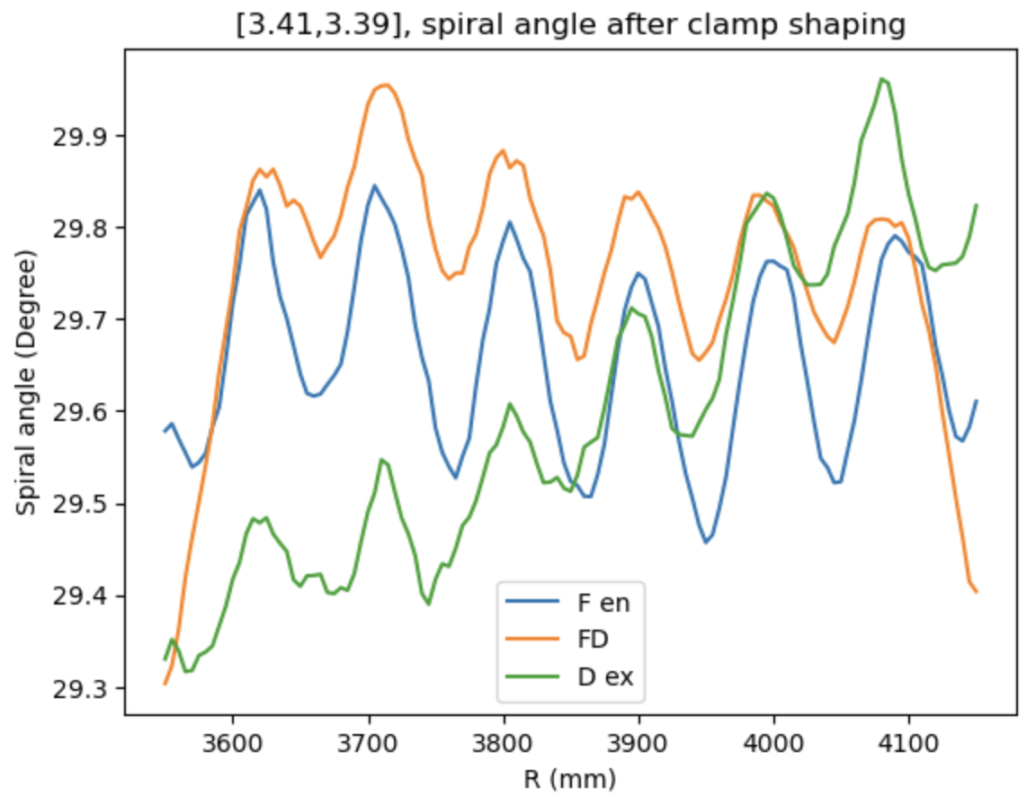
Comparing C1 and spiral angle before and after clamp shaping

Slide 8
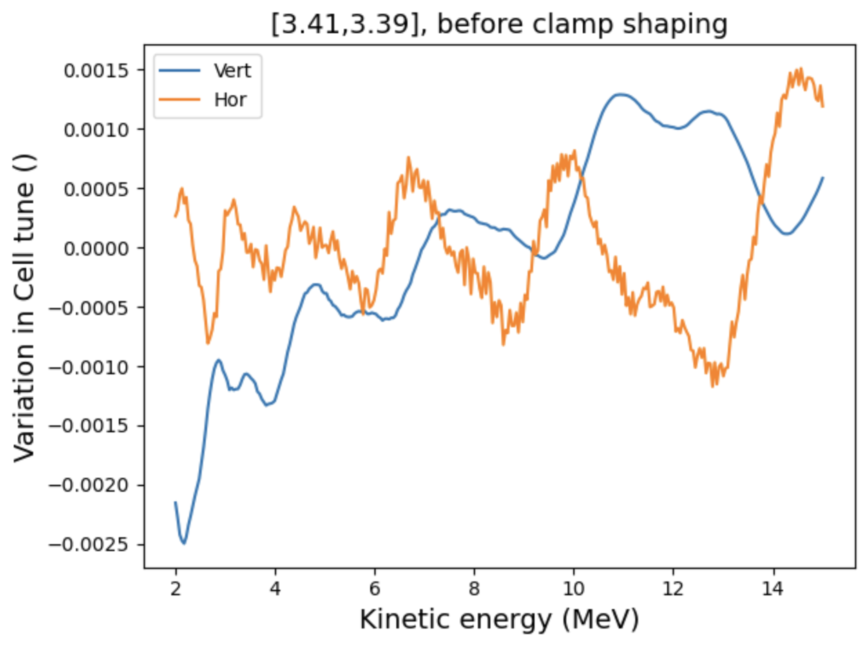
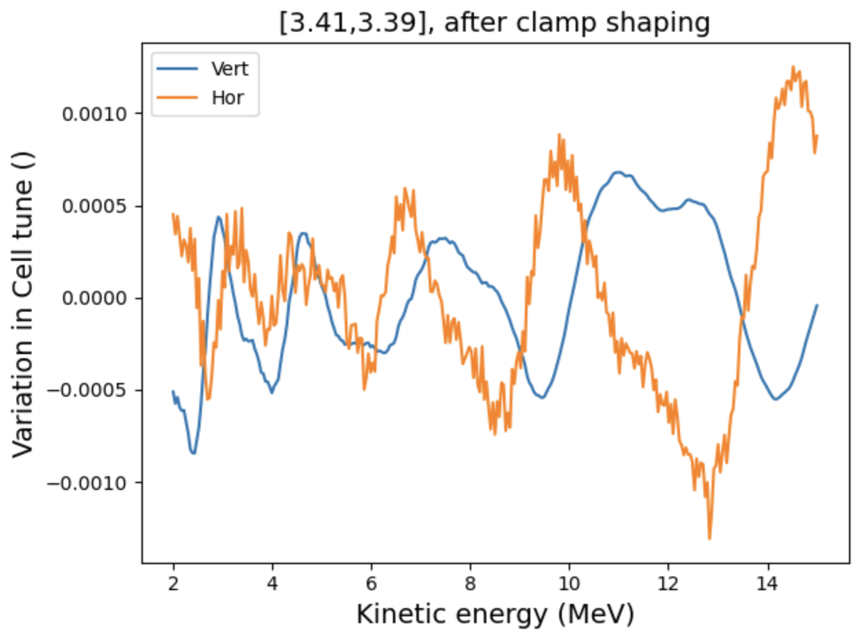
Tracking from 2-15 MeV to include finite beam size

Slide 9
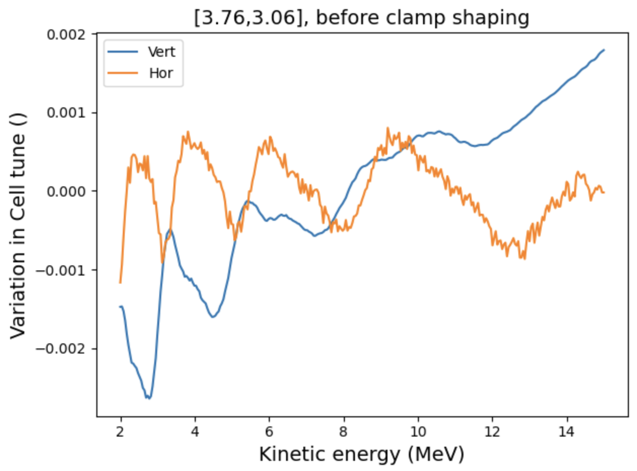
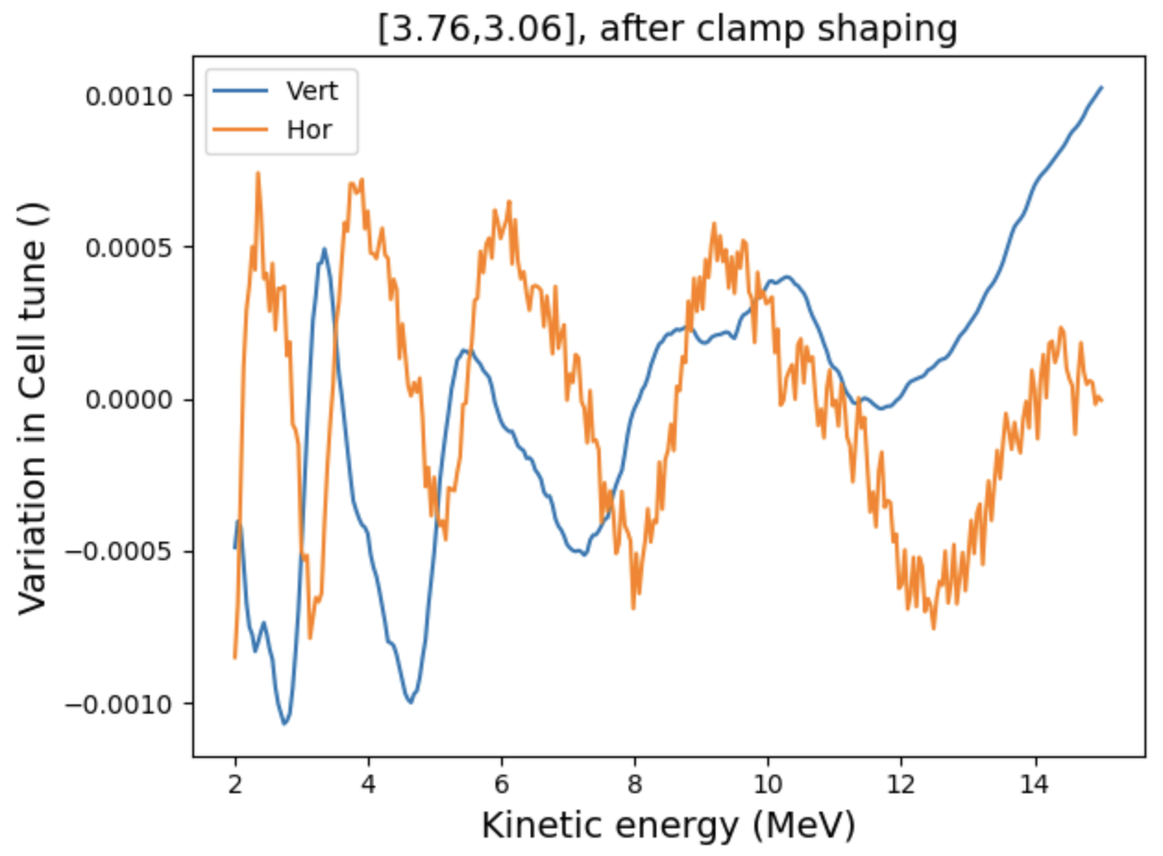
Using the same clamp shape, repeated the process for
[3.76, 3.06] tune point

Slide 10
Conclusion
Clamp shape flattens increasing trend in vertical tune variation for central working tune
[3.41, 3.39]
The same shape also partially flattens the vertical tune variation for [3.76, 3.06]
Optimisation will be carried out for the other three corners of the working tune space

Slide 11
Extra slides

Slide 12
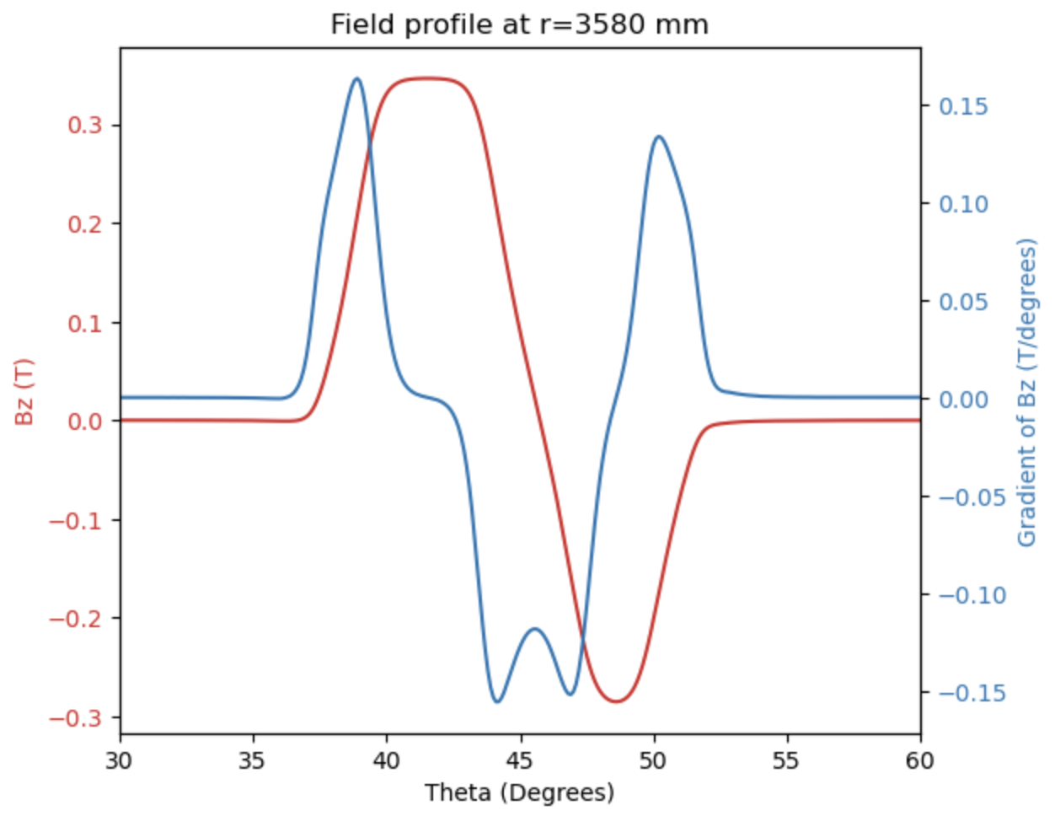


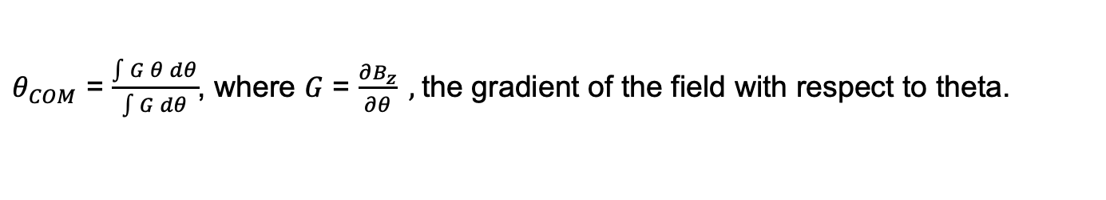
Spiral angle
Using the angle of the centre of moment $θ_{COM}$ on the longitudinal gradient G of the field along a constant radius
$θ_{COM}$ = $\frac{\int{G θ dθ}}{\int{G dθ}}$, where $G$ = $\frac{∂B_{z}}{∂θ} ,$the gradient of the field with respect to theta.
$$r\frac{dθ_{Com}}{dr}=\tan\left(z\right)$$
Introduce spiral angles for
entrance F
between F and D
exit D

Slide 13
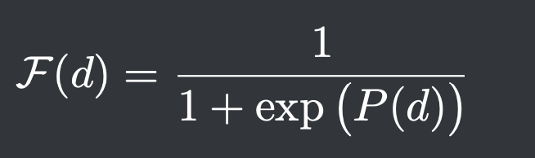
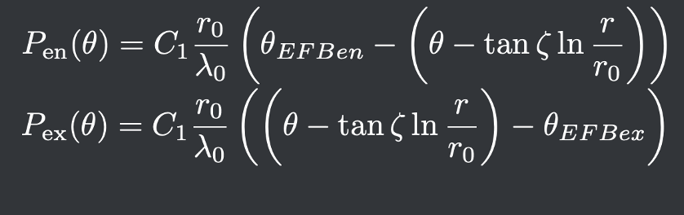
Fit C1 en and C1 ex with tanh model
Spiral angle computed with equation from
Last slide.
Fit for C1 en, C1 ex, EFBen, EFBex
Fit for F and D separately and add together for the final field model

