Slide 1
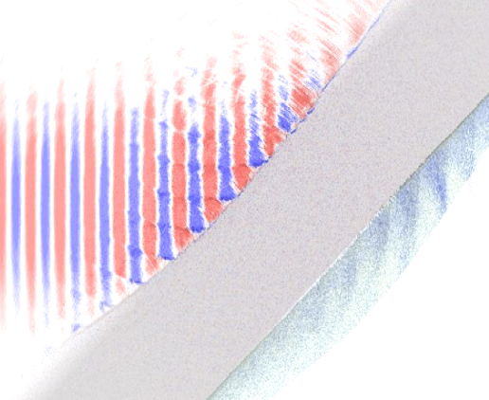
WP2: Assessment of risk in delivery of laser driven ion source
LhARA Advisory Board Meeting
27th October 2022
WP2 WPMs: E. Boella (Lancaster), N. P. Dover (ICL), R. Gray (Strathclyde)

Slide 2
The inherent risks for WP2
LhARA source parameters never been shown simultaneously
Relatively high energy (e.g. 15 MeV for protons, 4 MeV/u C⁶⁺)
High flux (e.g. ~10⁹ ions per shot in energy band)
High repetition rate (10 Hz), long term operation
Multi-ion species (protons, carbon, others…)
The key goals of WP2 are:
Demonstrate the concept and de-risk the source
Specify the drive laser, targetry and instrumentation for CDR
The risks in achieving the goals can be grouped:
Insufficient resources and beamtime
Insufficient beam parameters from the ion source
Challenges related to high repetition rate & long term operation

Slide 3
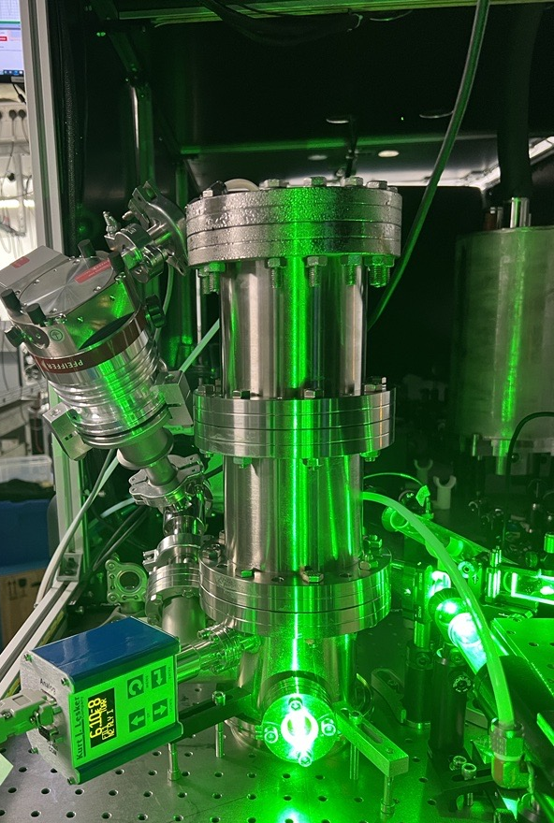
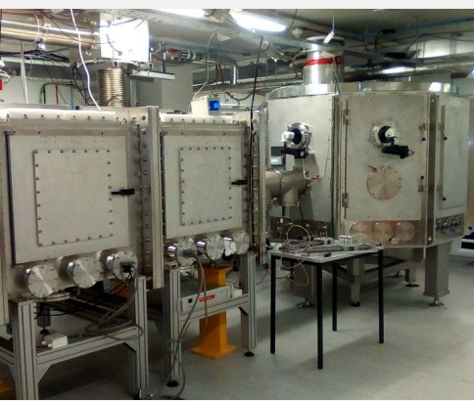
Insufficient resources and beamtime
What are the risks?
Not enough beamtime paid for on the SCAPA or Zhi facilities
Technical issues during the beamtimes
Insufficient computing resources for simulation
Insufficient staff/student effort to execute R&D
What is the mitigation?
Collaborate with other facilities to secure beamtime, piggy-back on other experiments
Competitively apply (or pay) for additional resources e.g. computational time, beamtime
Build links with outside groups with similar goals
Zhi laser cryo-amplifier (ICL)
SCAPA interaction chambers (Strathclyde)

Slide 4
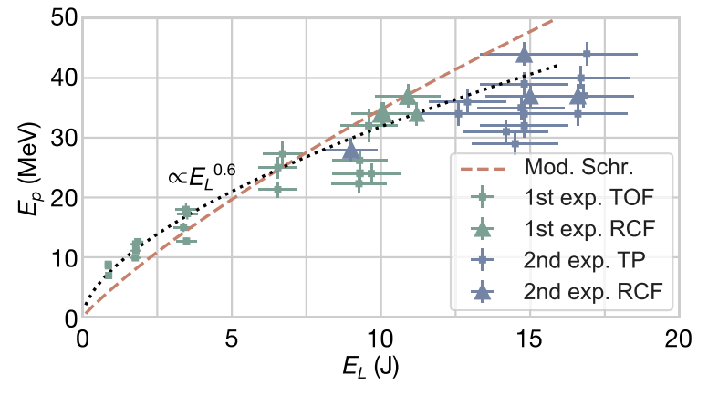
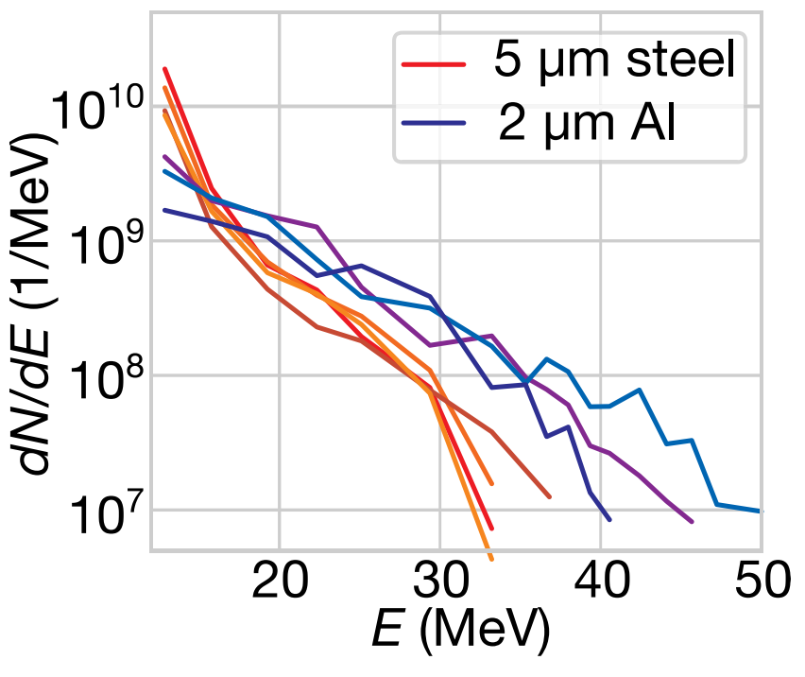
Insufficient beam parameters from the ion source
What are the risks?
Not able to reach required energy
Not enough beam flux
Difficulty with different ions (C, etc)
What is the mitigation?
Additional resources for source optimisation experiments and simulations
Investigate techniques for spectral shaping
CDR specification of larger laser system (more cost, space, shielding!)
Trade-off between particle flux, energy and/or repetition rate
From Dover et al. HEDP 37, 100847 (2020)

Slide 5
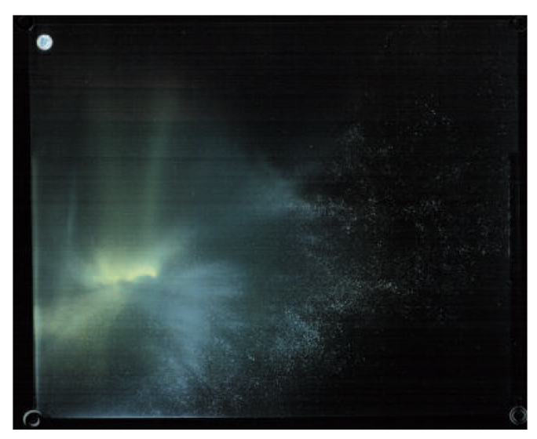
Challenges related to high repetition rate & long term operation
What are the risks?
Targetry replenishment and stability not sufficient
Large shot-to-shot variation of beam parameters
Target debris causes degradation of key optics
Activation and radiation safety issues of apparatus and surrounding area
What is the mitigation?
Allocate more resources and form collaborations on other innovative target types (see next talk)
Dedicate further resources to laser and target diagnostic suite to allow fast-feedback stabilisation
More effort on testing debris reduction and capture
Debris on a glass plate following PW irradiation of Au targets (Andrew et al. CLF Reports 2007/2008)

