Slide 1
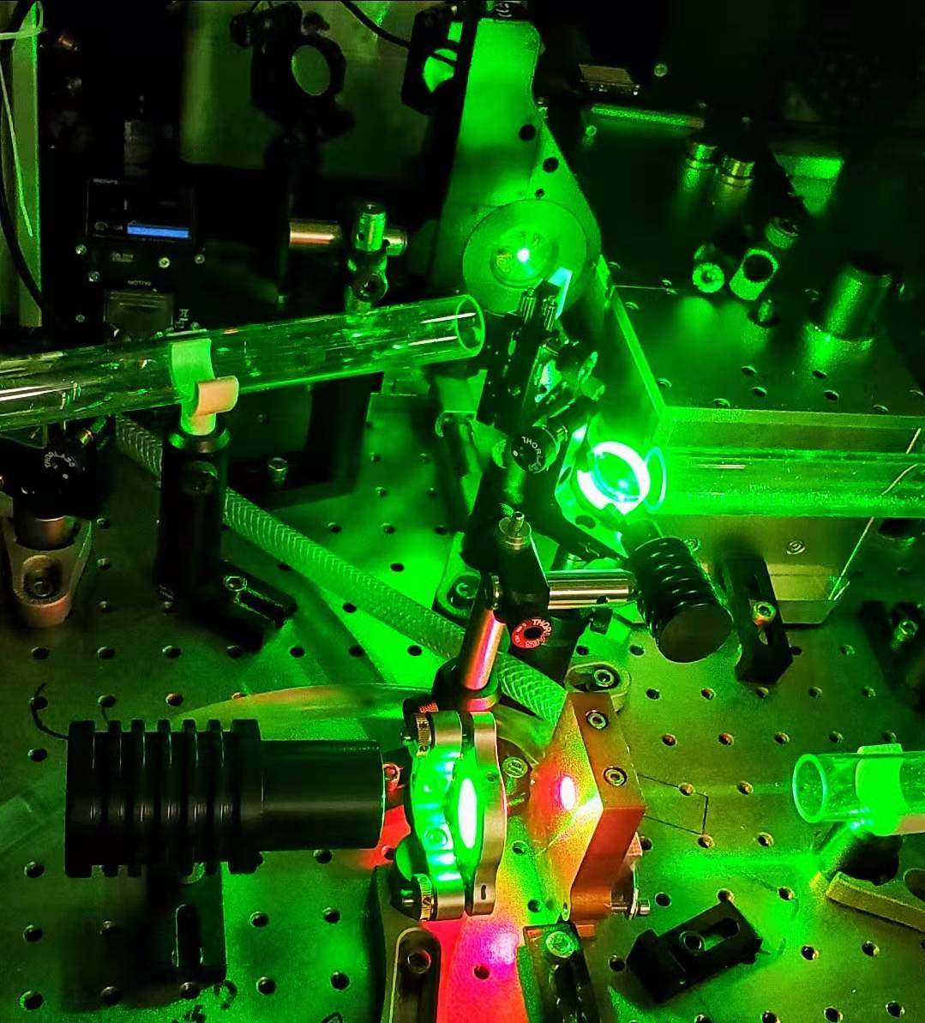
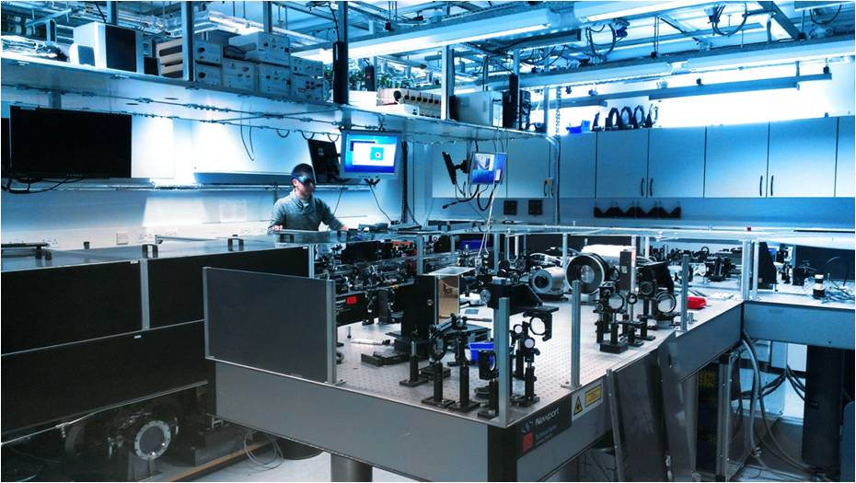
WP2 ion source development at ICL
N. P. Dover (ICL)
Two-year plan

Slide 2
R&D into high repetition rate at ICL
LhARA ion source presents various technological challenges due to the high repetition rate
Targetry – positioning, replacement, stability, ion species
Debris – longevity of key optics
Diagnostics – fast, reliable measurements for ion beam and laser
But, big potential benefits too!
Automated stabilisation for low frequency drift
Fast automated Bayesian source optimisation
We will use our facilities at ICL for R&D at 10 Hz operation

Slide 3
Technological development of ion source at ICL
Ion source commissioning at 10 Hz
Implement high stability tape target
Generate protons at ~1 MeV
Online shot-by-shot beam diagnosis
Preliminary activity (Y1 - Y2)
Debris
Measure debris properties and long term optics damage
Investigate debris control and mitigation
Contaminant removal for Z>1 ions
Hydrocarbon contaminant removal at 10 Hz
Measure increased ion energy and ionisation after removal

Slide 4

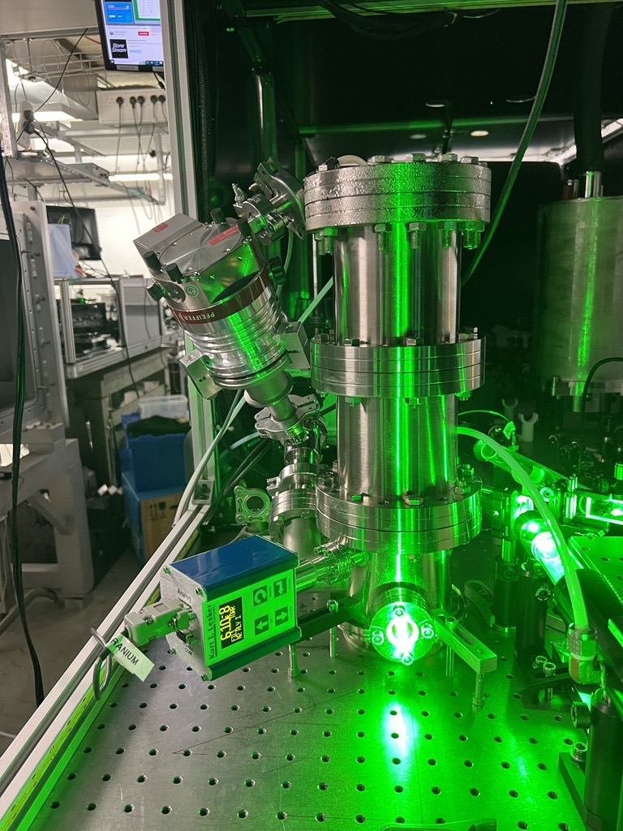
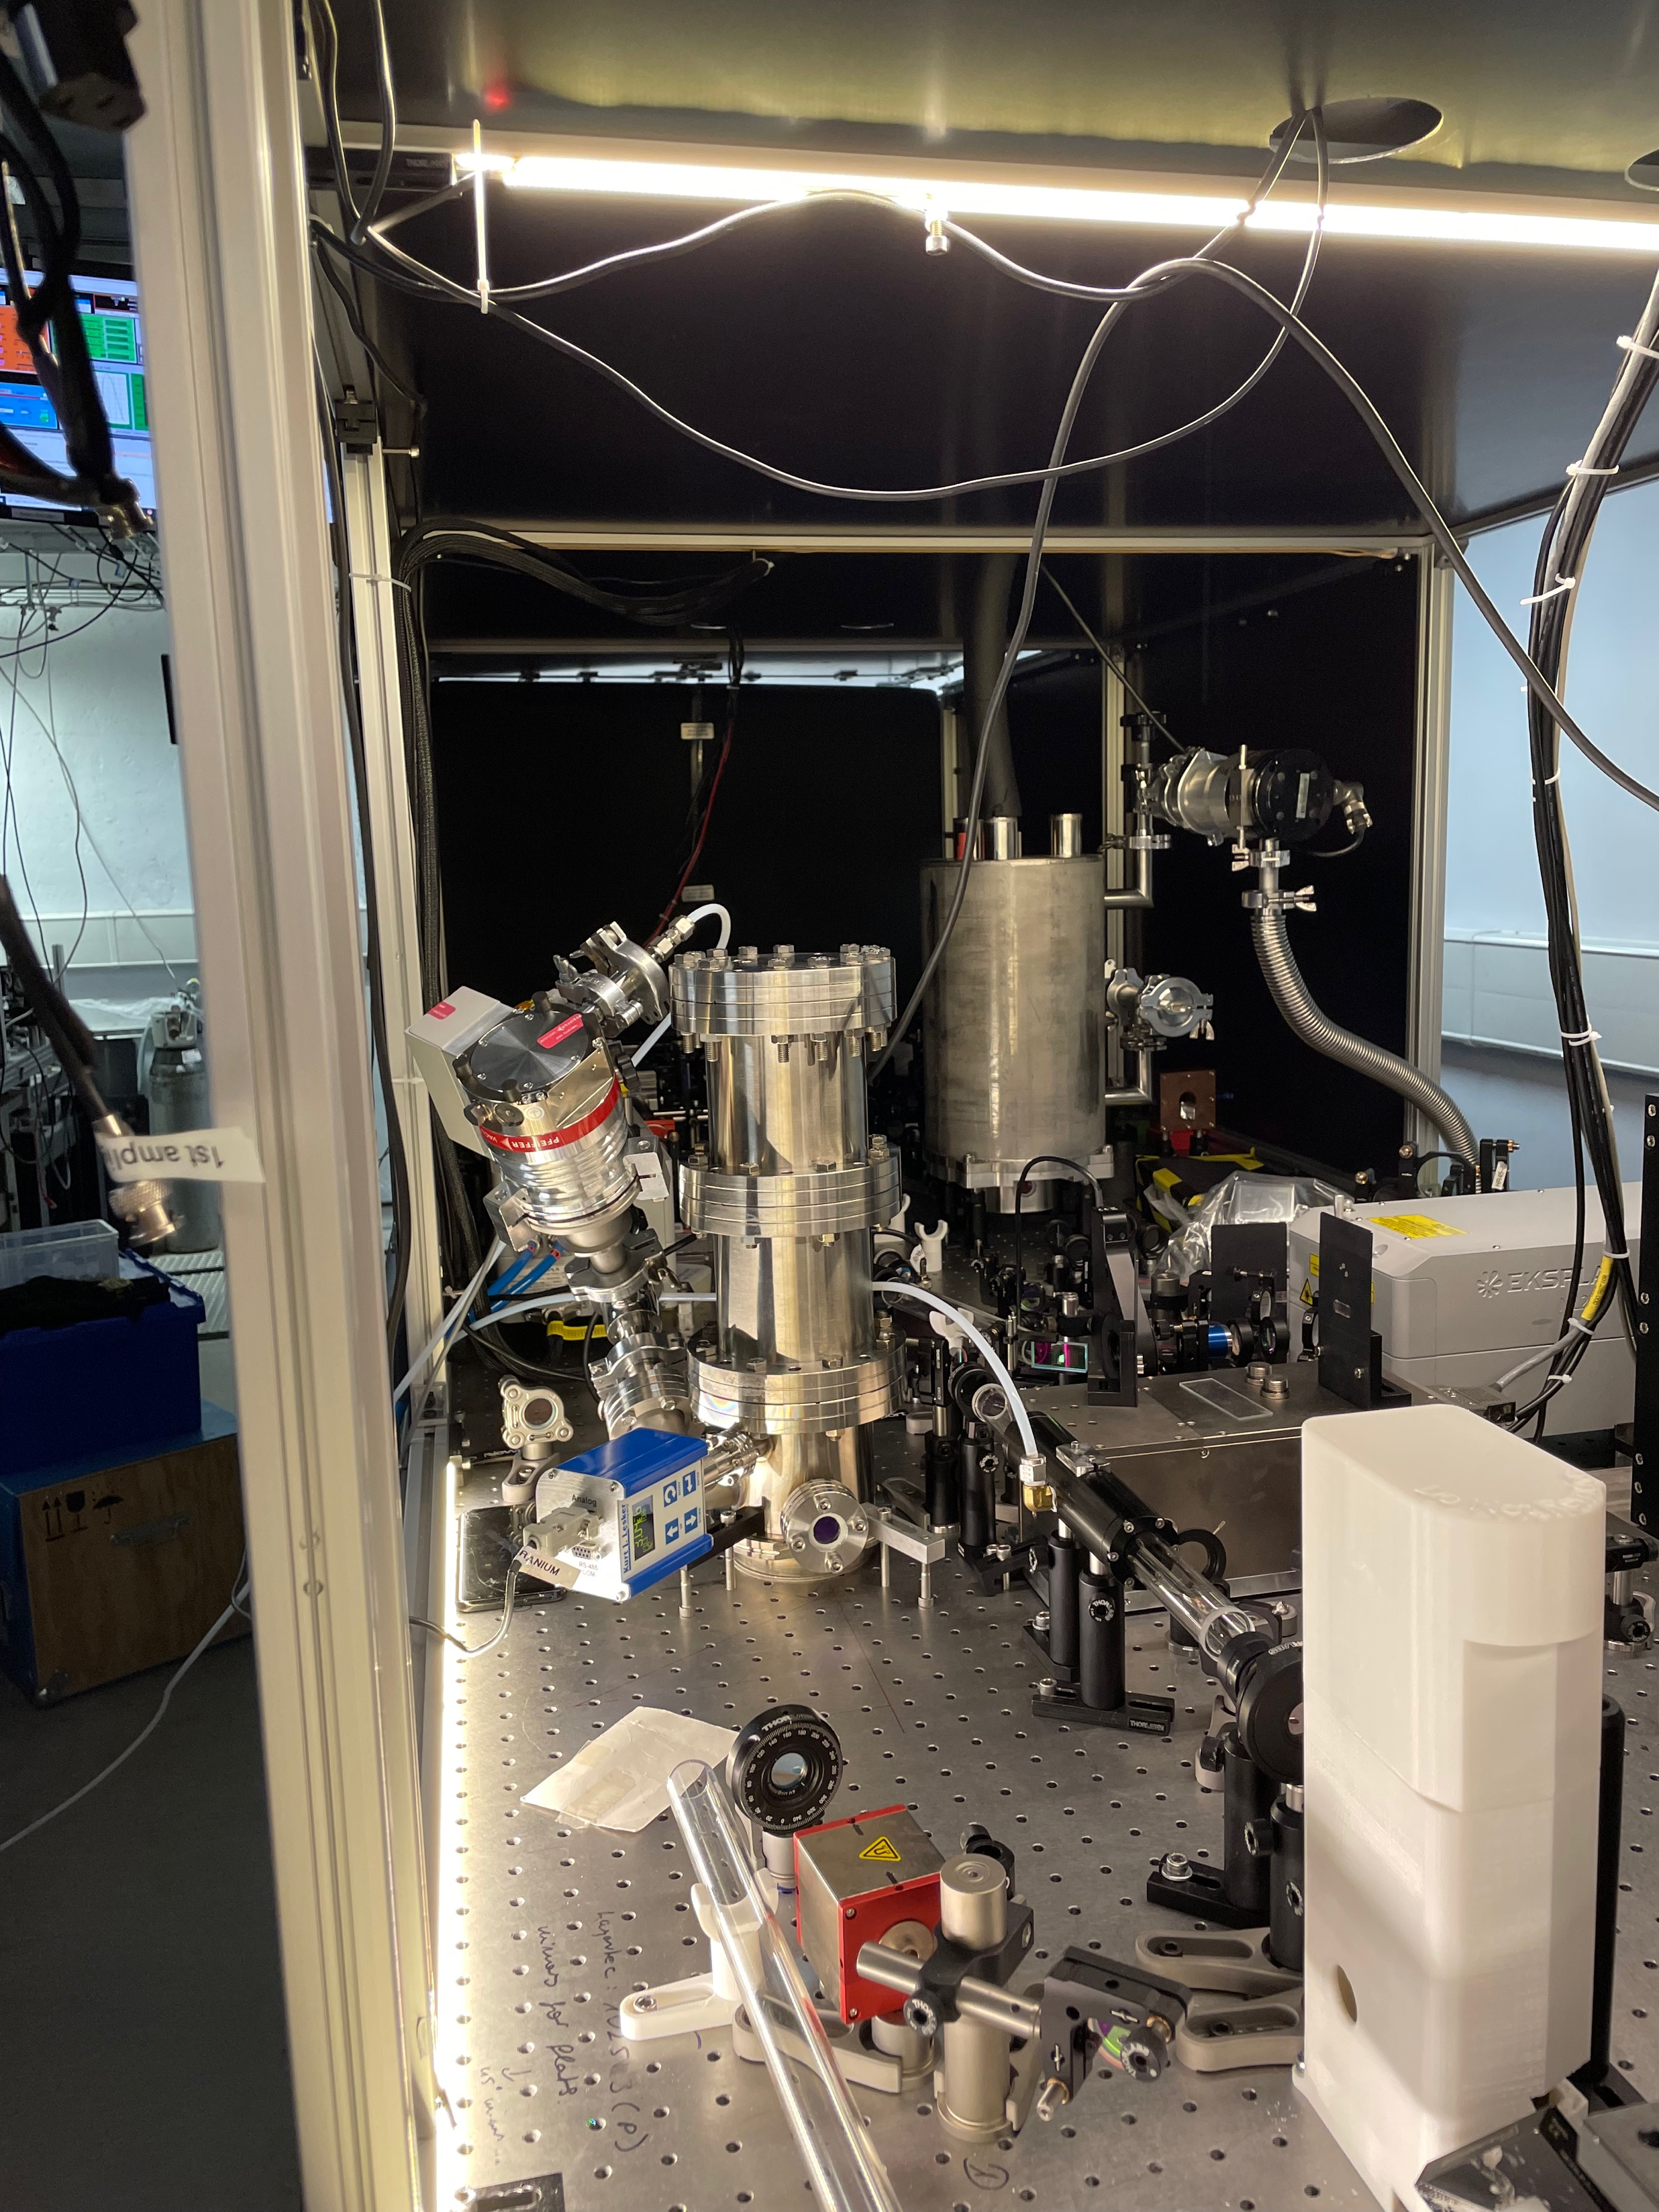
Zhi Laser at Imperial
Home-built 100Hz Ti:Sapphire laser delivering ~100 mJ pulses in 30 fs, run by Prof. Z. Najmudin’s group
Further amplifier at 10Hz currently being implemented, predicted to give pulses at ~1J energies.

Slide 5
Cerberus Laser at Imperial
Multibeam high energy, high power laser system, maintained by Prof. R. Smith’s group
~5 J at 0.001 Hz, 500 fs pulse length
OPCPA output can be used, currently 10 mJ at 10 Hz but soon to be upgraded to 100 mJ
Regularly used as driver of laser proton source exceeding 5 MeV

Slide 6
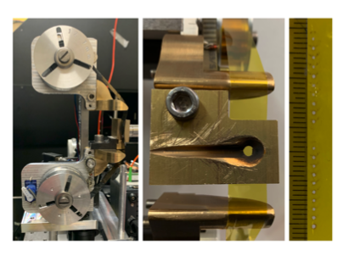
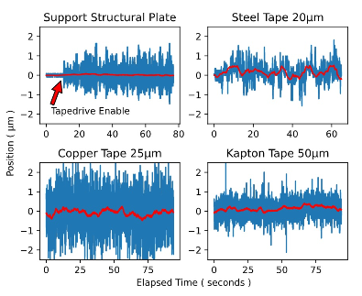
Tape target development
Designed by Nuo Xu (ICL)
Designed for >10 Hz operation with micron level stability.
Successfully demonstrated on experiment at the CLF to optimise ion acceleration with Bayesian optimisation.

