Slide 1


Update on Lhara Beamtime @ SCAPA
Setup: 10th July – 14th July 2023
Beamtime: 17th July – 21st July 2023
4th July 2023

Slide 2
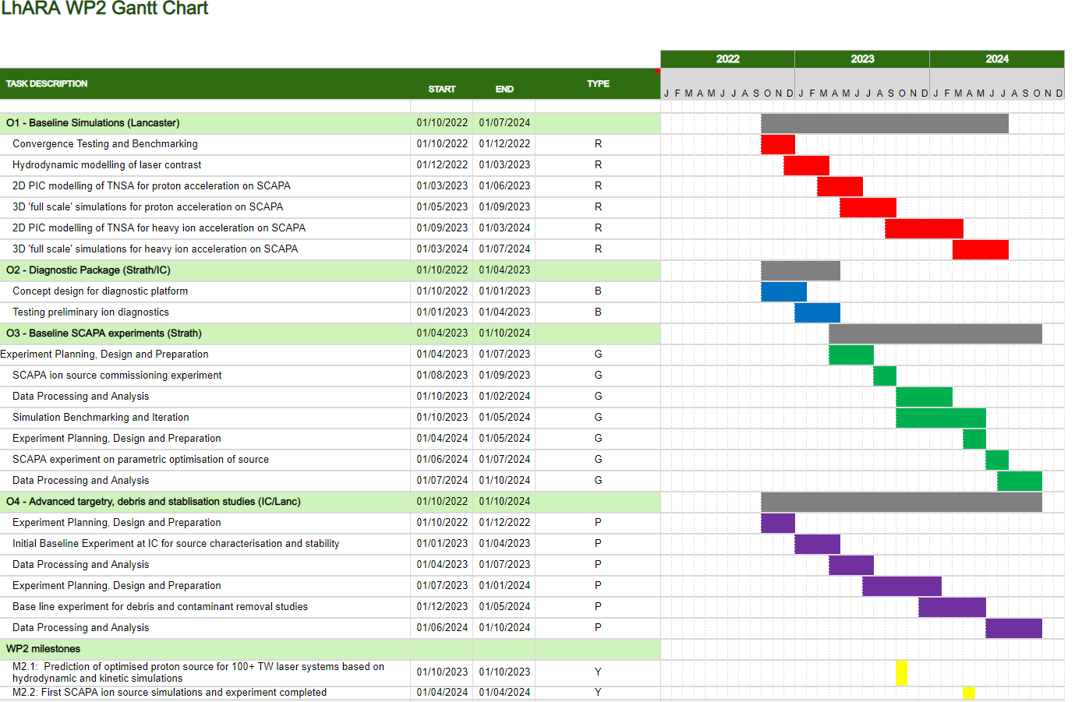
WP2 project plan…
Deliverables for the first two years are focused on early experiments and source benchmarking in simulations, as well as initial technology development in diagnostics and targetry.
For the initial experiments we would ideally like to perform detailed, statistically significant parameter scans to establish and optimise the source performance.

Slide 3
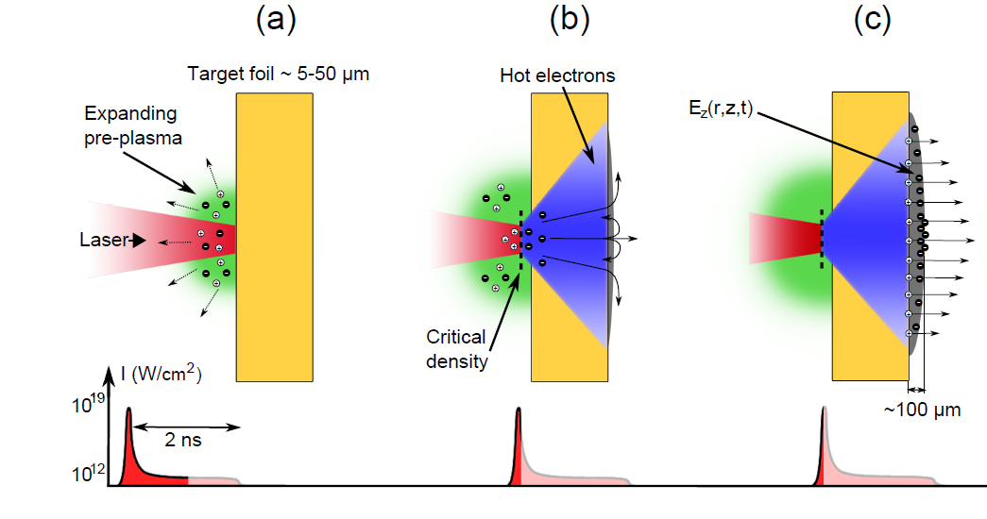
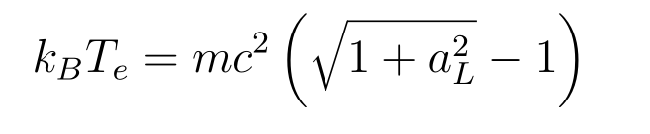
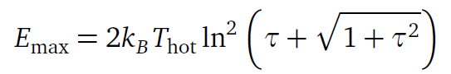
Considerations for a laser driven proton source from Target Normal Sheath Acceleration mechanism (TNSA)
Fast electron temperature and fast electron density and total number at the rear surface drive proton spectral characteristics
Transport physics defined by material, target properties and self generated fields drive proton spatial characteristics
These are sensitive to a wide range of input parameters:
Laser:
Intensity
Energy
Focal spot size
Laser intensity contrast
Polarisation
…
Plasma:
Energy conversion efficiency
Fast electron divergence angle
Z (scattering, resistivity)
Preplasma scale length
Incidence angle
…
Experimental Implementation:
Focusing geometry
Target Design
Laser intensity contrast
Polarisation
Pulse duration
…

Slide 4
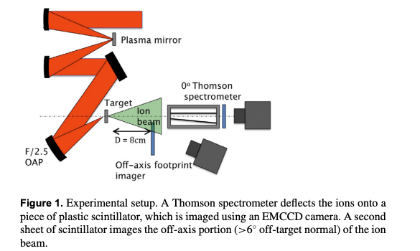
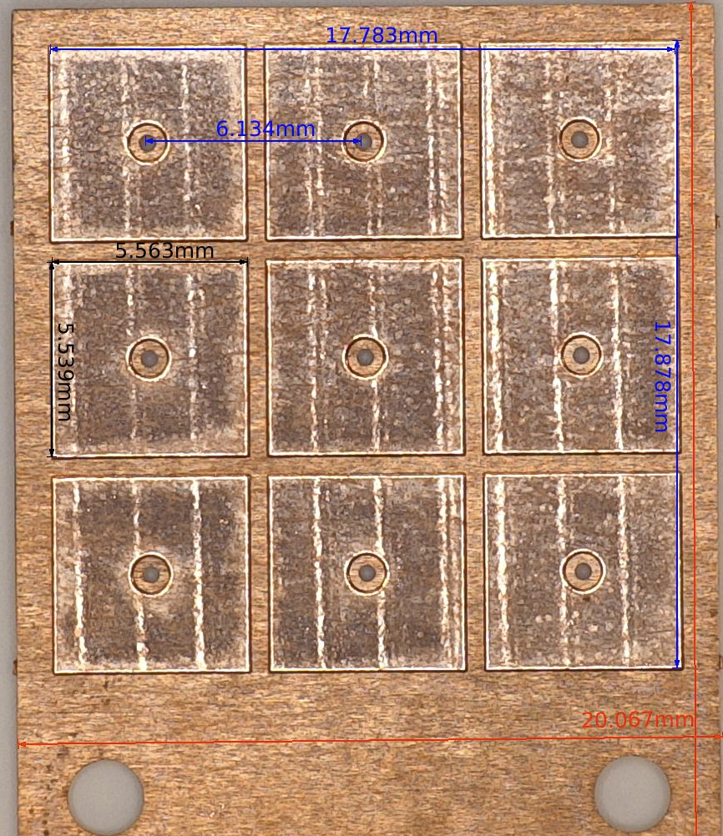
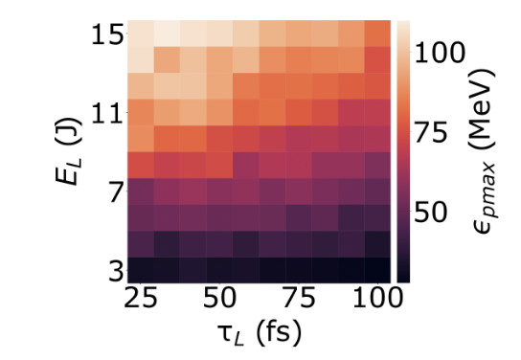
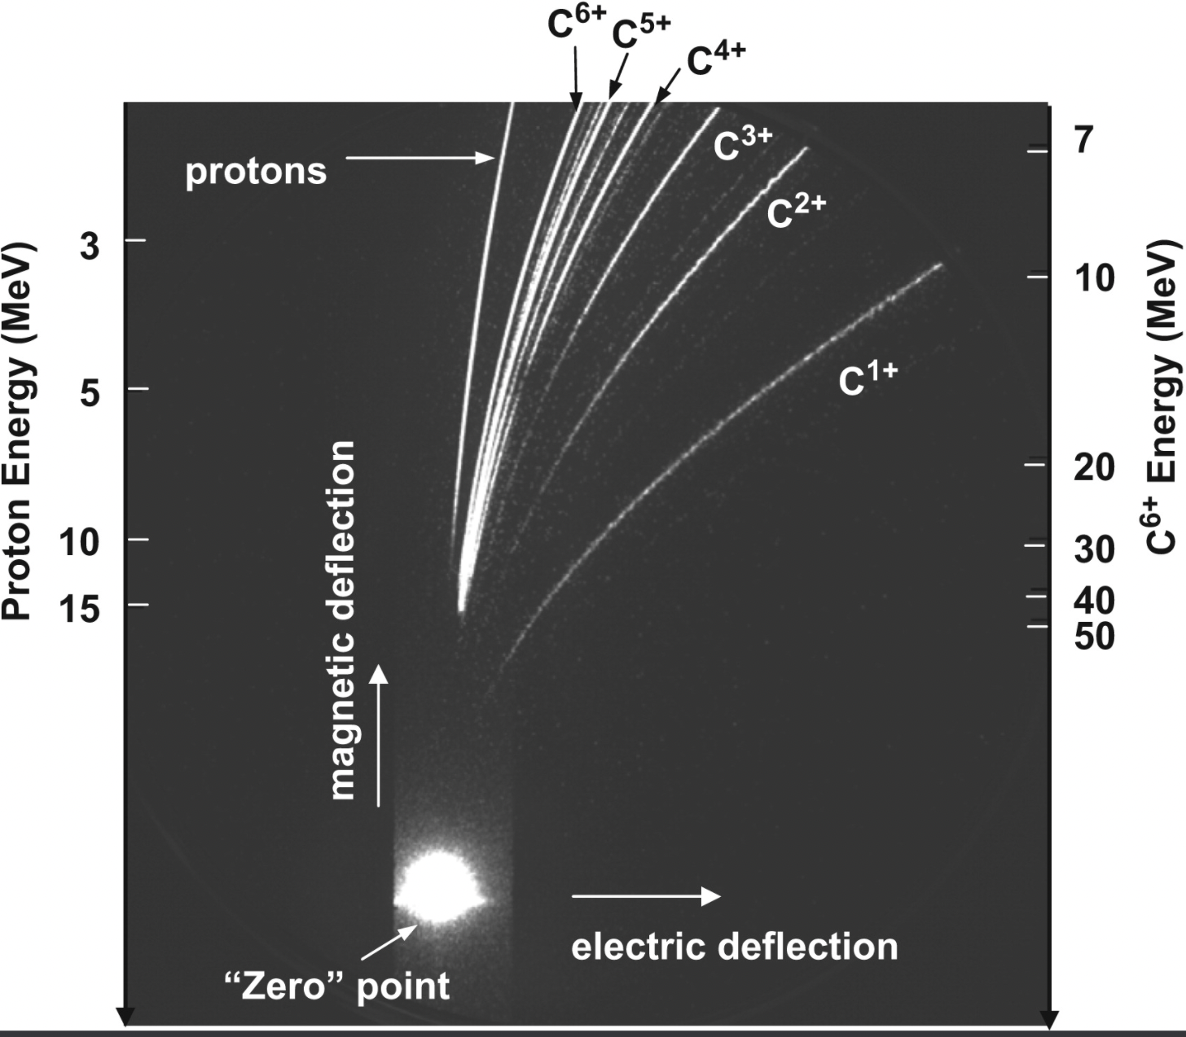
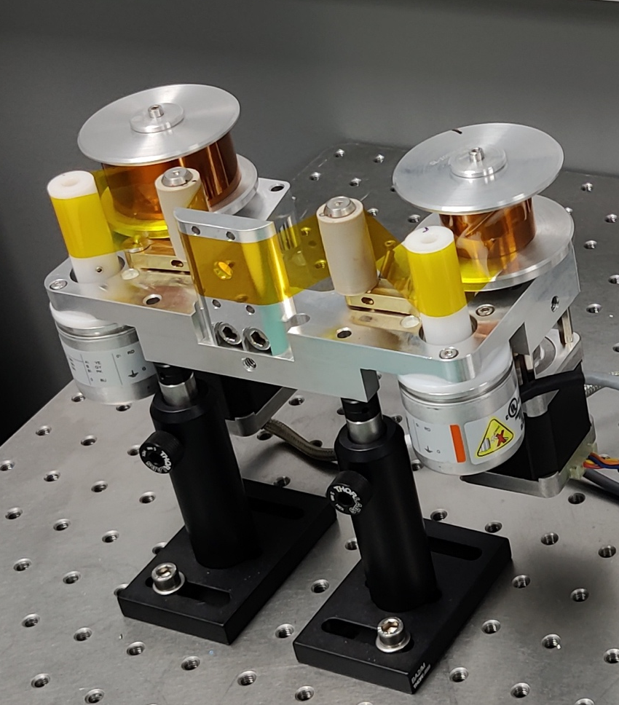
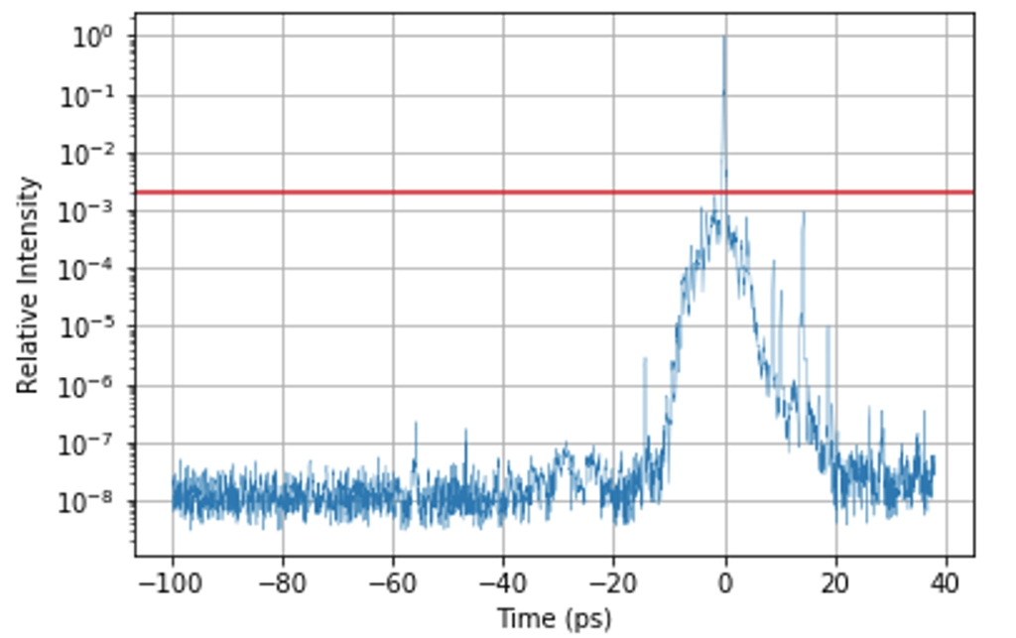
Experiments & Technology Development in 2-year Programme: Characterising Source and Benchmarking Simulations
Established Diagnostics…
Established Targetry…moving toward Hz-level targetry
….to build a systematic parameter space map of the source performance
Energy, Flux, Divergence across multiple ion species
Typical 9-target array
J.S Green et al., NJP. 12 (2010) 085012
..but also need to consider some other experimental contributions like temporal contrast
R. Prasad et al., Nucl. Instrum. Methods. 623.2 (2010): 712-715.
Tape targetry system (online in SCAPA 2022)

Slide 5




The experimental team includes a number of institutions…
Staff:
Paul McKenna
Ross Gray
Robbie Wilson
Timothy Frazer
Students:
Chris McQueen
Ben Torrance
Matt Alderton
Staff:
Charlotte Palmer
Students:
Peter Parsons
Staff:
Nick Dover
Oliver Ettlinger
Students:
Ginevra Casati
Staff:
James Green
Chris Armstrong
Chris Spindloe
Sam Astbury

Slide 6
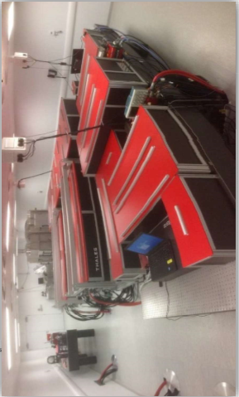
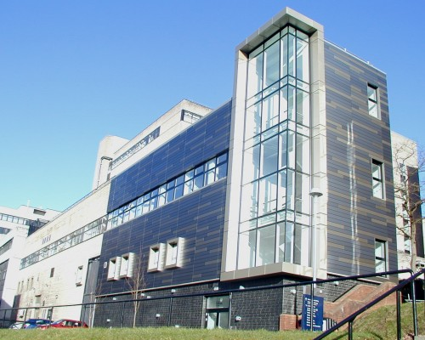
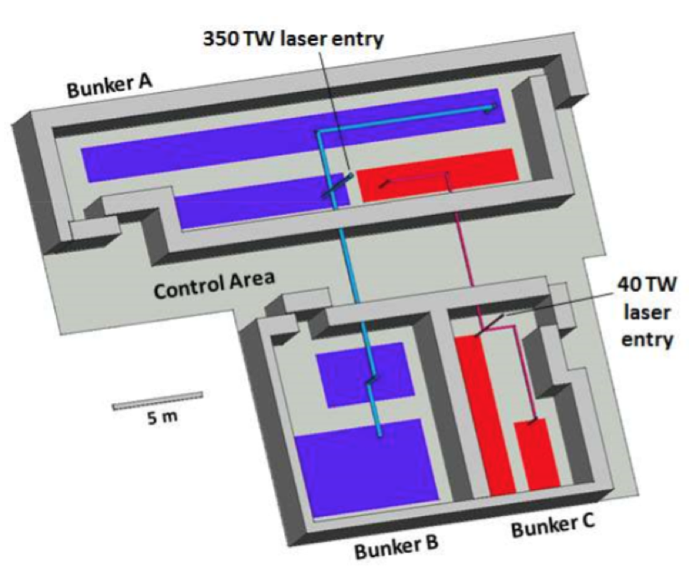
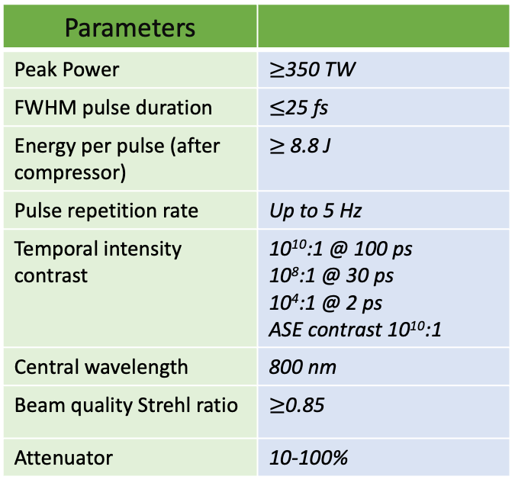
SCAPA: Scottish Centre for Application of Plasma based Accelerators
Parameters
Peak Power | $≥$350 TW
FWHM pulse duration | $≤$25 fs
Energy per pulse (after compressor) | $≥$ 8.8 J
Pulse repetition rate | Up to 5 Hz
Temporal intensity contrast | 10¹⁰:1 @ 100 ps 10⁸:1 @ 30 ps 10⁴:1 @ 2 ps ASE contrast 10¹⁰:1
Central wavelength | 800 nm
Beam quality Strehl ratio | $≥$0.85
Attenuator | 10-100%

Slide 7
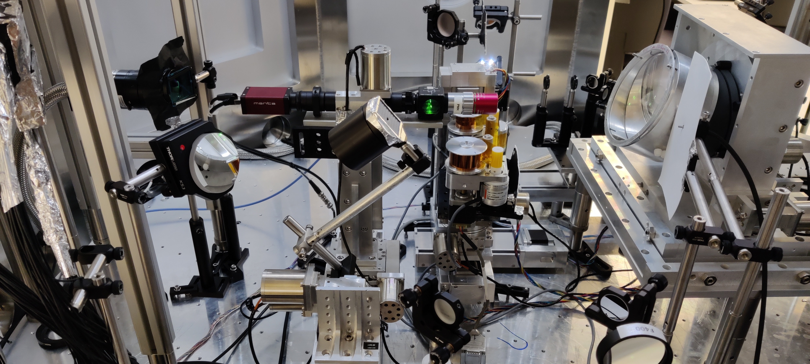
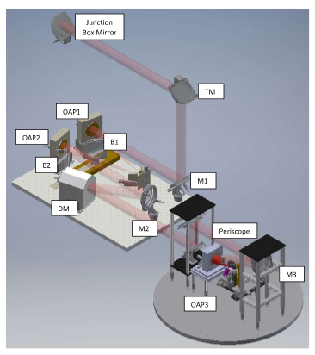
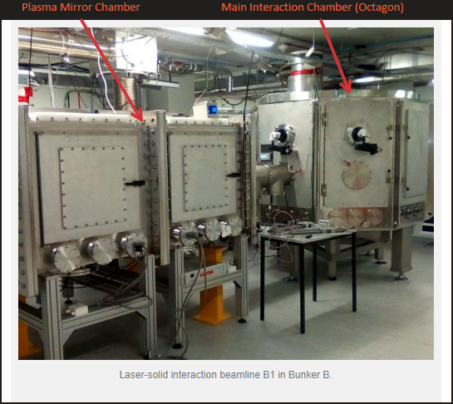
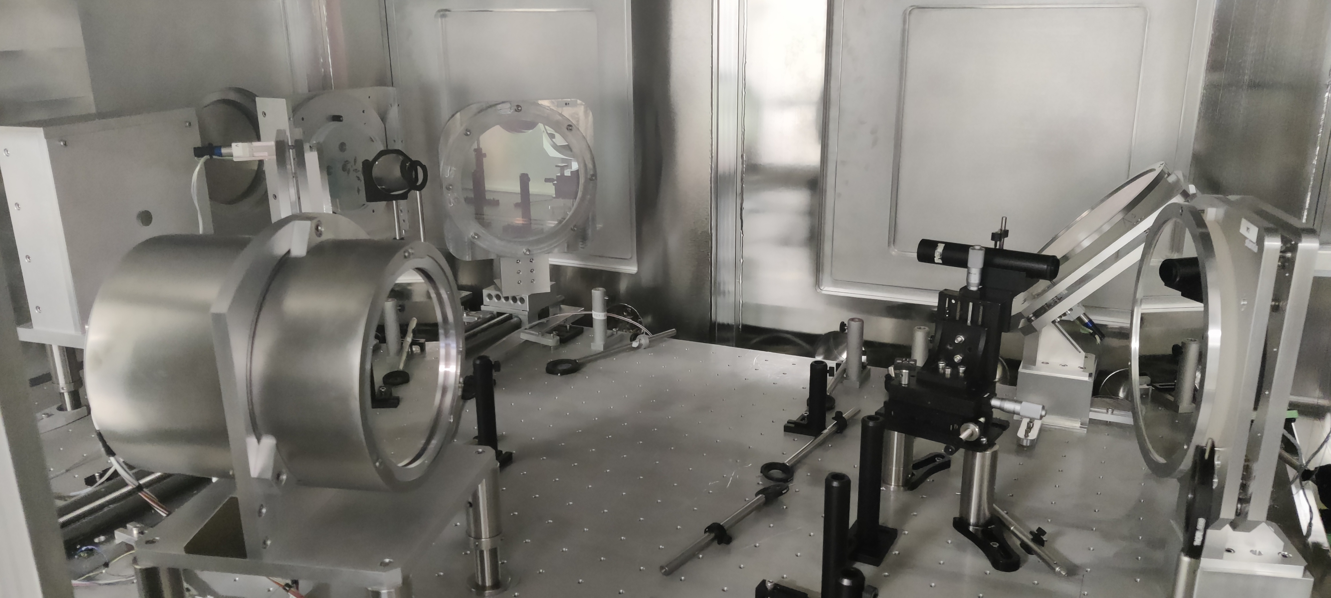
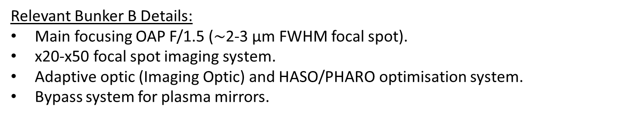
SCAPA Bunker B Target Station
Main Chamber Internals
Beamline
Plasma Mirror Chamber Internals
Relevant Bunker B Details:
Main focusing OAP F/1.5 ($\sim$2-3 µm FWHM focal spot).
x20-x50 focal spot imaging system.
Adaptive optic (Imaging Optic) and HASO/PHARO optimisation system.
Bypass system for plasma mirrors.

Slide 8
Objectives
Objective 1: Ion acceleration characterisation @1 Hz ($\sim$3 Days)
High resolution parameter scans: varying focal spot size, pulse energy, pulse length and pre-plasma.
Characterisation of generated proton/ion beam, specifically parameters related to the deliverables of WP2 (Max. E_{p}, energy spectrum and beam divergence).
Characterisation of generated proton beam parameter stability over a period of time @ 1Hz operation.
Objective 2: Debris characterisation @1 Hz ($\sim$1 Day)
Characterisation of generated debris from tape drive target system over a number of shots @ 1Hz operation.
Objective 3: Diagnostic development ($\sim$1 Day)
Testing of PROBIES Lanex detector lifetime over a series of fixed parameter shots @ 1Hz operation.

Slide 9
Main outputs of the run…
Power scaling of ion energy and flux
This will help to define basic laser requirements for LhARA
Demonstration of some basic technology for continuous 1 Hz operations
Identify key issues for 10 Hz operations
Dependence of ion energy and flux on: energy, pulse duration, preplasma etc…
Guides future experiment design and simulation benchmarking
Measurement of debris production rates, characterisation of debris
Establishes limits of continuous solid target operations builds evidence for liquid/cryo approaches

Slide 10

Table of changes from February CM….all changes complete
Issue | Action
1. Maximum proton energy measured up to 5 MeV with half laser energy | We need > 15 MeV. Higher laser energy (will double in next run) but thinner targets and contrast control likely required
2. High repetition rate (1 Hz +) possible but limited by data transfer/capture | Updated data capture system
3. Angle of incidence limited by tape drive design | Updated tape drive design
4. Tape drive horizontal stability needs to be improved | Adding position monitoring and updated drives
5. Laser contrast control required | Adding PM system in march and prepulser beamline
6. Online diagnostics operational but background subtraction and beam analysis needs to be improved | Working on a multichannel “two colour” design to improve electron background measurement

Slide 11
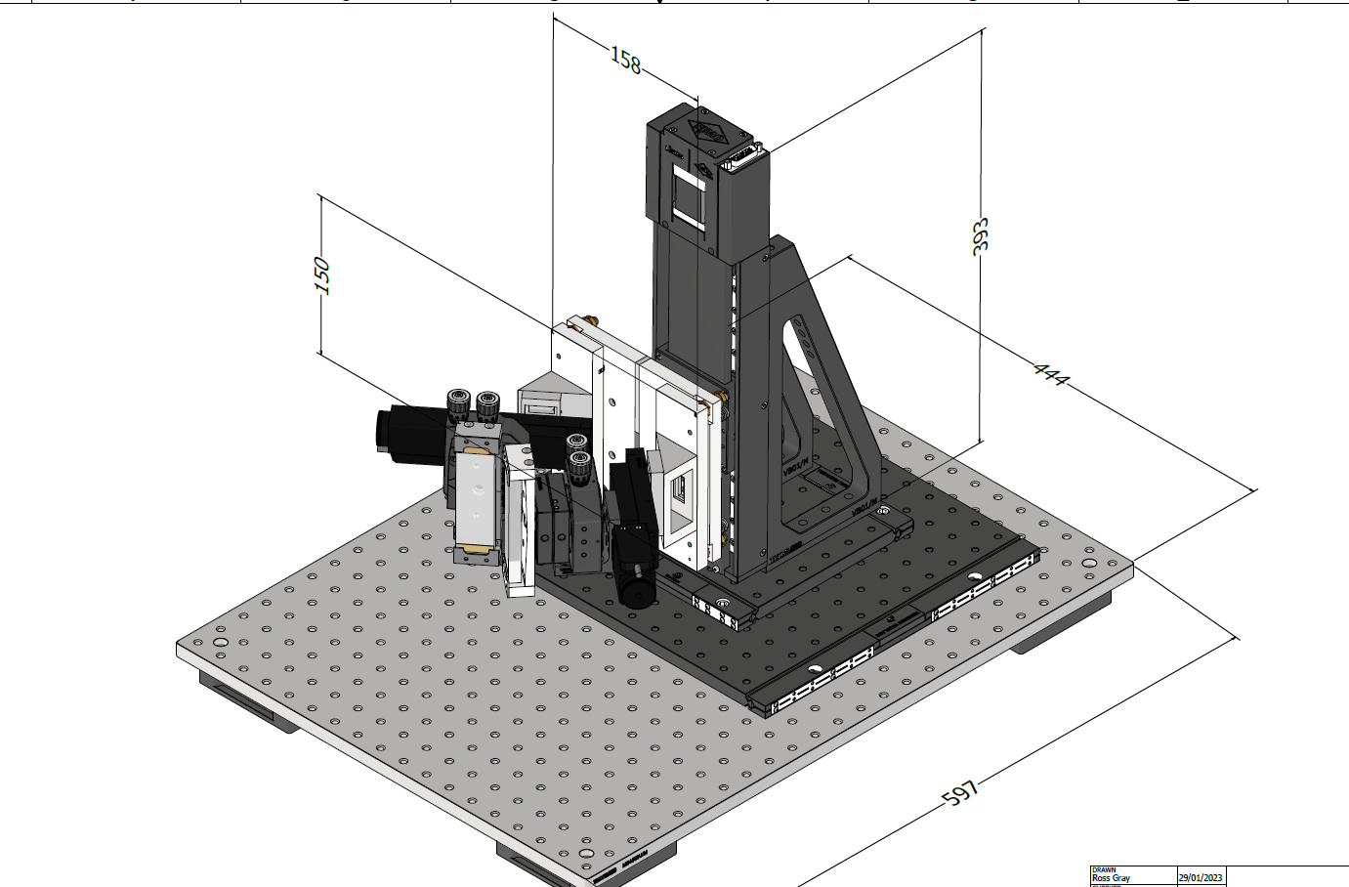
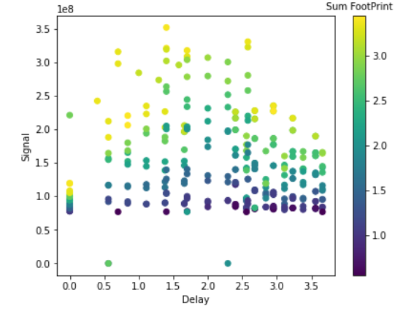
SCAPA Bunker: Developments
i) Double Plasma Mirror System
Short commissioning was conducted at end for March (27th March – 7th April) to bring the plasma mirror system online. This will support the move toward thinner targets.
Similar sized PM substrates as used on Gemini and under similar conditions, thus approx. 50 shots per PM set.
ii) Transverse optical probe
Currently under development/setting up, running @ 1w , with the option to run @ 2w.
Planning to use in a interferometry configuration to characterise target front surface plasma.
iii) Pre-plasma generator / Heater
The importance of pre-plasma scale length to laser coupling/electron temperature was highlighted with the use of a low intensity (x10¹² W/cm²) pre-heater pulse in our recent Gemini campaign and in E. Boella’s simulations.
A pre-heater pulse for SCAPA Bunker B is still to be designed.

Slide 12
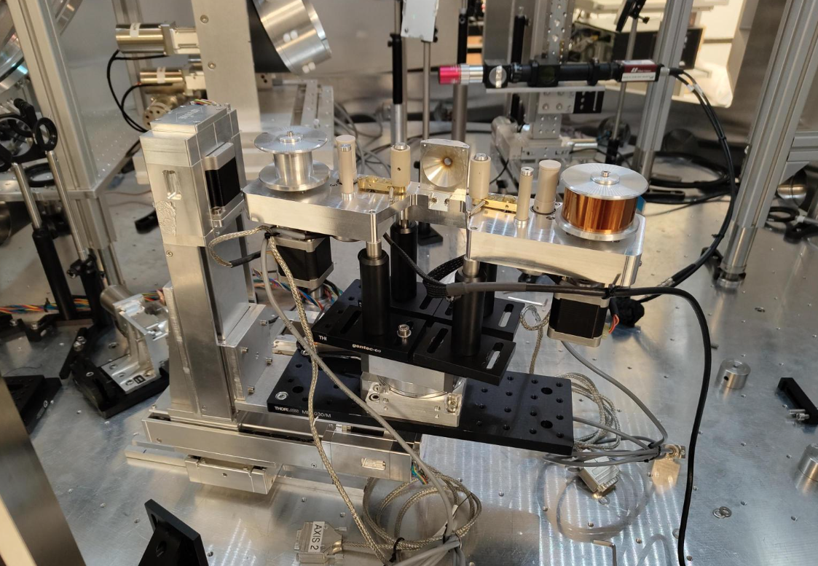
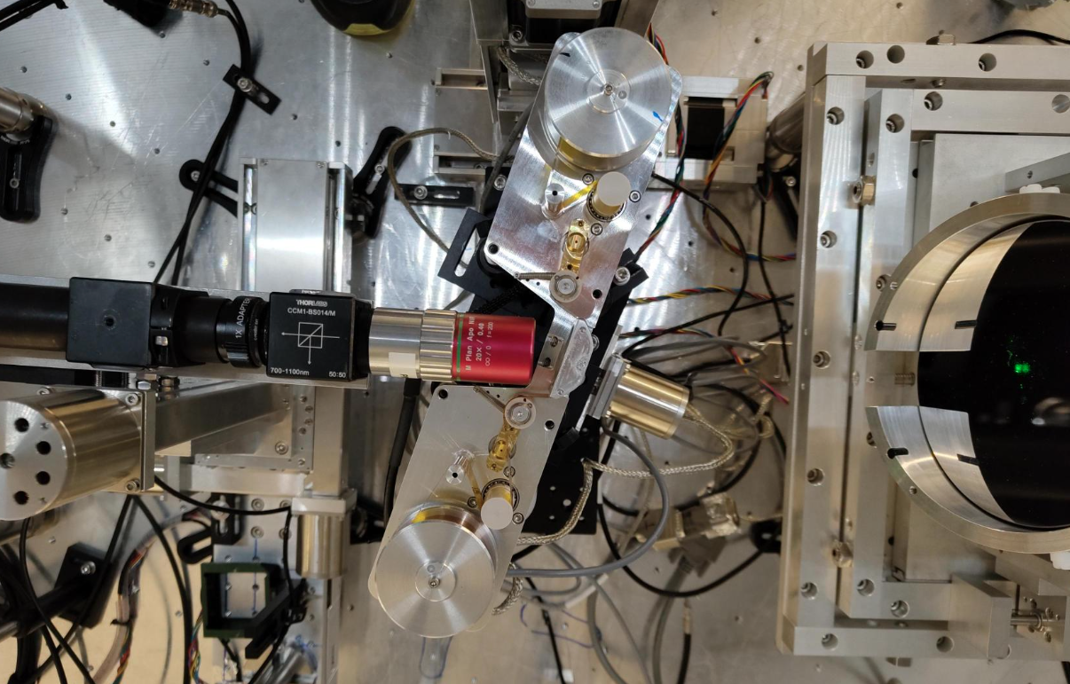

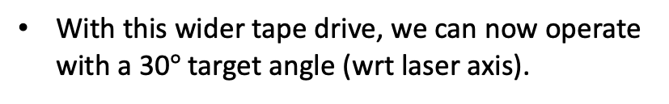
Targets- Tape Drive Updates
$$°$$
Wider tape drive now incorporated with target xyz (rot/goni) stages in Bunker B.
With this wider tape drive, we can now operate with a 30$°$ target angle (wrt laser axis).

Slide 13
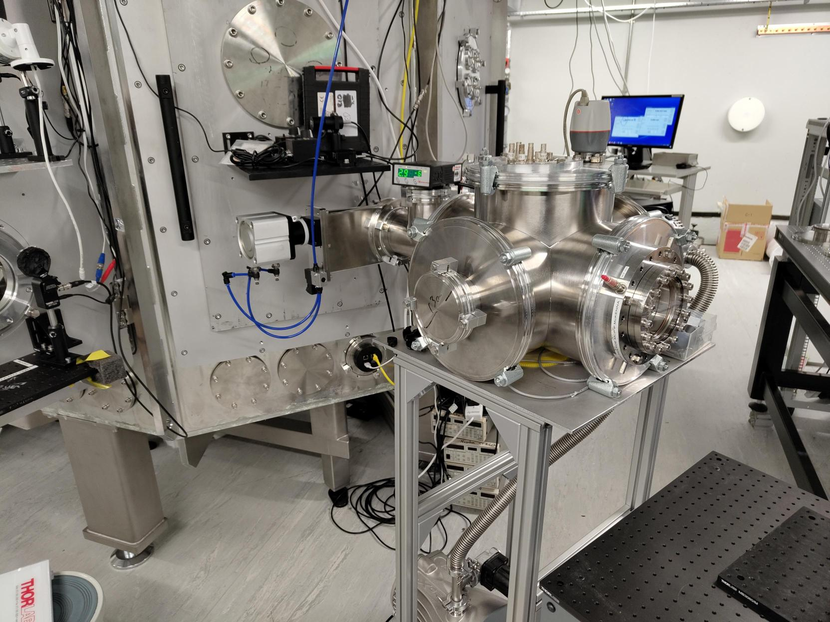
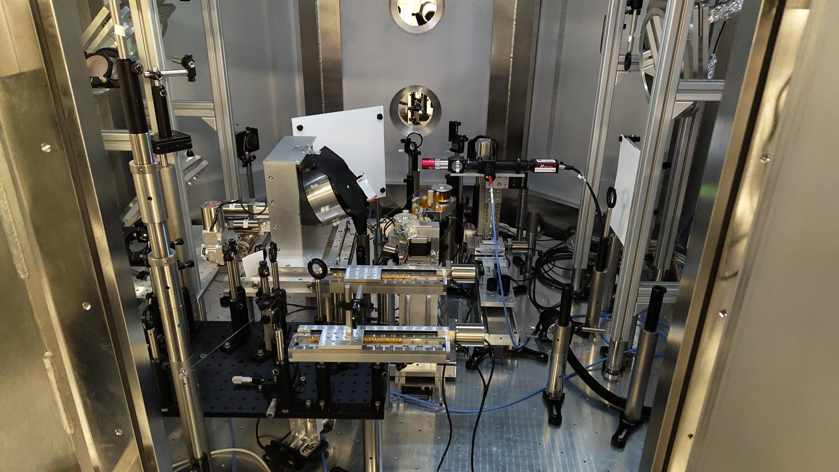
Setup Updates -
Probe beam and preheating beam currently being installed
New Thomson parabola ion spectrometer installed

Slide 14
Diagnostics-
Ion Diagnostics –
Online proton beam footprint monitor [PROBIES]
RCF Stack Thomson Parabola ion spectrometer (running with MCP)
Optical Diagnostics –
Specular reflection scatter screen (imaging 1w and 2w) and optical spectrometer
Backscatter scatter screen (imaging 1w and 2w) and optical spectrometer
Transmission scatter screen (imaging 1w and 2w) and optical spectrometer
Transverse OR Reflective Optical Probe, operating in an interferometry configuration
Electron Diagnostics –
Lanex beam imager
Espec
Debris Diagnostics–
Witness plates (glass slides with section covered with Kapton tape, to be post-characterised by target fab (CLF))
Witness optics (optical setup with a laser reflection from optics exposed to debris. Gives real time optic degradation measure.)
Fast Framing camera

Slide 15
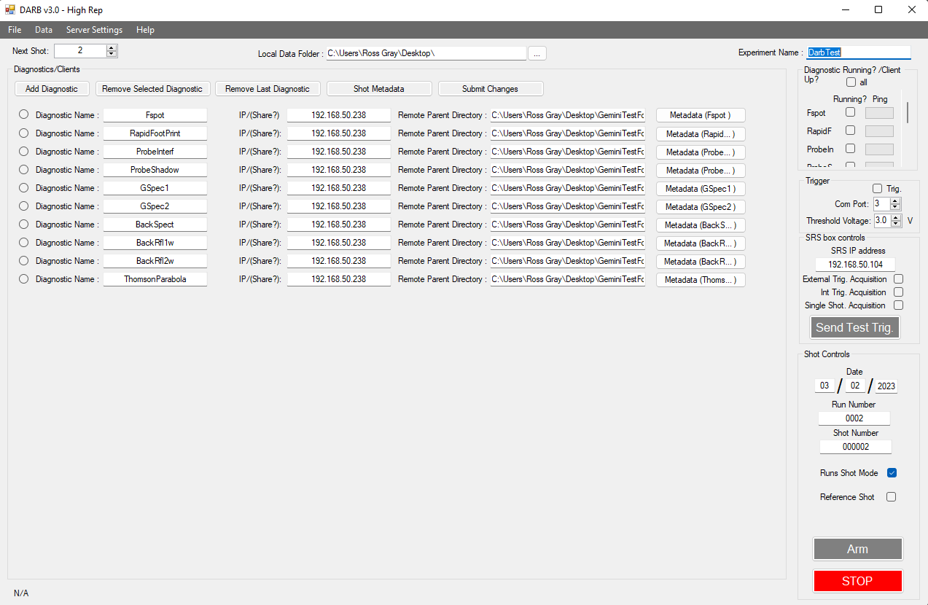
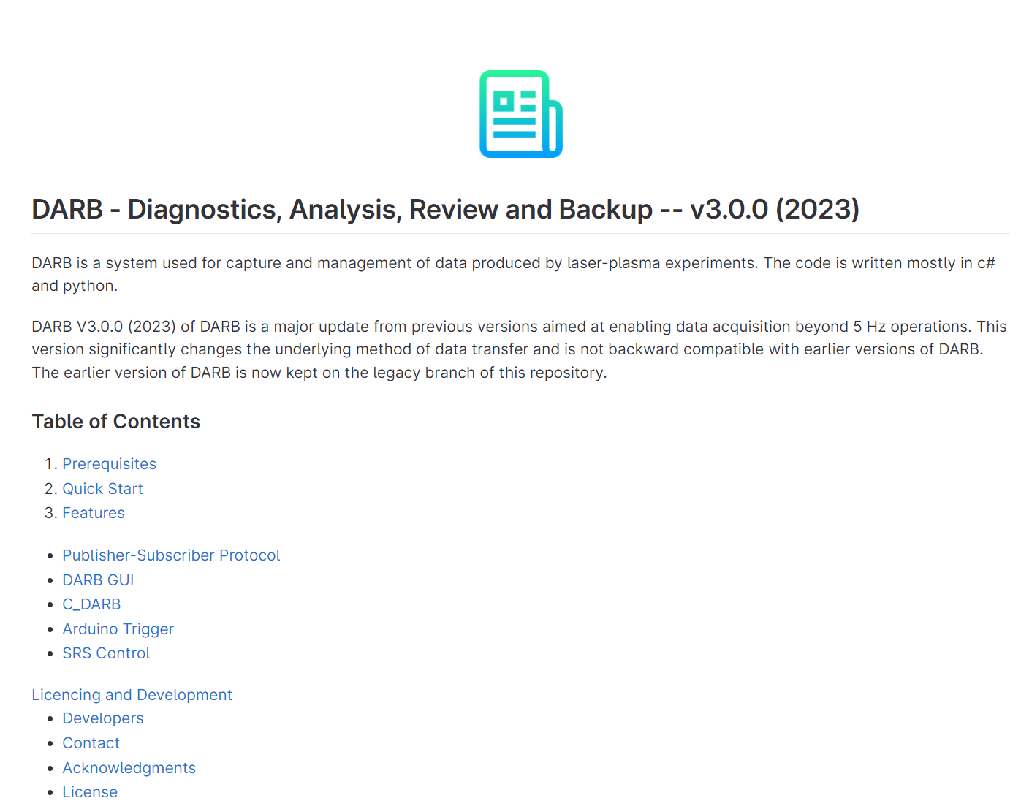
Data collection at 5 Hz – DARB V3.0
DARB Control Room Server
Laser Trigger
Shot type details
Asynchronous data transfer
DARB Client
DARB Client
DARB Client
Diagnostic A
Diagnostic B
Diagnostic …
File Shot/time stamping
File shot/time stamping
File Shot/time stamping

Slide 16
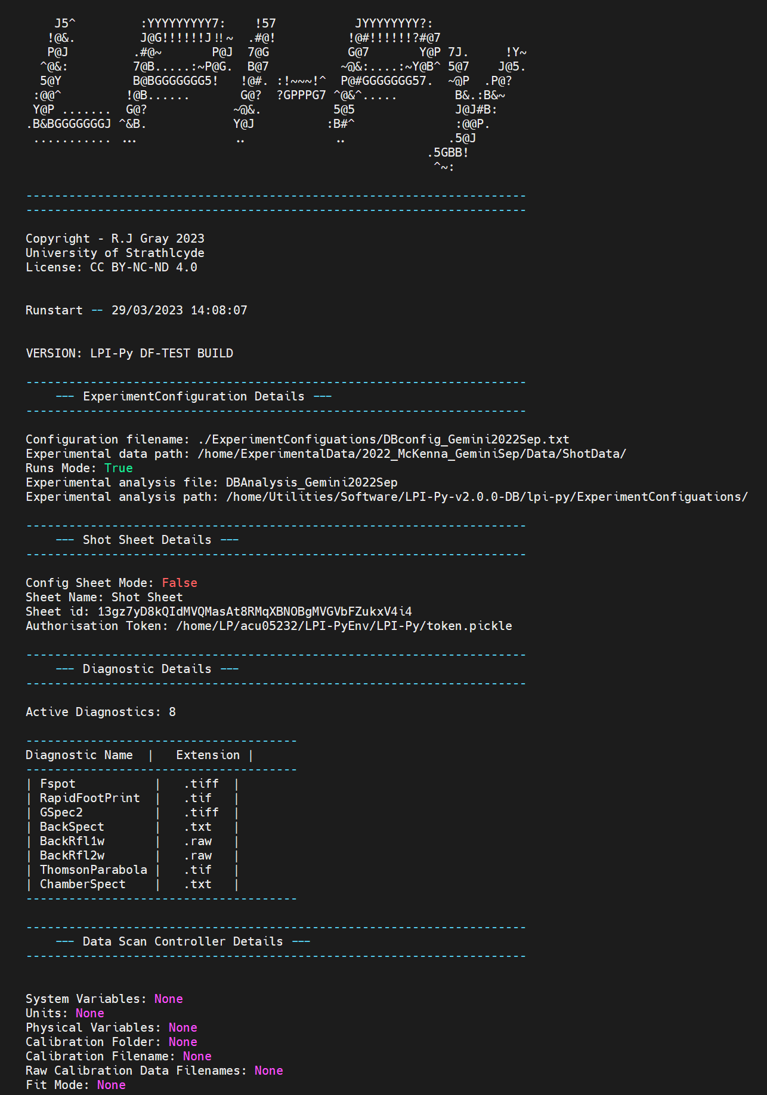
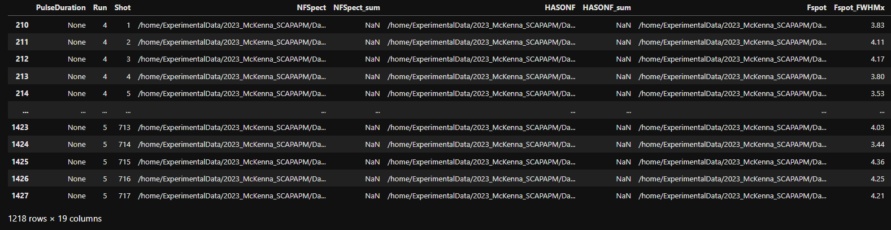
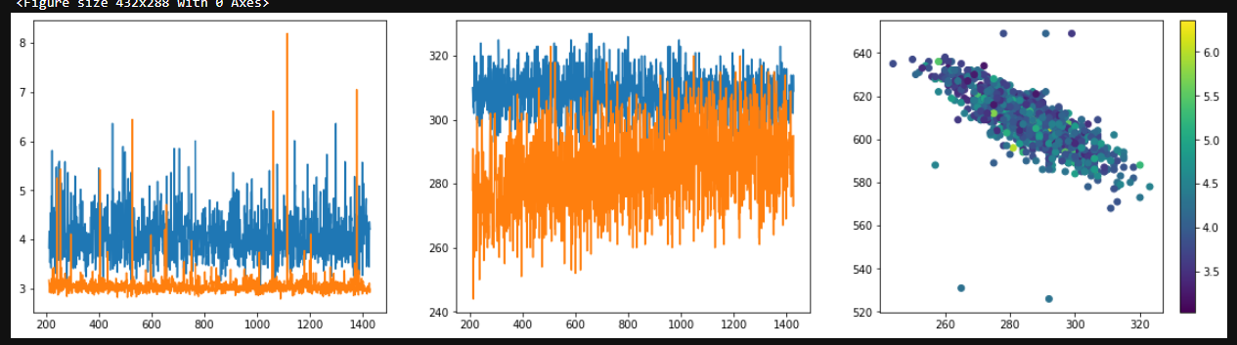
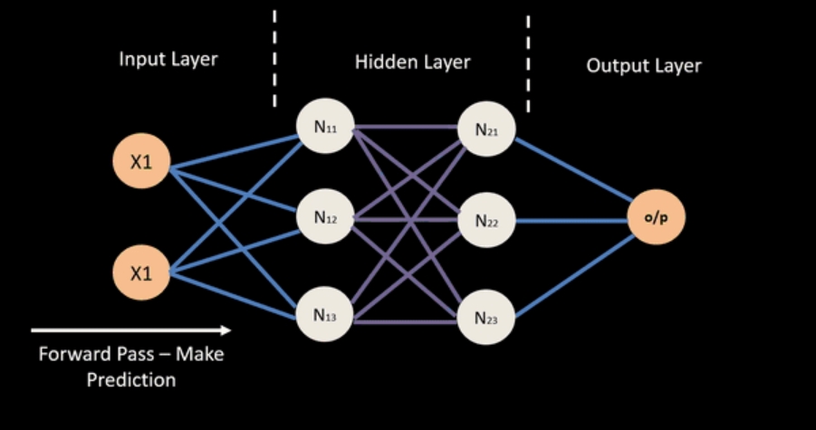
LPI-Py DB – Custom configurable analysis of experimental data and storge in a live database
Configuration profile defined for a specific experiment
Custom analysis class that make use of in-built fileloaders, analysis functions and calibrations
Actively updates on new data
applies user-defined analysis class
makes use of inbuilt file loaders, analysis functions and calibrations
Pushes processed data to a live, searchable database
Data Visualisation
Model Training

Slide 17
Summary:
First LhARA beamtime on SCAPA starts next week…
Progress in the beamline development and diagnostic setup is good
We have an experienced team running the beamtime, with members from many of the main institutions contributing to WP2
New developments in diagnostics and data handling should enable the first demonstration of WP2 source at 1 Hz
This short run will be key for planning 3-week experiment in early 2024 and benchmarking simulations

